Slide 1
One station observation system for Mars exploration
Changcheng Li

Slide 2
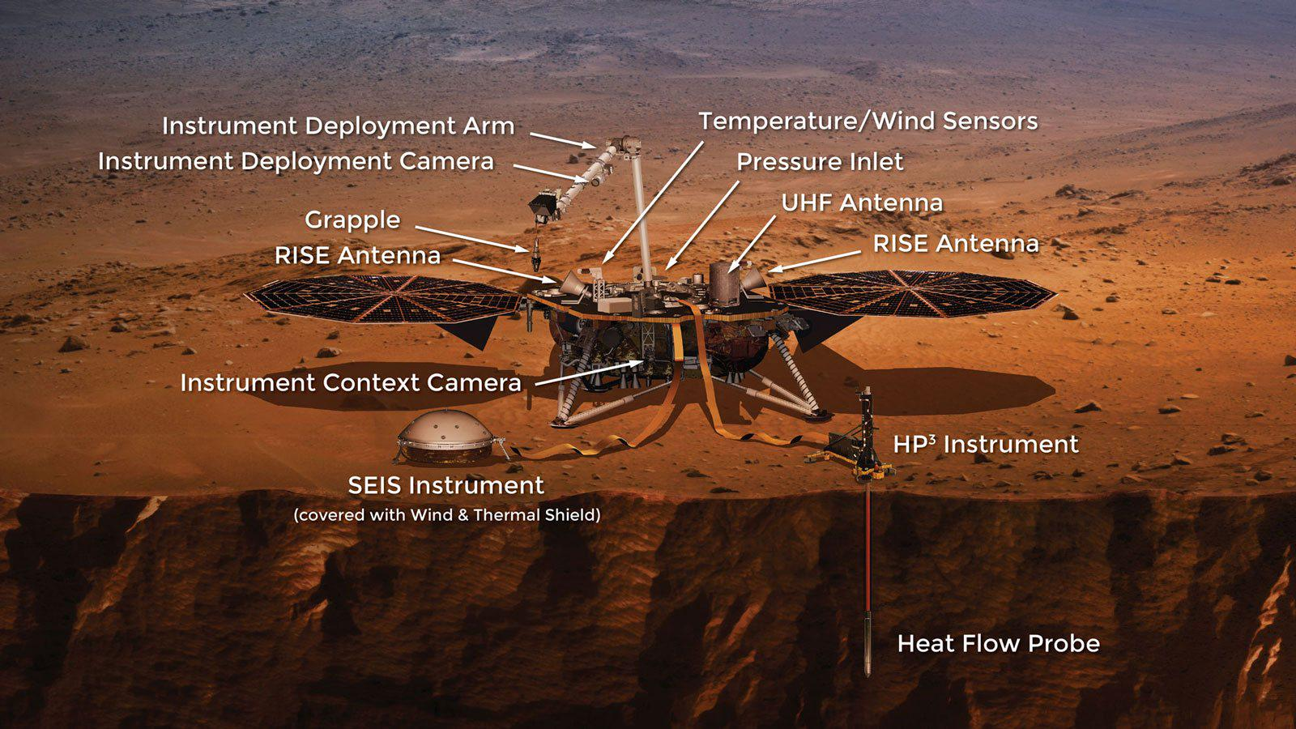

Insight Mission
1. One of the main purposes of this mission is to explore the internal structure of Mars by seismology.
$$v=\frac{d}{t}$$
v: the velocity of Mars internal structure
d: the distance between the source and the receiver
t: the travel time of the seismic wave
Travel time = Seismic wave time - Source initiation time
(The figure material comes from the internet)

Slide 3
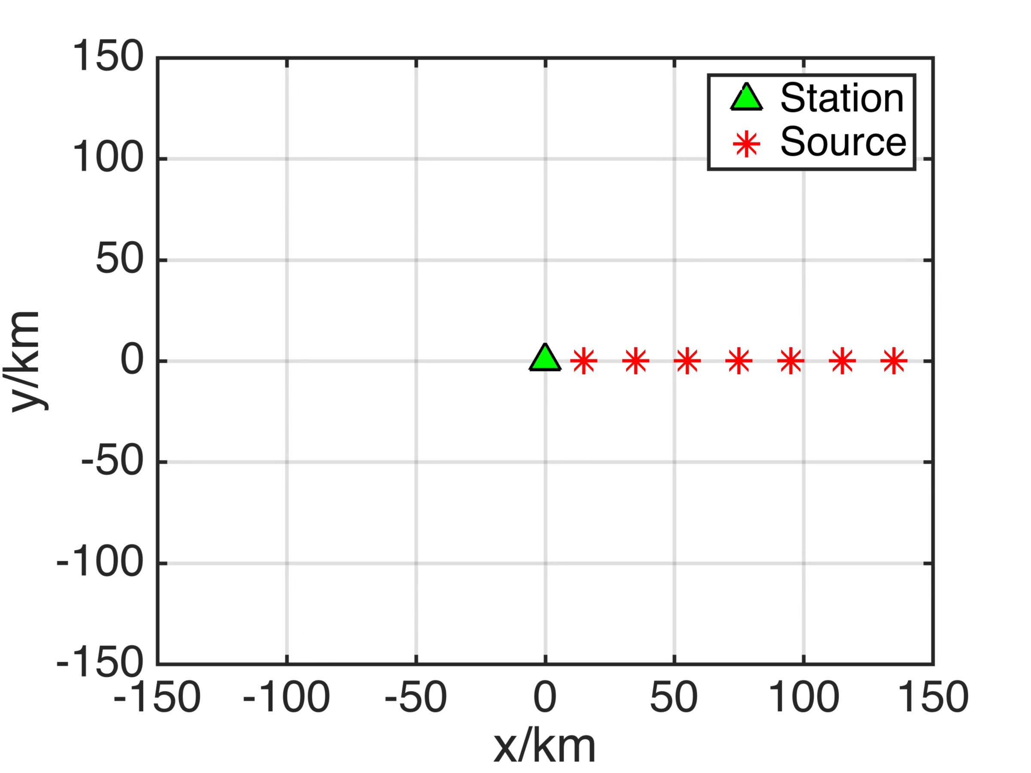



One station observation system
(a)
d: SLAM technology(simultaneous localization and mapping)
t: Set a reference station on the rover/install timer on seismic source
$$v=\frac{d}{t}$$
(The figure material comes from the internet)

Slide 4

Thank You
Address : Southern University of Science and Technology
E-mail: 11930785@mail.sustech.edu.cn

