Slide 1






Multi-temporal landslide inventory for validation of landslide susceptibility maps after 2018 Vaia windstorm event in Belluno province (Veneto Region, NE, Italy)
Sansar Raj Meena1,2, Silvia Puliero1, Kushanav Bhuyan1, Lorenzo Nava1, Lorenzo Faes3, Mario Floris1, Filippo Catani1, and Emanuele Lingua3
¹Machine Intelligence and Slope Stability Laboratory, Department of Geosciences, University of Padova, Padova, Italy
(sansarraj.meena@unipd.it)
²Department of Applied Earth Sciences, Faculty of Geo-Information Science and Earth Observation (ITC), University of Twente, Enschede, Netherlands

Slide 2
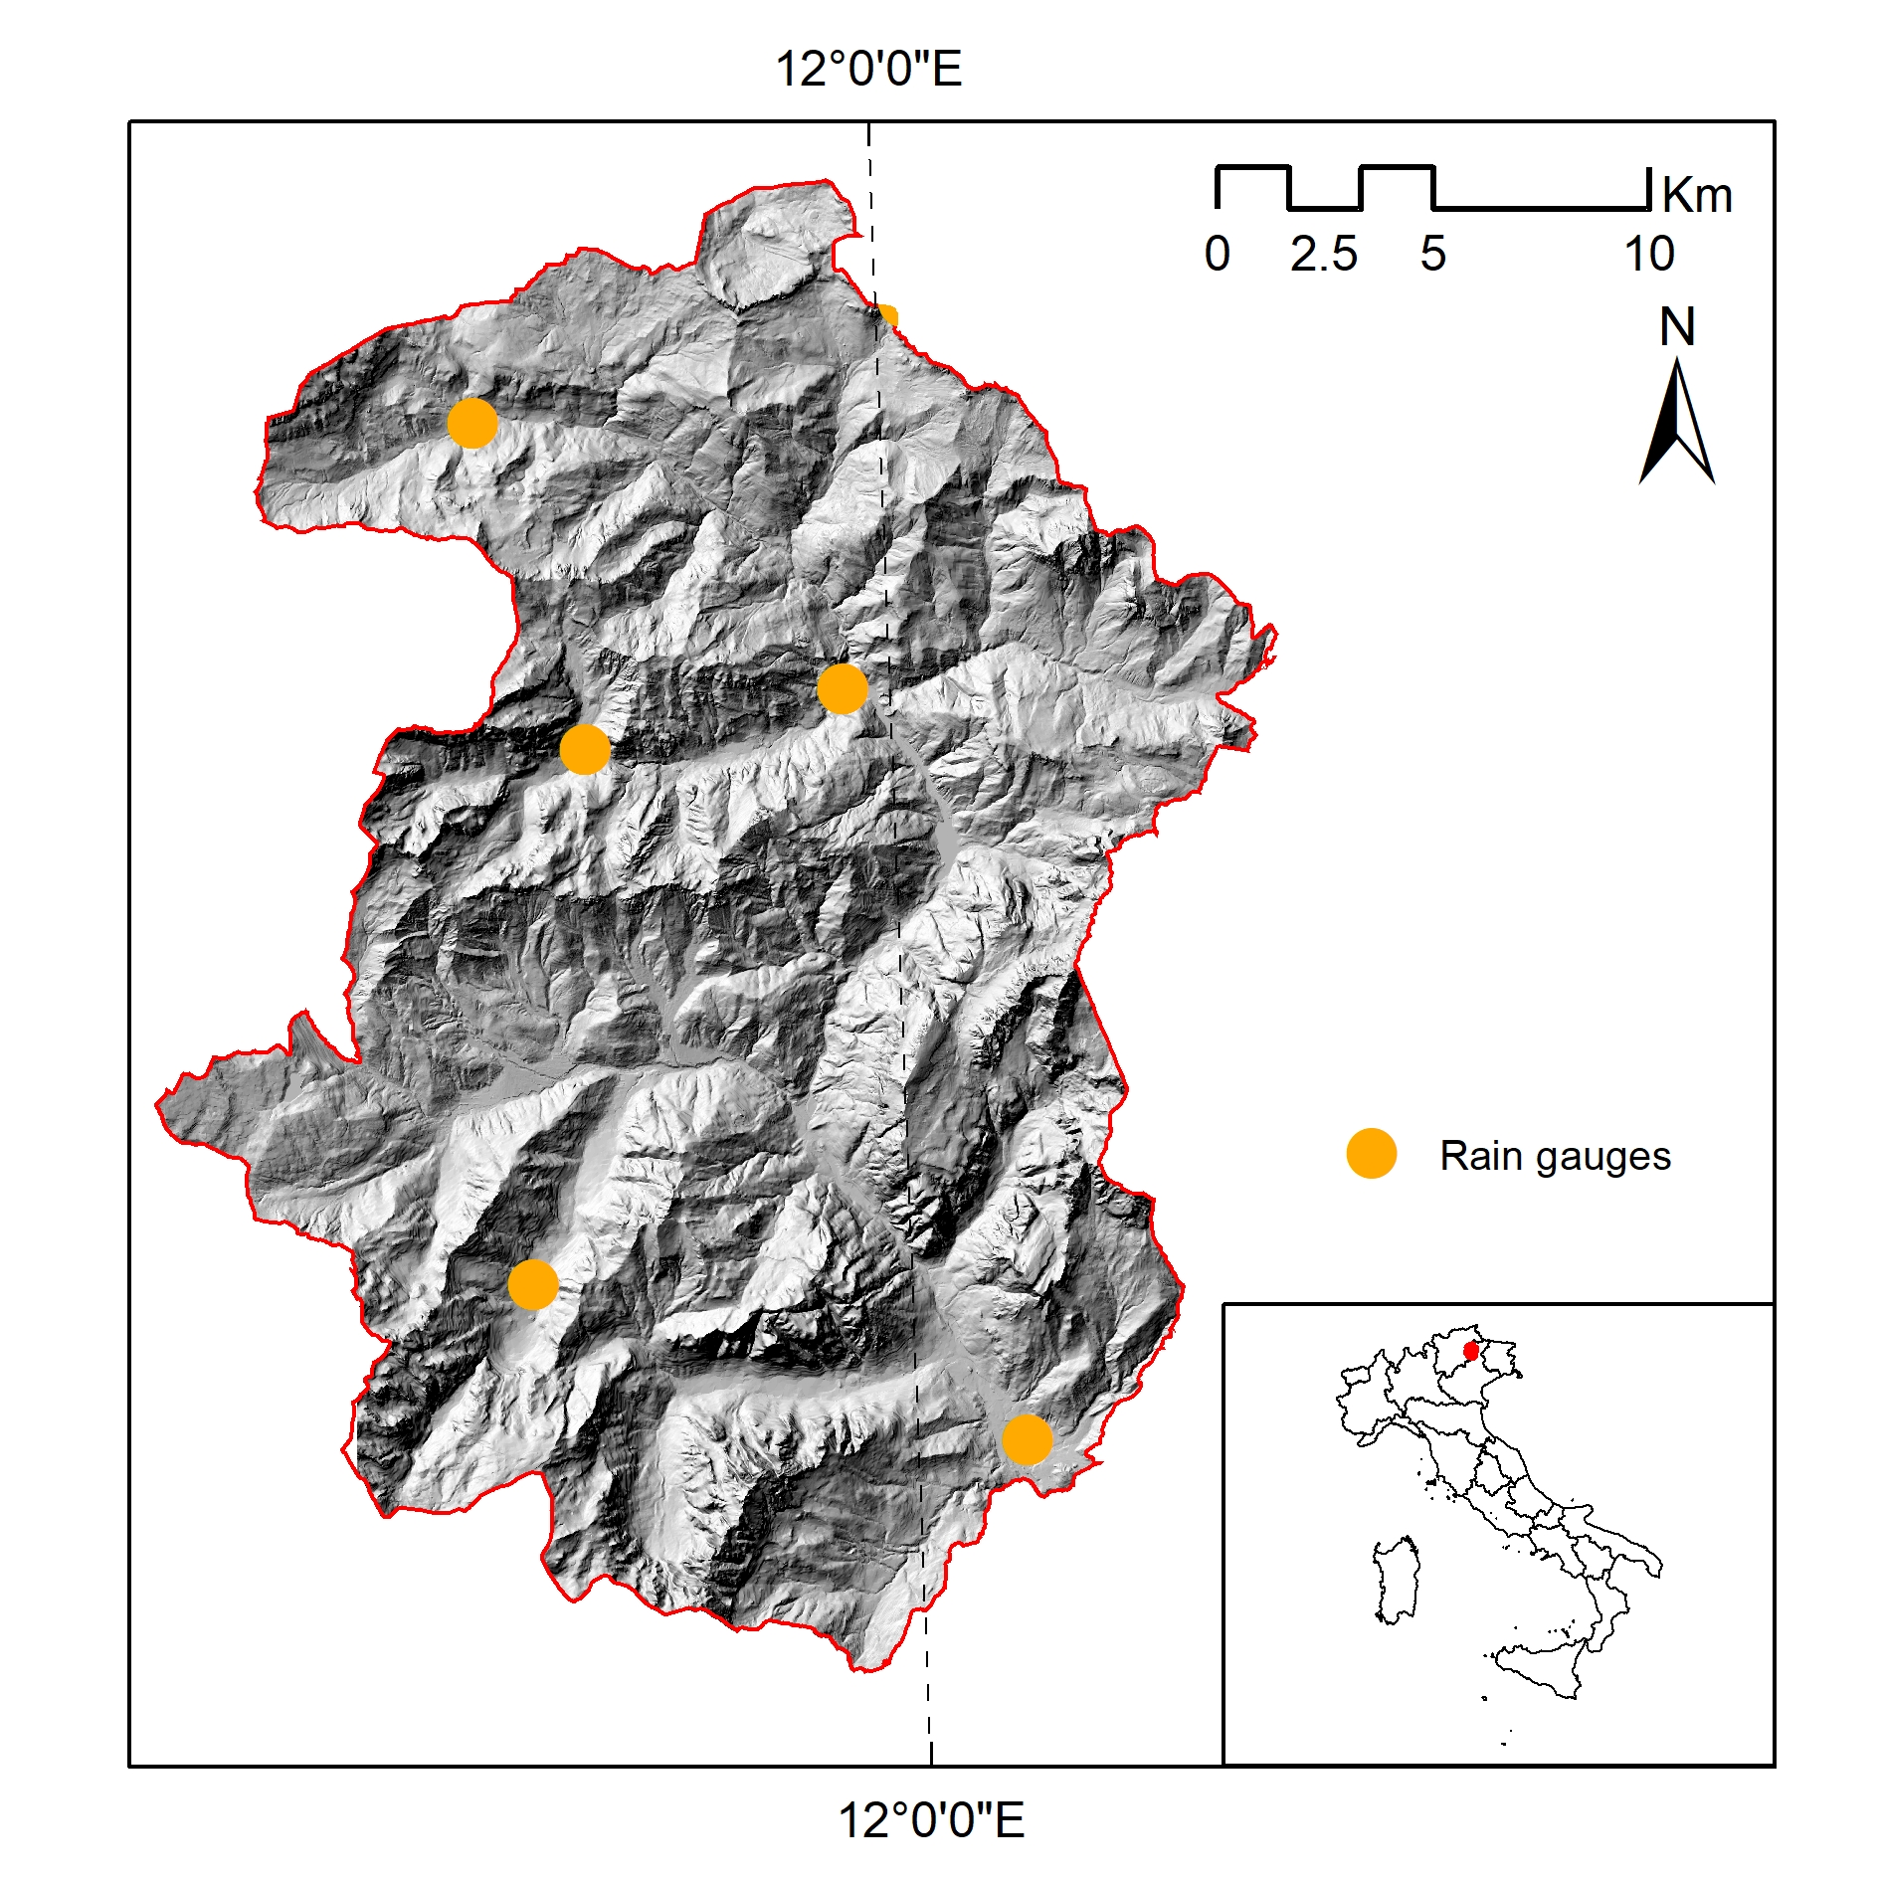
Recent rainfall events in Cordevole area (NE Italy)
The storm hit the area on October 27-30, 2018, causing 8,679 ha of damaged forests and widespread landslides.
27/10/2018
29/10/2018
27/10/2018
29/10/2018
04/12/2020
06/12/2020
04/12/2020
06/12/2020

Slide 3
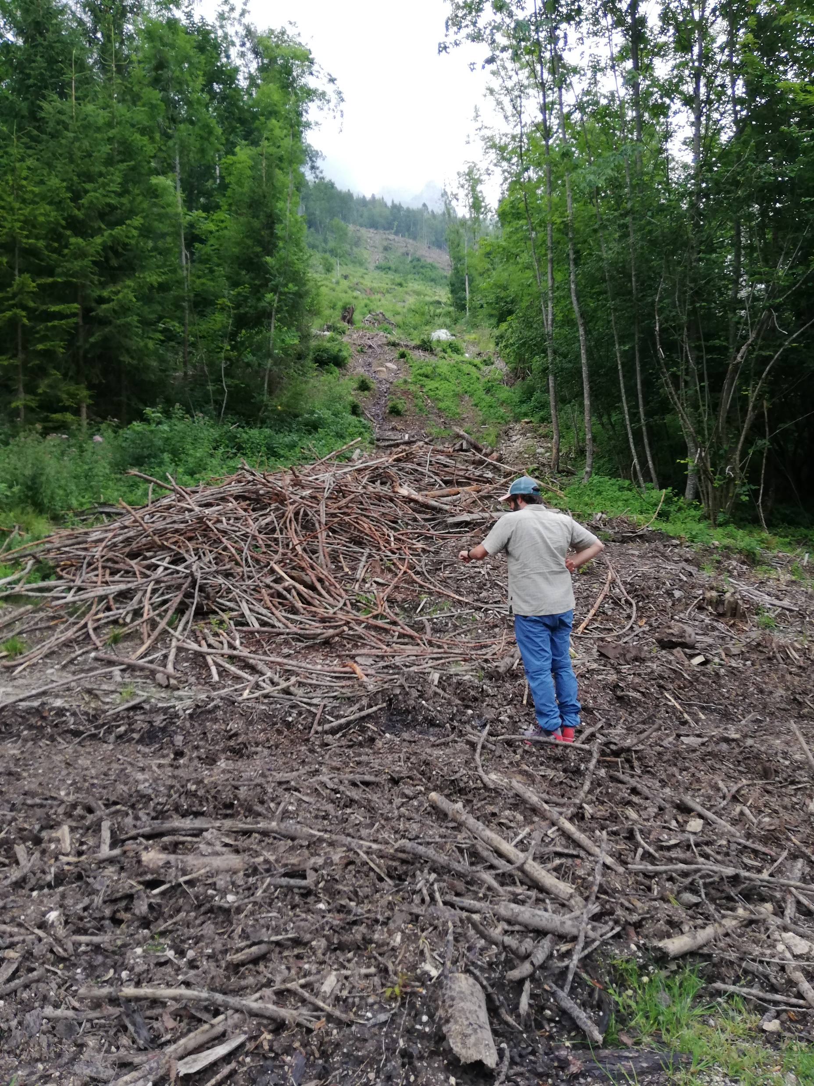
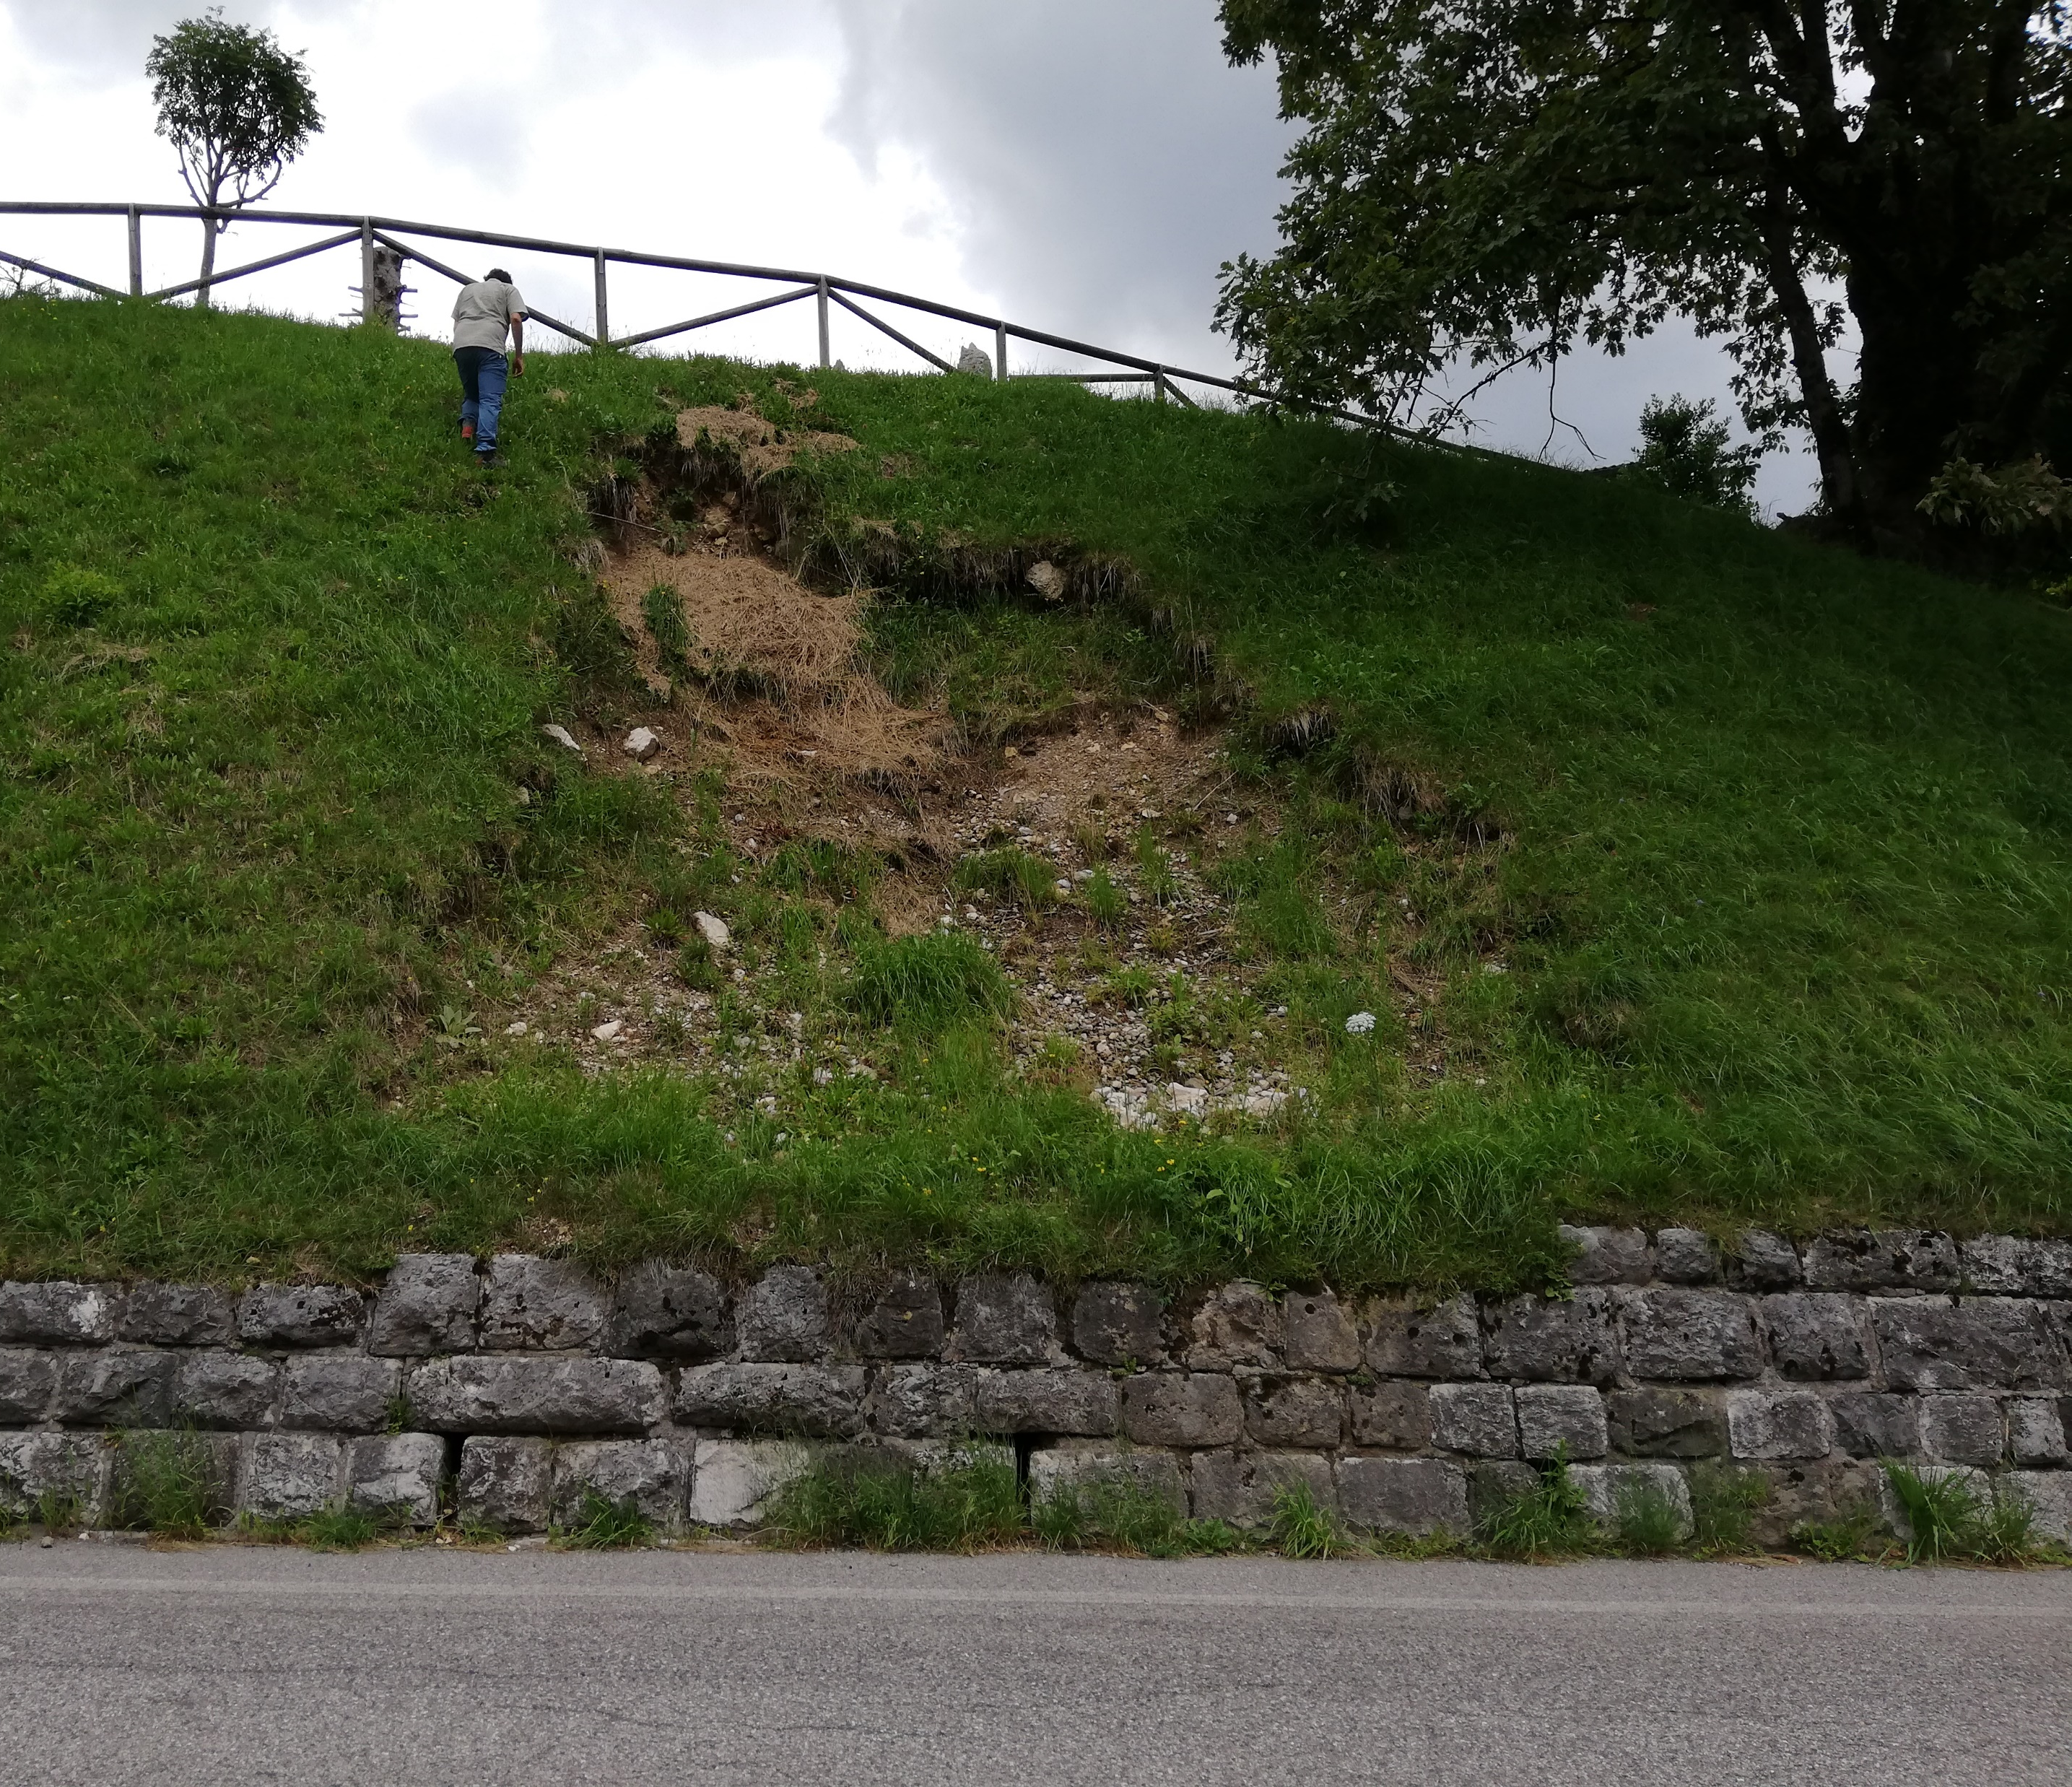
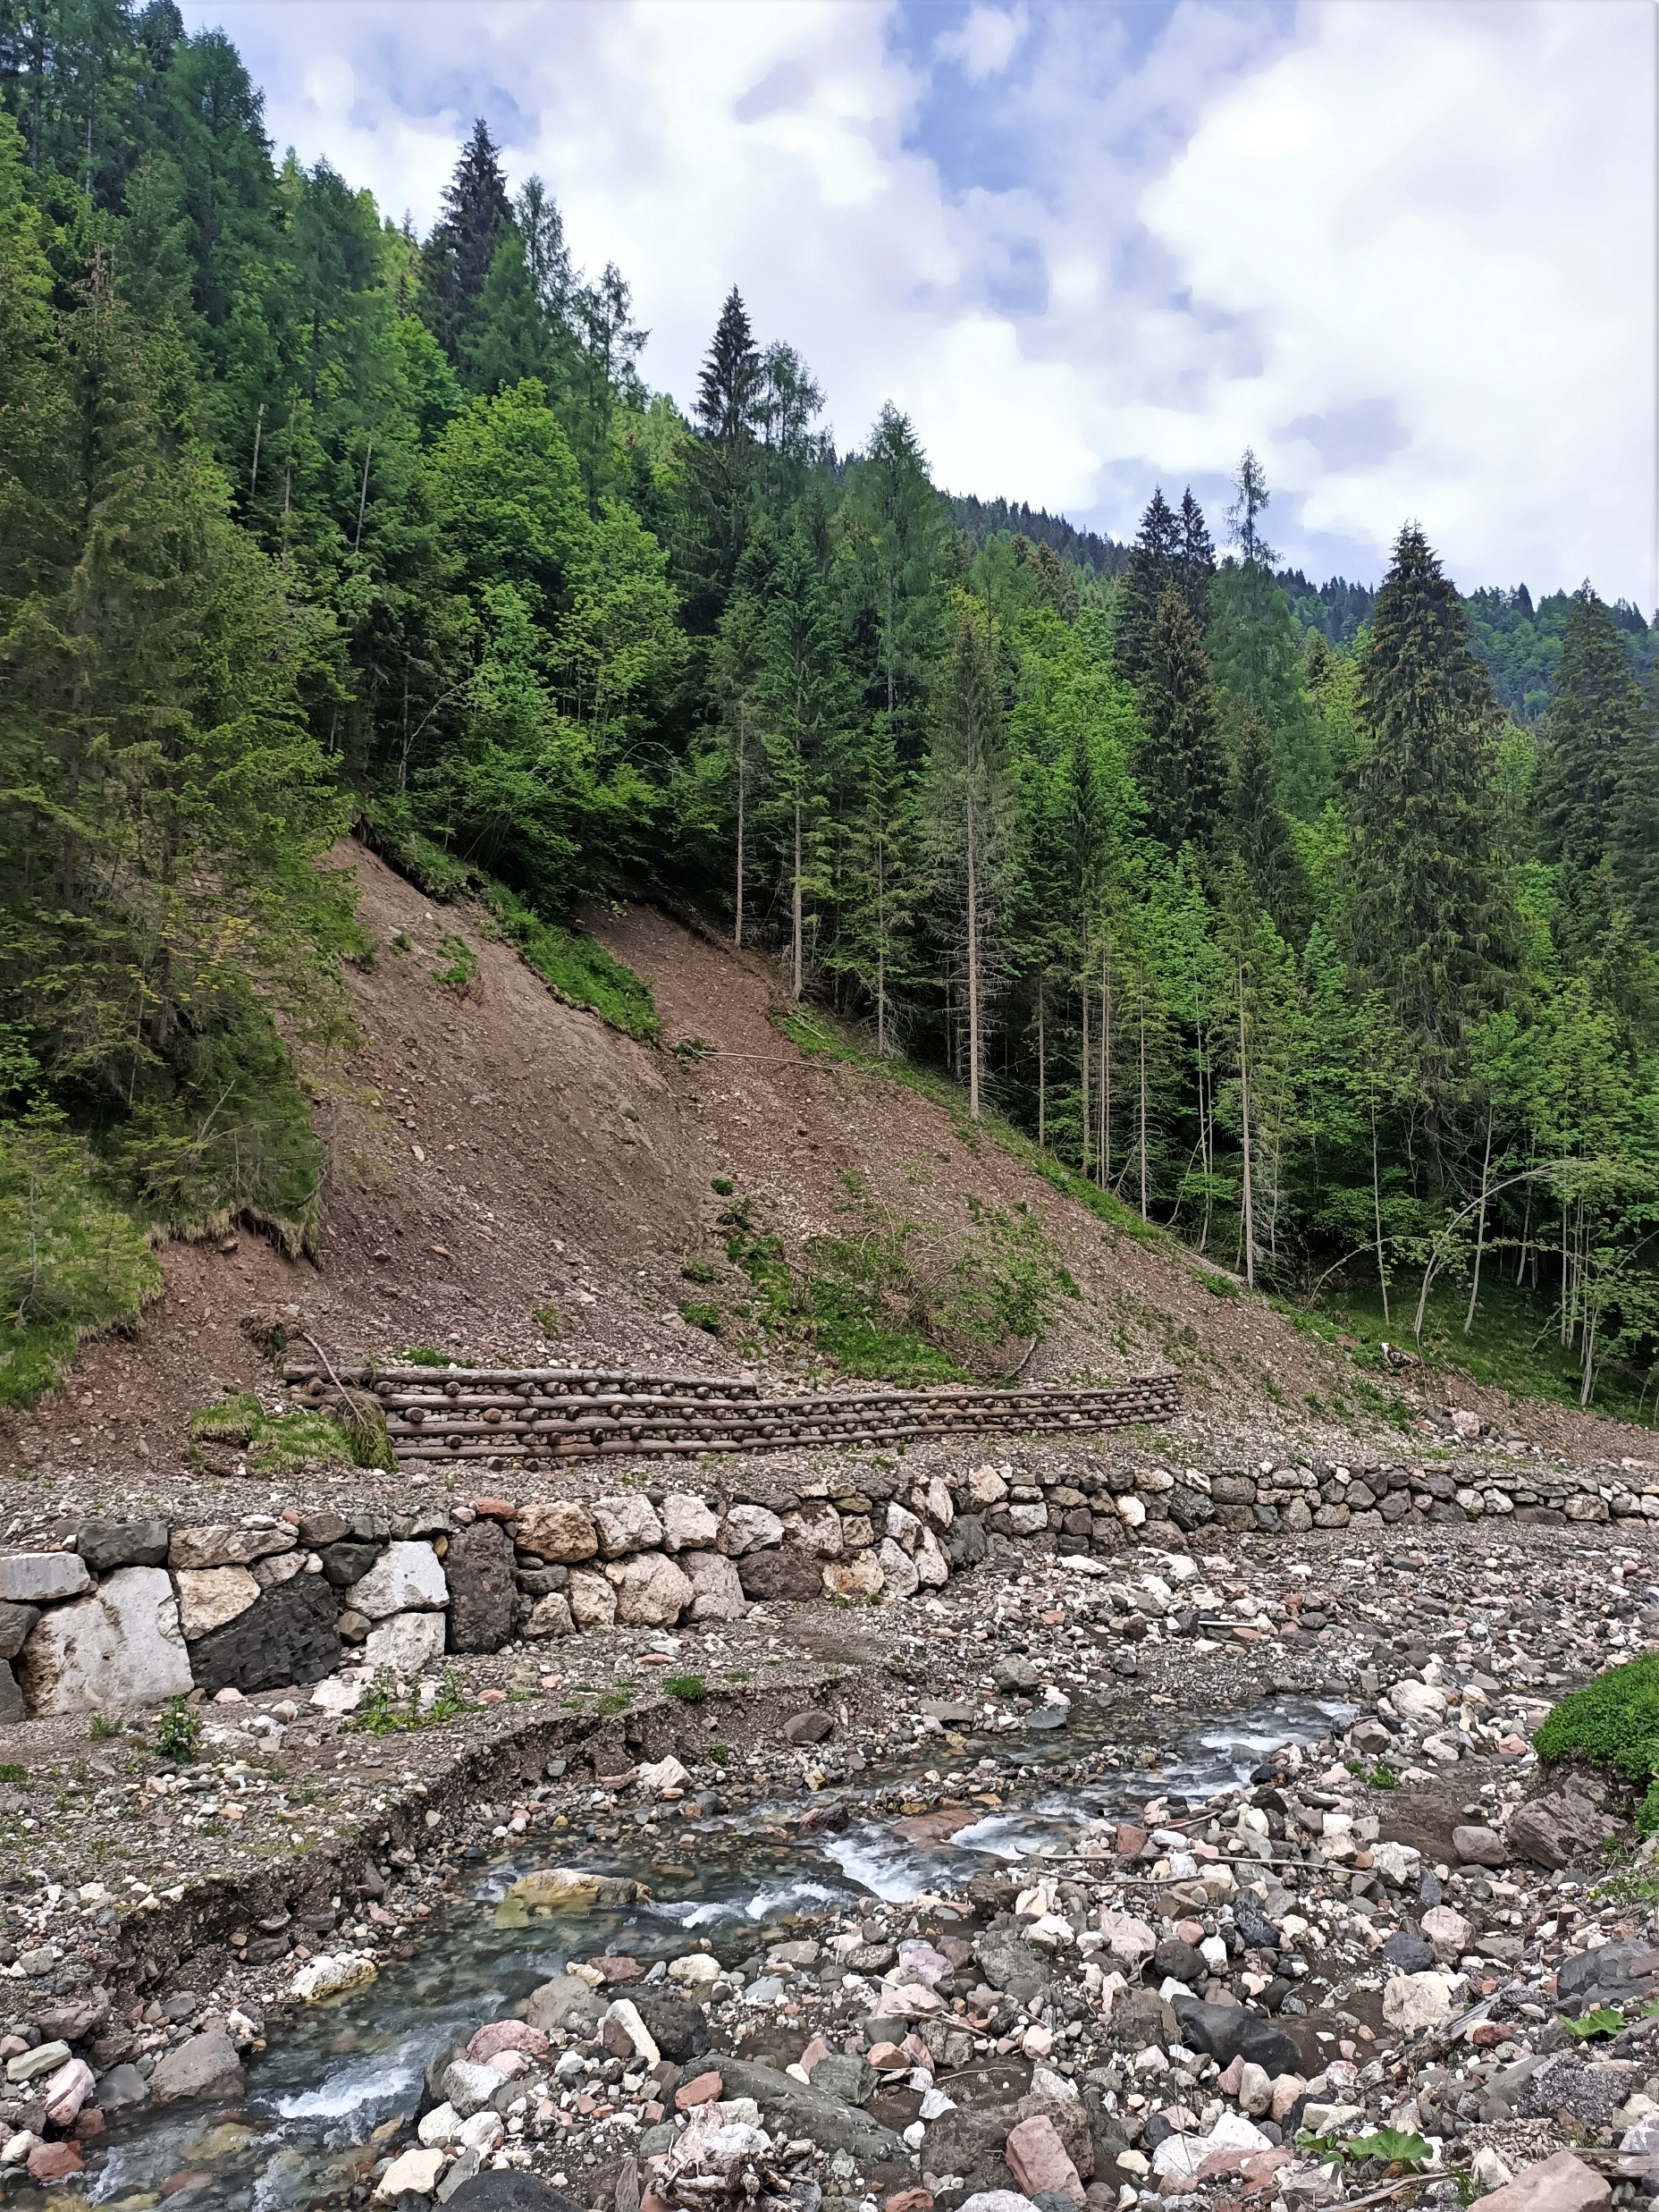
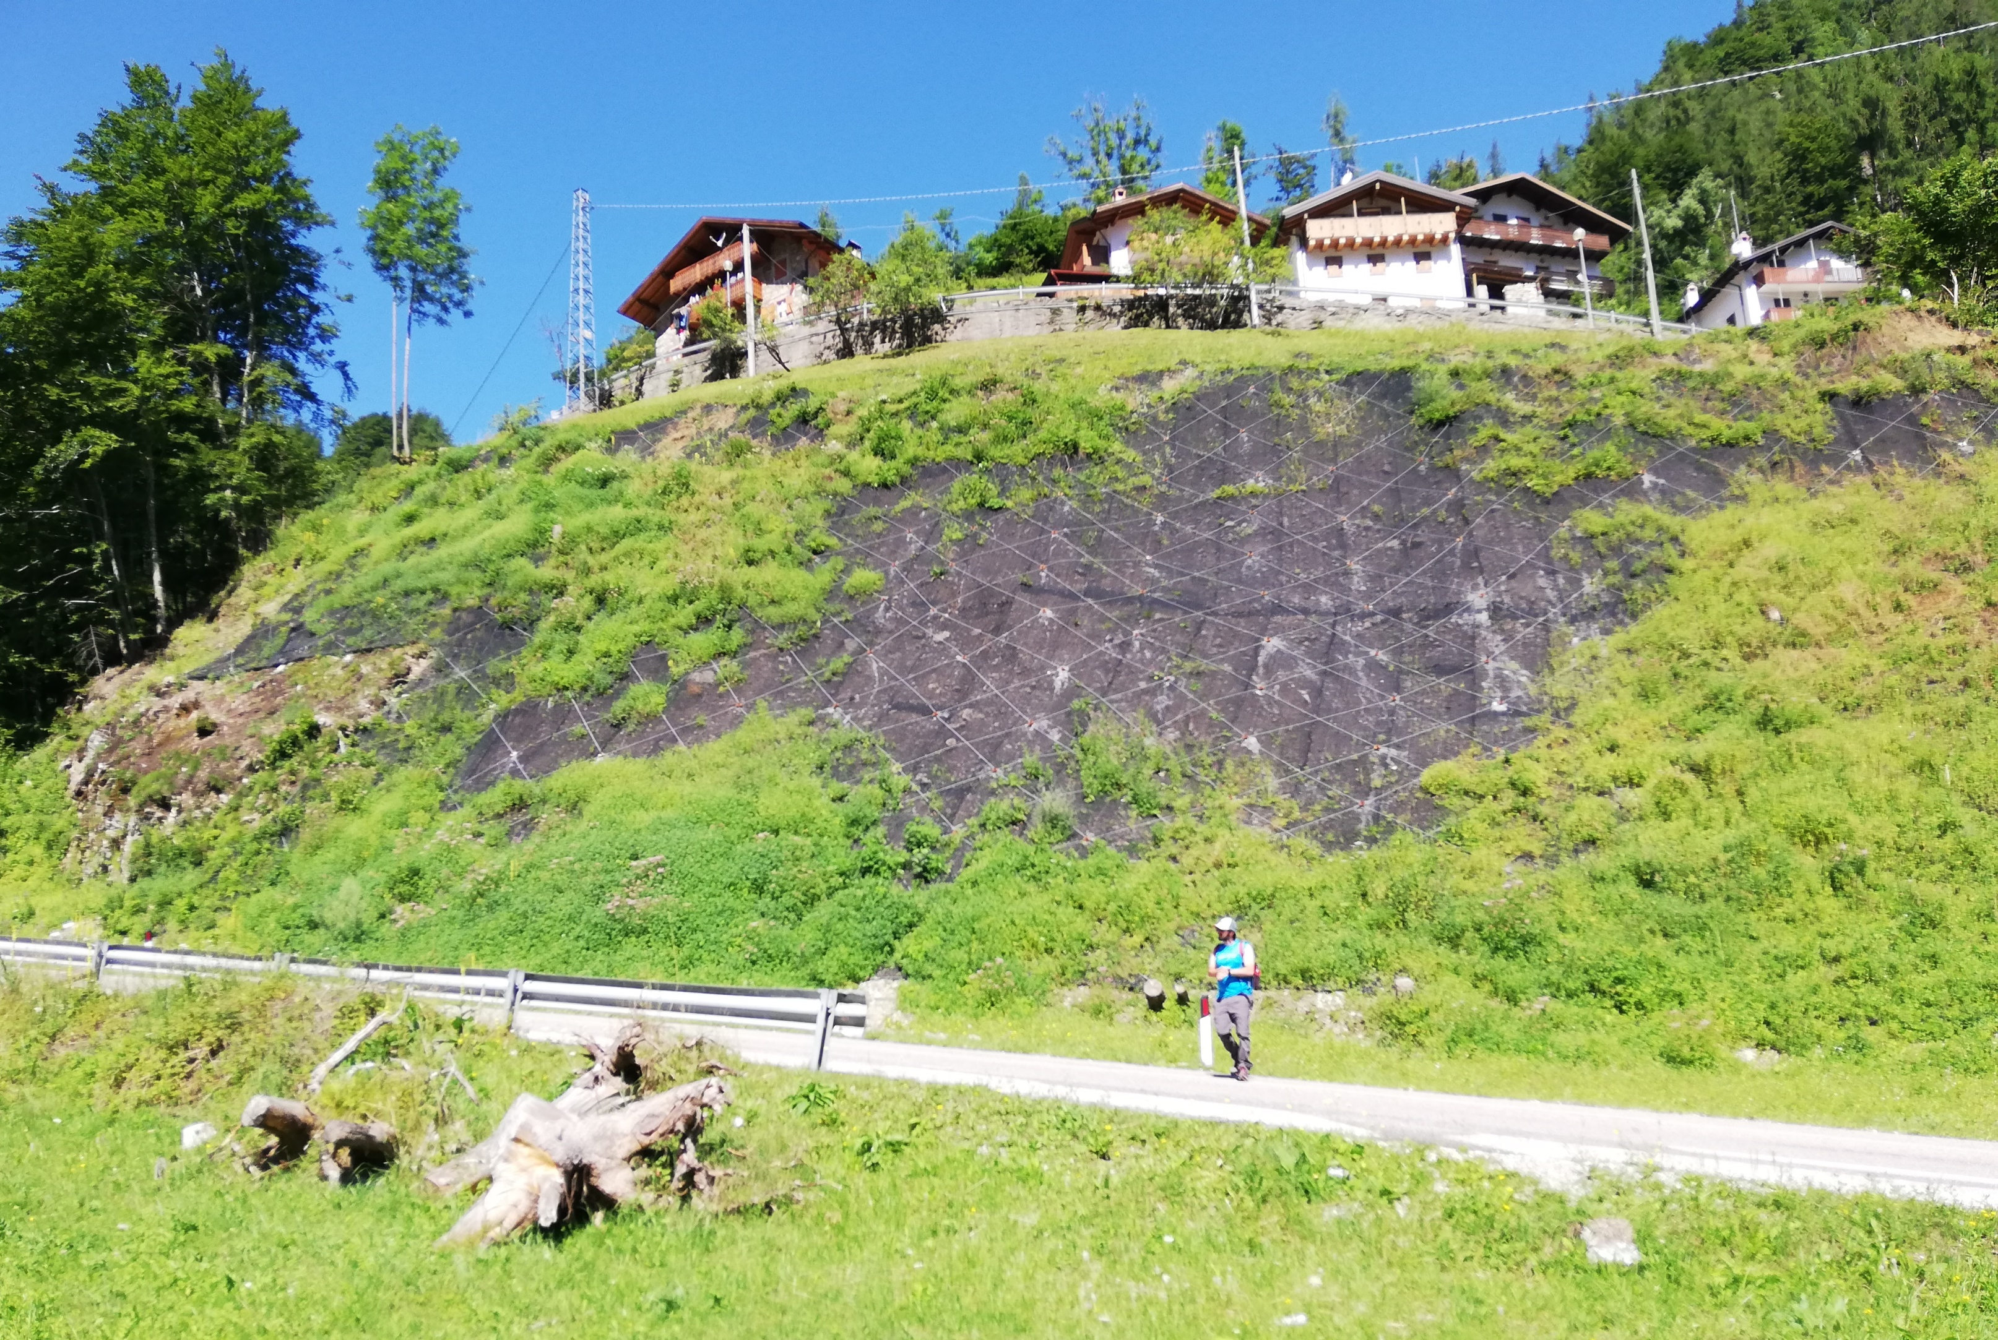
Aim
To study impact of Multi-temporal inventories and landcover changes on landslide susceptibility.
Can we use multi temporal inventories for validating susceptibility maps?
29/10/2018
27/10/2018
29/10/2018

Slide 4
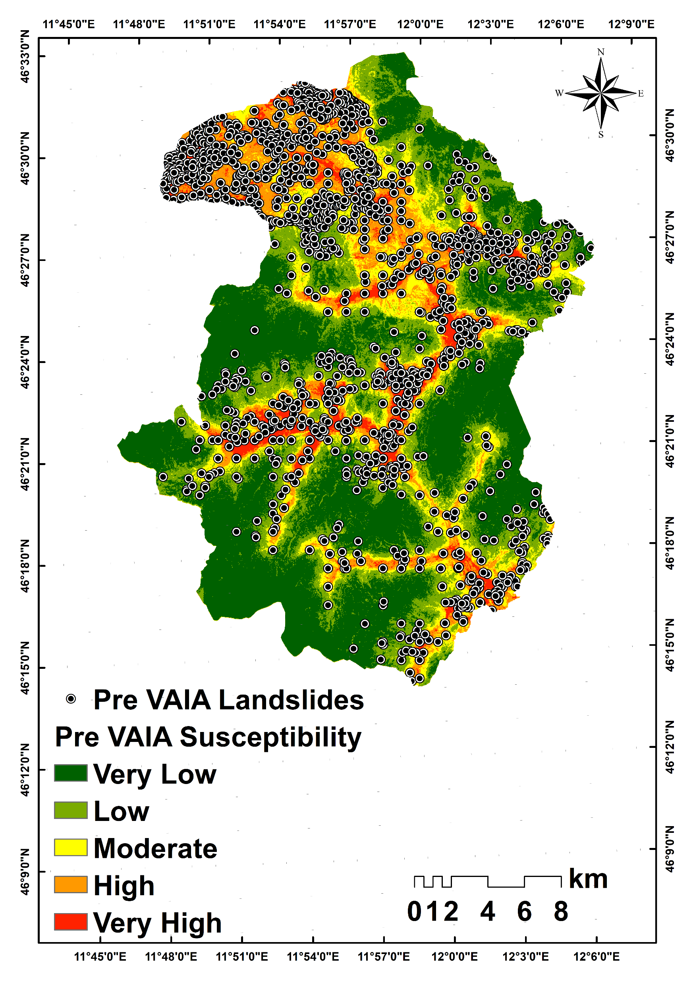
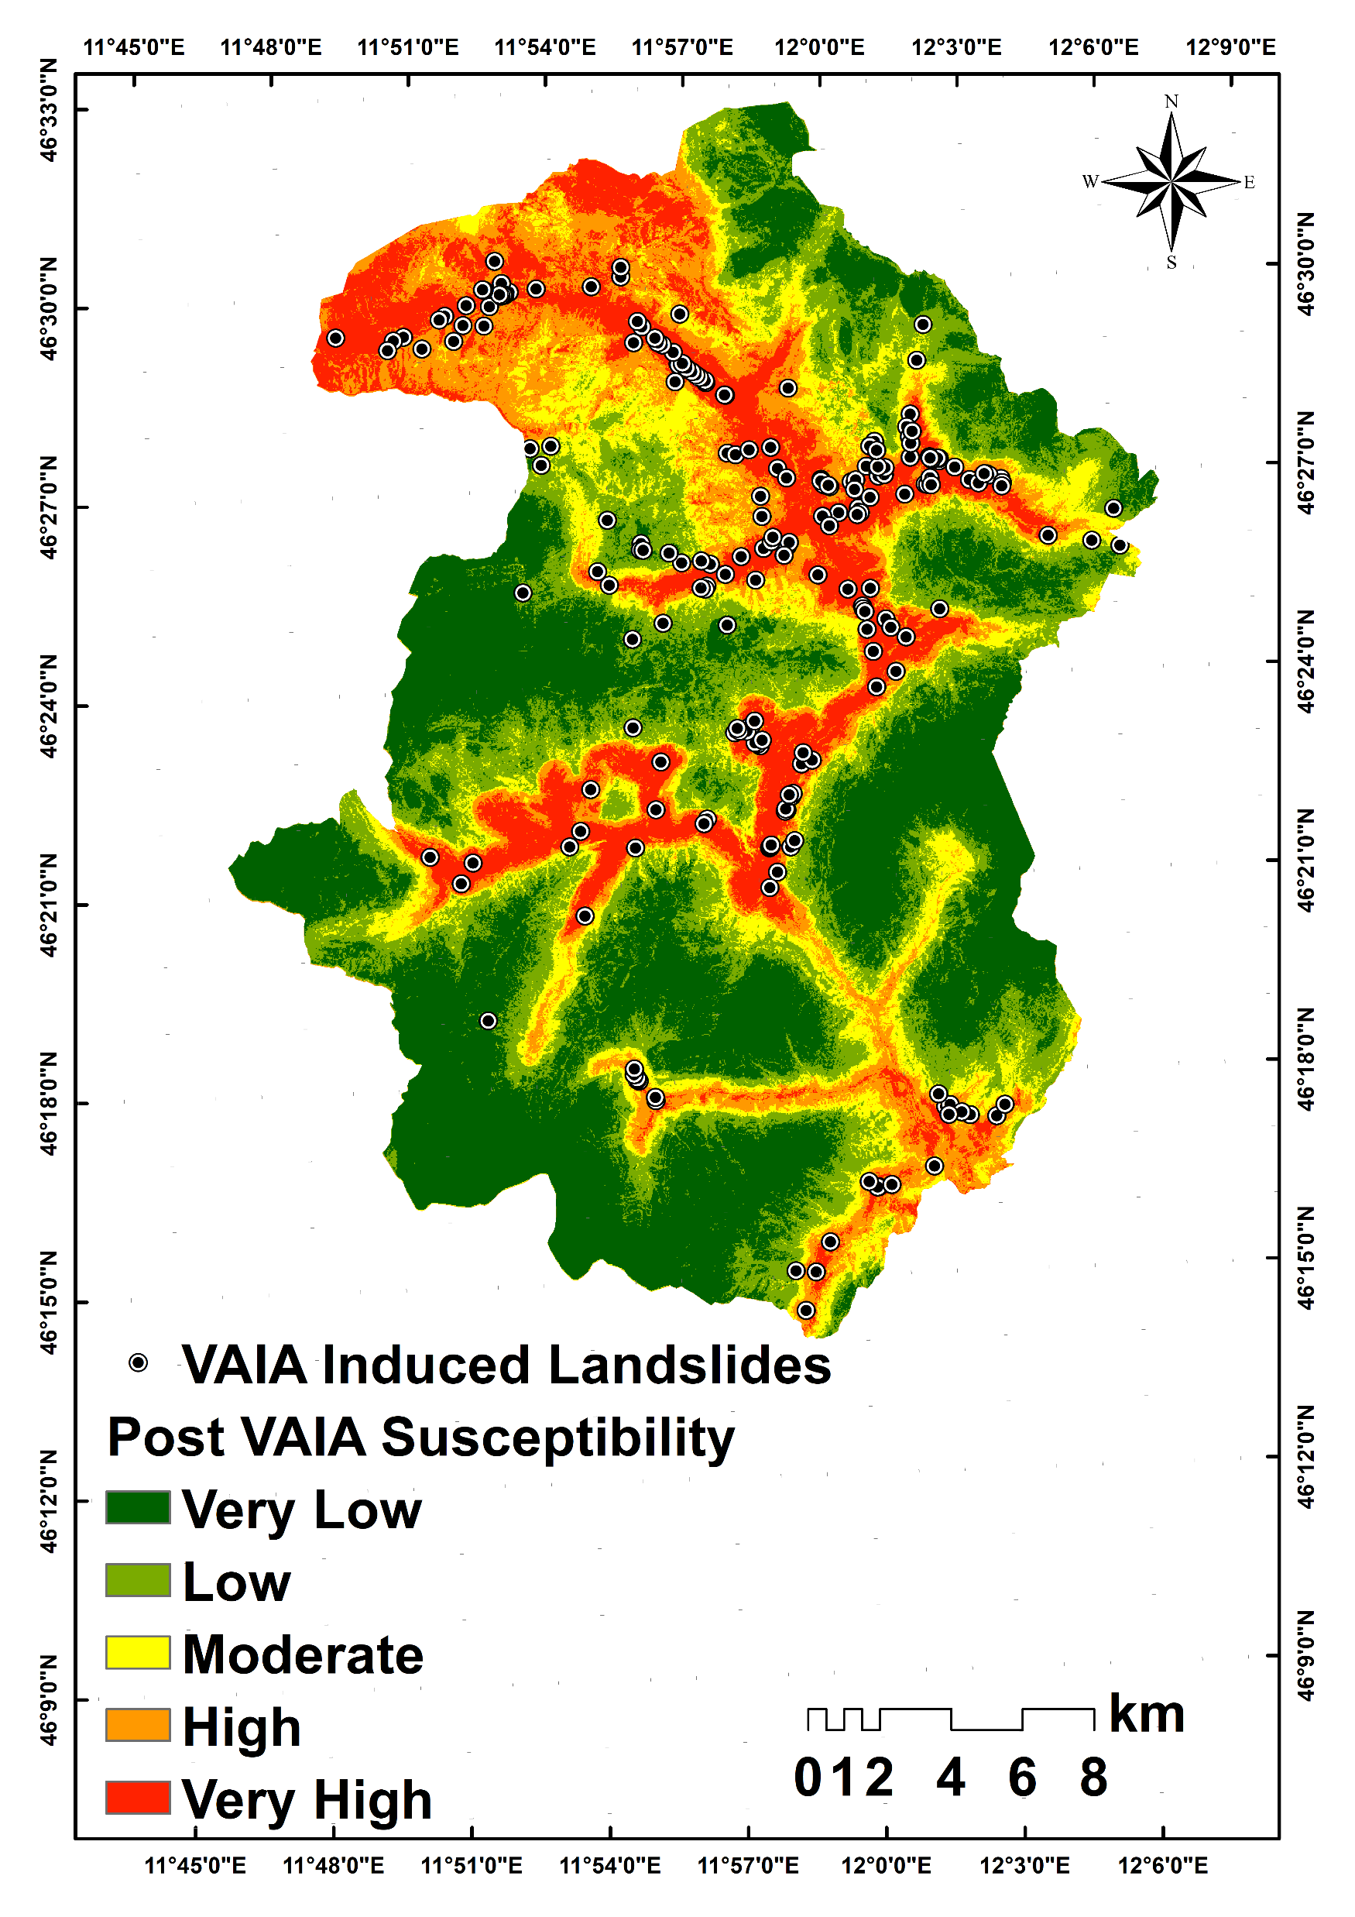
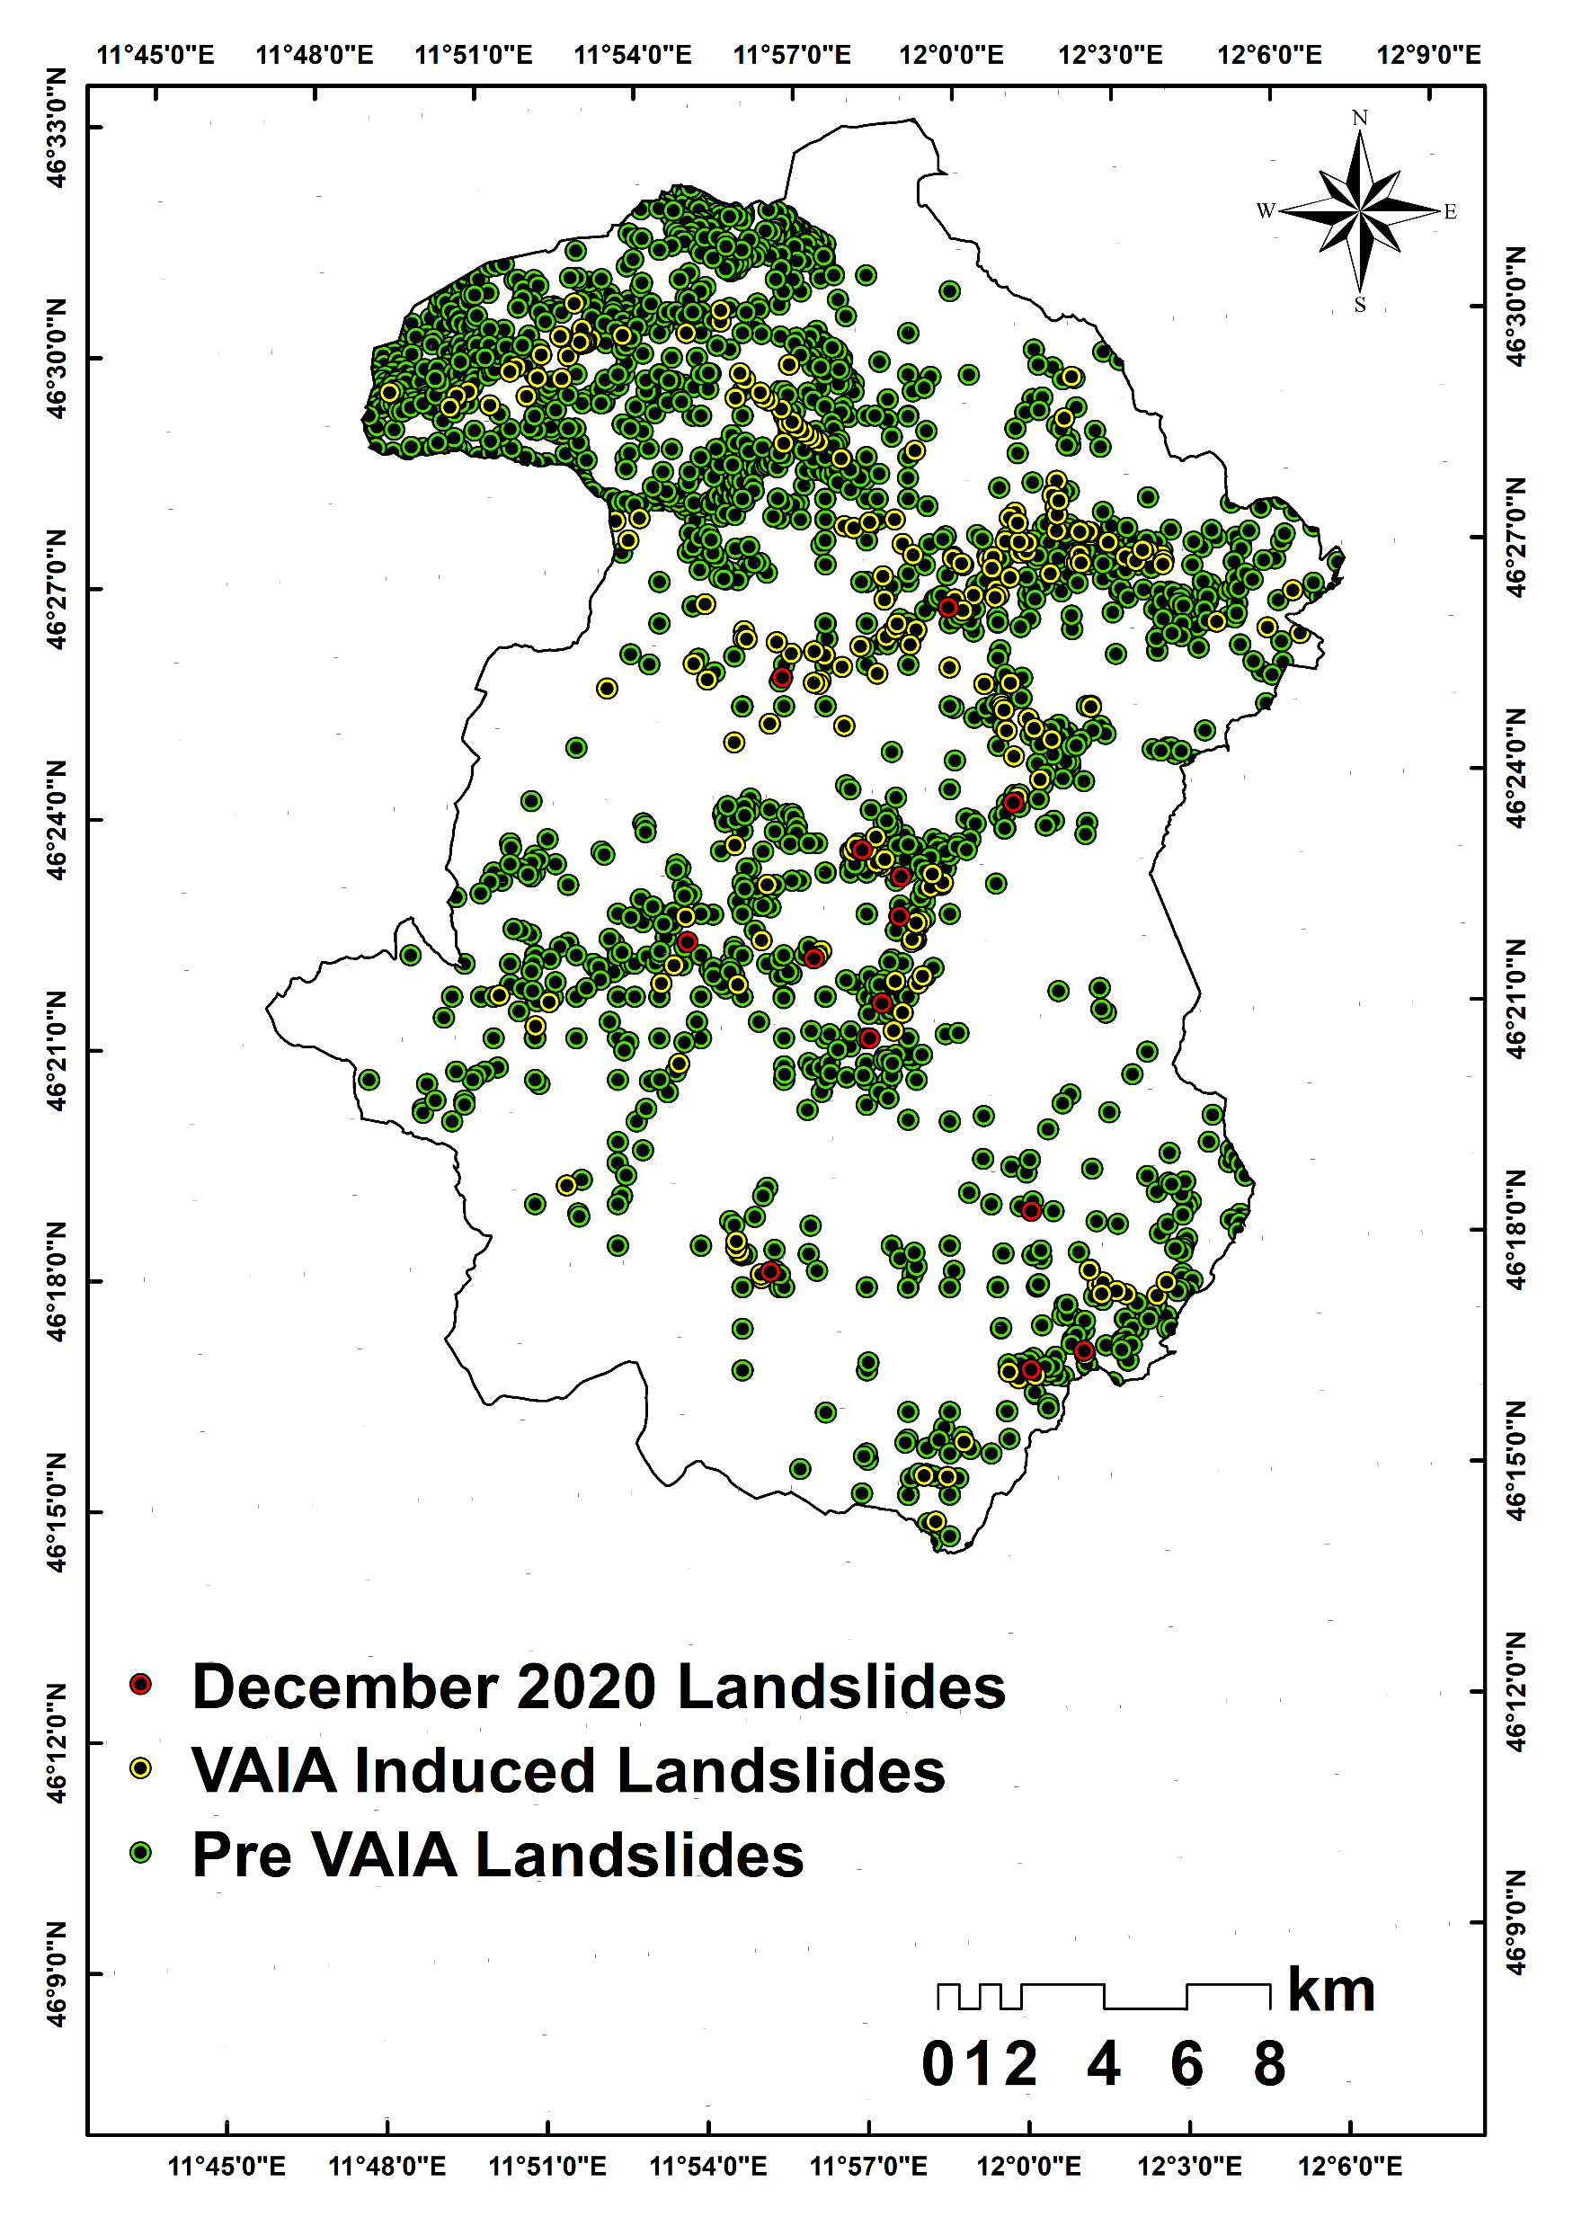
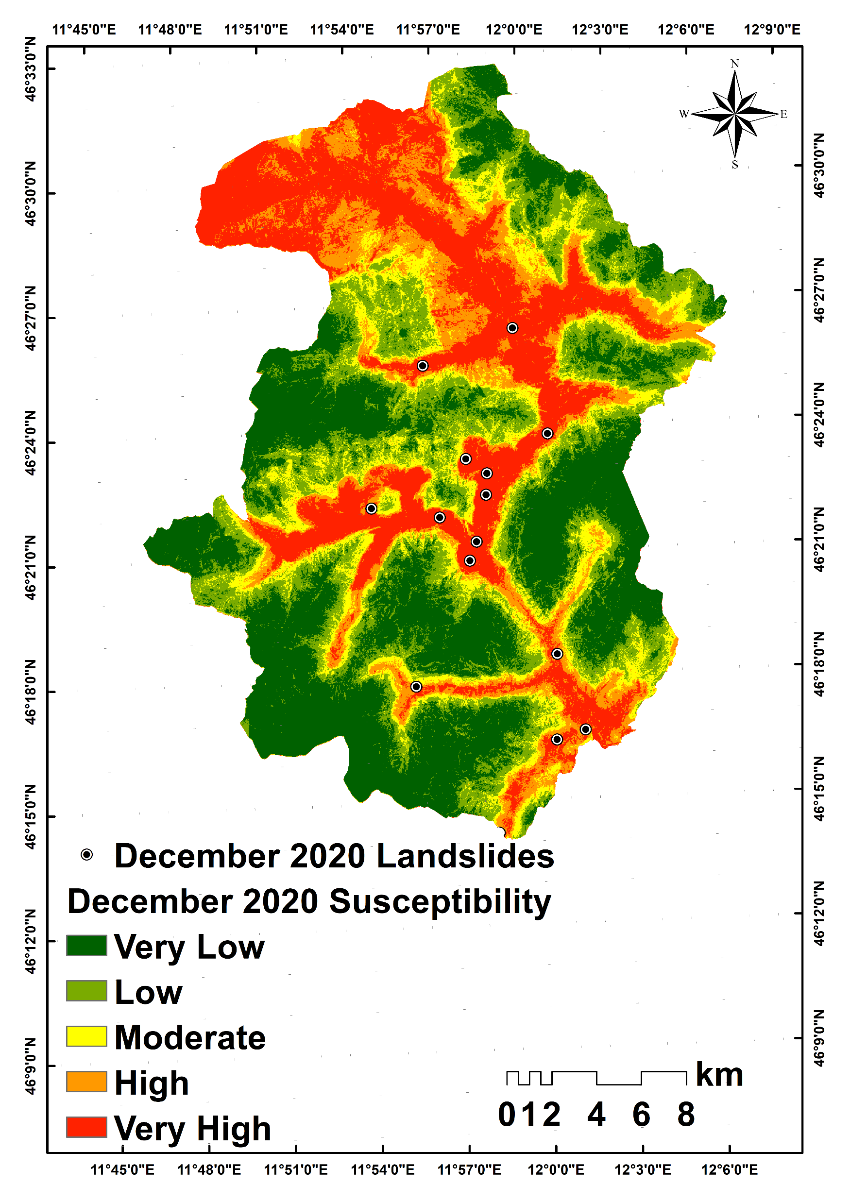
Multi-temporal field-based inventory for susceptibility assessment
Inventory | No. landslides
IFFI (pre-VAIA) | 2479
VAIA 2018 | 229
December 2020 | 14
TOTAL | 2722
14 feature layers
Susceptibility maps
Landcover
Lithology
Distance from roads
Distance from rivers
NDVI
Rainfall
DEM
Slope
Profile curvature
Plan curvature
Aspect
TPI
TRI
TWI

Slide 5
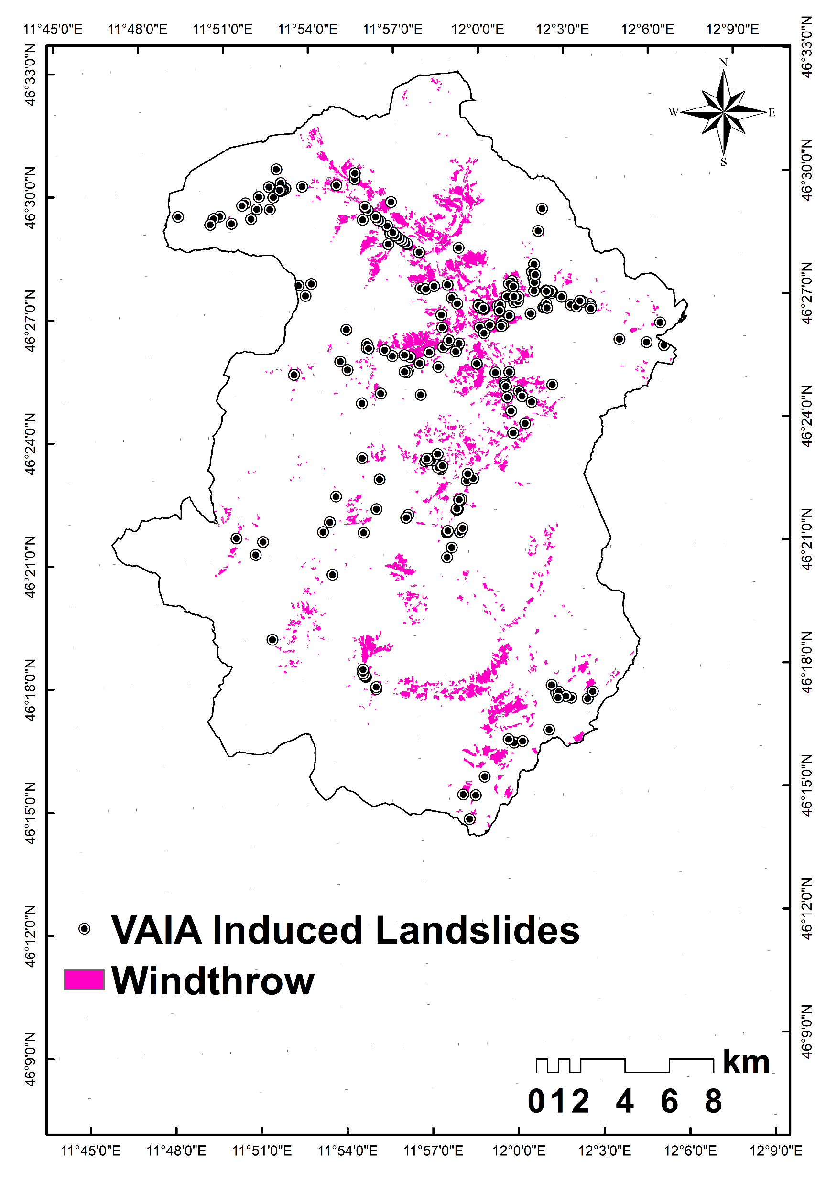
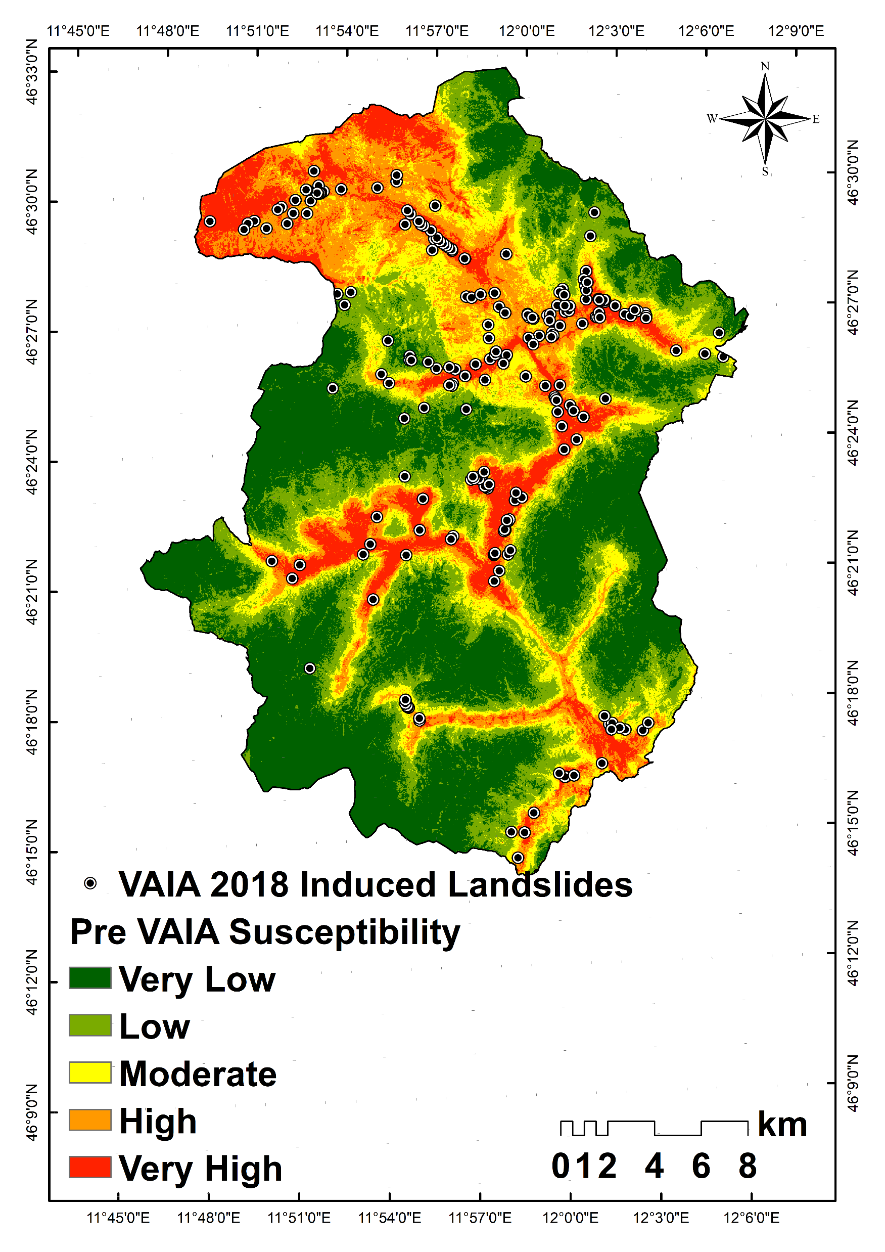
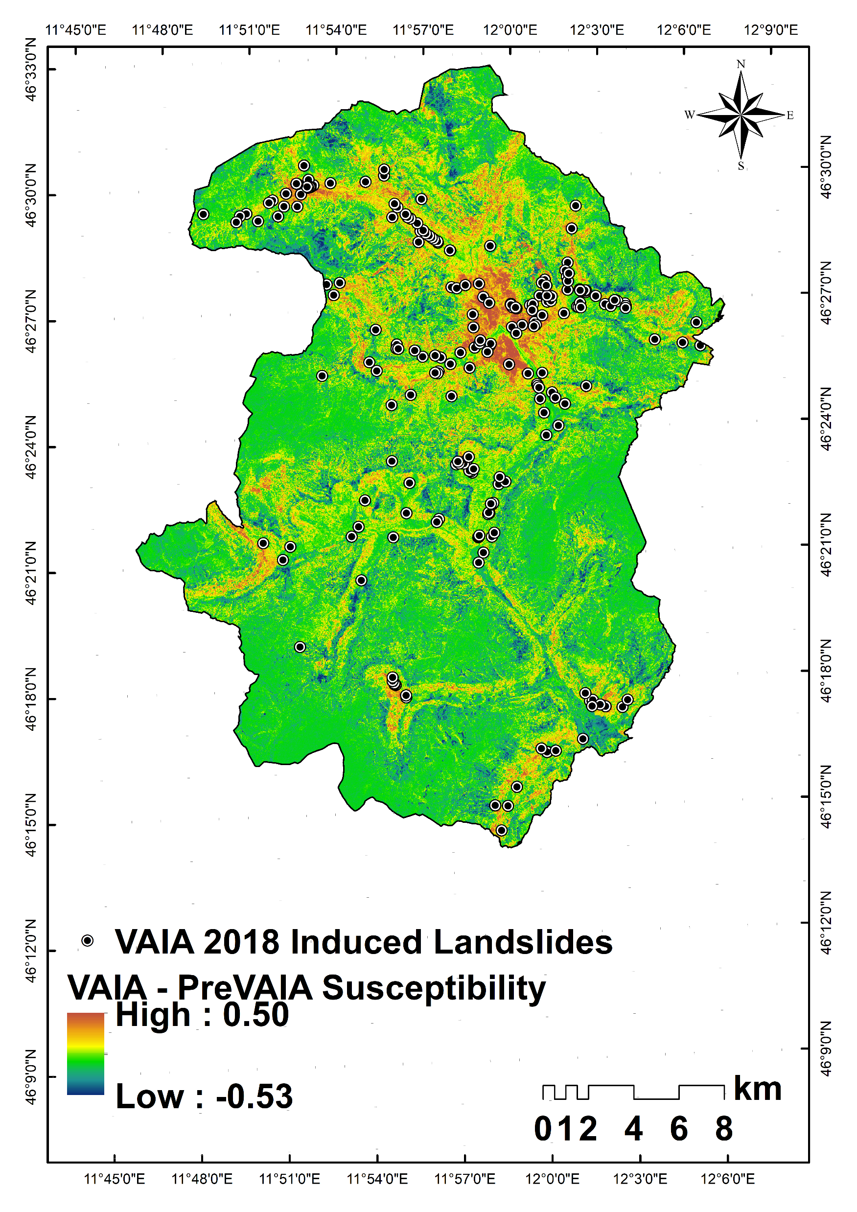
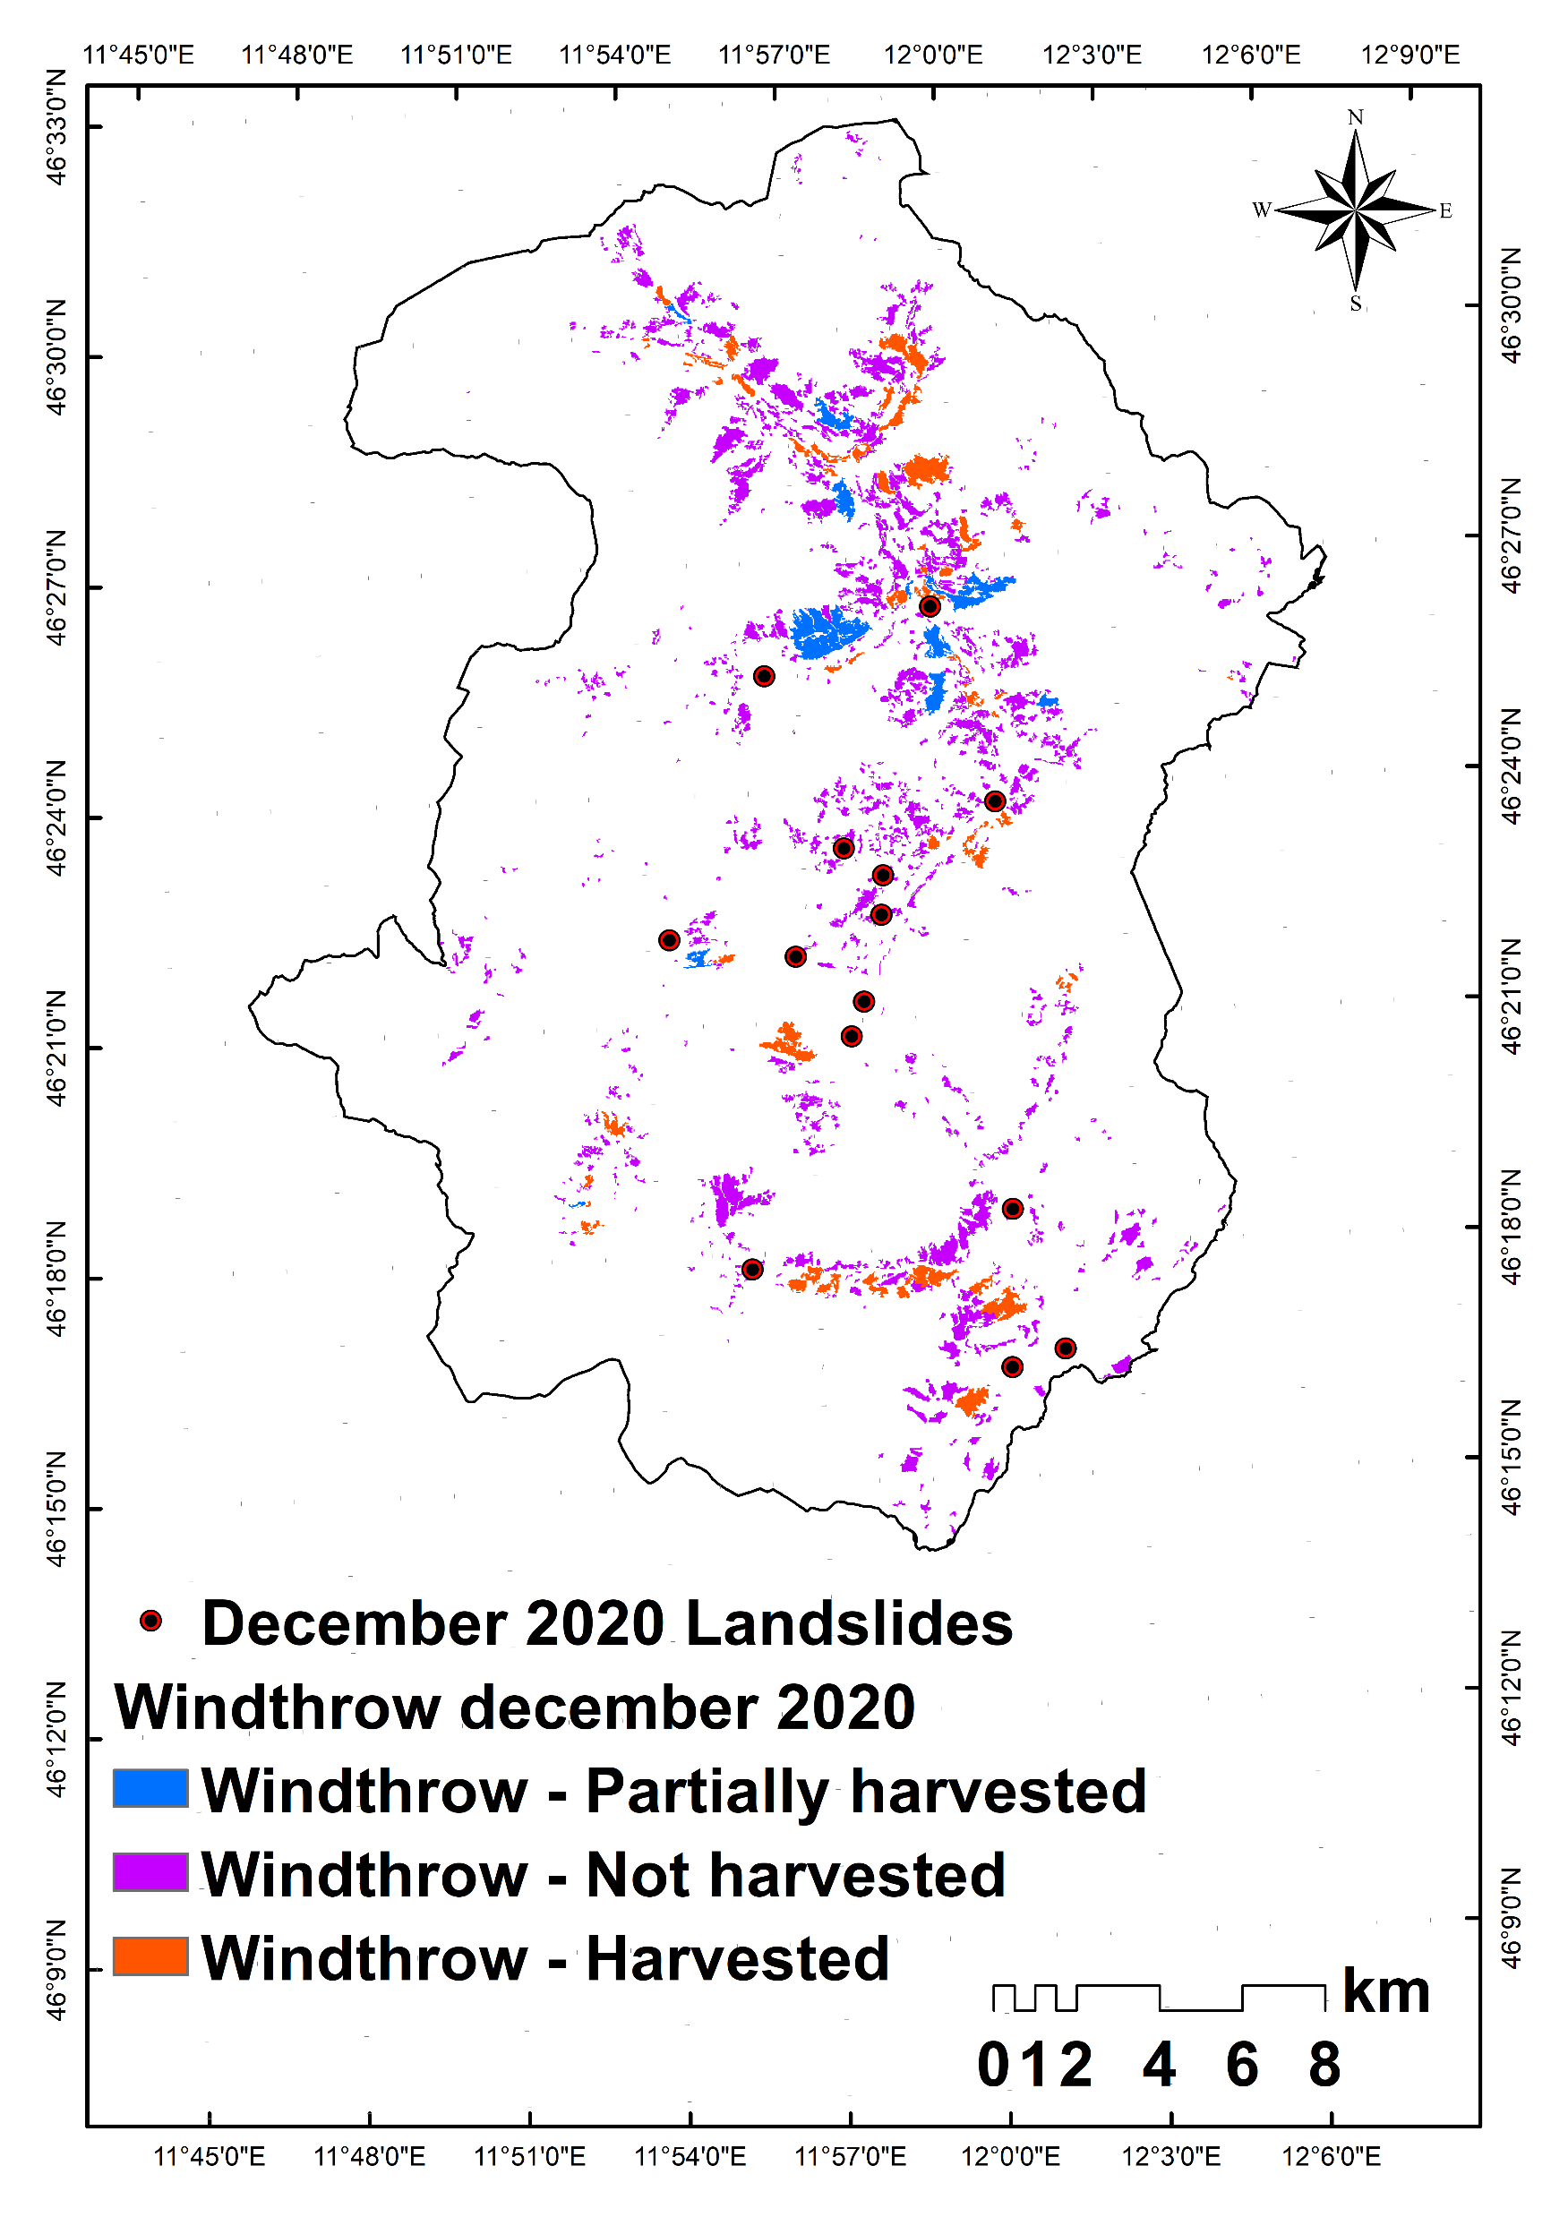
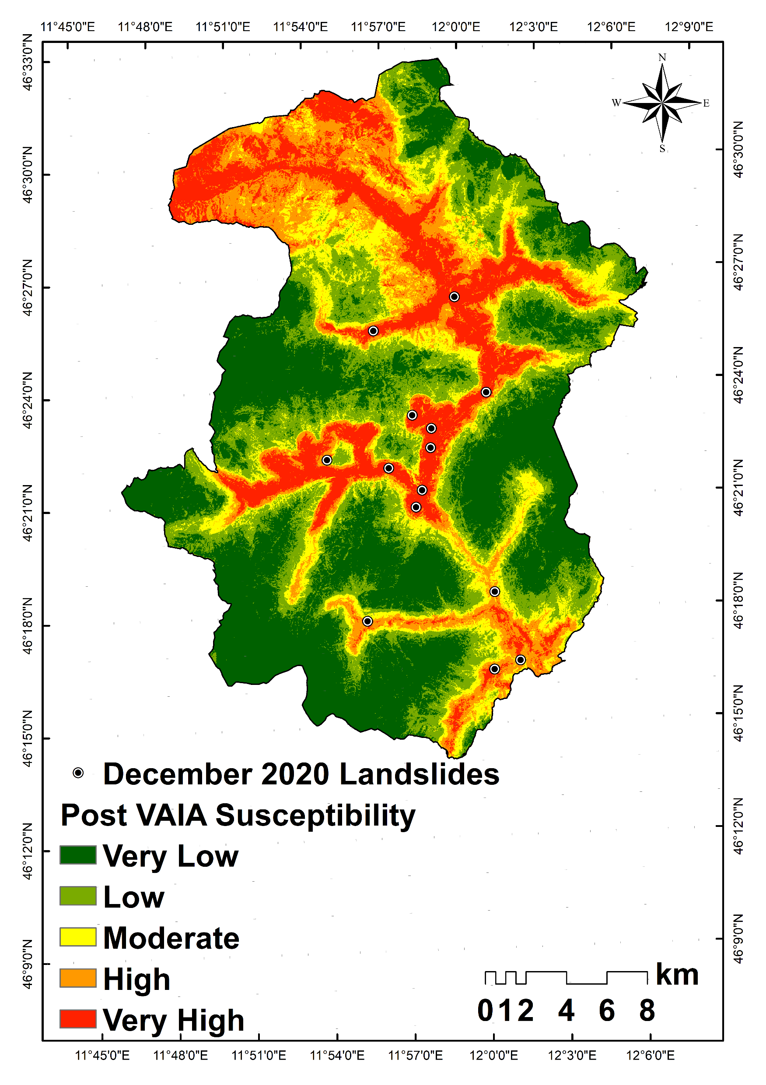
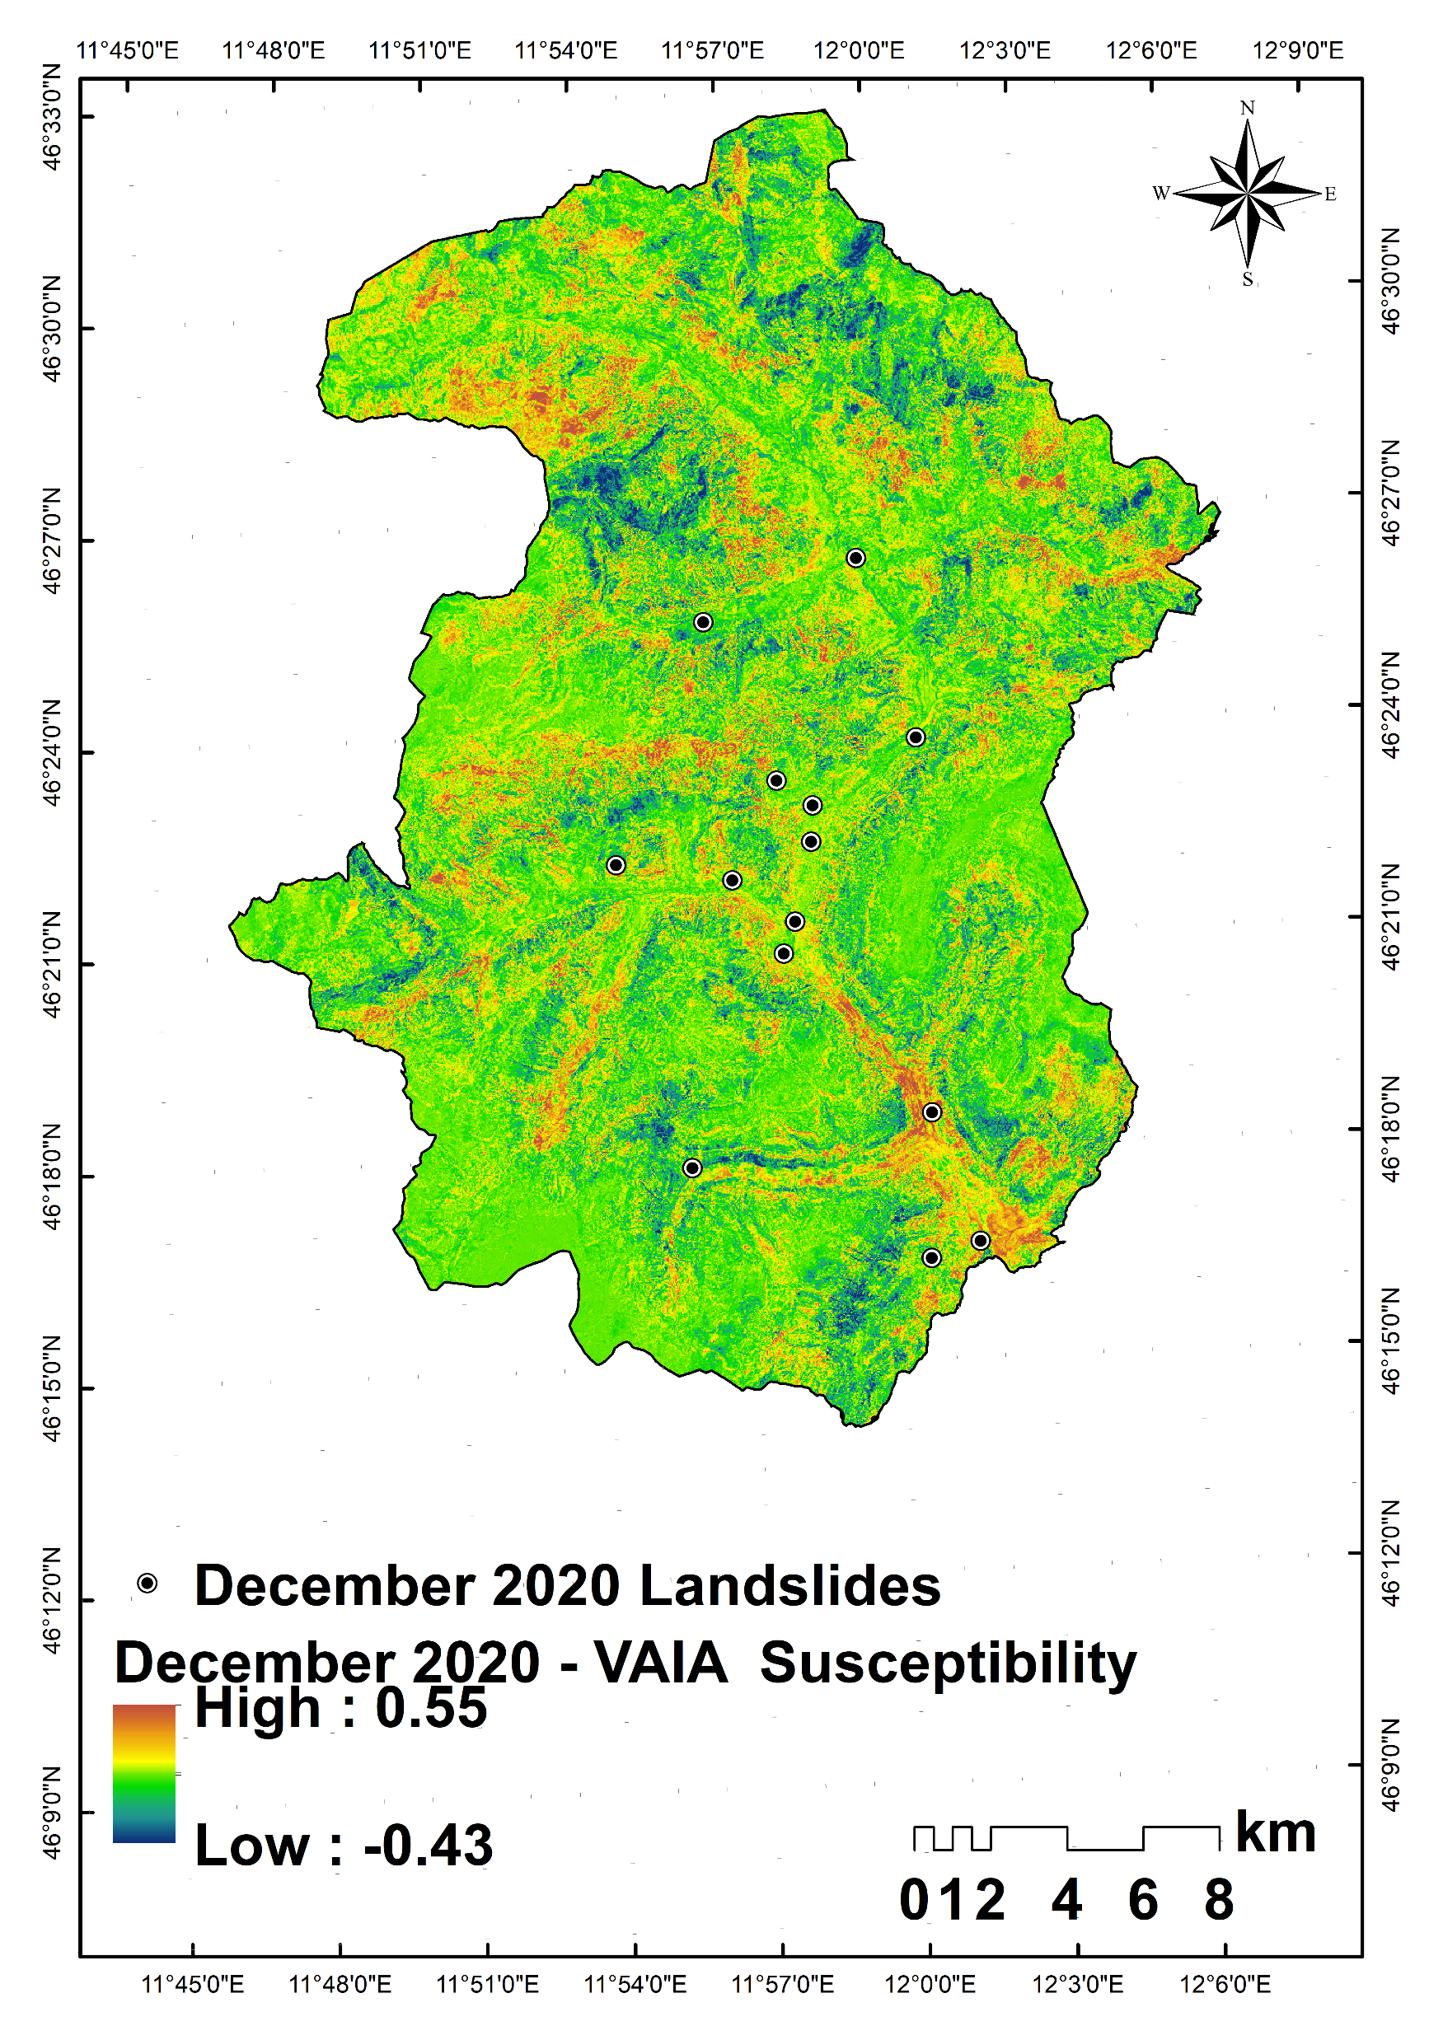
Windthrown areas were mapped using fieldwork and orthophotos for two different time periods (Post VAIA and Post December 2020 event).
A total of 229 field verified landslides induced by VAIA 2018 event, among which 22 landslides occurred in windthrown areas.
For December 2020 event, 14 new field verified landslides were identified and none of them were in windthrown areas.
AUC for pre-vaia, post-vaia and December 2020 events ranges from 0.89-0.90.

Slide 6
Conclusions and future work
Spatial distribution of the landslides after Vaia and Dec2020 extreme rainfall events and their relationship with windthrown regions.
Impact of updating of landcover and inventory on landslide susceptibility.
To update the multi temporal inventory and compliment it with high resolution satellite data.
To analyse long term rainfall patterns and multi temporal inventory from historical orthophotos.

Slide 7
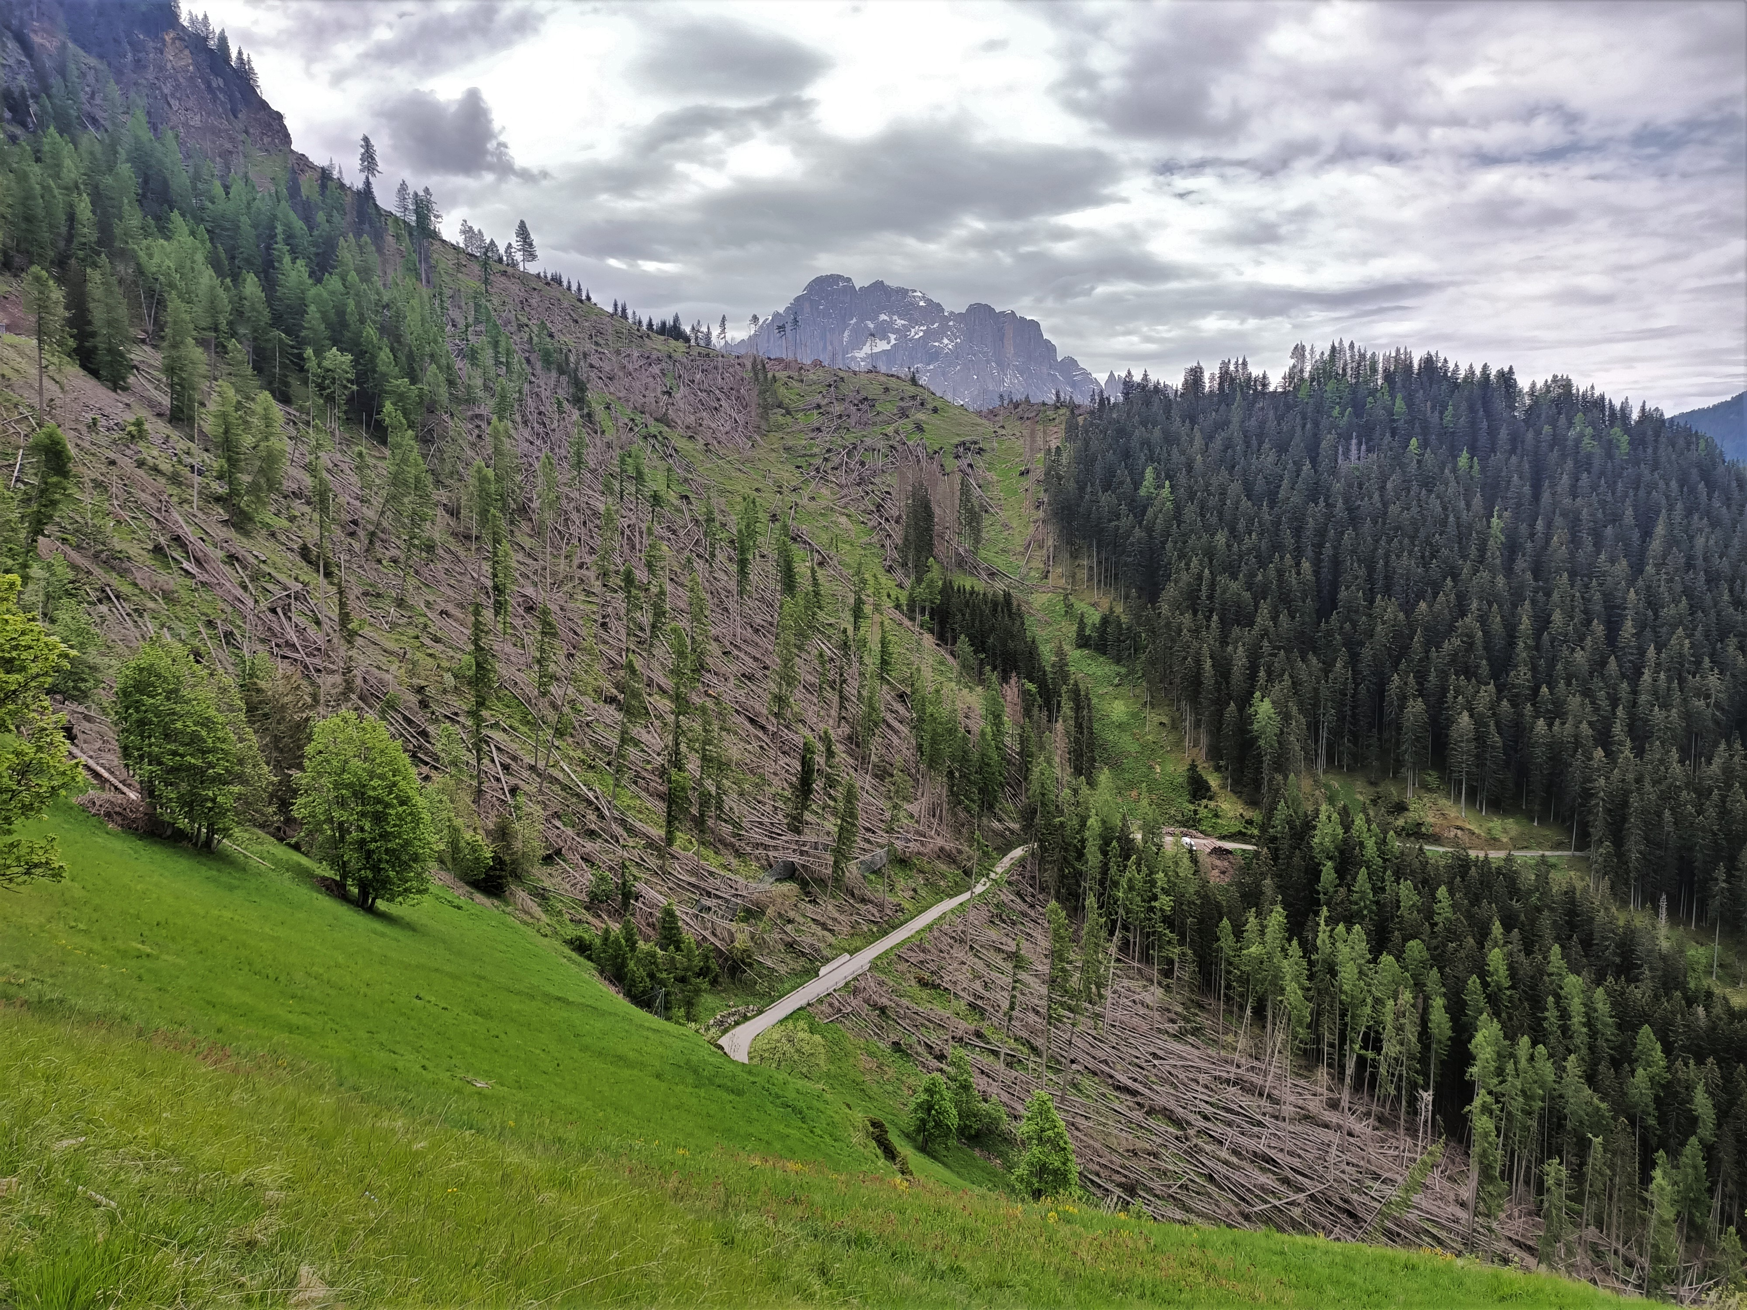
THANK YOU FOR YOUR ATTENTION
sansarraj.meena@unipd.it

