Slide 1
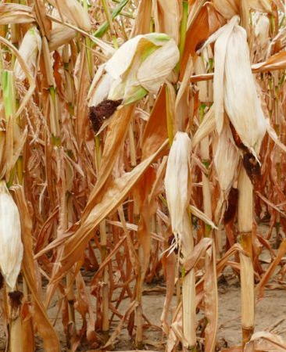


Seed Biopriming with Trichoderma sp. as an Effective Strategy for the Mitigation of Thermal Stress Effects in Food Crops
Hadeer Elgendy, Maria Krepakova, Chetan Keswani, Marina Voloshina, Anna Nefedova, Tatiana Minkina, Saglara Mandzhieva, and Svetlana Sushkova

Slide 2
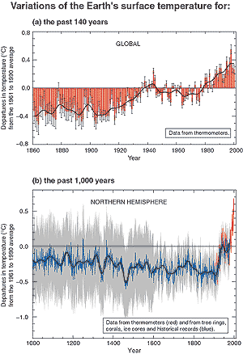
Introduction
According to the projections of the Intergovernmental Panel on Climate Change (IPCC):
climate change is already affecting food security through:
Increasing temperatures
Changing precipitation patterns
Great frequency of some extreme events (Natural disasters).

Slide 3
Introduction
High temperature stress in different agro-climatic zones
lower-latitude crops (e.g., maize and wheat) have been affected negatively by observed climate changes
Higher-latitude regions, yields of crops (e.g., maize, wheat, and sugar beets) are positively affected.
Africa
High mountain regions of Asia
Distributions of pests and diseases will change, affecting production negatively in many regions

Slide 4
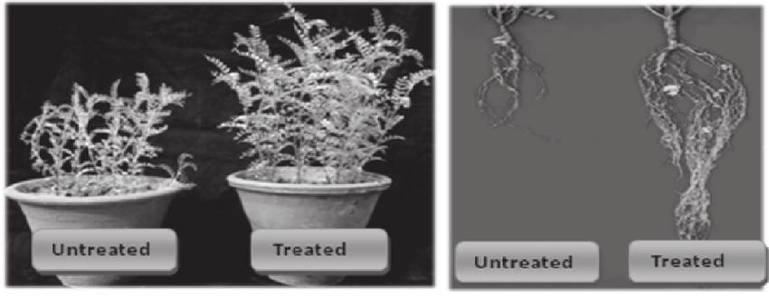
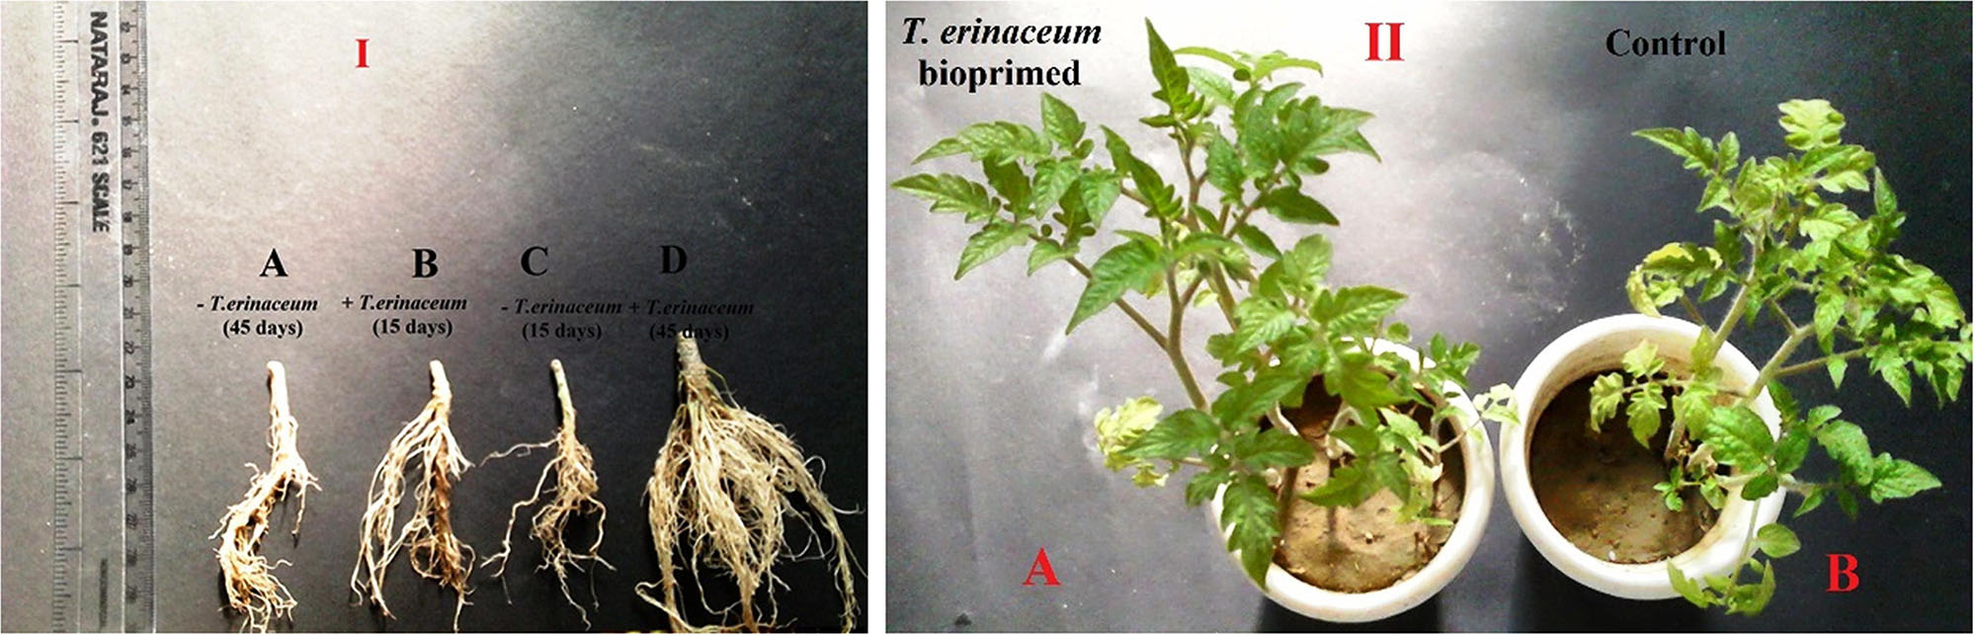
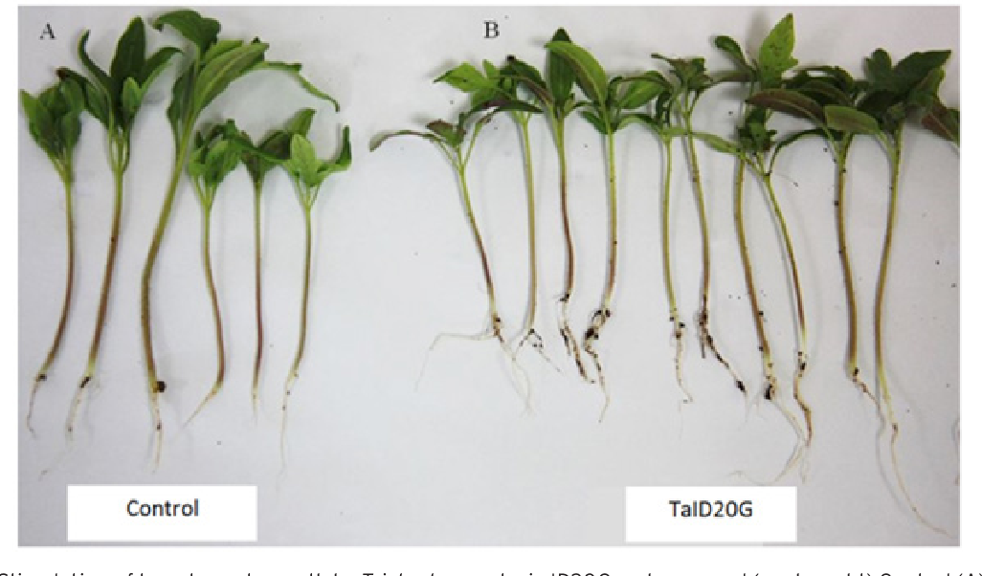
Seed biopriming
One of the available solution for tacking this challenge is the breeding of crop seeds with thermal stress tolerant cultivars with equivalent crop yield potential.
Seed priming with living bacterial inoculum is termed as biopriming
Keswani, C., Singh, S. P., & Singh, H. B. (2013). A superstar in biocontrol enterprise: Trichoderma spp. Biotech Today, 3(2), 27-30.
Aamir, M., Kashyap, S. P., Zehra, A., Dubey, M. K., Singh, V. K., Ansari, W. A., ... & Singh, S. (2019). Trichoderma erinaceum bio-priming modulates the WRKYs defense programming in tomato against the Fusarium oxysporum f. sp. lycopersici (Fol) challenged condition. Frontiers in plant science, 911.
Pehlivan, N., SARUHAN-GÜLER, N., & ALPAY-KARAOĞLU, Ş. (2018). The Effect of Trichoderma Seed Priming to Drought Resistance in Tomato (Solanum lycopersicum L.) Plants. Hacettepe Journal of Biology and Chemistry, 46(2), 263-272.

Slide 5
Aim of study
Demonstrate the role of seed biopriming with a thermotolerant strain of Trichoderma sp. capable of surviving at 470C for the mitigation of thermal stress effects in tomato.
Steps:
Isolate Trichoderma spp. from different heat stressed agro-ecosystems
Screen and select the thermotolerant Trichoderma spp.
Study the comparative proteomic profiling of selected Trichoderma spp. under stressed and ambient conditions through 2D gel electrophoresis
Study the host-Trichoderma interactions under stressed conditions

Slide 6
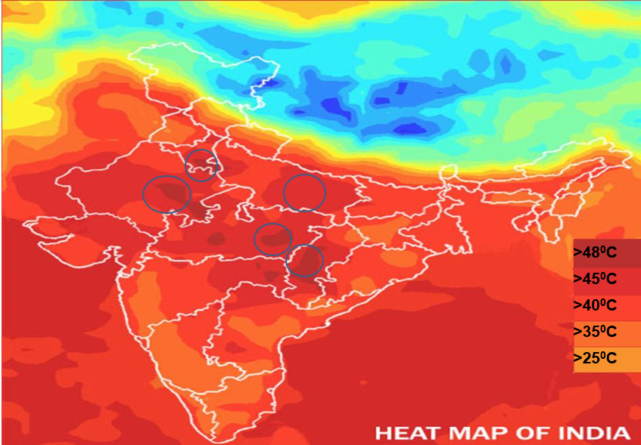
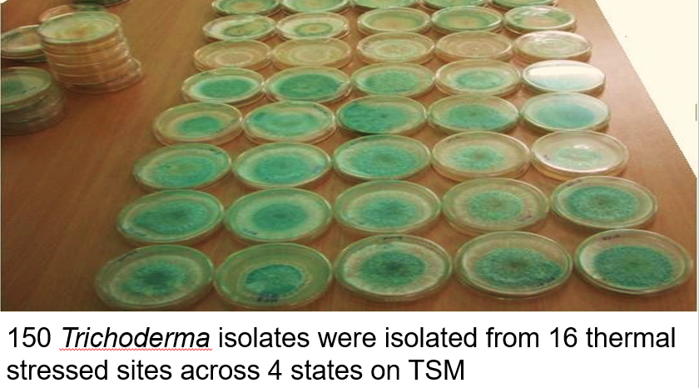
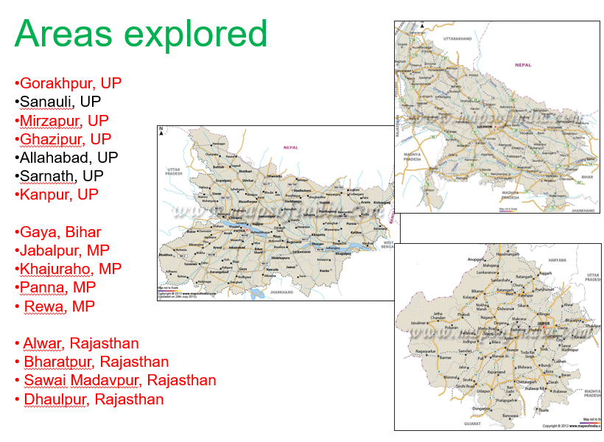
1-isolation OF Trichoderma spp. from different heat stressed agro-ecosystems
Keswani, C., Singh, S. P., & Singh, H. B. (2013). A superstar in biocontrol enterprise: Trichoderma spp. Biotech Today, 3(2), 27-30.

Slide 7
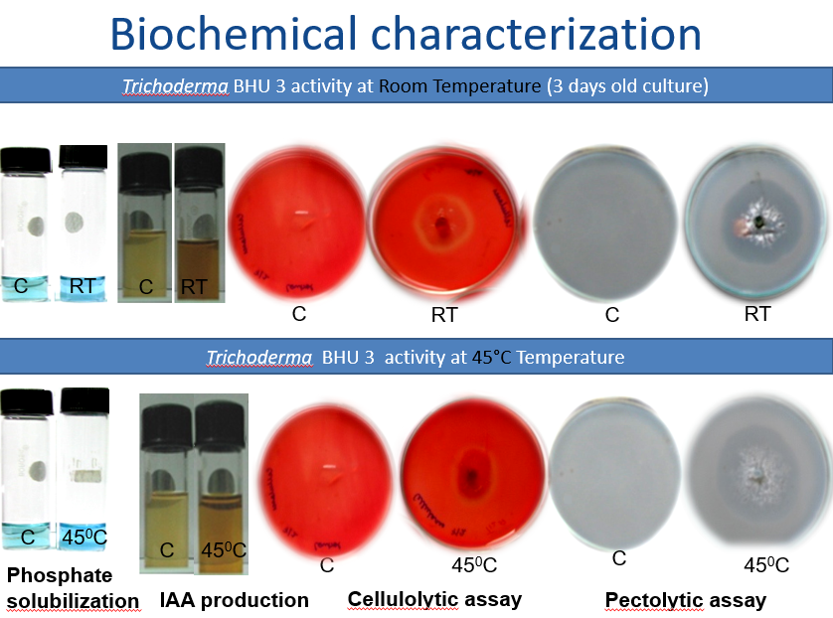
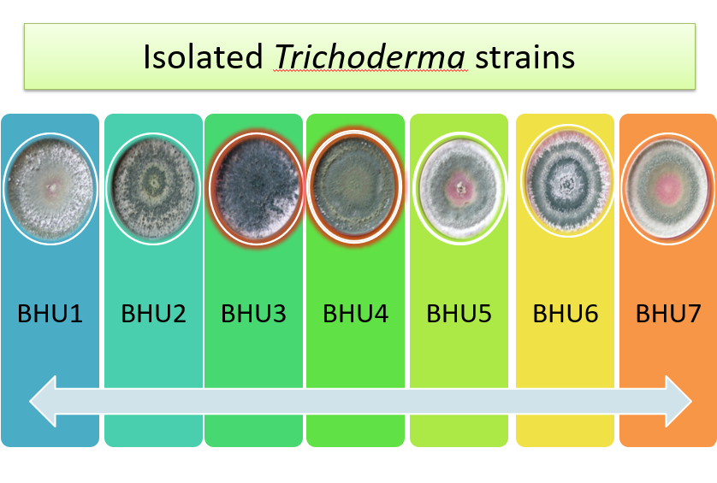
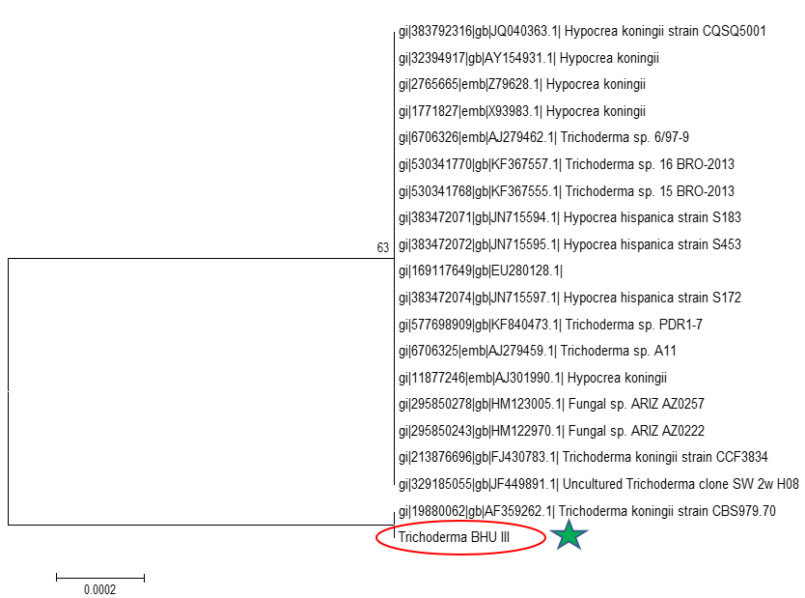
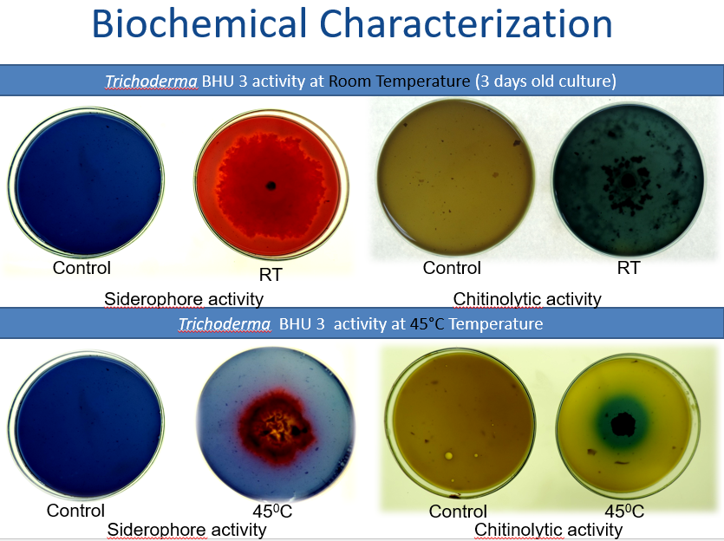
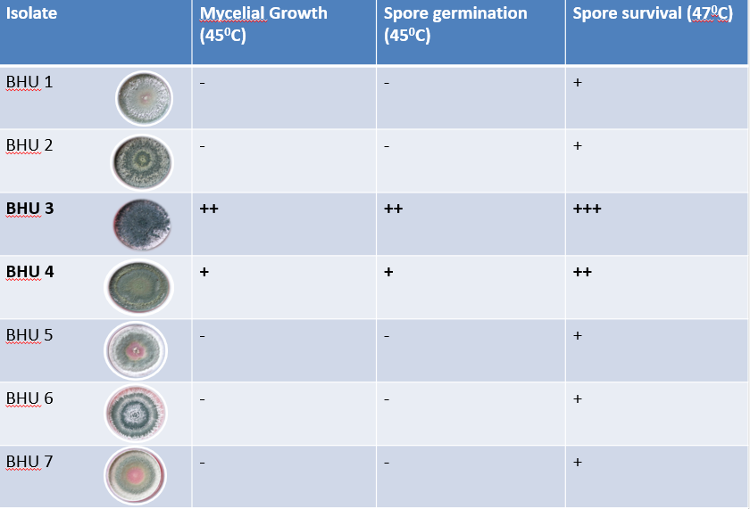
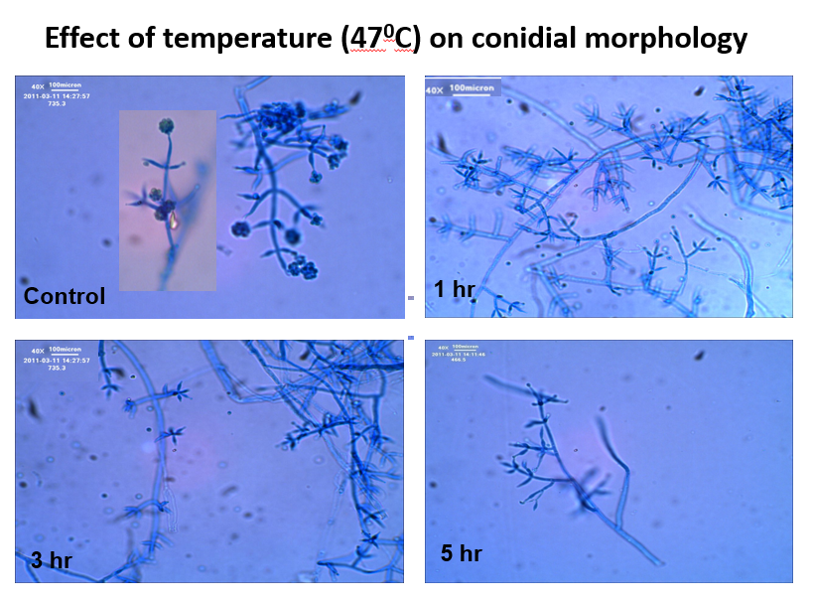
2-screening and selection OF the thermotolerant Trichoderma spp.
Keswani, C., Singh, S. P., & Singh, H. B. (2013). A superstar in biocontrol enterprise: Trichoderma spp. Biotech Today, 3(2), 27-30.

Slide 8
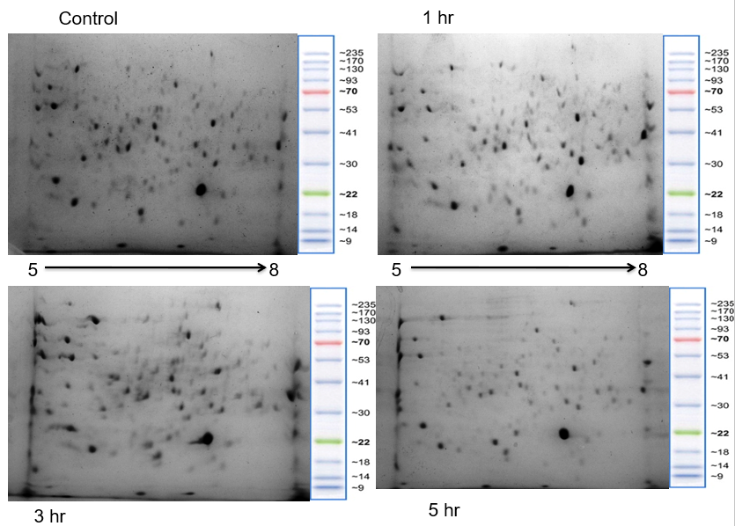
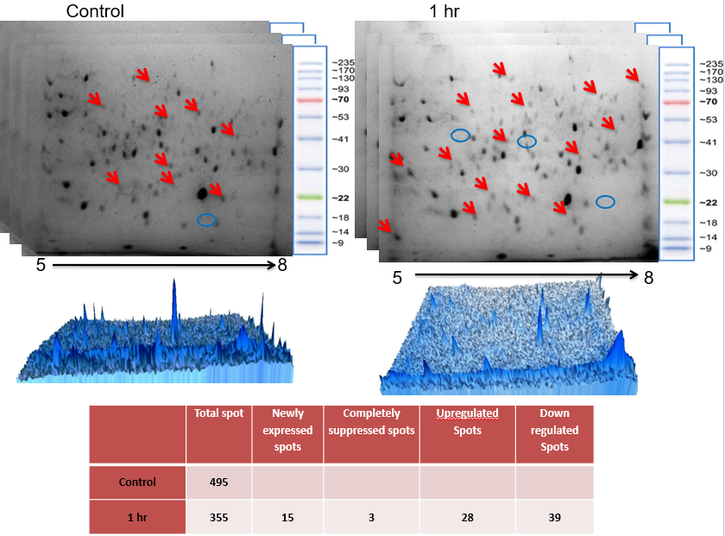
3-study the comparative proteomic profiling of selected Trichoderma spp. under stressed and ambient conditions through 2D gel electrophoresis
Keswani, C., Singh, S. P., & Singh, H. B. (2013). A superstar in biocontrol enterprise: Trichoderma spp. Biotech Today, 3(2), 27-30.

Slide 9
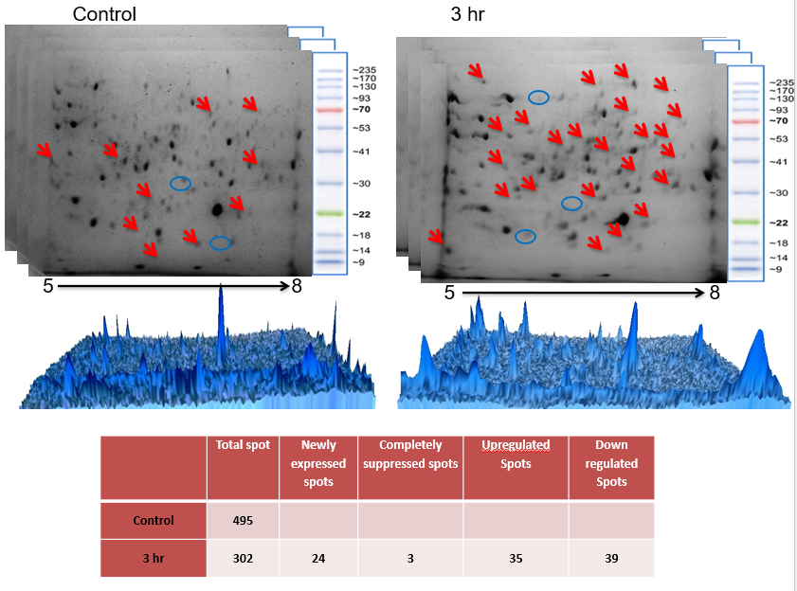
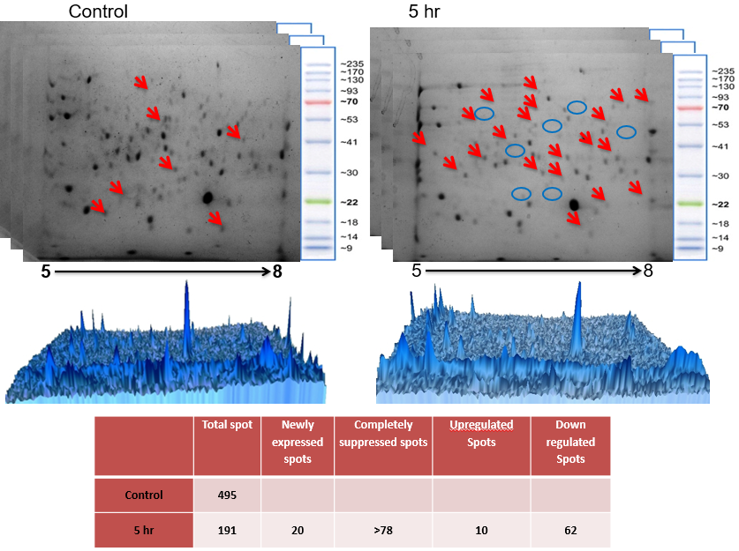
3-study the comparative proteomic profiling of selected Trichoderma spp. under stressed and ambient conditions through 2D gel electrophoresis
Keswani, C., Singh, S. P., & Singh, H. B. (2013). A superstar in biocontrol enterprise: Trichoderma spp. Biotech Today, 3(2), 27-30.

Slide 10
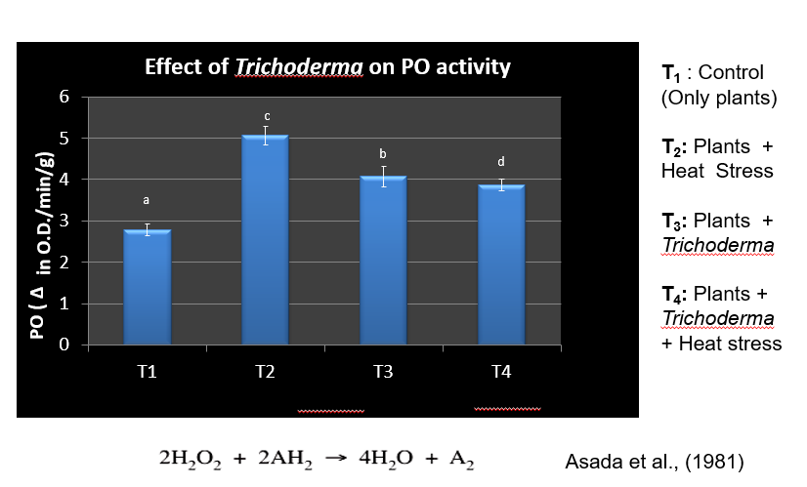
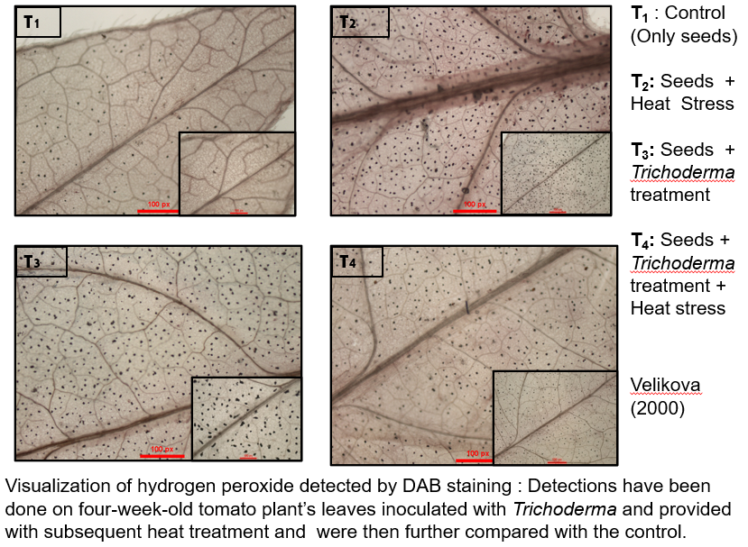
4- study the host-Trichoderma interactions under stressed conditions
Keswani, C., Singh, S. P., & Singh, H. B. (2013). A superstar in biocontrol enterprise: Trichoderma spp. Biotech Today, 3(2), 27-30.

Slide 11
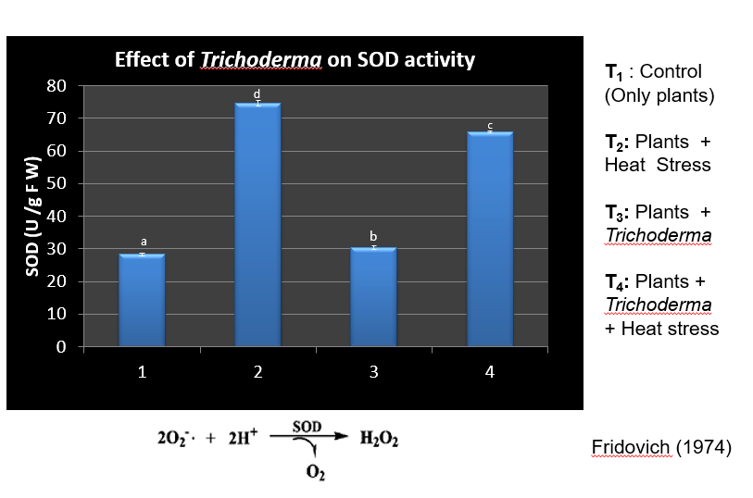
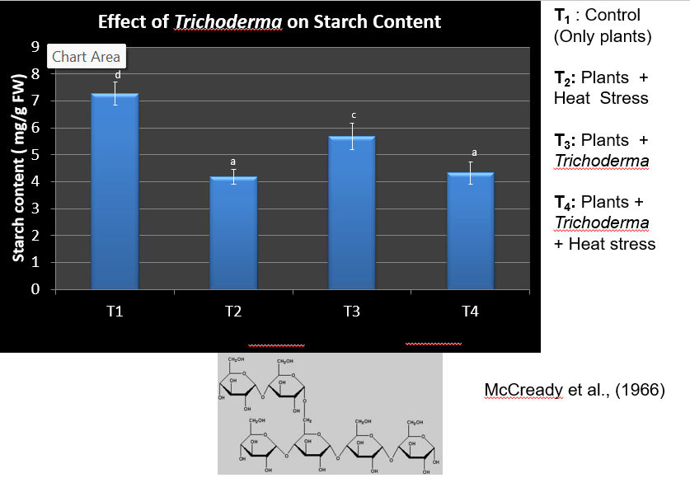
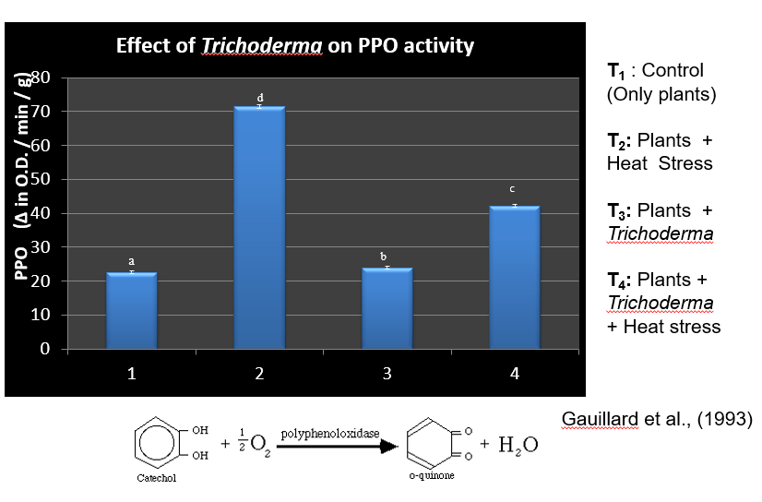
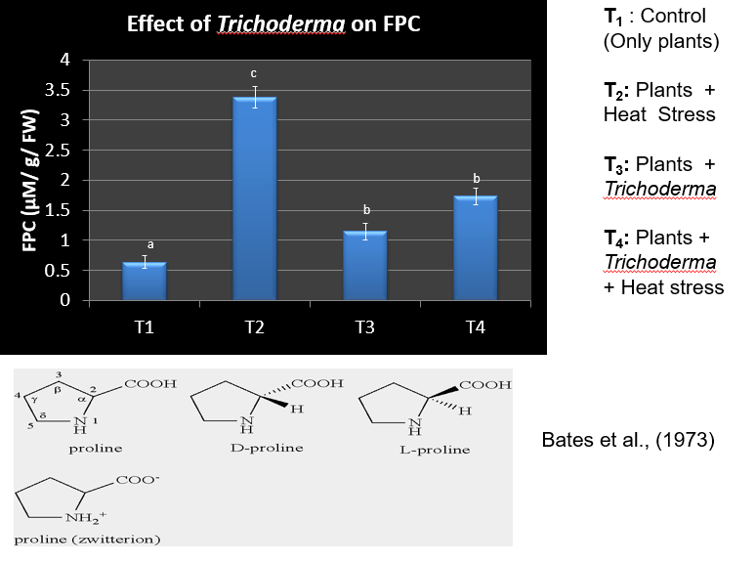
Keswani, C., Singh, S. P., & Singh, H. B. (2013). A superstar in biocontrol enterprise: Trichoderma spp. Biotech Today, 3(2), 27-30

Slide 12
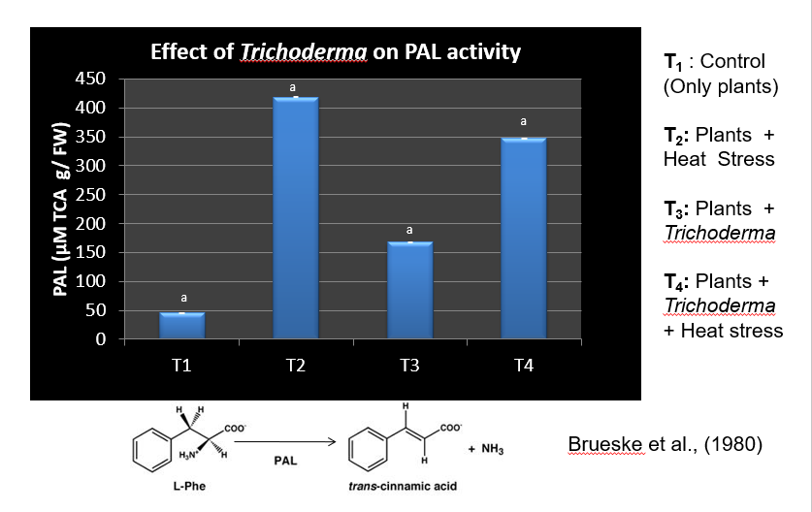
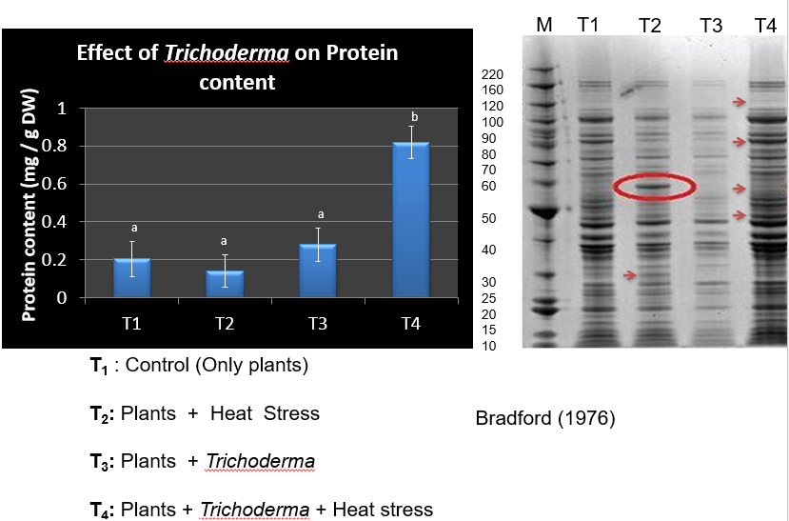
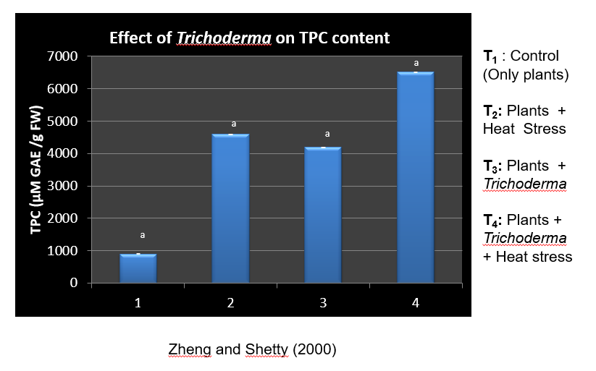
Keswani, C., Singh, S. P., & Singh, H. B. (2013). A superstar in biocontrol enterprise: Trichoderma spp. Biotech Today, 3(2), 27-30.

Slide 13
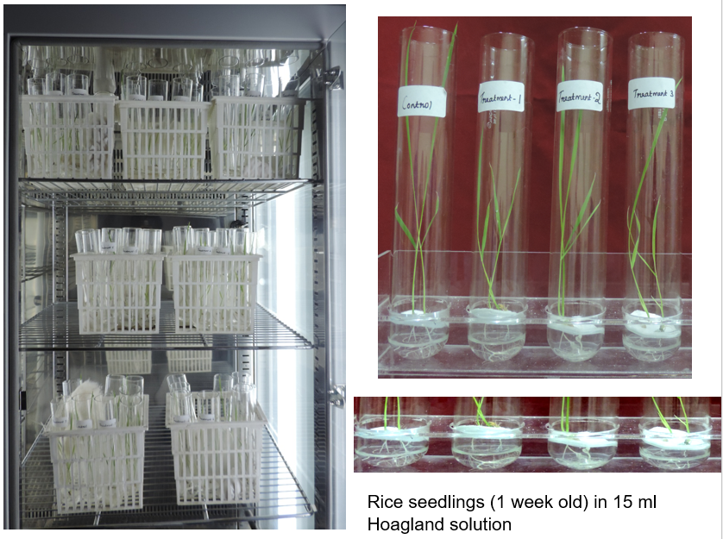
Keswani, C., Singh, S. P., & Singh, H. B. (2013). A superstar in biocontrol enterprise: Trichoderma spp. Biotech Today, 3(2), 27-30.

Slide 14
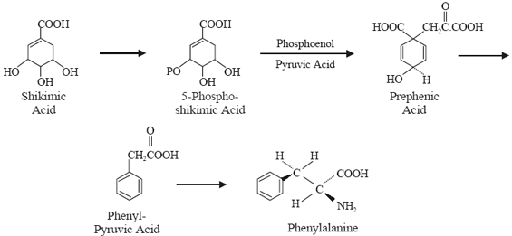
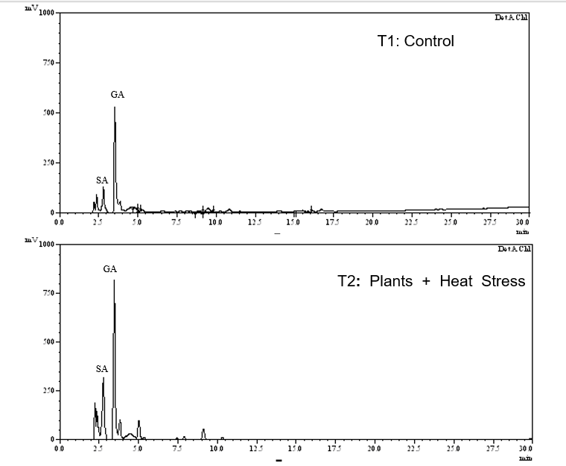
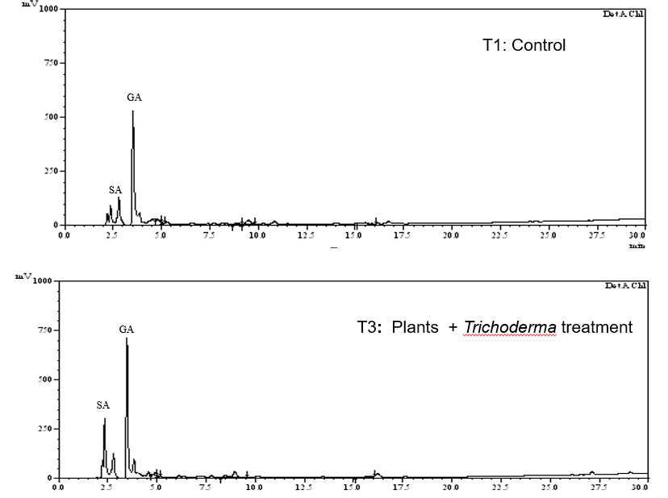
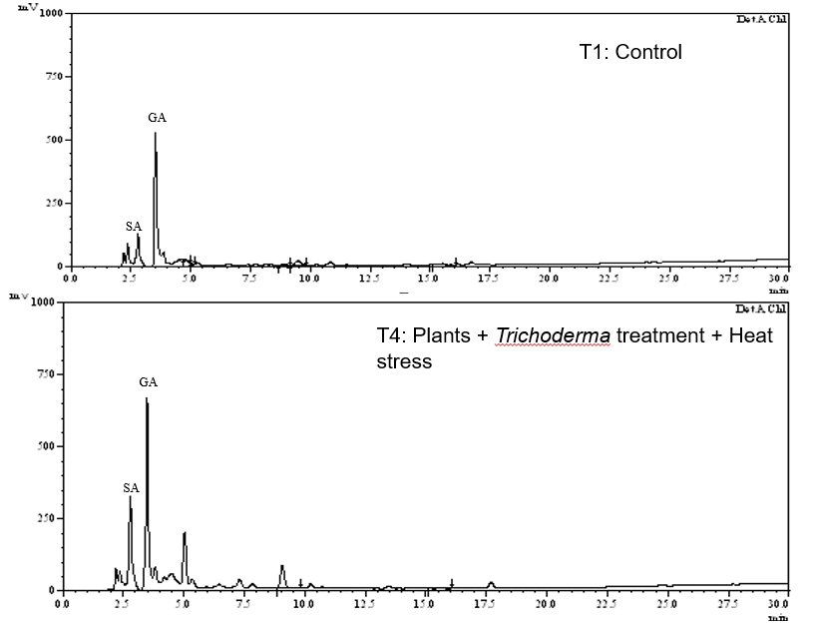
Keswani, C., Singh, S. P., & Singh, H. B. (2013). A superstar in biocontrol enterprise: Trichoderma spp. Biotech Today, 3(2), 27-30.

Slide 15
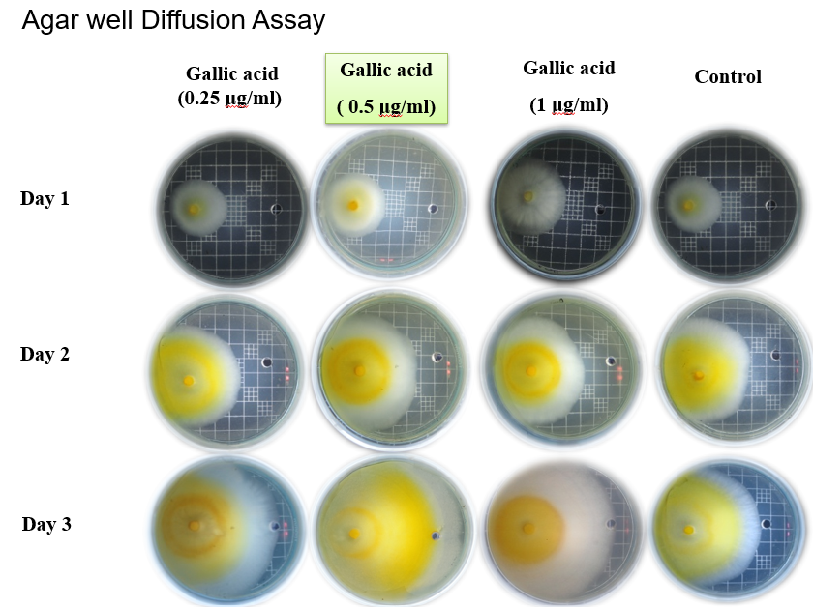
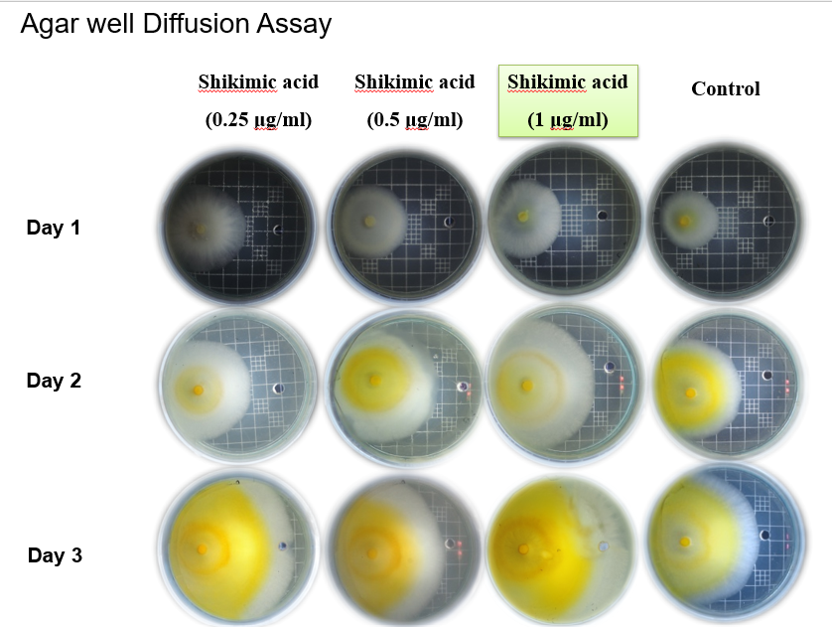
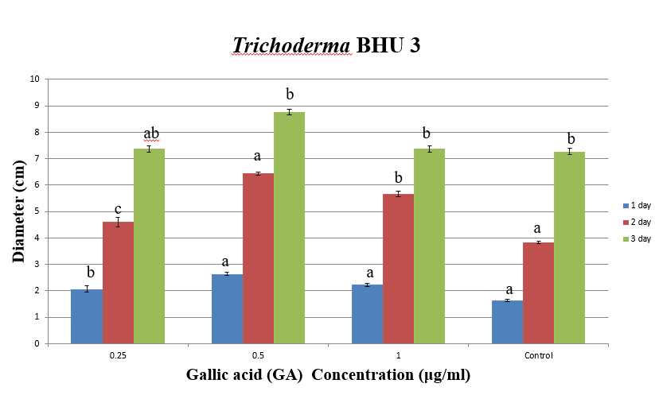
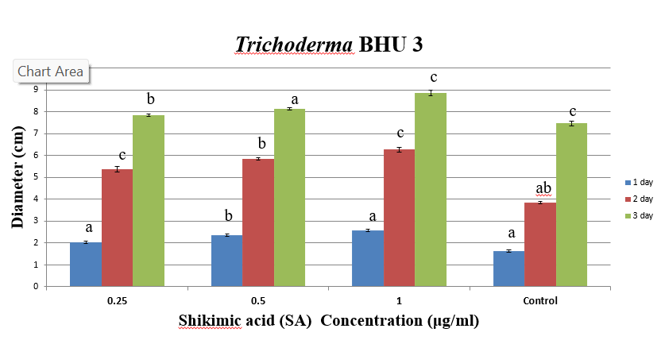
Keswani, C., Singh, S. P., & Singh, H. B. (2013). A superstar in biocontrol enterprise: Trichoderma spp. Biotech Today, 3(2), 27-30.

Slide 16
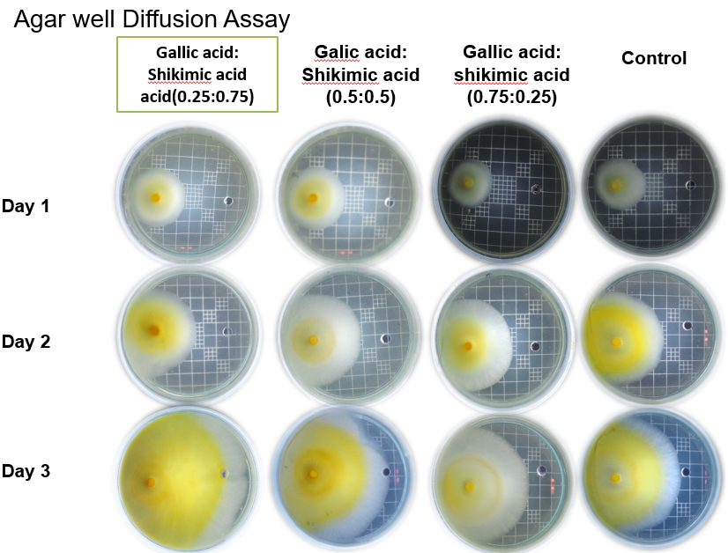
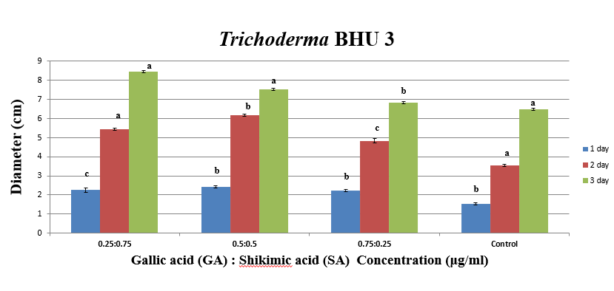
Keswani, C., Singh, S. P., & Singh, H. B. (2013). A superstar in biocontrol enterprise: Trichoderma spp. Biotech Today, 3(2), 27-30.

Slide 17
Conclusion
Trichoderma koningii BHU3 is a thermo-tolerant strain able to grow at 45 C and survives till 47C.
It retains a high biofertilizer and biocontrol potential at 450C.
It positively modulates the oxidative and defense network in the host.
Thus, it is suitable candidate to replace the commercially used thermo-susceptible strain of Trichoderma spp.

Slide 18
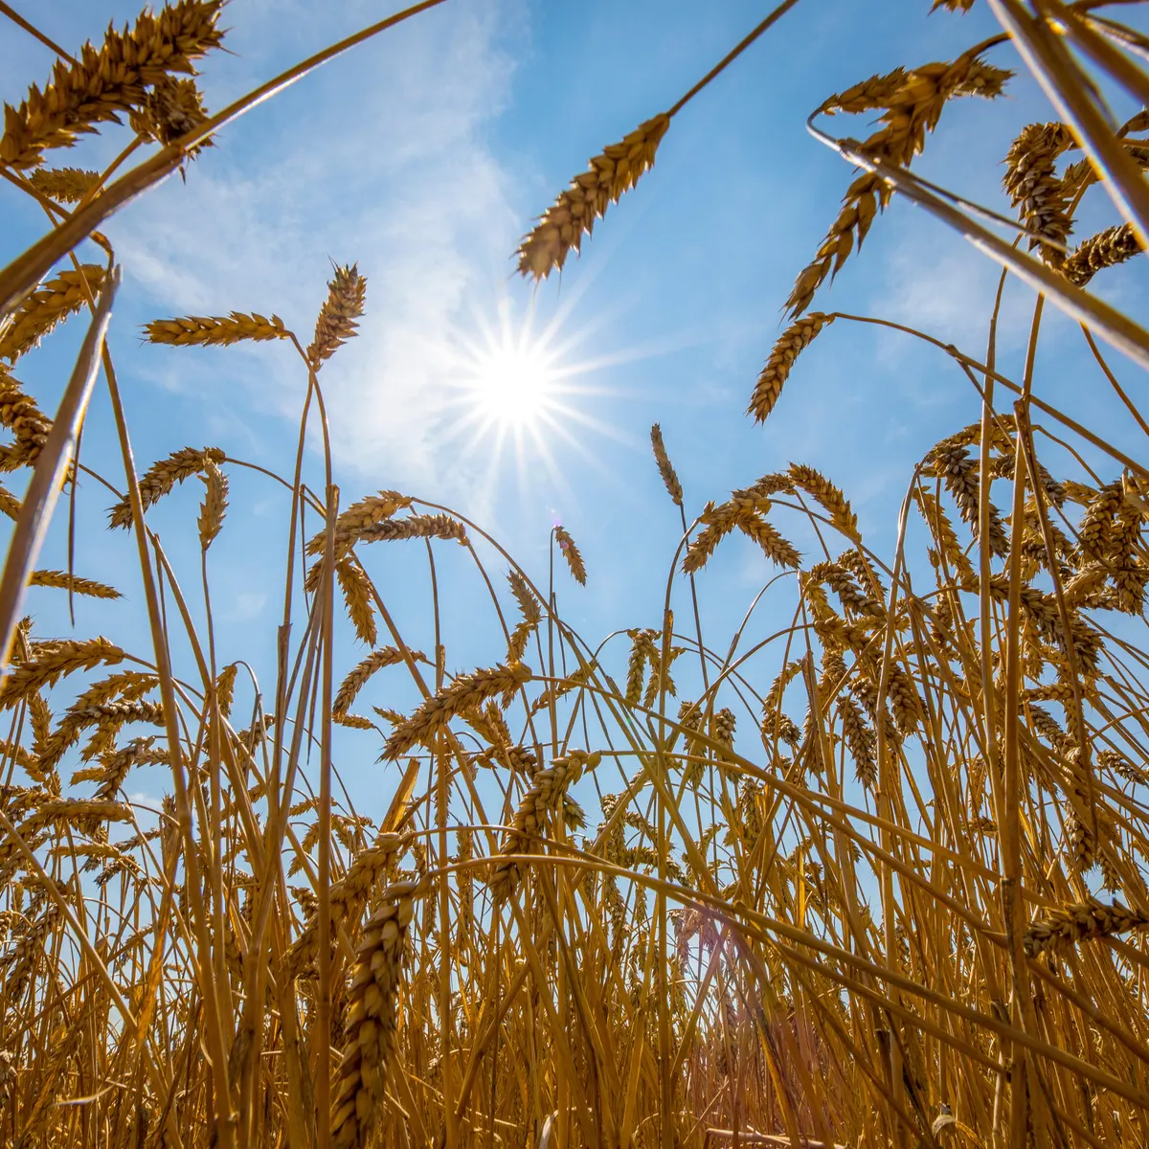
Thank you
for your attention! Any questions?

