Slide 1
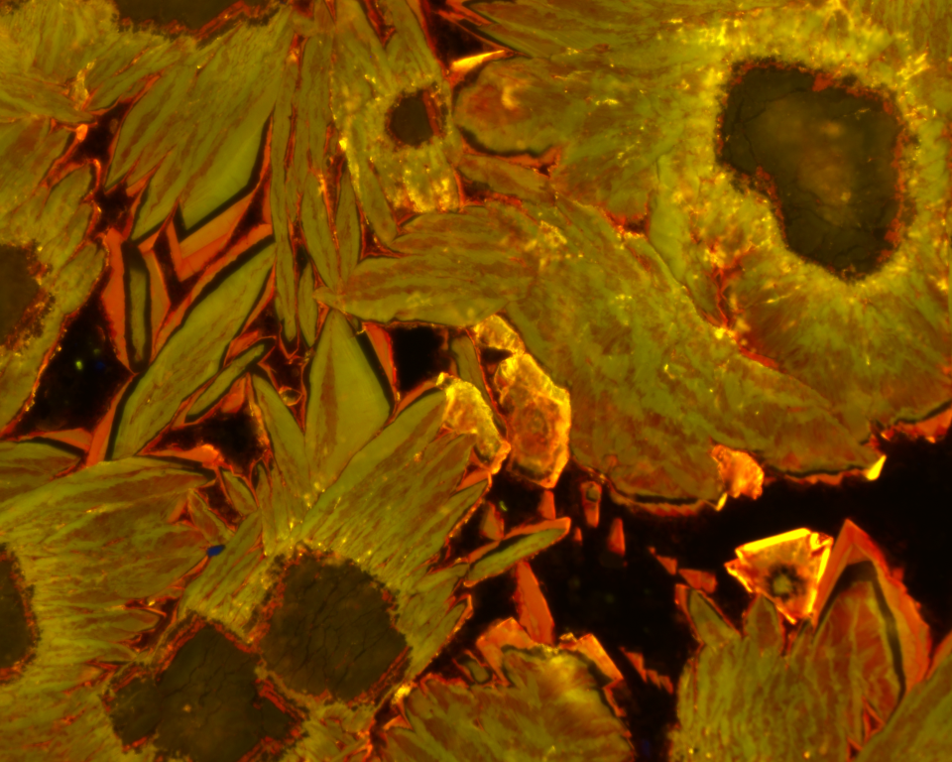

Peculiar micromorphologies of the middle Neoproterozoic dolomite-magnesite association formed in a hypersaline-alkaline periglacial lake
Maciej Bojanowski, Beata Marciniak-Maliszewska, Milena Matyszczak, and Jan Środoń

Slide 2
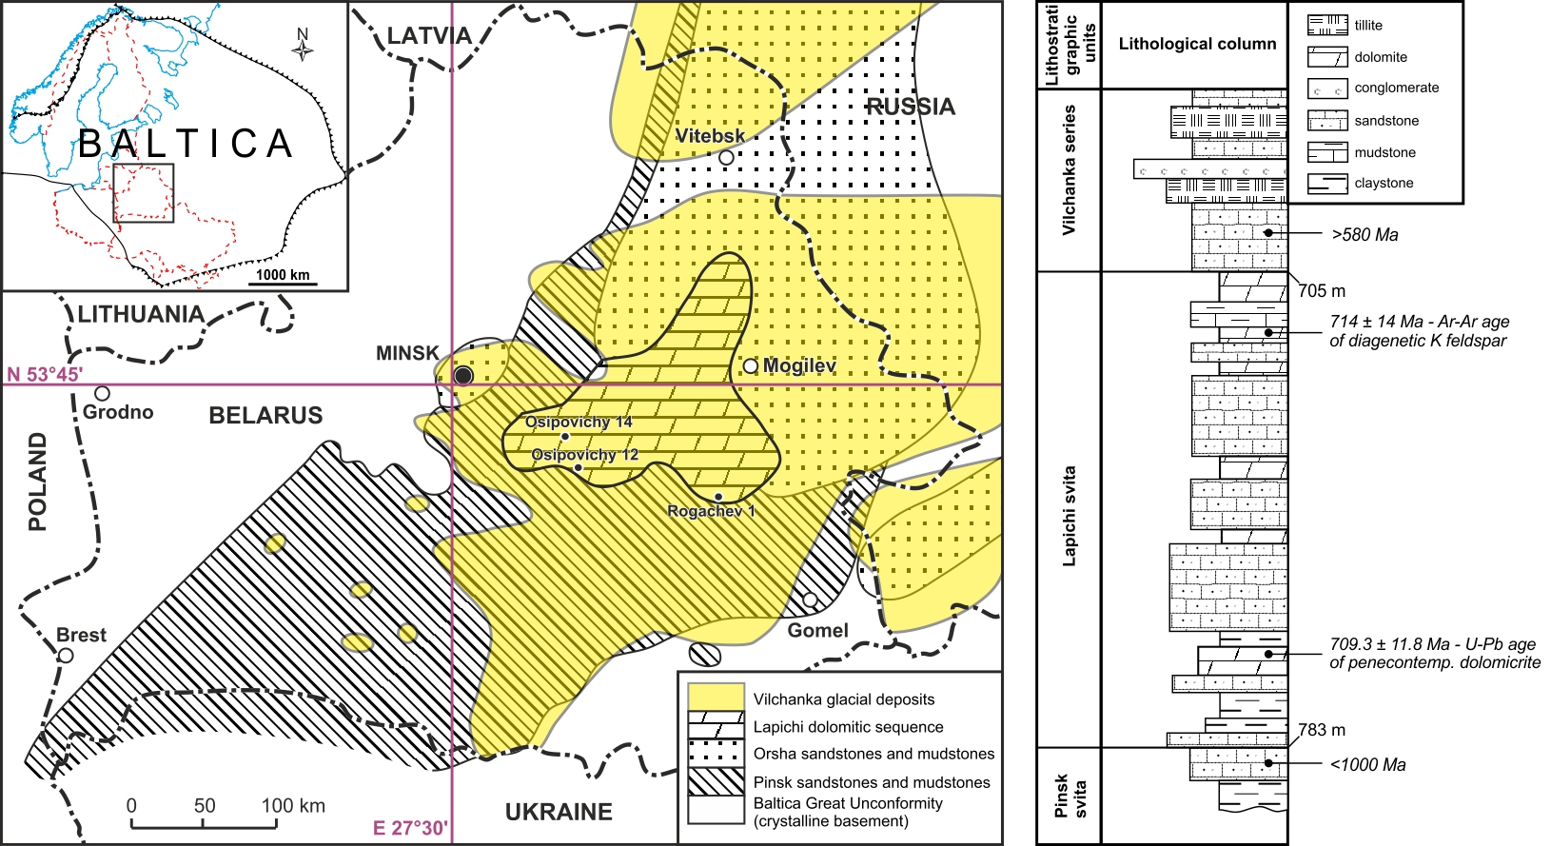
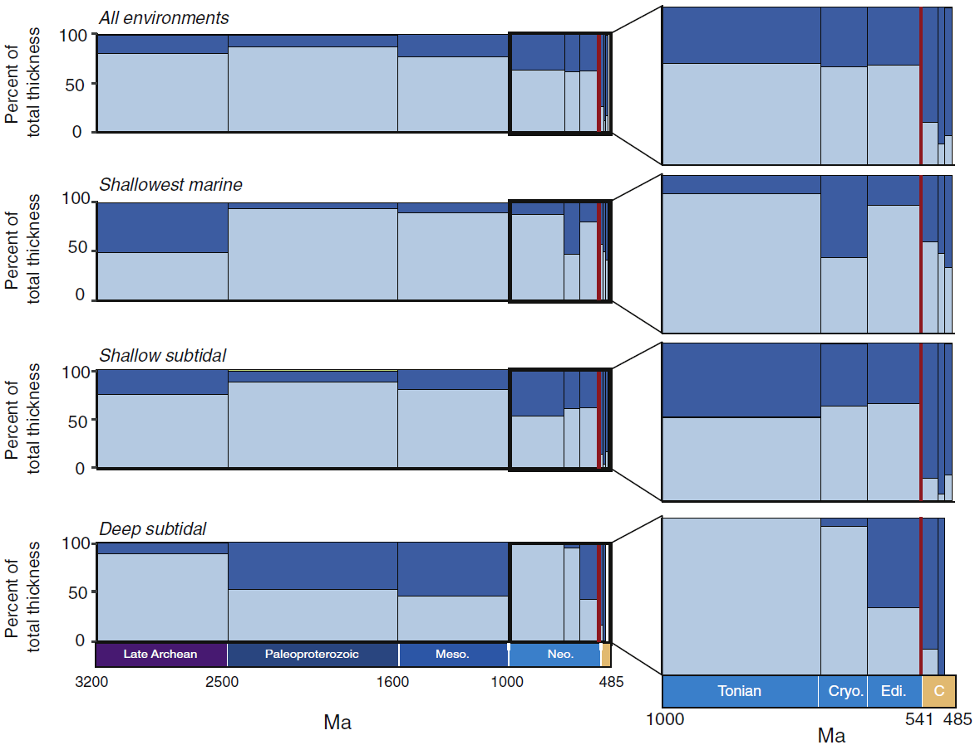
Lapichi Fm. from the East European Craton
Distribution of limestone and dolomite
Środoń et al. (2022) Prec. Res.
Cantine et al. (2020) Earth-Sci. Rev.
Sandwiched between glacial and periglacial continental deposits
Gaps at the base and the top
Cryogenian age
Sequence of mixed carbonate-siliciclastic deposits
Exceptionally low thermal maturity, insignificant diagenetic alteration, insignificant burial

Slide 3
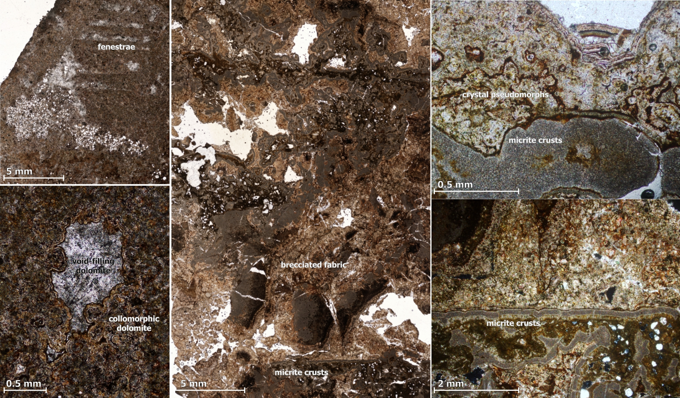

Slide 4
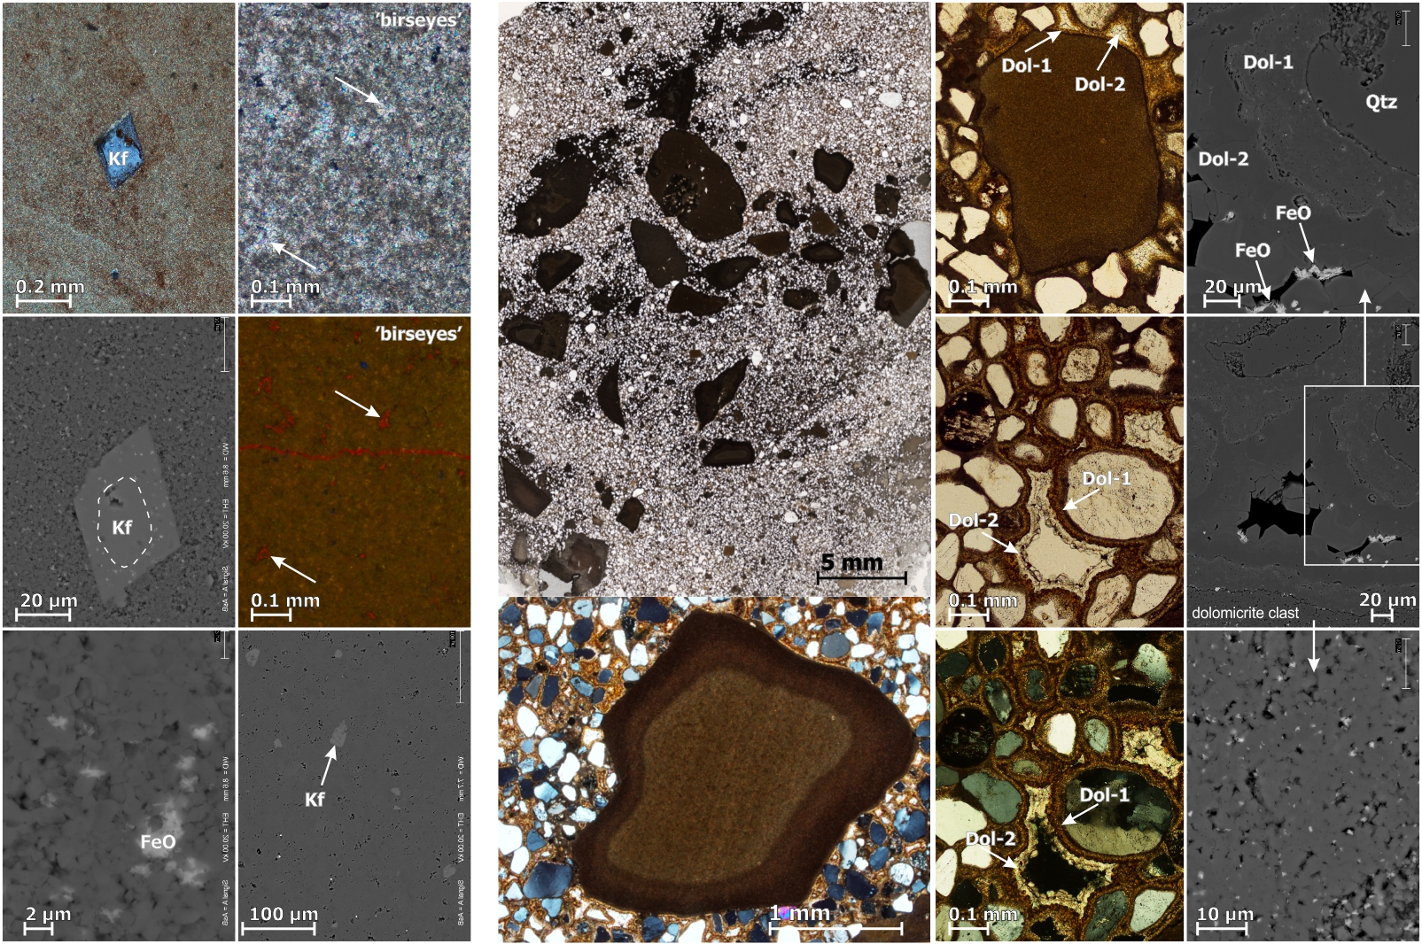
Stoichiometric
planar-S dolomicrite
+dolomicrosparite
+hematite/goethite
Weathered dolomicrite clasts – subaerial exposure and intrabasinal redeposition
Isopachous dolomite: micrite-to-microsparite – beachrock cements under micobial influence.
Fabric-retentive penecontemporaneous dolostone deposited in a shallow-water basin

Slide 5
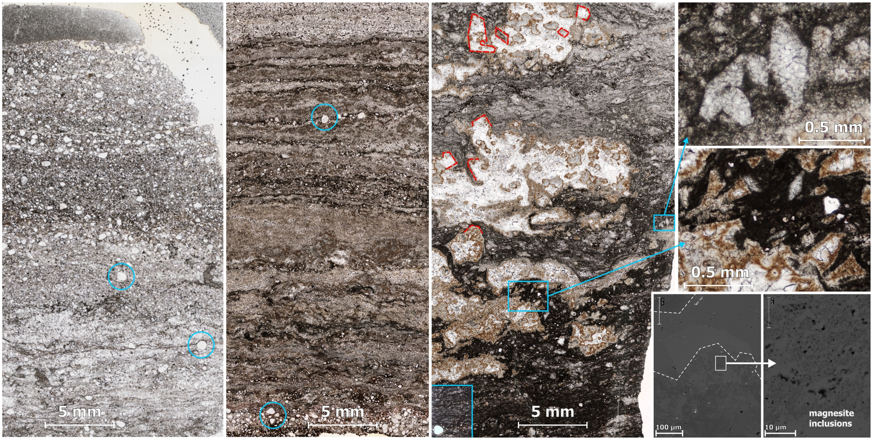
coccoidal cyanobacterial mats

Slide 6
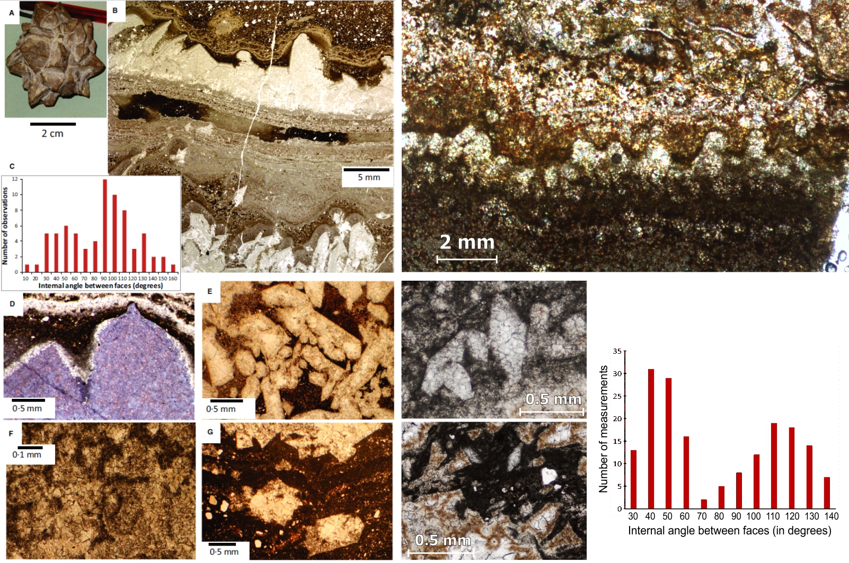
Marinoan carbonates from Svalbard (Fairchild et al., 2016 Sedimentology)
Cryogenian dolostones from EEC
Ikaite pseudomorphs?

Slide 7
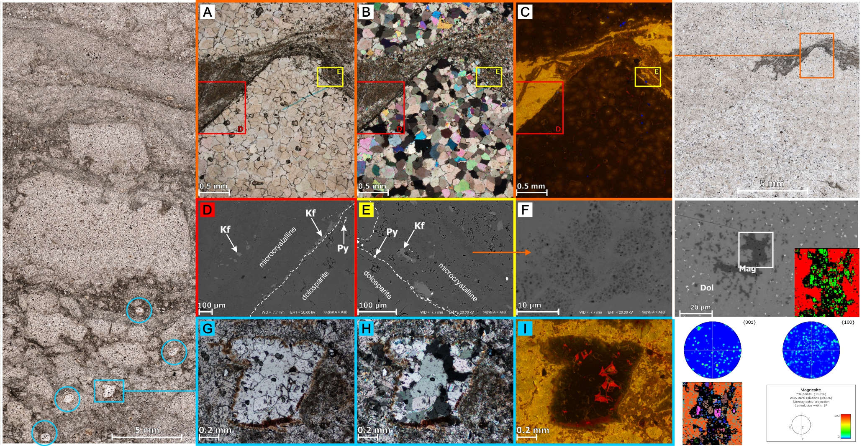
non-planar-A dolosparite – neomorphic alteration of non-stoichiometric, poorly ordered dolomicrite?
tabular dolosparite
EBSD

Slide 8
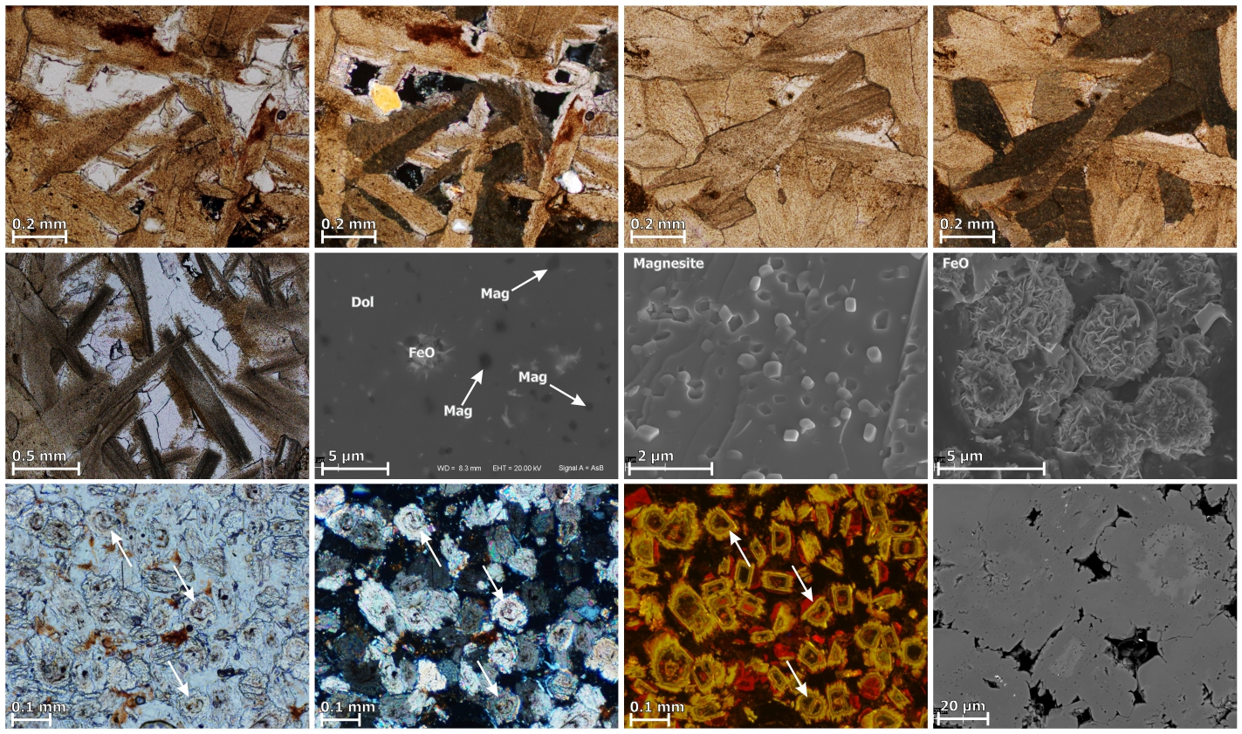
tabular, cloudy dolosparite with dense magnesite inclusions
limpid, zoned dolosparite with fringes of yellow-luminescing cement

Slide 9
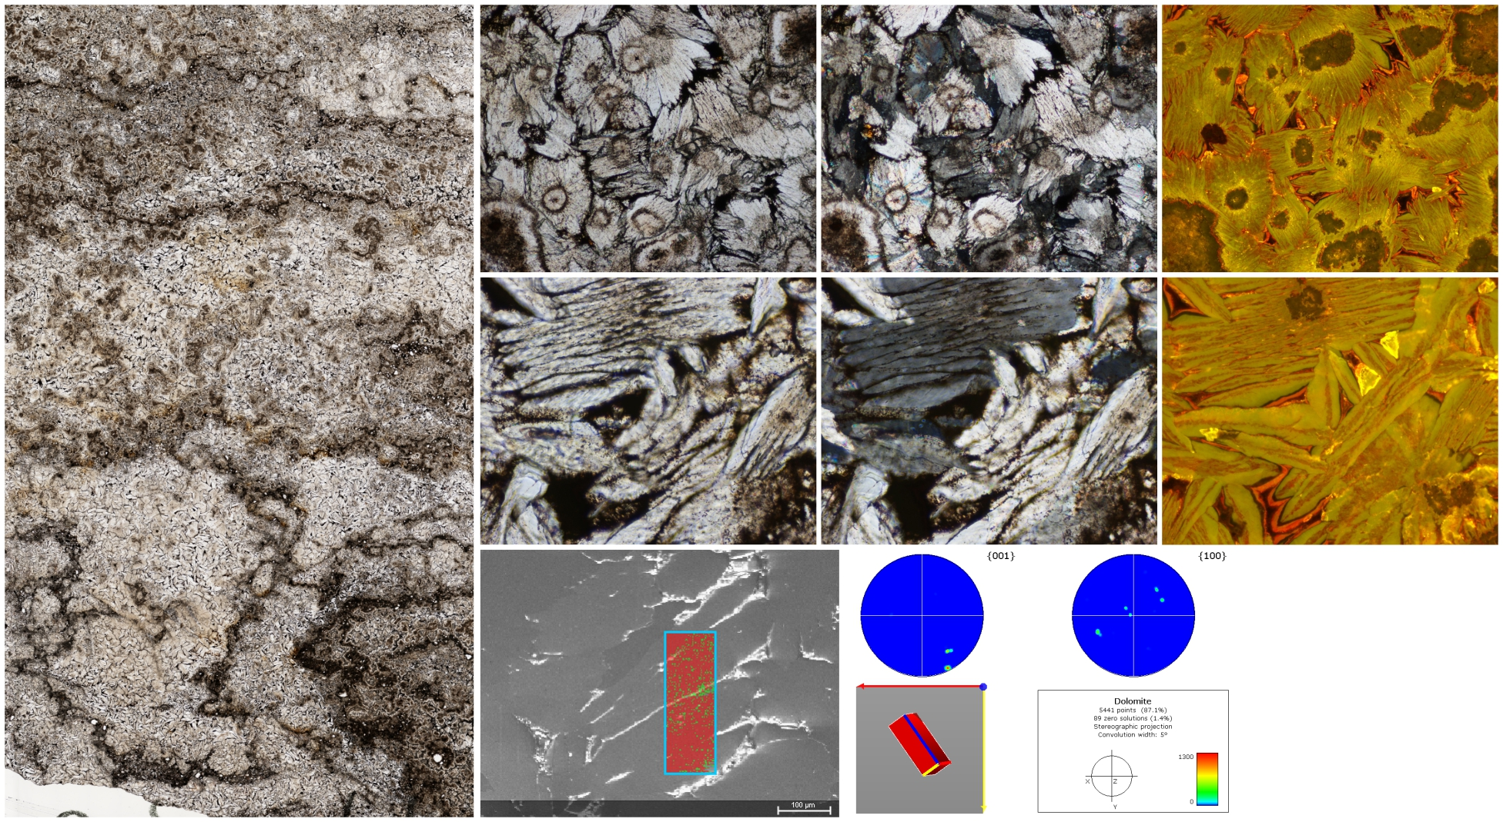
Tabular dolomite with CL zonation reflecting crystal habit – primary
Yellow-greenish CL
+ c-axic perpend. to the flattness – evaporative origin in high Mg/Ca water
EBSD

Slide 10
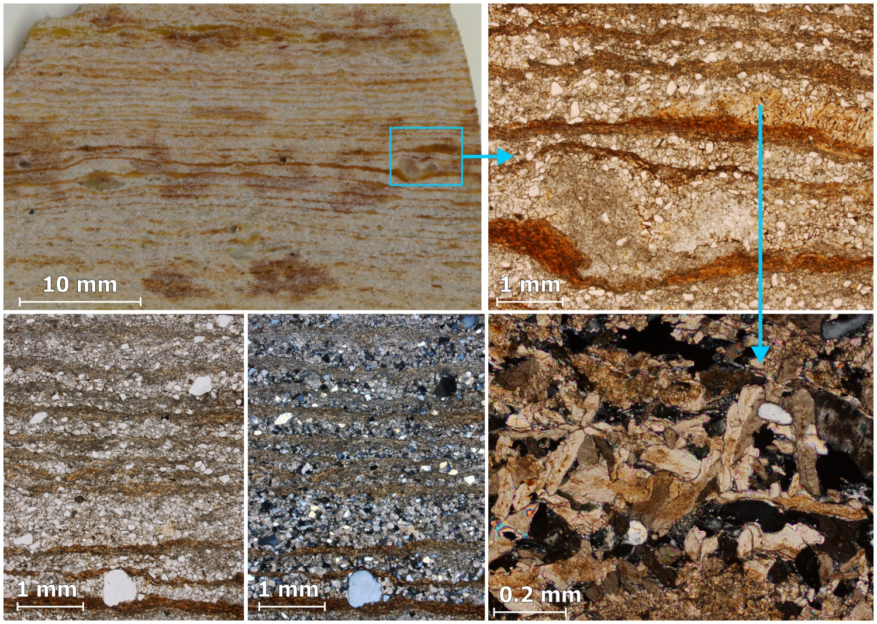
Dolomitic rythmite with ice-rafted? detrital grains
Tabular magnesite-rich dolosparite with yellow-greenish CL
Traces of artinite Mg₂(CO₃)(OH)₂ · 3H₂O
Hypersaline, alkaline basin in a cold climate

Slide 11
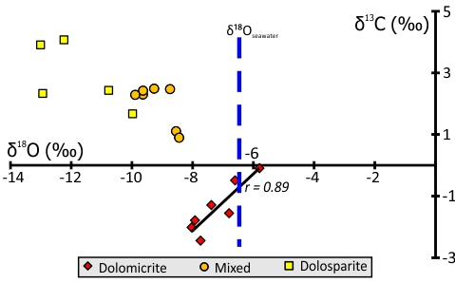
Geochemistry & Synthesis
Stoichiometric dolomite <98%, magnesite <3.4%, artinite traces, ikaite?
Enriched in Na, Cl, Sr relative to average sedimentary carbonate (EF from 10 to 20)
Abnormally high Sr content (<560 ppm) as for seawater
Highly radiogenic ⁸⁷Sr/⁸⁶Sr signal even in fabric-retentive dolomicrites (0.710-0.712 compared with seawater 0.709)
Absence of typical marine fabric, such as coated grains, molar tooth structures, tepee structures, aragonite crystal fans
Non-marine, hypersaline high Sr/Ca and Mg/Ca water
δ¹³C-δ¹⁸O covariation of dolomicrites –> meteoric & organic vs. evaporative & inorganic sources in a closed system
Perennial, closed, saline, alkaline, seasonally ice-covered lake in cold continental climate
with organic productivity-driven carbonate precipitation
Modern lake analogs: Great Plains of Canada, high-altitude Tibetan or Andean playas, Antarctic dry valleys...

