Slide 1

A Conditional Generative Adversarial Network for Rainfall Downscaling
EGU General Assembly 2022
Vienna, Austria & Online | 23–27 May 2022
M. Iotti¹, P. Davini², J. von Hardenberg^{3,2}, G. Zappa²
¹Dept. of Physics and Astronomy, University of Bologna, Italy - marcello.iotti3@unibo.it
²Institute of Atmospheric Sciences and Climate CNR-ISAC, Turin, Italy ³Dept. of Environment, Land and Infrastructure Engineering, Polytechnic University of Turin, Italy ⁴Institute of Atmospheric Sciences and Climate CNR-ISAC, Bologna, Italy

Slide 2
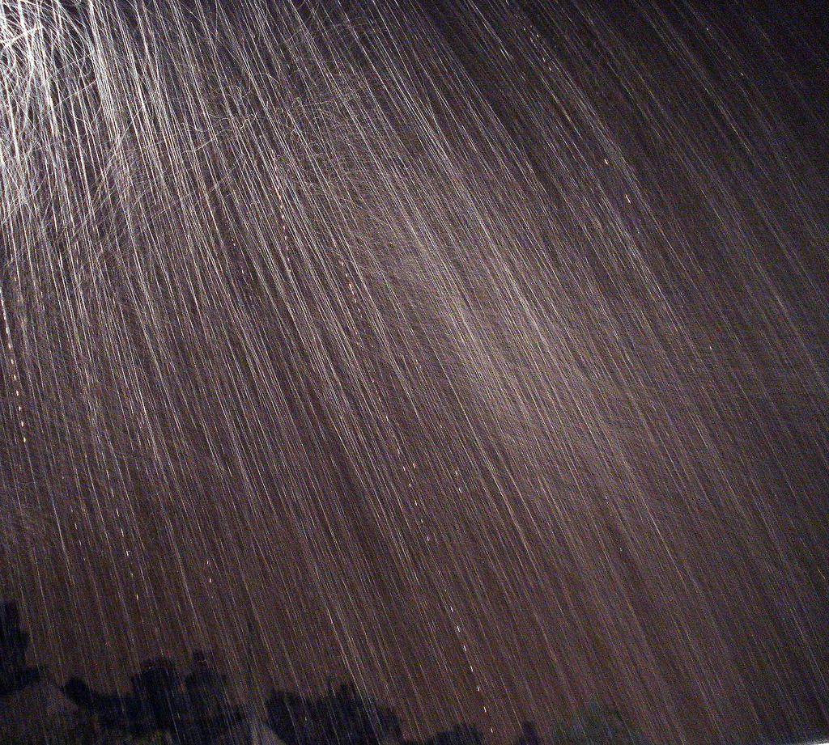
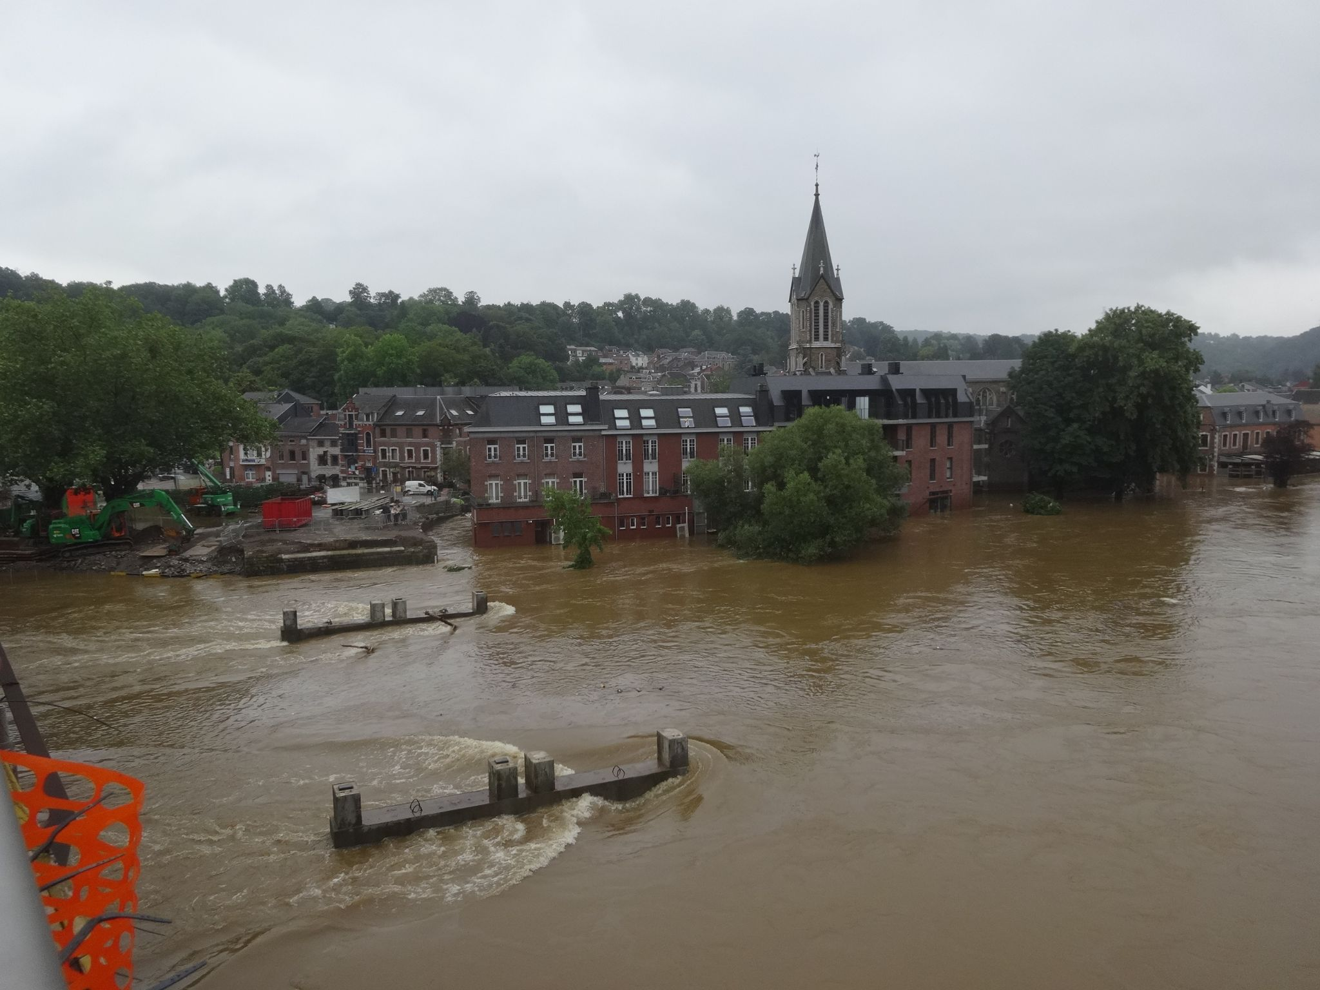
Introduction - aim and motivation
By Flickr user AlmazUK - https://www.flickr.com/photos/almaz73/1815415291/, CC BY 2.0, https://commons.wikimedia.org/w/index.php?curid=18955016
Extreme precipitation events frequency has increased since the second half of the 20th century in many regions of the world.
The trend is expected to continue as the Earth continues to warm.
Threats related to these events include:
Floodings (in particular over urban areas)
Landslides
Degradation of water quality
By Régine Fabri - Own work, CC BY-SA 4.0, https://commons.wikimedia.org/w/index.php?curid=107637907

Slide 3
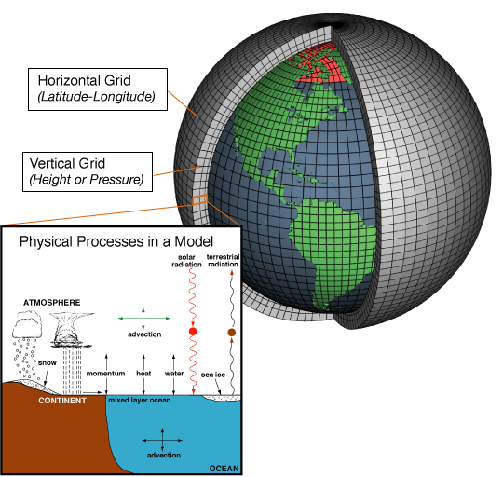
Downscaling of Global Climate Models (GCMs)
Precipitation shows variability on both spatial and temporal scales (much) smaller than the current state-of-the-art GCMs resolution (〜km vs. 50⇾200 km)
It cannot be adequately simulated!
A lot of research is devoted to bridge this gap: downscaling techniques
By NOAA - http://celebrating200years.noaa.gov/breakthroughs/climate_model/AtmosphericModelSchematic.png, Public Domain, https://commons.wikimedia.org/w/index.php?curid=7263986

Slide 4
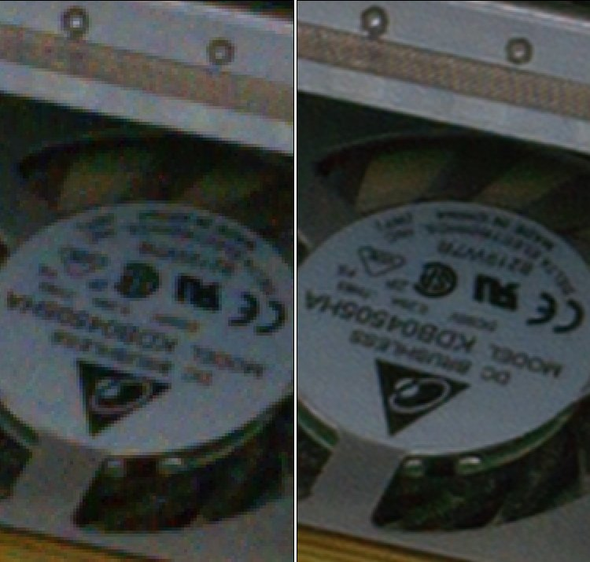
Downscaling has many similarities with image super-resolution
Super-resolution in recent years has taken advantage of the introduction of deep-learning techniques, in particular Convolutional Neural Networks (CNNs) and Generative Adversarial Networks (GANs).
Di Almalence, Inc. - http://photoacute.com/studio/examples/mac_hdd/index.html, CC BY 3.0, https://commons.wikimedia.org/w/index.php?curid=16680237

Slide 5
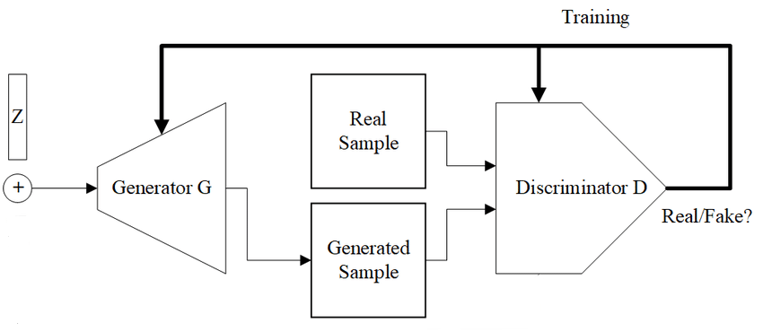
Generative Adversarial Networks (GANs)
2 NNs trained simultaneously and “adversarially”:
A generator trying to learn a map from a noise probability distribution z, to the distribution of the data to be reconstructed.
A discriminator, learning the probability that a sample is real or comes from the generator.
At the end of training data from the generator seem realistic, but there is no control on their modes.
In a conditional GAN (cGAN), both the generator and the discriminator are conditioned on additional informations, such as the labels of the classes to be reconstructed.
In image super-resolution, the idea is to feed the GAN with the original coarse-scale images.
By האדם-החושב - Own work, CC BY-SA 4.0, https://commons.wikimedia.org/w/index.php?curid=110701944

Slide 6
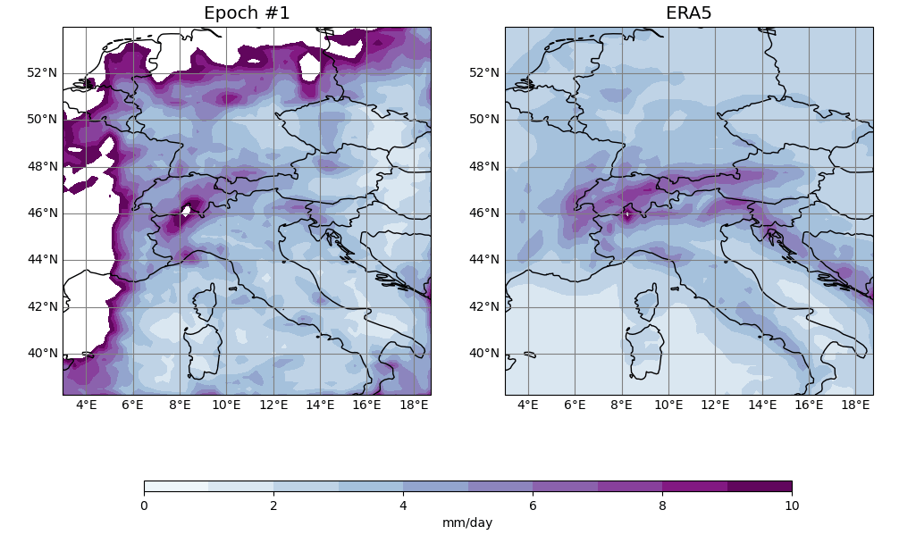
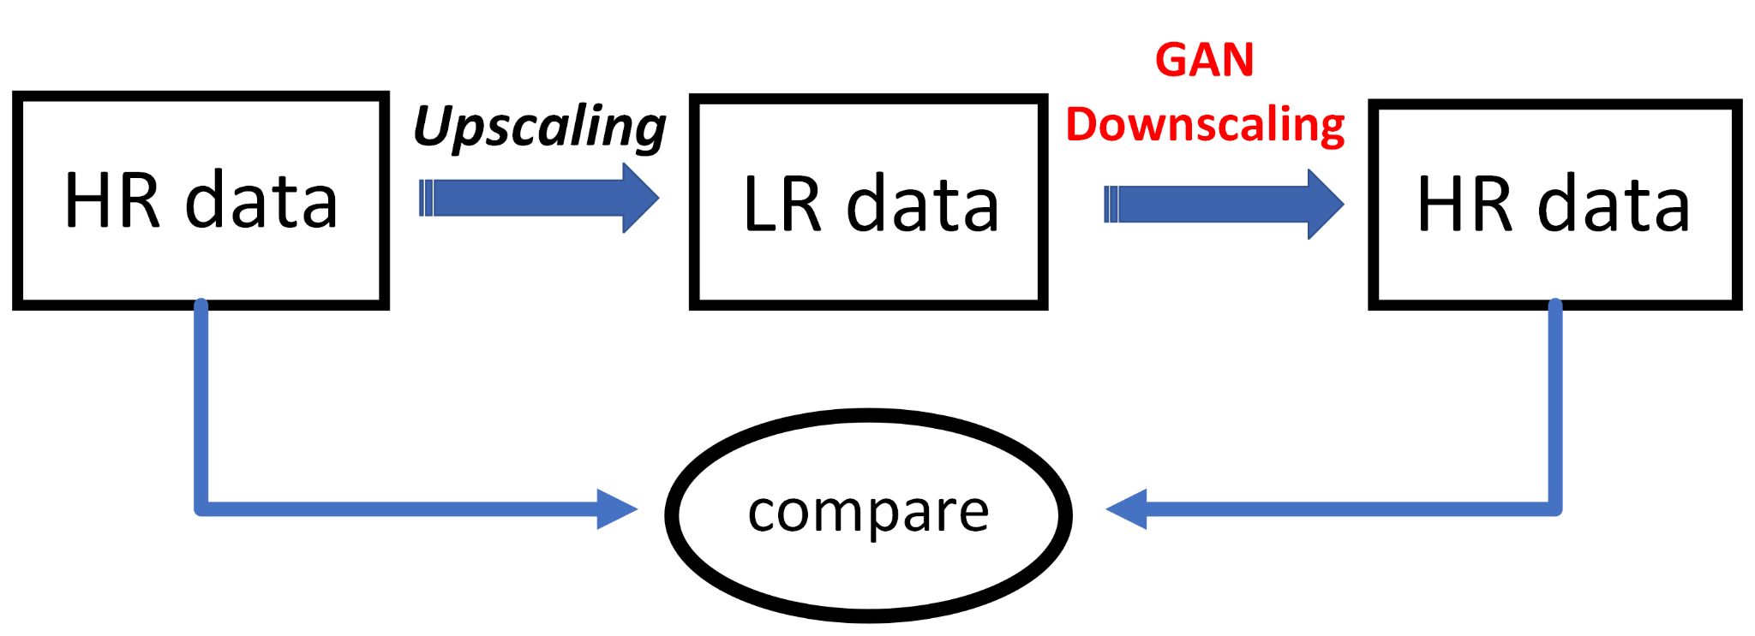
Reconstruction of the total daily precipitation climatology
Perfect model experiment
Data source: ERA5⁽¹⁾ (0.25° × 0.25°)
Variable: total precipitation, converted to total daily precipitation
Subset spanning the years 1950-2020 (25871 training examples)
⁽¹⁾The results presented hereafter contain modified Copernicus Climate Change Service (C3S) information 2020. Neither the European Commission nor ECMWF is responsible for any use that may be made of the Copernicus information or data it contains. Bell, B., et al. (2020): ERA5 hourly data on single levels from 1950 to 1978 (preliminary version). C3S Climate Data Store (CDS). (Accessed on 01/03/2022.
Hersbach, H., et al. (2018): ERA5 hourly data on single levels from 1979 to present. C3S CDS. (Accessed on 01/03/2022, DOI 10.24381/cds.adbb2d47

Slide 7
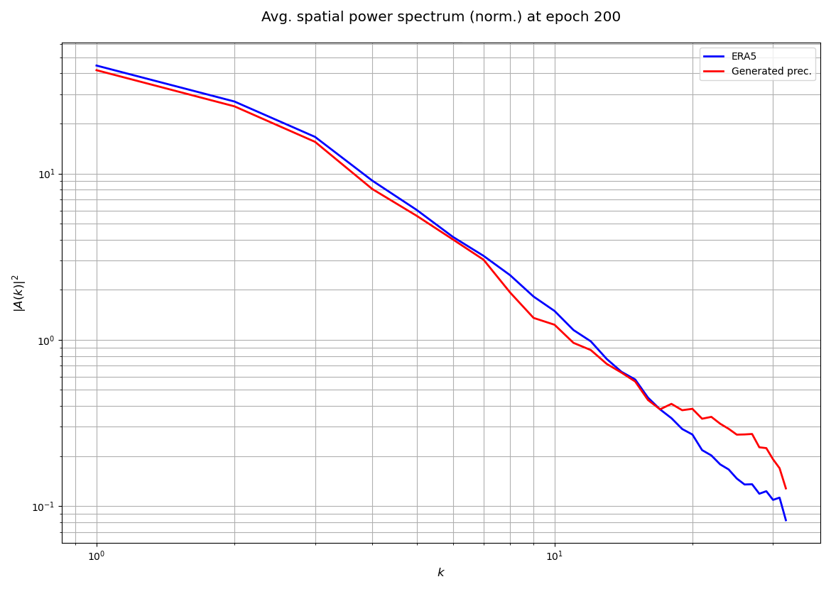
Average power spectrum of the daily rainfall field
The power spectrum gives a quantitative indication of the spatial scales of variability of precipitation.
For higher values of k (>15) the generated spectrum diverges, indicating the higher variability (noise) of the generated field at the small scale.
At the end of the training, the GAN generates a dataset whose spectrum matches the reference one for low values of k.

Slide 8
Thanks for your attention

Slide 9
Backup

Slide 10
Reconstruction of the total daily precipitation climatology
Some additional technical detail
Operational steps:
We considered the ECMWF ERA5 total (cumulative) daily precipitation dataset for the years 1950-2020, corresponding to 25871 training examples.
We performed the coarsening (upscaling) of this dataset.
The generator was fed with the coarsened precipitation fields and produced the corresponding precipitation fields at the original resolution.
The discriminator was trained with both the coarse-scale and the corresponding fine-scale precipitation fields, as well as with the labels (real/fake fields).
We evaluated the process of training computing some climatologically meaningful metrics (climatology, standard deviation, 95th percentile) on the generated precipitation fields.
The networks have been trained for 200 epochs on a Nvidia Volta V100 GPU, provided by the CINECA consortium (https://www.cineca.it/en).

Slide 11
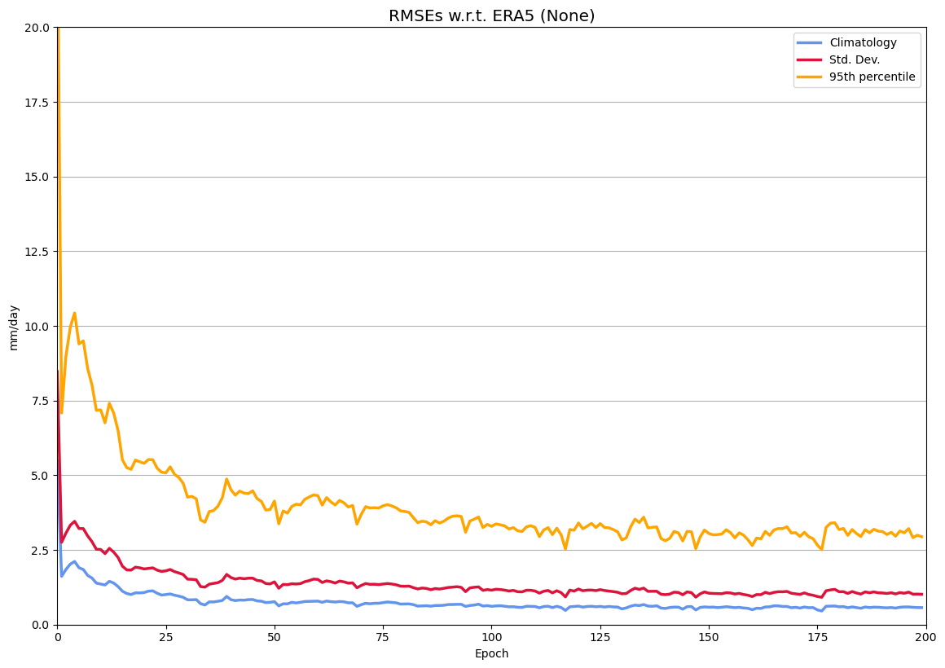
RMSE of climatology, standard deviation and 95th percentile

