Slide 1


Hybrid Modelling of Land-Atmosphere Fluxes: Estimating Evapotranspiration using Combined Physics-Based and Data-Driven Machine Learning
Reda ElGhawi^{1,2,3}, Alexander J. Winkler ¹, Basil Kraft^{1,2}, Christian Reimers¹, Marco Körner³,
and Markus Reichstein¹
1: Max Planck Institute for Biogeochemistry, Biogeochemical Integration, Jena, Germany
2: International Max Planck Research School for Global Biogeochemical Cycles, Max Planck Institute for Biogeochemistry, Jena, Germany
3: Technical University of Munich, TUM School of Engineering and Design, Department of Aerospace and Geodesy, Munich, Germany

Slide 2

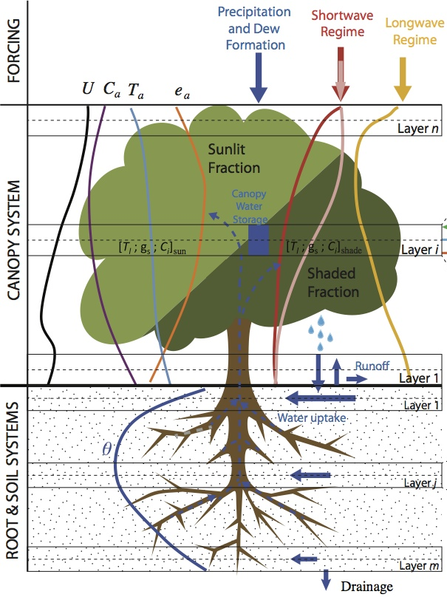
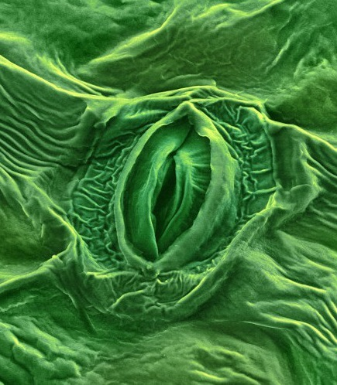



Evapotranspiration as a Key Flux: Looking into Stomatal and Aerodynamic Resistance
Aerodynamic resistance $r_{a}$
Latent heat flux
Boundary layer resistance $r_{b}$
Atm.
Stomatal resistance $r_{s}$
air flow
http://hydrocomplexity.net/research/carbon_nitrogen.html

Slide 3
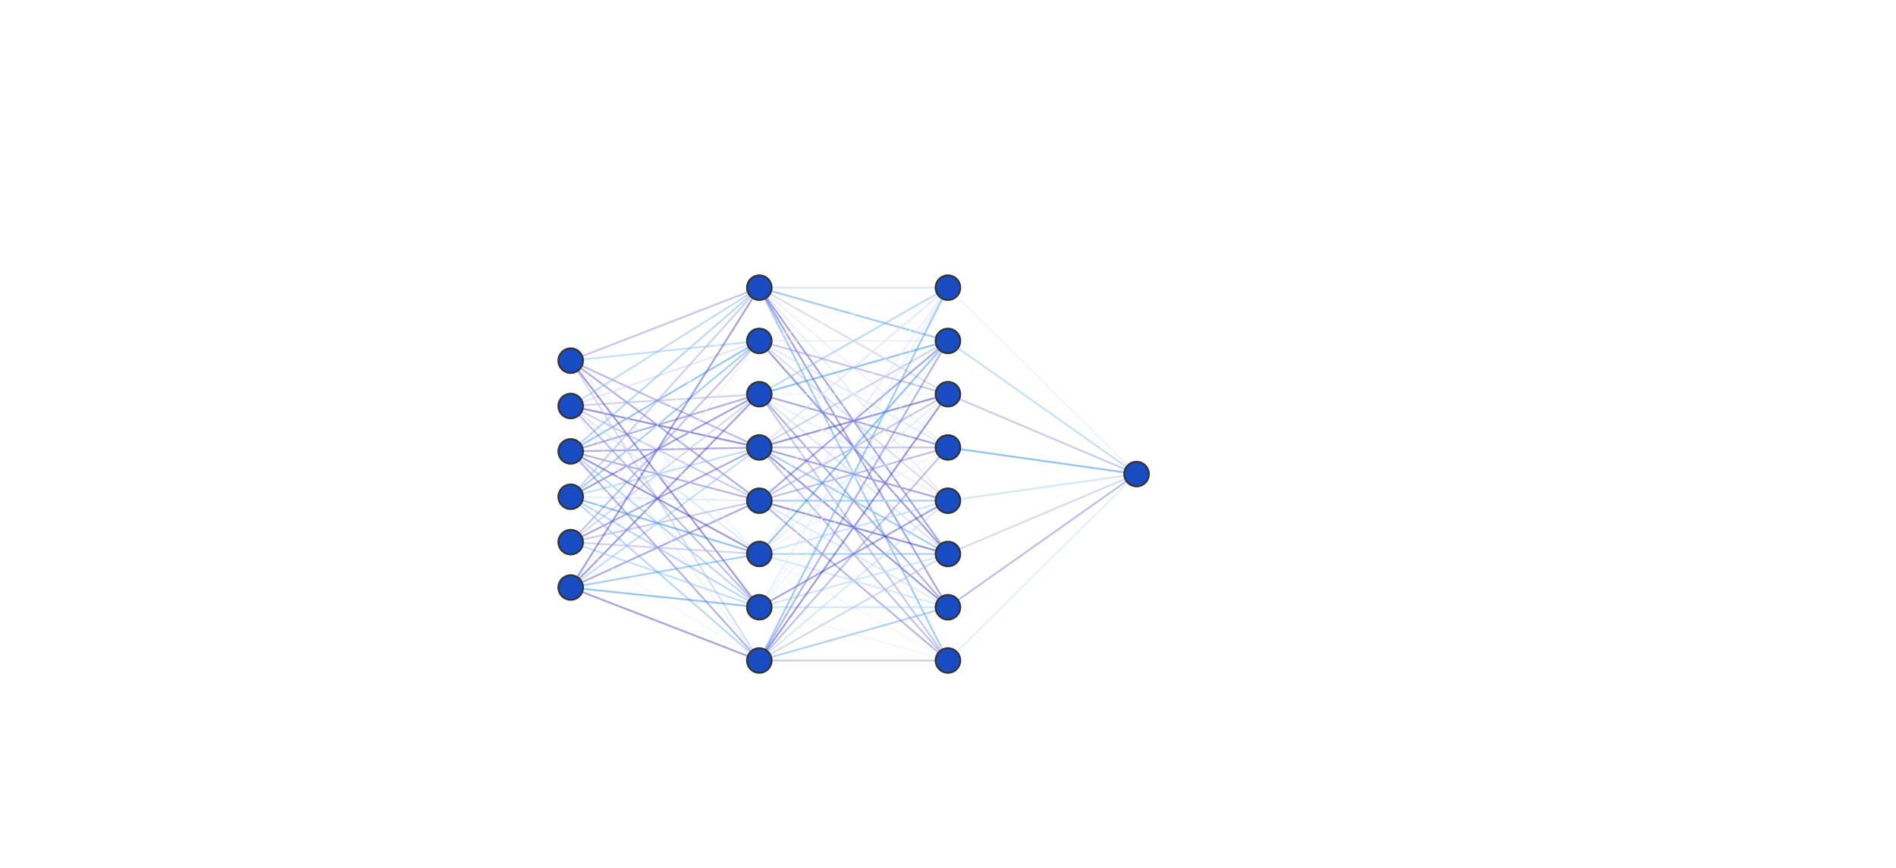
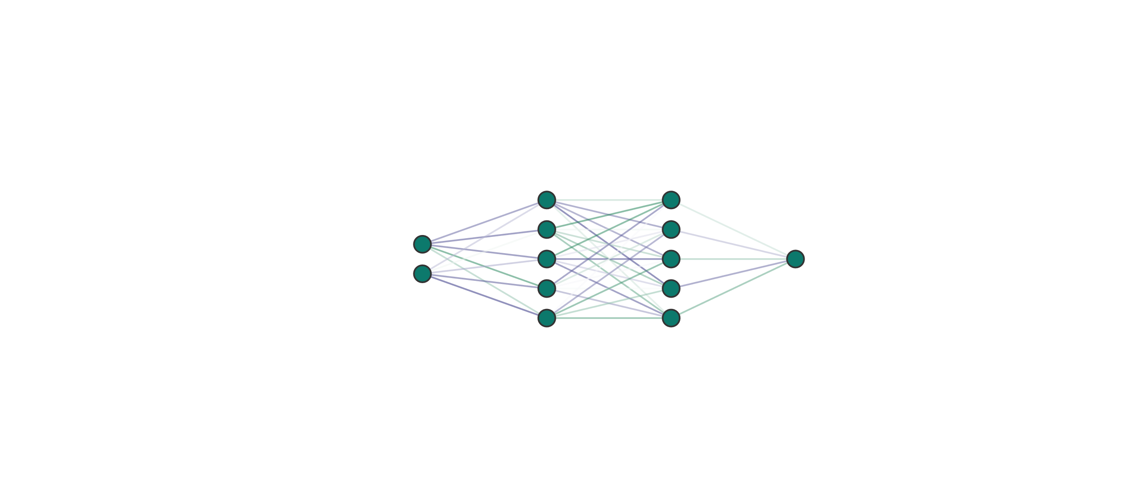
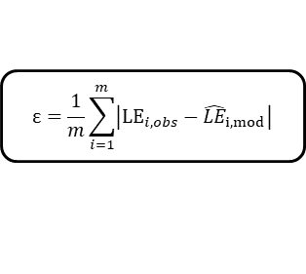



Hybrid Model
Neural Network
FLUXNET 2015 dataset (10-19 years)
3 Forests (DE-Tha, FR-Pue, FR-LBr)
3 Grasslands (DE-Gri, CH-Cha, US-Var)
WAI
VPD
TA
Rn
SW IN
SW POT sm
USTAR
WS
$$\hat{r_{s}}$$
Input climate variables
Physics-based PM eqn
$$\hat{LE} =\frac{s_{\text{c}} (R_{\text{n}}−Q_{\text{G}})+\frac{\left.ρ_{a}c_{\text{p}}(e_{\text{s}}−e_{\text{a}}\right)}{\hat{r_{a}}}}{s_{\text{c}}+γ \left(1+\frac{\hat{r_{s}}}{\hat{r_{a}}}\right) }$$
$$\hat{r_{a}}$$
$$\text{ε}=\frac{1}{m}\sum_{i=1}^{m}{\left|{LE}_{i,obs}−{\hat{LE}}_{i,mod}\right|}$$
3

Slide 4
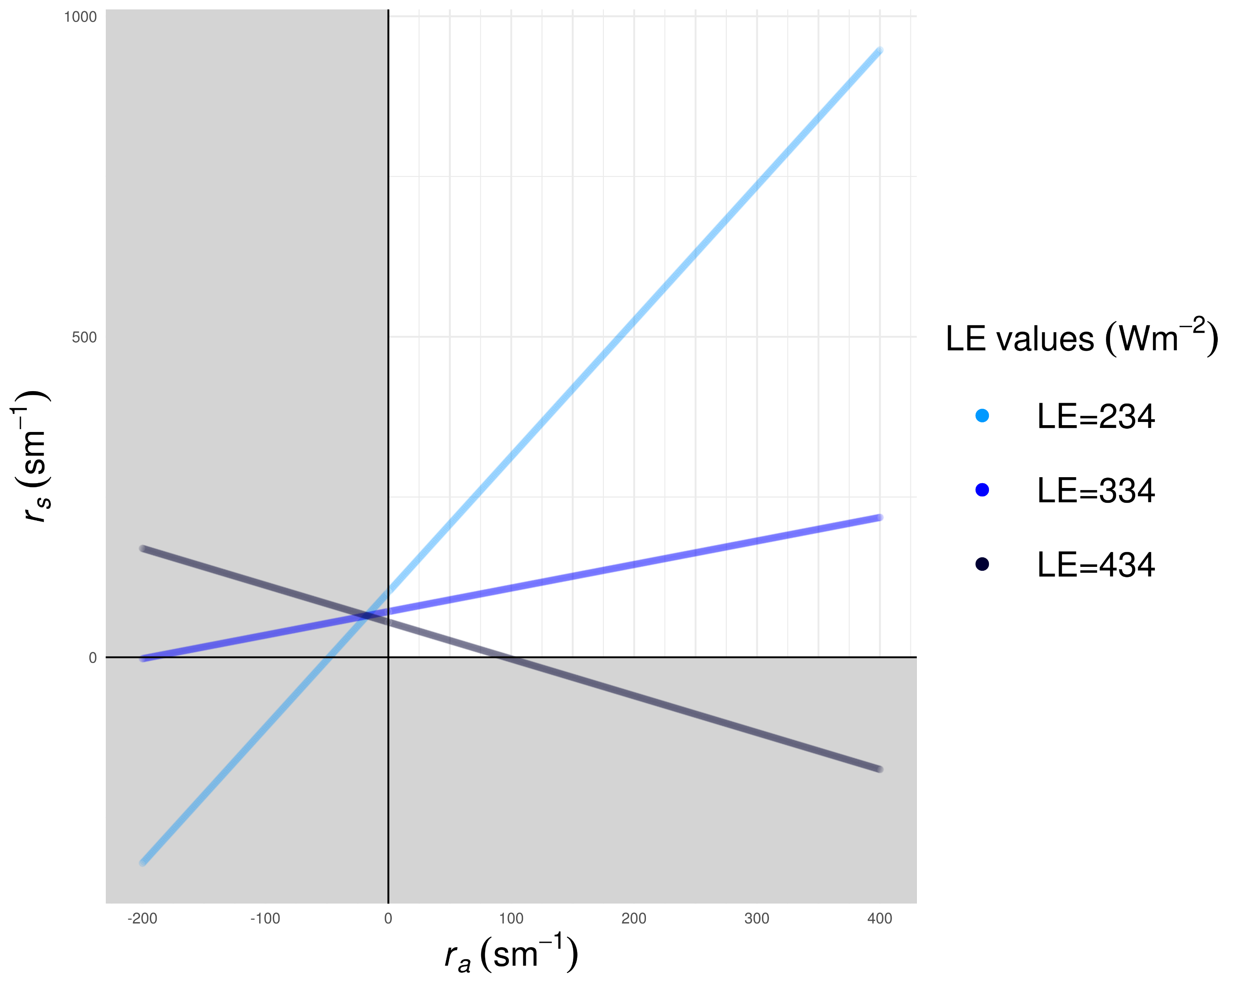
Equifinality in the physics-based component of unconstrained hybrid model

Slide 5
Data-driven
Theory-driven
H Observations
Hybrid LE
Big Leaf Model
More Data
More Theory
Hybrid LE
+
r_{a} Constraints
Hybrid LE-H
Multi-Task Learning
A priori Information
Notes:
We propose two additional hybrid models to circumvent the issue of equifinality. The first

Slide 6
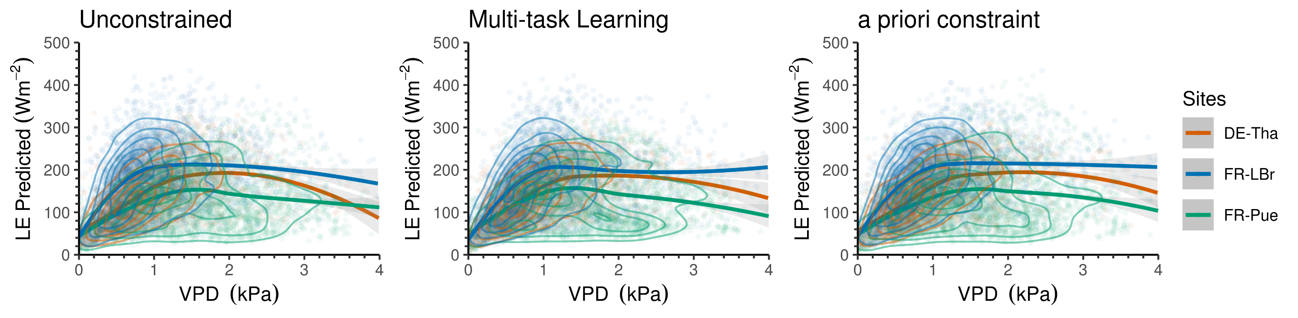
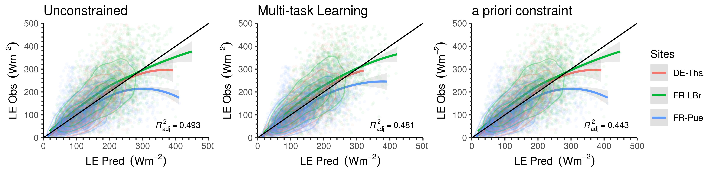
Evaluating predictions against relevant climate variables
Evaluating predictions against observations

Slide 7
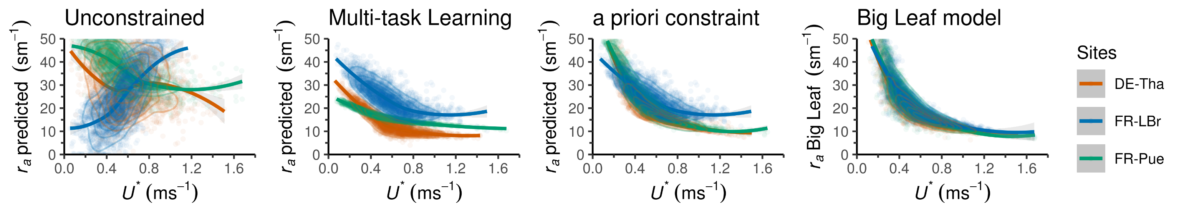
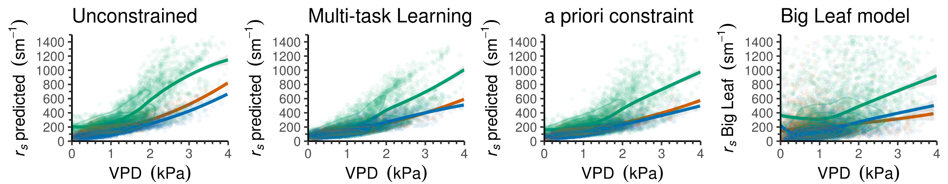
Evaluating predictions against relevant climate variables
r_{a} predictions differ between hybrid models due to equifinality
r_{s} predictions consistent among models
Big Leaf model overestimates r_{s} and overgeneralizes r_{a} in comparison to hybrid models

Slide 8
Conclusion
Hybrid modelling allows the retrieval of latent variables that are physically interpretable in comparison to purely data-driven and physics-based approaches, and equifinality can be circumvented by inducing more theory or data.
Thanks!
Q&A

Slide 9
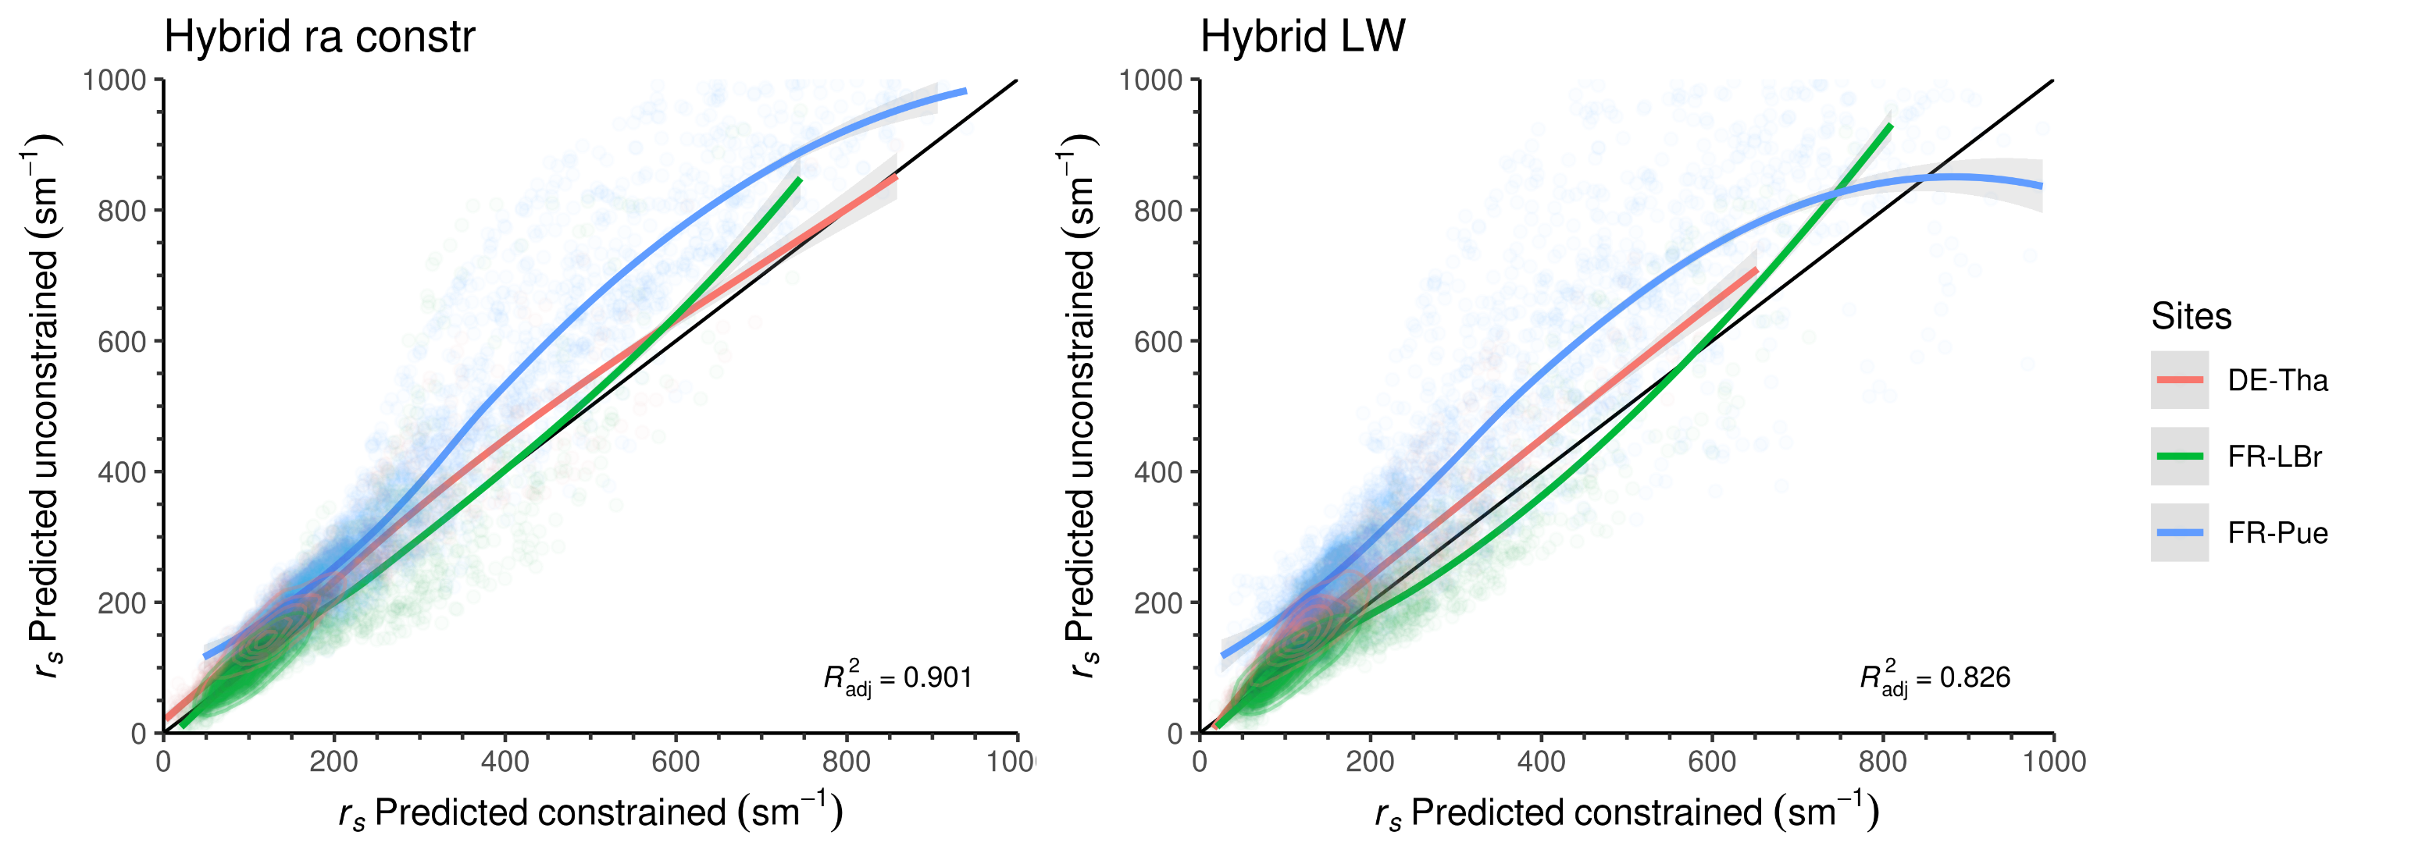
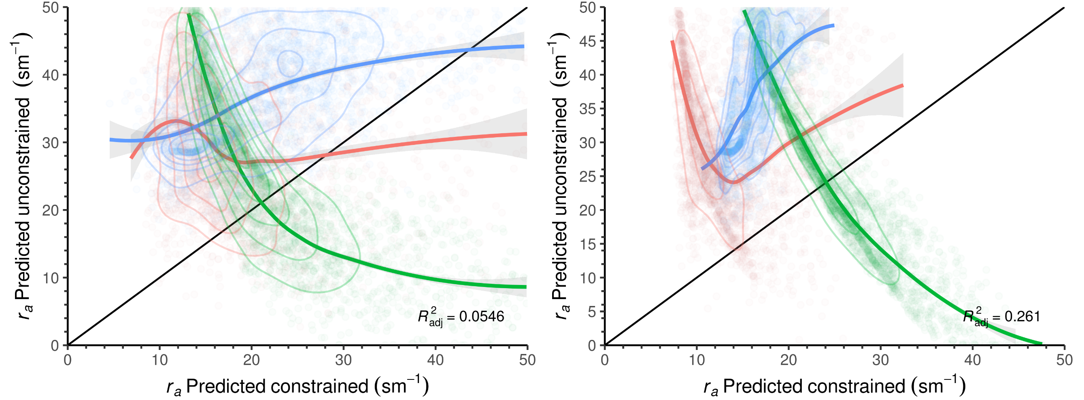

Slide 10
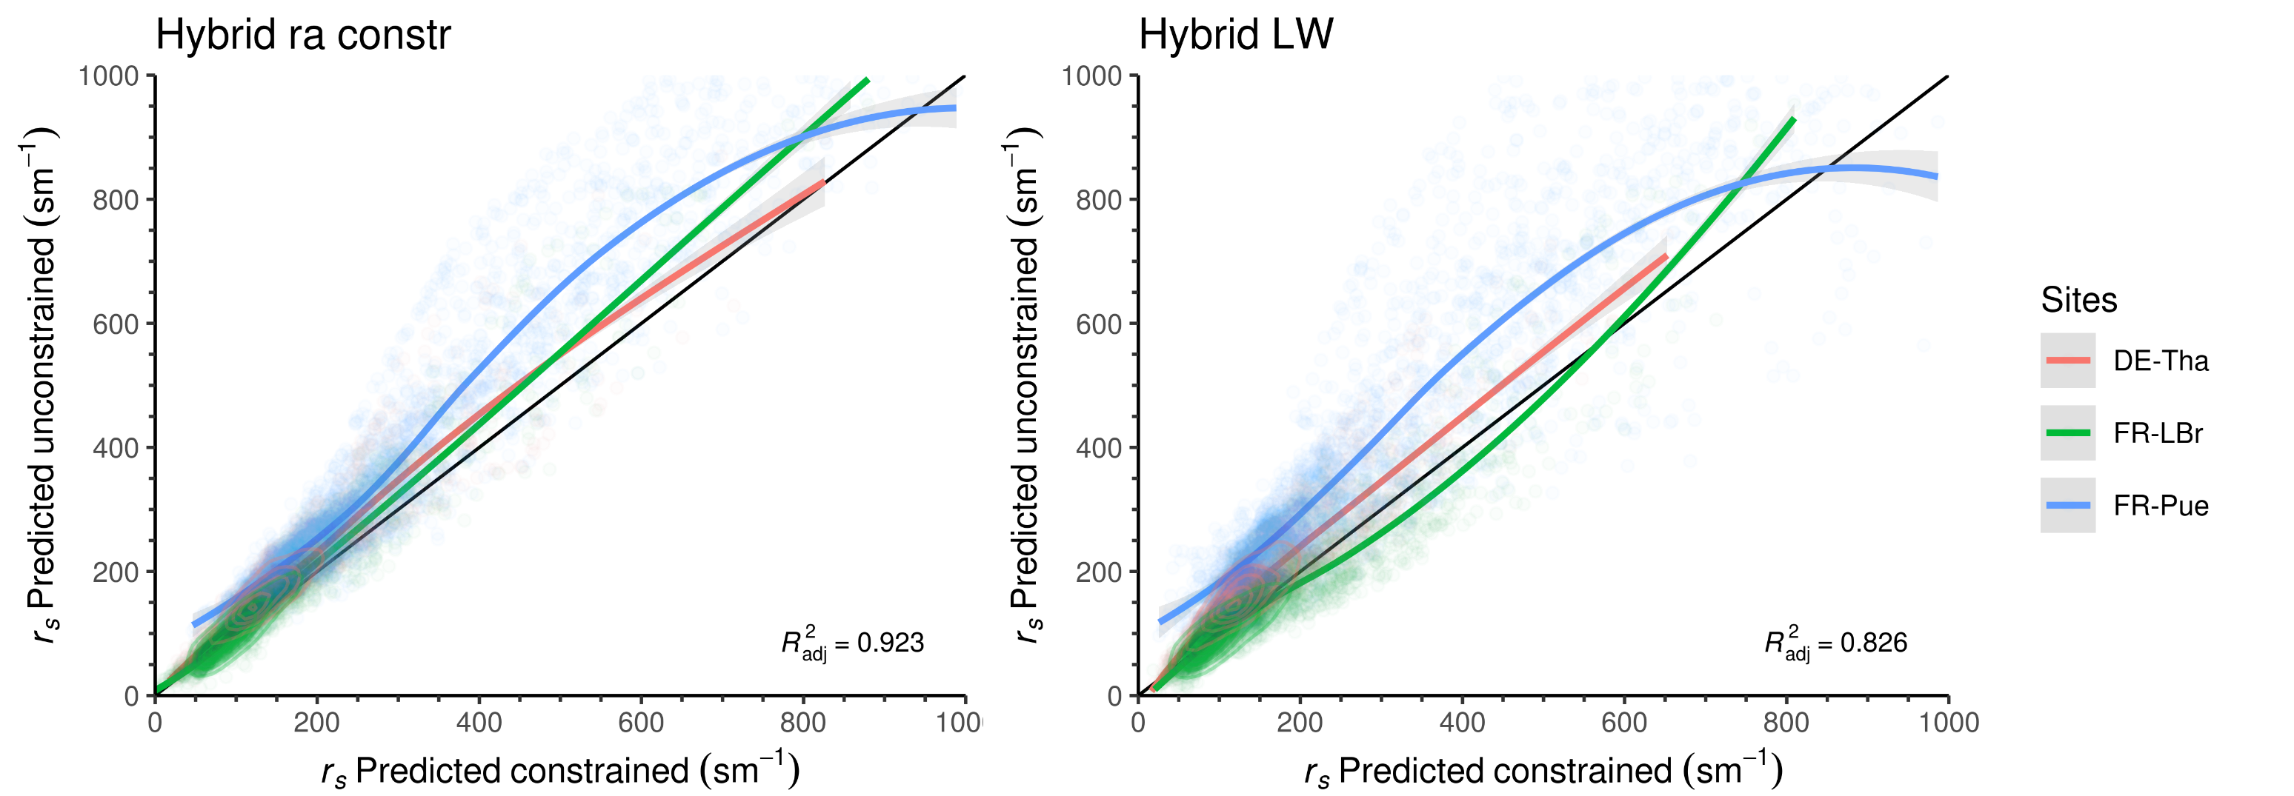
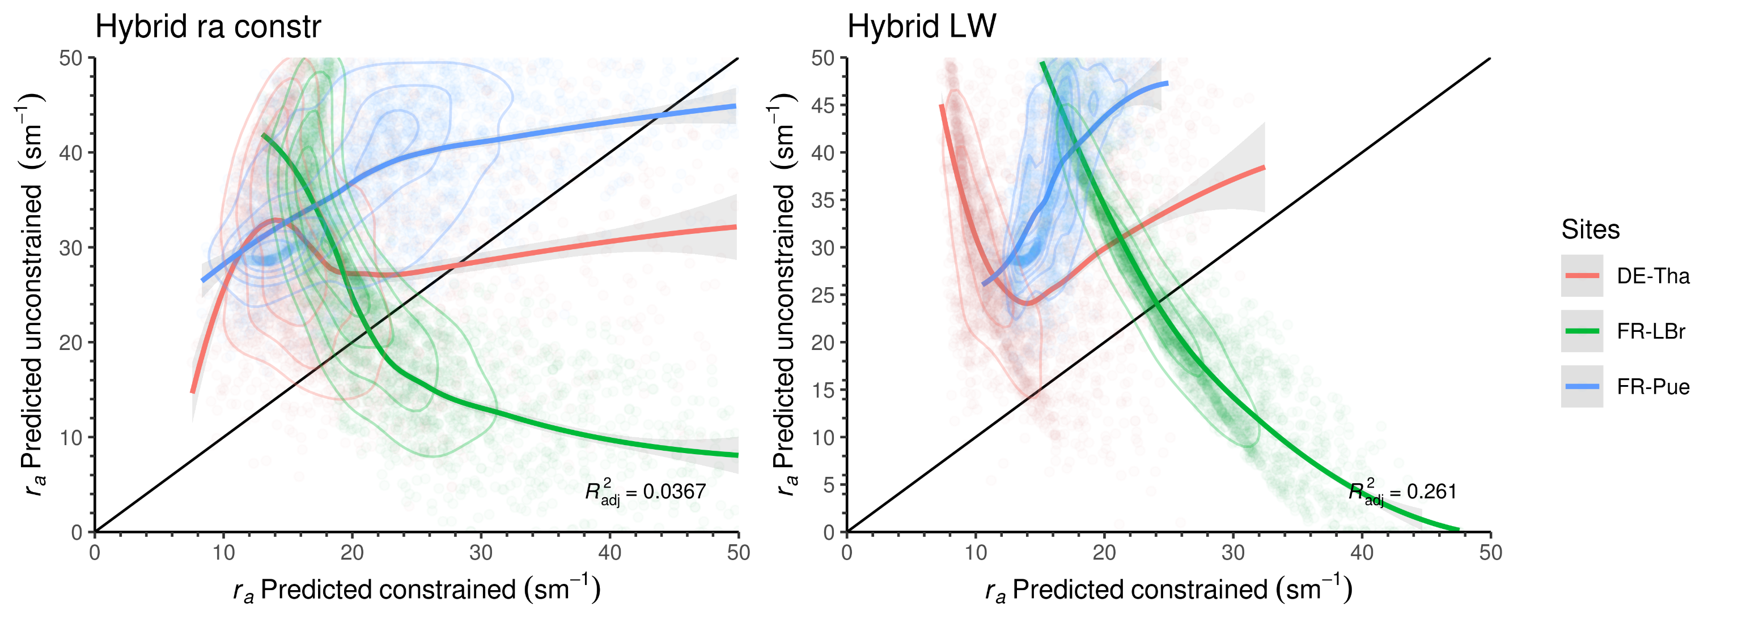
(sigma=2 hyb ra)
(sigma=2 hyb ra)

Slide 11
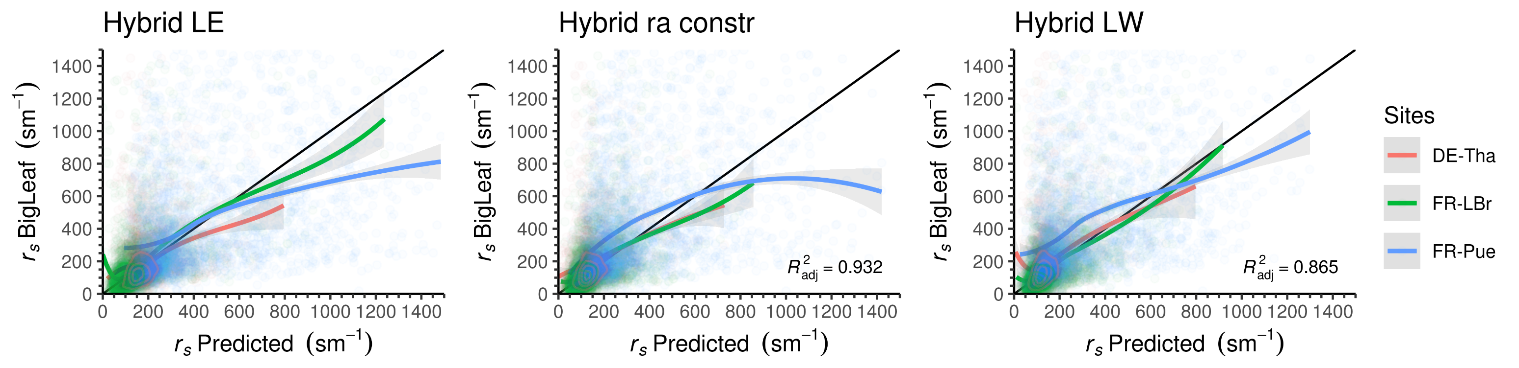
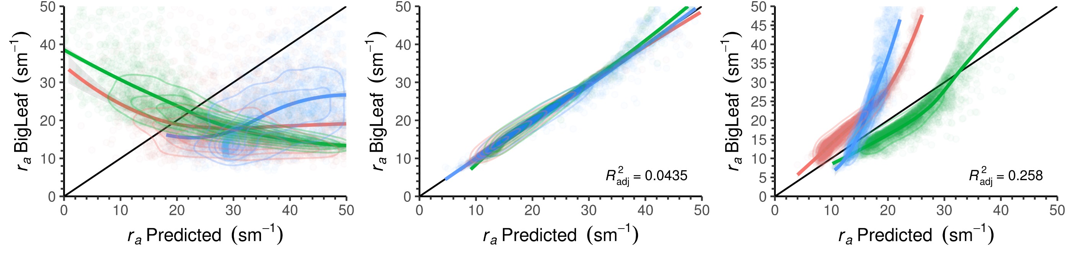
Evaluating predictions against observations

Slide 12
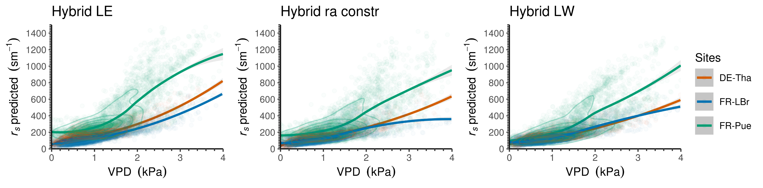
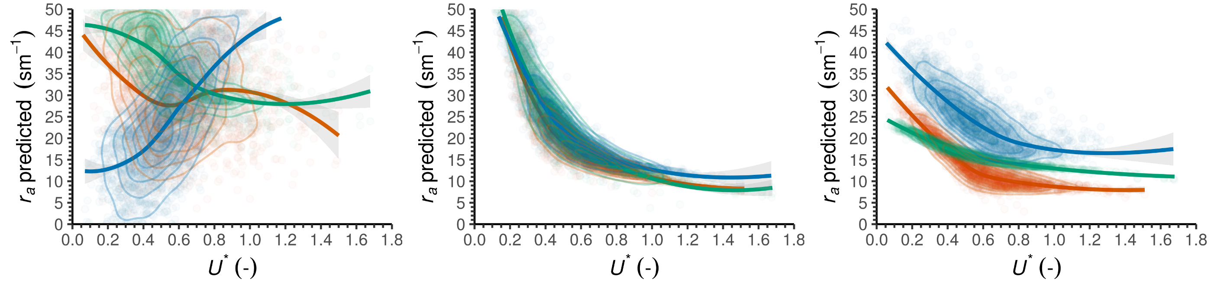
Evaluating predictions against relevant climate variables

Slide 13
Methods:
FLUXNET 2015 dataset
Site ID | IGBP | Elevation (m) | Mean Annual Temperature (°C) | Mean Annual Precipitation (mm) | Data Availability
DE-Tha | ENF¹ | 385 | 8.2 | 843 | 19 years (1996 - 2014)
FR-Pue | EBF² | 270 | 13.5 | 883 | 15 years (2000 - 2014)
FR-LBr | ENF¹ | 61 | 13.6 | 900 | 12 years (1996 - 2008)
CH-Cha | GRA³ | 393 | 9.5 | 1136 | 10 years (2005 - 2014)
DE-Gri | GRA³ | 385 | 7.8 | 901 | 11 years (2004 - 2014)
US-Var | GRA³ | 129 | 15.8 | 559 | 15 years (2000 - 2014)
ENF (Evergreen Needleleaf Forests: Lands dominated by woody vegetation with a percent cover >60% and height exceeding 2 meters. Almost all trees remain green all year. Canopy is never without green foliage).
EBF (Evergreen Broadleaf Forests: Lands dominated by woody vegetation with a percent cover >60% and height exceeding 2 meters. Almost all trees and shrubs remain green year-round. Canopy is never without green foliage).
GRA (Grasslands: Lands with herbaceous types of cover. Tree and shrub cover is less than 10%. Permanent wetlands lands with a permanent mixture of water and herbaceous or woody vegetation. The vegetation can be present in either salt, brackish, or fresh water.)

