Slide 1


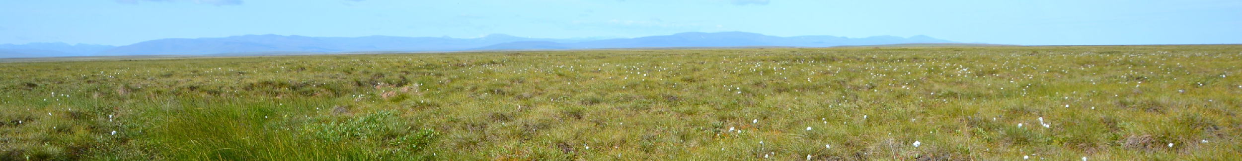
Spatial variability shapes microbial communities of permafrost soils and their reaction to warming
Cornelia Rottensteiner¹, Victoria Martin¹, Hannes Schmidt¹, Leila Hadžiabdić¹, Julia Horak¹, Moritz Mohrlok¹,
Carolina Urbina Malo¹, Julia Wagner², Willeke A’Campo², Luca Durstewitz², Rachele Lodi³, Niek Speetjens⁴,
George Tanski⁴, Michael Fritz⁵, Hugues Lantuit⁵, Gustaf Hugelius², Andreas Richter¹
¹University of Vienna, Centre for Microbiology and Environmental Systems Science, Vienna, Austria
²Stockholm University, Department of Physical Geography, Stockholm, Sweden
³Ca' Foscari University, Department of Environmental Sciences, Informatics and Statistics, and CNR Institute of Polar Sciences, Venice, Italy
⁴Vrije Universiteit Amsterdam, Department of Earth and Climate, Amsterdam, Netherlands
⁵Alfred Wegener Institute, Helmholtz Centre for Polar and Marine Research, Potsdam, Germany
© Victoria Martin, 2018

Slide 2
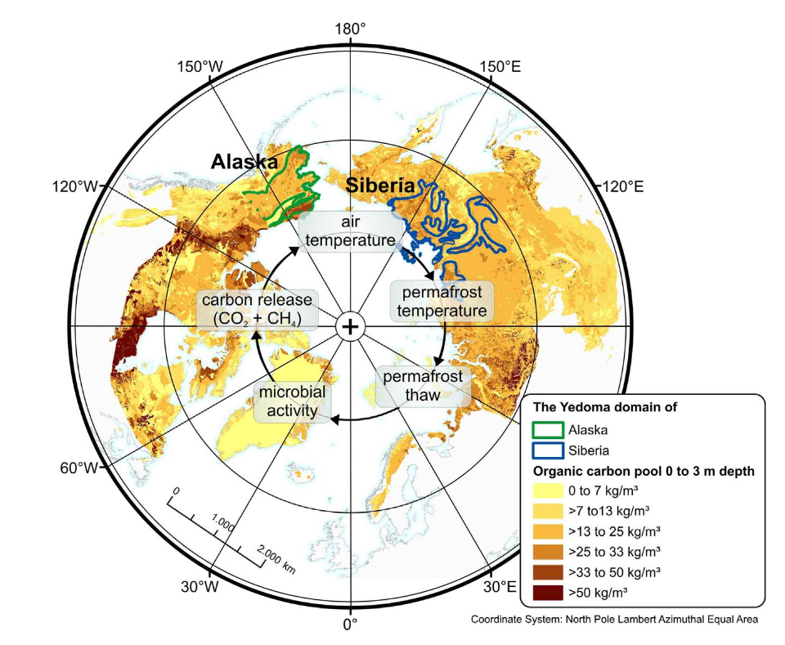
Permafrost is defined as ground that was frozen for more than two consecutive years. Most permafrost derives from the last glacial period. It covers app. 25 % of the land area in the Northern Hemisphere and stores huge amounts of soil organic carbon (app. 1300-1700 PgC).
The relevance of permafrost soils
The Arctic warms 2 to 4 times faster than the global average (polar amplification). Increasing temperatures thaw permafrost soils, increase microbial activity and make previously frozen carbon pools accessible for microbial decomposition. Permafrost carbon is taken up by microbes and respired into the atmosphere as CO₂ and CH₄, potentially leading to a positive permafrost carbon-climate feedback.
Strauss et al., 2017
Hugelius et al. 2014, Schuur et al. 2015, Strauss et al. 2017,
Rantanen et al. 2021 (preprint), International Permafrost Association

Slide 3
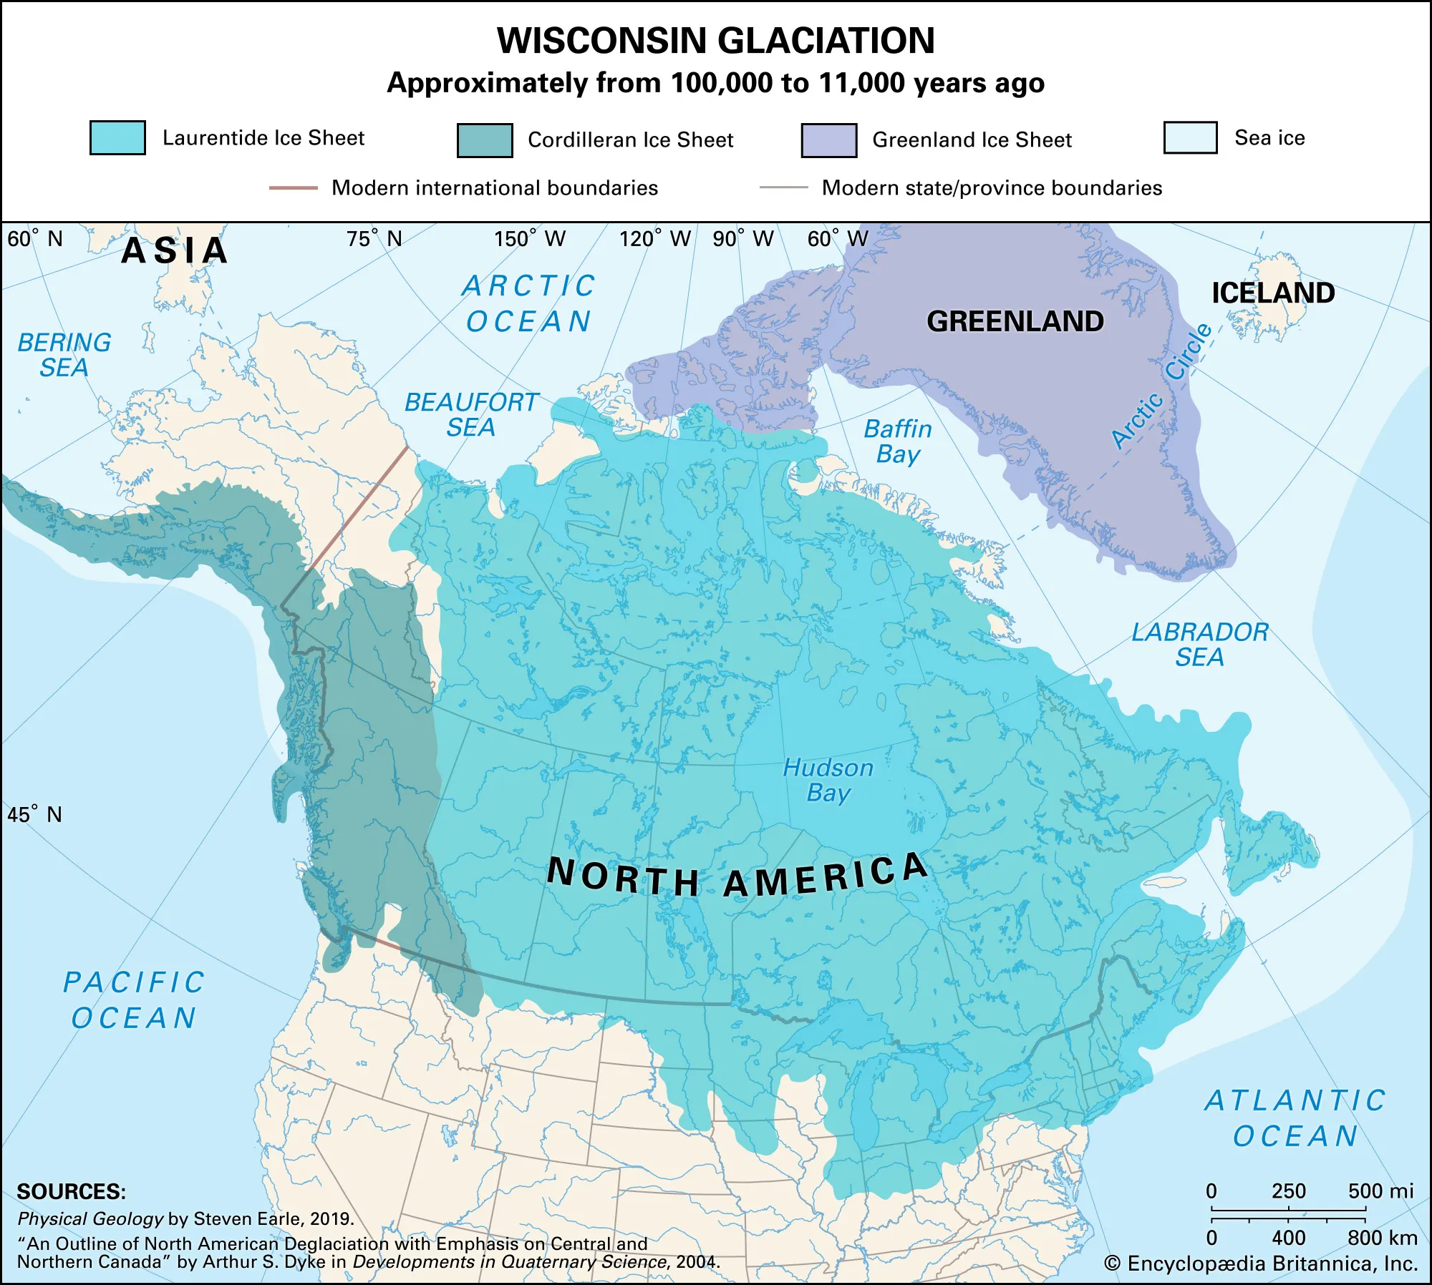
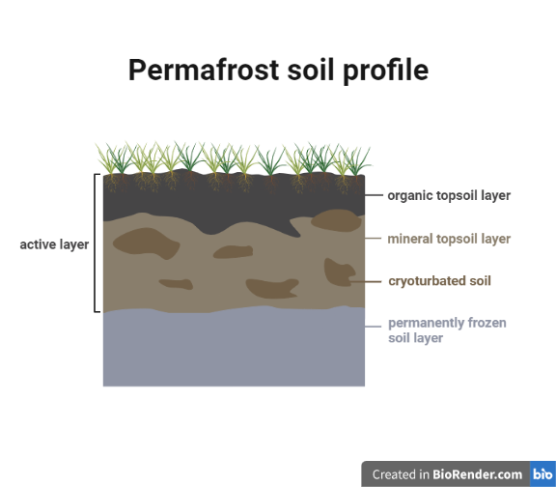
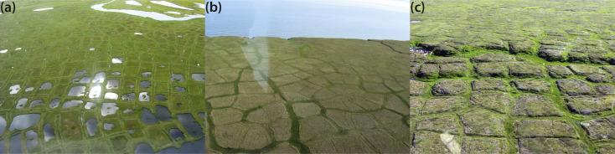
The spatial heterogeneity of the Arctic
Arctic soils are heterogeneous at multiple scales:
soil profile scale: repeated freeze and thaw events create complex and irregular soil profiles
landscape scale: different water and nutrient availabilities and different plant cover
temporal scale: e.g. previous glaciation
Little is known how these scales influence the decomposition potential of soil microbial communities.
Encyclopædia Britannica, Inc./Kenny Chmielewski, accessed 2022
low-center polygons
flat-center polygons
high-center polygons
Fritz et al., 2016

Slide 4
Part 1:
Does spatial variability affect microbial community composition?

Slide 5

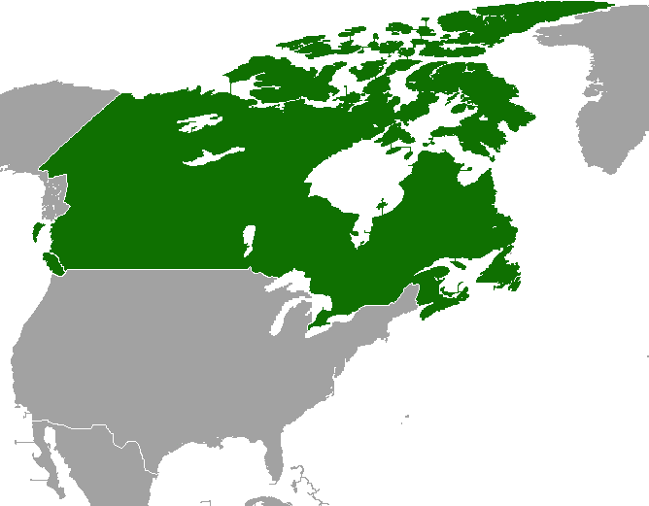
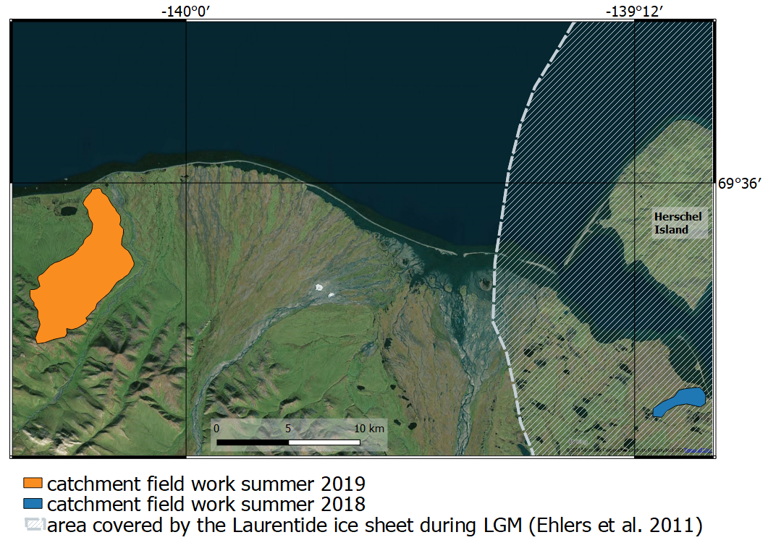
We took soil samples in two sampling areas differing in their glacial history: one has been covered by the Laurentide ice sheet during the last glacial maximum, while the other was not. In each of these sites we sampled about 40 soil samples, comprising three polygonal landscape types (low-center, flat-center, high-center) and four soil horizons (organic topsoil, mineral topsoil, cryoturbated organic matter, upper permanently frozen soil organic matter).
Methods
covered by Laurentide ice sheet during LGM
glaciation-free
Sampling Area 2019
Sampling Area 2018
Map adapted from Hugelius 2019
Sample Structure
glaciated: 39 samples |  |  |  | glaciation-free: 42 samples
 | low-center 8 | flat-center 17 | high-center 14 |  | low-center 12 | flat-center 15 | high-center 15
organic 15 | 4 | 6 | 5 | organic 20 | 8 | 6 | 6
mineral 7 | 1 | 3 | 3 | mineral 7 | 1 | 3 | 3
cryoturbated 7 | 0 | 4 | 3 | cryoturbated6 | 0 | 3 | 3
permanently frozen 10 | 3 | 4 | 3 | permanently frozen 9 | 3 | 3 | 3
We sequenced the 16S rRNA gene (bacteria/archaea) and the ITS1 region (fungi). Digital droplet PCR was used to quantify gene copy numbers per gram dry weight of soil.
Statistical analysis was done in R and RStudio.

Slide 6
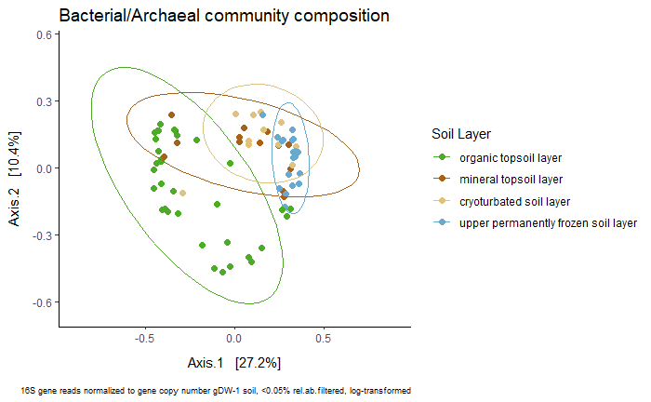
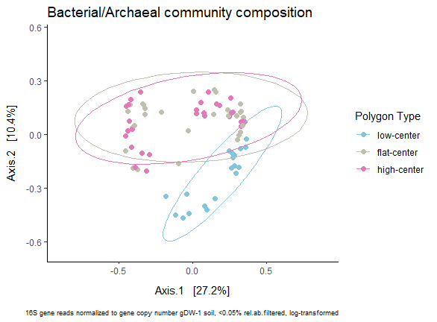
The majority of 16S gene amplicon sequence variants (ASVs; 3628) were bacteria, only 137 ASVs belonged to archaea. The bacterial and archaeal community composition was significantly affected by horizon and polygon type. We also observe a change of microbial community composition with soil depth. The separation of microbial communities from low-center polygons is likely caused by taxa that are adapted to these waterlogged systems and do not occur in the other polygon types.
Permanova:
organic : mineral p=0.006 *
organic : cryoturbated p=0.006 *
organic : permanently frozen p=0.006 *
mineral : cryoturbated p=0.222
mineral : permanently frozen p=0.006 *
cryoturbated : permanently frozen p=0.006 *
Soil Layer p=0.001 ***
Polygon Type p=0.001 ***
Interaction p=0.001 ***
low-center : flat-center p=0.003 *
low-center : high-center p=0.003 *
flat-center : high-center p=0.204

Slide 7
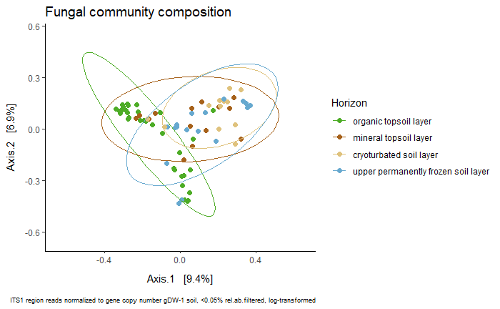
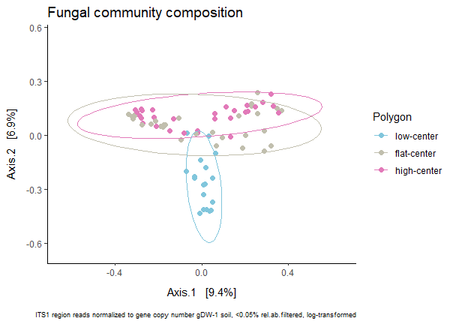
Fungal community composition (1604 ASVs) shows similar patterns to that of bacteria. Fungal communities of the organic soil layer are different from all other soil layers, possibly because fungal diversity decreases with soil depth. Analogous to bacteria, the waterlogged conditions of low-center polygons bring about distinct communities. In contrast to bacteria, fungal communities do slightly differ between high- and flat-center polygons.
Permanova:
organic : mineral p=0.006 *
organic : cryoturbated p=0.006 *
organic : permanently frozen p=0.006 *
mineral : cryoturbated p=0.216
mineral : permanently frozen p=1
cryoturbated : permanently frozen p=0.534
Soil Layer p=0.001 ***
Polygon Type p=0.001 ***
Interaction p=0.001 ***
low-center : flat-center p=0.003 *
low-center : high-center p=0.003 *
flat-center : high-center p=0.012 .

Slide 8
Part 2:
How do these different microbial communities react to warming?

Slide 9
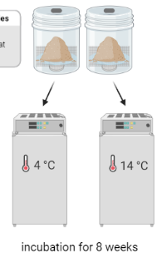
Methods
We performed a short-term warming experiment over the course of 8 weeks. Aliquots were incubated at two different temperatures (4 °C and 14 °C).
Soil microbial community composition was analyzed by 16S gene amplicon sequencing at the beginning and end of the incubation experiment.

Slide 10
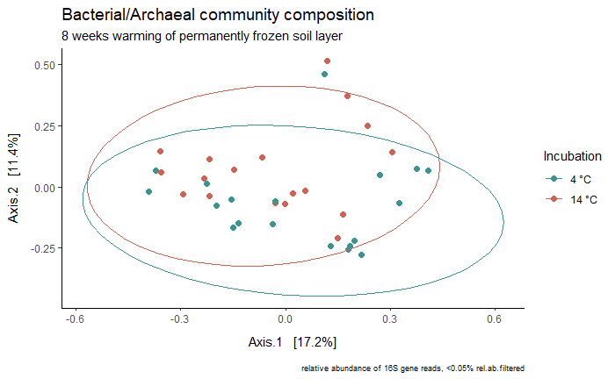
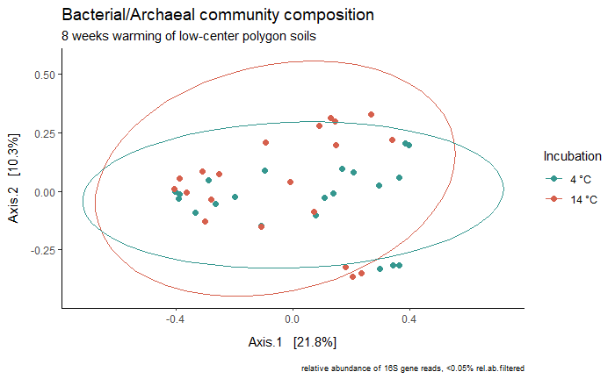
Bacterial/archaeal communities of permanently frozen soils and low-center polygon soils differ between the temperature treatments, indicating a warming effect in these extreme environments. This effect is not detectable in any other soil layer or polygon type, suggesting that those communities are used to fluctuating (and warmer) temperatures. In contrast, communities of frozen or waterlogged soils are probably highly adapted to these conditions and they might not cope with global warming or could at least change in their composition. These community shifts could potentially lead to changes in the decomposition potential.
Permanova:
Permanova:
p=0.015 *
p=0.027 *

Slide 11
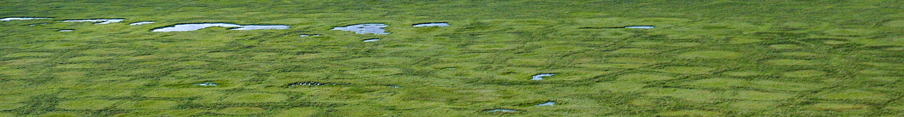




Take Home Message & Outlook
© Bering Land Bridge National Preserve, 2007, Flickr, CC BY 2.0, adapted
Microbial communities in permafrost affected soils are not only shaped by spatial heterogeneity within the soil profile, but are also different on the landscape scale and with ecosystem history. Distinct microbial communities also react differently when subjected to warming.
This study may help to answer the question, whether the composition of microbial communities can help to explain differences in microbial growth and respiration, which are observed in a short-term warming experiment.
cornelia.rottensteiner@ecosystem-science.at
@Cornelia_R

