Slide 1




In-situ gravity measurements using a vibrating beam MEMS accelerometer designed for surface microgravimetry.
Matthew Reed, Guillermo Sobreviela-Falces, Milind Pandit, James Mcintosh, Douglas Young, Callisto Pili, Julian Abbott, Guy Brook, Niall MacCarthy, Daniel Boddice, Farough Rahimzadah, Nicole Metje, Jamie Vovrosh, Colin Baker, and Ashwin Seshia

Slide 2
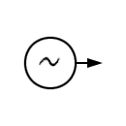


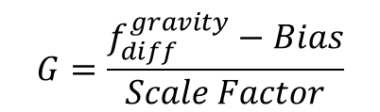



Resonant Beam Accelerometer
$$f_{2}^{gravity}= f_{2}^{rest}+ ∆f_{gravity}$$
This value includes:
gravity measurement,
Seismic effects
Audio effects
thermal and pressure effects,
electrical noise
common-mode noise
Tension
$$f_{common}^{gravity}=f_{2}^{gravity}+f_{1}^{gravity}$$
Proof Mass
This value includes:
gravity measurement,
Seismic effect
Audio effects
Gravity
$$f_{diff}^{gravity}=f_{2}^{gravity}−f_{1}^{gravity}$$
$$G=\frac{f_{diff}^{gravity}−Bias}{Scale Factor}$$
$$f_{1}^{gravity}= f_{1}^{rest}− ∆f_{gravity}$$
Compression

Slide 3
Field ready gravimeter prototype
Tilt Sensor (500 µdeg precision)
Heat Control
System
Controller
(Sysc)
Sensor Module
Pressure
Temperature
Heating Elements
Tilt
Data-In
Data
Out
Insulation
Tilt Control
Controlled Piezo motor micrometre
Tilt
data
(in/out)
Sysc
data
Digital Resonance Tracking Unit
(DRTU)
Collection Device
In 2
In 1
Out 1
Out 2
Data
Out
DRTU
data

Slide 4
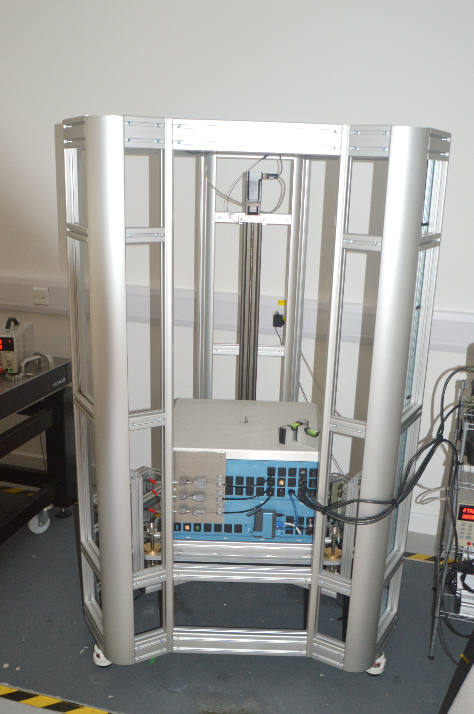
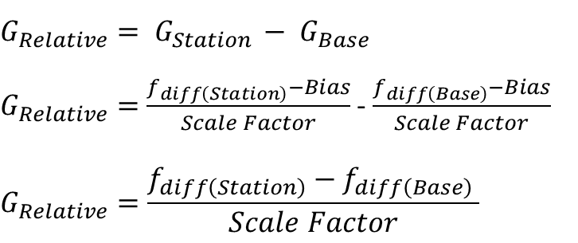
Elevation testing
6
Experimental procedure:
600 mm
Base Station
Measurement Station
After every measurement system returns to base station
Height/Changing Gravity
<1 mm precision
Time
$$G_{Relative}= G_{Station }− G_{Base}$$
$G_{Relative}=$ $\frac{f_{diff\left(Station\right)}−Bias}{Scale Factor}$ - $\frac{f_{diff\left(Base\right)}−Bias}{Scale Factor}$
$$G_{Relative}=\frac{f_{diff\left(Station\right)}−f_{diff\left(Base\right)} }{Scale Factor}$$
0 mm

Slide 5
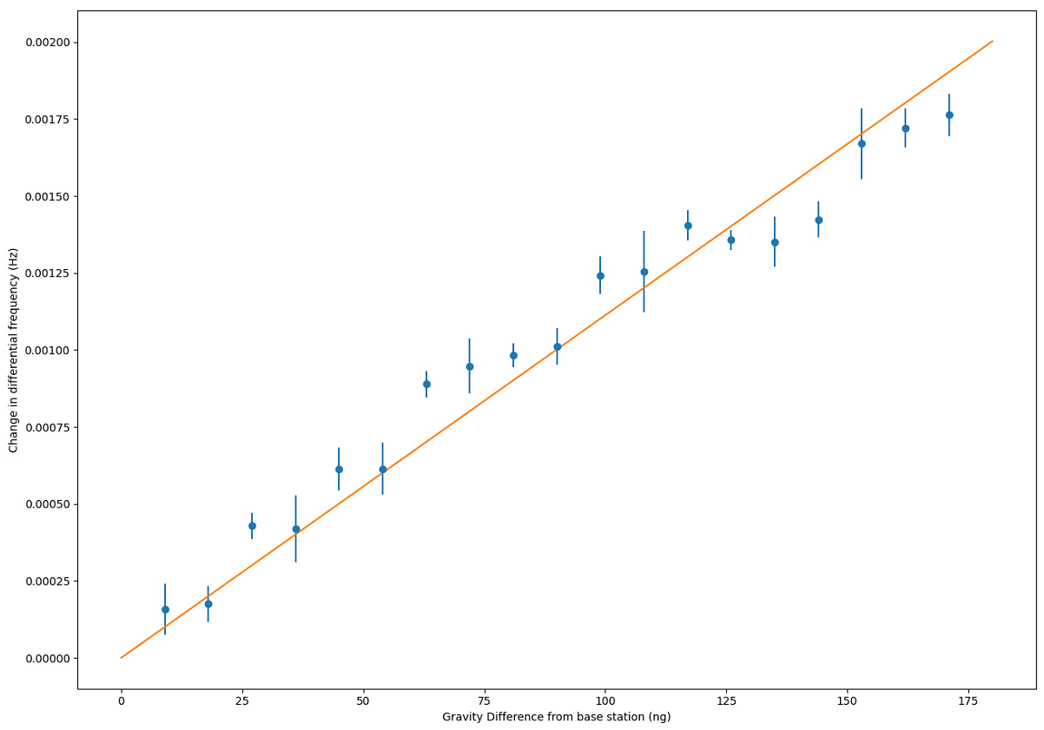
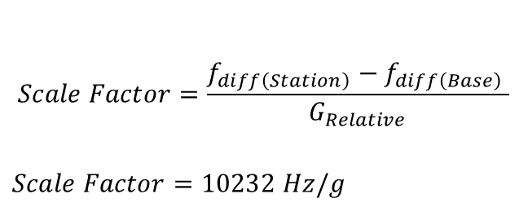
Elevation testing
$$Scale Factor=\frac{f_{diff\left(Station\right)}−f_{diff\left(Base\right)} }{G_{Relative}}$$
$$Scale Factor=10232 Hz/g$$
Gravity measurements at varying height to simulate effect of moving system and varying gravity
Measurement time at each height 20 mins and 5 repeats used
Detection levels below <15 µGal
Average gravity repeatability of 6.5 µGal
Time varying residual compared to fit is due to earth tides (not compensated)

Slide 6
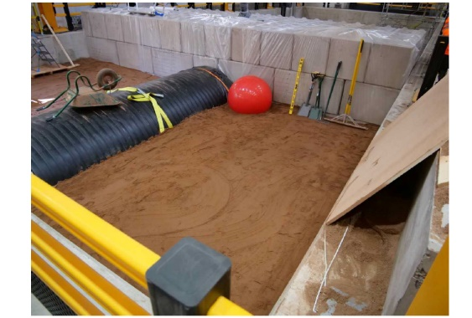
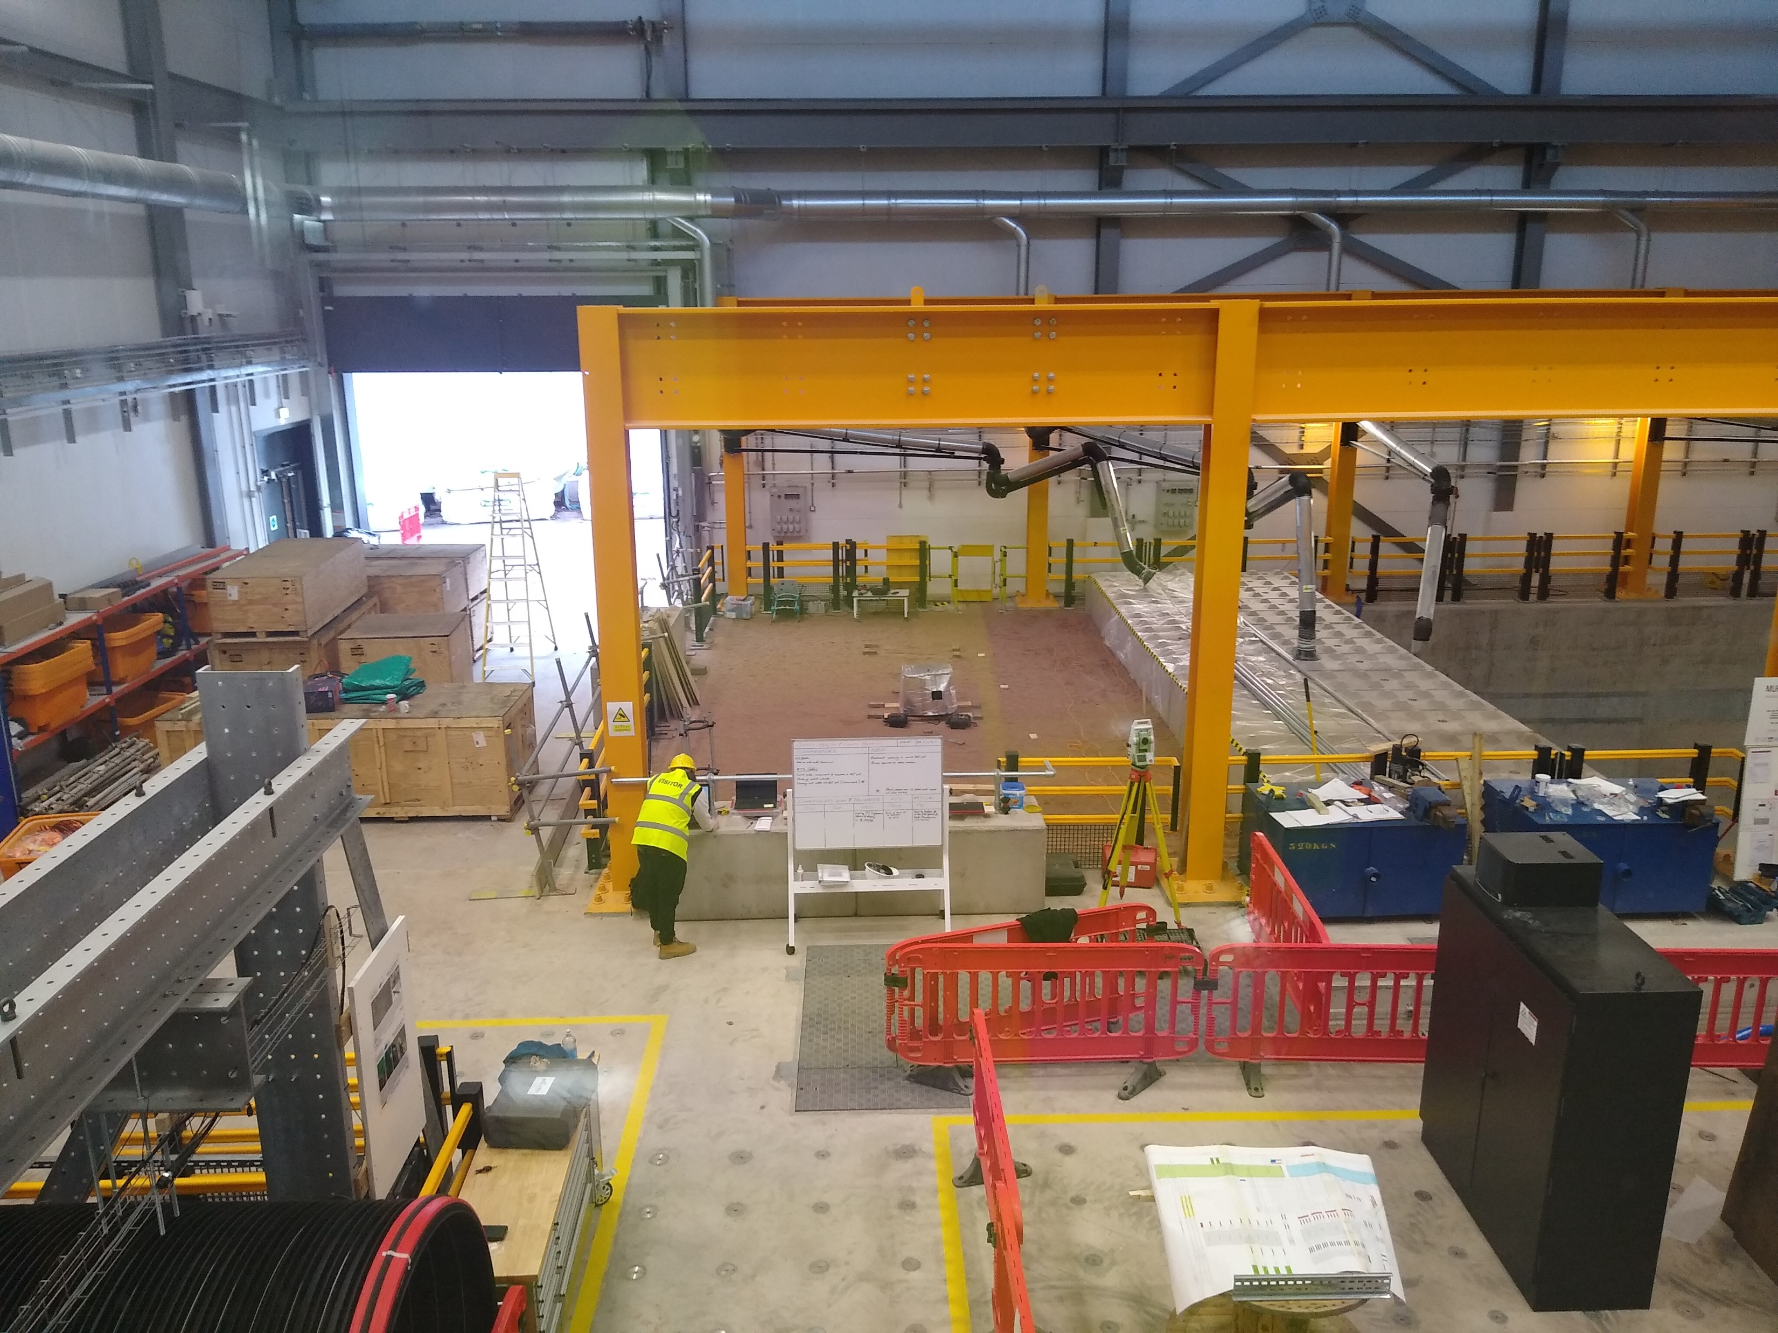
NBIF Field trial
Measurement Station
Base Station (0)
And Station 1
2
3
4
5
6
7
0.3 m
2 m
1 m
1 m
1 m
1 m
1 m
1 m
Not performed due to time constraints

Slide 7
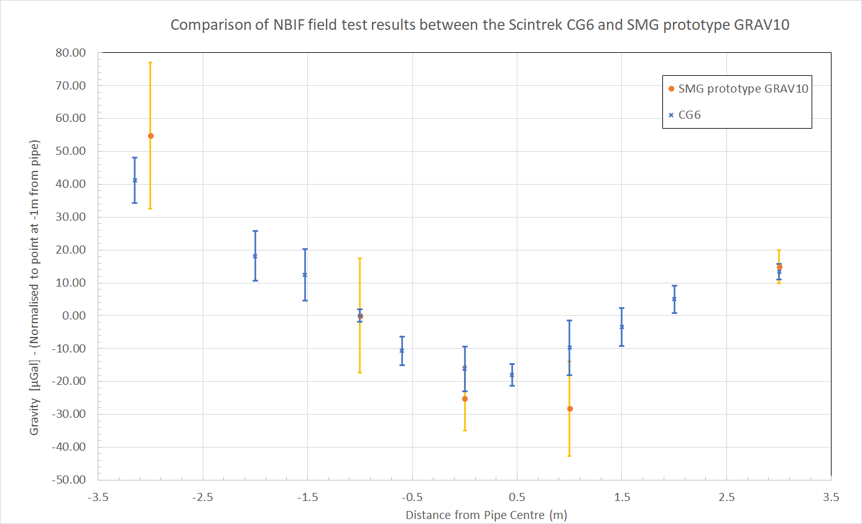
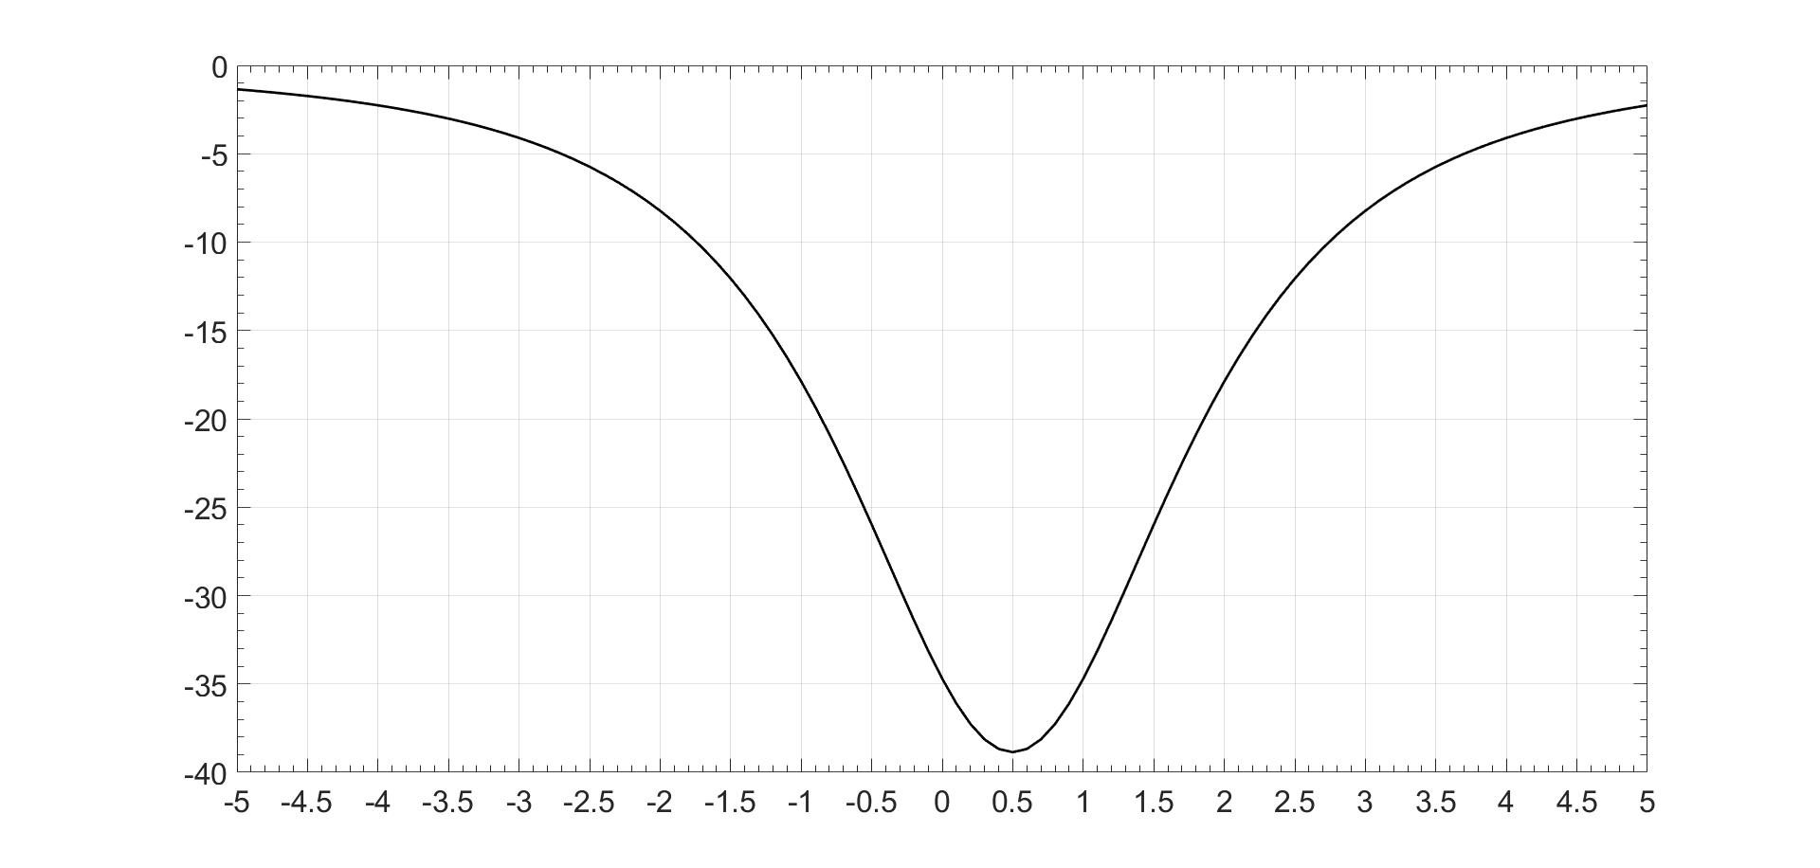
NBIF Field trial
Results (Compared with Scintrex CG6 – Provided by D. Boddice)
Model – Provided by D. Boddice
1
3
4
5
7

Slide 8
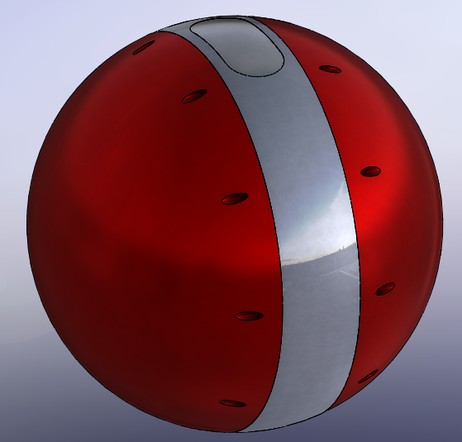
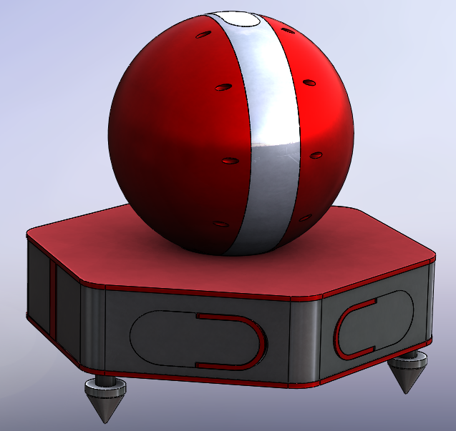
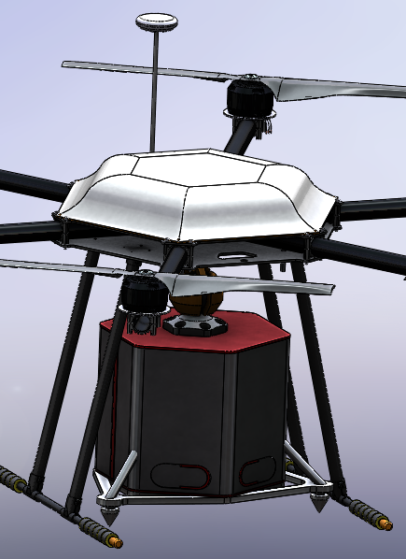
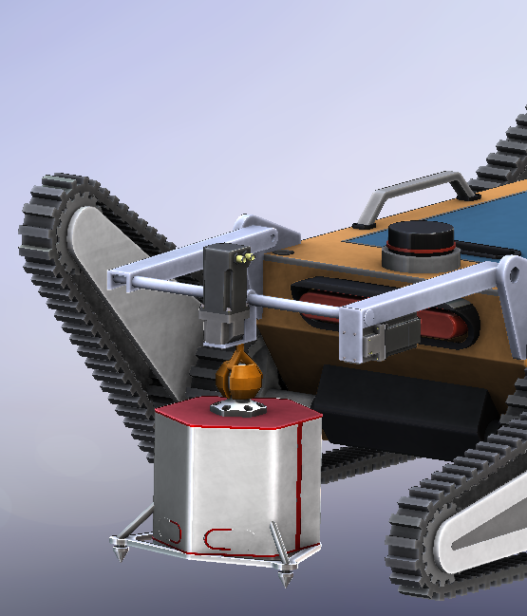
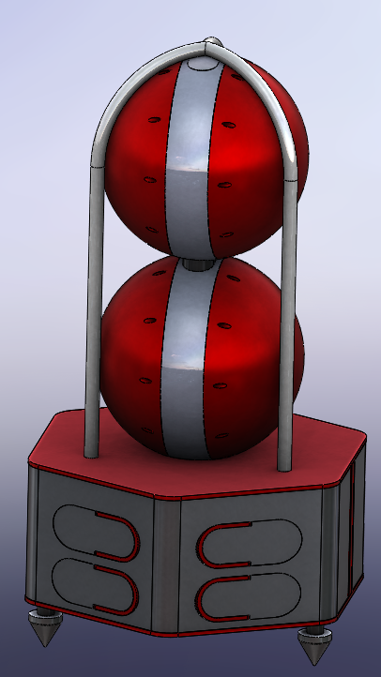
Future Directions and proposed product range
OEM Gravimeter | Static Gravimeter | Drone Deployed | Rover Deployed | Stacked Gradiometry
Single OEM Gravity Sensor | Static independent system on a Tripod | Drone deployment for wide area surveys | Ruggedized tracked vehicle for automated surveys | Stacked pair for gradiometric studies
Property | OEM Gravimeter
Resolution | <5 µGal
Power | ~5 W @25°C
Size | L<20cm, W<20cm, D<20cm
Weight | <5 kg

Slide 9

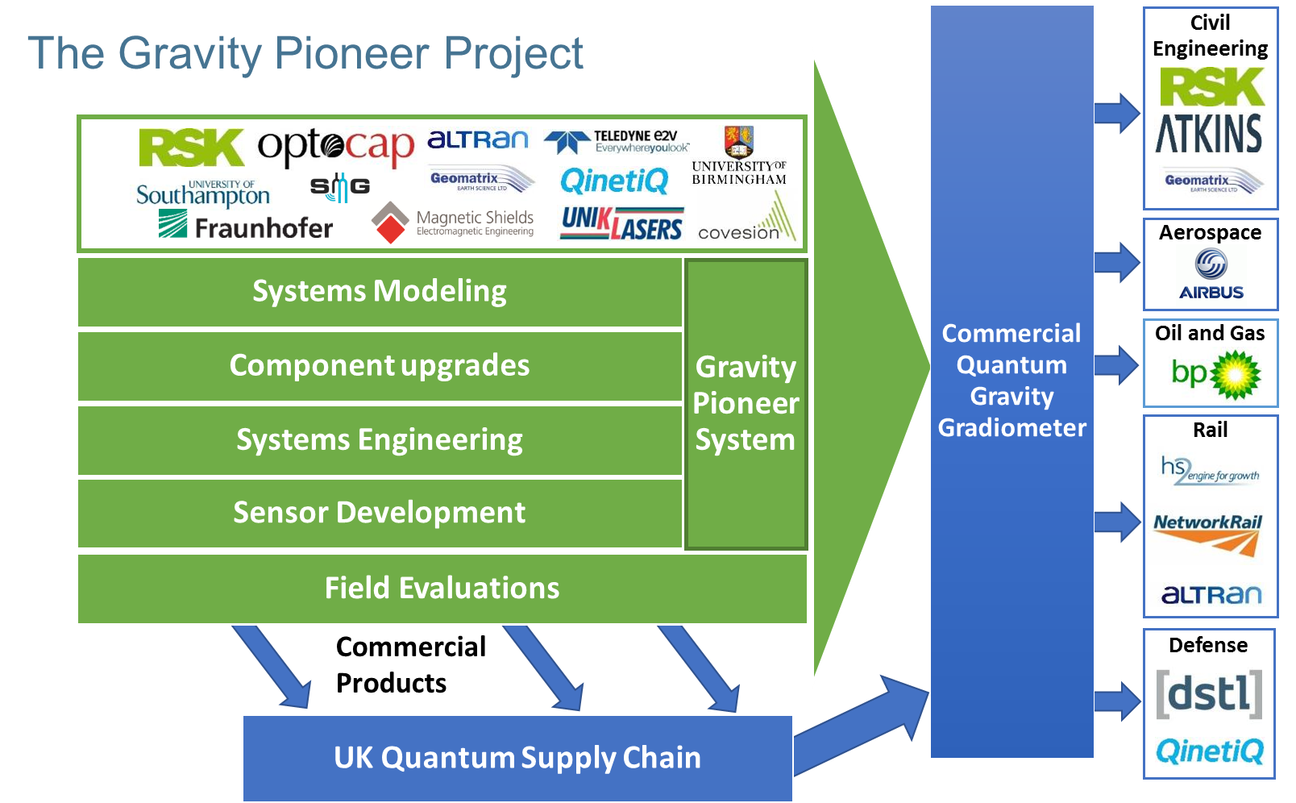

Acknowledgements

Slide 10
Thank You for your Attention!

