Slide 1
Thunderslide - from rainfall to preliminary landslide mapping: an automated open data workflow for regional authorities
Stefano Crema¹*, Alessandro Sarretta¹, Donato Maio ², Francesco Marra³, Giorgia Macchi¹, Velio Coviello¹, Marco Borga⁴, Lorenzo Marchi¹ and Marco Cavalli¹
¹Hydrogeomorphology Research Group, CNR-IRPI, Padova, Italy
²CNR-IMAA, Italy
³CNR-ISAC, Italy
⁴University of Padova, Italy
*e-mail: stefano.crema@irpi.cnr.it

Slide 2
QUESTIONS
Rainfall (or other severe conditions) -induced Landslides (“land cover changes”)
    Can we improve bias in census?
    Can we systematize it on a budget?
    Can we provide a tool for management authorities?

Slide 3
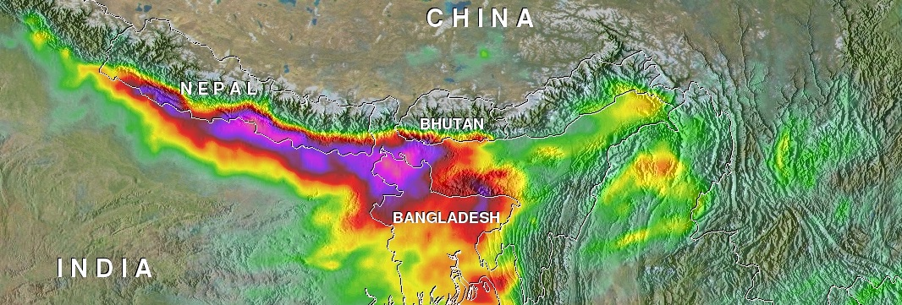

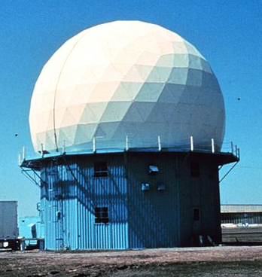



IDEA-WORKFLOW/1
AVAILABLE INPUTS
(Open) weather data
SEVERE WEATHER
IMAGE ANALYSIS
MASK
Area shrinking to speed up the analyses

Slide 4
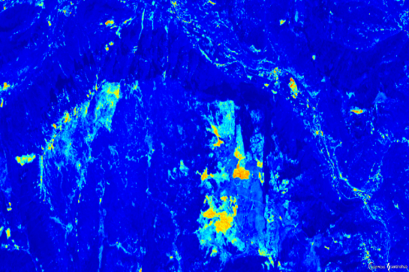
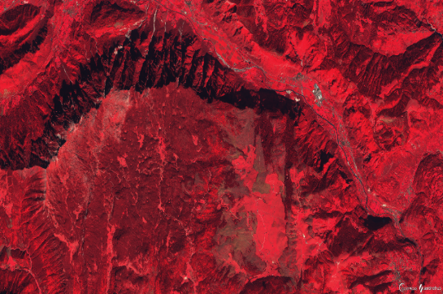
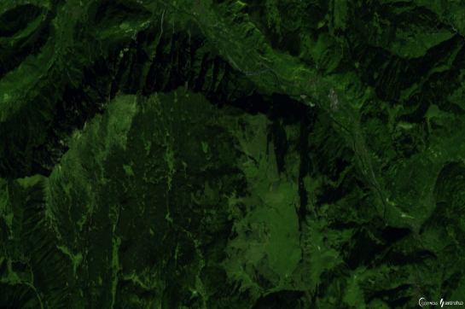
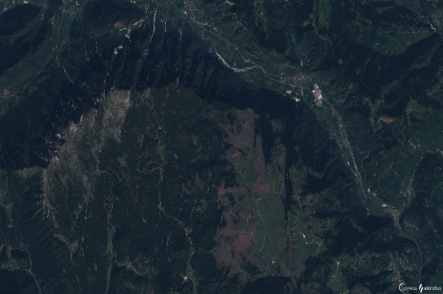

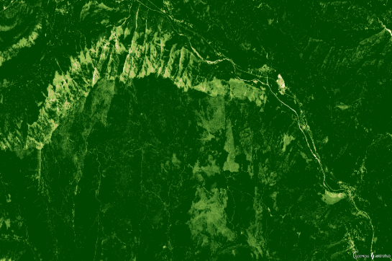
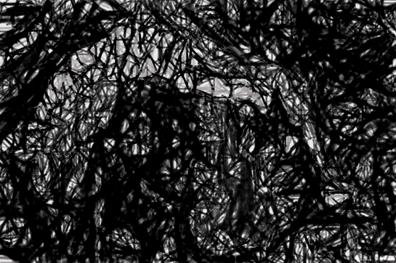
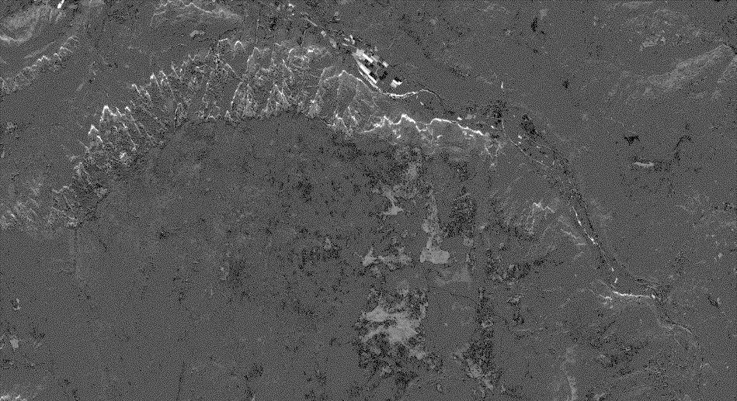

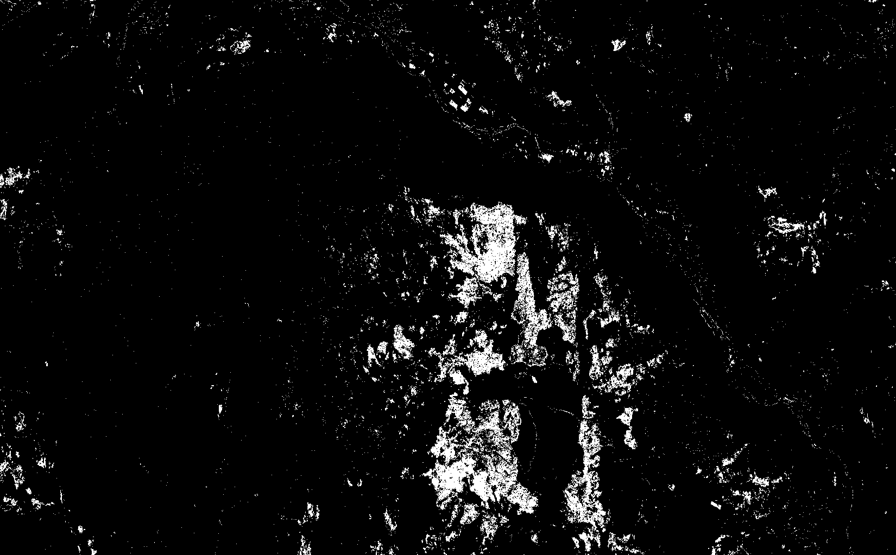
IDEA-WORKFLOW/2
«Quick and dirty» approach, with or without ad hoc software, for landscape management authorities
Erosional features
PRE-POST SENTINEL-2(1)
MULTISPECTRAL IMAGES
CHANGE DETECTION
Windthrows
RAW CLASSIFICATION

Slide 5
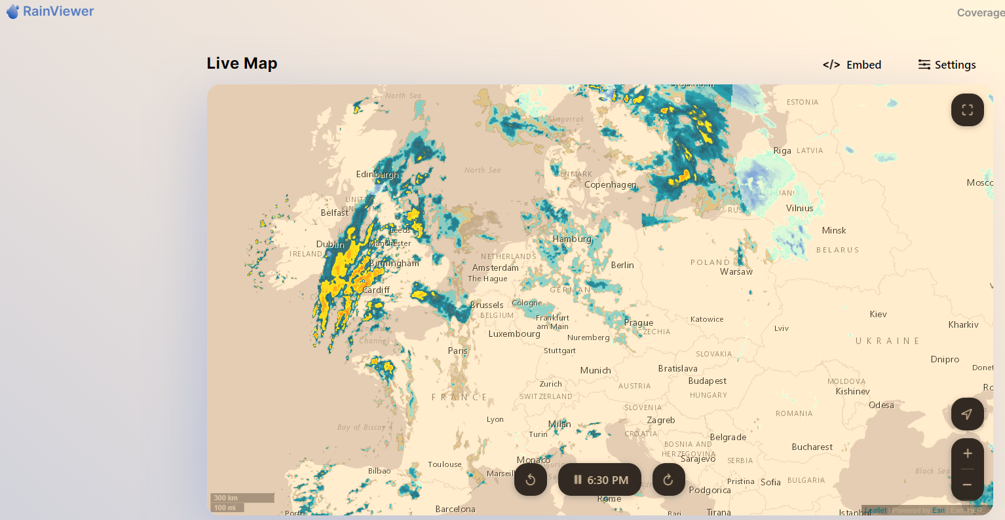
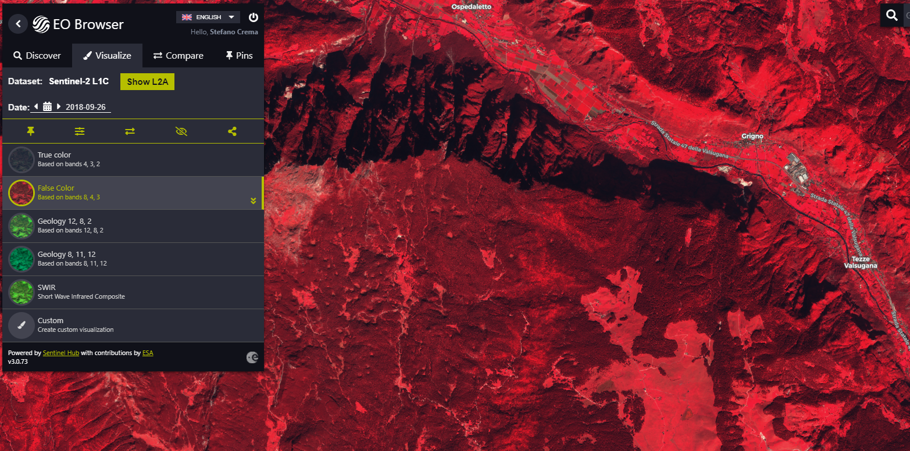

SAMPLE APPLICATION
«How do we do it?» this is one of the possible configurations
RAINVIEWER API
or other severe weather products e.g., meteosat
SENTINEL EO BROWSER
+ scripting/API
MATLAB IMAGE PROCESSING
+ change detection

Slide 6
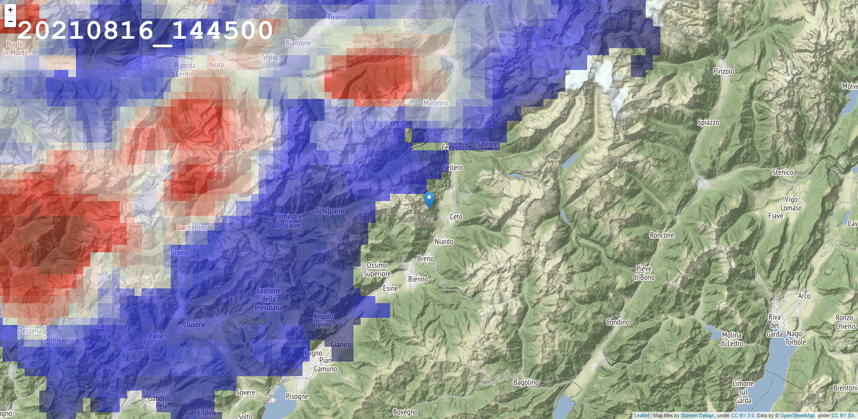
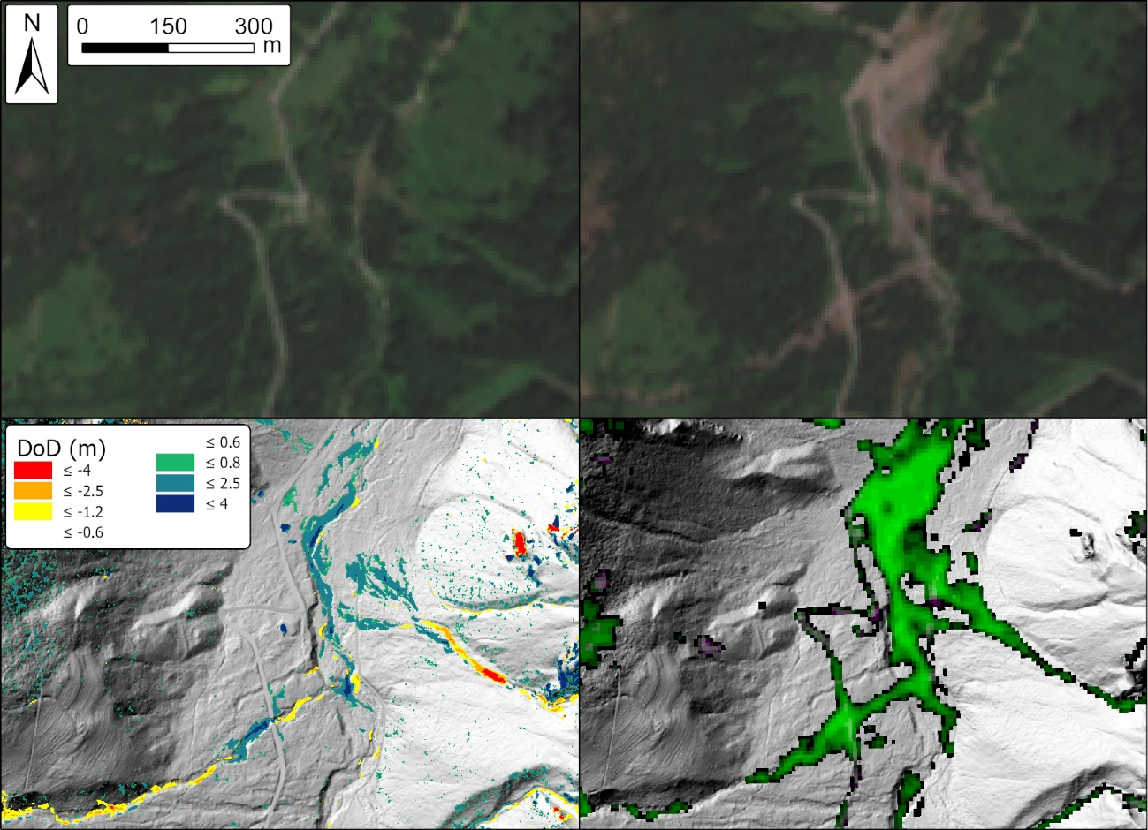
SAMPLE APPLICATION
Severe weather and event mask
Change detection and DoD comparison

Slide 7




KEY POINTS
SIMPLE EFFECTIVE APPROACH - Raw change detection products are obtainable without in depth knowledge in RS
FLEXIBILITY (Weather products, RS products)
SCALABILITY/PORTABILITY (Free global products or other)
IMPROVE-ABILITY (Refinement layers can be added as optional modules, e.g., image transformation, component analysis, machine learning, but this will target only RS experts)

Slide 8
Thanks for your patience!

