Slide 1




High-resolution reflection seismic imaging of fault systems in Metropolitan Seoul, South Korea
Samuel Zappalá¹, Alireza Malehmir¹, Tae-Kyung Hong², Junhyung Lee², Bojan Brodic¹, Dongchan Chung², Christopher Juhlin¹, Byeongwoo Kim², Myrto Papadopoulou¹, Seongjun Park², Jeongin Lee², and Dongwoo Kil²
1 Dept. of Earth Sciences, Uppsala University, Uppsala, Sweden
2 Dept. of Earth System Sciences, Yonsei University, Seoul, South Korea
1

Slide 2



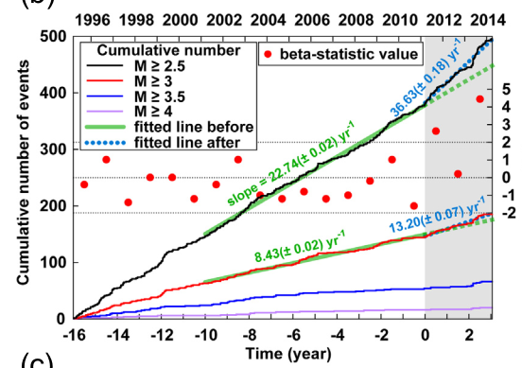
KOREAN SEISMICITY
After Tohoku-Oki earthquake (Mw 9.0, 2011), in Japan, Korean peninsula faced an increment of its seismicity, resulting in the higher plus Mw 5.0 number of earthquake historically recorded.
Until recent, seismicity in Korean peninsula was considered induced by geothermal fluids. However, in the last years a connection with tectonic and regional fault systems has been considered.
(Hong et al., Long-term evolution of intraplate seismicity in stress shadows after a megathrust, Physics of the Earth and Planetary Interiors, 2015)
2

Slide 3
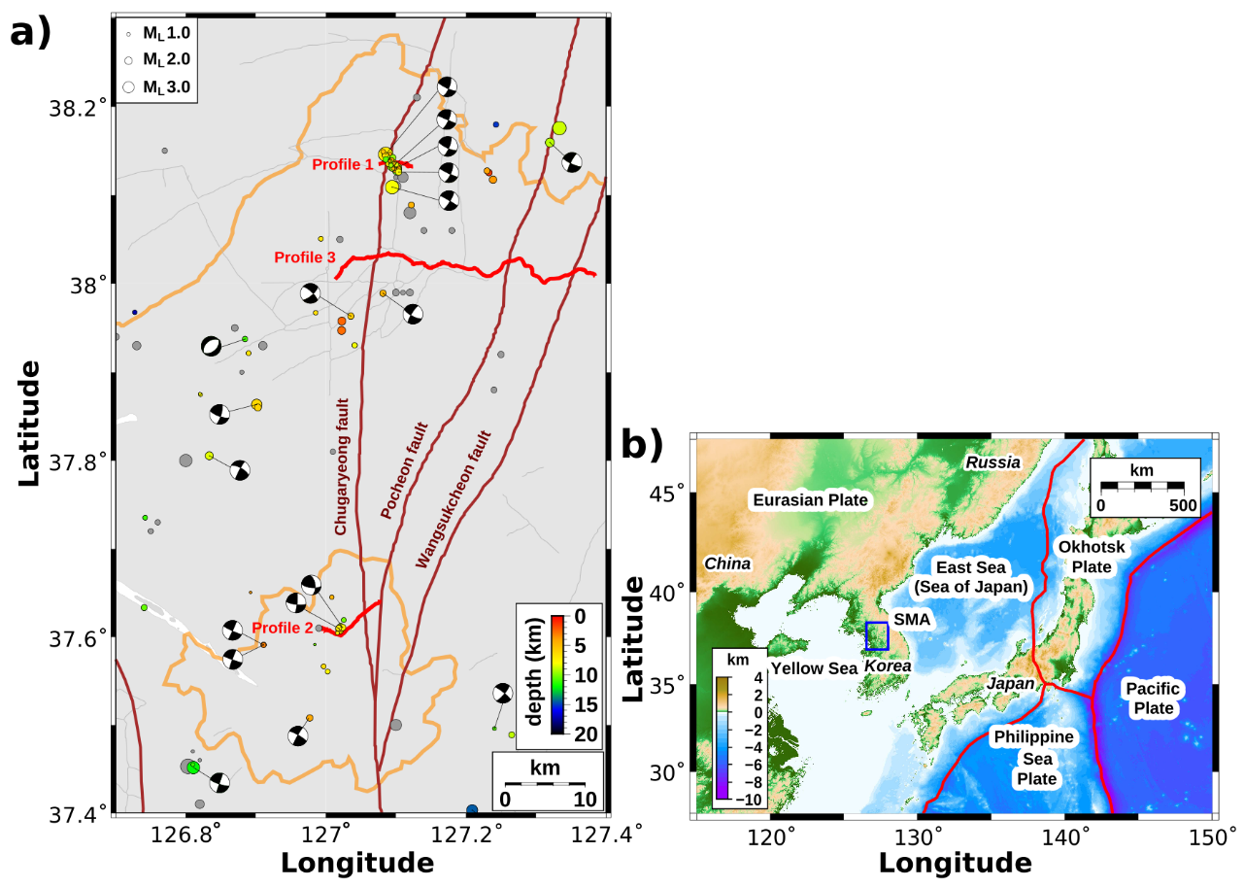
INTRODUCTION
During 2020 and 2021, we attempted to develop acquisition and processing solutions to delineate fault systems in the subsurface of a major city, and to correlate them with the recorded seismicity.
For this purpose, three high-resolution reflection seismic profiles (55 km in total) were acquired in Seoul metropolitan area (South Korea).
(Zappalá et al., Crustal-scale fault systems in the Korean Peninsula unraveled by reflection seismic data – in preparation)
3

Slide 4
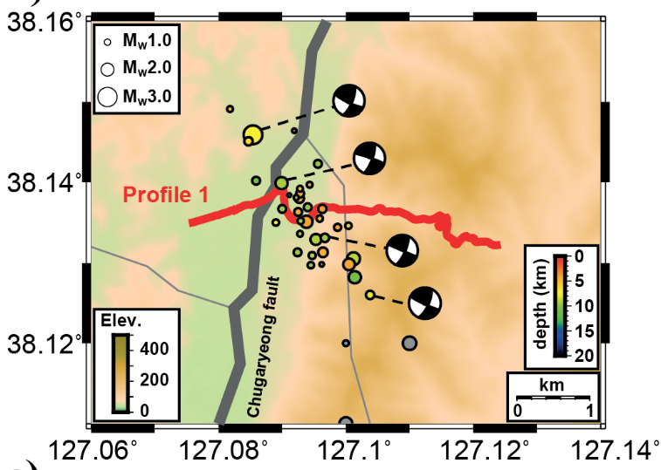


ACQUISITION
In this presentation I will focus on Profile 1 and Profile 2, located above 2 important seismic clusters.
Profile 3 was mainly focused on detect the overall fault systems structure.
(Malehmir et al., Fault intersections control short period intraplate start-stop seismicity in the Korean Peninsula, Tectonophysics, 2022)
4

Slide 5
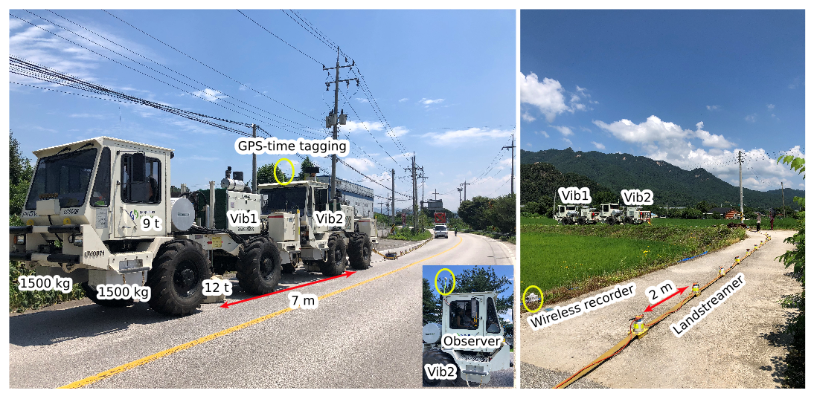
SURVEY SETTING
Subsurface studies in major cities has always been a big challenge.
Receivers: dual-element consisting of 10 Hz vertical geophones connected to wireless units (20 m spacing) and MEMs-based landstreamer (2 m spacing).
Sources: 2 synchronized seismic vibrators.
(Zappalá et al., Crustal-scale fault systems in the Korean Peninsula unraveled by reflection seismic data – in preparation)
5

Slide 6
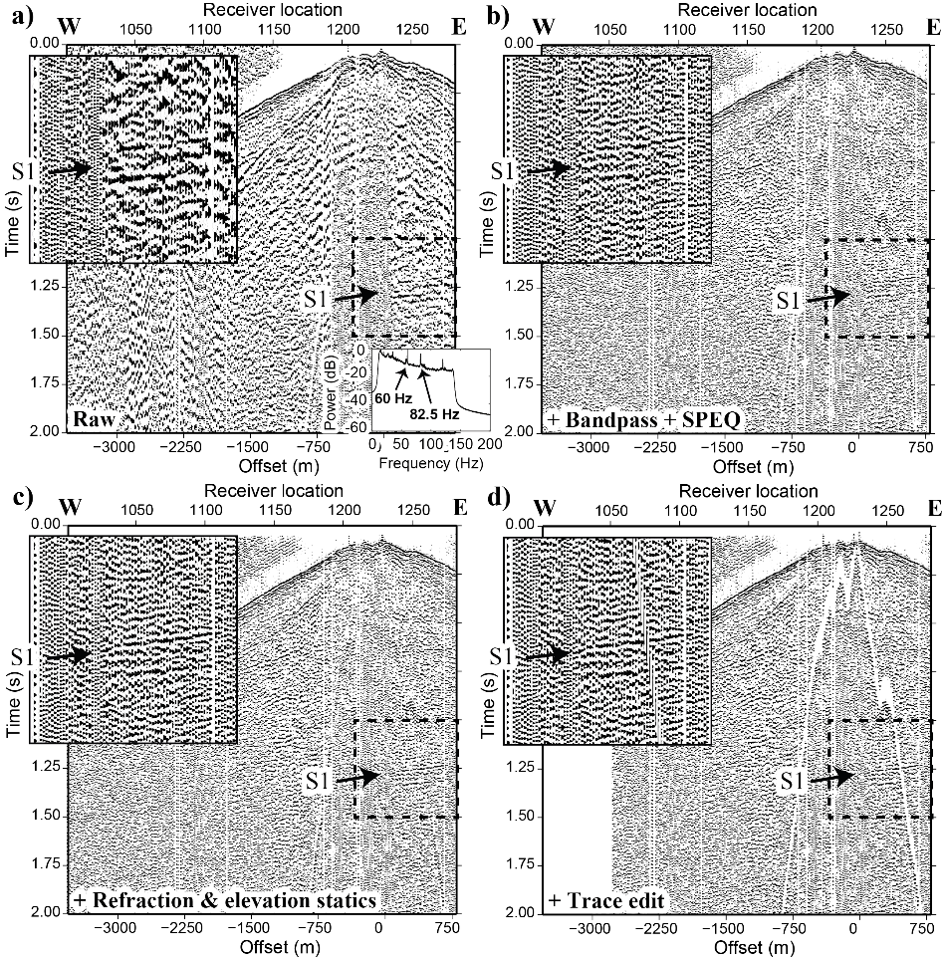
PROCESSING
  Landstreamer data was aimed to image shallow reflectors, mainly the bedrock, requiring a conventional processing.
  Data from geophones was aimed to image deep reflectors and needed a more accurate processing.
(Malehmir et al., Fault intersections control short period intraplate start-stop seismicity in the Korean
Peninsula, Tectonophysics, 2022)
6

Slide 7
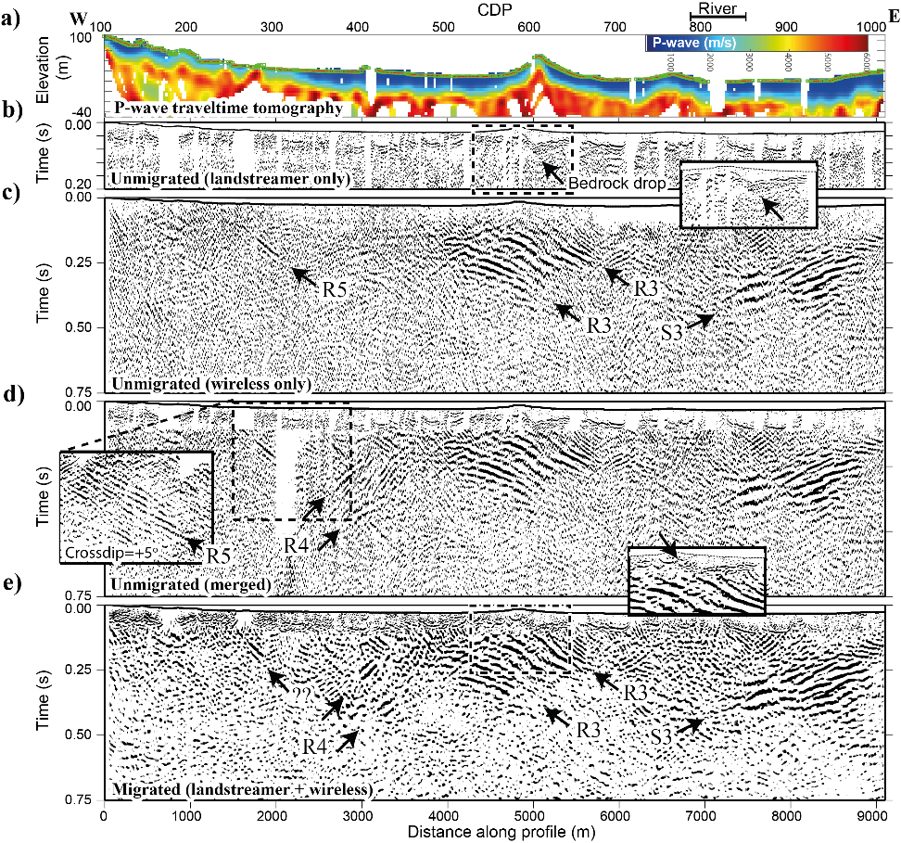
ANALYSIS
Profile 2
To overcome the low S/N and the complexity of the subsurface all the acquired information were implemented together.
Other analysis as travel time tomography and cross-dip analysis, were performed to complement the results.
(Malehmir et al., Fault intersections control short period intraplate start-stop seismicity in the Korean Peninsula, Tectonophysics, 2022)
7

Slide 8
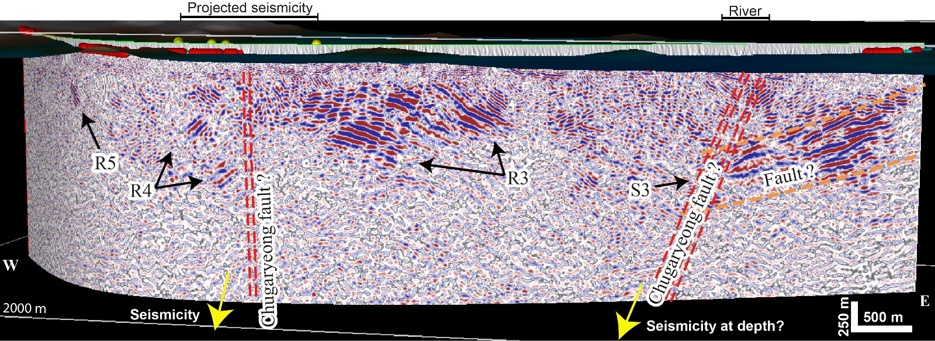
INTERPRETATION
Profile 2: reflections to 1.5 km of depth. Too shallow for seismic correlation but allows some structure consideration on the interested fault systems.
(Malehmir et al., Fault intersections control short period intraplate start-stop seismicity in the Korean Peninsula, Tectonophysics, 2022)
8

Slide 9
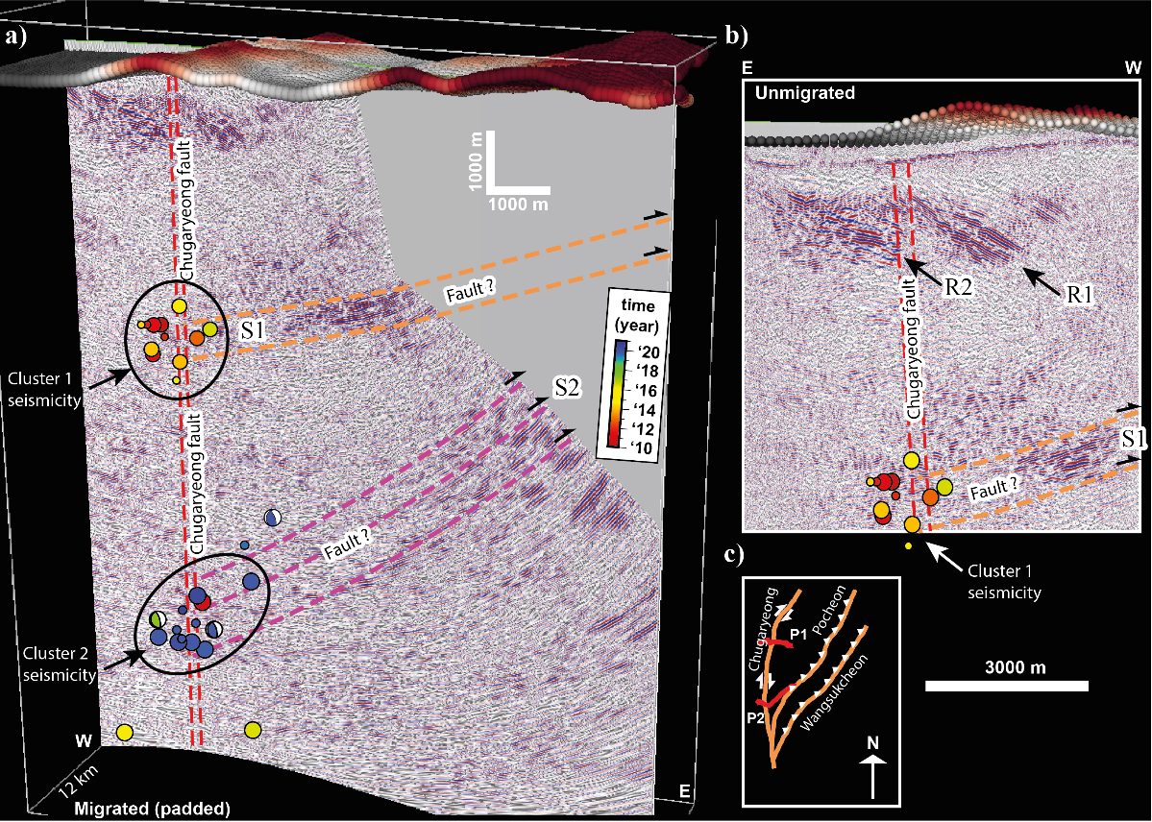
INTERPRETATION
Profile 1: reflections to 9 km of depth. Correspondence between seismic activity and reflection intersections suggests an important correlation between them.
(Malehmir et al., Fault intersections control short period intraplate start-stop seismicity in the Korean Peninsula, Tectonophysics, 2022)
9

Slide 10
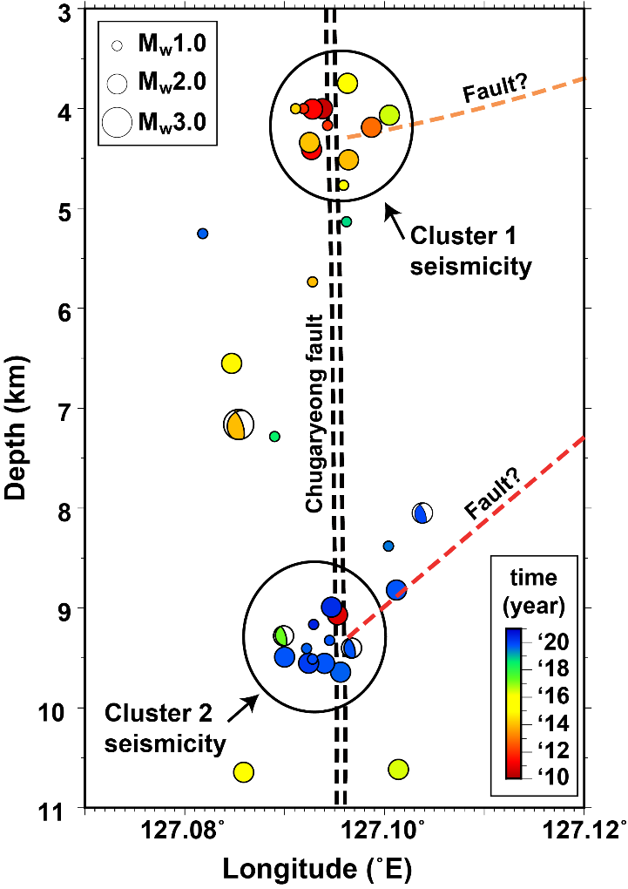
CONCLUSION
(1) A setting able to acquire data with reasonable results in major cities environment has been implemented.
(2) The first in depth information ever recorded for these important fault systems were acquired.
And (3) an important correlation, in depth and in time, between seismicity and reflectors intersections was detected, moving towards a better understanding of the regional seismicity.
(Malehmir et al., Fault intersections control short period intraplate start-stop seismicity in the Korean Peninsula, Tectonophysics, 2022)
10

Slide 11
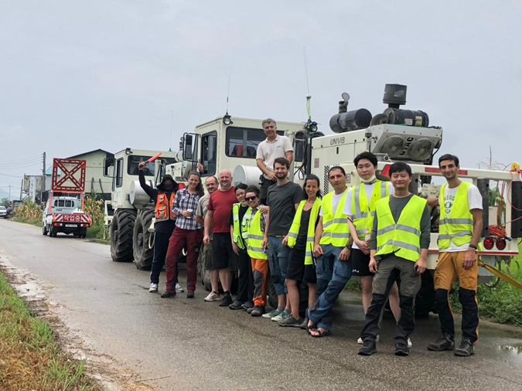

THANK YOU
Contact me for more questions and information:
Email: samuel.zappala@geo.uu.se
LinkedIn: Samuel Zappalá

