Slide 1
Citing large numbers of diverse datasets
EGU 2022 – 27th May 2022 – ESSI3.1 – Best Practices and Realities of Research Data Repositories: Balancing the needs of Repositories, Researchers and Publishers
James Ayliffe (National Oceanography Center), Martina Stockhause (DKRZ German Climate Computing Centre), Shelley Stall (American Geophysical Union), Deb Agarwal (Lawrence Berkeley National Laboratory), Justin James Henry Buck (National Oceanography Center), Chris Erdmann (AGU)
(Plus many more contributors to the workshops)

Slide 2
The Challenge
Enable citation of a large numbers of papers, software, and datasets (research objects) in a paper by providing a means to collapse them into a small number of references.
Allow a project or data system collecting large numbers of research objects to enable citation of the group and constituents within it
Empower an individual to create a group of research objects that might span repositories
Provide an ability to cite any subset of research objects belonging to one or multiple groups
Working name “Reliquary”
  A reliquary is defined as an object collection where precious objects (relics) are held for posterity.

Slide 3
The Use Cases: Large Collaborative Earth Science Projects
Repo 1 (CC-BY-4.0)
Repo 2 (Custom License)
Repo 3 (CC0)
DOI
…
DOI
DOI
…
DOI
Ack
Filter by ecosystem +years
Filter by location and variable
Filter by location
DOI
DOI
+ filter info
Ack
DOI
DOI
+ citation + filter info
DOI
DOI
DOI
+ filter info
DOI
DOI
DOI
DOI
DOI
DOI
DOI
DOI
Reliquary
Stall, Shelley, Buck, Justin, Ayliffe, James, Stockhause, Martina, Agarwal, Deb, Coward, Caroline, & Erdmann, Chris. (2021, October 29). Data Citation Community of Practice - 29 October 2021 Workshop. Zenodo. https://doi.org/10.5281/zenodo.5641236

Slide 4
Use Case IPCC: Model Intercomparison Study (Data User View)
CMIP Input Data Collections
Further Input Datasets
DOI
DOI
Handle ID
Handle ID
…
Handle ID
…
Handle ID
Handle ID
Handle ID
DOI
PID
Handle ID
Handle ID
…
Handle ID
Handle ID
DOI
PID
Code
Final Data
Reliquary
DOI
DOI
Digital Information for a Figure (or Table)
Stall, Shelley, Buck, Justin, Ayliffe, James, Stockhause, Martina, Agarwal, Deb, Coward, Caroline, & Erdmann, Chris. (2021, October 29). Data Citation Community of Practice - 29 October 2021 Workshop. Zenodo. https://doi.org/10.5281/zenodo.5641236

Slide 5
Use Case IPCC: Digital Information for Chapters and Reports
WGI AR6 DOI
DOI
DOI
DOI
DOI
WGI AR6 Chapter
Reliquary
DOI
Code
Final Data
Handle ID
Handle ID
…
Handle ID
Handle ID
DOI
PID
DOI
DOI
Digital Information for a Figure (or Table)
DOI
Code
Final Data
Handle ID
Handle ID
…
Handle ID
Handle ID
DOI
PID
DOI
DOI
Digital Information for a Figure (or Table)
Stall, Shelley, Buck, Justin, Ayliffe, James, Stockhause, Martina, Agarwal, Deb, Coward, Caroline, & Erdmann, Chris. (2021, October 29). Data Citation Community of Practice - 29 October 2021 Workshop. Zenodo. https://doi.org/10.5281/zenodo.5641236

Slide 6
The Use Cases: BODC
Data Accessions
DOI
DOI
DOI
DOI
Data Collections
PID
PID
PID
PID
PID
PID
PID
PID
PID
Data brokerage service
PID
PID
PID
PID
PID
PID
PID
PID
PID
Data delivery/request
Methodology
Code
PID
PID
PID
PID
PID
PID
PID
PID
Reliquary
Aggregated Data Product/Paper
Stall, Shelley, Buck, Justin, Ayliffe, James, Stockhause, Martina, Agarwal, Deb, Coward, Caroline, & Erdmann, Chris. (2021, October 29). Data Citation Community of Practice - 29 October 2021 Workshop. Zenodo. https://doi.org/10.5281/zenodo.5641236

Slide 7
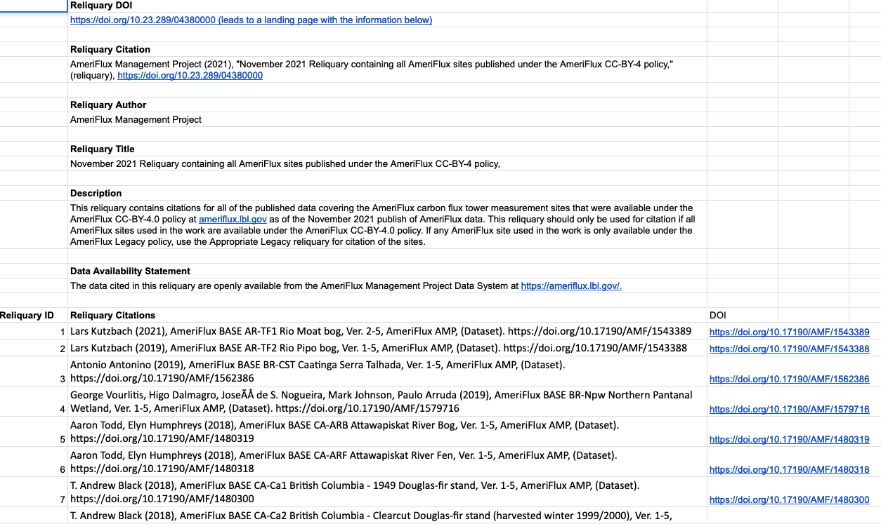
Defining a reliquary for each use case
Reliquary examples for each use case
Citation CoP Deb Agarwal 03/05/2022

Slide 8

Next steps
Early draft of recommendations
  Examples of how a reliquary might look
  Who can create them?
  Machine vs human readable
Work with Indexers
RDA Earth, Space, and Environmental Science Complex Citations Working Group

Slide 9
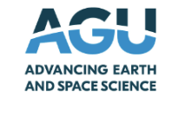



Thank You

Slide 10
Abstract here for notes
In Earth and Biological sciences, data are often preserved and publicly available in data repositories where the data are citable by DOIs and published under a Creative Commons CC-BY license. Researchers combine many datasets across disciplines, repositories, and regions to better understand processes, patterns, and drivers. Citing these many datasets is difficult as the large number does not fit into the references section of a paper but the licenses of the datasets require that credit is given to their creators.
The Data Citation Community of Practice (CoP) was formed to target such challenges in data citation and other scholarly work that will support indexing and measuring the impact. The CoP identified a container as a solution for large numbers of data citations that holds the citations and its internal format, which is referred to as a 'reliquary'. The existing dataset collection methods have been gathered and evaluated using concrete citation use cases. Requirements for the reliquary content have been identified and applied to the use cases. In this presentation, we will report on the current progress on an approach to building a reliquary.
Reliquaries are an important part of enabling cross-disciplinary analysis of large amounts of data stored in many repositories. The challenge with a reliquary will be to design a method that works across diverse repositories and domain citation practices and to enhance the indexing system to direct credit to the reliquary content and authors. The CoP is in the process of setting up a Research Data Alliance (RDA) Working Group on Complex Citations in the Earth, Space, and Environmental Sciences to broaden the discussion and to find further use cases for evaluation and interested early adopters.
How to cite: Ayliffe, J., Stockhause, M., Stall, S., Agarwal, D., Buck, J., Coward, C., and Erdmann, C.: Citing large numbers of diverse datasets, EGU General Assembly 2022, Vienna, Austria, 23–27 May 2022, EGU22-9964, https://doi.org/10.5194/egusphere-egu22-9964, 2022.

