Slide 1
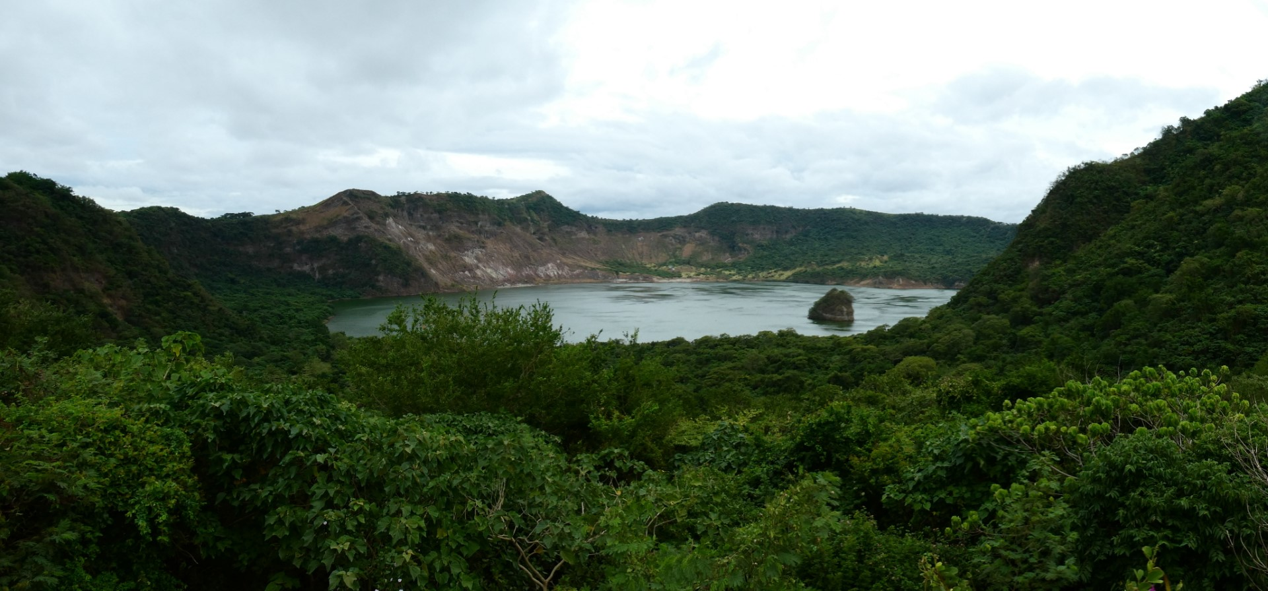

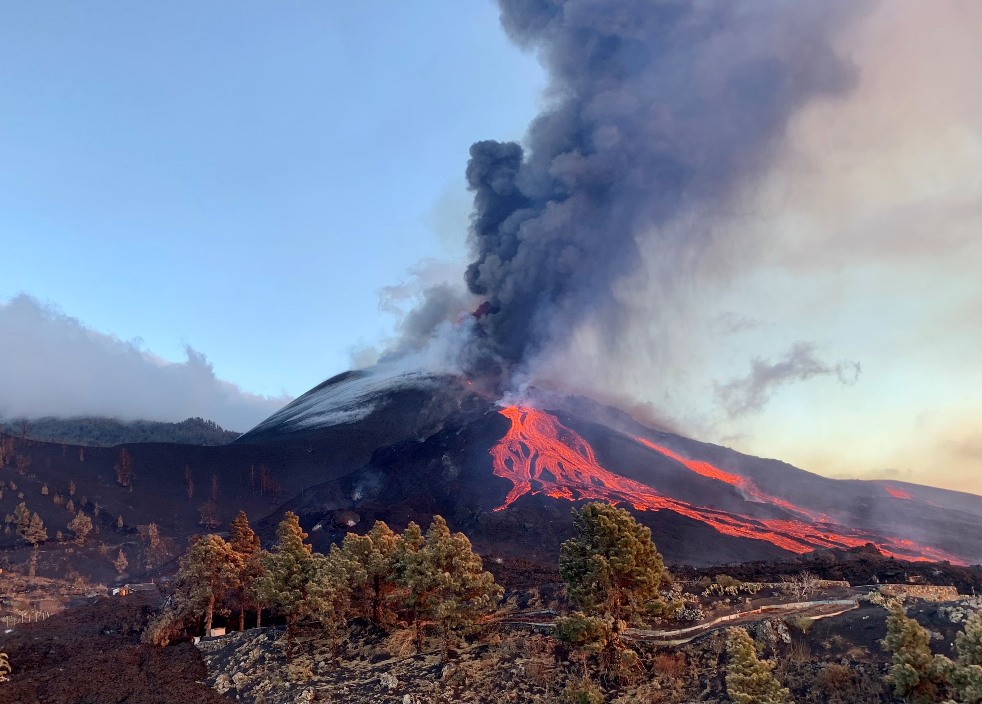






Preliminary results from textural studies on tephra deposits erupted during the 2021 eruption at Cumbre Vieja volcano
Alba Martín-Lorenzo ^{1,2}, Daniele Andronico³, Fátima Rodriguez¹, Beverley Coldwell^{1, 2}, Matt Pankhurst ^{1,2}, Jacopo Taddeucci⁴, Piergiorgio Scarlato⁴, Costanza Bonadonna⁵, Marco Pistolesi⁶, Jorge E. Romero ⁷, Gladys Melián^{1, 2}, Nemesio M. Pérez ^{1, 2}
¹Instituto Volcanológico de Canarias (INVOLCAN), 38240 San Cristóbal de La Laguna, Tenerife, Spain
²Instituto Tecnológico y de Energías Renovables (ITER), 38600 Granadilla de Abona, Tenerife, Spain
³Istituto Nazionale di Geofisica e Vulcanologia, Osservatorio Etneo, P.zza Roma 2, 95125, Catania, Italy
⁴Istituto Nazionale di Geofisica e Vulcanologia, Sezione Roma1, Via di Vigna Murata 605, 00143 Roma, Italy
⁵Department of Earth Sciences, University of Geneva, 1205 Geneva, Switzerland
⁶Department of Earth Sciences, University of Pisa, 56126 Pisa, Italy
⁷University of Manchester (Department of Earth and Environmental Sciences), Manchester, United Kingdom.

Slide 2
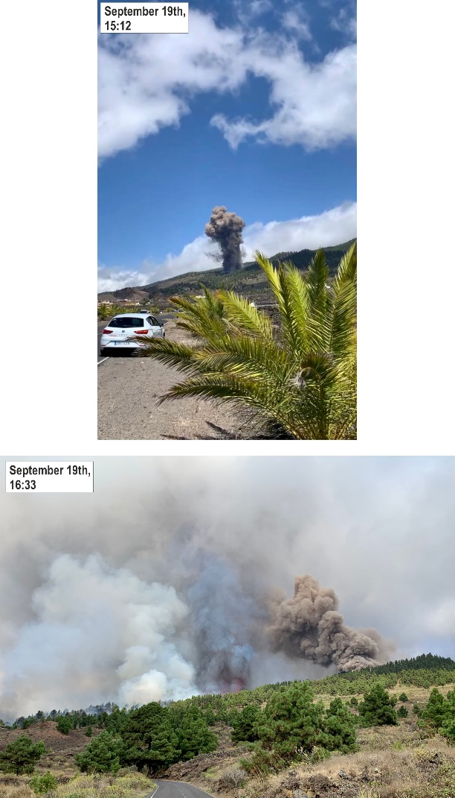
INTRODUCTION
INTRODUCTION
METHODOLOGY
CONCLUSIONS
RESULTS
The first ten days of eruption were represented by prevalent lava fountaining alternated to powerful Strombolian activity.
The eruption plume dispersed tephra products mostly to the SW.
A significant pause occurred on 27 September for a ten of hours, after which the explosive activity resumed with similar or higher intensity than before
Notes:
2) With rotation of the dispersal for few days towards other directions.

Slide 3
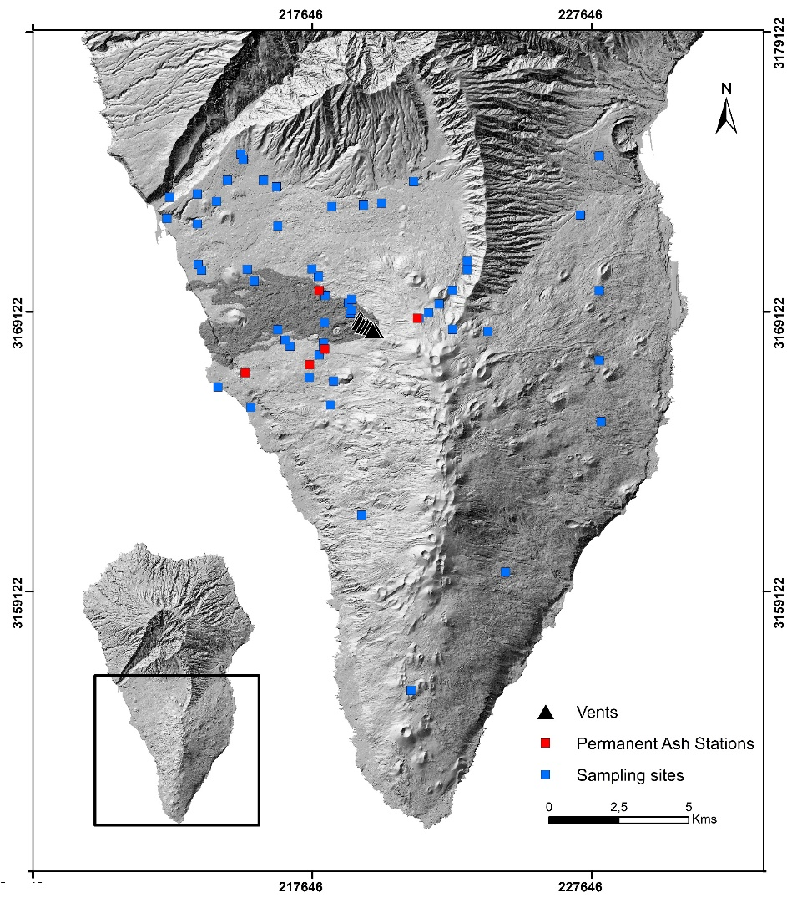
Tephra Sampling
INTRODUCTION
METHODOLOGY
CONCLUSIONS
RESULTS
Daily tephra sampling (periods)
Permanent Ash Stations: From September 25 to December 14.
Total = 438
Temporary Sampling Sites: From September 22 to October 1.
Total = 64

Slide 4
Grain-size and Componentry analysis
INTRODUCTION
METHODOLOGY
CONCLUSIONS
RESULTS
Permanent Ash Stations: From September 25 to December 14.
Temporary Sampling Sites: From September 22 to October 1.
Componentry analysis: Seventeen ash samples (22 September – 1 November)
Grain-size distribution by CAMSIZER (Retsch): Thirty Nine ash samples (22 September – 1 October)
Notes:
A total of 39 Samples were used to evaluate the mass load per square meter unit, together with grain-size analysis. The grain-size distribution of samples was measured at half-phi steps by CAMSIZER (Retsch).
Componentry analysis on ash samples was performed to assess both style and changes in the explosive activity. Seventeen ash samples
(22 September – 1 November) were sieved to separate the 0.25-0.5 mm fraction, which allows easier distinction of particle components.

Slide 5
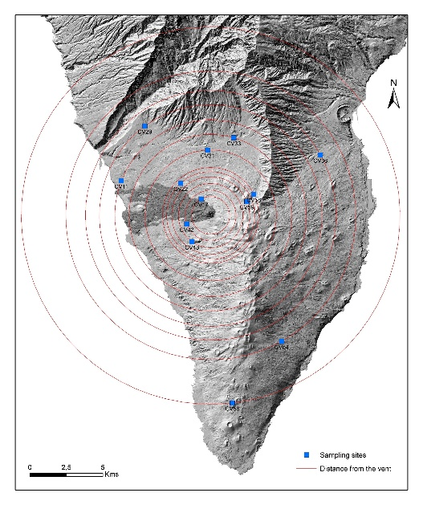
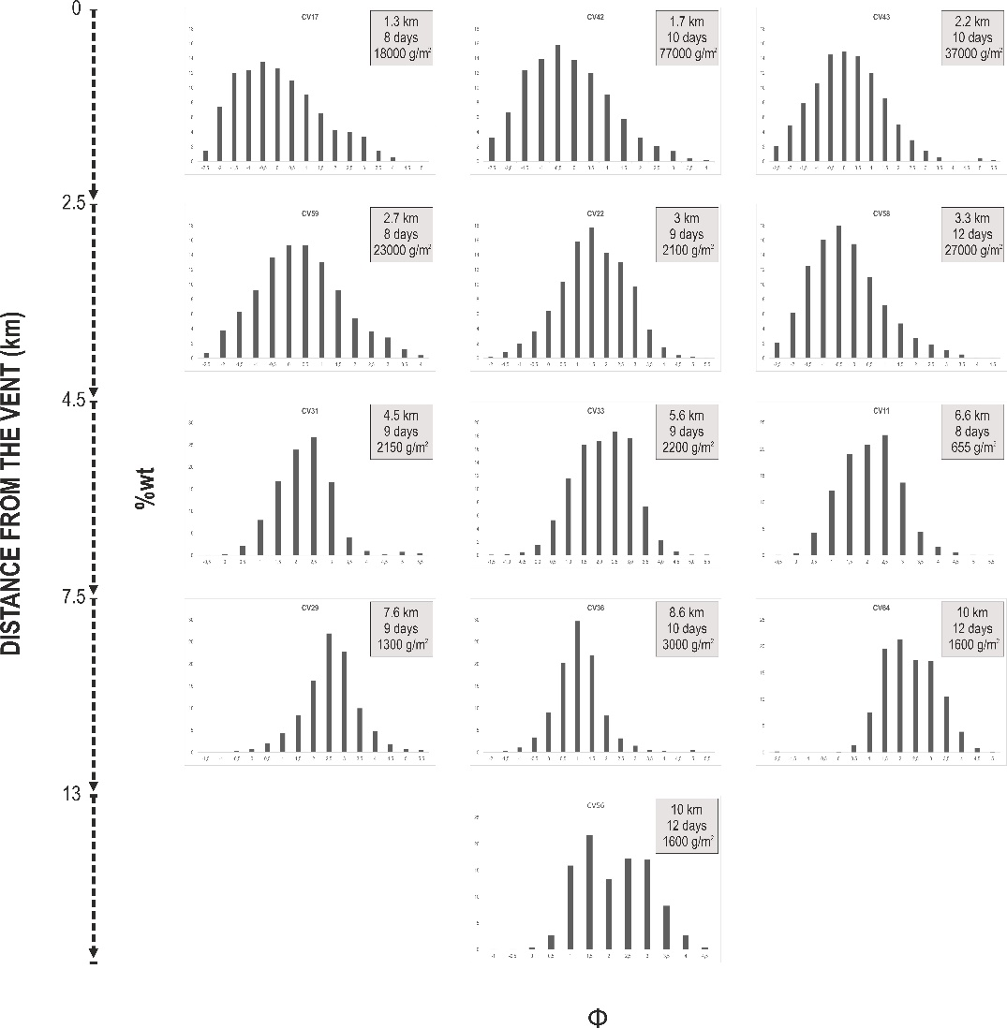
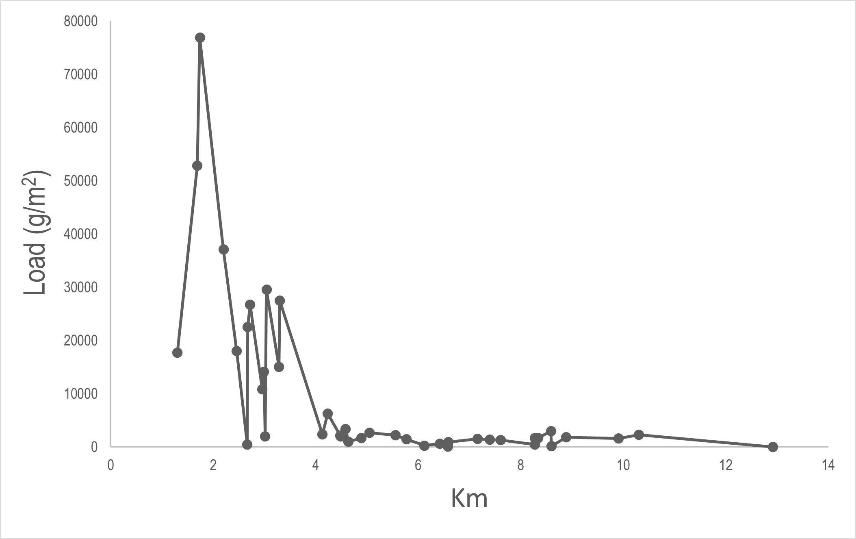
Grain-size analysis
INTRODUCTION
METHODOLOGY
RESULTS
CONCLUSIONS

Slide 6
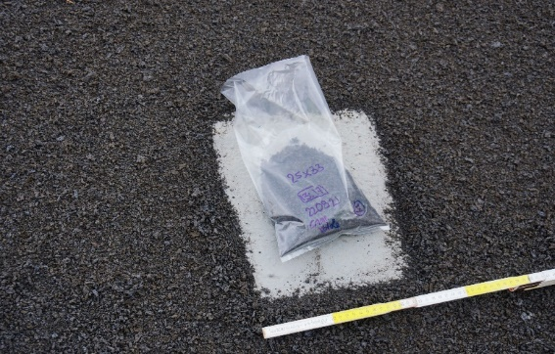
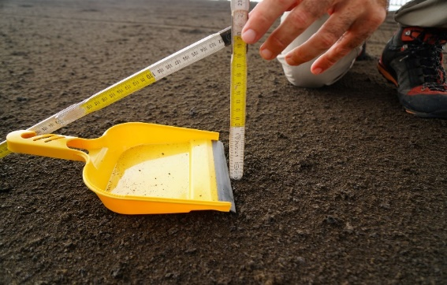
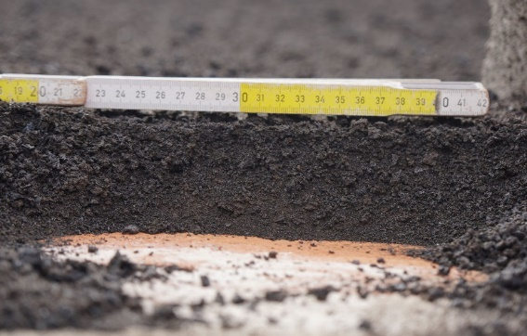
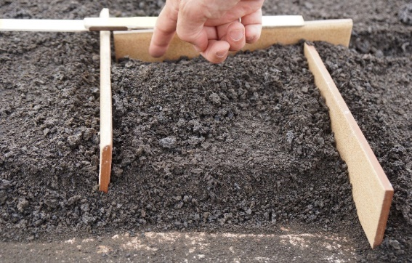
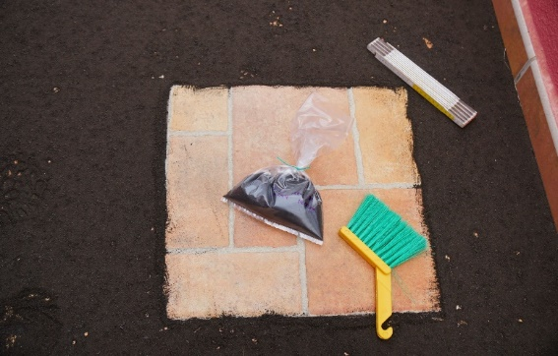
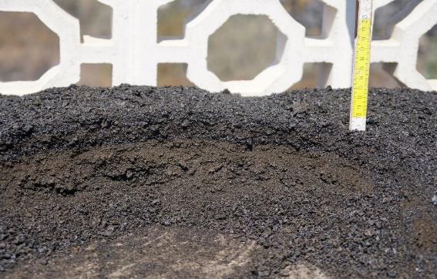
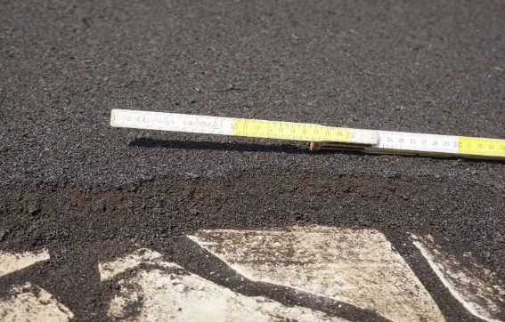
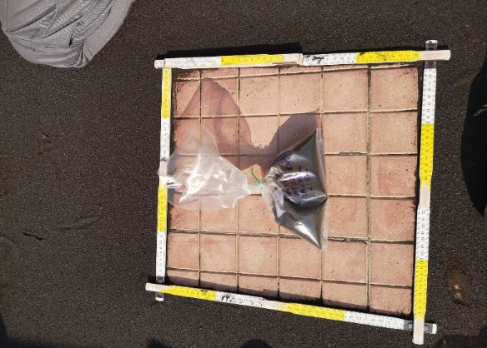
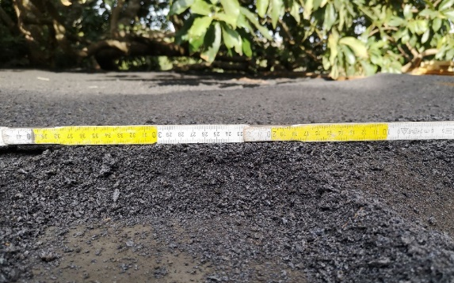
Tephra Sedimentation around the volcano
INTRODUCTION
METHODOLOGY
RESULTS
CONCLUSIONS
3rd day – 2.5 km W
3rd day – 2.5 km W
8th day – 2.6 km W
8th day – 2.8 km W
9th day – 4.5 km W
10th day – 2.5 km SW
11th day – 4.7 km SW
11th day – 7.5 km SE
12th day – 3.5 km E
Notes:
This slide provides a tangible idea of the tephra sedimentation rate during the first days of the eruption from sites at different distances from the cone much better than any quantitative diagram. You can see that after few days different stratigraphic units are visible both based on colour and grain-size of products.

Slide 7
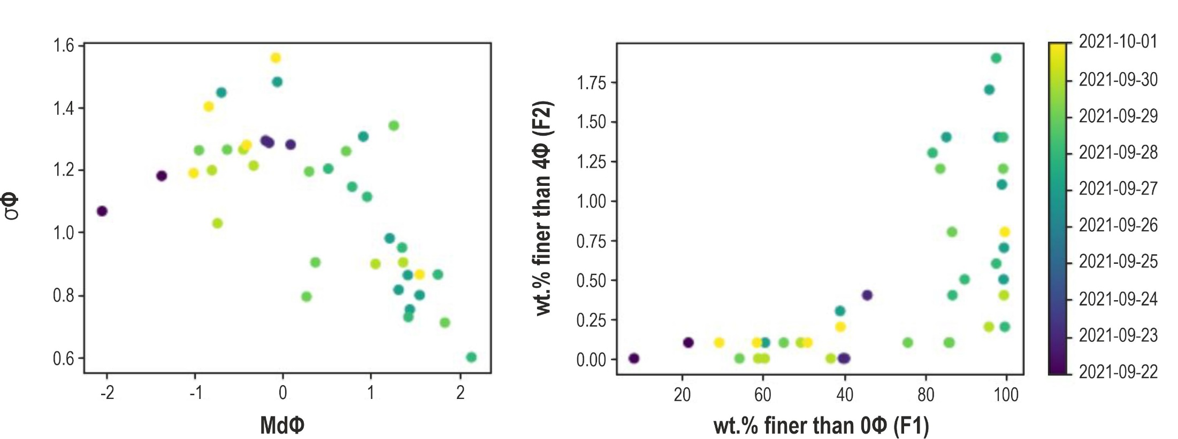
Grain-size analysis
INTRODUCTION
METHODOLOGY
RESULTS
CONCLUSIONS
Notes:
We can see how Median (Md$) varies from –2 to +2 (fine gravel to fine ash), whereas sorting (σ$) varies from 0,6 to 1,55 (Moderately Well l to poorly sorted ash). F2 accounts for between 0,1 and 1,9 wt.% and F1 represents 1rom 10 to 99,8 wt.%.
THIS PART LATER

Slide 8
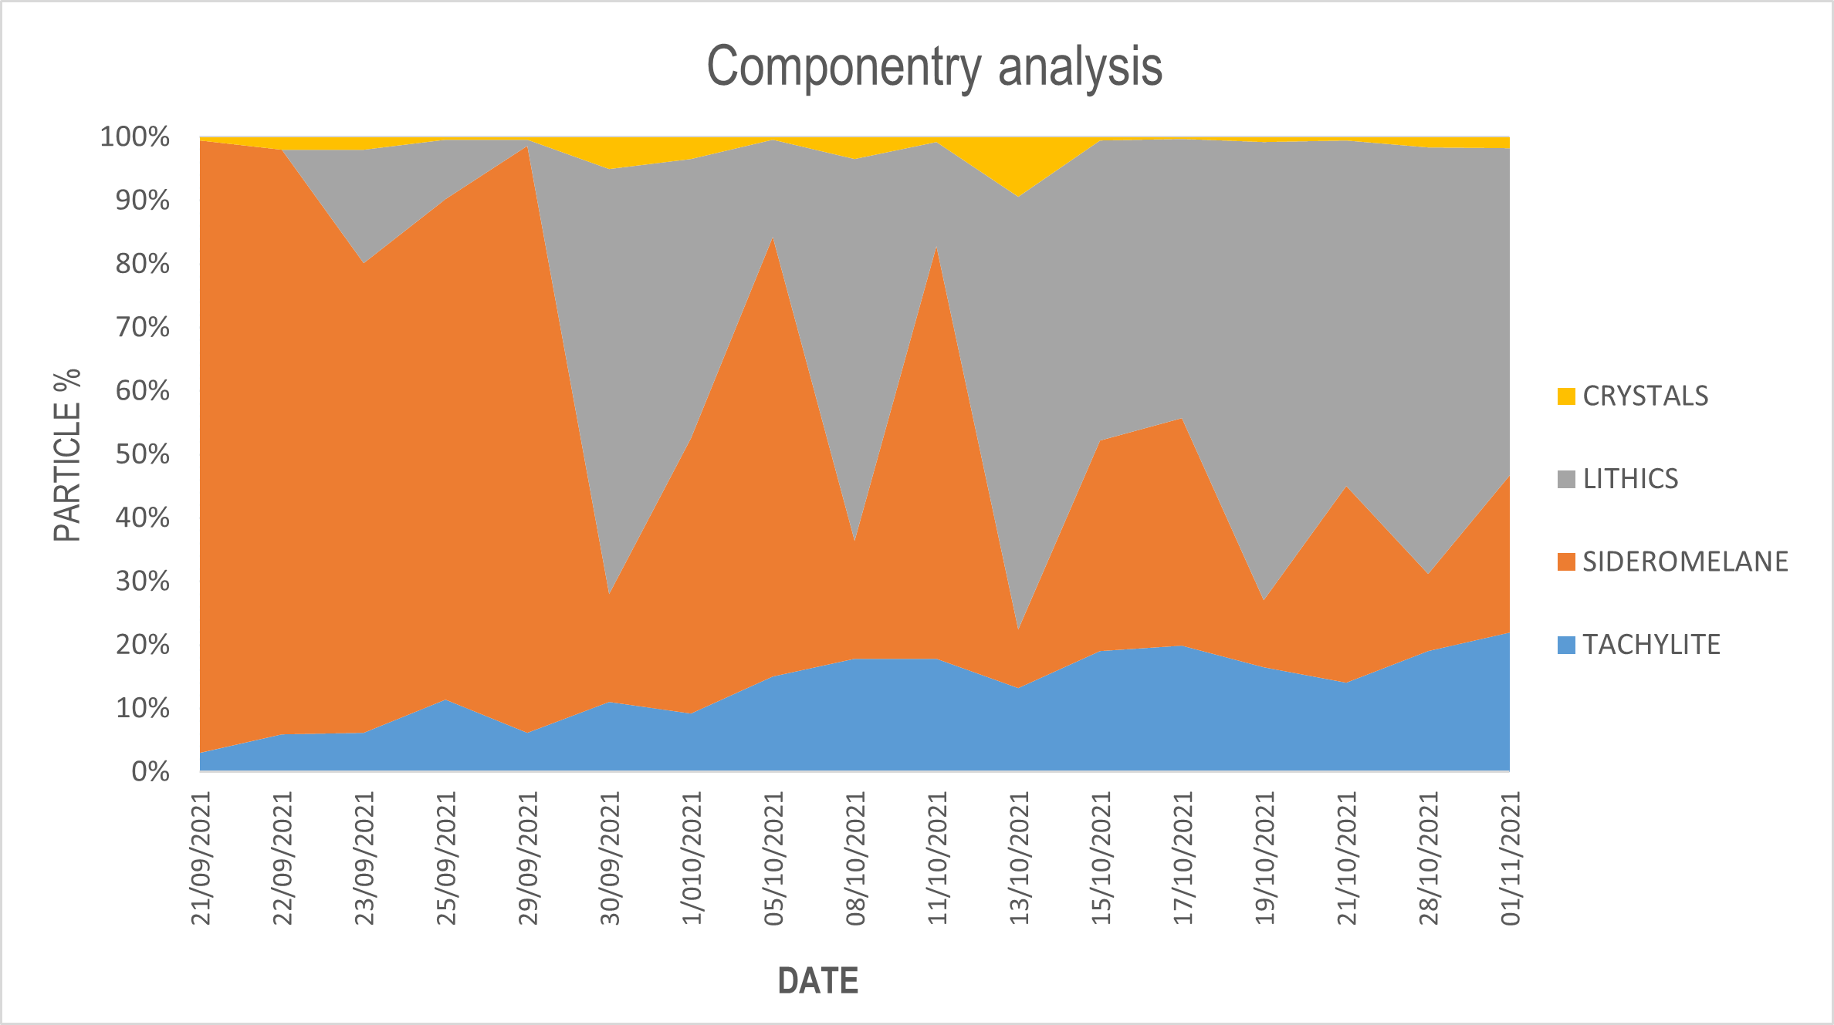
Componentry analysis
INTRODUCTION
METHODOLOGY
RESULTS
CONCLUSIONS

Slide 9
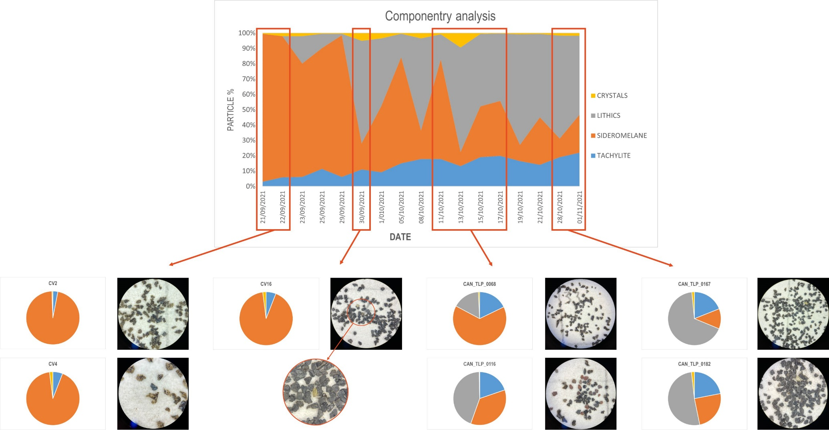
Componentry analysis
INTRODUCTION
METHODOLOGY
RESULTS
CONCLUSIONS

Slide 10
CONCLUSIONS
INTRODUCTION
METHODOLOGY
CONCLUSIONS
RESULTS
During the first 12 days of the eruption, the eruption style was quite homogenous ranging from powerful Strombolian to lava fountaining.
Tephra deposits are composed of lapilli up to 4.5 km, afterward they are dominated by ash particles.
The masses per square meter evidence loads not impacting the roofs from a collapsing point of view, ranging from 503 to 77000 g/m² per day from 1.3 km up to 4.5 km, while the tephra loads range from 99 to 3000 g/m² from 4,6 to 13 km.
The total mass estimation in terms of distal tephra fallout is in progress.
The componentry analysis carried out on all the available samples throughout the whole eruption can help to improve the interpretation of magma dynamics or eruption style changes (future work).
Such a data can be used for hazard assessment in case of new eruptions at Cumbre Vieja.

Slide 11



Acknowledgements
Project TFassistance – TENERIFE VOLCANO DISASTER ASSISTANCE TEAM financed by the Program Tenerife INNOVA 2016-2021 coordinated by the Tenerife 2030 Area of the Cabildo Insular de Tenerife.

Slide 12
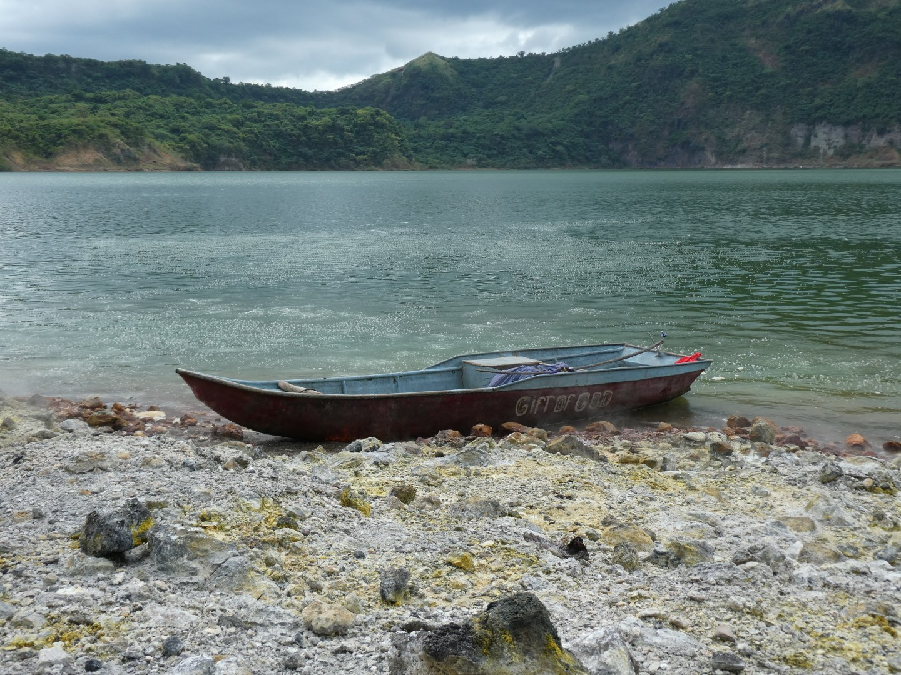
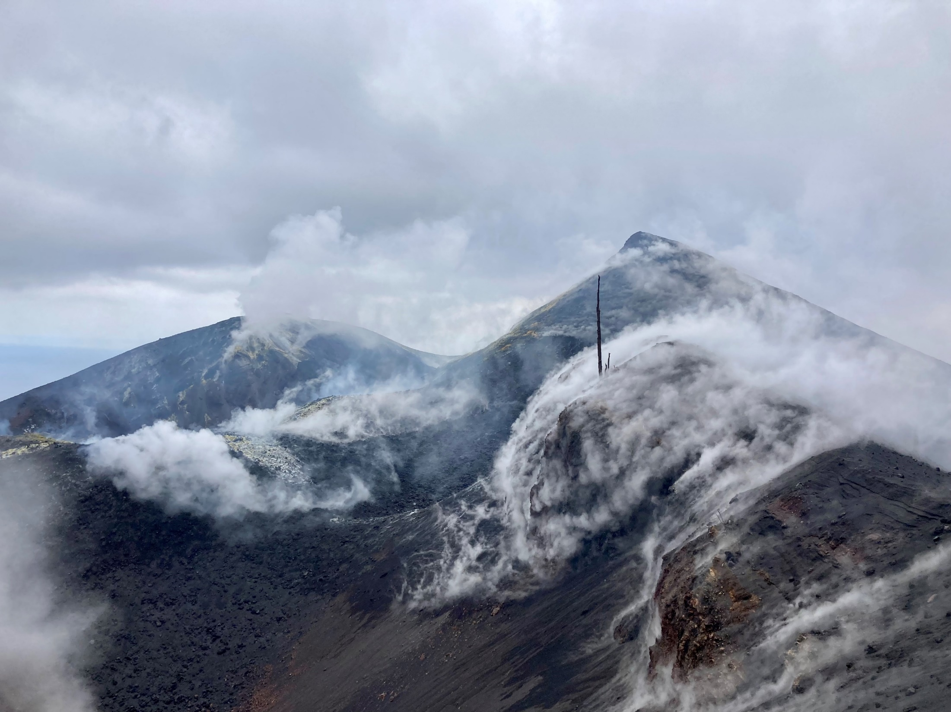
THANK YOU
FOR YOUR ATTENTION

