Slide 1
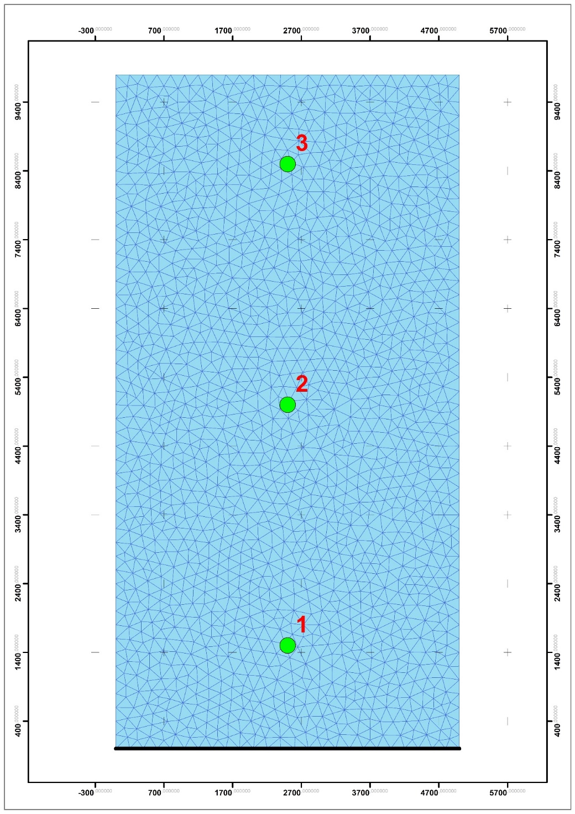
Homogeneous Model and Location of observation wells
No Flow Boundary
River

Slide 2
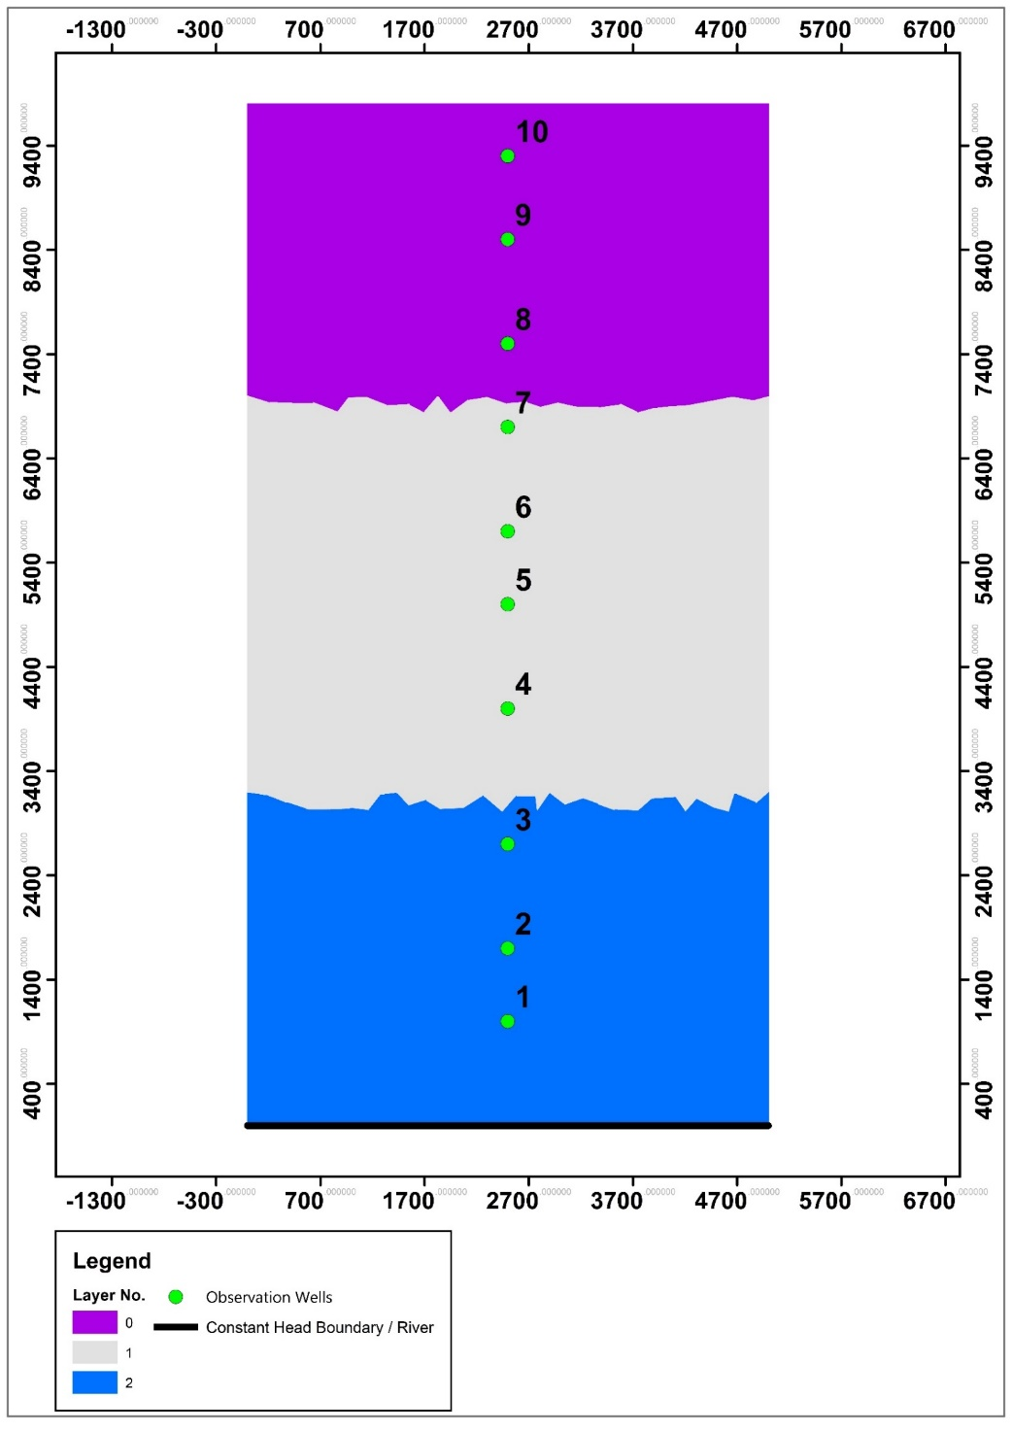
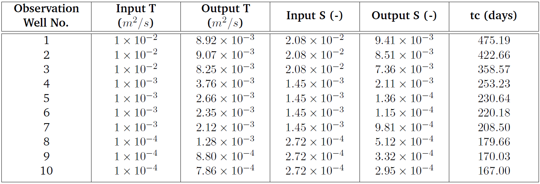
Heterogeneous model with observation wells and results
No Flow Boundary
Table 2: Spectral Analysis results for the heterogeneous model
River

Slide 3
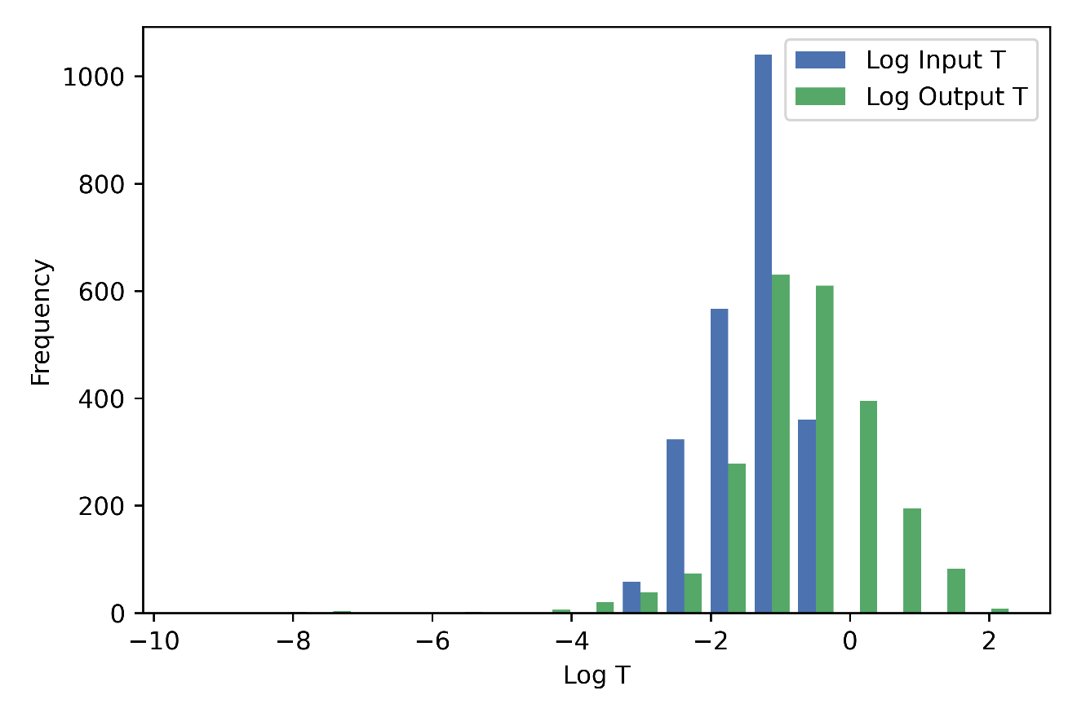
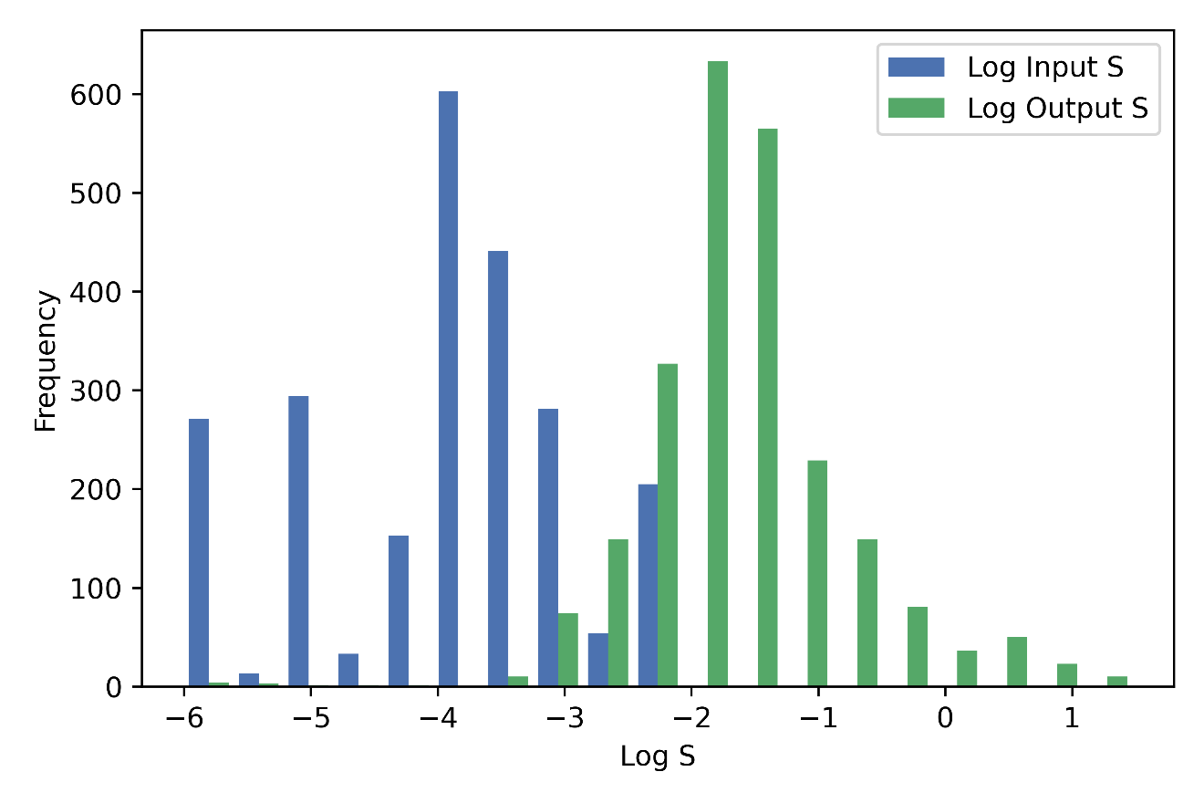
(A) Histogram for Input T vs Output T for the Upper Danube Catchment. (B) Histogram for Input S vs Ouput S for the Upper Danube Catchment.
A
B

Slide 4
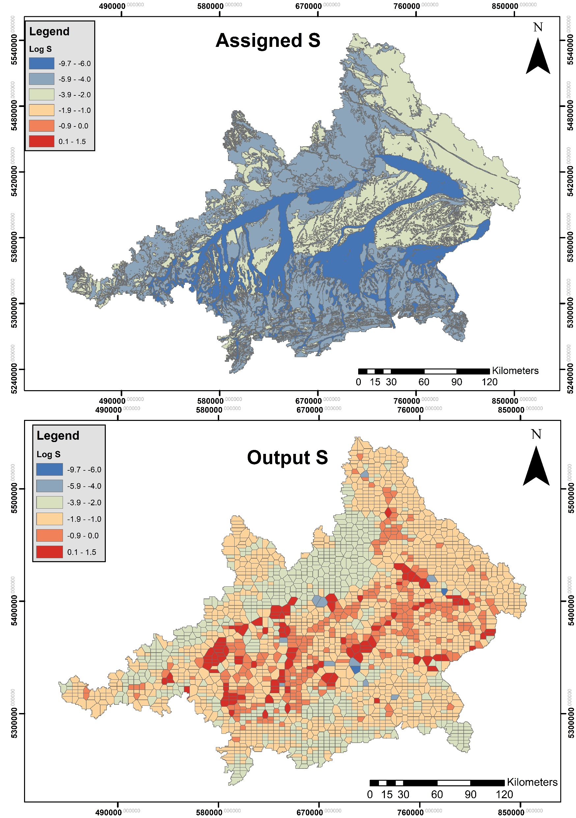
Input and Output Storativity from the Analysis of the Upper Danube Catchment
Parameterization of the numerical model
S obtained through Spectral Analysis

Slide 5
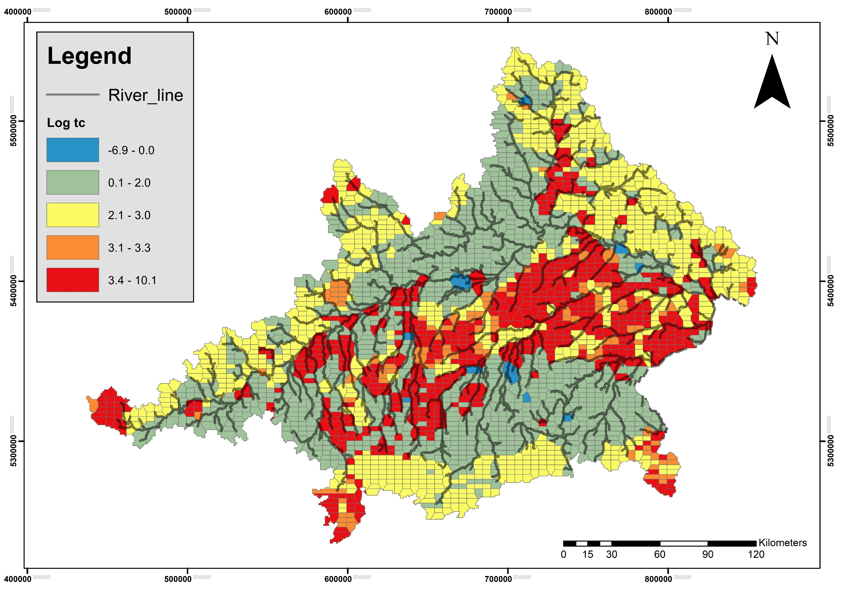
Characteristic time from the Analysis of the Upper Danube Catchment

Slide 6
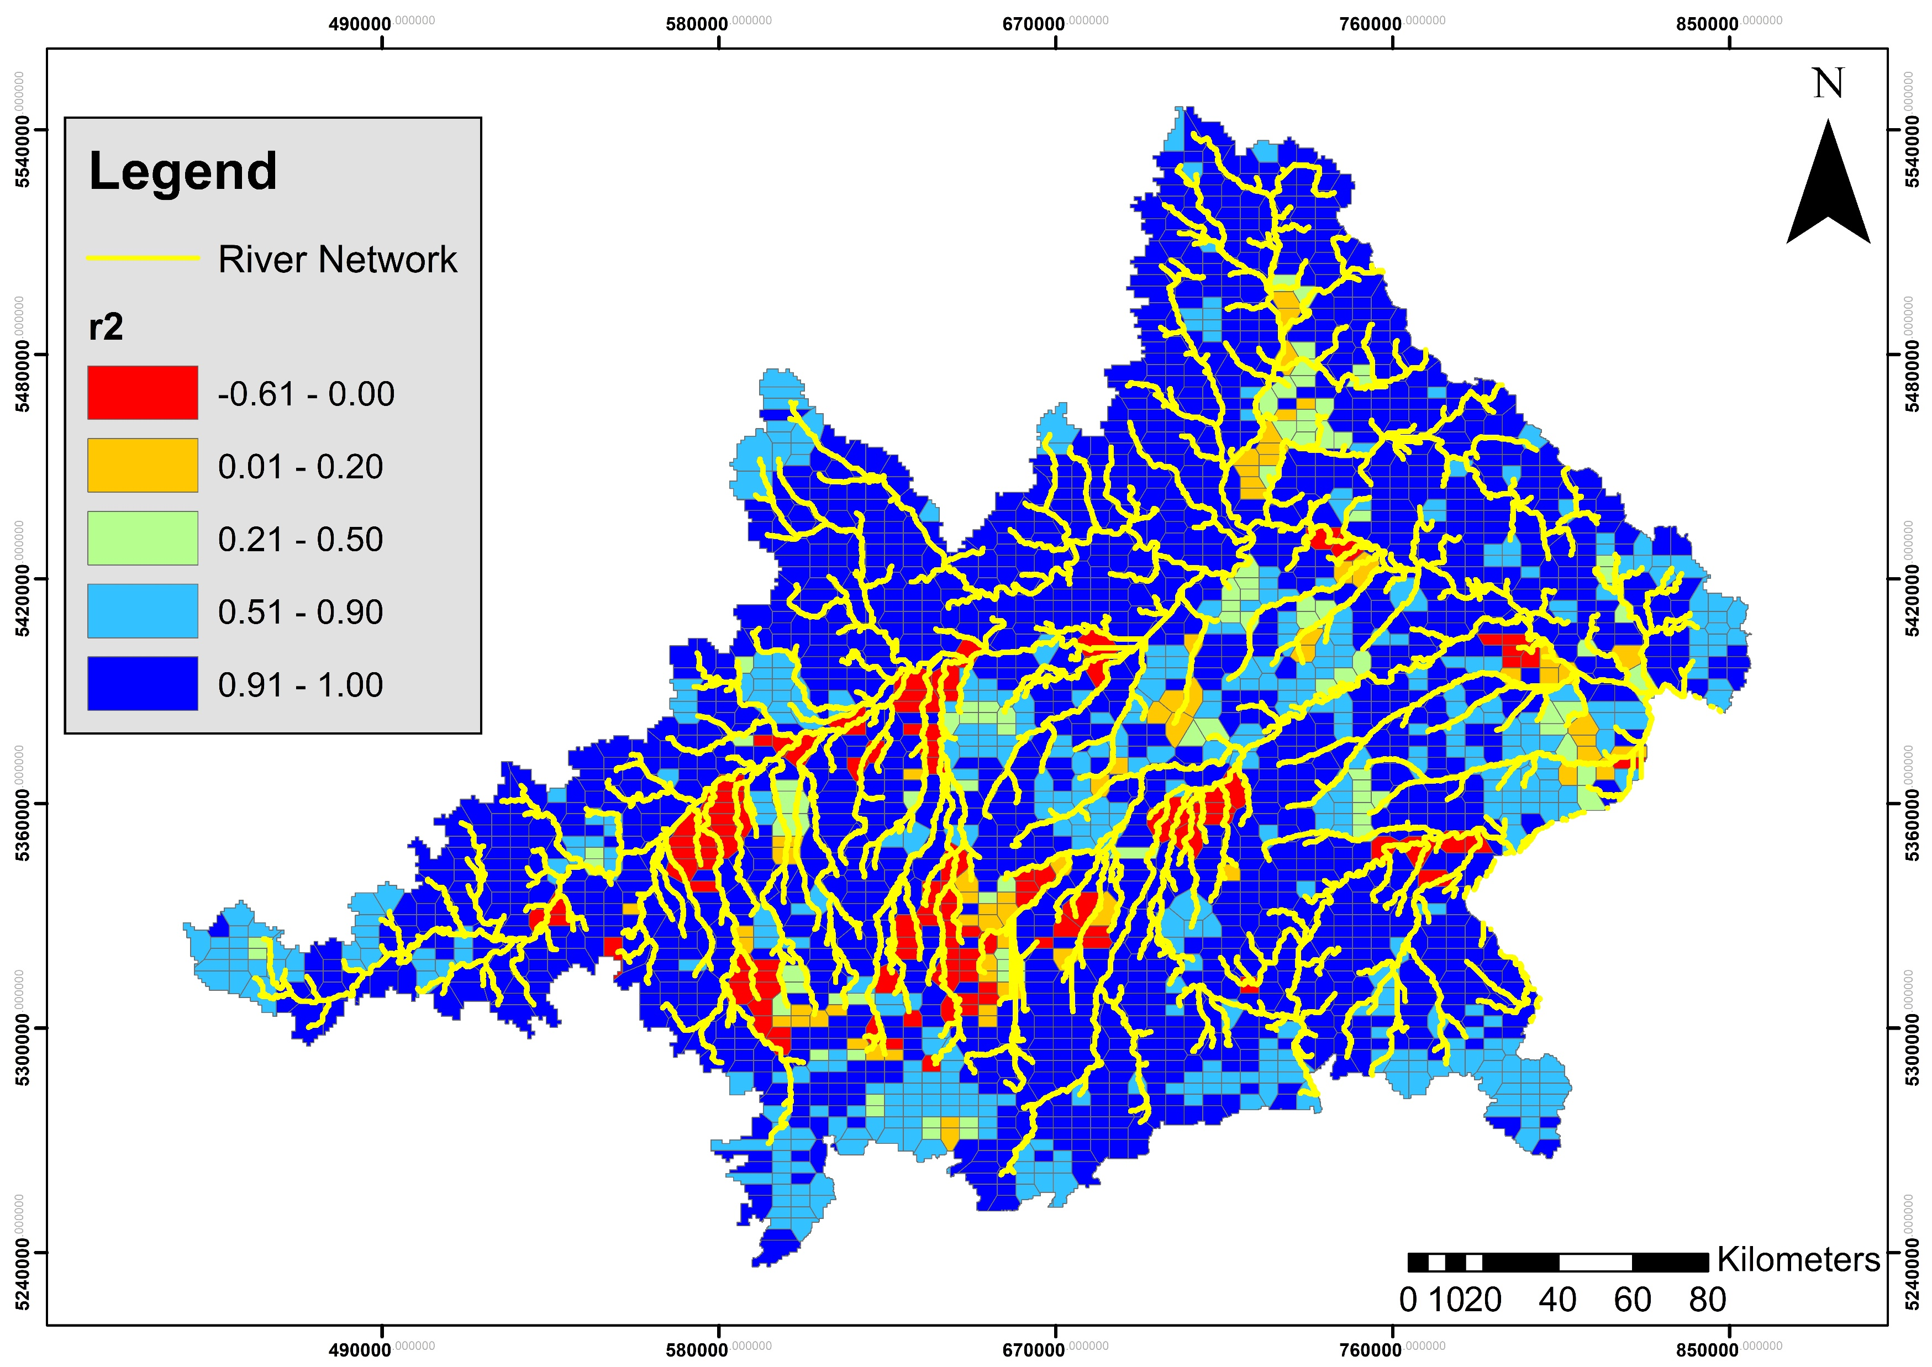
Goodness of Fit from the Analysis of the Upper Danube Catchment

Slide 7
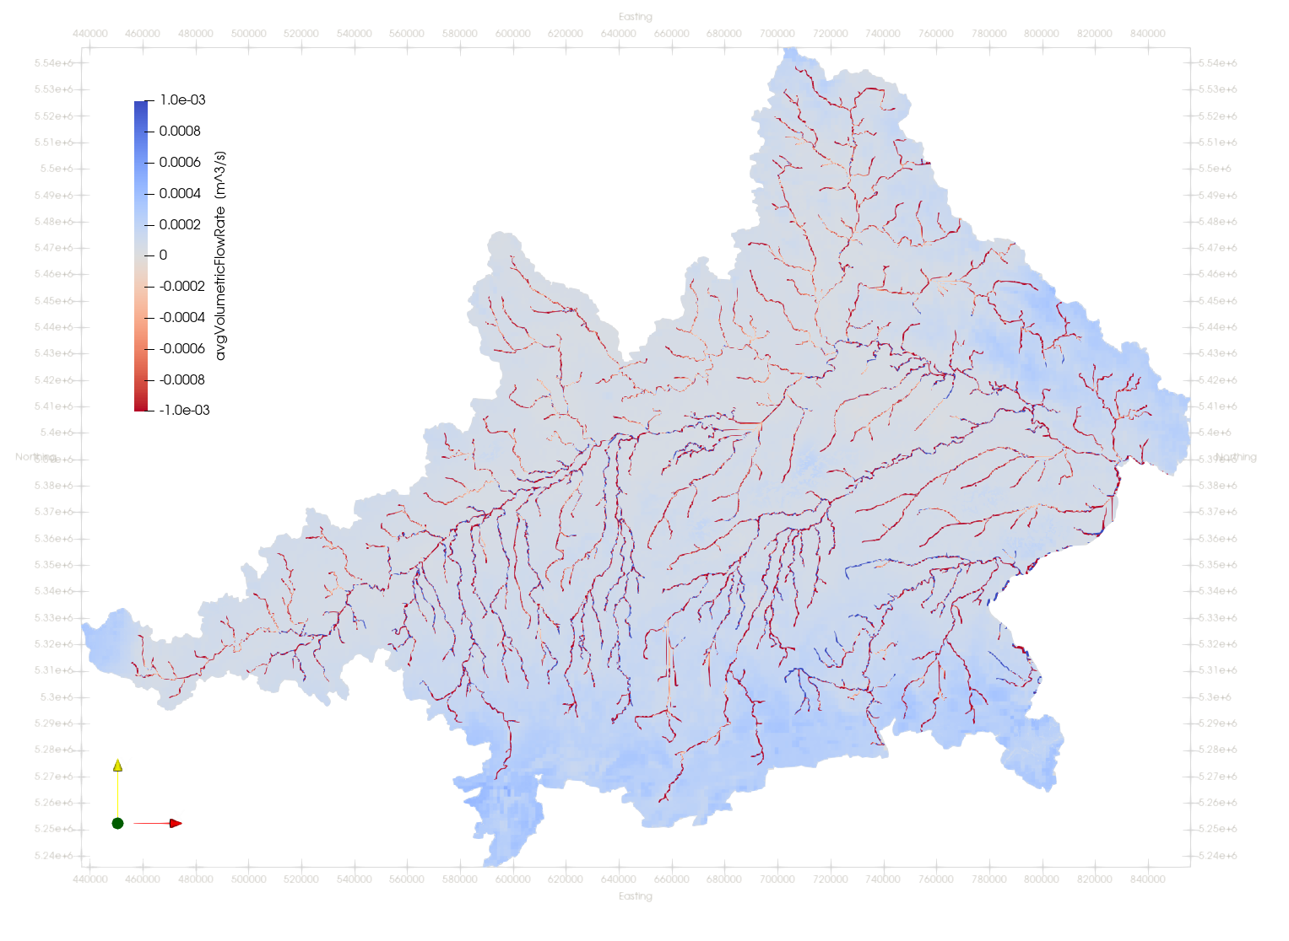
Average Flux along the rivers from the transient simulation of the Upper Danube Catchment

Slide 8
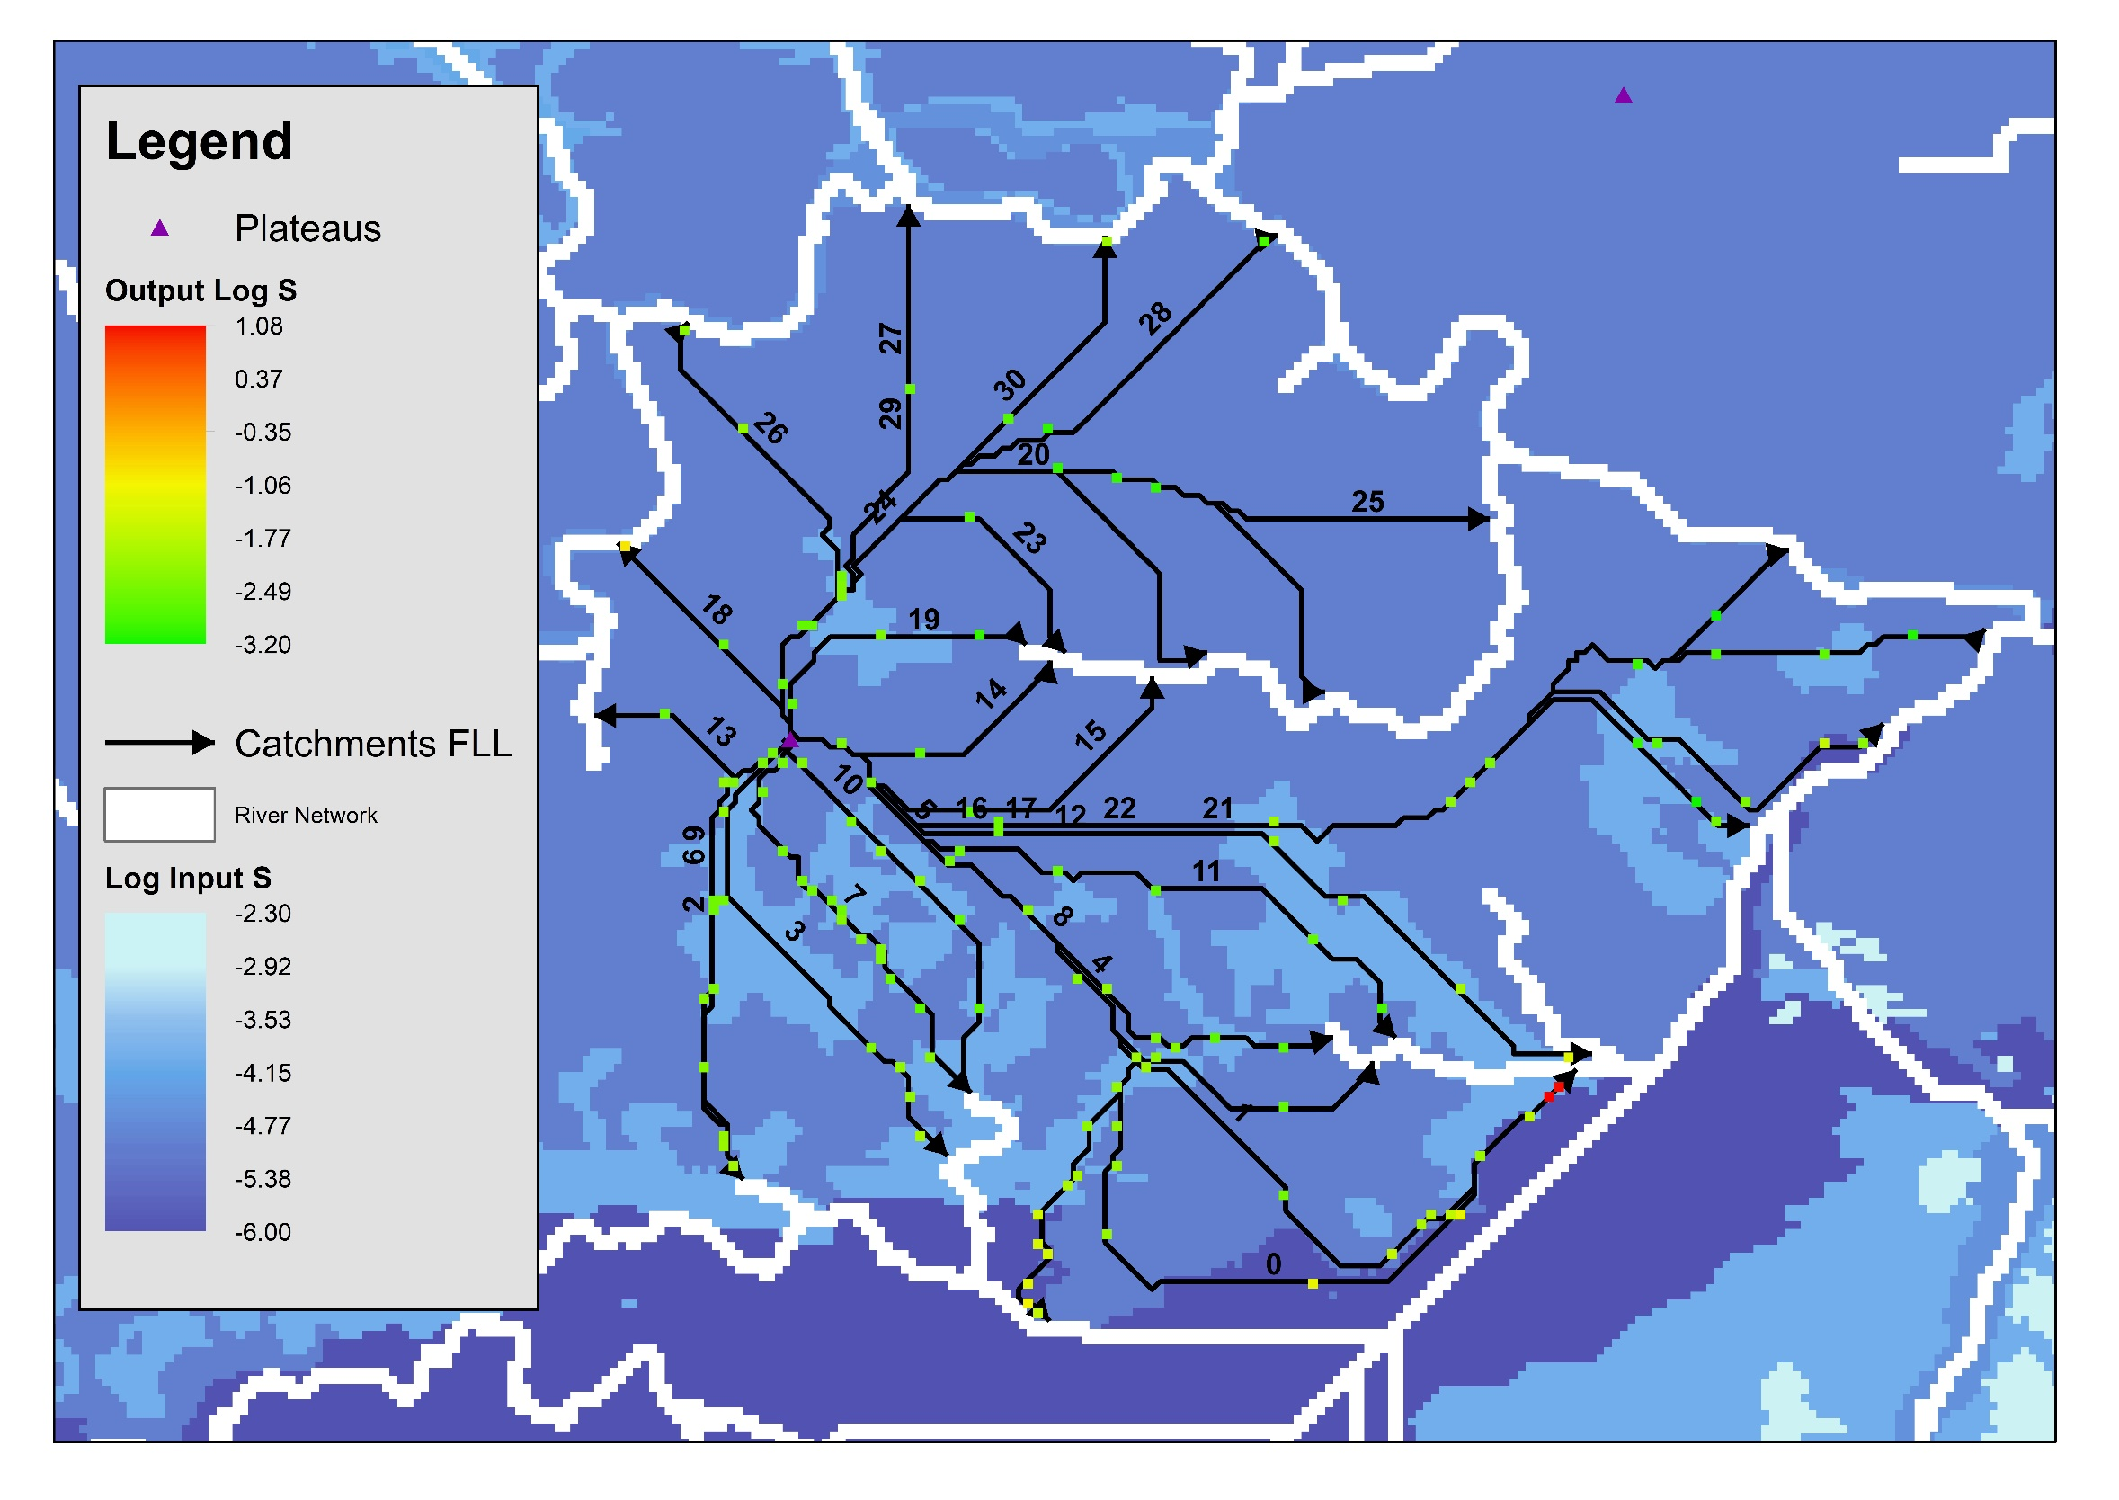
Variation of Storativity in a Catchment along the FLLs

Slide 9
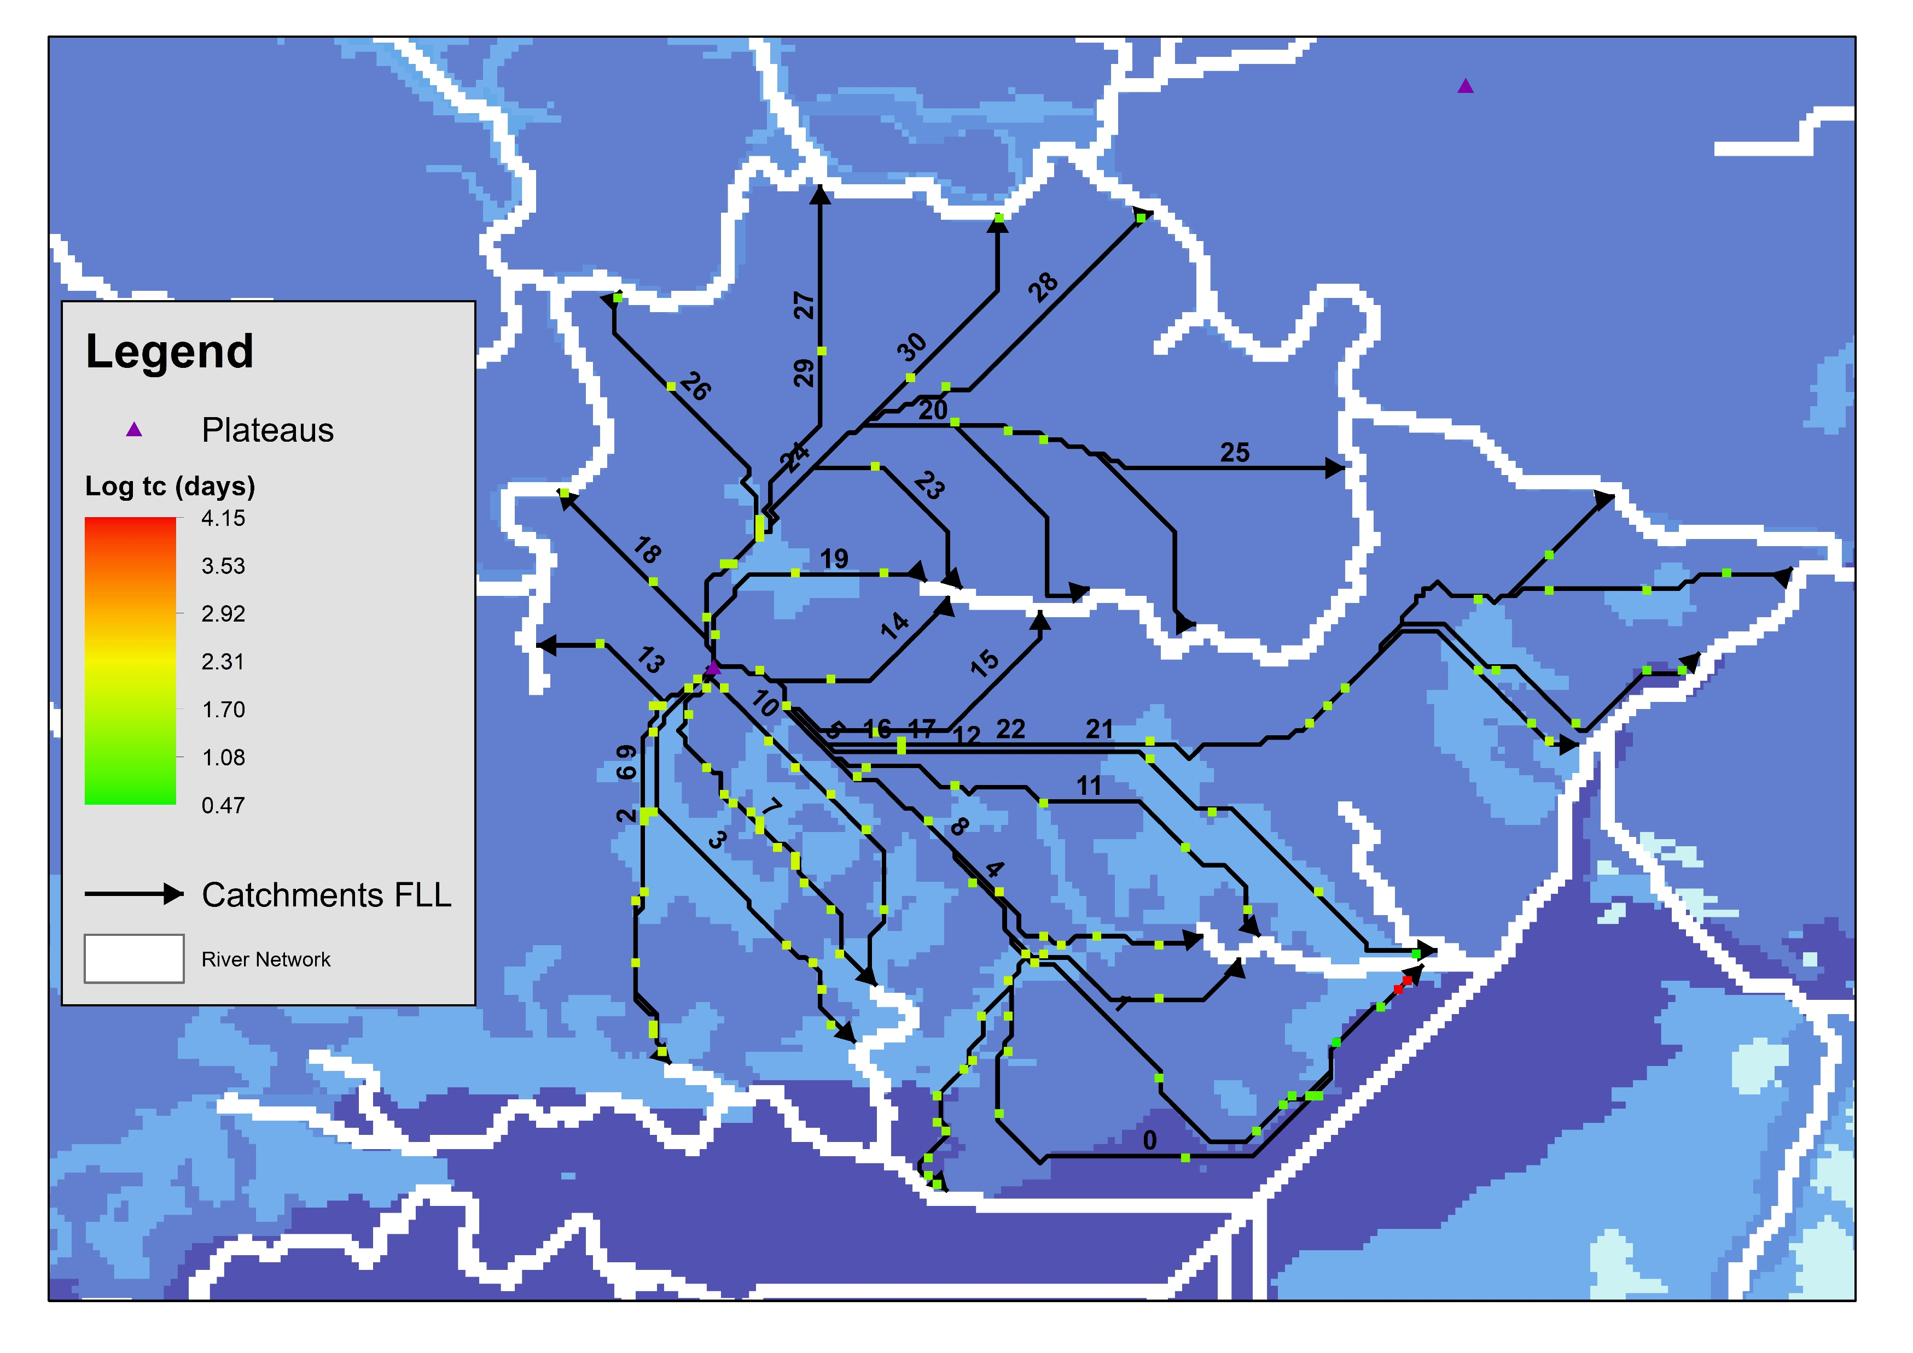
Variation of tc in a Catchment along the FLLs

Slide 10
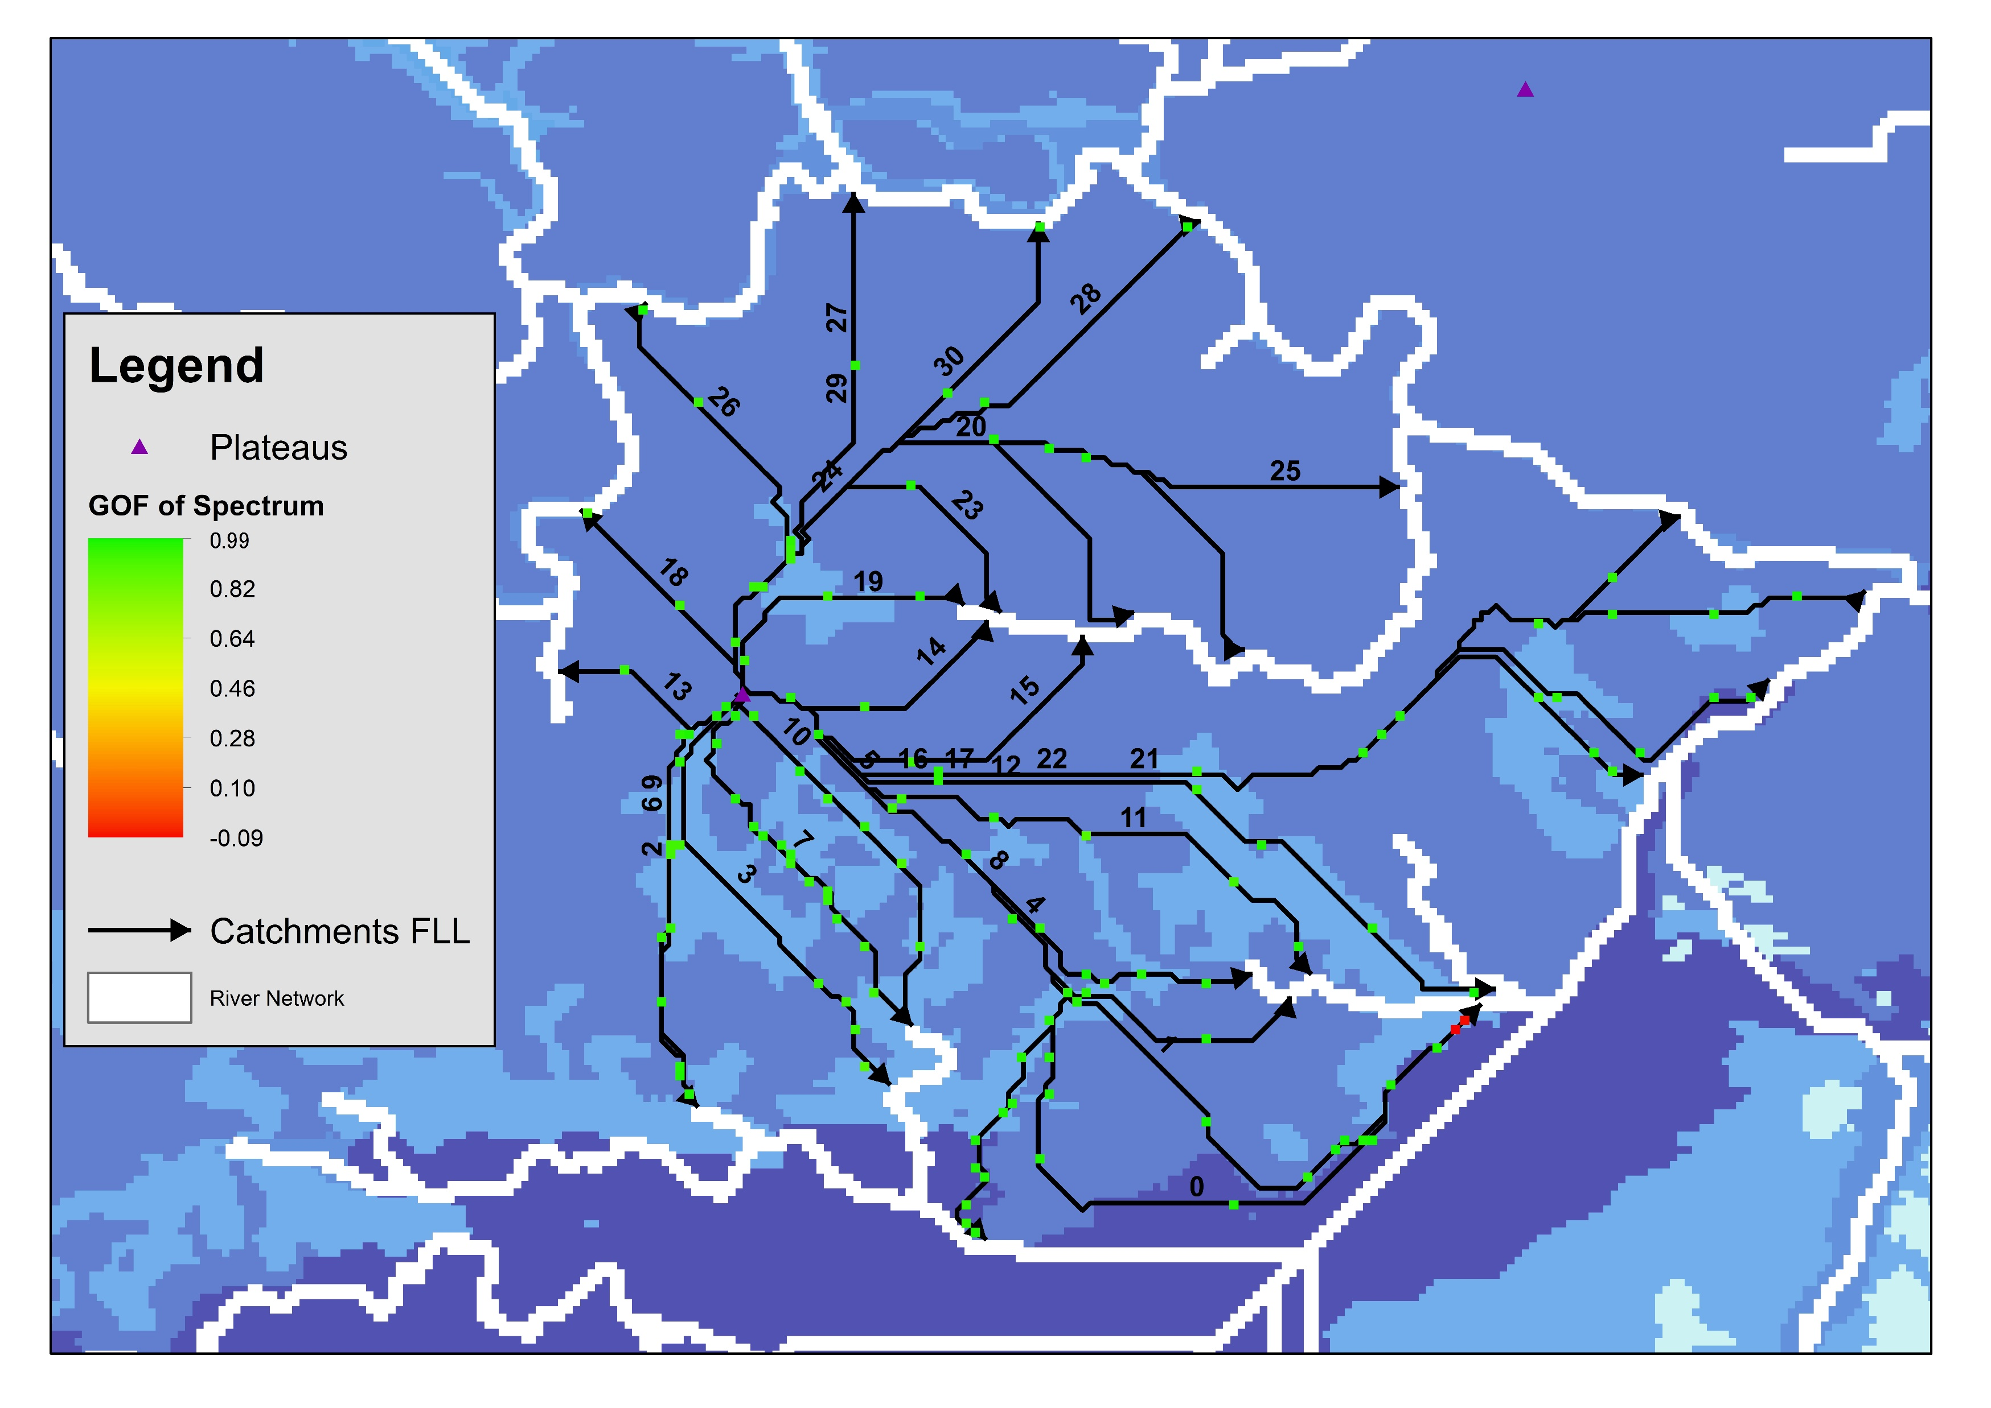
Goodness of fit in a Catchment along the FLLs

Slide 11
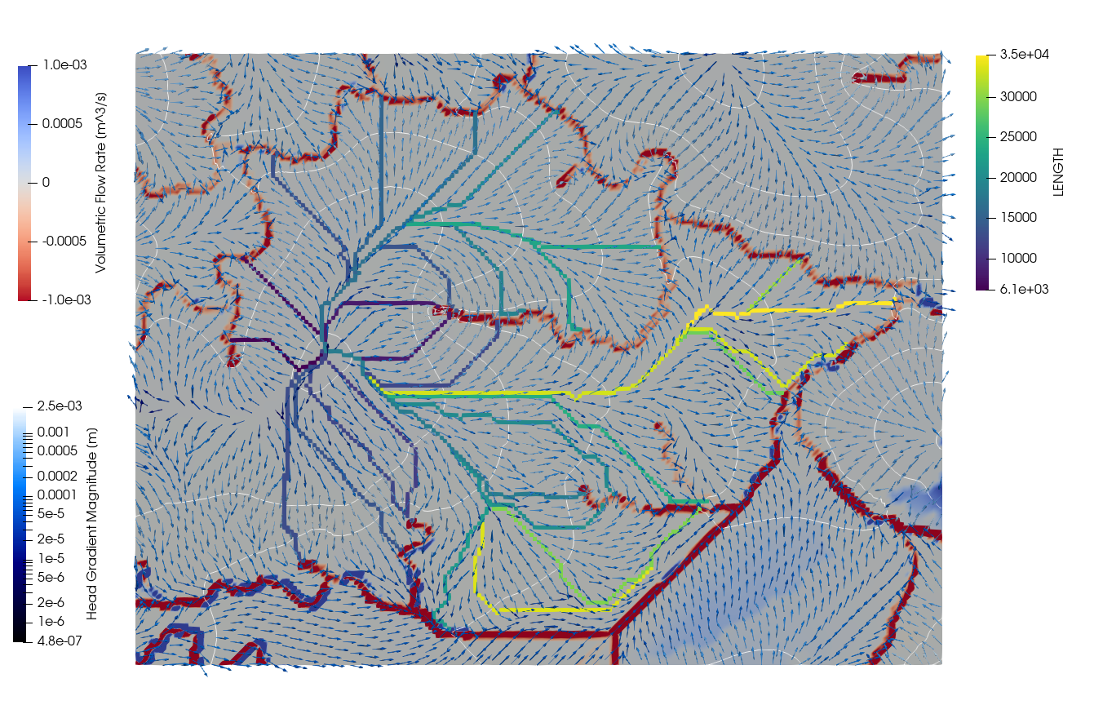
Average flux along in a Catchment along the FLLs

Slide 12
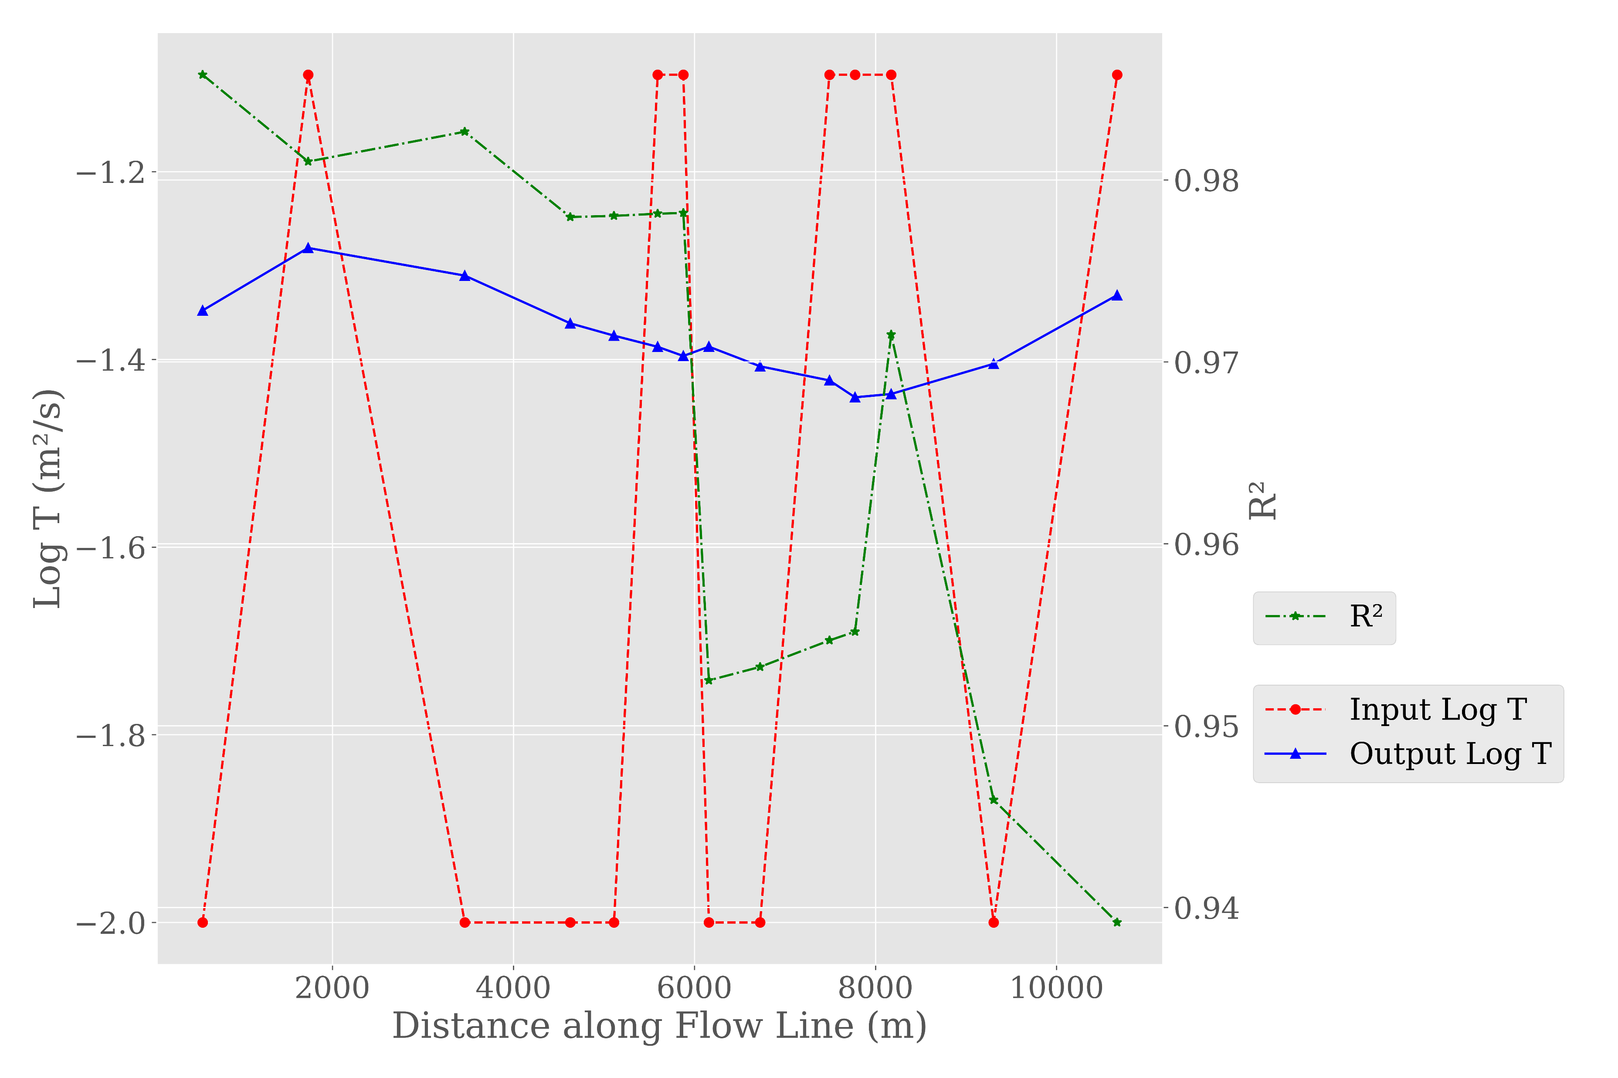
Change in T along FLL no. 7

Slide 13
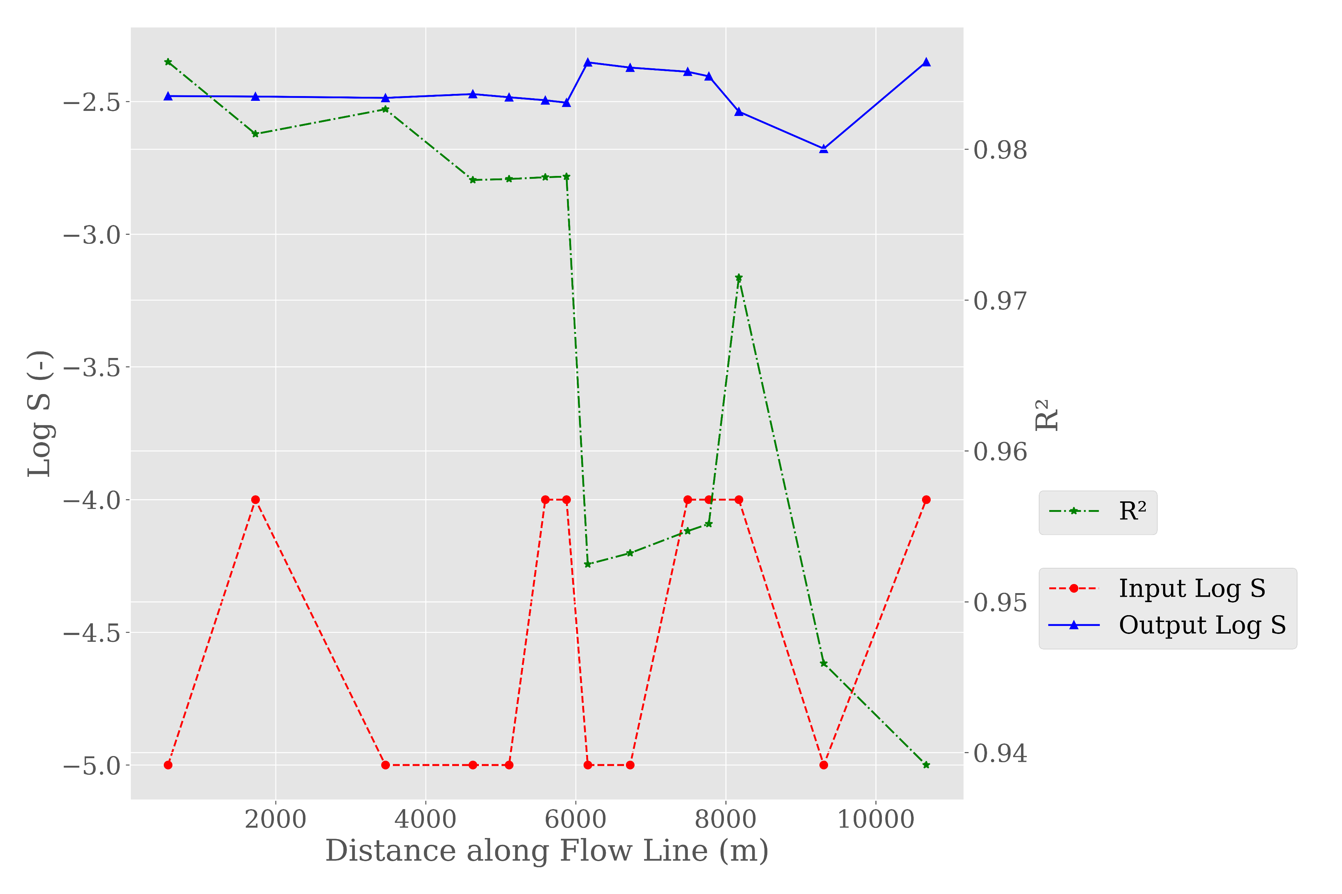
Change in S along FLL no. 7

Slide 14
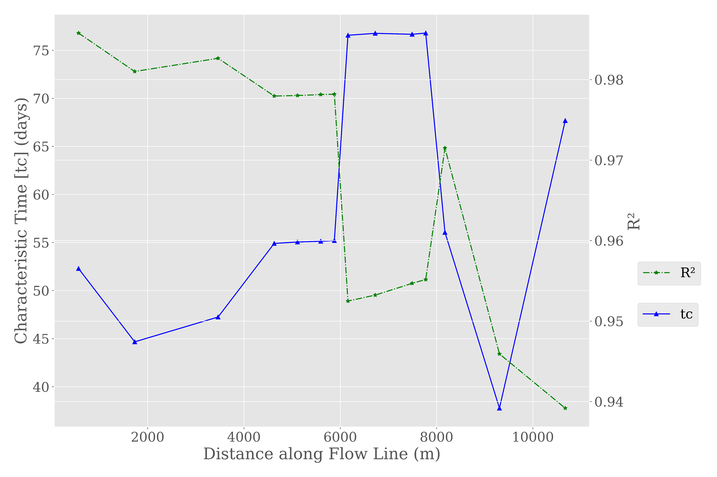
Change in tc along FLL no. 7

