Slide 1
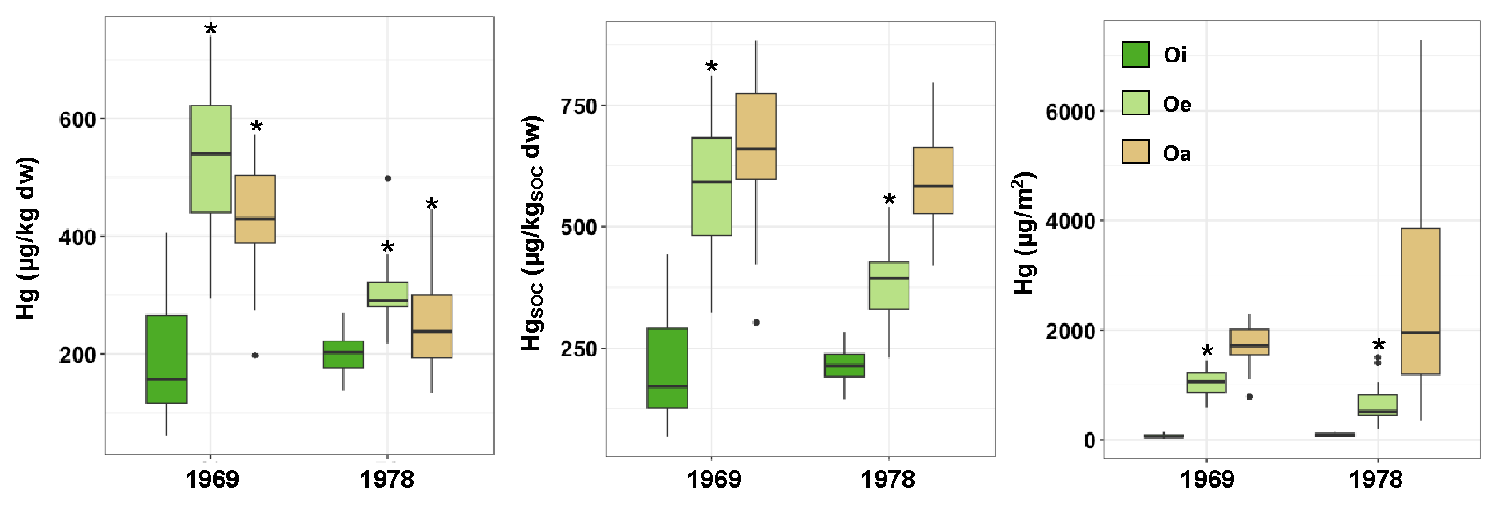
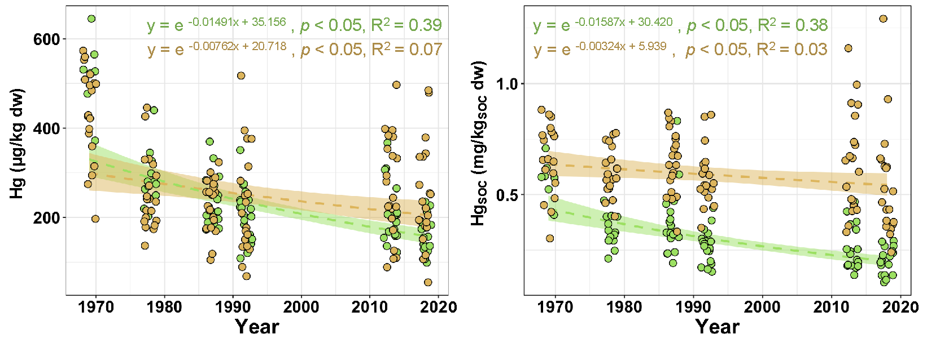
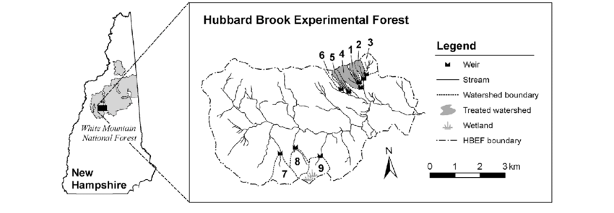
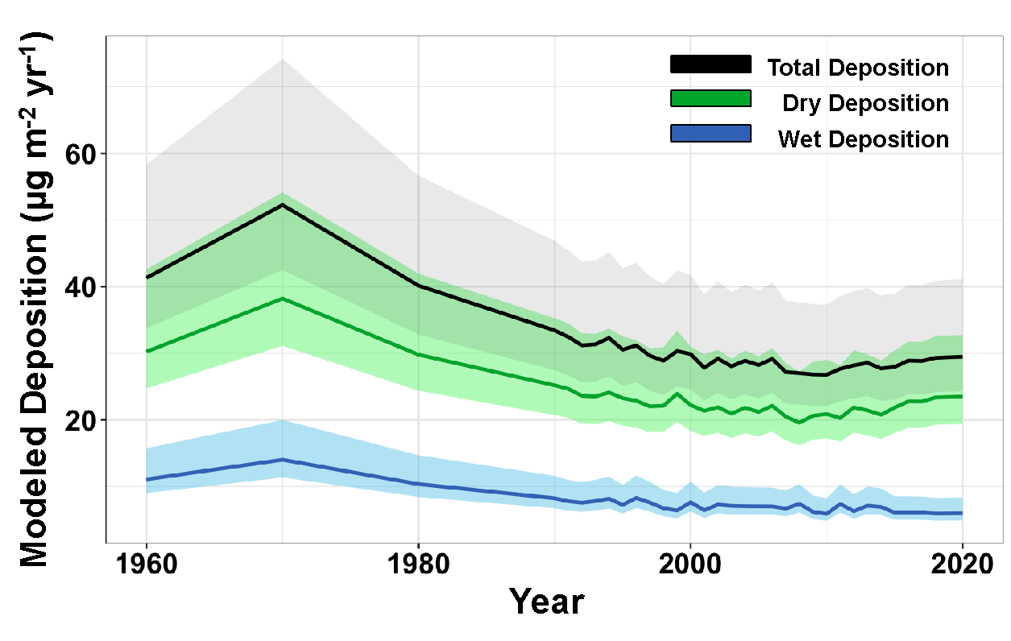
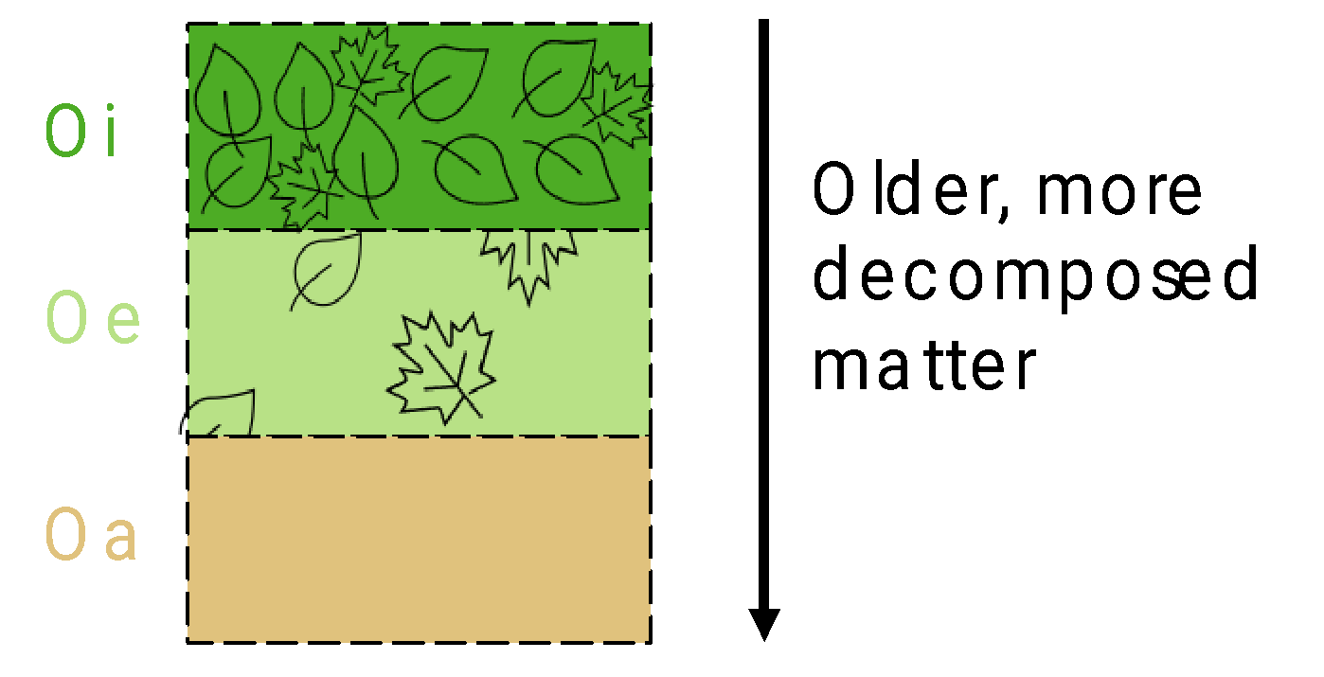
Changes in Organic Soil Mercury Concentrations Over 50 years at the Hubbard Brook Experimental Forest, New Hampshire, USA
Connor I. Olson*, Benjamin M. Geyman, Colin P. Thackray, Chris E. Johnson, Elsie M. Sunderland, Charles T. Driscoll
Conta
Abstract
Results and Discussion
Over the past half century, air quality management efforts have led to substantial decreases in mercury emission across North America and Europe. Subsequent declines of mercury concentrations in air and precipitation have been well documented, resulting in lower mercury fluxes in wet deposition. The responsiveness of ecosystems to these decreasing inputs is an on-going point of scientific inquiry, and for some matrices, considerable uncertainty exists. Organic surface soils are one such example, with relatively little known about how and on what time scale soils react to changes in mercury deposition. Here, we present an analysis of total mercury in organic soils from the Hubbard Brook Experimental Forest (HBEF), New Hampshire USA, spanning over 50 years. Archived soil samples representing the Oie and Oa horizons in the watershed (WS6) were oven-dried, milled, and analyzed via direct mercury analyzer. Trends in total mercury concentration varied over time and among organic soil horizons, with overall mercury concentrations decreasing. Changes in Oie mercury concentration were more pronounced that of the Oa horizon and matched modeled deposition for the experimental area (GEOS-Chem). Conversely, Oa mercury concentrations showed little agreement with deposition and are likely integrating atmospheric inputs over a much longer period. Overall, results suggest that organic soils at HBEF are dynamic and responsive to changes in atmospheric emissions.
Mercury concentration, soil organic carbon (SOC)-normalized concentration, and mass generally increased from Oi to Oe to Oa
The Oe horizon exhibited statistically significant differences in mercury content between the two sampling periods
Introduction
Soils are an important part of the global mercury cycle, acting as both a source to the atmosphere and downstream aquatic systems, and a sink for atmospheric mercury
For background sites, the majority of mercury in surface soils is from atmospheric deposition, with dry deposition being dominant
Despite the importance of soils in the mercury cycle, there are essentially no long-term measurements of soil mercury
Figure 3 – (Left) Hg concentrations, (center) Hg_{SOC} concentrations, and (right) Hg areal densities in organic horizons (Oi, Oe, Oa) from two sampling periods (1969,1978) at Hubbard Brook Experimental Forest. Asterisks indicate significant differences in mean values between sampling years. Points represent potential outliers.
Mercury concentrations in organic soils exhibited significant decreases over the 50-year period
The Oie was decreasing at a greater rate than the Oa, particularly for SOC-normalized mercury
How has organic soil mercury content changed over time?
Site Description and Methods
The Hubbard Brook Experimental Forest (HBEF) is located in the White Mountains of New Hampshire, USA
HBEF has a number of experimental watersheds and a biogeochemical reference watershed (W6)
W6 is 13 Ha (10,000 m²) and is divided into 208 sampling plots
Figure 4 – Changes in (left) Hg concentrations and (right) HgSOC concentrations over time in the Oie (green) and Oa (brown) horizons at Hubbard Brook Experimental Forest. Shaded areas represent 95% confidence intervals.
Figure 1 – Location of Hubbard Brook Experimental Forest (HBEF) and watershed layout. The samples analyzed in this work were collected in the biogeochemical watershed (W6)
Modeled deposition values peaked in 1970 and subsequently decreased. Dry deposition was greater than wet deposition.
Annual total deposition values were significantly correlated to the average Oie values for the corresponding year, but not for the Oa values, likely reflecting the turnover time of SOC
Methods
Subsamples of archived soils were collected in 1969, 1978, 1986, 1992, 2017, 2020 (n ≈ 20 per year)
Oi, Oe, and Oa samples were collected in 1969 and 1978. Later samples collected Oie and Oa
Samples were dried, homogenized and analyzed for total mercury using a direct mercury analyzer (DMA; milestone)
To contextualize results, atmospheric deposition was modeled using GEOS-Chem (v.12.8). Hg emissions data was from Streets et al. 2019a, 2019b. Met data was from Merra-2 (Gelaro et al. 2017). Atmospheric mercury chemistry was from Shah et al. (2021) and Horowitz et al. (2017)
Figure 5 – (Left) Modeled Hg deposition for Hubbard Brook Experimental Forest using Geos-CHEM (v.12.8). Shaded areas represent 80% confidence intervals, approximated from Streets et al. (2019a). (Right) Simply linear regressions of annual total deposition and the average soil mercury concentration in the Oie (top) and Oa (bottom) horizon for the corresponding years.
Conclusions
Figure 2 – Conceptual diagram showing changes in soil organic carbon age with the soil horizons collected In the present study.
This work is the first longitudinal study of forest floor mercury, spanning over 50 years. The results from this study indicate that concentrations of mercury in organic soils at Hubbard Brook are decreasing in response to decreases in atmospheric deposition, though the rate of decrease is dependent on the turnover of soil organic carbon. Future work will aim to assess qualitative changes in forest floor mercury and quantify mercury movement between horizons.

