Slide 1
Optical and radar remote sensing improve DEM-based geomorphic change detection from multi-temporal lidar
Simon Walker, Scott Wilkinson, Tim McVicar, Pascal Castellazzi, Shaun Levick, Rebecca Bartley, Sana Khan, Anne Kinsey-Henderson
Simon Walker
Postdoctoral Fellow (Erosion Hazard Modelling)
Terrain and Surface Processes
Commonwealth Scientific and Industrial Research Organisation
simon.walker@csiro.au

Slide 2
Objective
Assess suitability of satellite optical and radar remote sensing for addressing error in geomorphic change detection using high-resolution topography at relatively large scales (>1 km²)

Slide 3
Wheel Creek
Semi-arid savannah landscape in the Burdekin River basin
Repeat airborne-lidar (ALS) in 2013 and 2021
Figure 1: Wheel Creek study catchment in the Burdekin River basin

Slide 4
Error in geomorphic change detection (GCD)
Random error assessed using Limit of Detection (LoD)
$σ_{c}= t{\left(σ_{z1}^{2}+σ_{z2}^{2}\right)}^{\frac{1}{2}}$
Systematic error assessed as mean elevation difference over control points or ‘stable features’ and referred to as ‘co-registration’
$∆\overline{z}=\frac{1}{n}\sum_{i=1 }^{n}{{\tilde{o}}_{i}− {\tilde{n}}_{i}}$
Both difficult with little or no local site information or ground control points

Slide 5
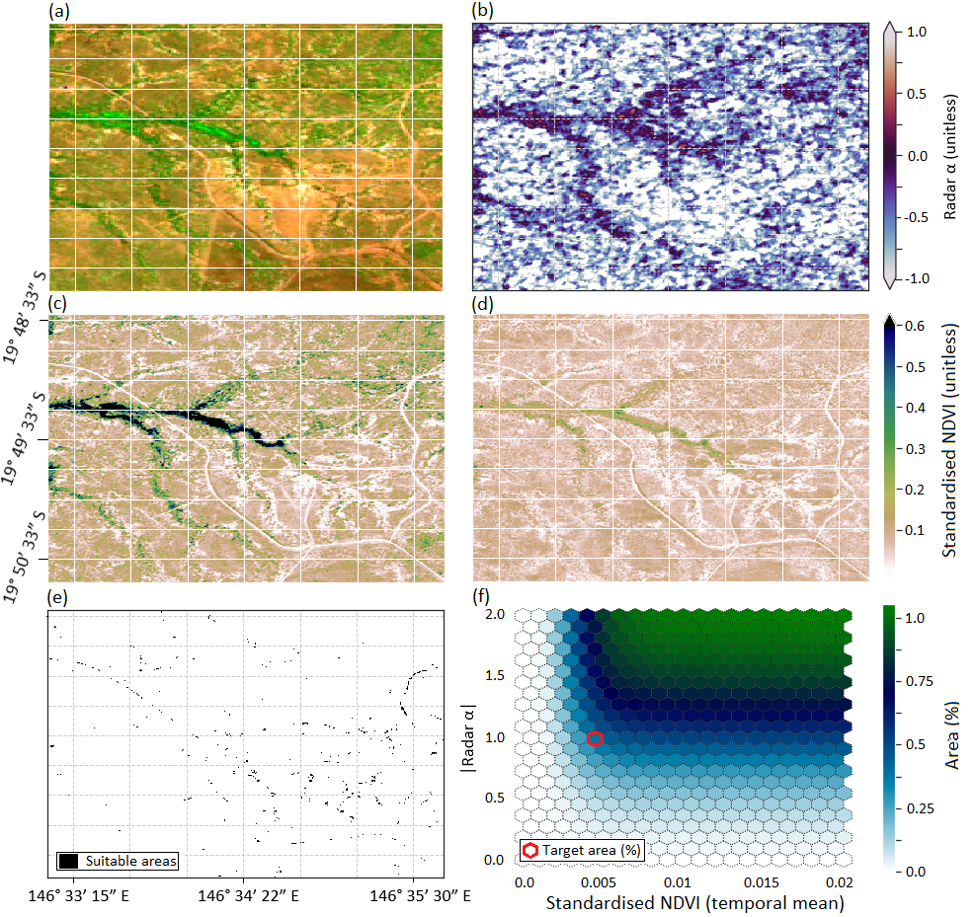
Co-registration using optical and radar remote sensing
Locate persistently bare (optical) and geomorphically stable (radar) areas of the catchment
Figure 2: Combined satellite-based optical and radar analysis of persistently bare ground across Wheel Creek. Panel (a) false colour composite from Sentinel-2. Panel (b) radar coherence mapping of stable areas. Panels (c) and (d) standard deviation and mean of standardised NDVI from 2017-2021, respectively. Panel (e) proportion of area covered by setting NDVI threshold to <0.005 and radar alpha to 0±1, and Panel (f) sensitivity of area covered to gradual increases in mean NDVI and radar coherence.

Slide 6
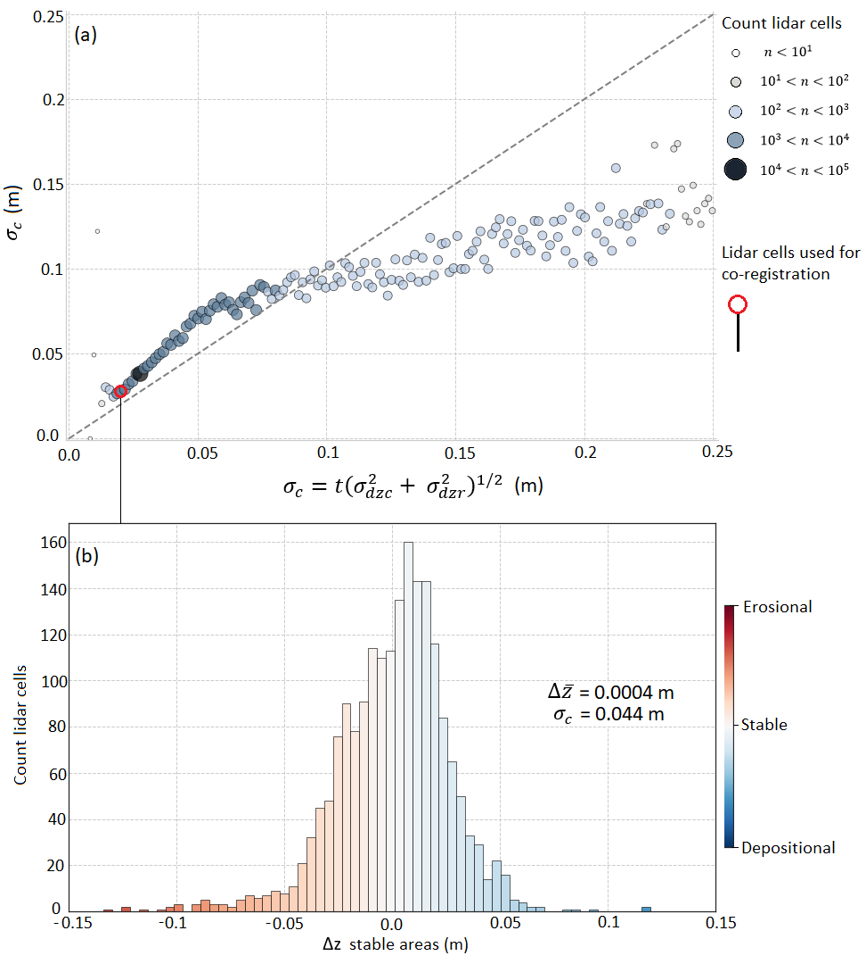
DEM co-registration
For low surface variation, the modelled error under predicts measured
For areas with high surface variation the modelled error over predicts error
Figure 3: Using stable persistently bare areas to co-register DEMs and assess expected error. Panel (a) shows modelled error (x-axis) against measured error (y-axis) over bare stable areas. Panel (b) shows distribution of DoD values over bare stable areas (taken to be error) after DEM co-registration

Slide 7
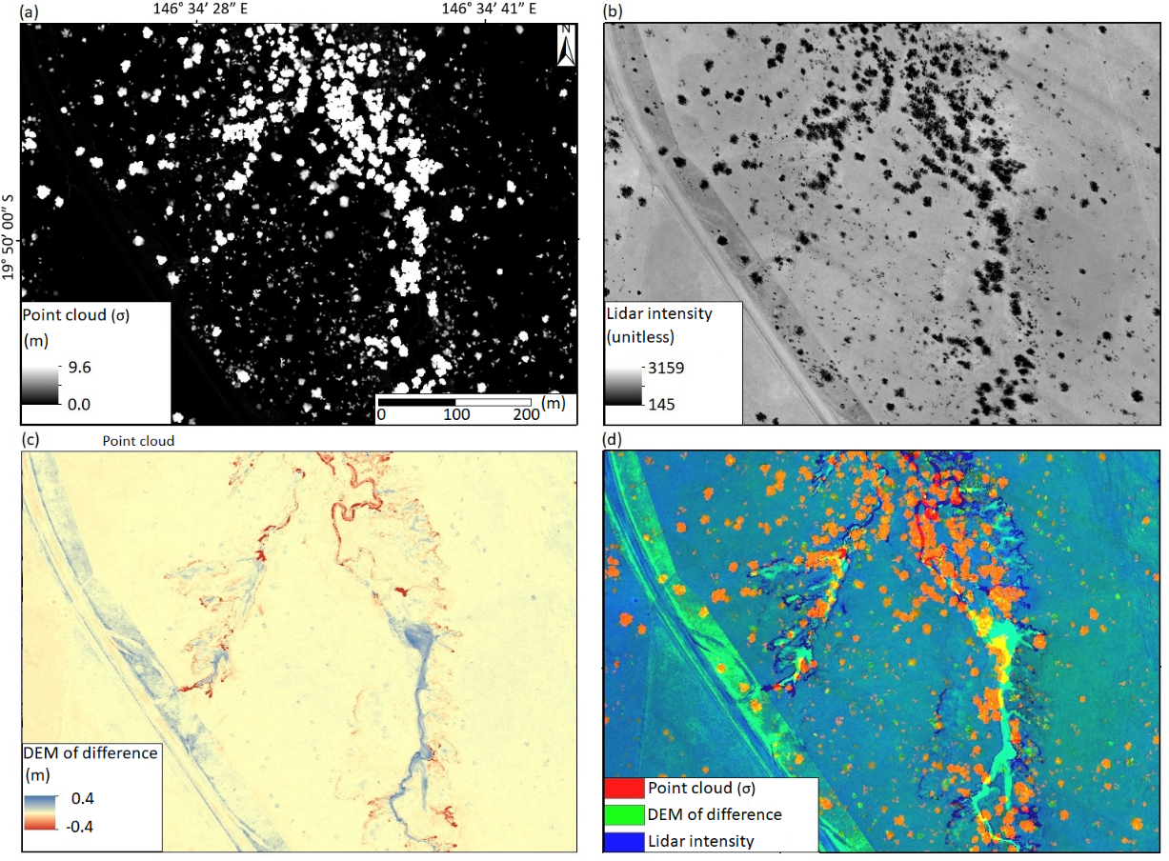
Lidar-RGB for vegetation error
Point cloud variance identifies trees and shrubs
Intensity discriminates bare and vegetated surfaces
Geomorphic change separates depositional and erosional surfaces
Figure 4: Creation of lidar-RGB used to discriminate land cover classes. The standard deviation of all points, Panel (a), identifies tree canopies. Lidar intensity, Panel (b), helps to distinguish bare bright surface from vegetation surfaces. An initial uncorrected DoD, Panel (c), clearly identifies channel banks, depositional zones, and grassed roadsides.

Slide 8
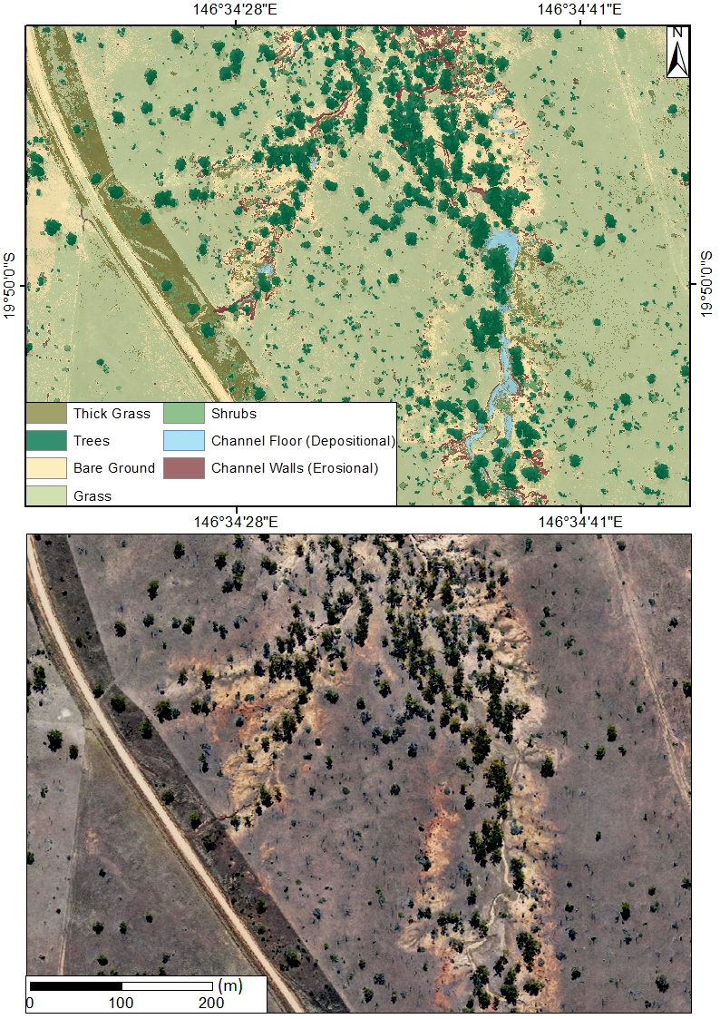
Landcover classification
Grass is a major challenge for point classification algorithms
Landcover classification helps to identify grass and assess error
Lidar-RGB classifies landcover at the resolution of the lidar
$σ_{c}= t{\left(σ_{z1}^{2}+σ_{z2}^{2}\right)}^{\frac{1}{2}} {+ δ}_{veg}$
Figure 5: Landcover classification from the lidar RGB'. Panel (a) shows seven land cover types classified using a maximum likelihood estimator trained on high-resolution (~10 cm) optical imagery of the catchment shown in Panel (b).

Slide 9
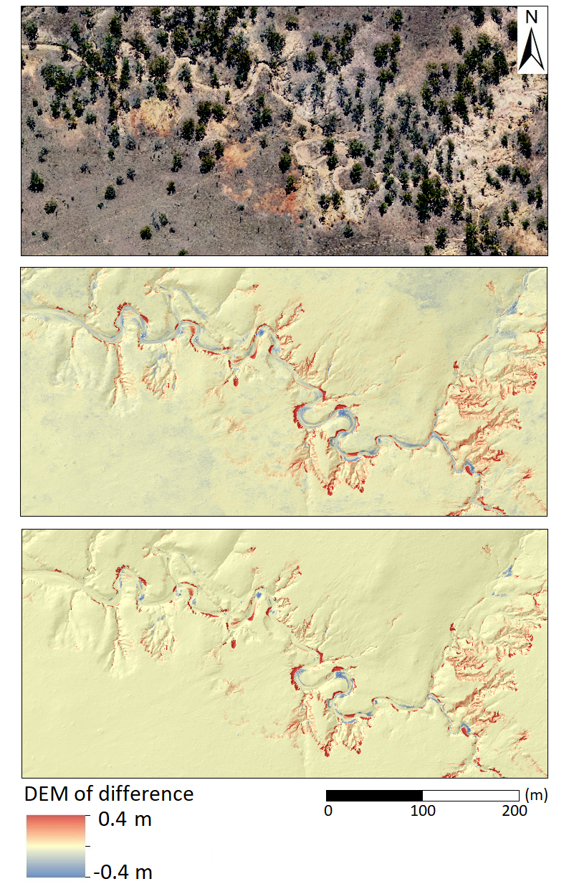
Geomorphic change detection
Detects erosion on cutbanks and deposition on point bars
Applying spatially variable error assessment removes noise on hillslopes while retaining changes in gullies and streambanks
Figure 6: DEM of Difference before and after applying Limit of Detection.

Slide 10
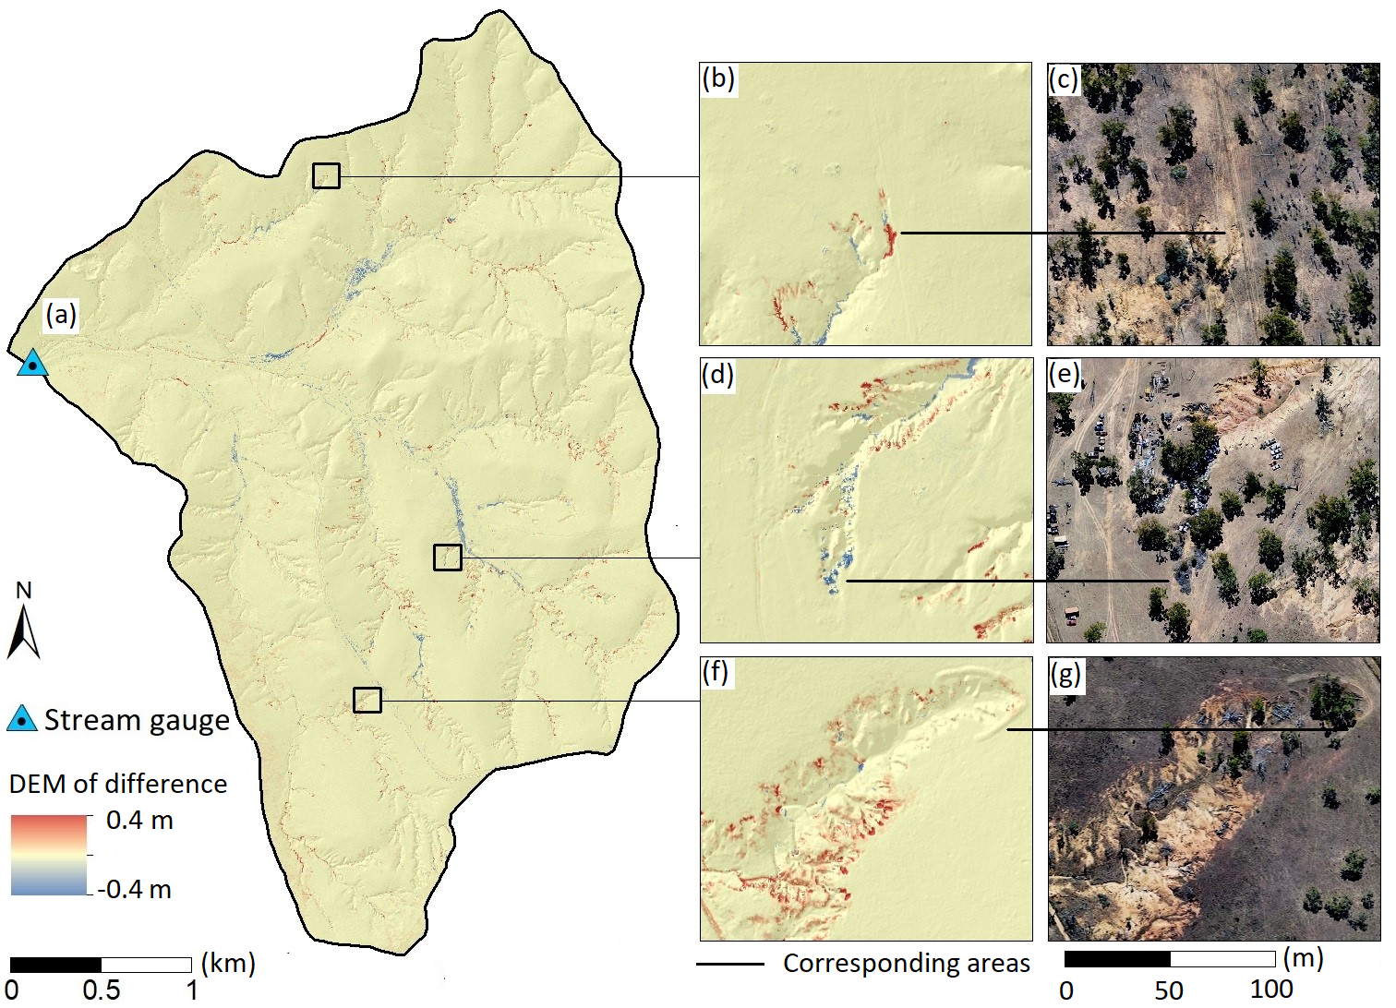
Figure 7: Examples of small-scale change detection and erosion.

Slide 11
Comparison to sediment load monitoring
Total suspended sediment (TSS) load monitoring estimates 1.4 t·ha·y⁻¹ (2000-2017)
Rainfall-TSS model estimates 1.55 t·ha·y⁻¹ (2017-2021)
Soil erosion 1.54 t·m⁻³ and channel deposition 1.38 t·m⁻³
Initial fine sediment (<63 μm) fraction ~30%
Confidence interval | t = 0 | t = 1 | t = 1.96
Erosion volume (m³·ha⁻¹) | 9.31 ± 5.81 | 7.61 ± 2.95 | 5.08 ± 1.30
Deposition volume (m³·ha⁻¹) | 6.27 ± 2.97 | 4.99 ± 1.28 | 3.79 ± 0.66
Erosion mass (t·ha·y⁻¹) | 14.34 ± 8.95 | 11.71 ± 4.54 | 7.82 ± 2.00
Deposition mass (t·ha·y⁻¹) | 8.66 ± 4.09 | 6.88 ± 1.77 | 5.23 ± 0.91
Erosion (RE) | 0.62 | 0.39 | 0.24
Deposition (RE) | 0.47 | 0.26 | 0.17
Export ratio (%) | 0.40 | 0.41 | 0.33
Outlet mass (t·ha·y⁻¹) | 5.68 ± 3.12 | 4.83 ± 1.56 | 2.58 ± 0.54

Slide 12
Conclusions
Optical and radar remote sensing offer valuable approach to co-registering DEMs in semi-arid landscapes.
Cloud to cloud methods essential where most geomorphic change happens on steep surfaces.
Lidar-RGB can help to identify and remove error due to grass affecting lidar point classification.
Applying 1, 2 and 3 enables catchment-scale DEM-based GCD at sub-meter resolution, producing estimates that agree with field-based sediment monitoring.

Slide 13
Thank you
Living Landscapes
Simon Walker Postdoctoral Research Fellow
+61 2 6218 3646
simon.walker@csiro.au

