Slide 1
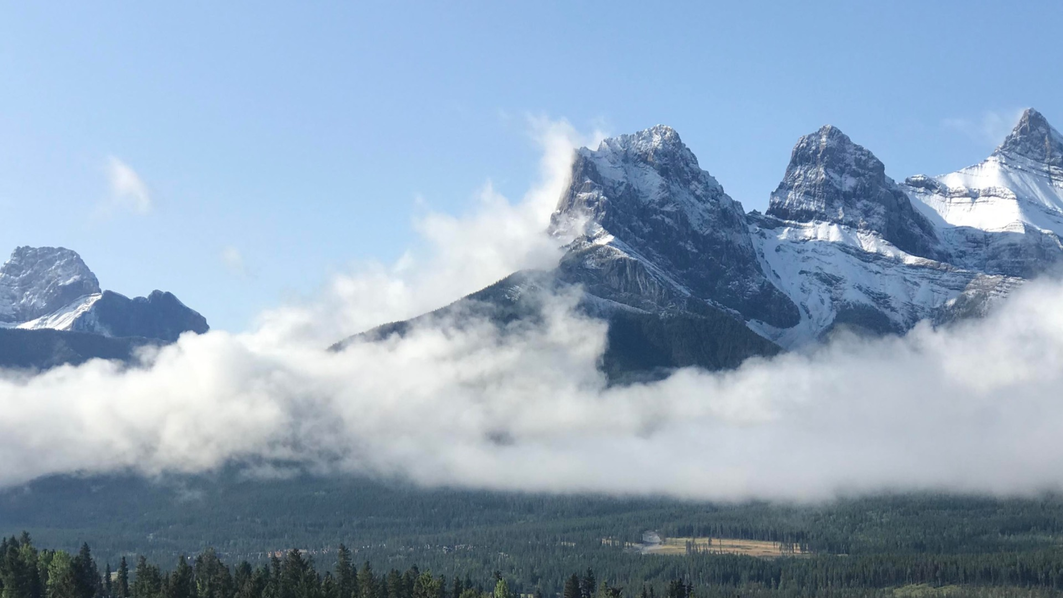





A reproducible data-driven workflow for probabilistic seasonal streamflow forecasting over North America
EGU 2023
Louise Arnal, Martyn Clark, Vincent Fortin, Al Pietroniro, Vincent Vionnet, Paul Whitfield & Andy Wood

Slide 2

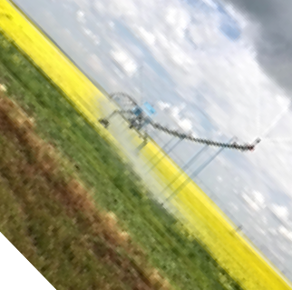
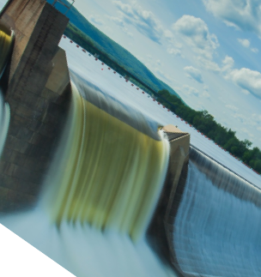
Background
Context
Seasonal streamflow forecasts are critical for many water sectors & for society.
Initial hydrological conditions are an important source of seasonal hydrological predictability.
In high-latitude &/or high-altitude headwater basins across N. America, snowmelt is the main source of runoff generation.
Aims
  Benchmark the skill of probabilistic seasonal streamflow forecasts in snow-fed river basins across N. America.
  Develop a reproducible workflow for data-driven forecasting.
Phillip Harder, USask

Slide 3
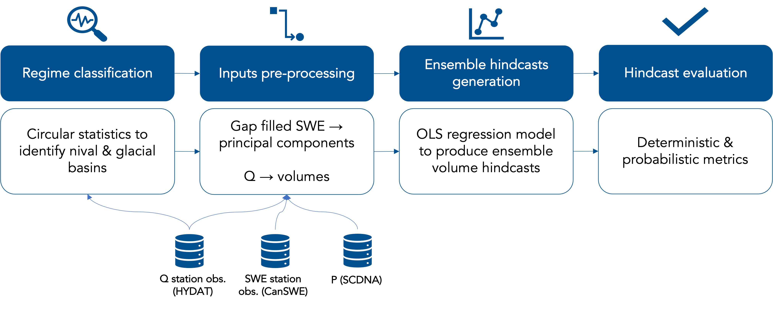
Workflow
    Can snow water equivalent be used as a reliable predictor of future streamflow?
Regime classification
Data pre-processing
Forecasting
Hindcast verification
Circular statistics* to identify snow-fed basins across N. America.
*Burn et al. (2010)
Predictors: SWE gap filling (using quantile mapping) & principal component analysis.
Predictands: Daily streamflows to volumes.
OLS regression to produce seasonal ensemble volume hindcasts. Hindcasts for Jan-Sep, Feb-Sep, …, Sep produced on the 1st Jan, 1st Feb, …, 1st Sep.
Range of deterministic & probabilistic verification metrics.
Streamflow stations obs. (HYDAT & USGS), 1979-2021
SWE stations obs. (CanSWE, SNOTEL, USA snow surveys), 1979-2021
Precip. (SCDNA), 1979-2018

Slide 4
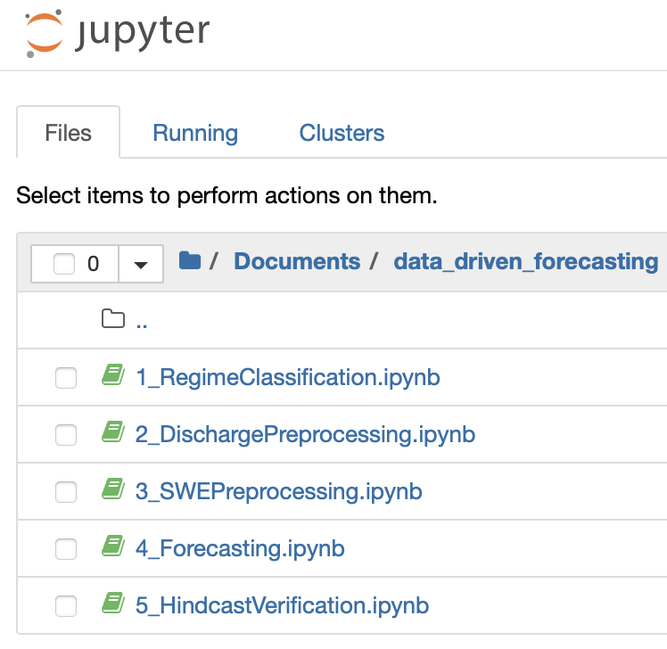

Workflow
Organized as a series of Jupyter Notebooks.
Contains a user-friendly step-by-step overview of the workflow for a testbed basin, with
          Python functions,
          and visuals.
It will be made openly available on GitHub alongside the article.
          0_DataDownload&Reformat (in progress)

Slide 5
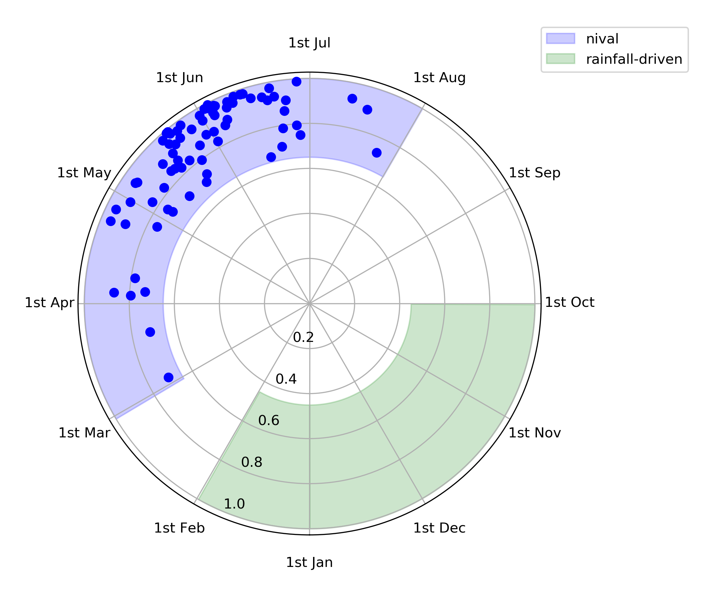
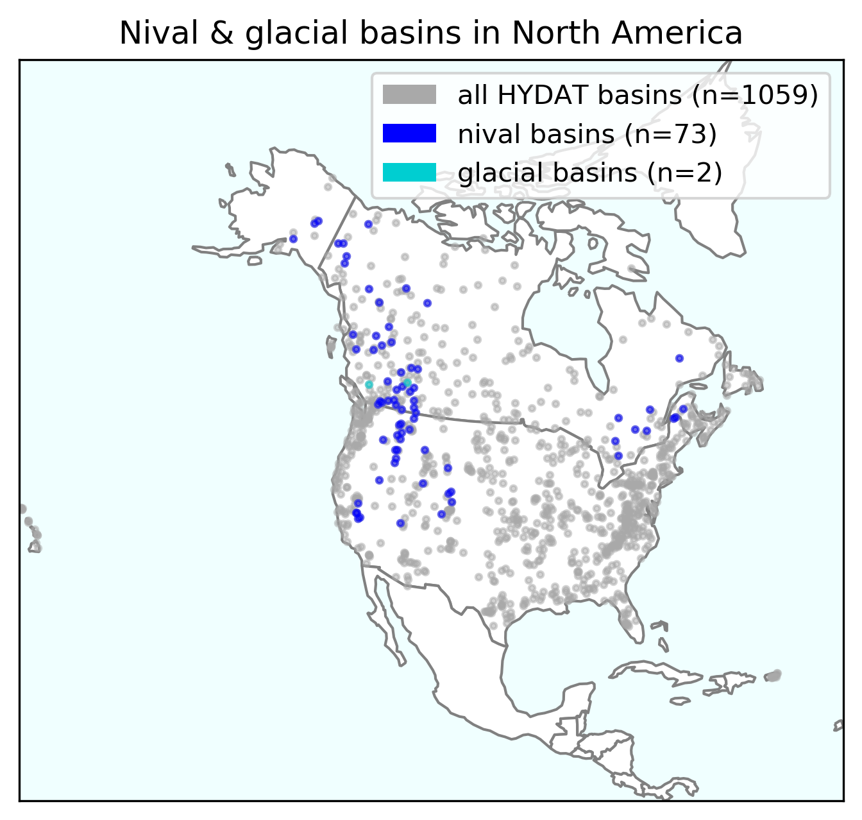
Snow-fed basins with limited regulation in N. America
We select snow-fed (nival) basins with
  limited regulation,
    Canada: HYDAT Reference Hydrometric Basin Network (RHBN)
    USA: USGS Hydro-Climatic Data Network (HCDN-2009)
  ≥ 20 years of SWE-Q data.
We identify glacial basins for skill diagnosis later on.
(left) Polar plot of nival & glacial basins’ mean Qmax timing.
(right) North American map of nival & glacial basins with limited regulation and ≥ 20 years of overlapping Q-SWE data.

Slide 6
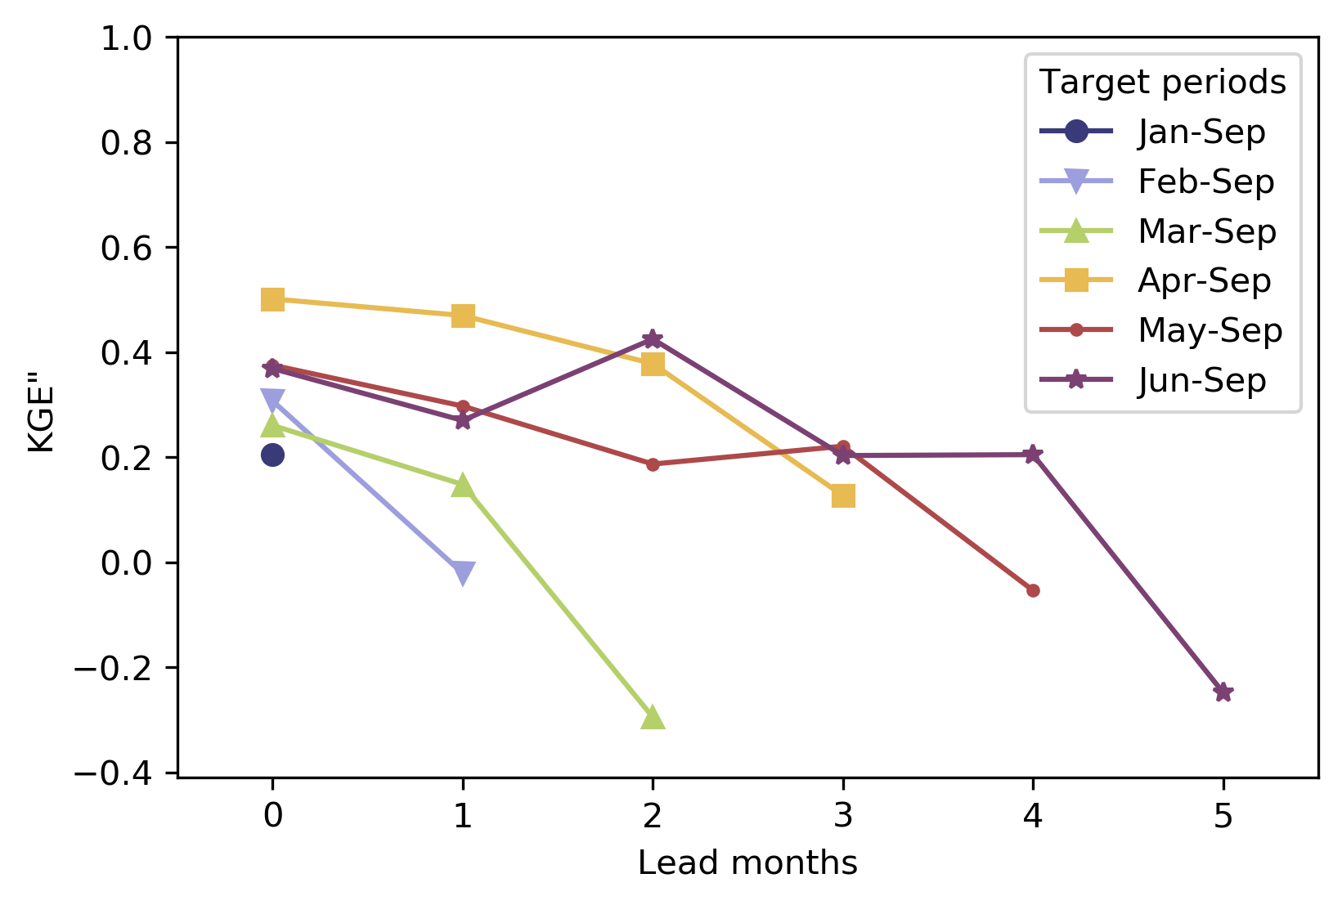
How good are the hindcasts?
This shows the evolution of the quality of the hindcast medians per lead time & target period, averaged over Canada*.
The quality is measured with the KGE”: a combined measure of correlation, bias & variance (Clark et al., 2021).
Overall, the hindcasts have high KGE”, which decreases with increasing lead time.
Spatial average of the hindcast KGE” (revised Kling-Gupta efficiency) per lead month (x-axis) for each target period (lines). Higher KGE” is better. The lower threshold is -0.41 and corresponds to the mean flow benchmark (Knoben et al., 2019).
*USA results pending

Slide 7
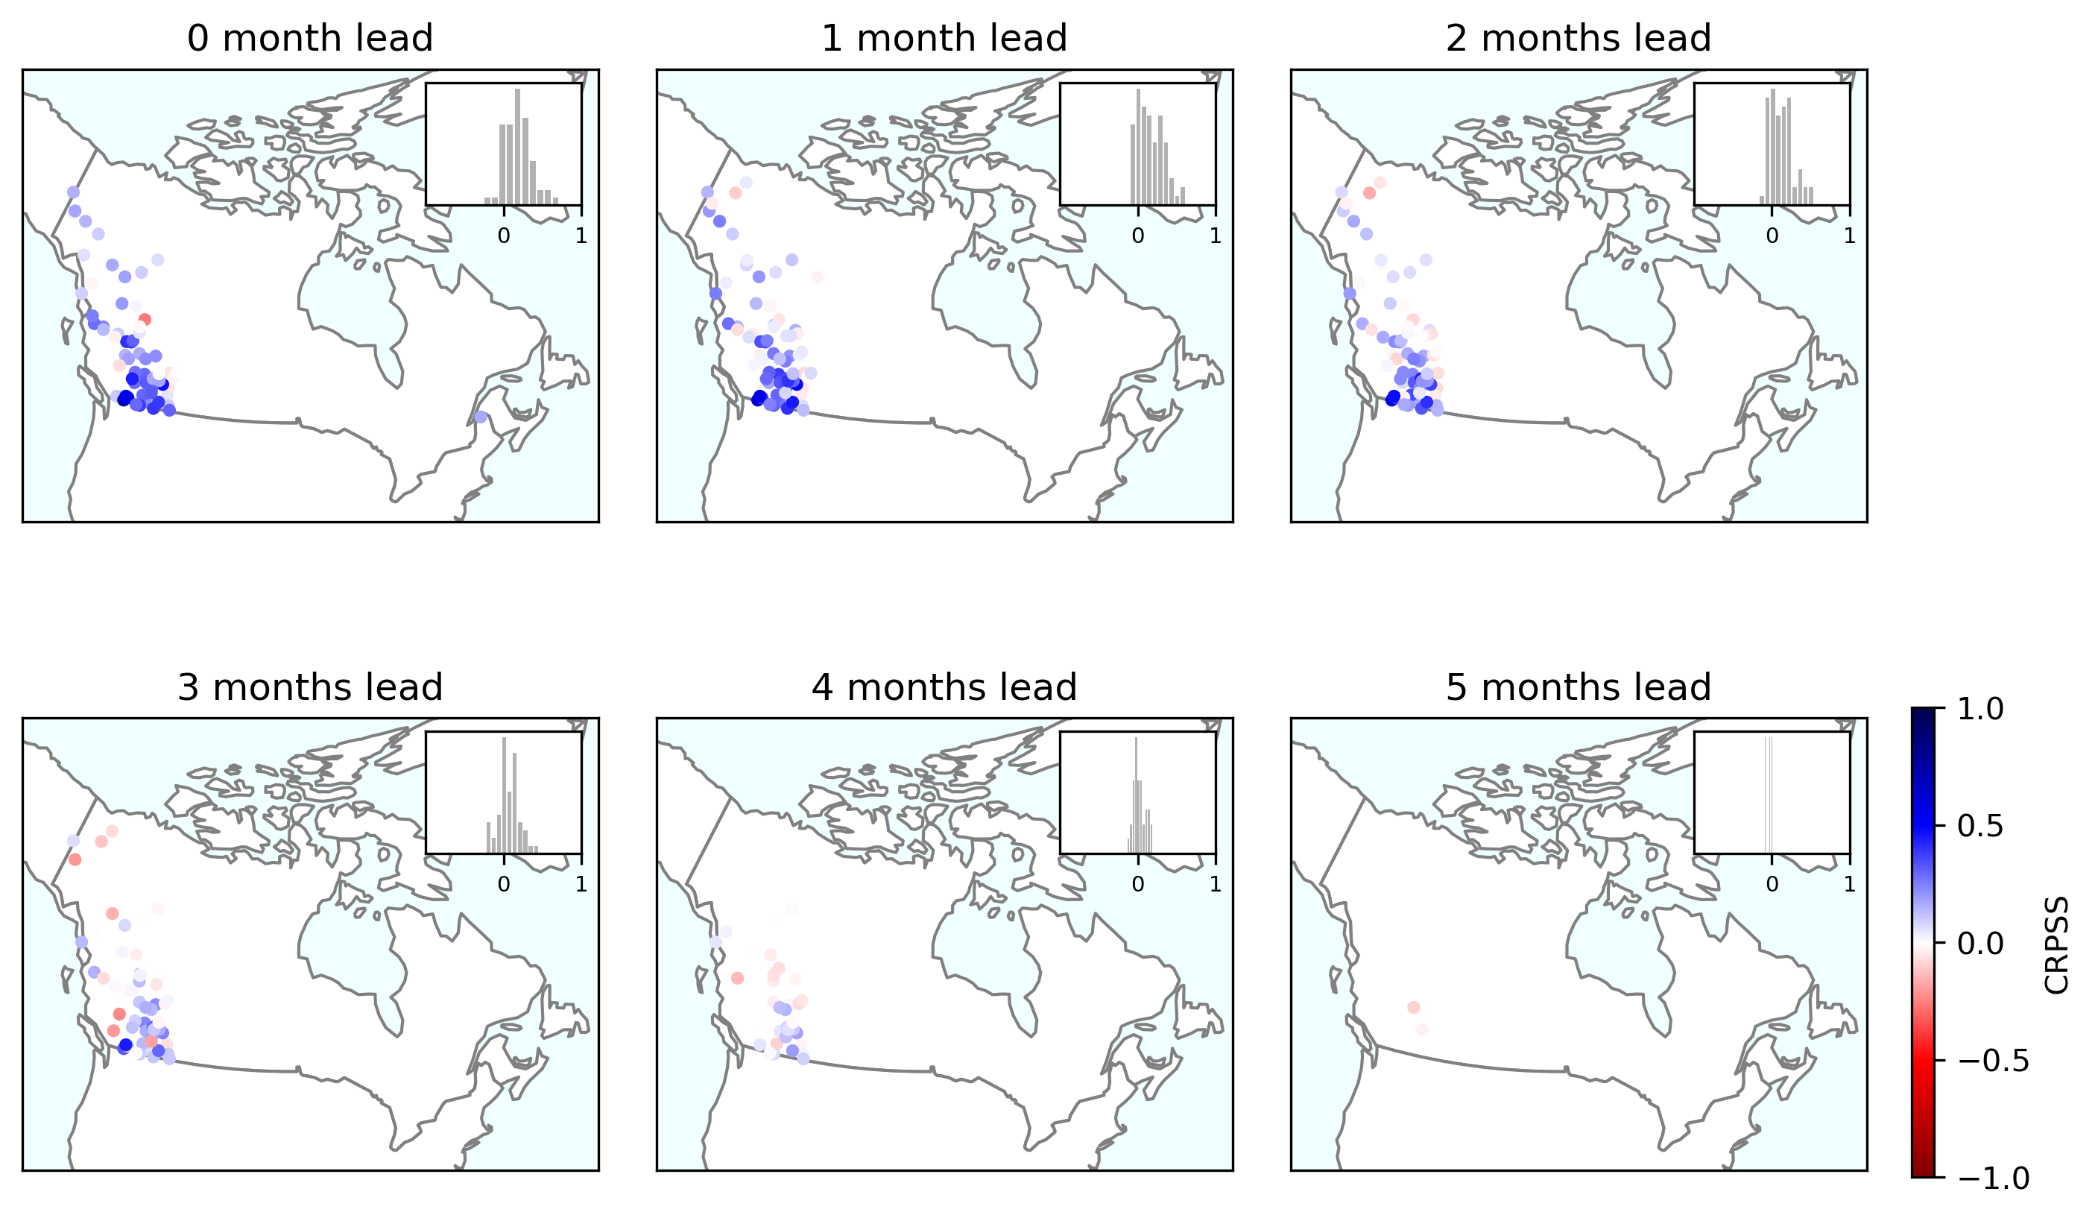
Are the hindcasts better than climatology?
This shows the evolution of the ensemble hindcast skill (CRPSS) compared to the observed climatology, with lead time.
Overall, the hindcasts are better than climatology up to 2 months lead time. Beyond this they do not have probabilistic skill.
Maps of hindcast CRPSS (Continuous Rank Probability Skill Score) per lead month (subplots) and the histograms of CRPSS values distributions. Each map shows the CRPSS for the freshet target period in each basin. Note that results are only shown for basins with ≥10 years of hindcasts.
Skill: hindcasts > climatology
No skill: hindcasts < climatology
*USA results pending

Slide 8

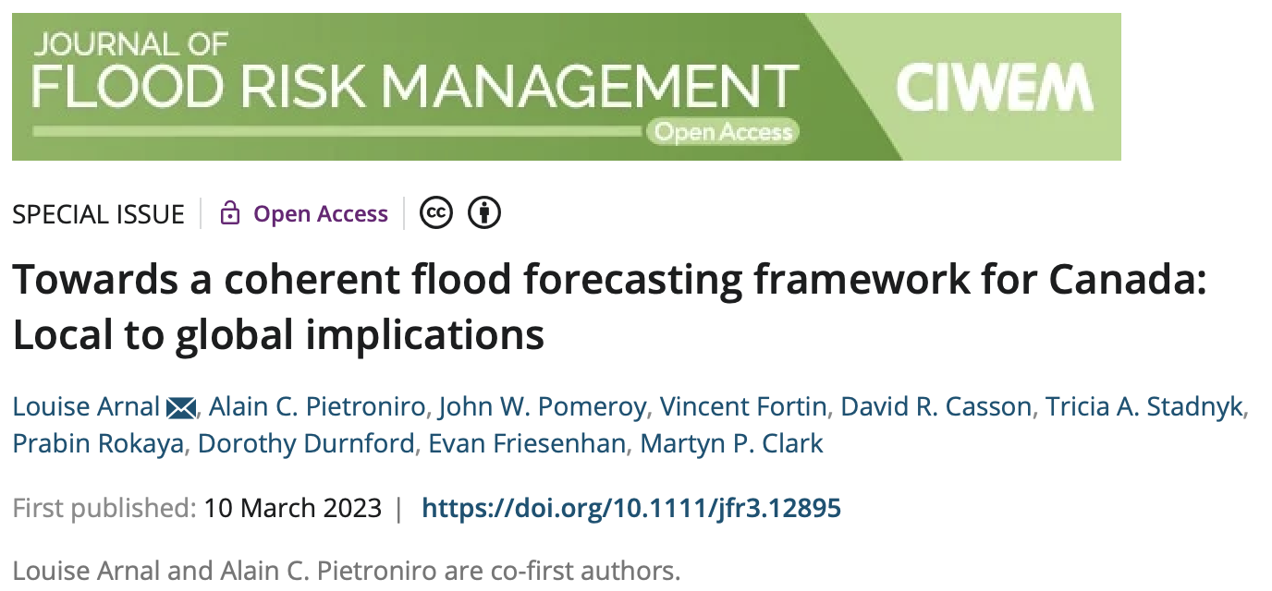

Thank you!
Merci!
Future steps:
Finish N. America analysis.
Publish the results.
Share the data & workflow*.
*Feel free to contact me if you would like to receive a link to the GitHub repo as soon as it is published.
VirtualWaterGallery.ca
@ArnalLouise
louise.arnal@usask.ca

