Slide 1



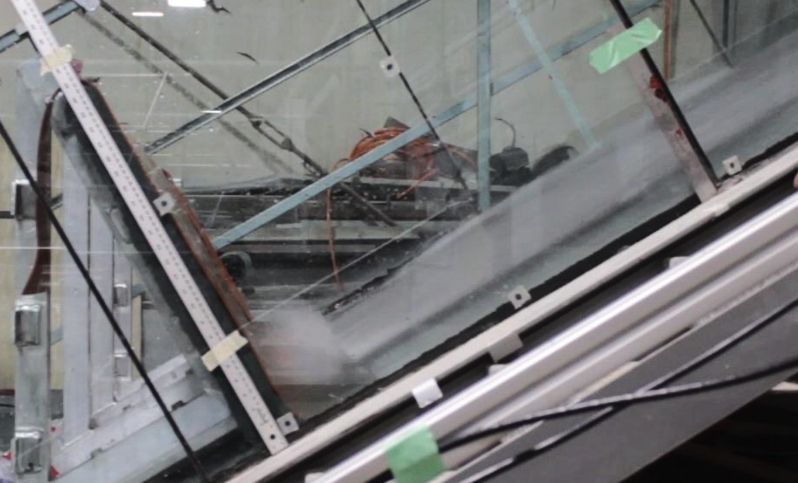
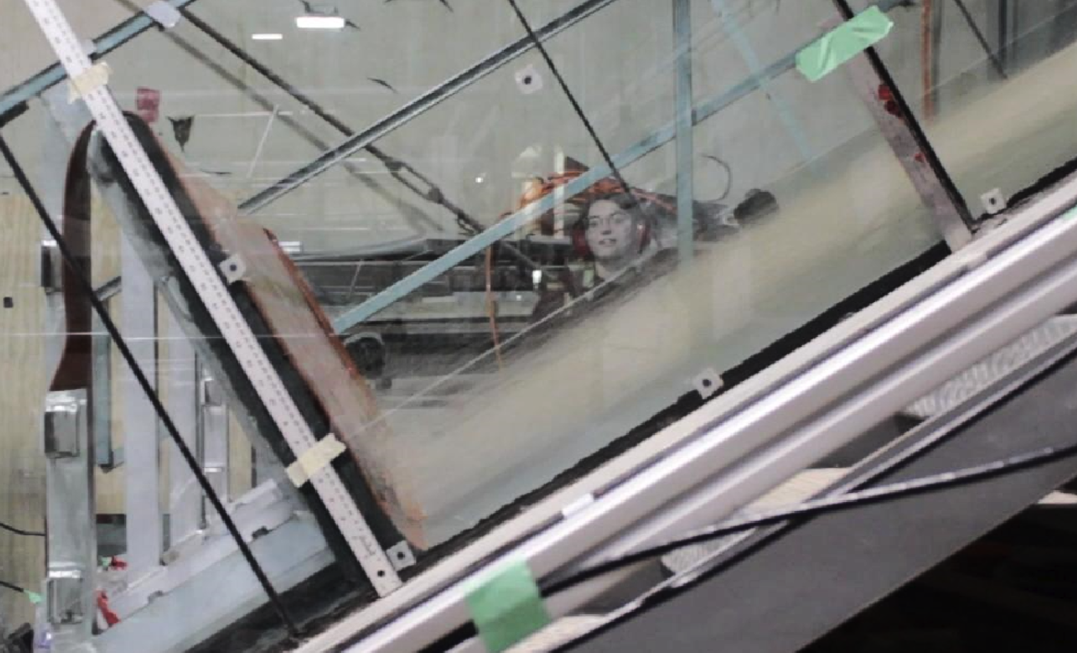
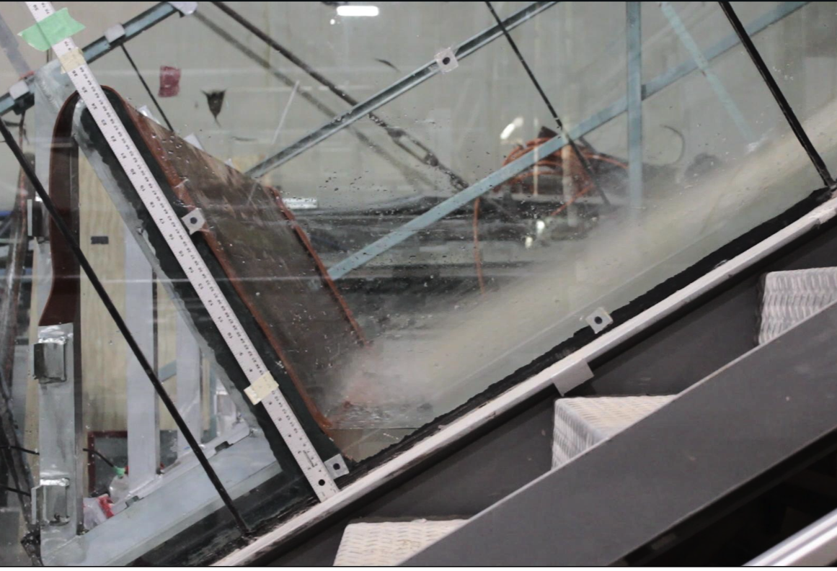
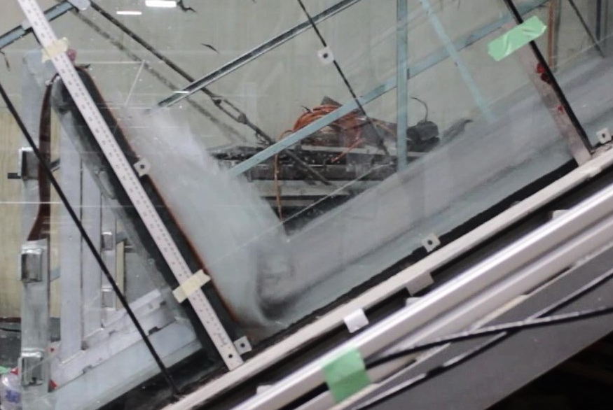
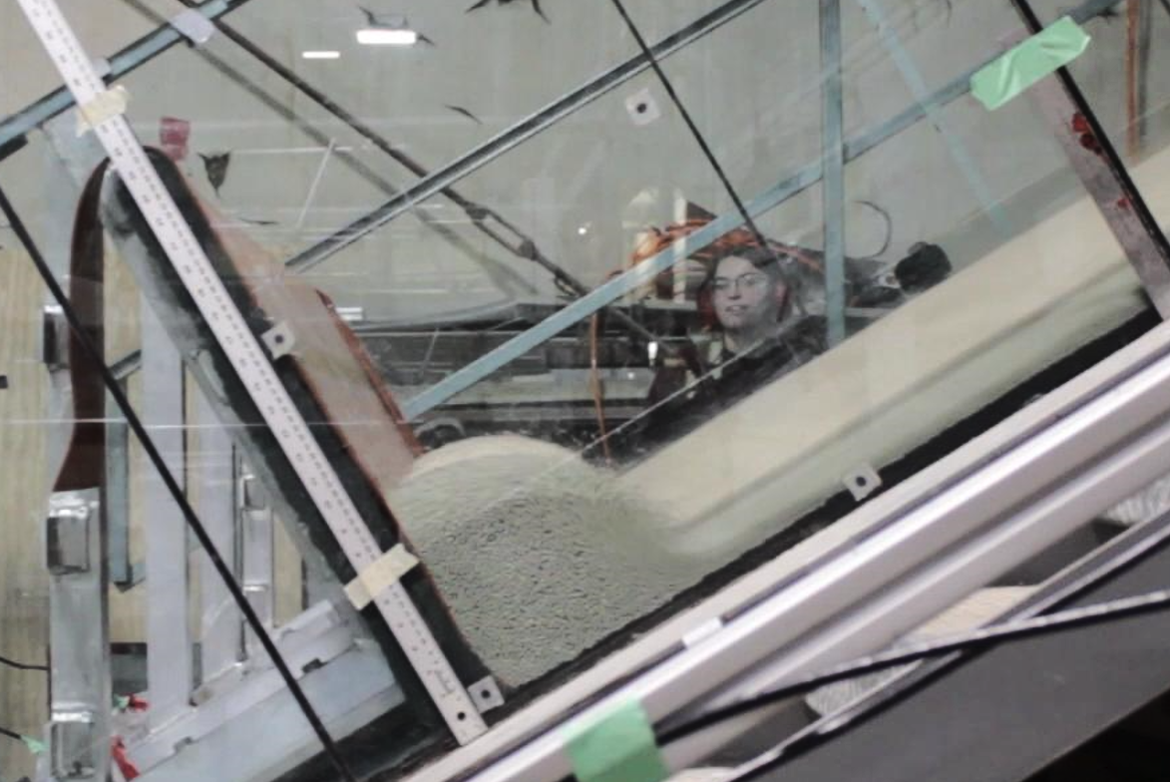
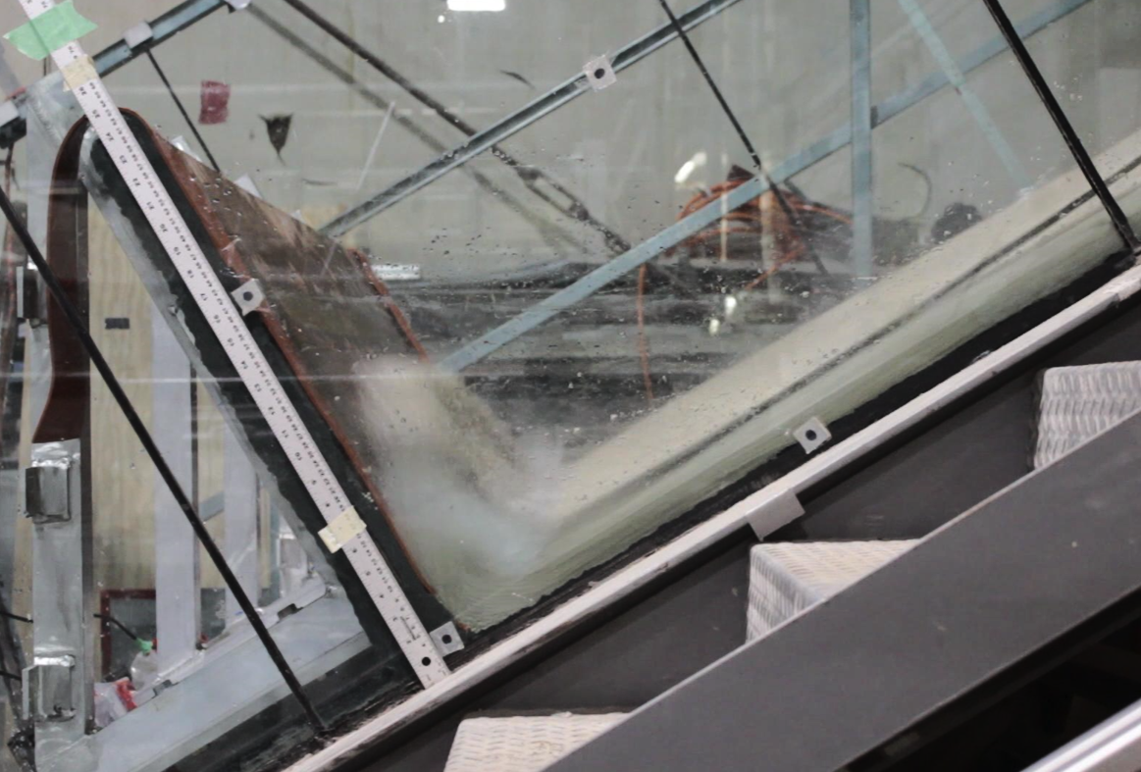
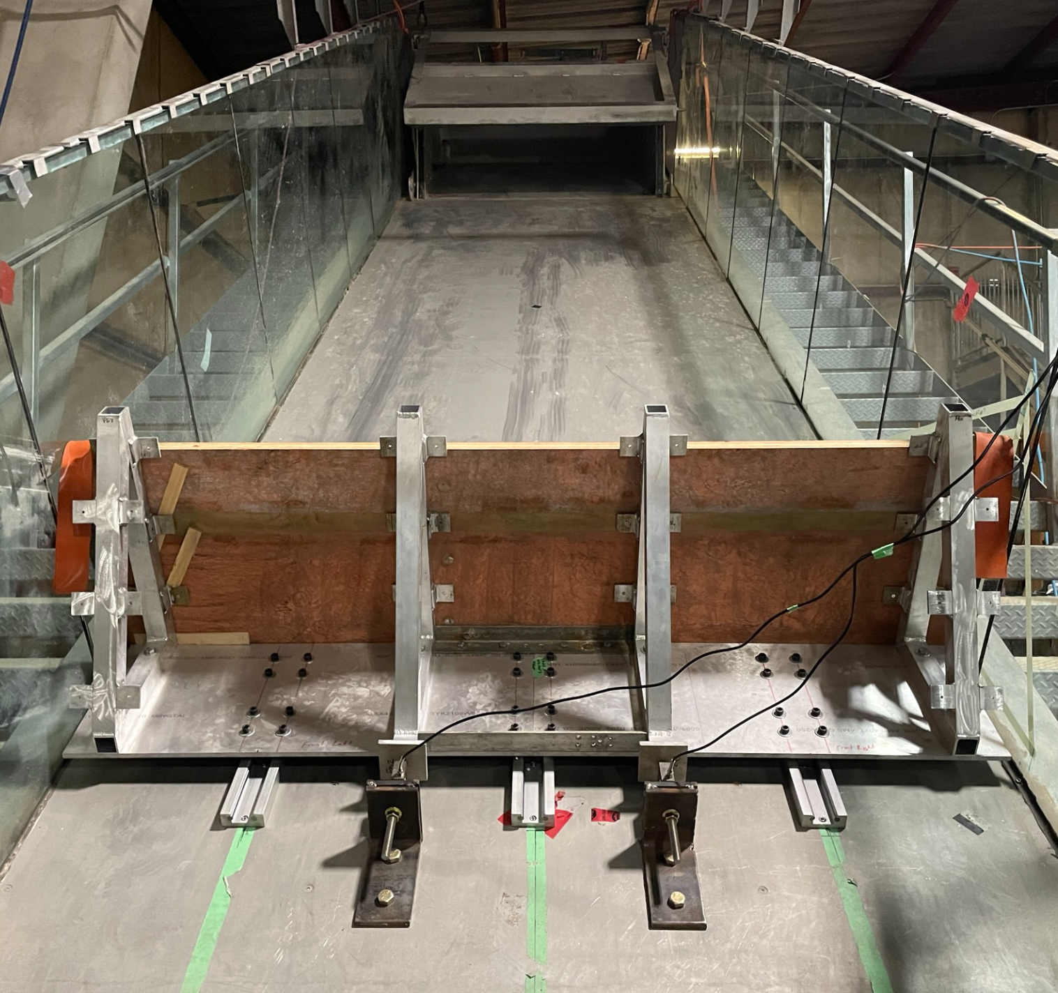
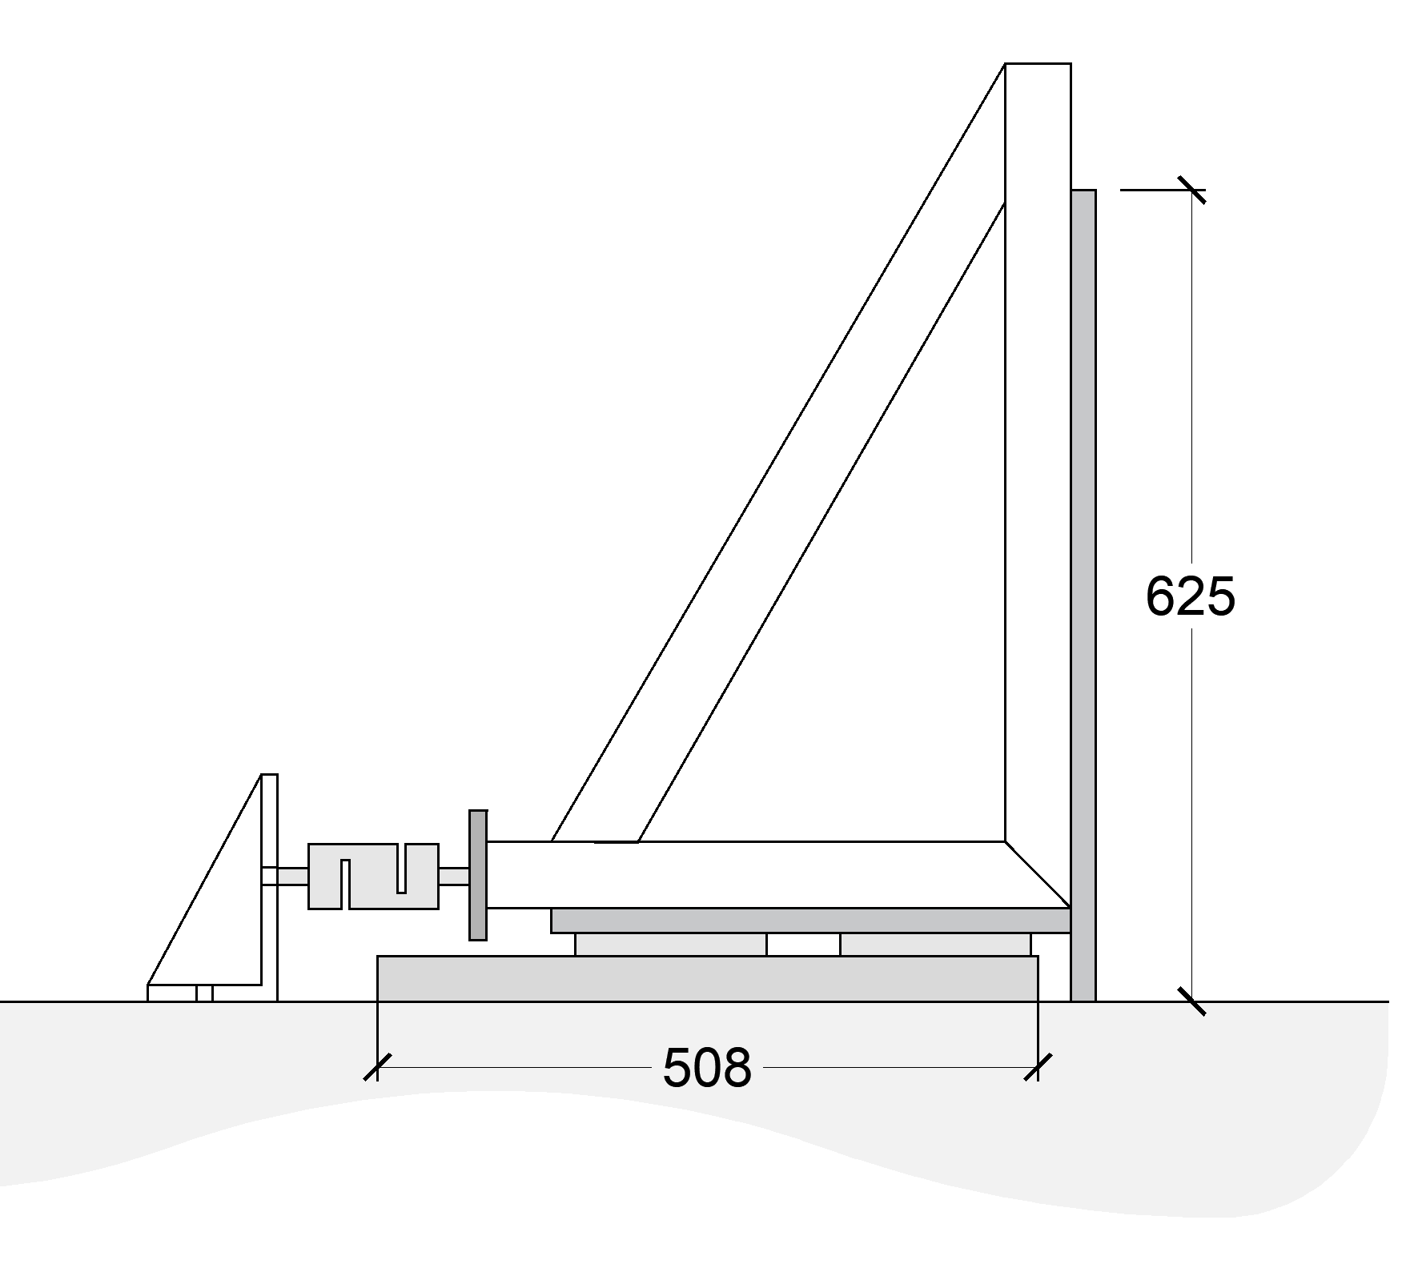
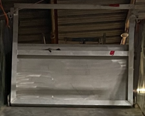
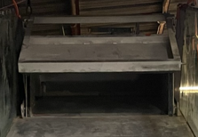
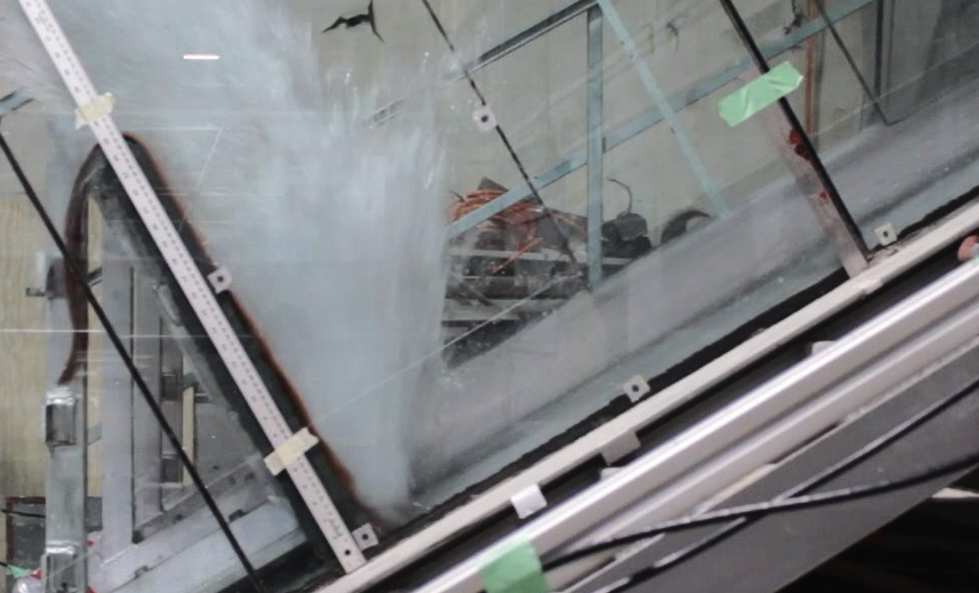
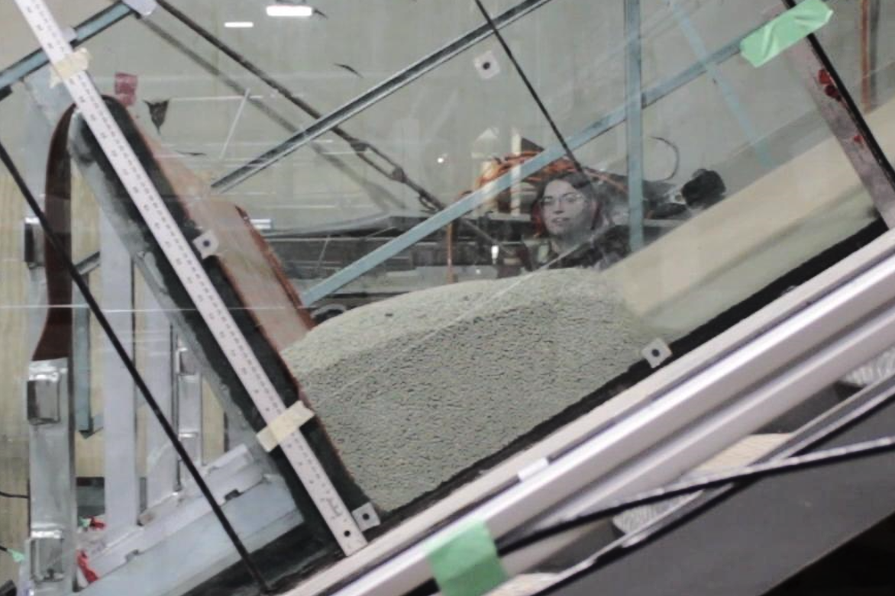
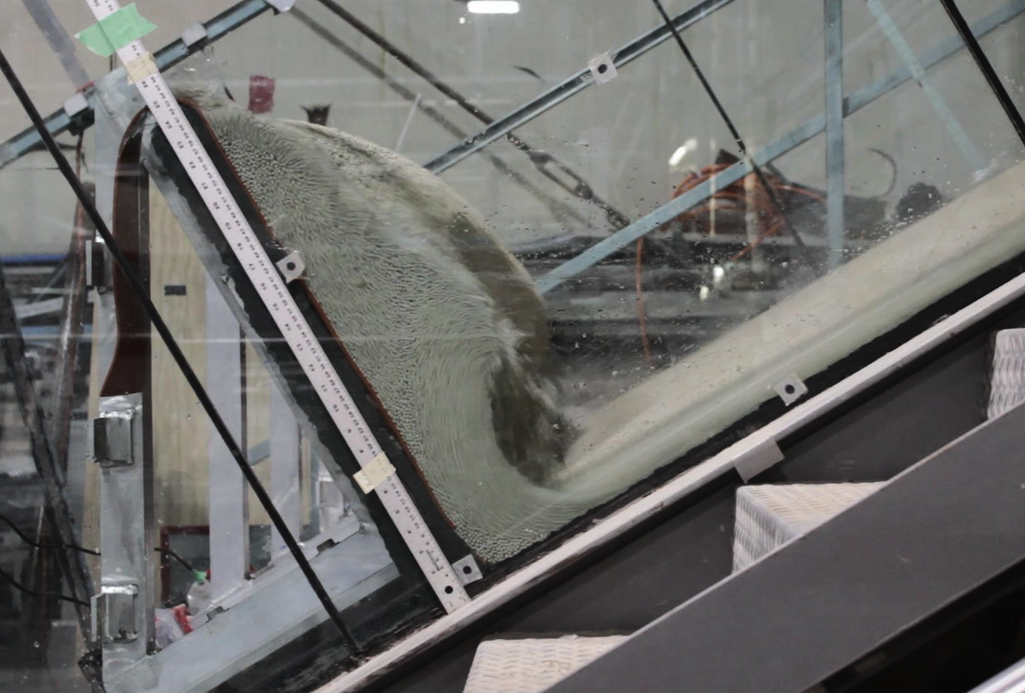
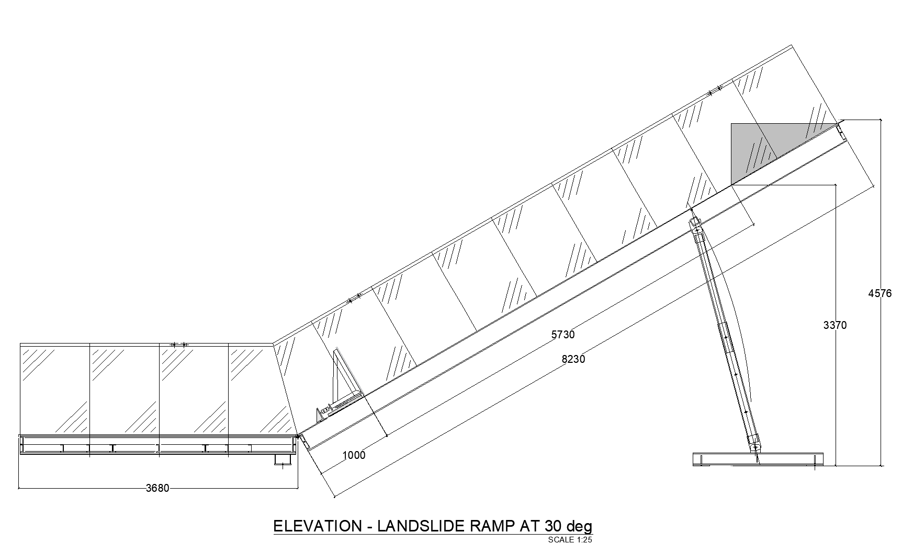
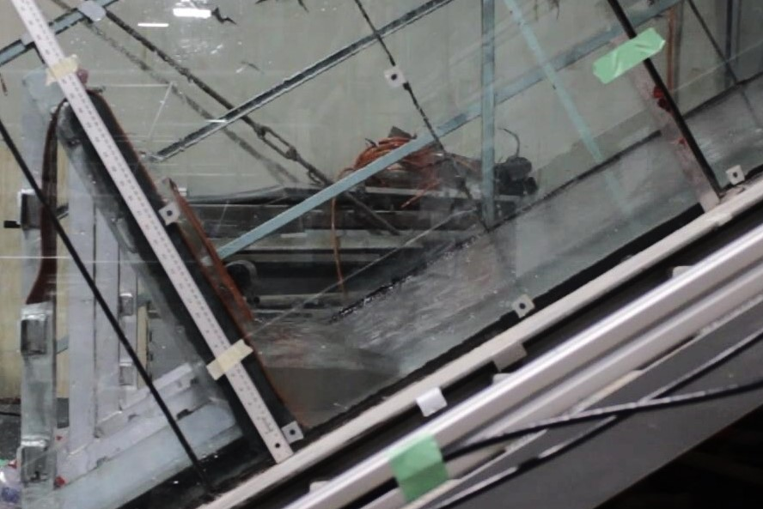
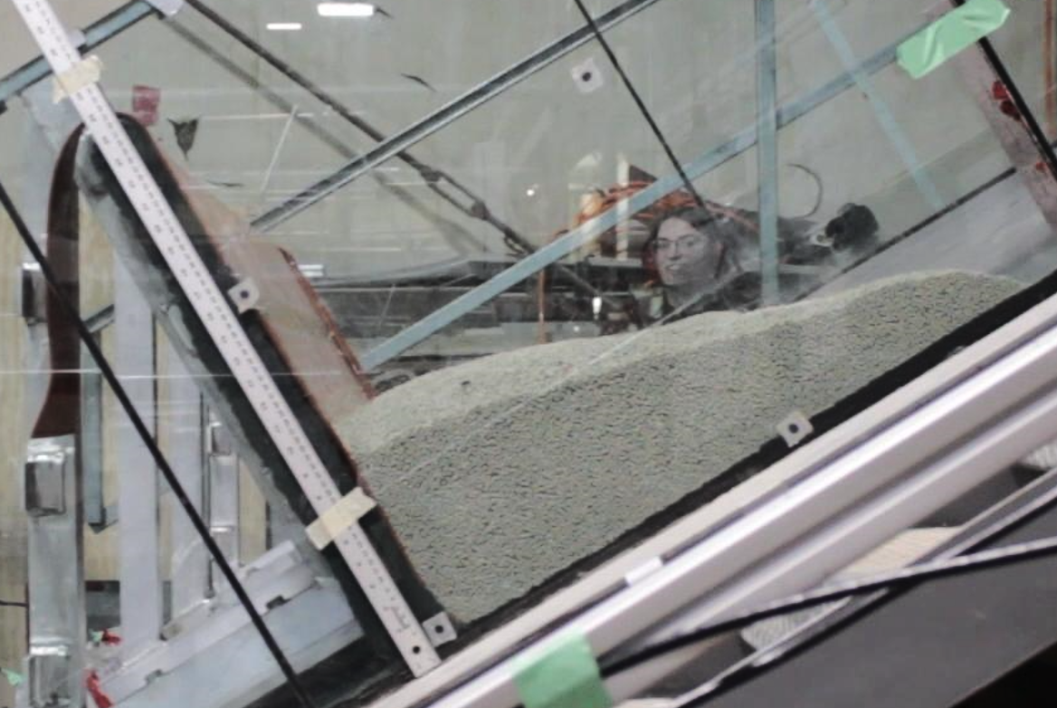
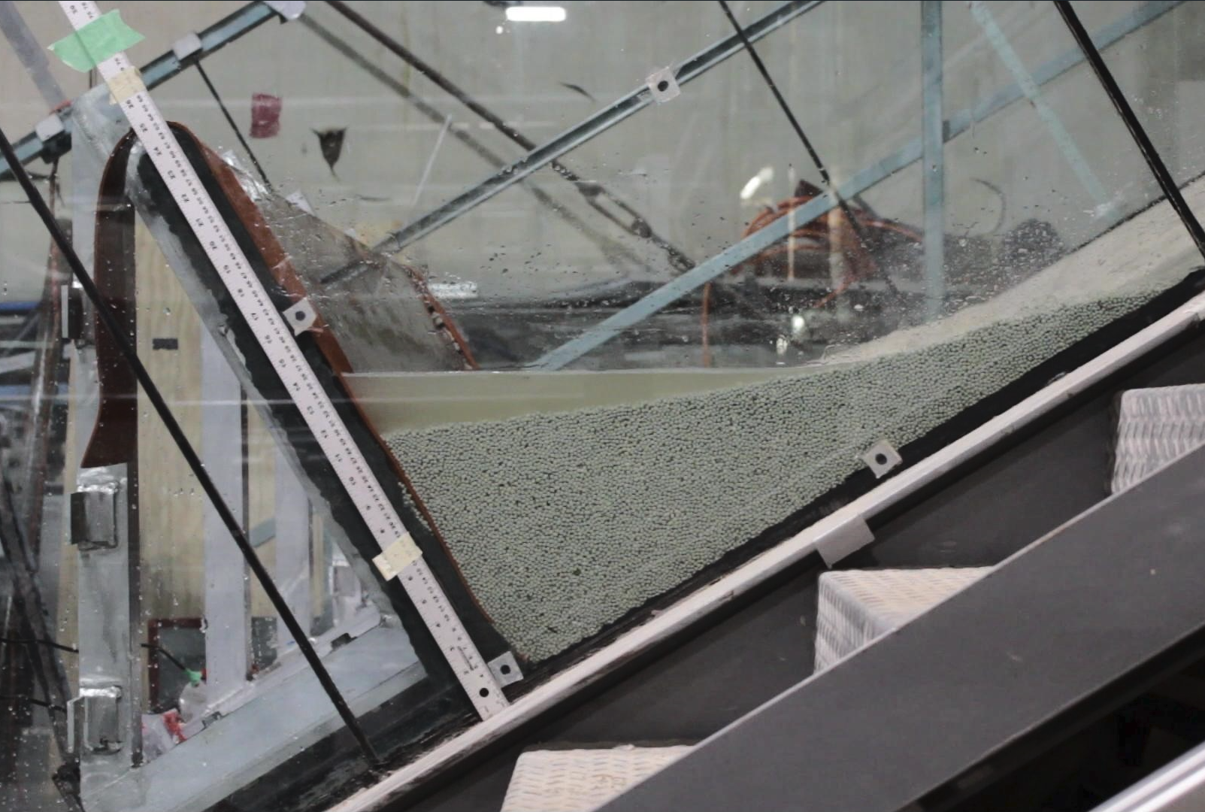


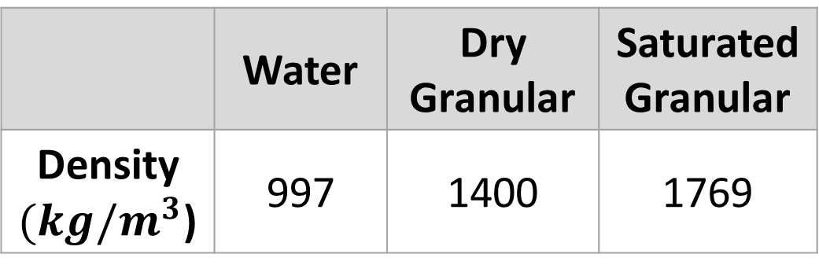


Exploring the relative contributions of fluid and solid phases in debris flow barrier impact
Questions Contact:
Esmé Hirsch, MASc
17ech2@queensu.ca
Esmé Hirsch, Joshua Woods, Ryan Mulligan, and Andy Take
Department of Civil Engineering, Queen’s University, Kingston, Ontario
Introduction
Impact Events
Calibration
Debris flows are a catastrophic type of fast-moving landslide comprised of water, debris, soil, and rock. Debris flows are a common natural hazard in mountainous regions around the world and pose serious risk to human life and infrastructure. Landslide barrier structures constructed on high-risk slopes are a useful strategy to halt and retain debris to protect vulnerable downslope infrastructure and inhabitants. To appropriately design these systems, the structural demand on the barrier must be defined. Various debris flow parameters, including the grain size distribution and the water content, as well as the volume, thickness, and velocity, govern this force response.
Water
Dry Granular
Saturated Granular
A hydrostatic fill test was conducted using known volumes of water to assess the frictional losses within the barrier system. These results illustrate the importance of quantifying frictional losses due to the waterproofing sealant and the sliding rail bearings.
t=0s
t=0s
T=?
t=0s
$$t_{0}$$
Research Facility
t=0.2s
t=1s
t=0.3s
Impact Plots
Testing was conducted in the Queen’s University West Campus Coastal Facilities in the landslide flume.
$$t_{1}$$
1. View up slope
2. Barrier
3. Release box
2.10m
t=0.4s
t=1.5s
t=0.7s
$$t_{2}$$
3.
Distinct dynamic force responses were observed for each test case. Water content appears to significantly influence the initial force peak, which corresponds to the observed jetting. Saturation of the granular material more than doubled the peak force when compared to the dry granular test, indicating the significance of the behaviour at the impact zone when quantifying force.
Load cells
Linear sliding rails
t=7s
t=8s
t=5.5s
2.
$$t_{f}$$
All dimensions in mm
Conclusions and Next Steps
Physical Testing
Behaviour at the impact zone varies significantly for the three tests cases. The dry granular impact is characterized by a reflected wave whereas the saturation of the granular material results in a jet-like behaviour. This is in agreement with results from Taylor-Noonan et al. 2022 regarding the influence of pore fluid on mobility of granular flows. The impact of the water release resulted in more extreme jetting at the barrier, with significant overtopping.
The fluid phase has a significant impact on the dynamic force response of a structure to an incoming flow. Reflected wave vs jet-like behaviour at impact results in significant differences in the time-history of the force as well as the magnitude of the peak force.
Next steps include expanding the test matrix to include a range of saturation levels, different release volumes, and different grain size gradations. Additionally, further instrumentation including highspeed cameras for PIV analysis and assessment of material segregation, as well as pore pressure sensors to determine vertical load distribution
Tests were performed using equal volume (0.2m³) releases for three cases: water only, dry granular, and saturated granular. The granular material consisted of 3.85 mm diameter ceramic beads with a volume fraction of
 | Water | Dry Granular | Saturated Granular
Density $(kg/m^{3}$) | 997 | 1400 | 1769
approximately 0.63. Two load cells were installed behind the barrier to measure the impact force and cameras were used to capture the impact behaviour.
References
Taylor-Noonan, A. M., Bowman, E. T., McArdell, B. W., Kaitna, R., McElwaine, J. N., & Take, W. A. 2022. “Influence of pore fluid on grain-scale interactions and mobility of granular flows of differing volume.” Journal of Geophysical Research: Earth Surface, 127, doi.org/10.1029/2022JF006622.

