Slide 1
Evolution and development of ephemeral gully erosion in hilly and gully region of the Loess Plateau in China
Boyang Liu^{1,2}, Biao Zhang^{1,2}, Ziming Yin³, Bai Hao⁴, Shufang Wu^{1,2}, Hao Feng¹, and Kadambot H.M. Siddique⁵
¹Key Laboratory of Agricultural Soil and Water Engineering in Arid and Semiarid Areas, Ministry of Education, Northwest A & F University, China; ²Institute of Water Saving Agriculture in Arid Areas of China, Northwest A & F University, China; ³College of Natural Resources and Environment, Northwest A&F University, China; ⁴Sichuan Expressway Construction & Development Group Co., Ltd., China; ⁵The UWA Institute of Agriculture and School of Agriculture & Environment, The University of Western Australia, Australia
1/8
EGU23 SSS9.12-Challenges in cooperative research between EU-China on sustainable use of soil and water resources in agricultural systems

Slide 2
Objectives
Spatial-temporal development
Analyzed the spatial-temporal evolution and development rate of ephemeral gully erosion at the watershed scale on the Loess Plateau from 2009 to 2021
V-L relationship
Built an empirical model between ephemeral gully erosion volume and length to assess historical ephemeral gully erosion volume
Ephemeral gully erosion rate
Calculated ephemeral gully erosion volume based on the V–L model using ephemeral gully length in 2009, and estimated ephemeral gully erosion volume change rate from 2009 to 2021
EGU General Assembly 2023
2/8

Slide 3
Study Area and Data
Study area
The Zhoutungou watershed (36°42’10” N to 36°47’10” N, 109°09’00” E to 109°13’45” E), a typical small watershed (area 33.60 km²) in the hilly and gully region of the Loess Plateau, the annual average temperature is 8.80 ℃ and annual average rainfall is 550 mm (74% falls from July to September).
Study Data
The remote sensing image data included 0.50 m high-resolution digital orthophoto map(DOM) in 2009, 2012, and 2018 and 0.50 m high-resolution DOM images by UAV in 2021. The digital elevation model (DEM) with 0.15m resolution by UAV in 2021.
EGU General Assembly 2023
3/8
Notes:
人们为了研究沟壑的空间分布对流域管理的重要性，创建了沟壑侵蚀敏感图

Slide 4
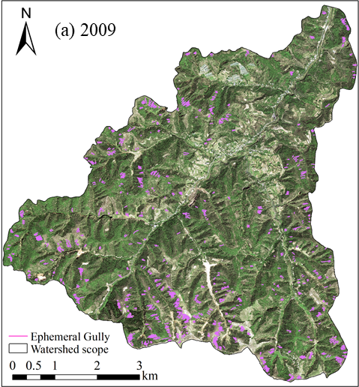
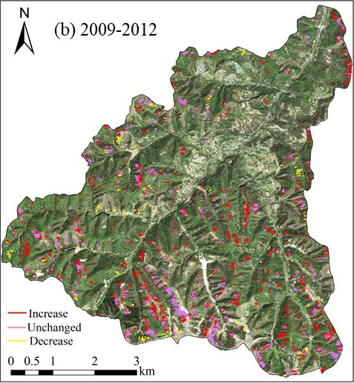
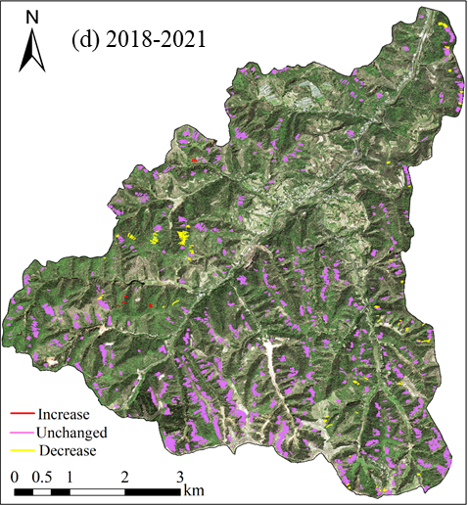
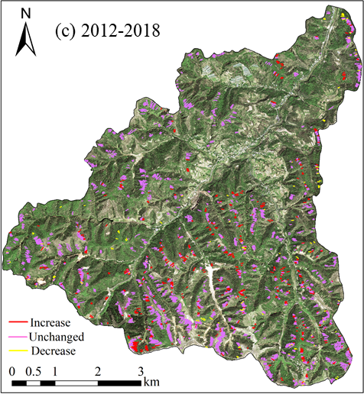
Spatial-temporal changes
EGU General Assembly 2023
4/8
Notes:
人们为了研究沟壑的空间分布对流域管理的重要性，创建了沟壑侵蚀敏感图

Slide 5
Ephemeral gully features
Morphological features | Year | Number | Minimum | Maximum | Mean | Total | Average annual development rate in 2009 – 2021
Frequency (km^{–2}) | 2009 | 1,153 |  |  |  | 34.32 | 2.87 (km^{–2} y^{–1})
 | 2012 | 2,045 |  |  |  | 60.86
 | 2018 | 2,413 |  |  |  | 71.82
 | 2021 | 2,312 |  |  |  | 68.81
Length (m) | 2009 | 1,153 | 7.00 | 209.50 | 48.39 | 5.58×10⁴ | 1.66 (m y^{–1})
 | 2012 | 2,045 | 5.00 | 228.00 | 46.58 | 9.53×10⁴
 | 2018 | 2,413 | 2.00 | 230.00 | 45.75 | 1.10×10⁵
 | 2021 | 2,312 | 5.00 | 209.50 | 45.84 | 1.06×10⁵
Density (km km⁻²) | 2009 | 1,153 | 2.08×10⁻⁴ | 6.24×10⁻³ | 1.44×10⁻³ | 1.66 | 0.12 (km km⁻² y^{–1})
 | 2012 | 2,045 | 1.49×10⁻⁴ | 6.79×10⁻³ | 1.39×10⁻³ | 2.84
 | 2018 | 2,413 | 5.95×10⁻⁵ | 6.85×10⁻³ | 1.36×10⁻³ | 3.29
 | 2021 | 2,312 | 1.49×10⁻⁴ | 6.24×10⁻³ | 1.36×10⁻³ | 3.15
Width (m) | 2009 | 1,153 | 0.50 | 2.50 | 1.01 | 1.17×10³ | 0.04 (m y^{–1})
 | 2012 | 2,045 | 0.50 | 2.00 | 1.01 | 2.07×10³
 | 2018 | 2,413 | 0.50 | 2.00 | 1.00 | 2.42×10³
 | 2021 | 2,312 | 0.50 | 2.00 | 1.01 | 2.34×10³
Area (m²) | 2009 | 1,153 | 6.50 | 230.71 | 49.12 | 5.66×10⁴ | 4.22×10³ (m² y^{–1})
 | 2012 | 2,045 | 4.64 | 246.86 | 47.34 | 9.68×10⁴
 | 2018 | 2,413 | 4.64 | 230.00 | 46.05 | 1.11×10⁵
 | 2021 | 2,312 | 5.36 | 209.50 | 46.36 | 1.07×10⁵
Dissection degree (%) | 2009 | 1,153 | 1.93×10⁻⁵ | 6.87×10⁻⁴ | 1.46×10⁻⁴ | 0.17 | 0.01 (% y^{–1})
 | 2012 | 2,045 | 1.38×10⁻⁵ | 7.35×10⁻⁴ | 1.41×10⁻⁴ | 0.29
 | 2018 | 2,413 | 1.38×10⁻⁵ | 6.85×10⁻⁴ | 1.37×10⁻⁴ | 0.33
 | 2021 | 2,312 | 1.60×10⁻⁵ | 6.24×10⁻⁴ | 1.38×10⁻⁴ | 0.32
5/8
EGU General Assembly 2023
Notes:
人们为了研究沟壑的空间分布对流域管理的重要性，创建了沟壑侵蚀敏感图

Slide 6
V-L relationship
Construction
$$\left.V=0.0842L^{1.1932} (R^{2}=0.80, n=1,594\right)$$
Validation
EGU General Assembly 2023
6/8
Notes:
人们为了研究沟壑的空间分布对流域管理的重要性，创建了沟壑侵蚀敏感图

Slide 7
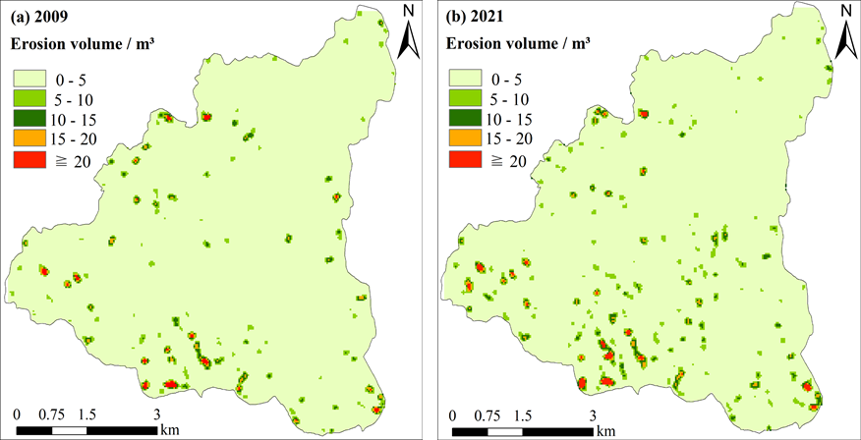
Ephemeral gully volume
Average annual development rate is 743.20 m³ y^{–1} in 2009 – 2021
EGU General Assembly 2023
7/8
Notes:
人们为了研究沟壑的空间分布对流域管理的重要性，创建了沟壑侵蚀敏感图

Slide 8
Acknowledgements
National Natural Science Foundation of China (41977064)
111 Project of the Ministry of Education
State Administration of Foreign Experts Affairs (B12007)
National Key R&D Program of China (2021YFD1900700)
Thanks for your attention !
EGU General Assembly 2023
8/8
Notes:
人们为了研究沟壑的空间分布对流域管理的重要性，创建了沟壑侵蚀敏感图

