Slide 1
OBSTransformer: A Generalized Transfer-Learned OBS Phase Picker (Supplementary File)
Alireza Niksejel (alireza.niksejel@dal.ca)
Miao Zhang (miao.zhang@dal.ca)
Dalhousie University
EGU General Assembly, 2023

Slide 2
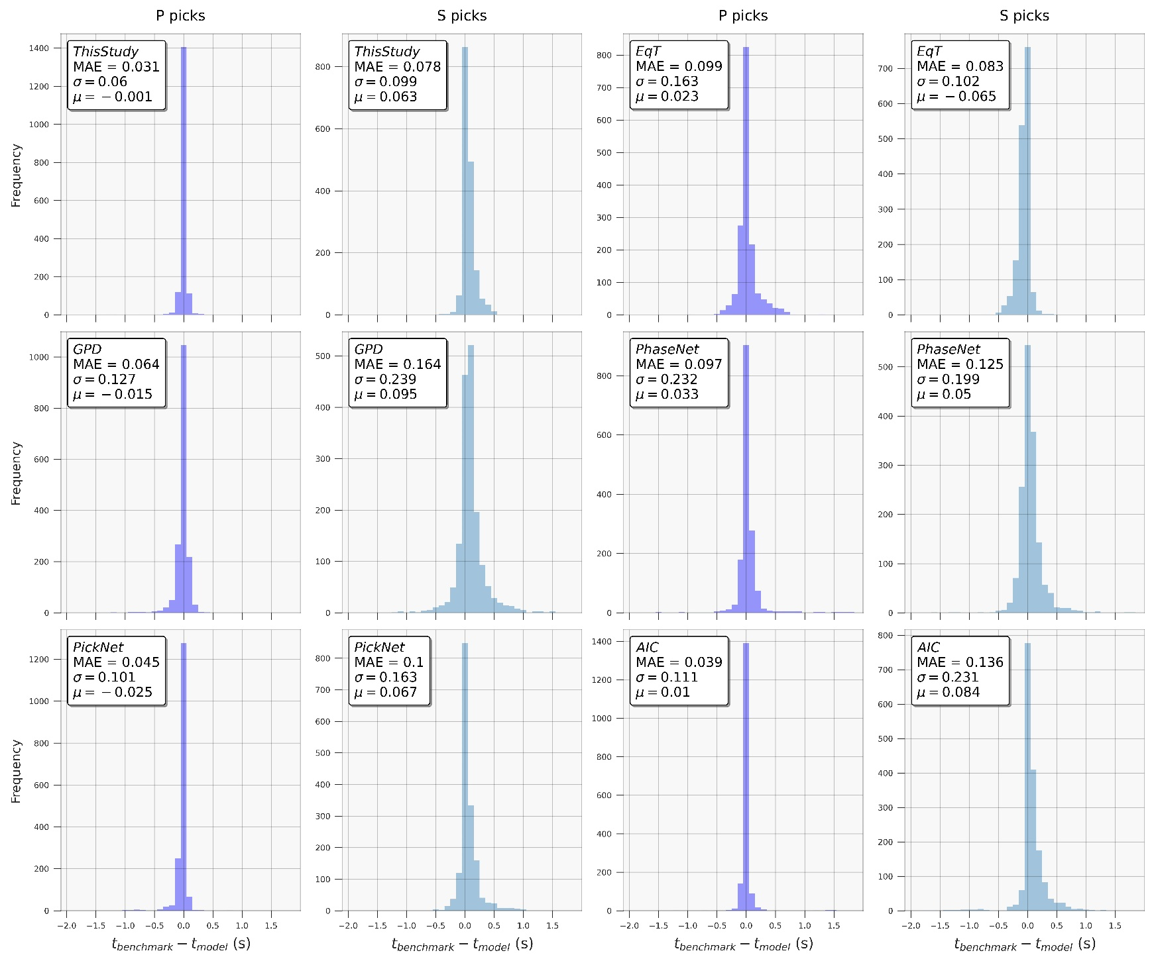
Labeling approach
Performance on our ~3k test dataset:
MAE:
0.03 sec for P waves
0.08 sec for S waves

Slide 3
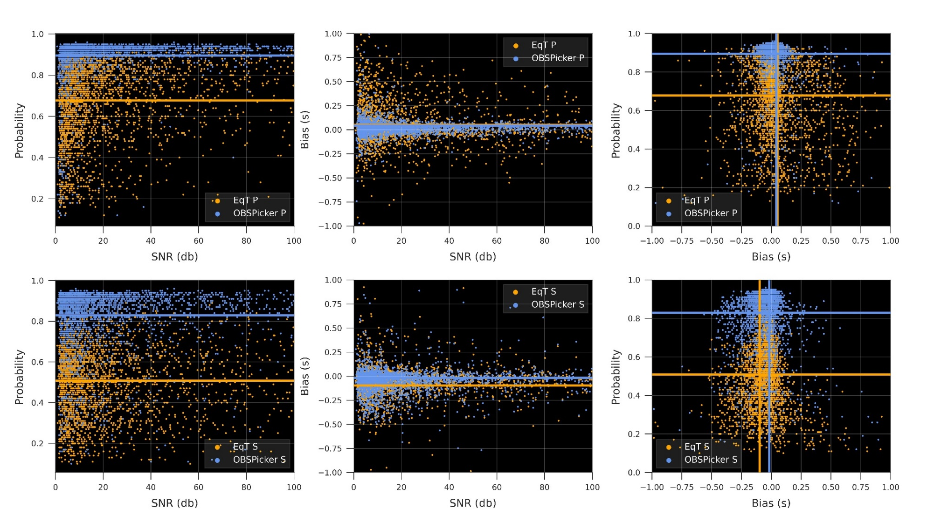
OBST performance
Probability and Bias distributions of P (top) and S (bottom) waves from EqT and OBST with respect to SNR.
Dataset: our ~3k test dataset

Slide 4
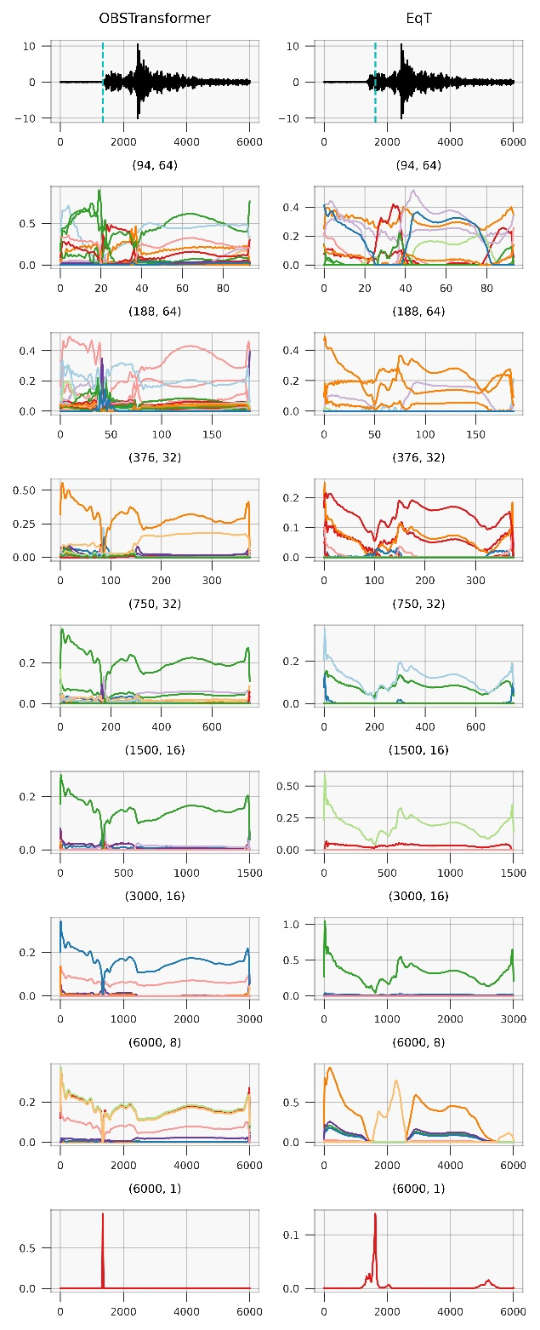
Sample feature maps from both pickers
Feature maps from P-decoder branch of EqT and OBST
Both pickers recognize some specific features at shallower CNN layers.
These features become less relevant to the actual P onset for EqT leading to a low probability detection (~15% confidence) with a bias of ~3 sec.
OBST has learned the most relevant features to the P onset. Final detection is with 95% confidence and a bias of 0.04 seconds.

Slide 5
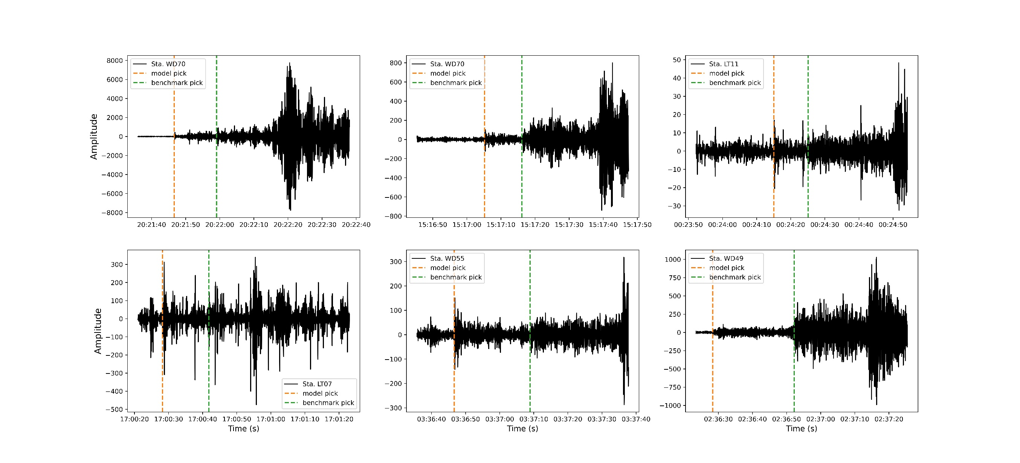
Large P residuals by OBST on AACSE dataset

Slide 6
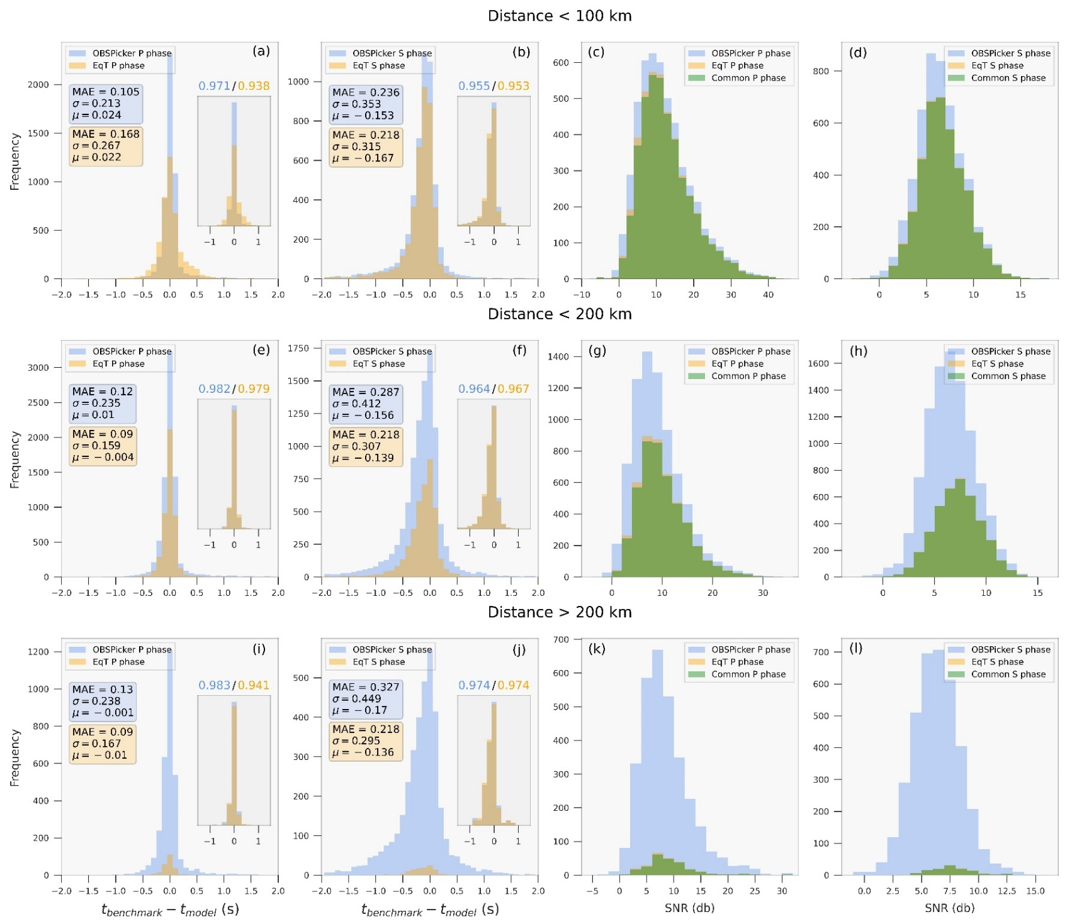
AACSE test
Test results on AACSE dataset in three different epicentral distance ranges.
Figures on the two right panels show the SNR of detection by both pickers as well as the common detections (green)

