Slide 1
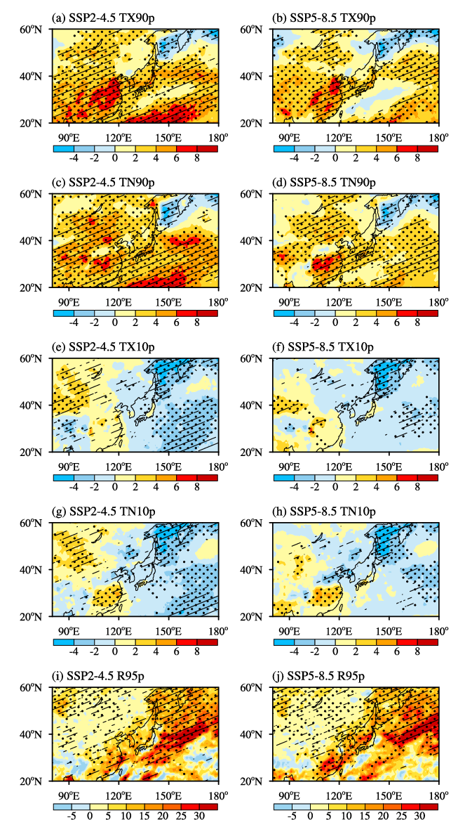
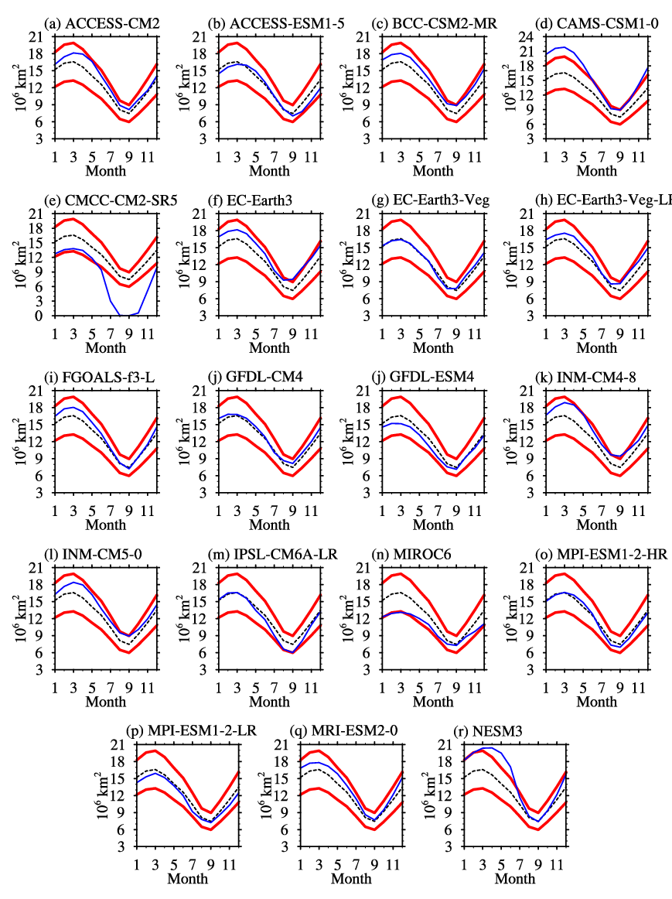
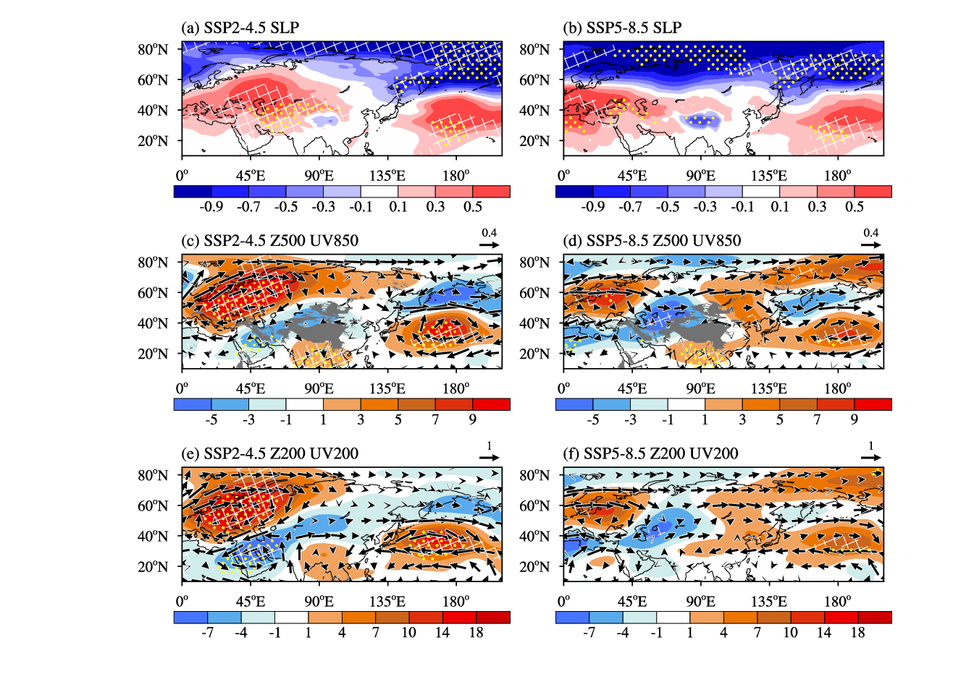
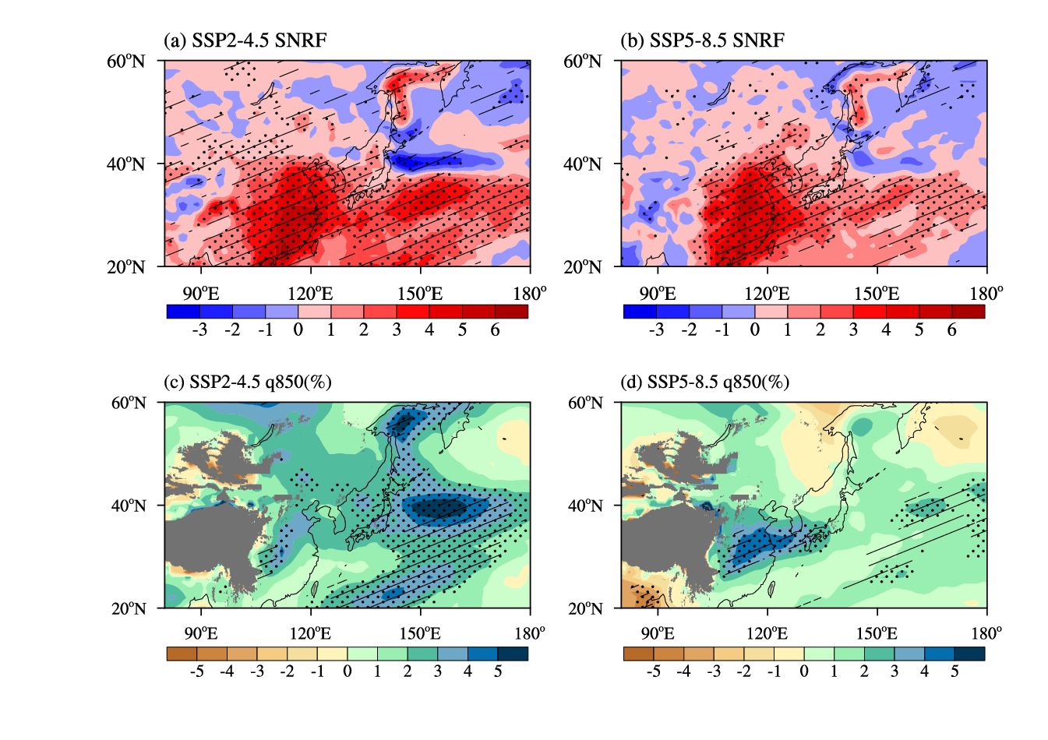
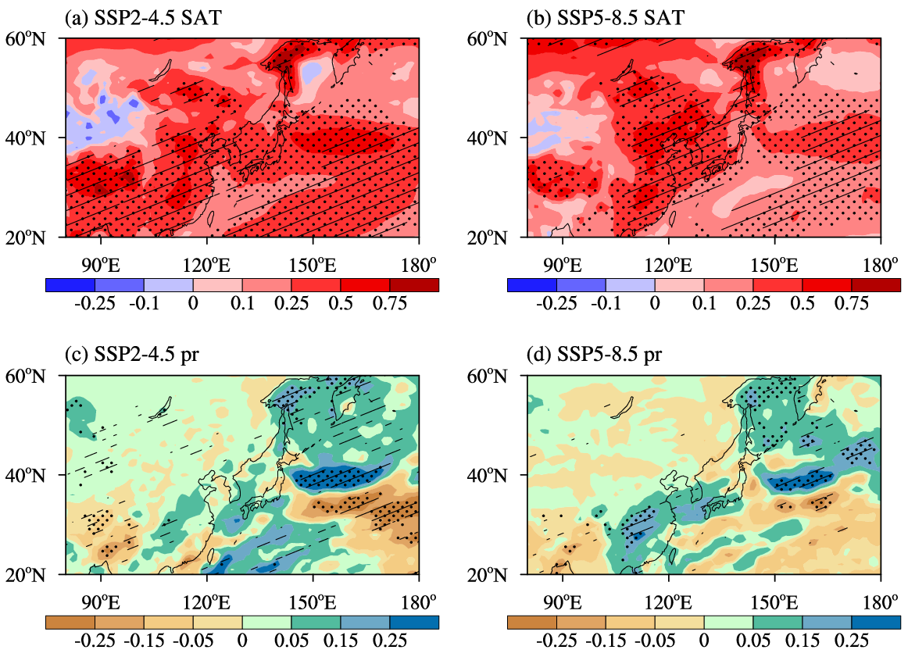
CMIP6 Projected Response of the East Asian Winter Climate to the Sea Ice Free Arctic
Ziyi Song (ziyi.song@foxmail.com)
School of Atmospheric Sciences, Nanjing University of Information Science and Technology, Nanjing, China
1. Background
(1) The East Asian winter monsoon (EAWM) anomalies tend to result in disastrous weather and climate, which may cause huge economic losses in East Asia.
(2) The Arctic sea ice is documented as one of the key factors that influence the East Asian winter climate. Accompanied with further warming, the Arctic sea ice is likely to completely melt in September within 30 years particularly under higher warming levels.
Motivation: How the East Asian winter climate responds to the projected sea ice-free Arctic under the CMIP6 framework?
2. Data and method
Data: Datasets of 19 CMIP6 models output from the historical simulation and the SSP2-4.5 and SSP5-8.5, and the observational gridded HadISST SIC is to evaluate the performance of the CMIP6 models in simulating the Arctic sea ice.
Methods: Taylor diagram and the interannual variability skill score. The free of Arctic sea ice is defined as the September SIE in the Arctic dropping below 1 million km². The average of 30 years following the first ice-free year is regarded as the climatology for the sea ice-free Arctic.
3. Results
Fig.3 Time series of September Arctic SIE from 1960 to 2100 as simulated by the optimal models and the MME, in which 1960-2014 is from the historical simulation and 2015-2100 is from (a) SSP2-4.5 and (b) SSP5-8.5. The thick green line indicates the time series of observed SIE from 1980 to 2014. The red dashed line represents the threshold of the Arctic sea ice-free condition (1 million km²)
Fig.1 Annual cycle of the Arctic SIE for the historical simulation (blue line) and the observation (black dashed line). The red lines represent ±20% range of the observation
Fig.7 Projected changes (relative to 1995-2014) in (a, b) surface net radiation flux (W·m⁻²) and (c, d) projected percentage changes (relative to 1995-2014) in 850 hPa specific humidity (%) in winter under the sea ice-free Arctic of (a, c) SSP2-4.5 and (b, d) SSP5-8.5.
References:
Song, Z.(2023). CMIP6 projected response of the East Asian winter climate to the sea ice-free Arctic. International Journal of Climatology, 43(3), 1529-1542.
Fig.6 Projected changes (relative to 1995-2014) in (a, b) sea level pressure (hPa), (c, d) 500 hPa eddy geopotential height (shadings, gpm) and 850 hPa horizontal wind (vectors, m·s⁻¹), and (e, f) 200 hPa eddy geopotential height (shadings, gpm) and 200 hPa horizontal wind (vectors, m·s⁻¹) in winter under the sea ice-free Arctic of (a, c, e) SSP2-4.5 and (b, d, f) SSP5-8.5.
Fig.2 Portrait diagram of the rankings of model performance for September SIC
Fig.4 Projected changes (relative to 1995-2014) in (a, b) surface air tempoerature (ºC) and (c, d) precipitation (mm·day⁻¹) in winter under the sea ice-free Arctic of (a, c) SSP2-4.5 and (b, d) SSP5-8.5.
Fig.5 Projected changes (relative to 1995-2014) in (a, b) TX90p (%), (c, d) TN90p (%), (e, f) TX10p (%), (g, h) TN10p (%), and (i, j) R95p (mm) in winter under the sea ice-free Arctic of (a, c, e, g, i) SSP2-4.5 and (b, d, f, h, j) SSP5-8.5.
4. Conclusions
(1) The ensemble result shows that the appearance time of the sea ice-free Arctic will begin around 2060 under SSP2-4.5 while it emerges 10 years earlier under SSP5-8.5..
(2) When the Arctic is free of sea ice, significant warming is anticipated nearly in the whole East Asian-western North Pacific region. Warm days and warm nights are projected to increase in the East Asian-western North Pacific region and the projected cold days and cold nights decrease in the western North Pacific, while for the East Asian continent, cold days and cold nights are projected to increase in the southeastern and northwestern parts and decrease in the northeastern and southwestern parts. A general intensification of the extreme precipitation is projected in the East Asian-western North Pacific region.
(3) The atmospheric circulation and the radiation anomalies contribute to the changes in both extreme weather and climate.

