Slide 1
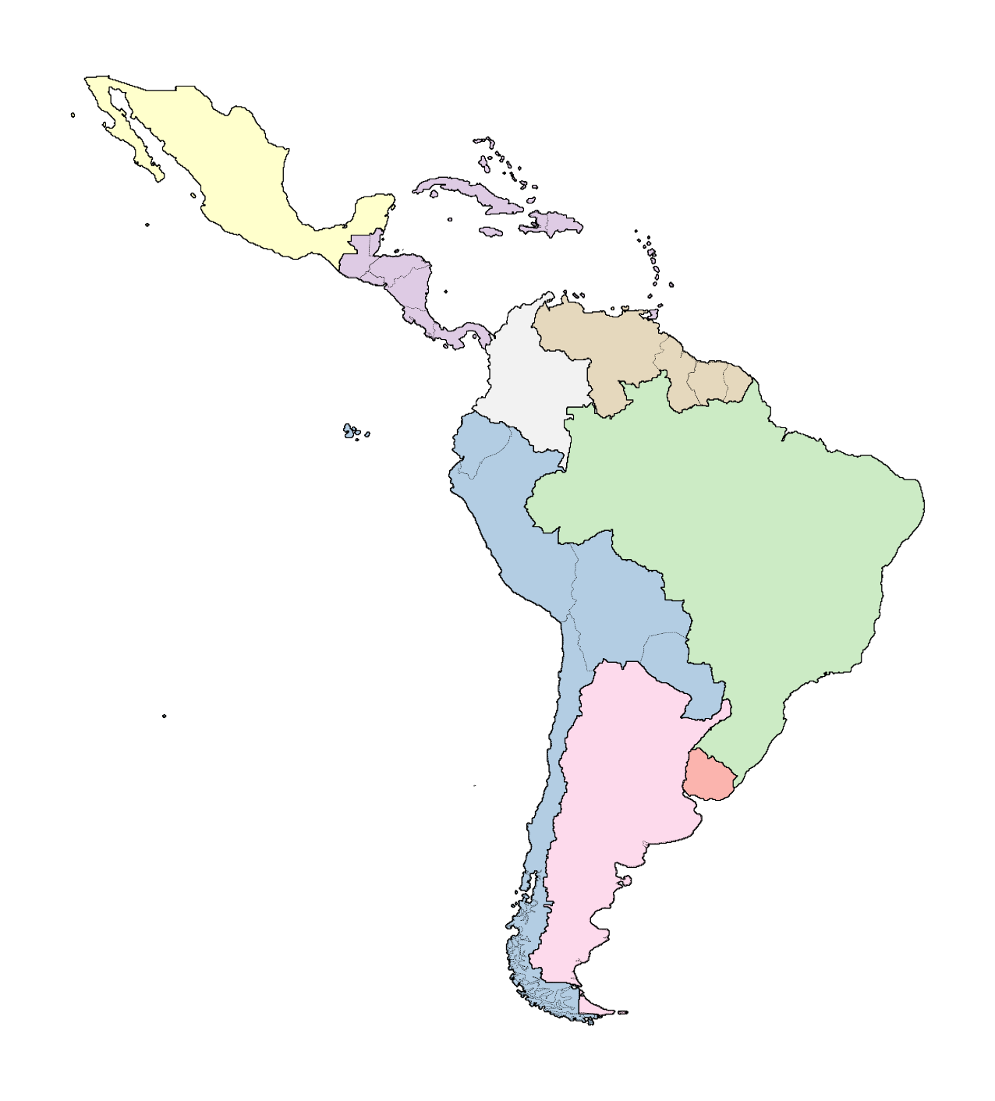
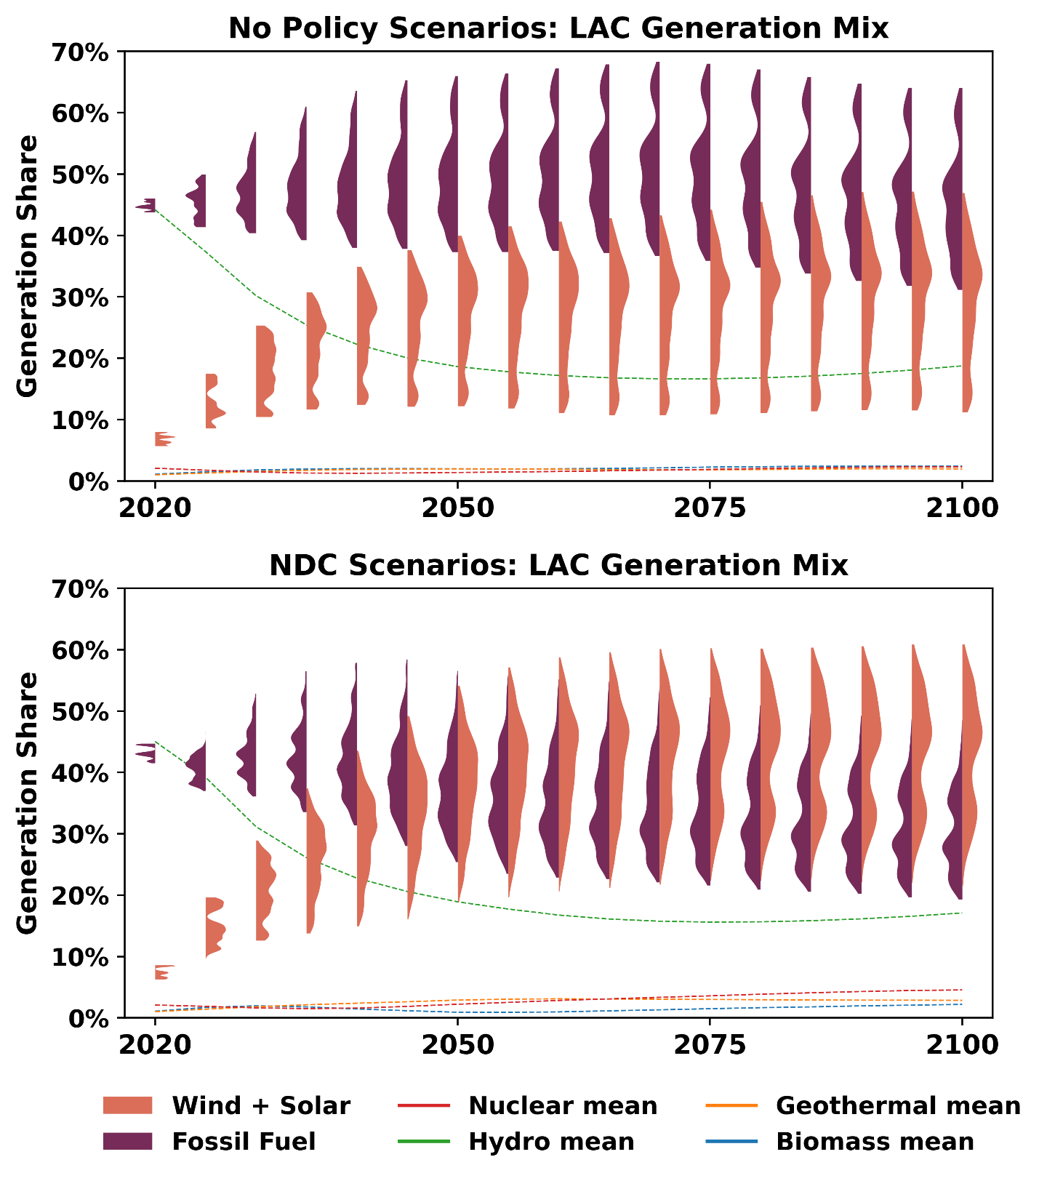
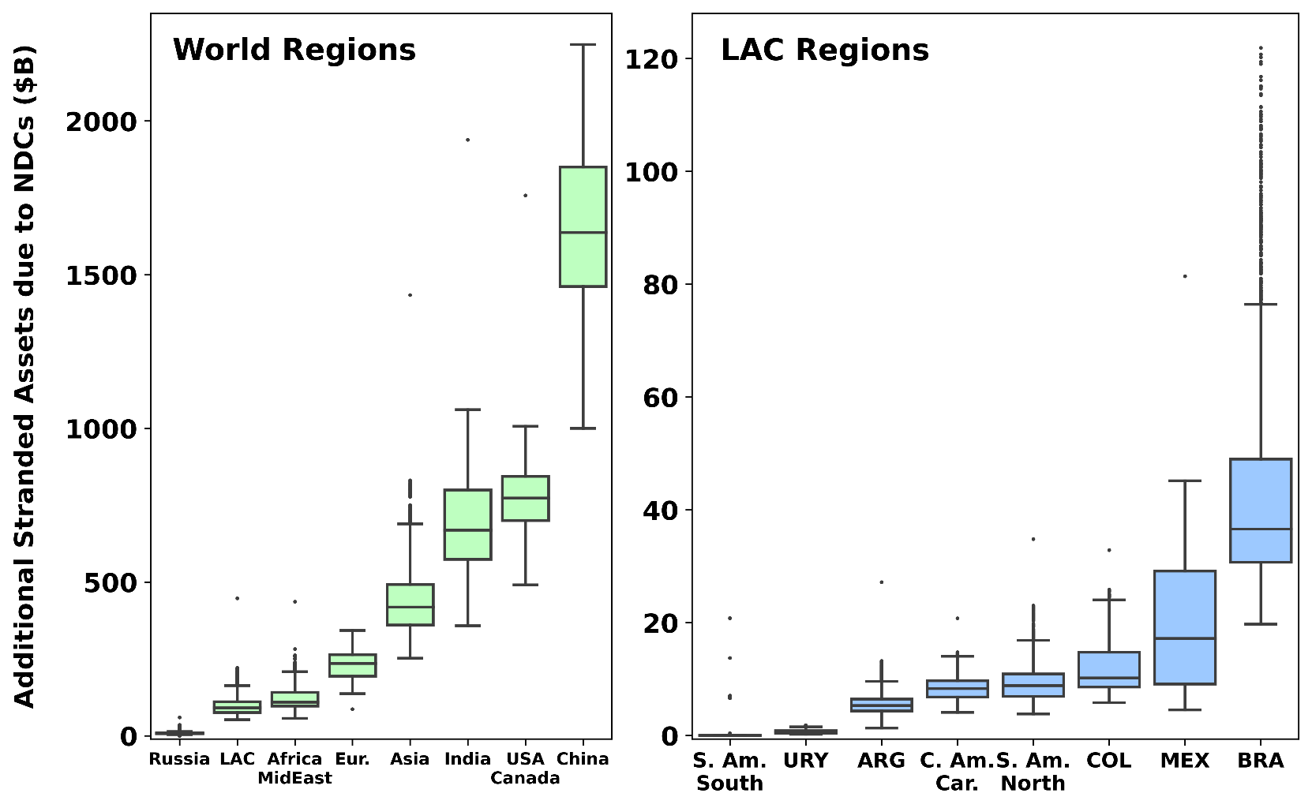
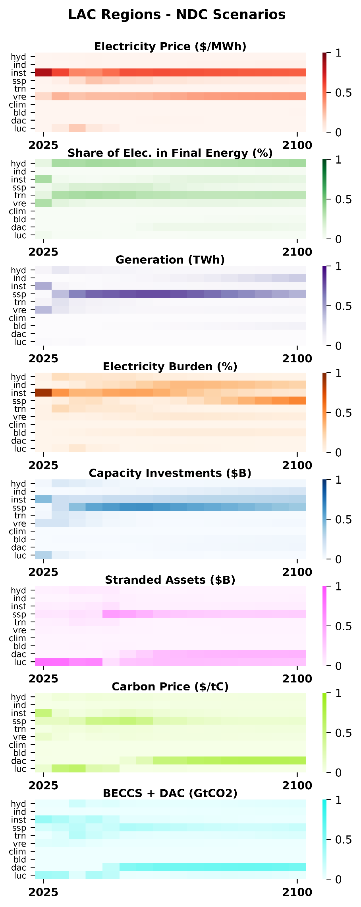
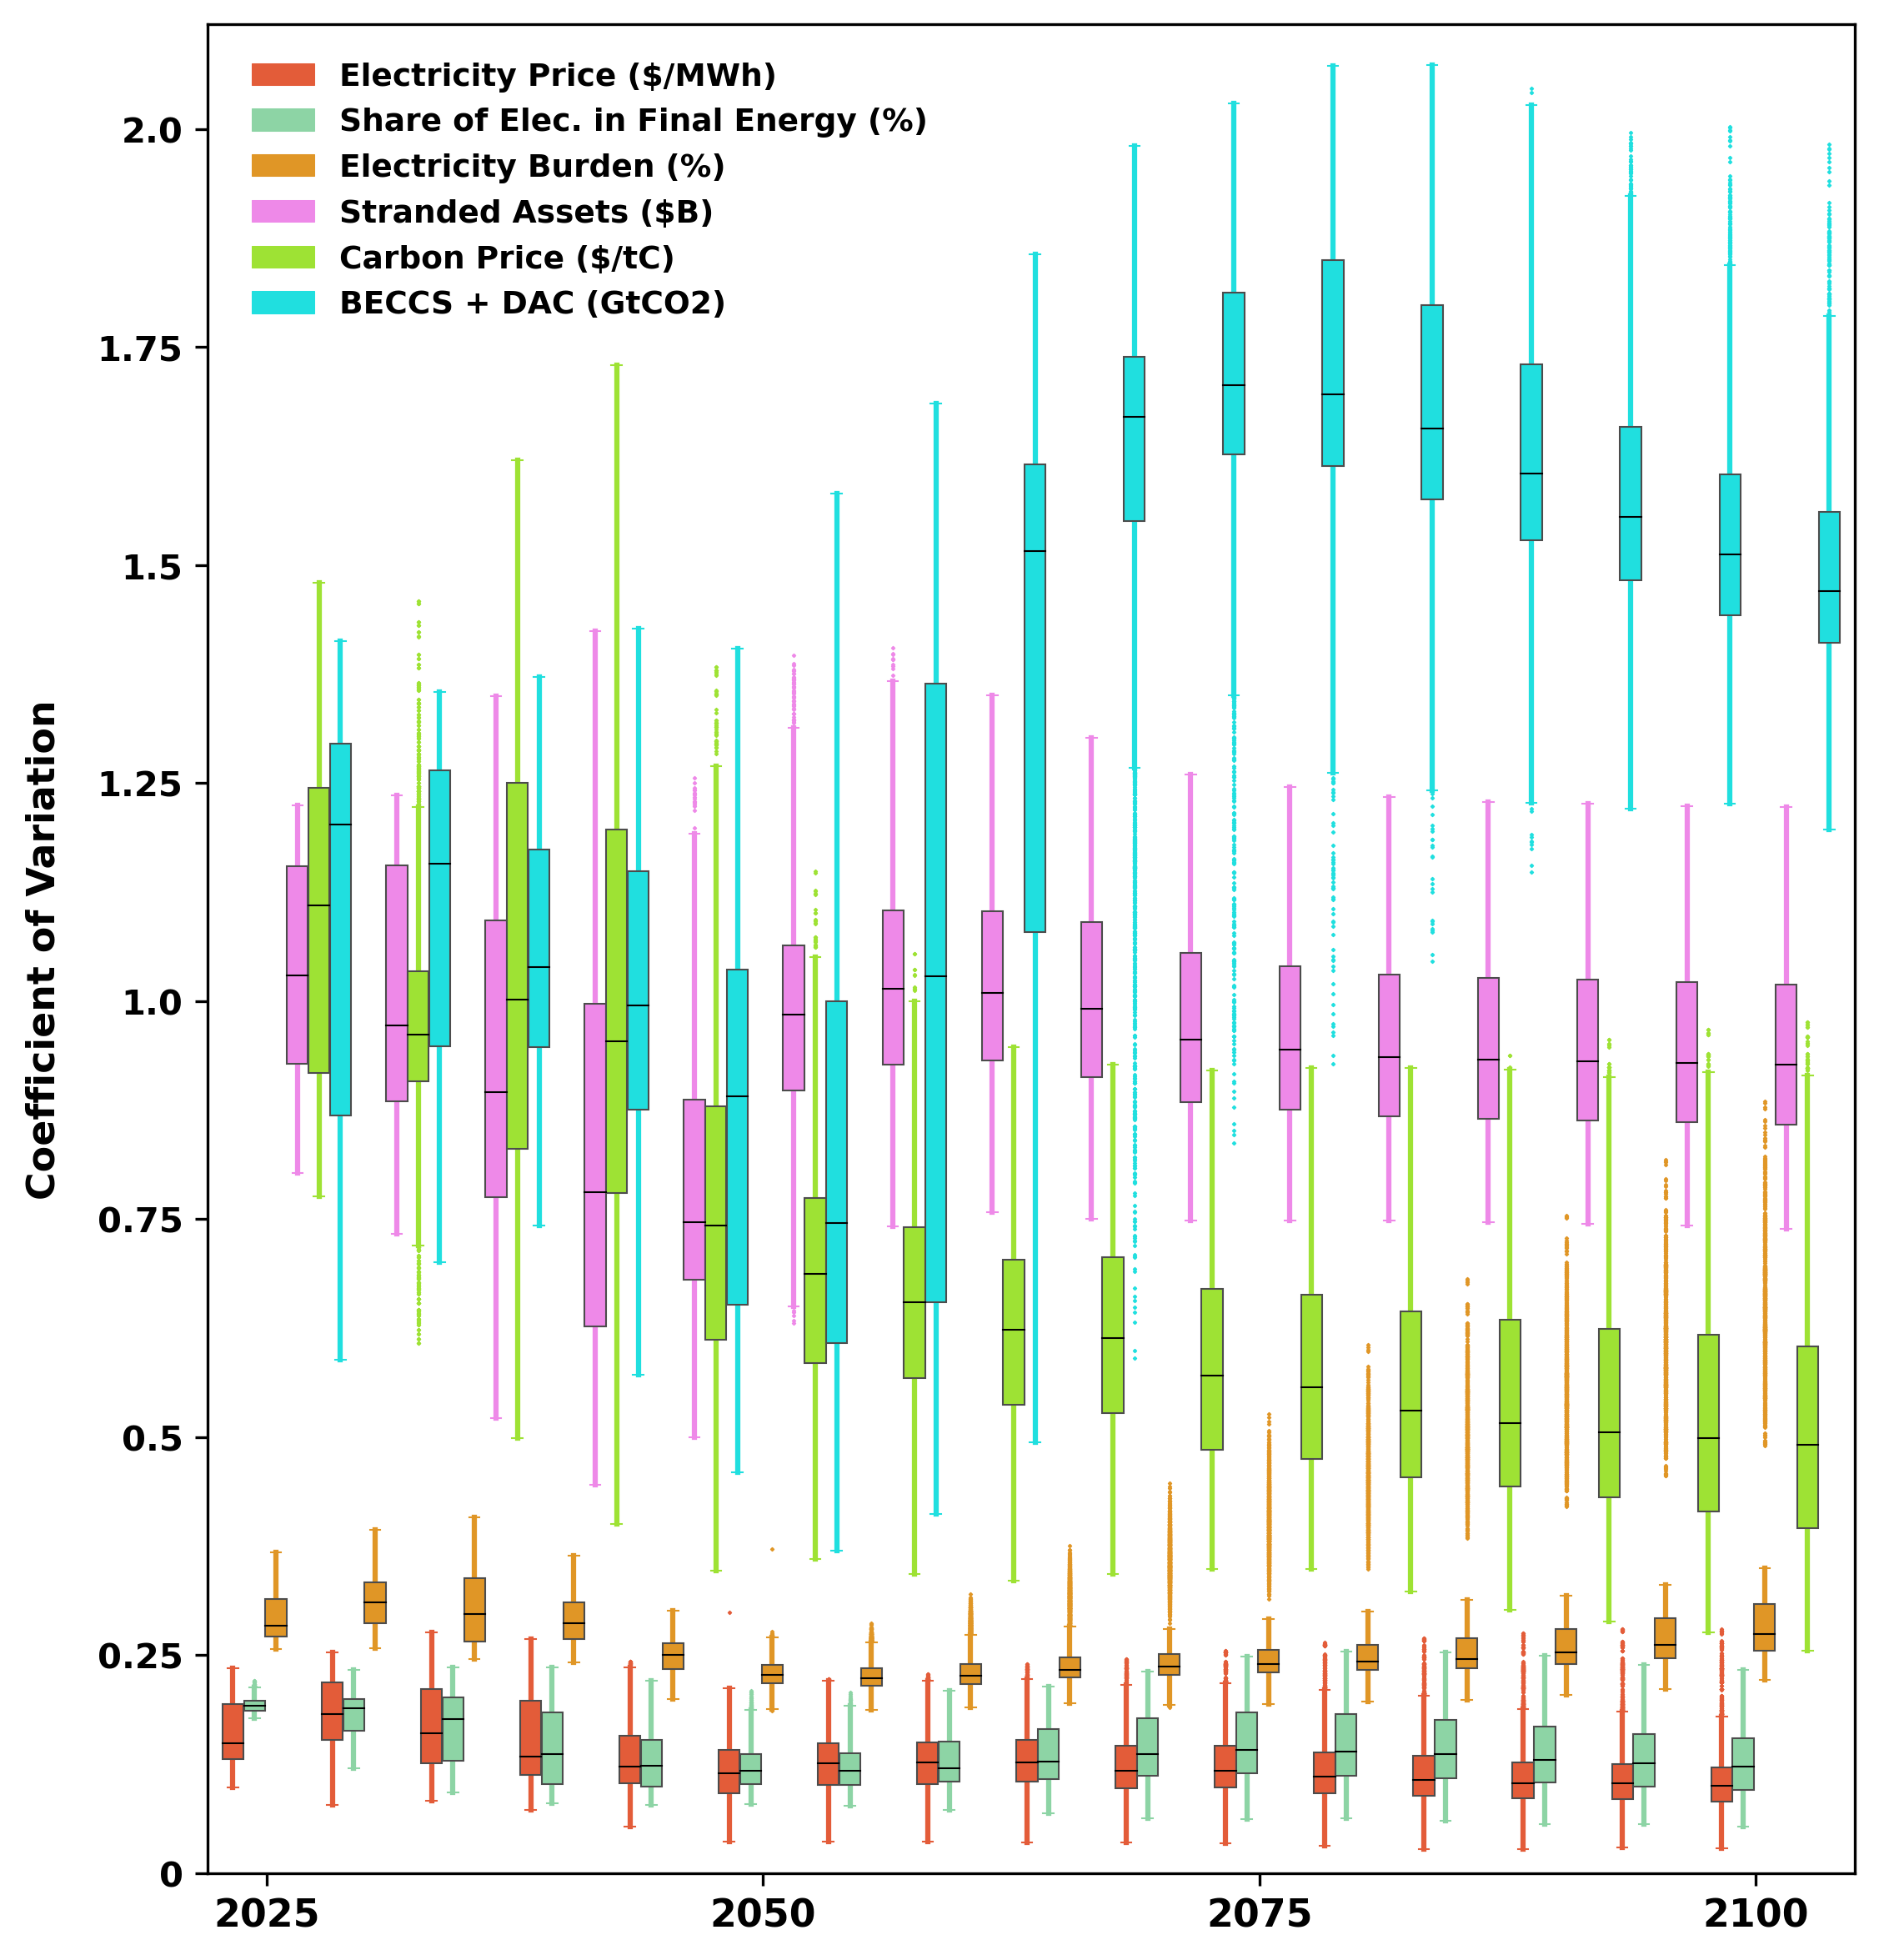
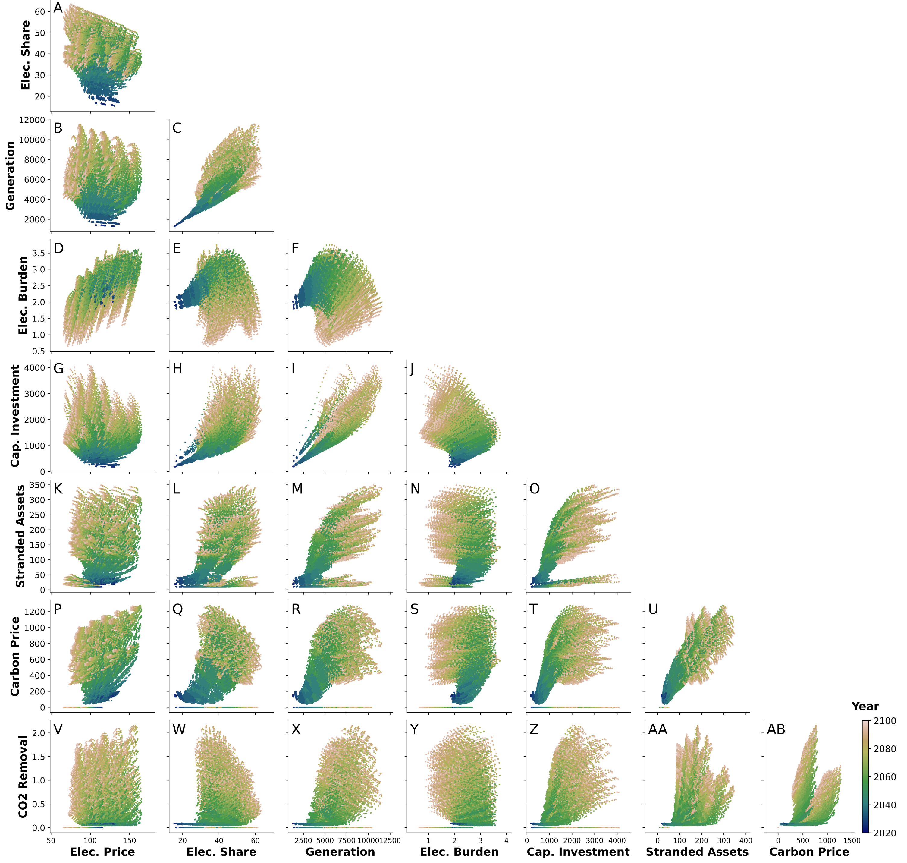
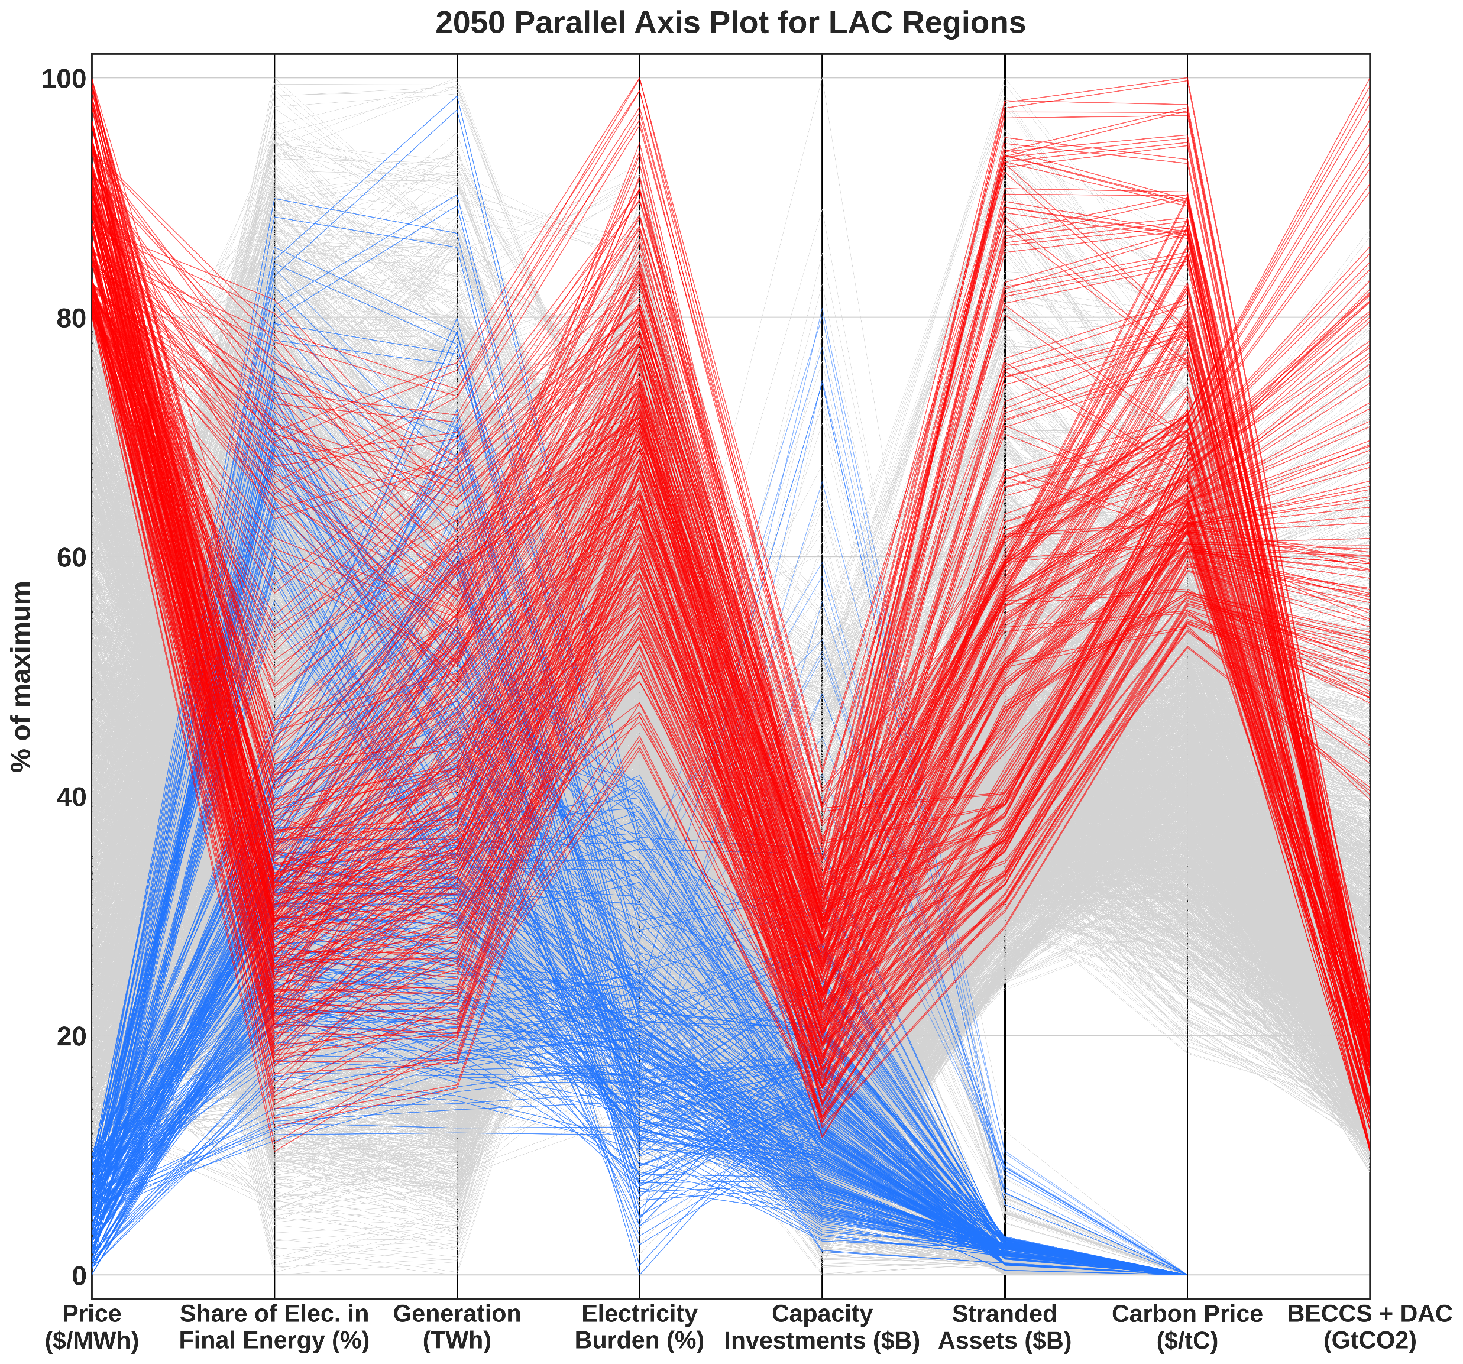
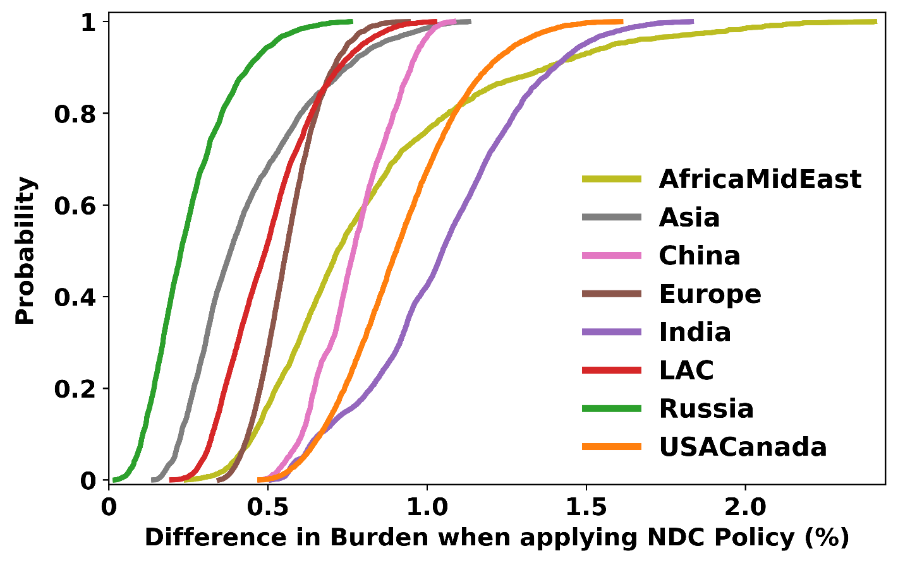
Scenario discovery with an integrated assessment model to identify robust, policy-relevant scenarios for capacity expansion in Latin America
Jacob Wessel^{1*}, Jonathan Lamontagne¹, Gokul Iyer^{2,3}, Thomas Wild^{2,3}
Cost of Wind
and Solar
Industrial
Energy
Efficiency
[4]
¹Civil and Environmental Engineering, Tufts University
²Civil and Environmental Engineering, University of Maryland
³Joint Global Change Research Institute, Pacific Northwest National Lab
*Corresponding author: jwesse03@tufts.edu
1
Motivation and Context
2
Institutional
Factors
[3]
Techno-economic
Sensitivities
Advanced
Hydrogen
Generation Mix and Stranded Asset Risk
The global transition to a decarbonized electricity system represents a complex problem with unique multi-scale, multi-sector consequences across regions. Deep uncertainty in power system capacity expansion pathways necessitates the use of robust methods capable of describing tradeoffs and synergies among technological and policy pathways. Here, we apply scenario discovery techniques to a large ensemble of model realizations generated using GCAM, a global integrated assessment model, and focus our analysis on Latin America and the Caribbean (LAC). Scenario discovery is commonly used in integrated assessment modeling for its advantages in describing coupled systems using large-scale scenario ensembles [1]. LAC is a developing region rich in natural resources whose climate mitigation decisions will have increasing global impact. This study focuses on uncertain energy sensitivities and their impacts on the Latin American power system. Future work will explore cross-sectoral implications of these factors.
Figure 3 (right). The evolution of Latin America’s generation mix has fundamentally different trajectories when emissions are constrained according to countries’ NDC targets. Compared to the No Policy cases, the violin plots to the right show a distinct tradeoff between fossil-fuel based electricity generation and variable renewable energy from wind and solar. Though it is a minimal share, an opportunity for more baseload from nuclear generation also emerges in the NDC realizations, as well as an increased role for hydrogen in some cases. Also, even with a noticeably declining share over time, hydro continues to be an importance source of electricity, especially for individual countries. The declining generation share is a result of increasing demand without new opportunity for hydropower generation.
NDC
Emissions
Constraint
[2]
Population
Transport
Electrification
[4]
Power System
Scenario
Discovery
(5,760 Scenarios)
GDP
Climate
Mitigation &
Adaptation
Demand
Land Use Change
Emissions
Sink
Climate
Impacted
Demand
Figure 2. Map of GCAM regions in LAC. In this version of GCAM6.0, Uruguay is configured as a separate region, broken out from South America Southern.
Direct Air
Capture Cost
Buildings
Energy
Efficiency
[4]
3
4
Figure 1. The large multi-dimensional ensemble developed for this work consists of a full factorial sampling of energy-related sensitivities, several of which were adapted from previously published work using earlier versions of GCAM [2-4]. The factors chosen represent a wide range of power system and economic uncertainties consistent with previous analyses in the literature, and outcomes are explored through eight commonly used performance metrics.
Figure 4 (left). Stranded assets are a critical economic concern over the course of a major energy transition towards decarbonization. In all cases, sunken costs of stranded assets increase when constraining emissions (mainly for coal and natural gas). The boxplots show cumulative additional costs across LAC regions as well as global regions in 2050 as a result of implementing NDCs. Stranded assets are higher for regions with higher demand and more stringent NDCs.
Feature Importance
Variability in Metrics
Analysis Metrics
Electricity Price
Electricity Generation
Capacity Investments
Stranded Assets
Electricity Share
Carbon Price
Electricity Burden
Level of CO2 Removal
5
Tradeoffs Across Metrics
Figure 7 (left). Pair plots illustrate bivariate distributions for each pair of study metrics for LAC over the model timeline, for every scenario in the ensemble. Many of these plots exhibit strong relationships, such as panel U showing higher stranded assets when carbon prices are higher. Some, however, interestingly show less dependency, such as panel V showing little correlation between electricity price and the amount of CO2 removal technology implemented. These relationships can also vary over time and can show changing variability as well as the strength of the relationship.
Figure 6. The inter-regional variability of metrics across LAC in emissions-constrained scenarios highlights the importance of viewing results across scales. While electricity price variability is mostly stable across regions, the mitigation-related metrics of Carbon Price, CO2 Removal (BECCS and DAC), and Stranded Assets vary more widely across scenarios and regions, and over time. Variability in carbon price and co2 removal show the efforts of these measures are not being shared across regions, while the long tails suggest that the scenario makeup plays a role in this variability. Results for electricity burden show an increasing risk after mid-century for individual regions for a handful of extreme scenarios.
6
Electricity Burden
Figure 8 (above). Visual clustering of realization outcomes can intuitively illustrate relationships among metrics. Here, a parallel axis plot for LAC is constructed for the model year 2050, with outputs scaled as a percent of each metric’s maximum. High (low) price scenarios are shown in red (blue). No low-price scenarios have NDCs implemented, and high-price scenarios tend to have expensive DAC (low in last column). Those that do not follow this pattern all have high cost VRE and institutional factors switched on.
Figure 9. The proportion of income spent on electricity is an important consideration in energy equity. Although aggregated at the regional level here, this metric can still identify average differences. These CDFs plot regional differences in electricity burden between scenarios in 2050 which differ only by implementing NDCs or not.
Figure 5. Using random forest, importance scores for eight metrics were computed and shown here as temporal heatmaps for the NDC scenarios in LAC. Not surprisingly, population and GDP inputs (ssp) are a major determinant for many metrics. Notably, cost of capital across regions according to investment risk (institutional factors) is also a major driver in this region, especially for price of electricity. Energy efficiency factors gain higher relative importance in late century.
References
Acknowledgements
[1] Lamontagne et al. (2018), Large Ensemble Analytic Framework for Consequence‐Driven Discovery of Climate Change Scenarios, Earth’s Future. 10.1002/2017EF000701
[2] Ou et al. (2021), Can updated climate pledges limit warming well below 2°C?, Science. 10.1126/science.abl8976
[3] Iyer et al. (2015), Improved representation of investment decisions in assessments of CO2 mitigation, Nature Clim Change. 10.1038/nclimate2553
[4] Gambhir et al. (2022), Near-term transition and longer-term physical climate risks of greenhouse gas emissions pathways, Nature Clim Change. 10.1038/s41558-021-01236-x
This material is based upon work supported by the National Science Foundation under Grant No. 1855982.

