Slide 1
Dynamic distribution modeling of arboviral vesicular stomatitis and its vector, the biting midge (Culicoides spp.): two case studies
EGU23-10475:
by Melanie Veron

Slide 2
An introduction
I’m a post-MSc ORISE fellow working with the USDA-ARS SCINet Office
Wide-ranging career interests in biology, ecology, and public health, with a particular focus on computational disease ecology
Current research revolves around species distribution modeling (SDM) and environmental niche modeling (ENM)

Slide 3
Research goals and aim of this presentation
Vesicular stomatitis (VS) – a multi-vector arboviral illness that affects livestock and negatively impacts agriculture in the USA and Mexico
Biting midges (Culicoides species) – known insect vectors (among others) of VS, Culicoides sonorensis being one of the most well-studied
Species distribution modeling with tools like Maxent provides a powerful way to estimate the geospatial distributions of biting midges and the zoonotic viruses they spread
Using georeferenced presence-only occurrence data from Culicoides spp. observations in N. America as well as epidemiological records of clinical VS cases in endemic regions of Mexico, we can evolve our understanding of VS and the biology of its insect vectors – leading to more informed decision-making on VS and insect vector surveillance, mitigation, and ecological research

Slide 4
Maxent algorithm used for species distribution / environmental niche modeling workflow
Popular algorithmic tool for ENM/SDM workflows in the context of presence-only occurrence data
Robust to low sample sizes as well as multicollinearity among environmental variables (uses L1 regularization to account for this)
Main R packages used for this presentation’s Maxent modeling research studies:
SDMtune
ENMeval
dismo

Slide 5
Dynamic/time-specific distribution modeling
Used time-specific climate data paired with other static variables (soil, land cover, livestock density, topology)
More accurate/better performance compared to fully static/non-time-specific modeling workflows
Time-specific occurrence, background, and environmental data pooled together into one data set (used as input for Maxent modeling algorithm)

Slide 6
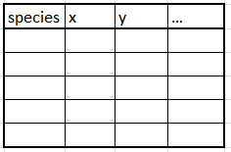
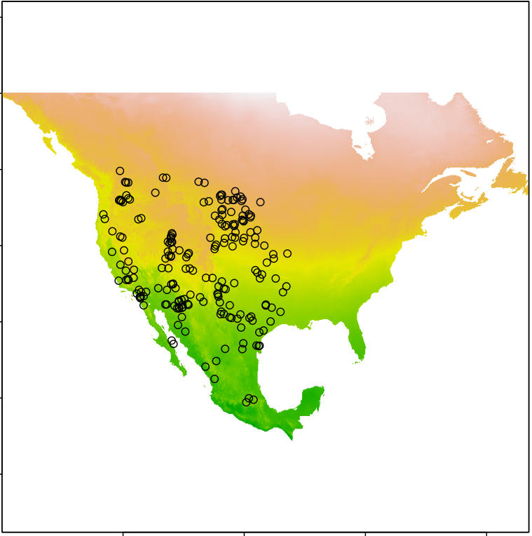
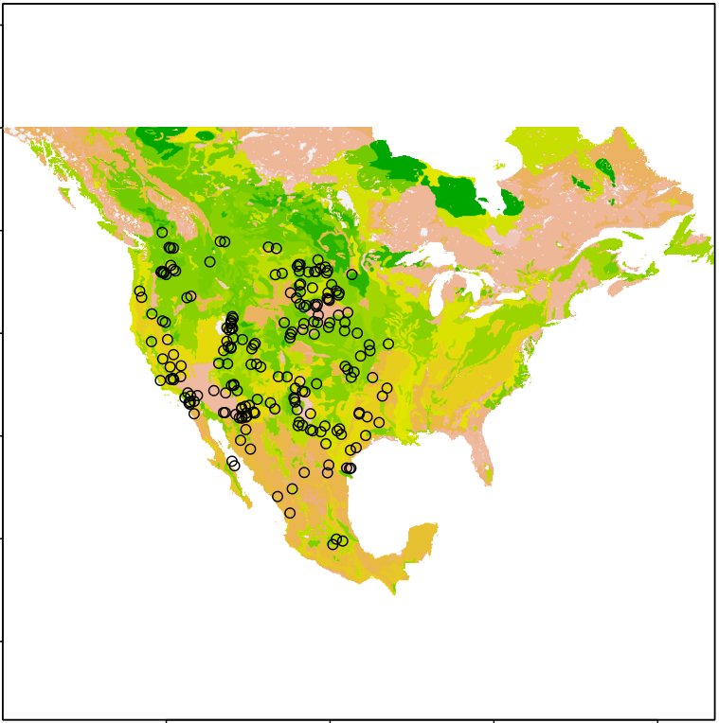
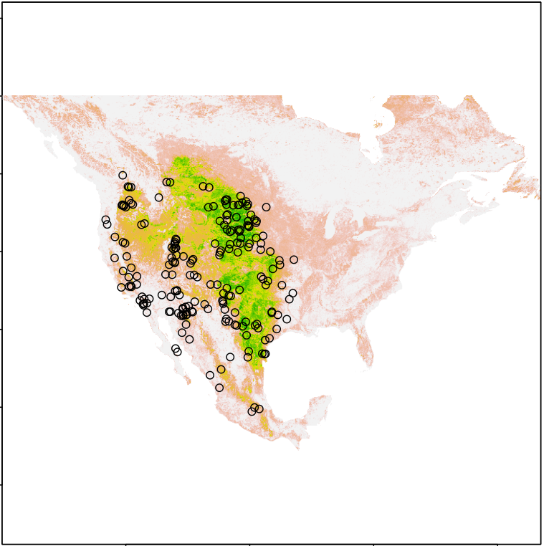
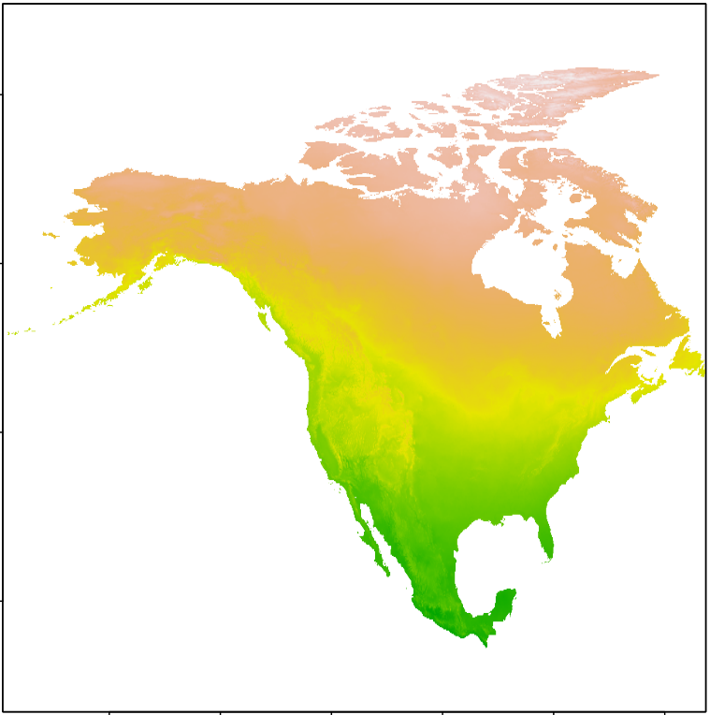
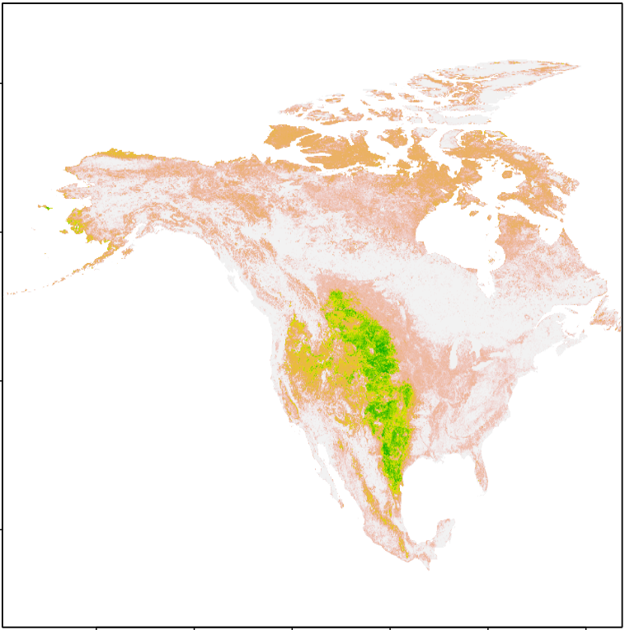
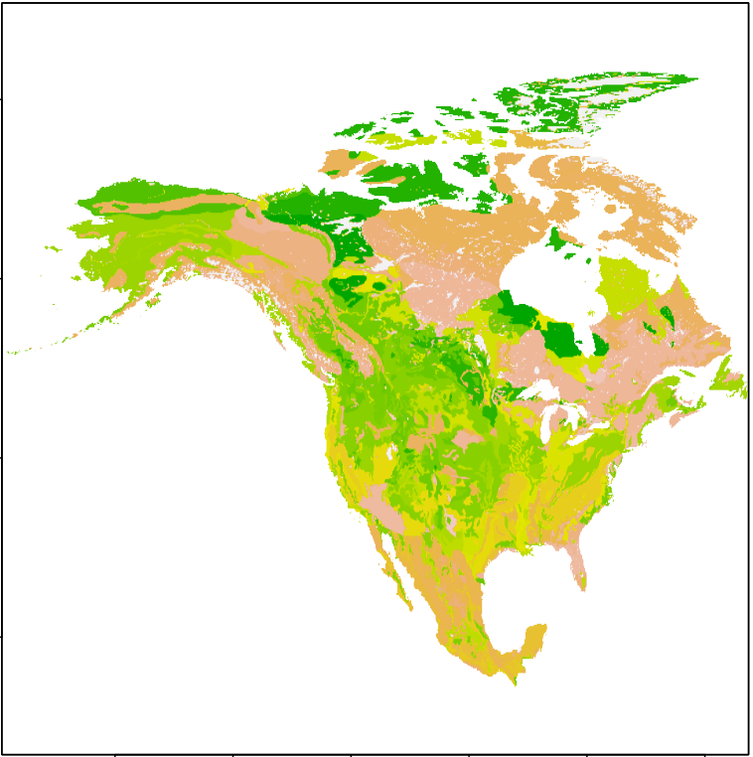
Static Maxent SDM
(with average climate values from most recent past decades) workflow
Collections data
Randomly generated background locations
Species presence locations
Literature records
Data from researchers
Extract env values
to presence and
background locations
Data integration
prepareSWD()
SWD (sample with data) object
trainValTest()
Split into train and test data sets
Environmental data layers
Rest of workflow, including initial cross-validation Maxent model, hyperparameter tuning, nested cross-validation testing, final Maxent model, and distribution prediction
Recent climate averages + other static env raster stacks

Slide 7
Randomly generated background locations
(proportional to # of presence points collected for given year/decade)
Dynamic Maxent SDM
(with pooled time-specific climate values) workflow
Collections data
Species presence locations (filtered by year/decade)
Literature records
Data from researchers
mergeSWD()
One SWD object with combined/pooled data
TrainValTest()
Extract env values
to presence and
background locations
Data integration
prepareSWD()
Time-specific SWD (sample with data) object
Split into train and test data sets
Environmental data layers
Rest of workflow, including initial cross-validation Maxent model, hyperparameter tuning, nested cross-validation testing, final Maxent model, and distribution prediction (on recent climate averages + static env vars)
Per timestep (e.g., 1910s, 1920s, … 2010s), depending on presence location availability
Time-specific (year or decade) climate averages + other static env raster stacks

Slide 8
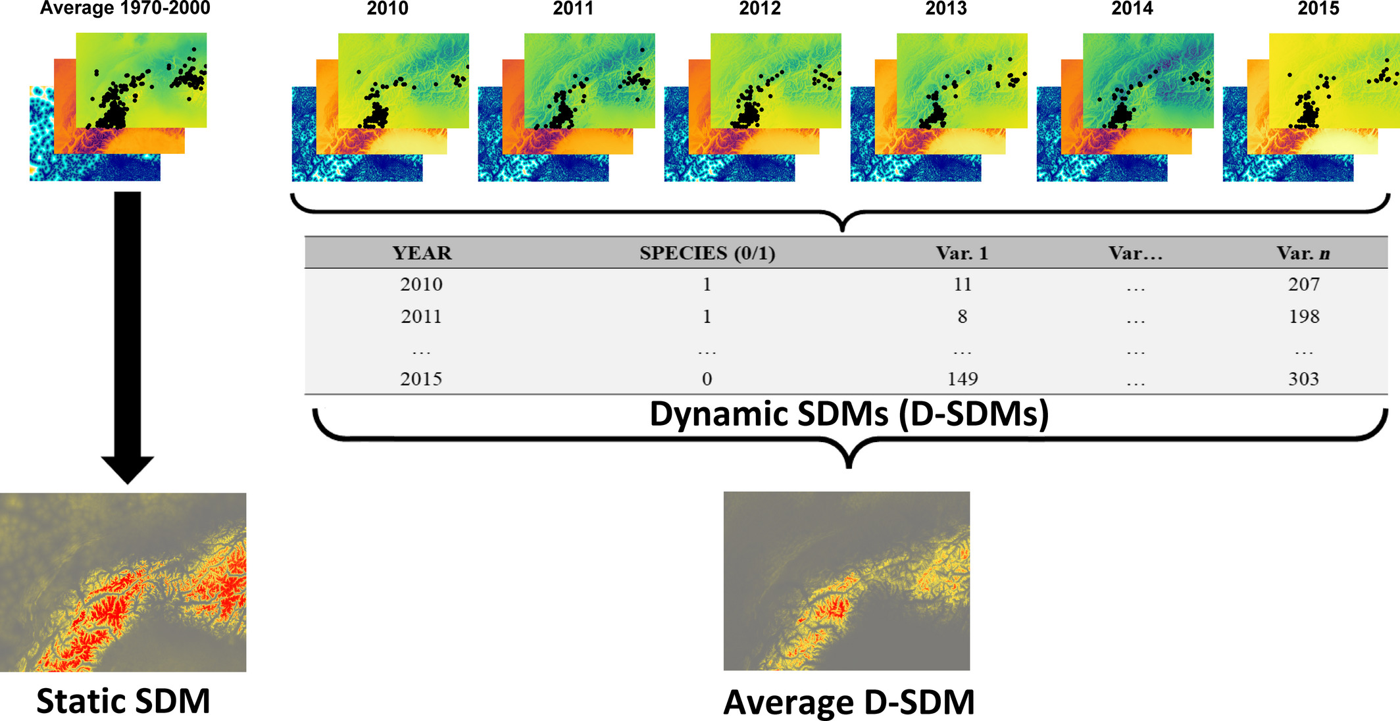
Example of how environmental data are processed in static vs. dynamic SDM workflows
Credit:
Milanesi, P, Della Rocca, F, Robinson, RA. Integrating dynamic environmental predictors and species occurrences: Toward true dynamic species distribution models. Ecol Evol. 2020; 10: 1087–1092. https://doi.org/10.1002/ece3.5938

Slide 9
Nested cross-validation for estimating generalization error of final model
Outer loop (evaluation of model calibration process – i.e., the inner loop):
5-fold random non-spatial cross-validation models (for testing inner-loop models on corresponding withheld test data sets)
Inner loop (model calibration process):
4-fold spatial hierarchical checkerboard cross-validation models (for hyperparameter tuning using SDMtune’s optimizeModel genetic algorithm function, choosing optimal hyperparameter combination for a given cross-validation model)

Slide 10
Hyperparameter tuning for Maxent models via optimizeModel function from SDMtune package
Credit: Vignali, Sergio, Arnaud G. Barras, Raphaël Arlettaz, and Veronika Braunisch. 2020. “SDMtune: An R Package to Tune and Evaluate Species Distribution Models.” Ecology and Evolution 00: 1–18. https://doi.org/10.1002/ece3.6786.
Based on a directed, automated genetic algorithm that relies on the concepts of natural selection and genetic permutation
Algorithm runs through several “generations” from a random starting population of hyperparameter sets to ultimately determine optimal model settings for the given input model and data
Comparable results to grid search tuning methods at a fraction of the computational time (Vignali et al., 2020).

Slide 11
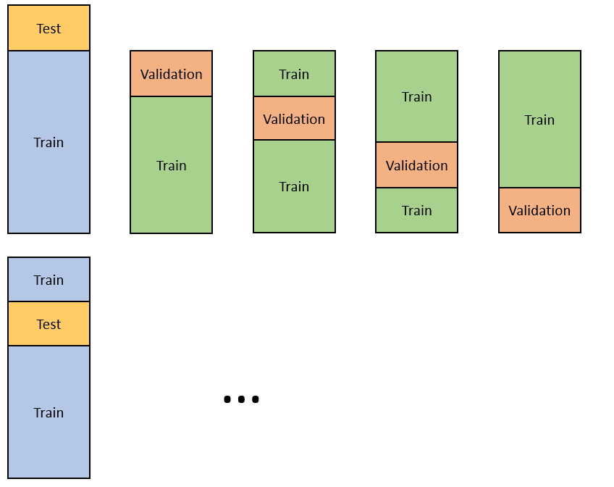
Conceptual diagram of 5-fold nested cross-validation
Note: the averaged results from the outer loop can then be used as (indirect) evaluation metrics against the final model built from the full set of occurrence data!
Credit: Castilla, Jaime Arboleda. 2021. "A step by step guide to Nested Cross-Validation." Analytics Vidhya, March 28.

Slide 12
Evaluation metrics
NOTE: Model calibrated from data with higher occurrences-to-extent ratio are expected to have comparatively poorer-looking statistical output.
Test AUC
↑ = better accuracy/discrimination capacity
>0.7 generally considered acceptable for a Maxent model, but this value is relative to the sampled presence/background data
Test TSS
↑ = better accuracy/discrimination capacity
Omission rate (OR)
Train OR
Baseline OR for training data given a defined predicted value statistical threshold (excludes presence points located in pixels deemed environmentally unsuitable by the model)
↓ = better model performance
Test OR
↓ = better model performance
If test OR = train OR, model fitted perfectly
If test OR > train OR, model overfitted to training data
Difference between train & test metrics (AUC, TSS, OR, etc.)
Measure of goodness-of-fit
↓ = better fit
Hyperparameters
L1 Regularization multiplier
↑ = more smoothed-out response curve = less fitted model
Feature classes
Linear, quadratic, product, hinge
More features used = more complex response curve = more fitted model

Slide 13
Removal of collinear variables vs. native Maxent ML process to account for multicollinearity
Credit: Feng, Xiao, Daniel S. Park, Ye Liang, Ranjit Pandey, and Monica Papeş. 2019. “Collinearity in Ecological Niche Modeling: Confusions and Challenges.” Ecology and Evolution 9 (18): 10365–76. https://doi.org/10.1002/ece3.5555.
“…there are two competing views regarding the issue of collinearity in Maxent. Some have argued that, because Maxent can regulate model complexity by downplaying the importance of redundant variables, the algorithm is robust to issues of collinearity (Elith et al., 2011; Phillips & Dudík, 2008; Shcheglovitova & Anderson, 2013). Others attest that Maxent may partially handle collinearity, but predictor collinearity should be minimized by the user (Merow, Smith, & Silander, 2013)” (Feng et al., 2019).
Removal of highly correlated variables from Maxent model (rather than letting Maxent regulate responses from full set of variables) had a negative effect on the degree of predictor collinearity, but both of these factors had inconclusive effects on model performance (Feng et al., 2019).

Slide 14
Case study: North American Culicoides species distribution modeling

Slide 16
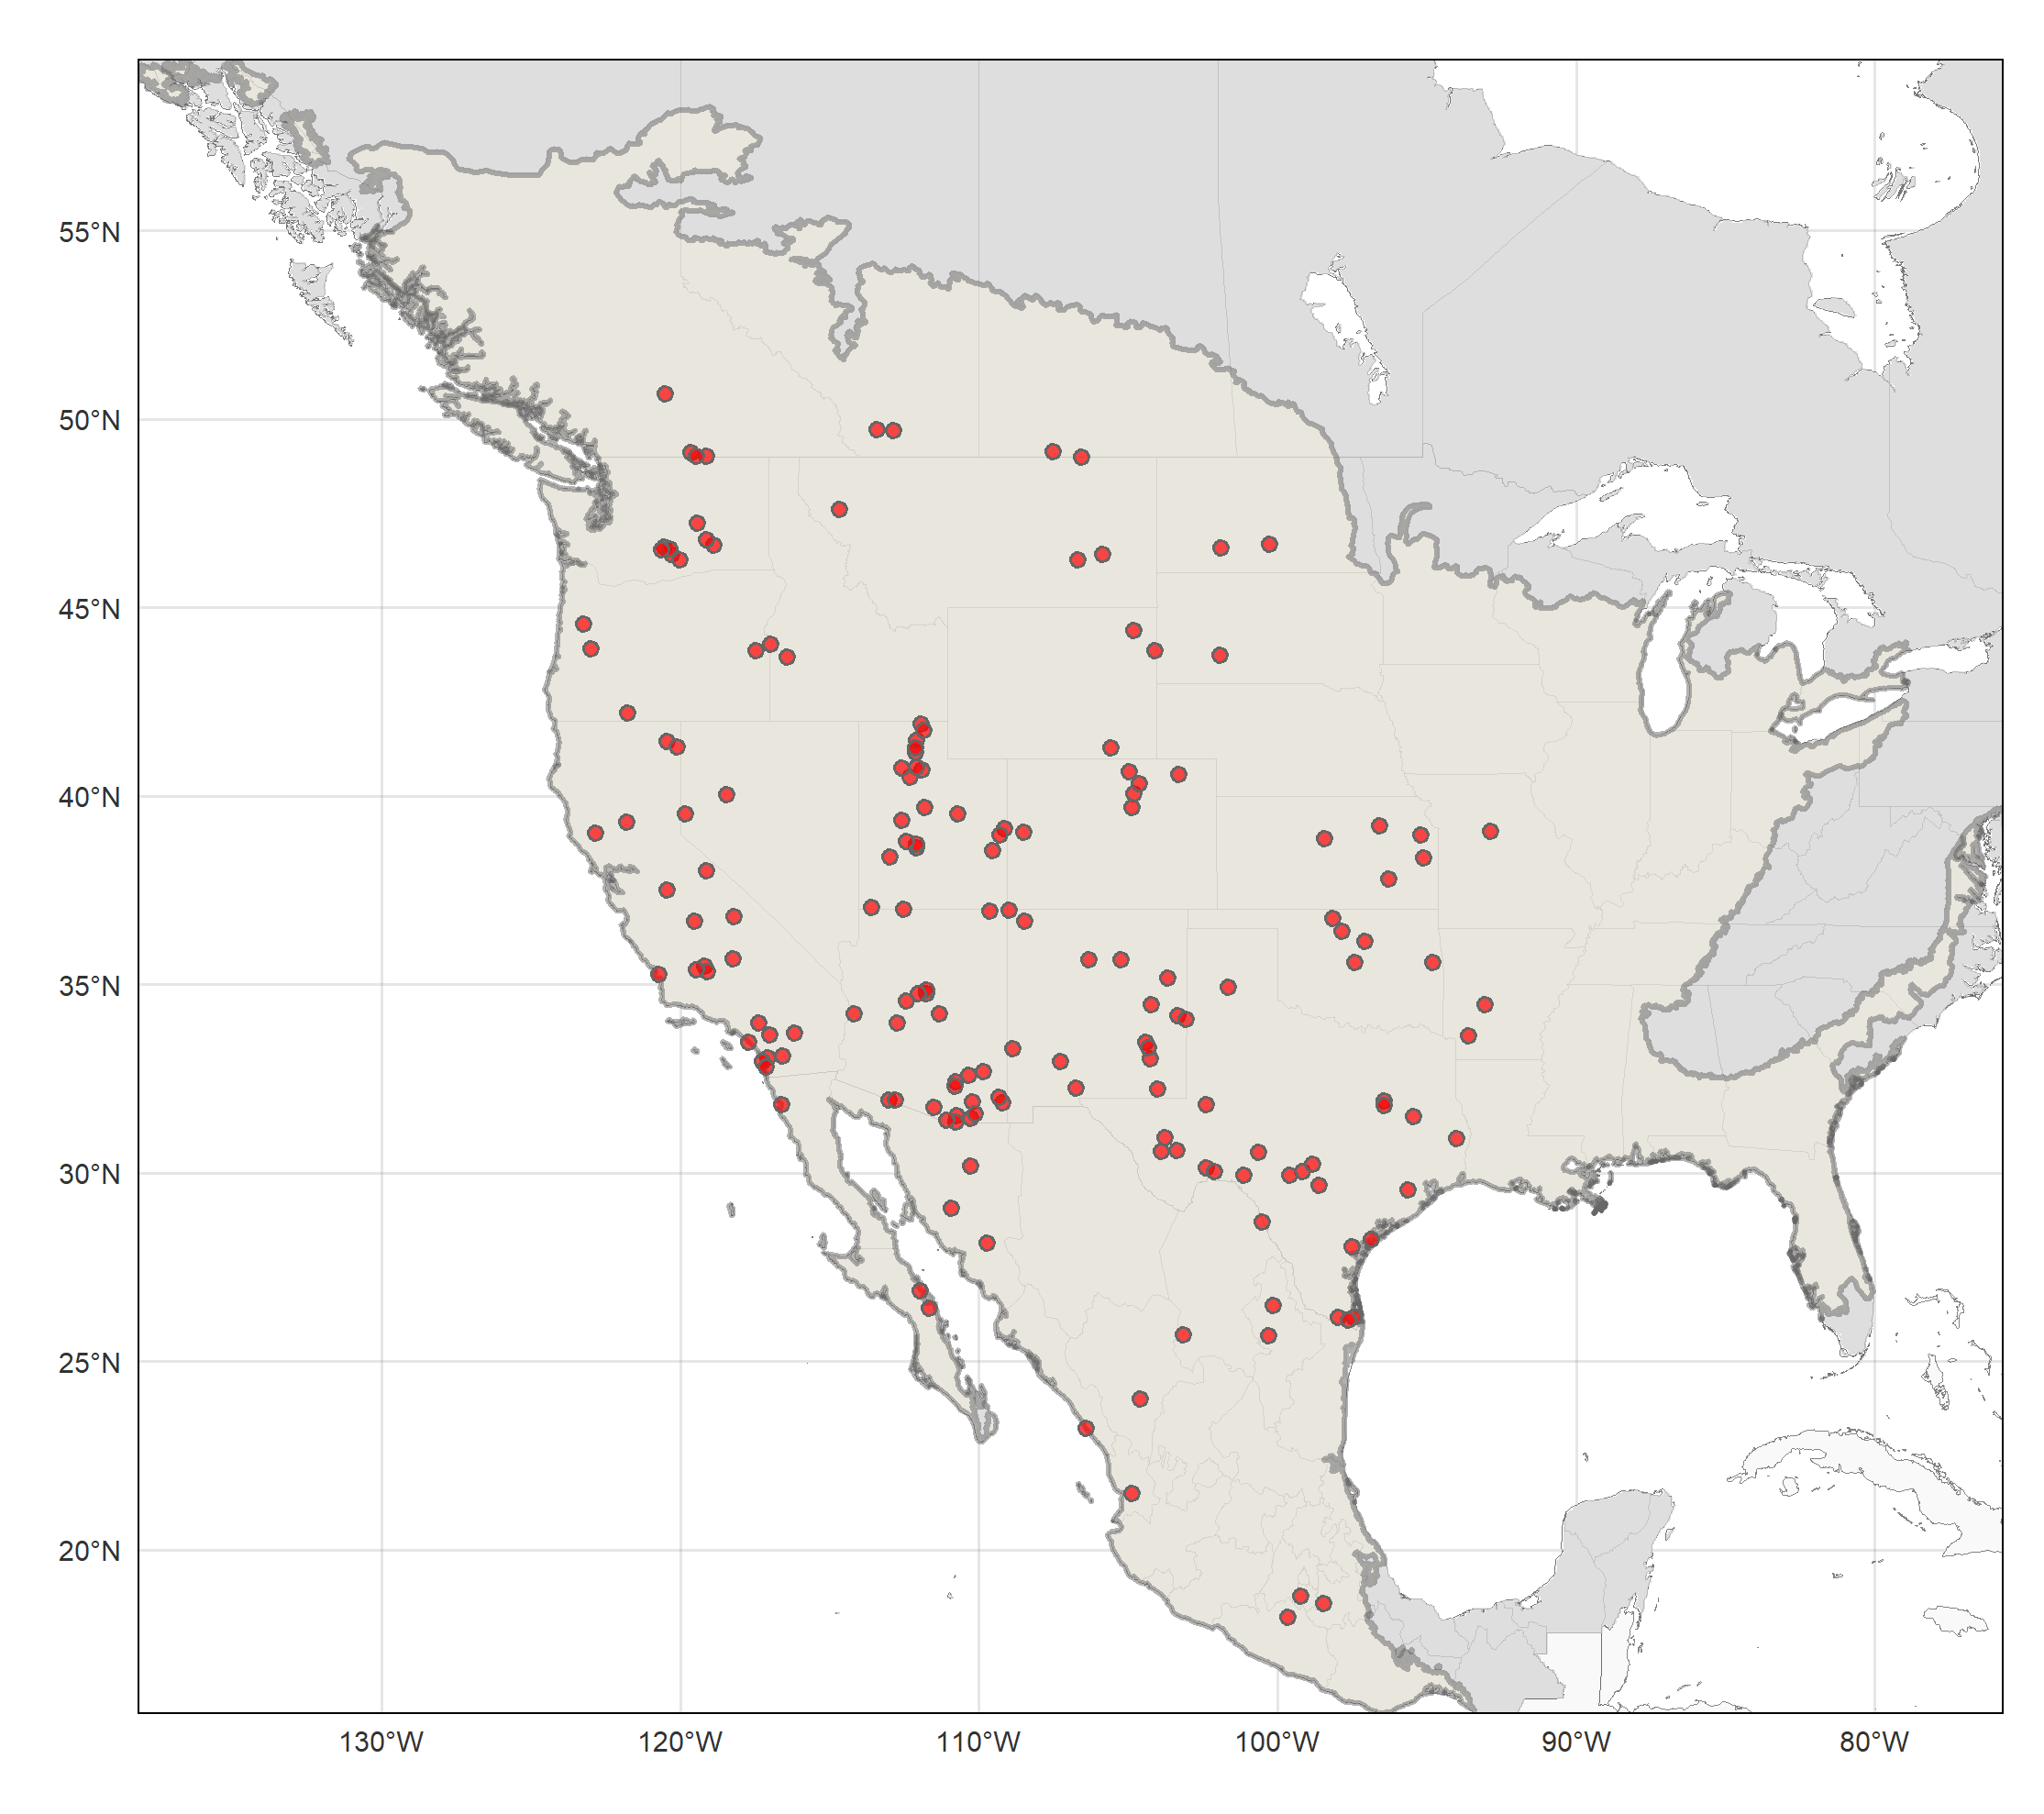
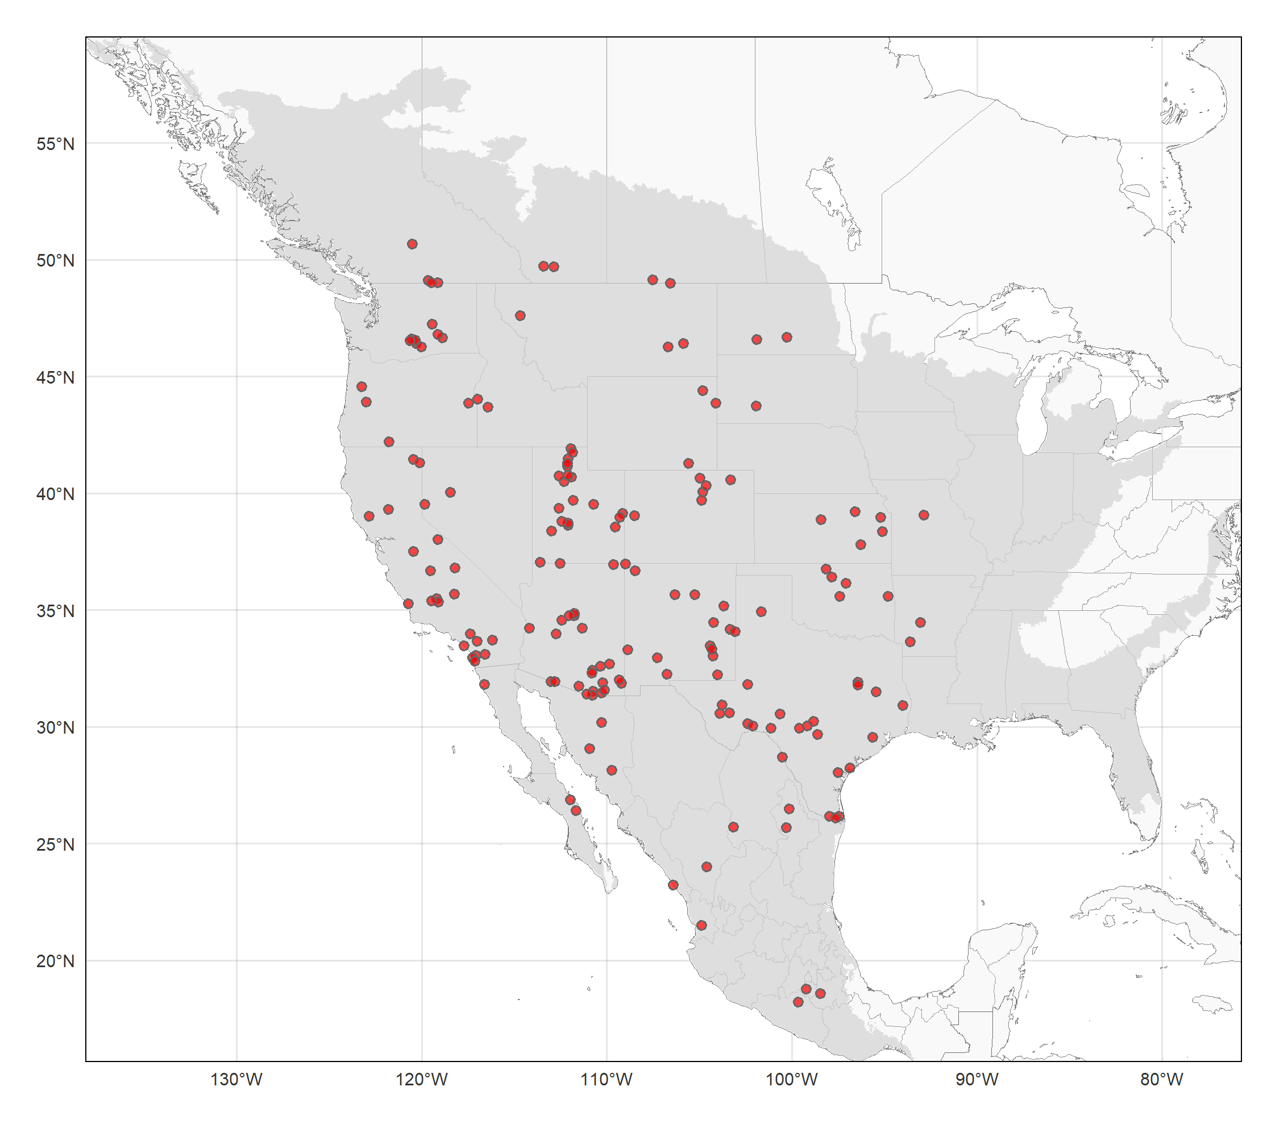
Establishing study (model calibration) area for Culicoides sonorensis presences using ecoregions (intersecting/surrounding occurrence points) as boundaries

Slide 17
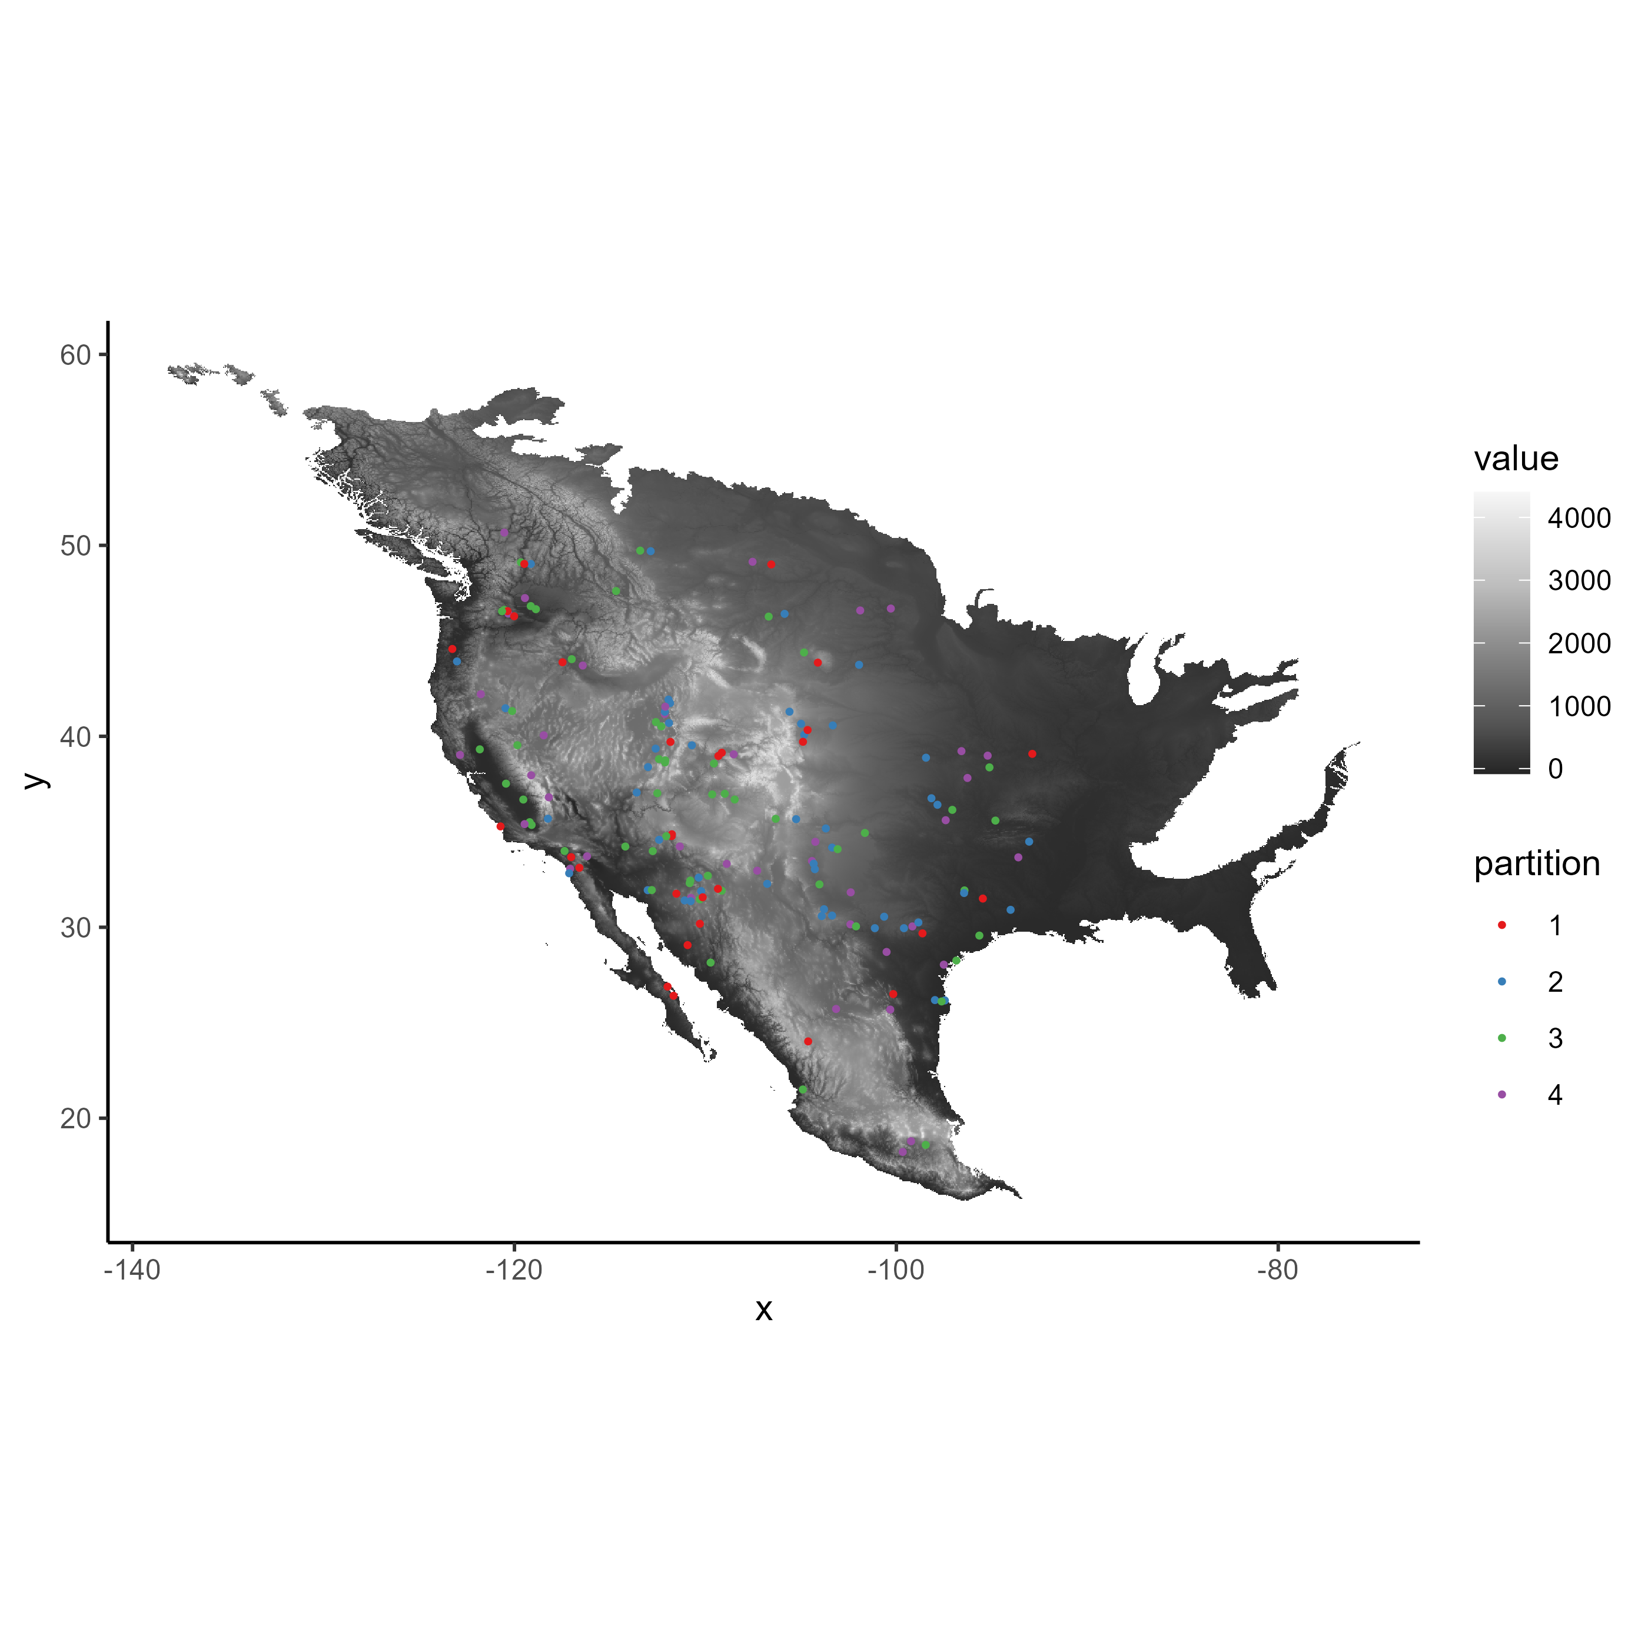
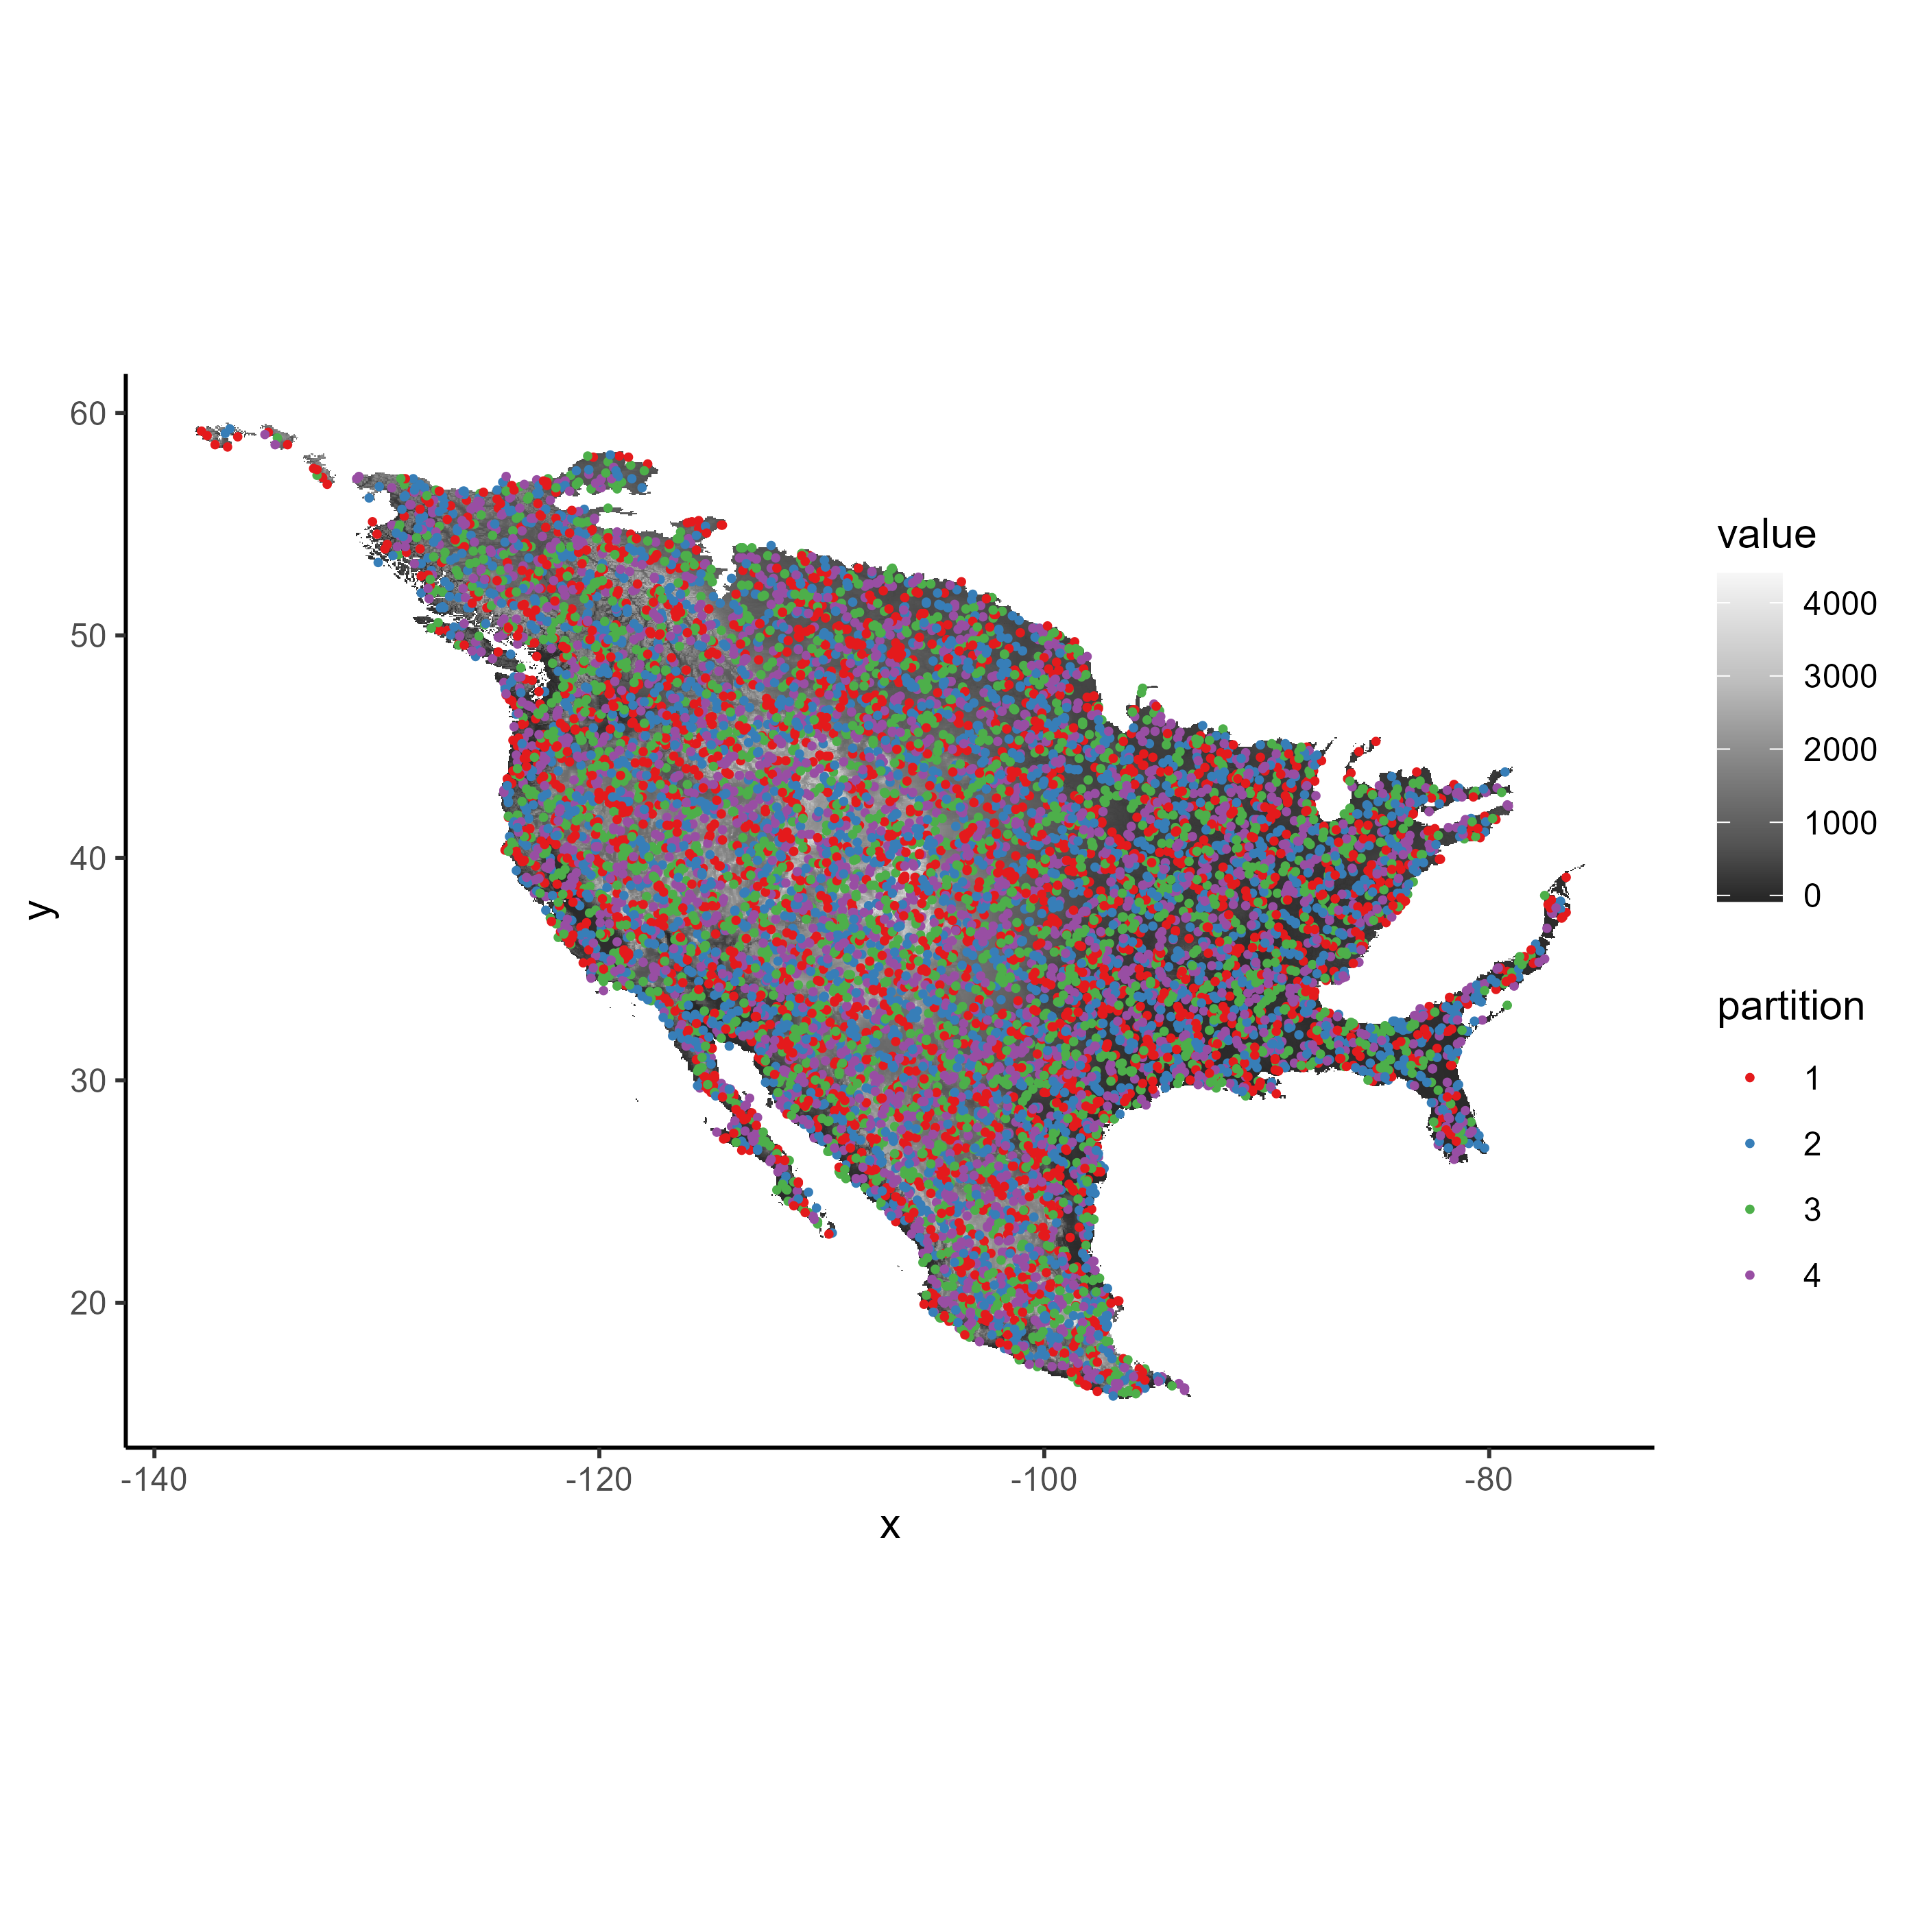
Spatial cross-validation folds (k = 4) for final model tuning process

Slide 18
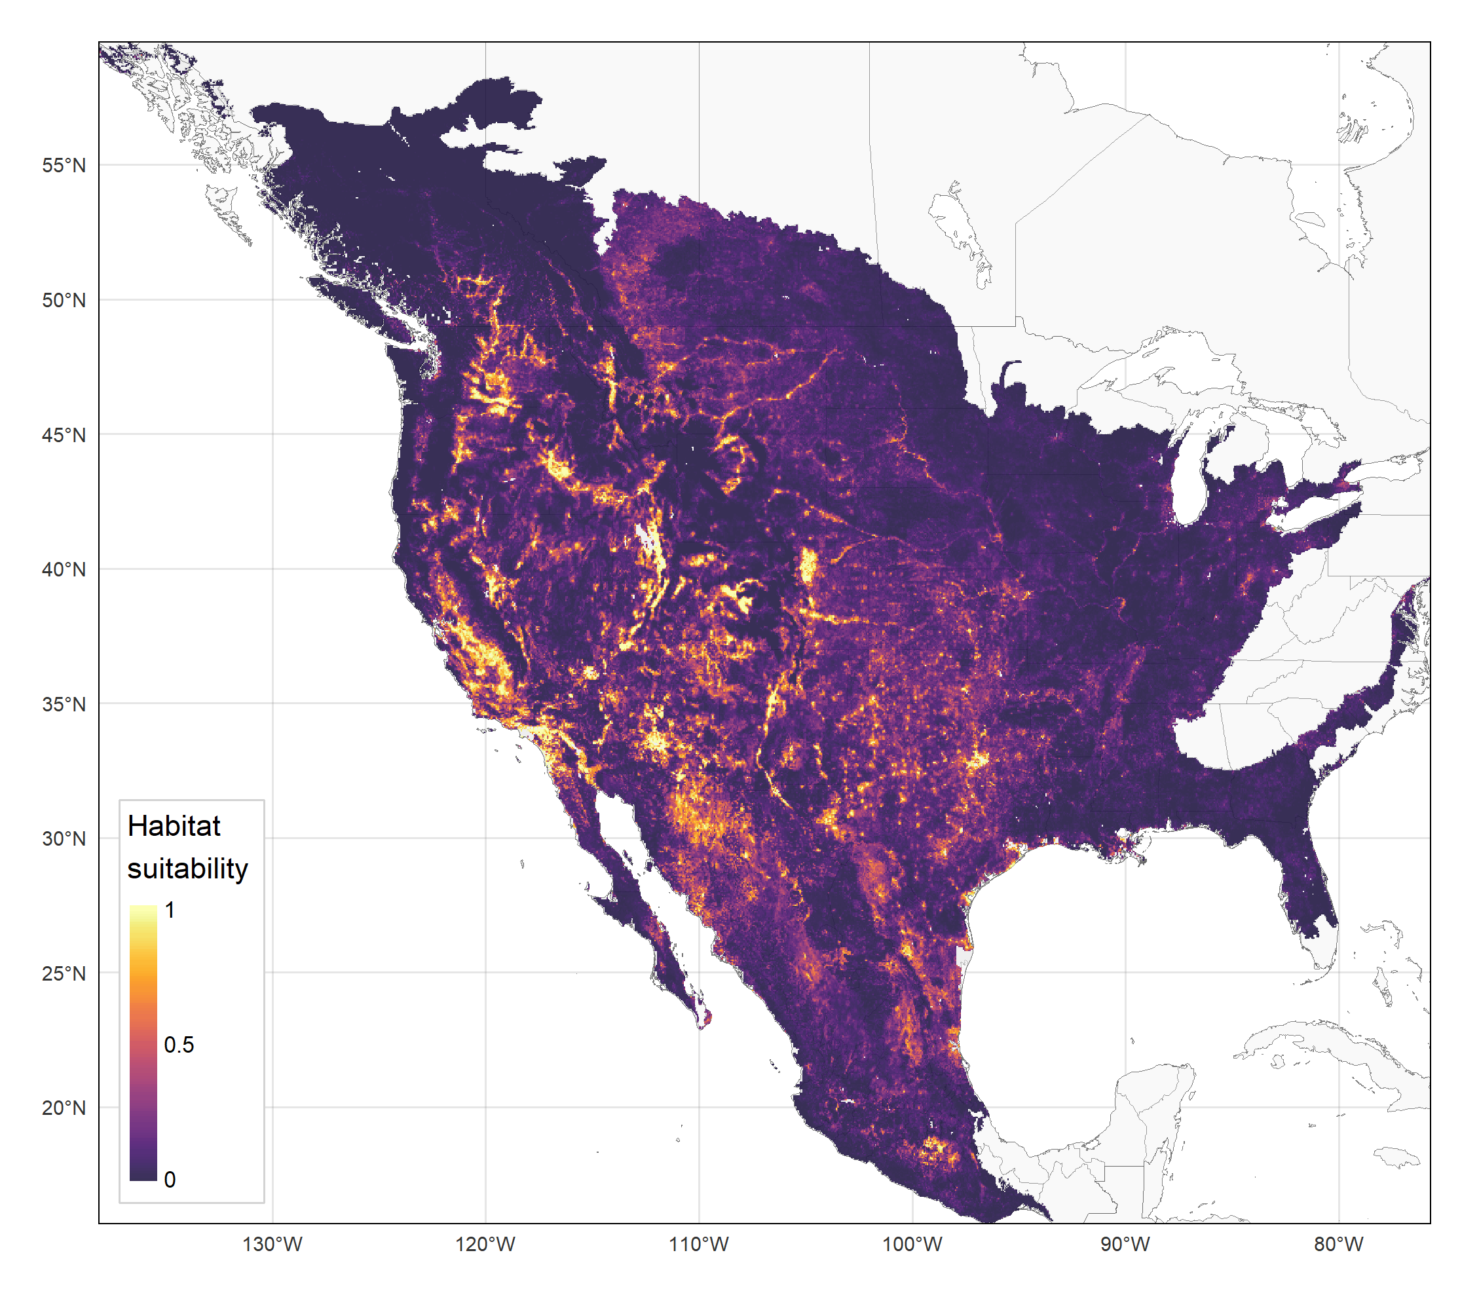
Final distribution estimates for C. sonorensis (VS vector)

Slide 19
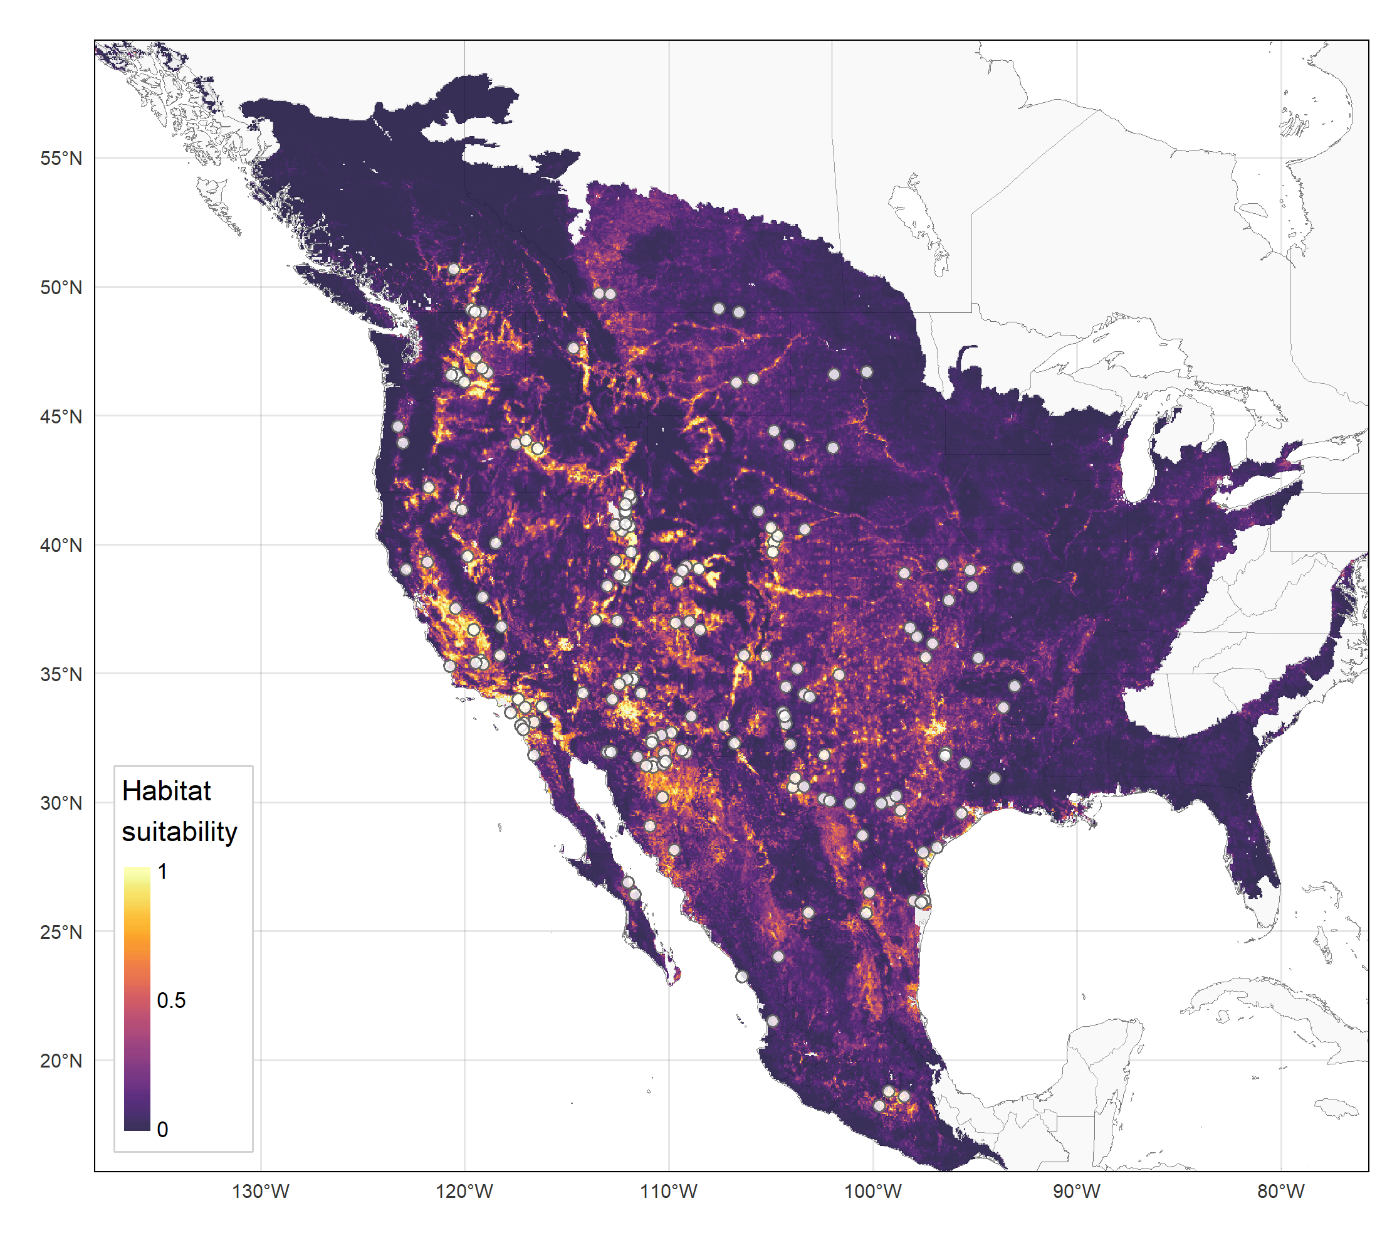
Final distribution estimates for C. sonorensis (VS vector)

Slide 20
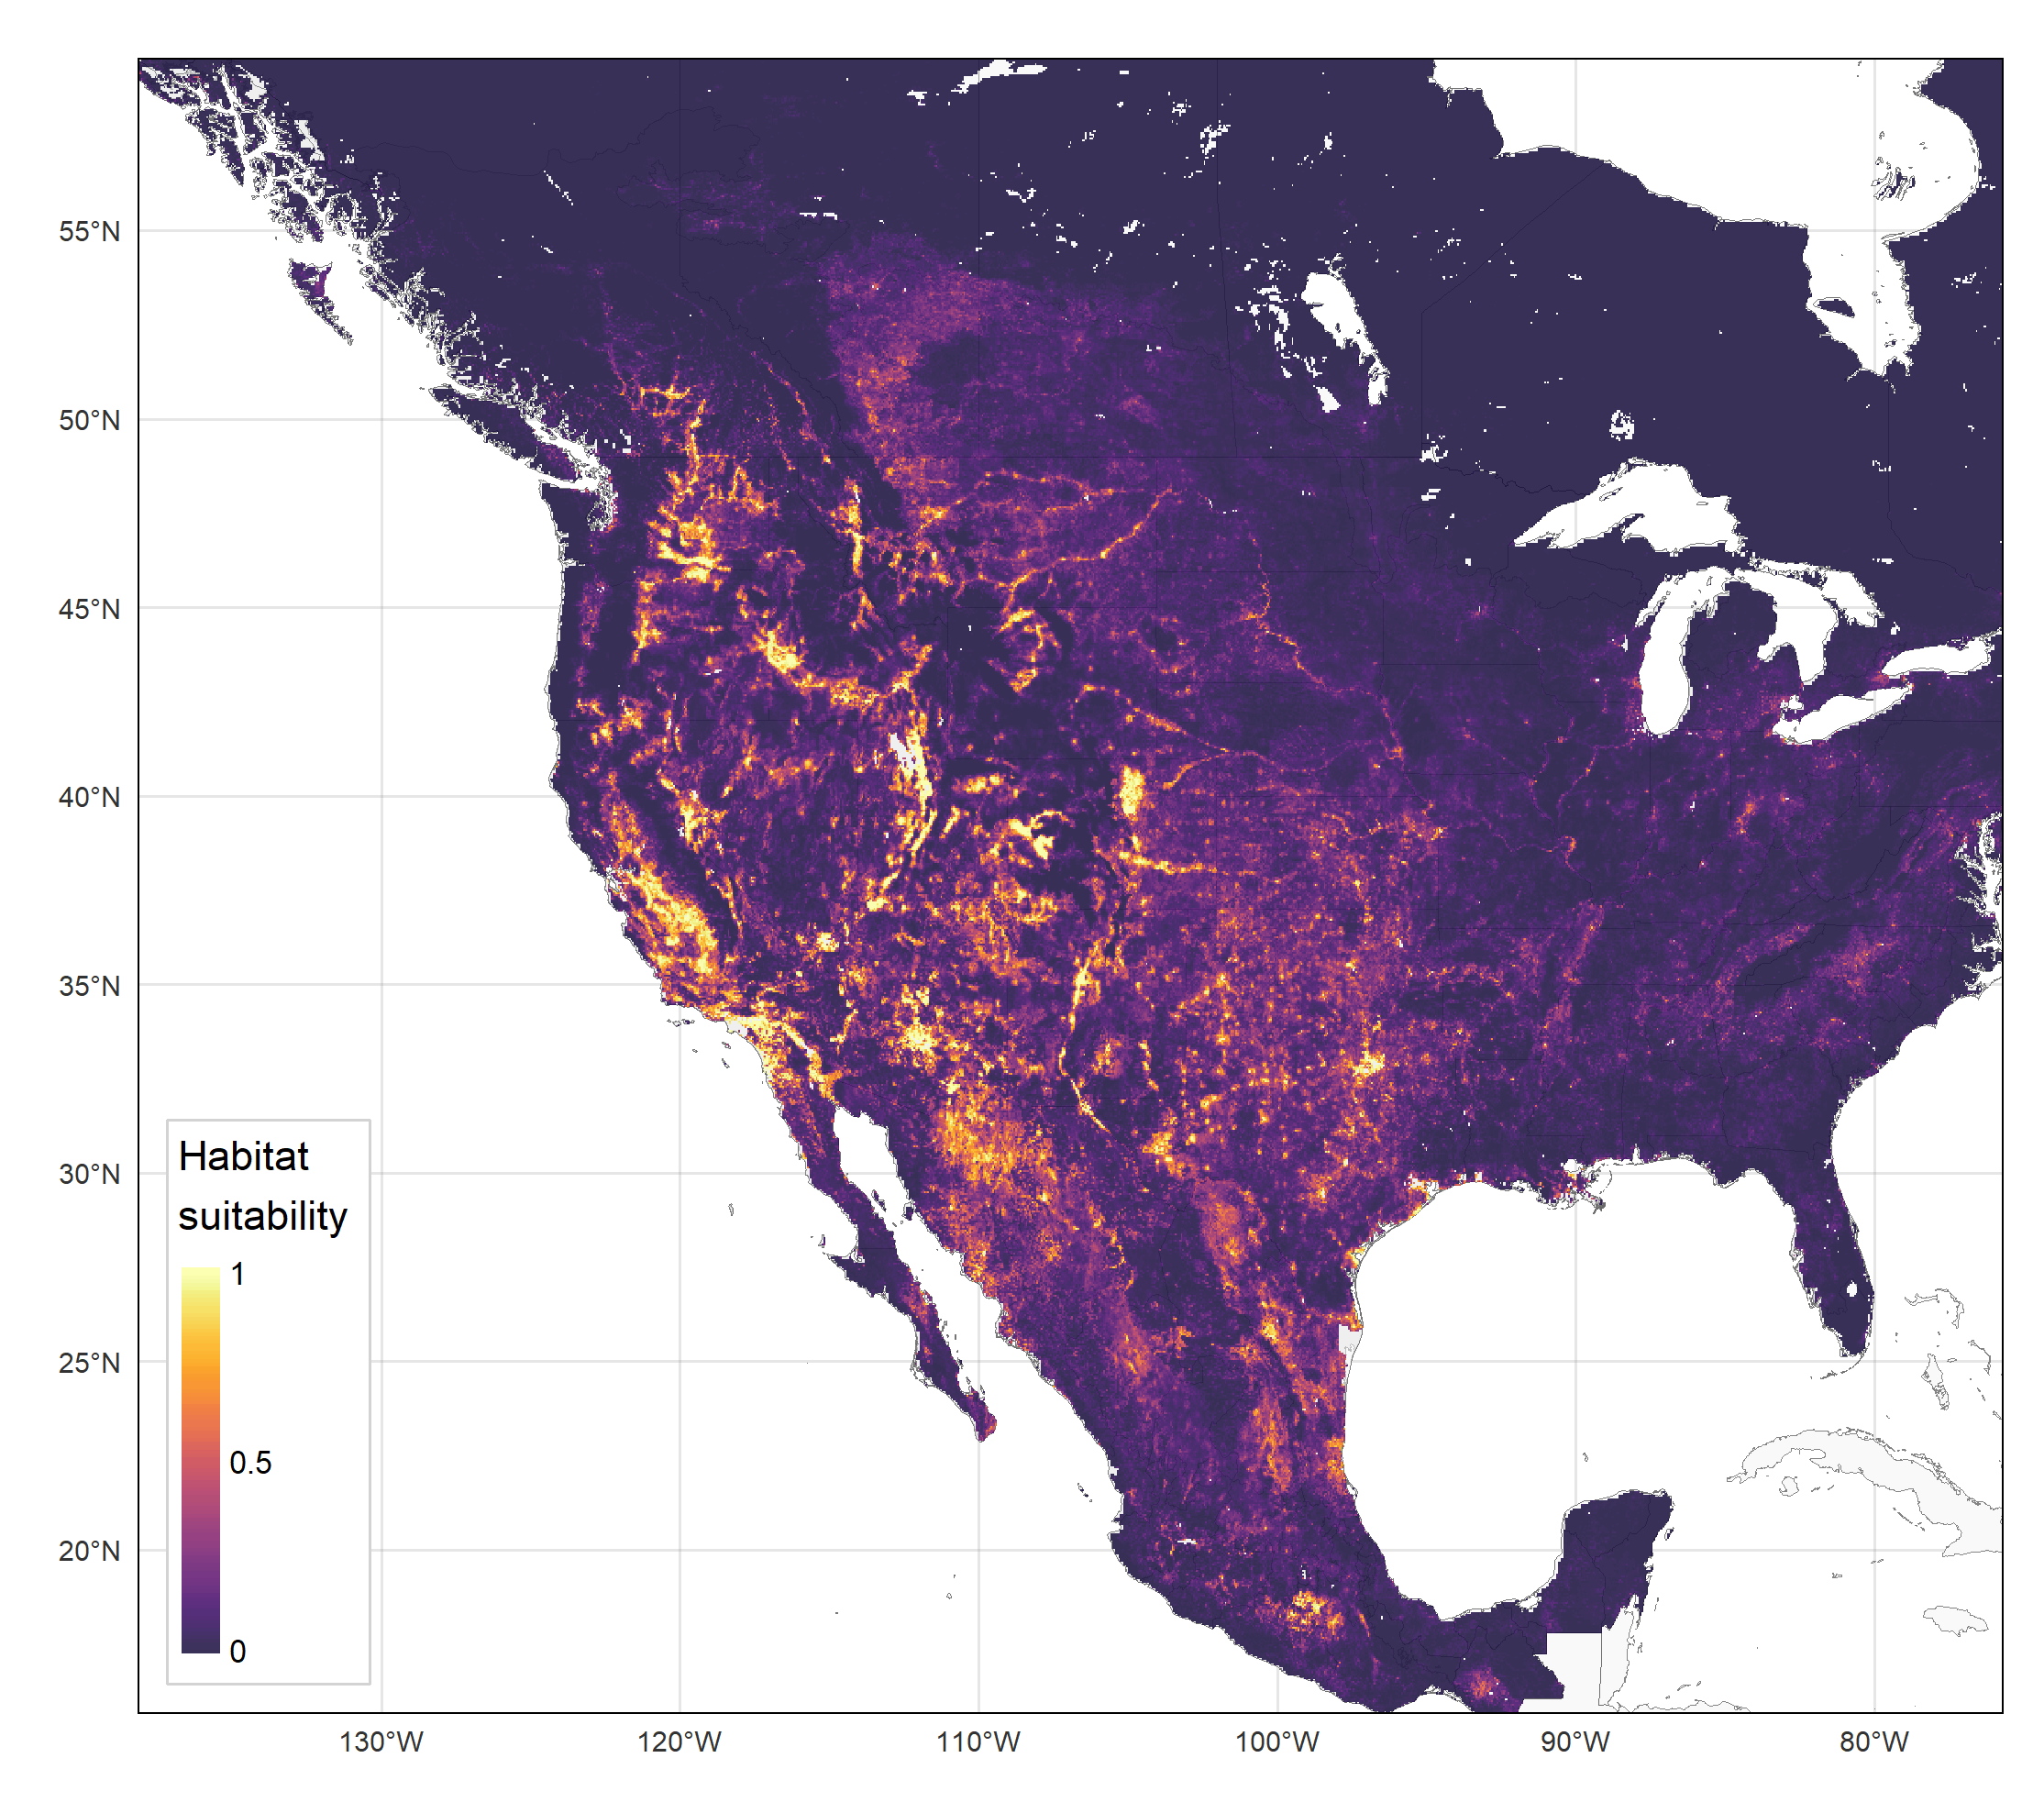
Final distribution estimates for C. sonorensis (VS vector)

Slide 21
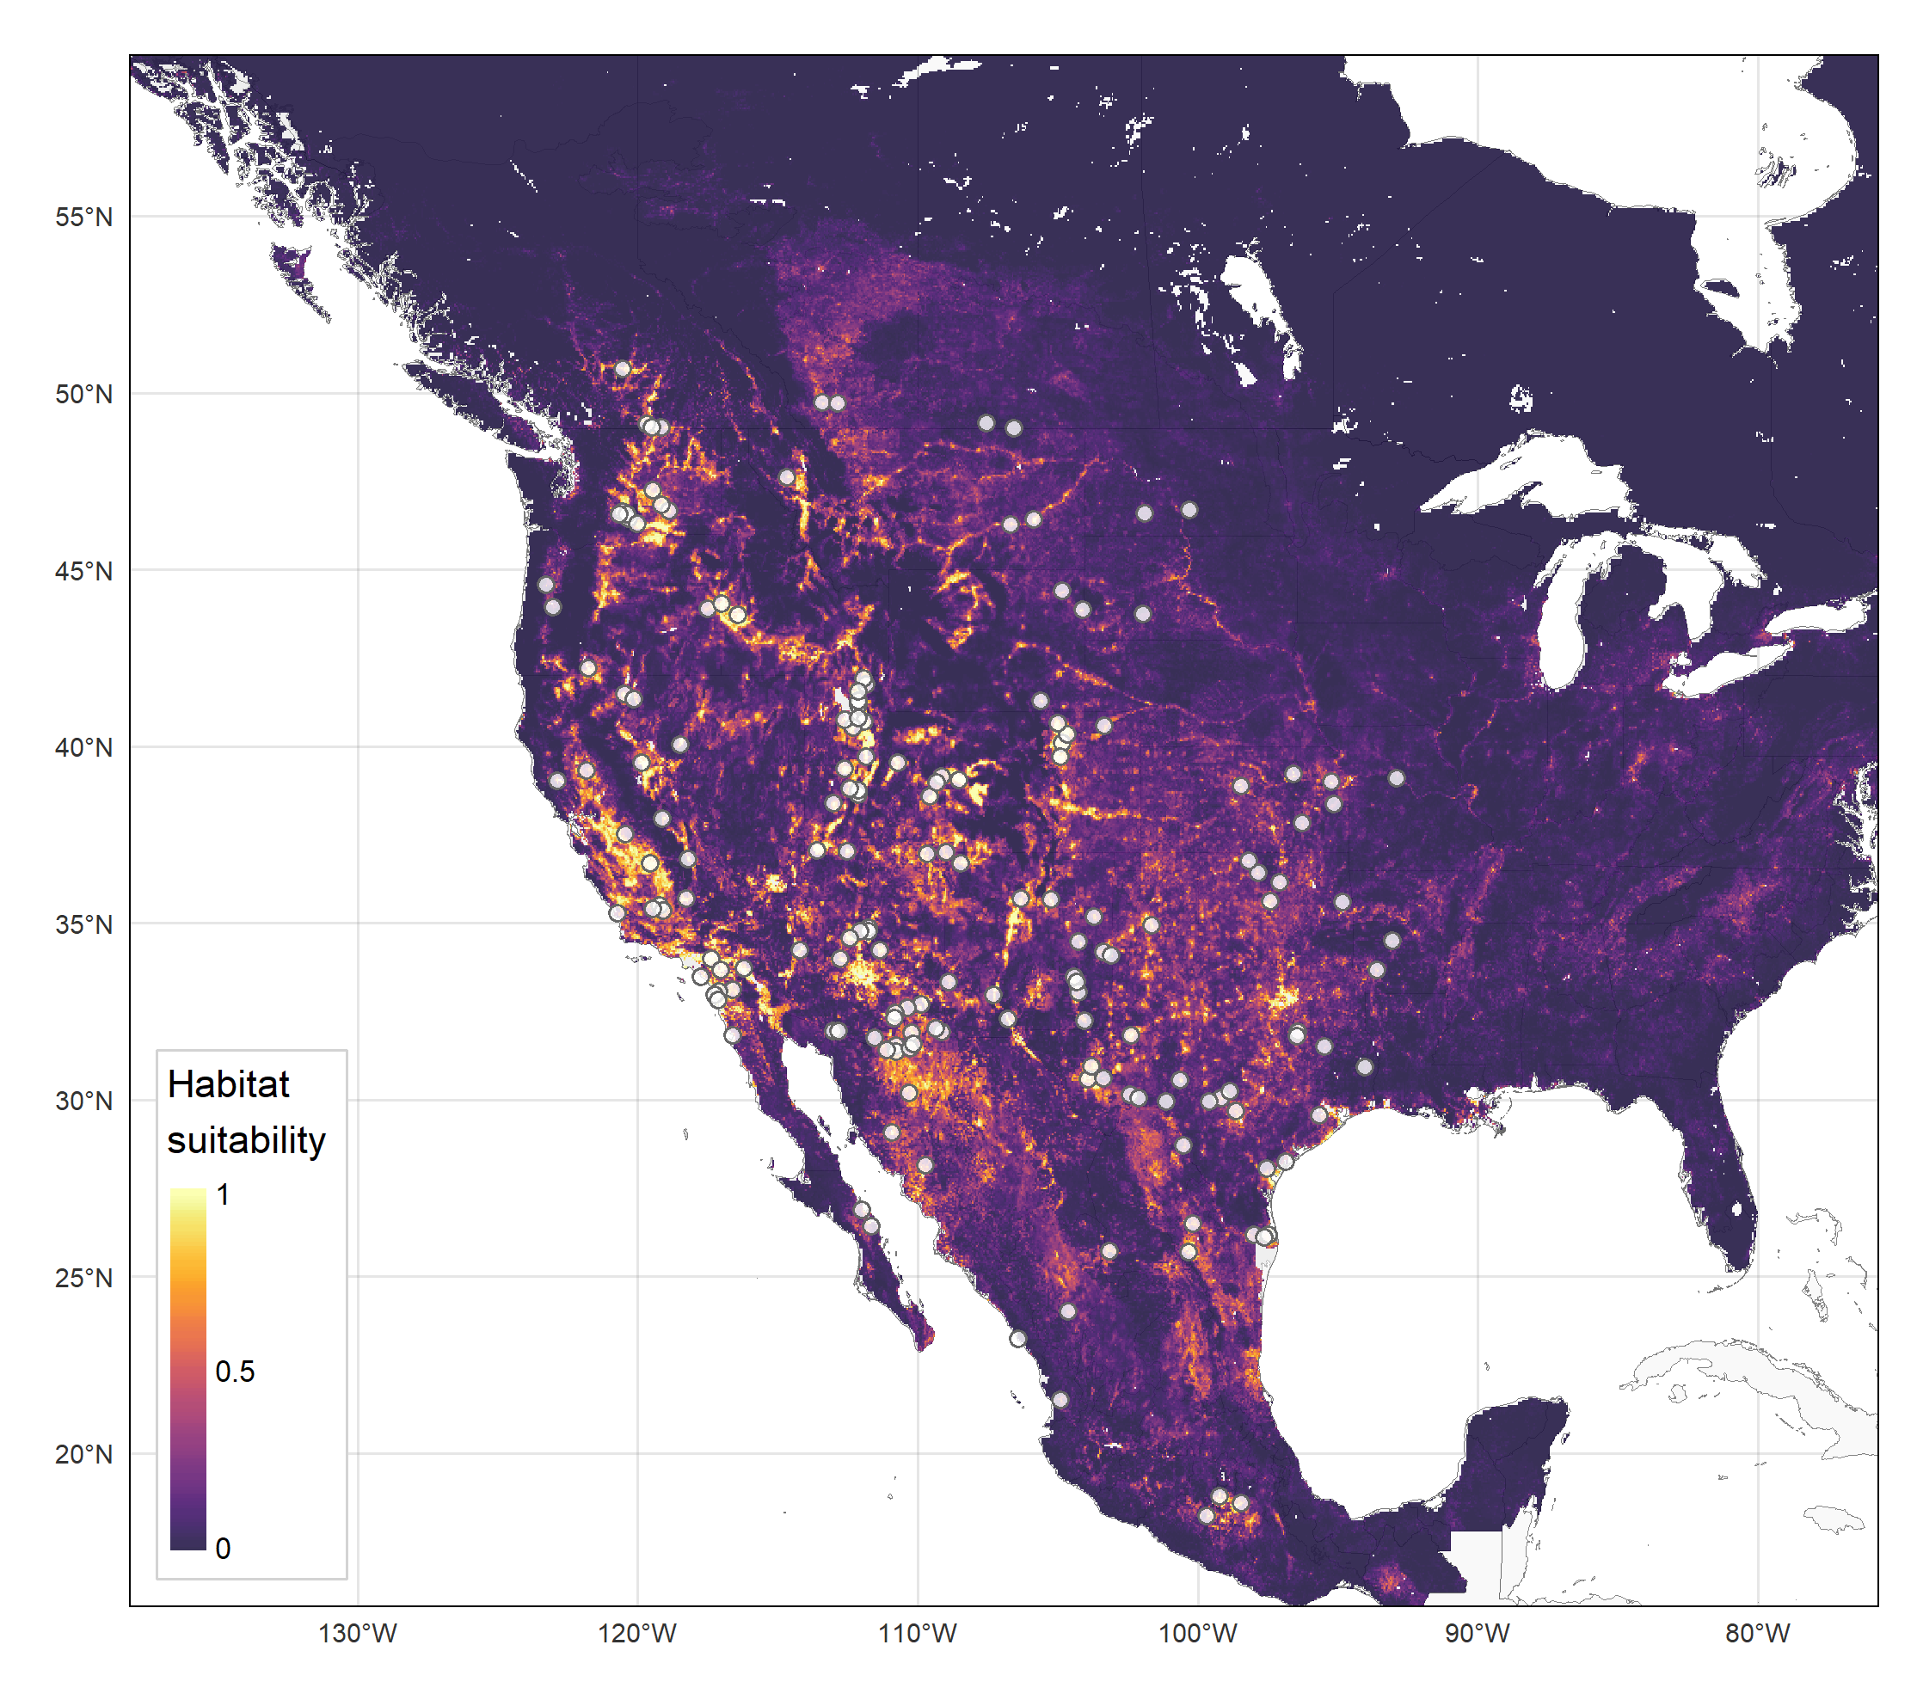
Final distribution estimates for C. sonorensis (VS vector)

Slide 22
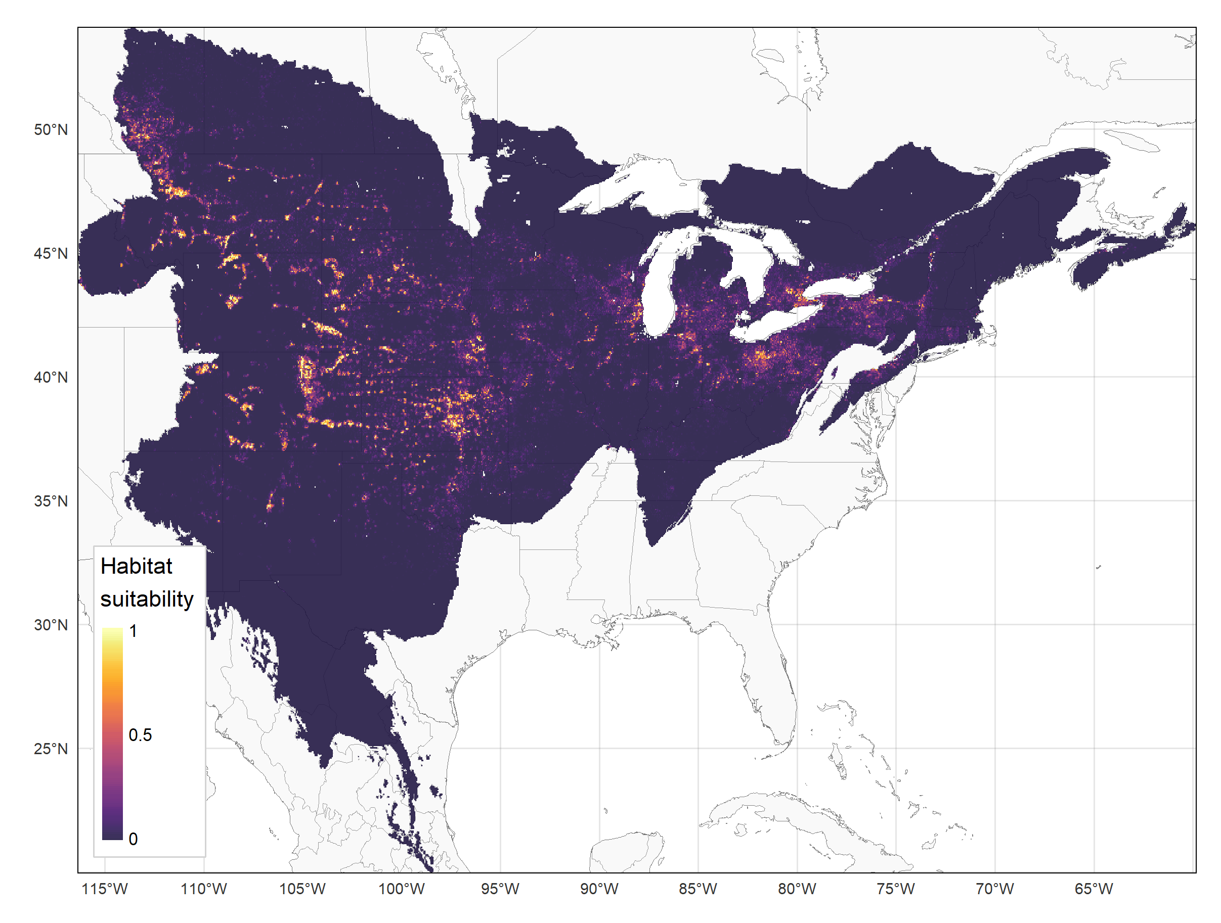
For comparison… final distribution estimates for Culicoides albertensis, a close relative of C. sonorensis (using same SDM workflow)

Slide 23
For comparison… final distribution estimates for Culicoides albertensis, a close relative of C. sonorensis (using same SDM workflow)

Slide 24
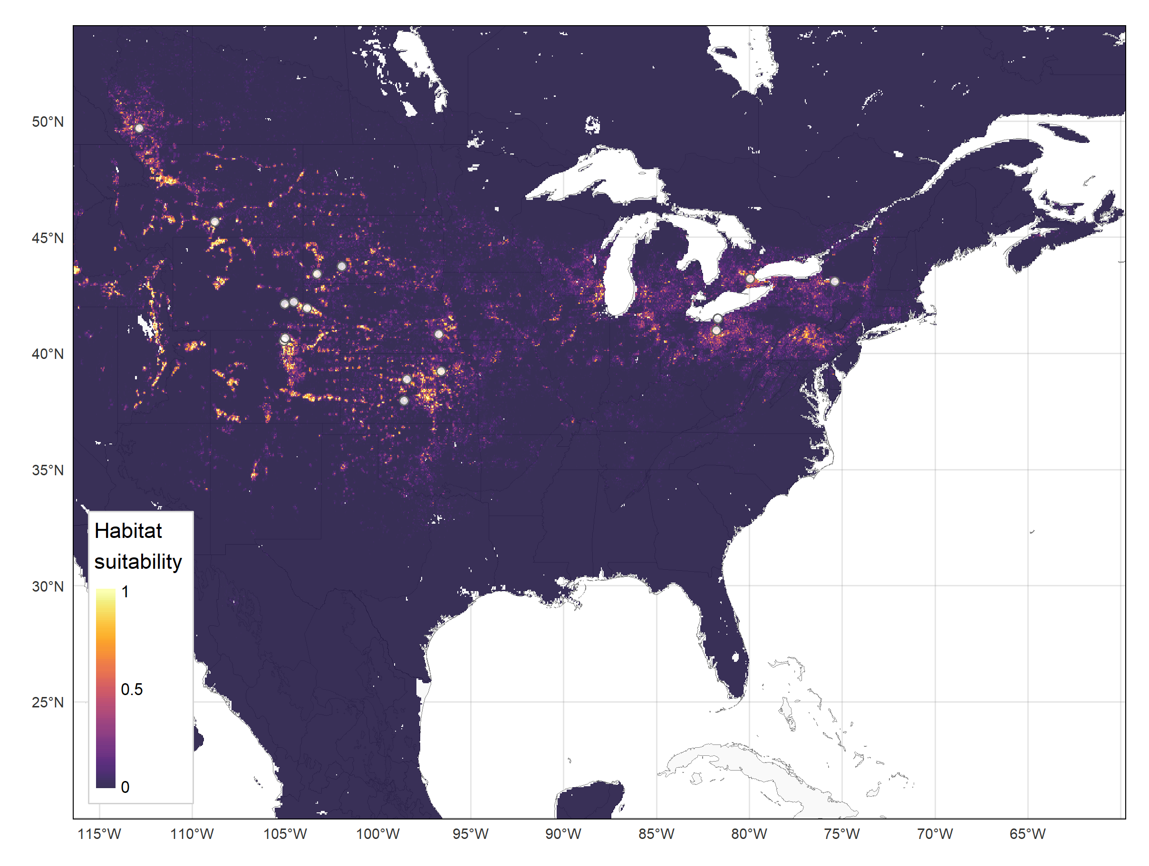
For comparison… final distribution estimates for Culicoides albertensis, a close relative of C. sonorensis (using same SDM workflow)

Slide 25
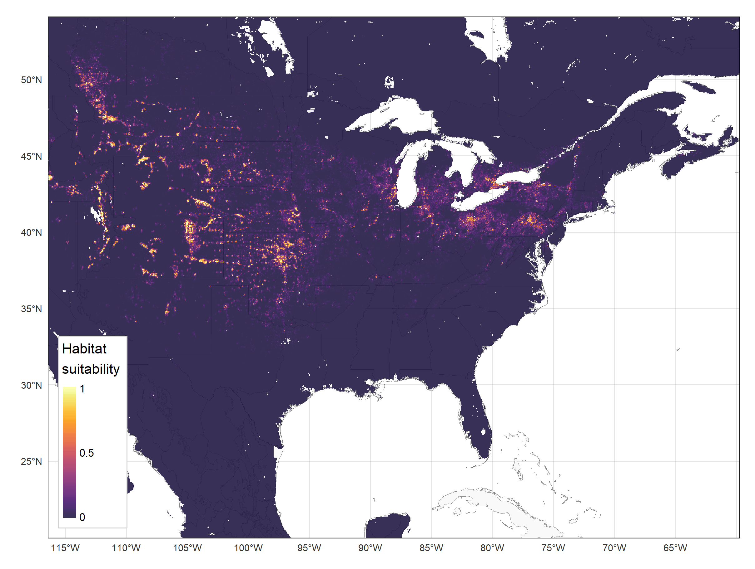
For comparison… final distribution estimates for Culicoides albertensis, a close relative of C. sonorensis (using same SDM workflow)

Slide 26
Results from nested cross-validation estimated generalization error for model tuning procedure and thus estimated performance of final model
Performance Metric | Mean | Standard deviation | Standard error
Test AUC | 0.845 | 0.063 | 0.028
Δ AUC (training-test difference) | 0.078 | 0.054 | 0.024
Test TSS | 0.581 | 0.113 | 0.050
Δ TSS (training-test difference) | 0.139 | 0.105 | 0.047
Test omission rate at minimum training presence threshold | 0.0001 | 0.0001 | 0.0001
Test omission rate at max training sensitivity plus specificity threshold | 0.0011 | 0.0004 | 0.0002
Δ Omission rate at max training sensitivity plus specificity threshold (training-test difference) | 0.1254 | 0.0319 | 0.0143

Slide 27
Case study: Environmental niche modeling of endemic VS in Mexico

Slide 28
ade

Slide 29
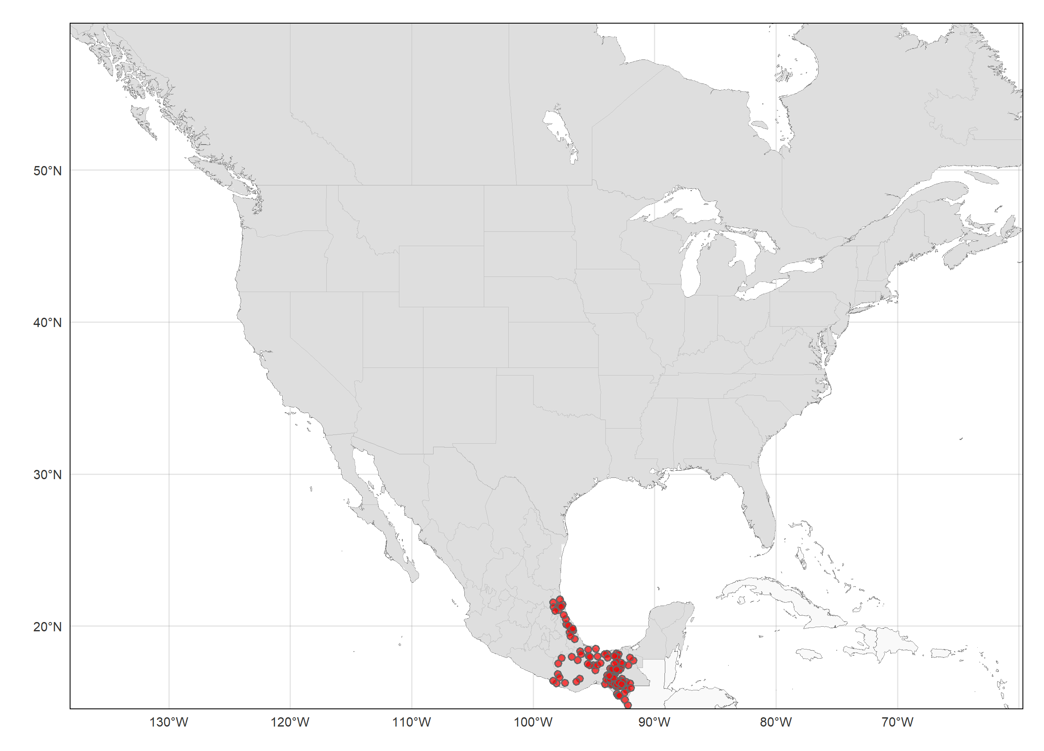
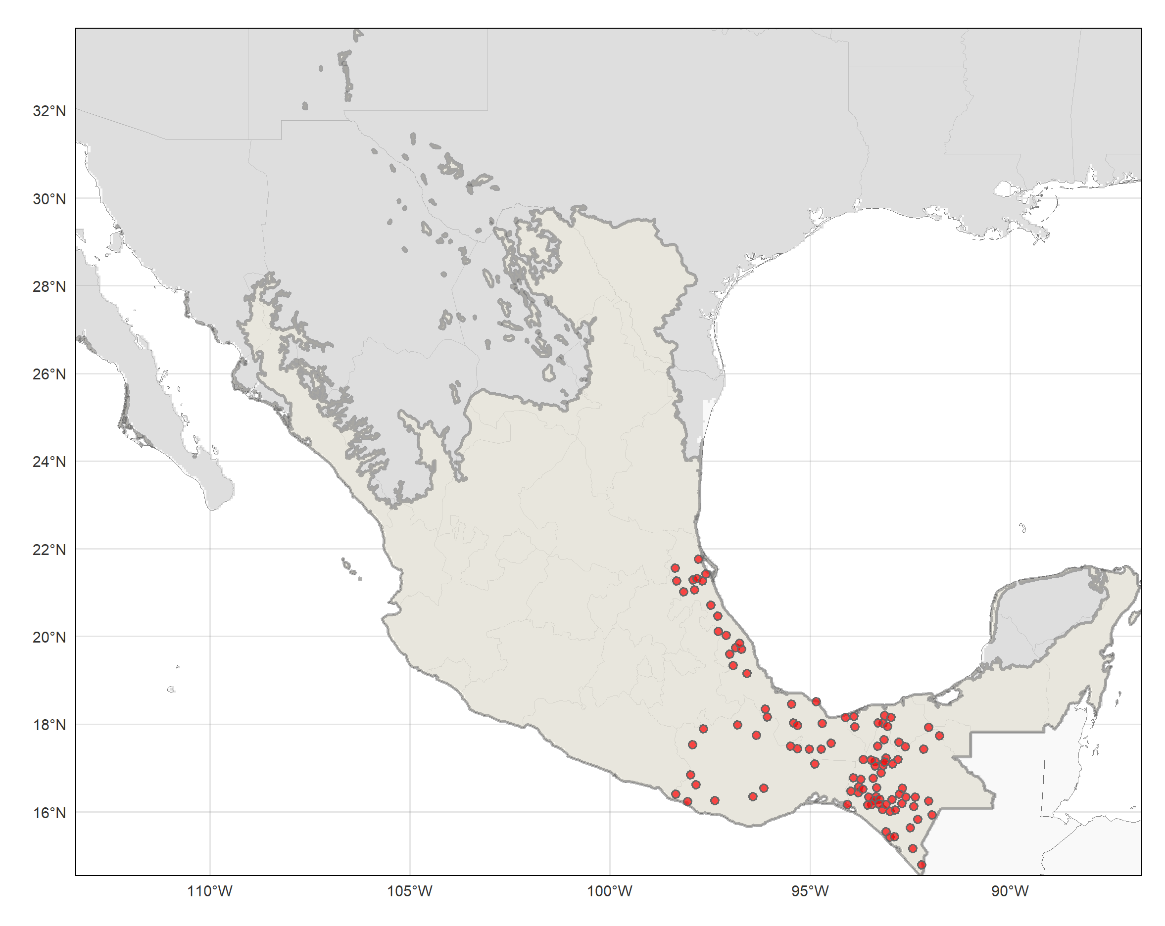
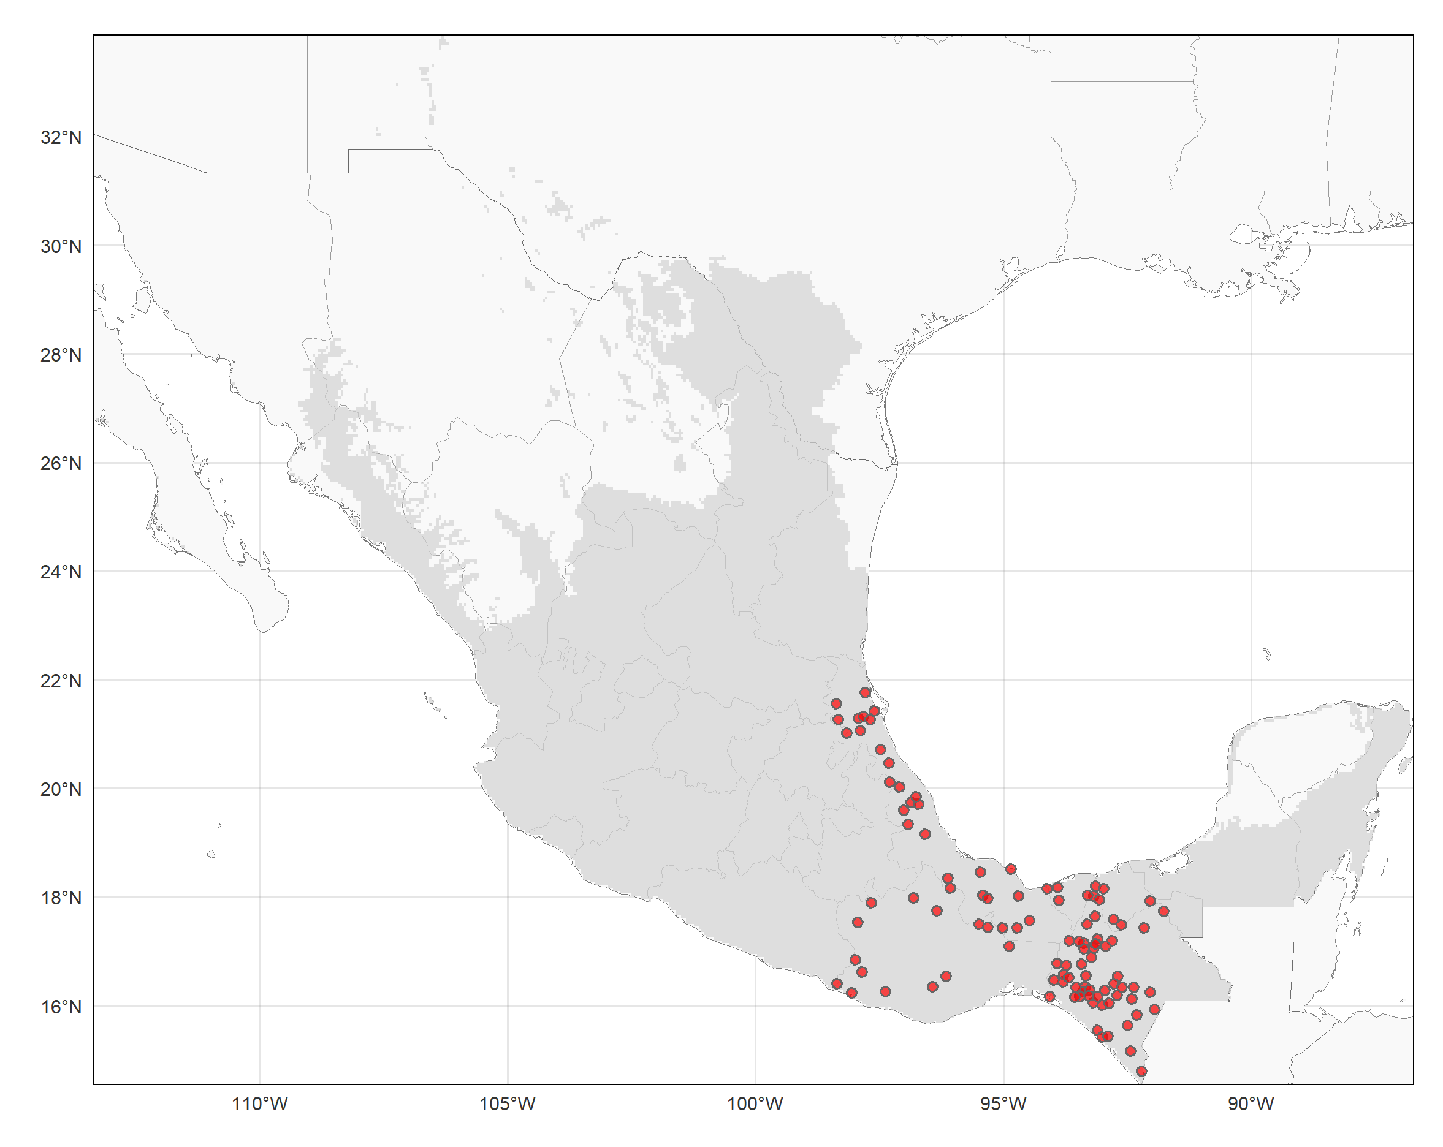
Establishing study (model calibration) area for VS case presences using ecoregions (intersecting/surrounding occurrence points) as boundaries

Slide 30
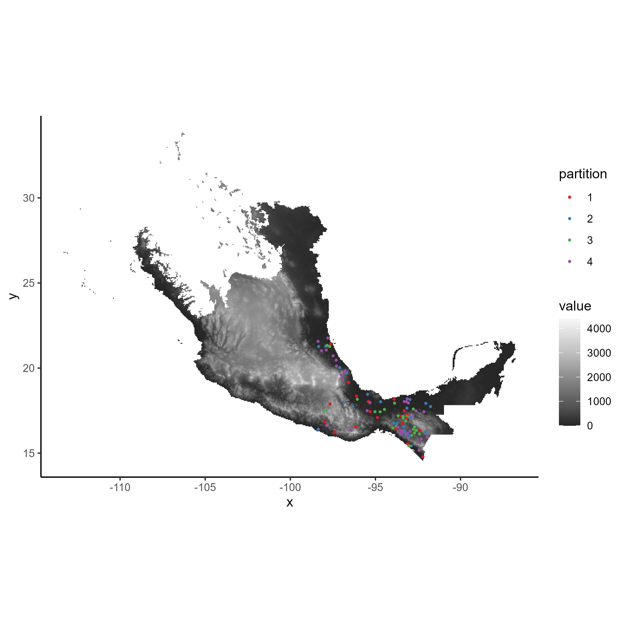
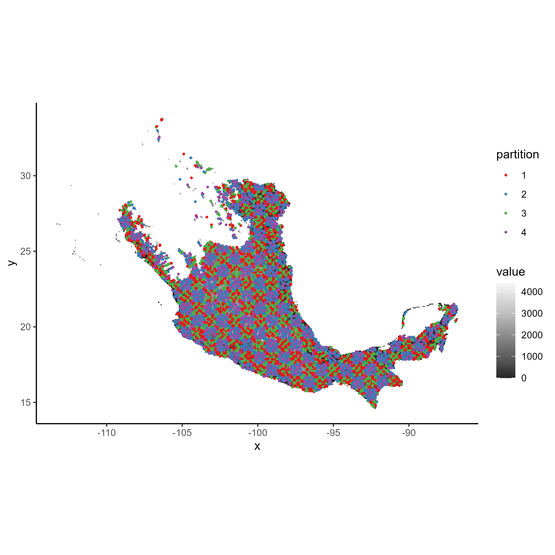
Spatial cross-validation folds (k = 4) for final model tuning process

Slide 31
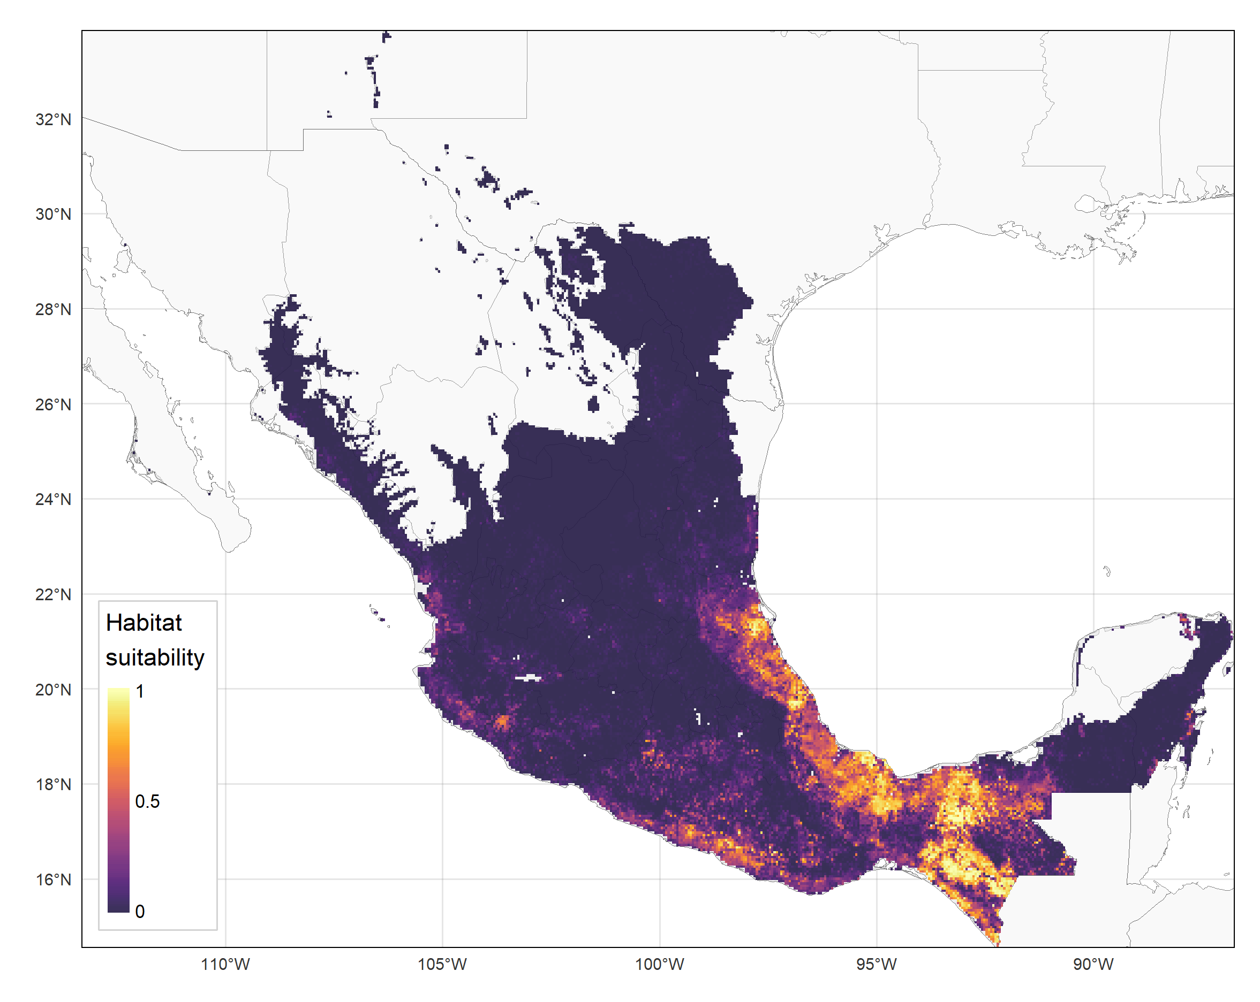
Final distribution estimates for VS cases in endemic regions of Mexico

Slide 32
Final distribution estimates for VS cases in endemic regions of Mexico

Slide 33
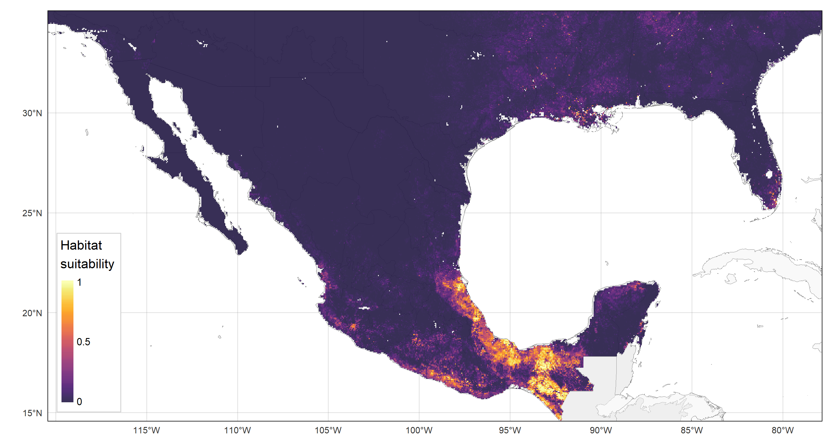
Final distribution estimates for VS cases in endemic regions of Mexico

Slide 34
Final distribution estimates for VS cases in endemic regions of Mexico

Slide 35
Results from nested cross-validation estimated generalization error for model tuning procedure and thus estimated performance of final model
Performance Metric | Mean | Standard deviation | Standard error
Test AUC | 0.908 | 0.016 | 0.007
Δ AUC (training-test difference) | 0.046 | 0.021 | 0.009
Test TSS | 0.735 | 0.023 | 0.010
Δ TSS (training-test difference) | 0.069 | 0.036 | 0.016
Test omission rate at minimum training presence threshold | 0.0001 | 0.0001 | 0.0000
Test omission rate at max training sensitivity plus specificity threshold | 0.0004 | 0.0002 | 0.0001
Δ Omission rate at max training sensitivity plus specificity threshold (training-test difference) | 0.0546 | 0.0167 | 0.0073

Slide 36
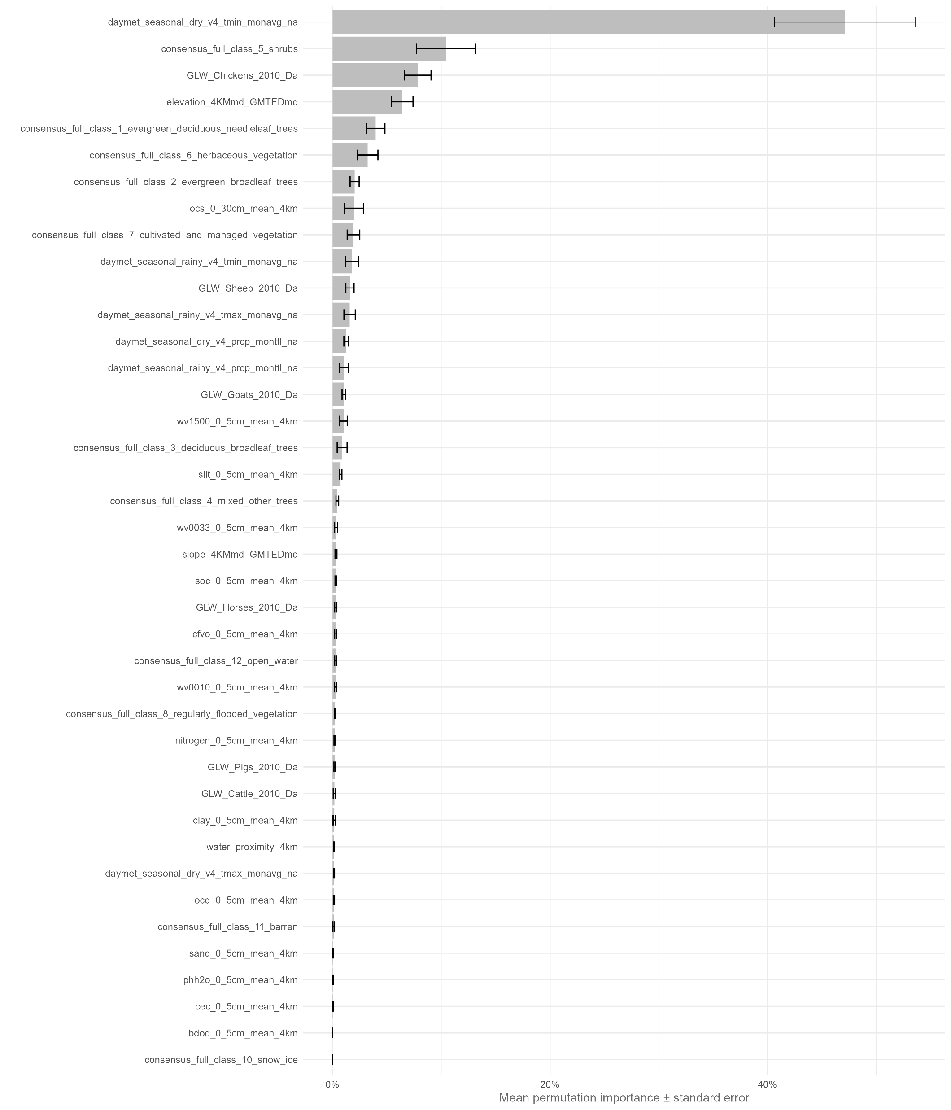
Variable importance (average across nested cross-validation outer loop models)
Mean relative permutation importance from 5 tuned models, per Maxent algorithm (resulting from nested cross-validation procedure)
Including standard error bars for each averaged variable ranking/percentage

Slide 37
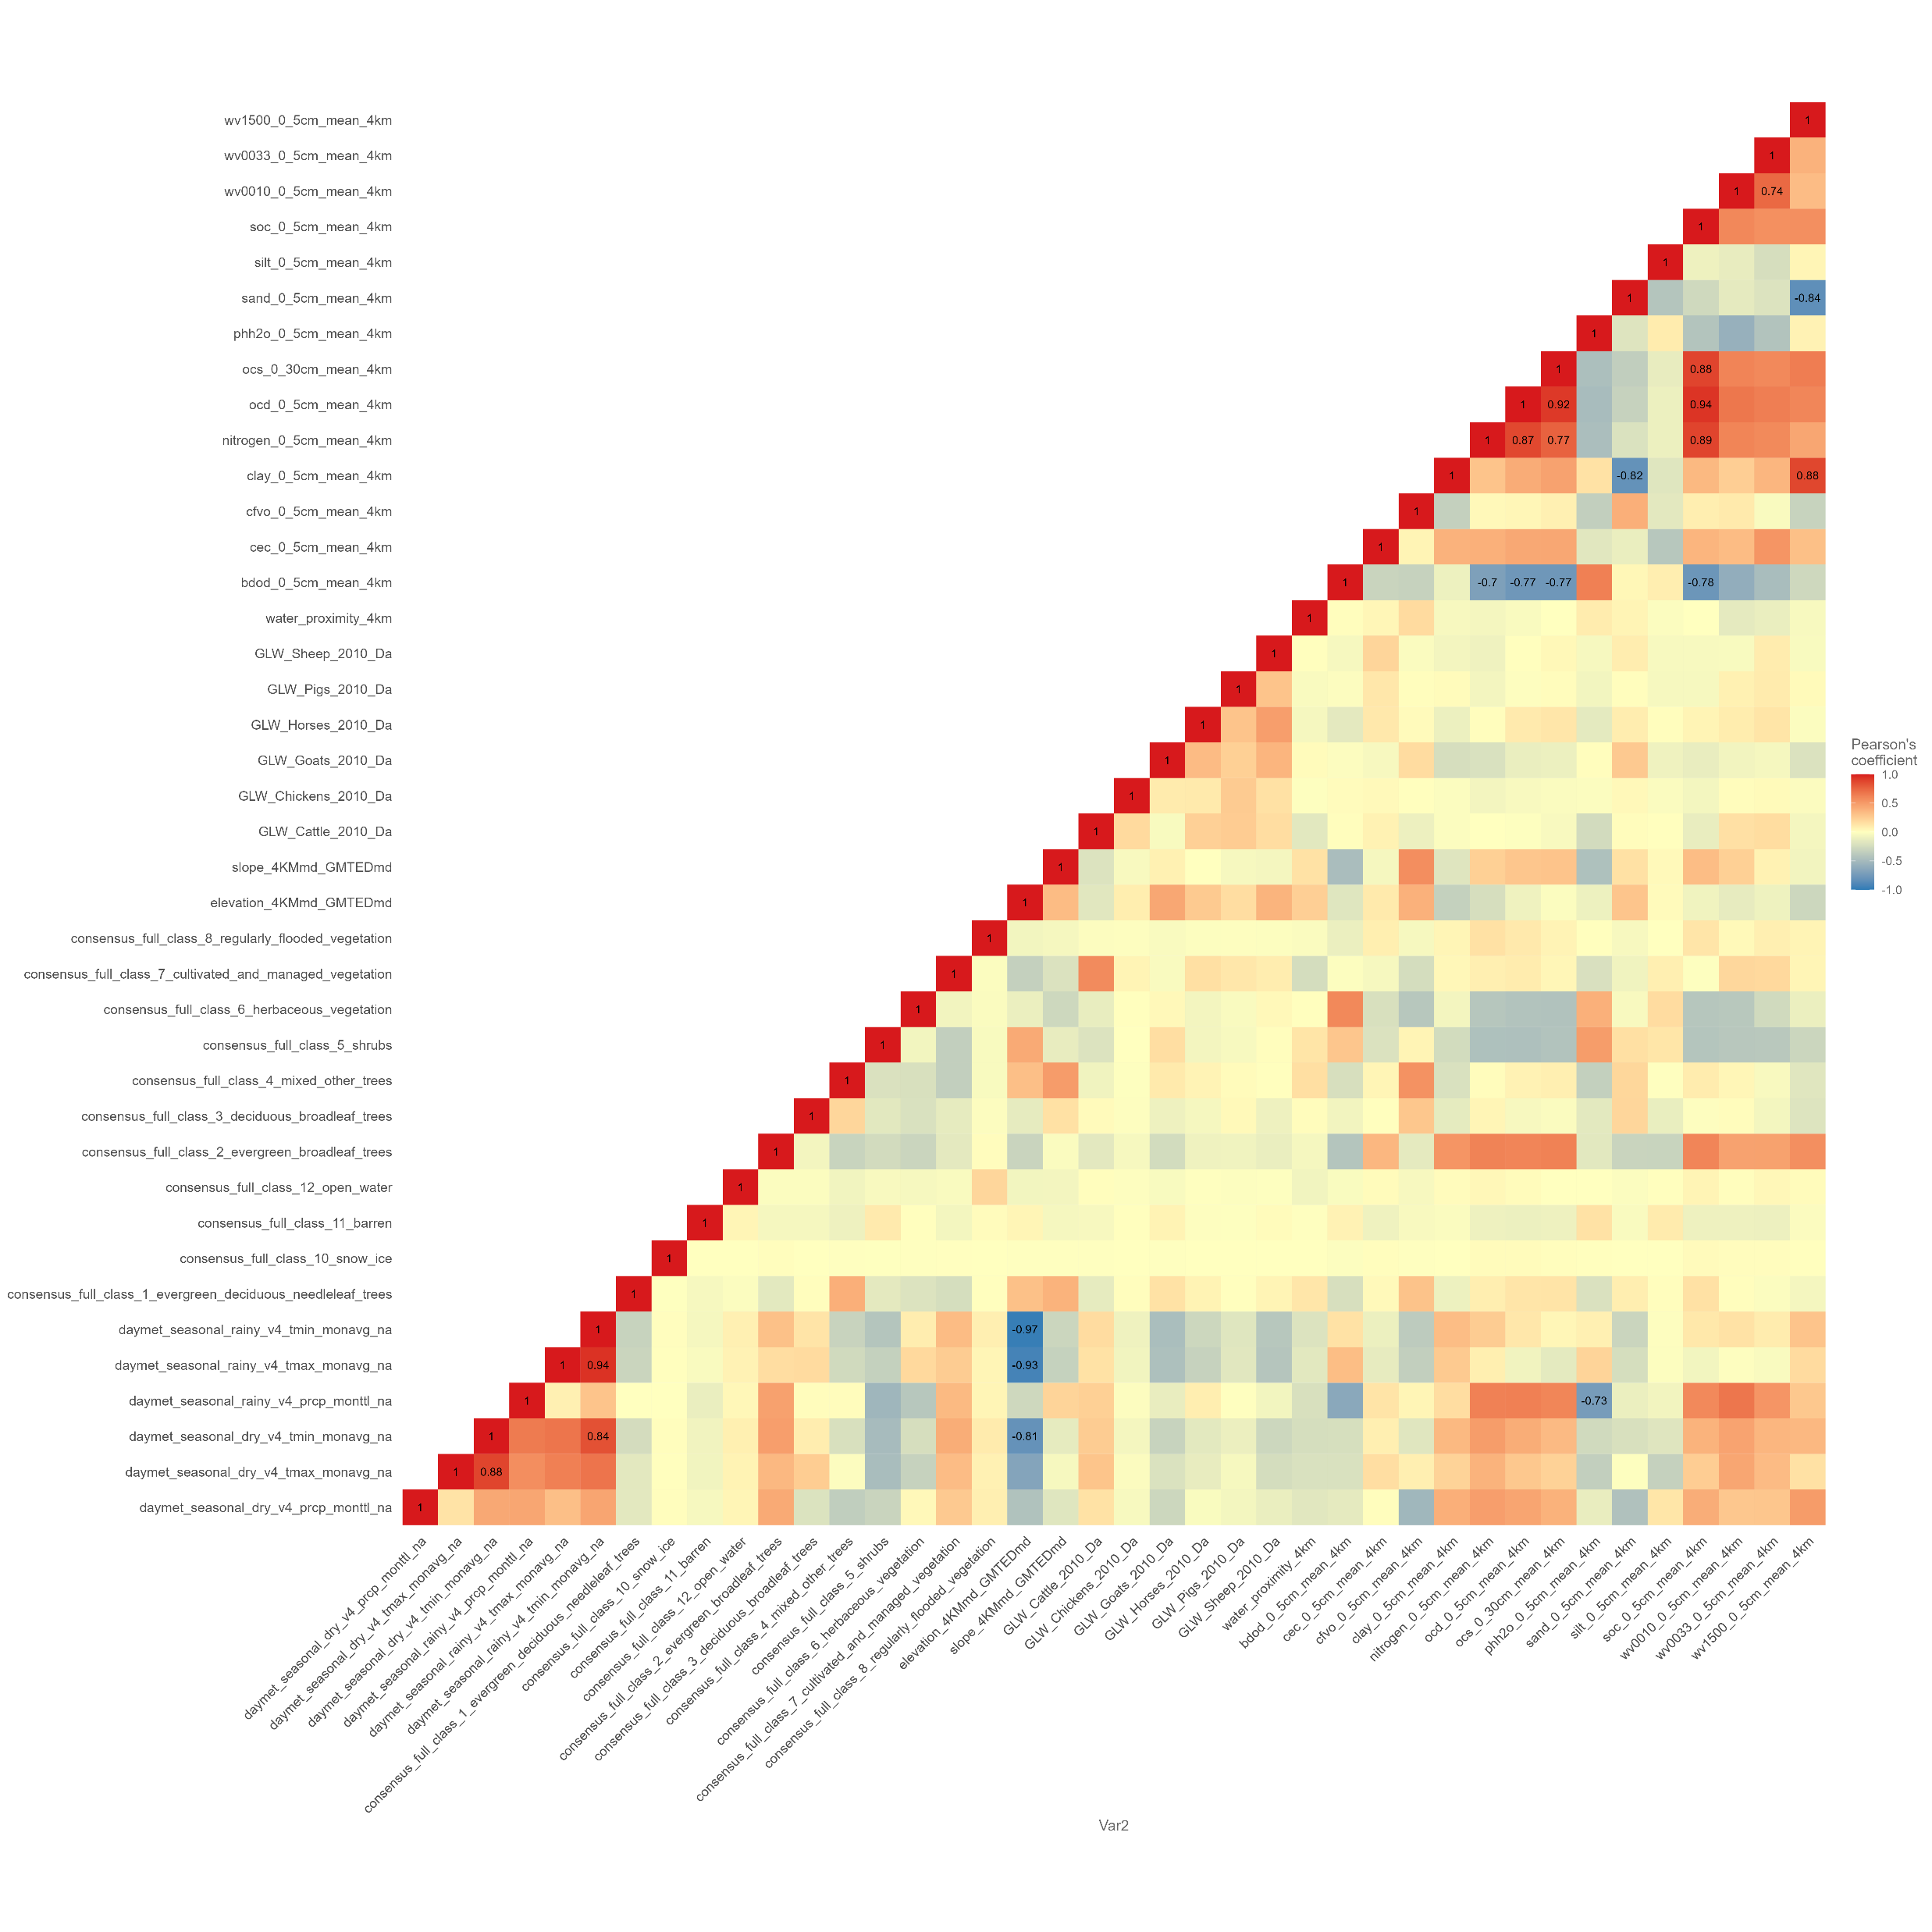
Multicollinearity and variable importance among environmental variables
Correlation matrix visually indicating significantly collinear variables (>0.7 Pearson values) – hard to see here, though, due to the high number of variables!
Easier to sort variable pairs by highest collinearity ranking in a data table, then select one variable from each pair to exclude from the model-derived variable importance calculation
Can also do the same thing using VIF (variable inflation factor), a measure that can be used to rank each variable by their overall multicollinearity (correlation with all other variables in the set)

Slide 38
Next steps & future research directions
Improving and refining current SDM/ENM workflow
Expanding on analysis of variable importance and multicollinearity, particularly for the endemic Mexico VS study
Generating results on estimating distributions of additional Culicoides species related to C. sonorensis using similar workflow – to compare prediction distributions between a known VS vector (C. sonorensis) and other closely related species that are nonetheless non-vectors for VS
Full generalization of this dynamic SDM workflow to use for estimating distributions of any species

Slide 39
Acknowledgements & thanks to…
Colleagues in the VS working group at USDA-ARS for their collaborations and contributions toward upcoming manuscripts related to the two case studies shown in this presentation
North American Culicoides species distribution modeling:
Phillip Shults (phillip.shults@usda.gov), Lee Cohnstaedt (lee.cohnstaedt@usda.gov), Debra Peters (peters.debra@gmail.com), Brian Stucky (brian.stucky@usda.gov)
Environmental niche modeling of endemic VS in Mexico:
Debra Peters (peters.debra@gmail.com), Brian Stucky (brian.stucky@usda.gov), Katie Young (kiyoung@uchicago.edu), Kathy Hanley (khanley@nmsu.edu)
SCINet for providing HPC resources and technical guidance
SCINet/ARS AI-COE for ORISE fellowship support
Everyone here both on-site and virtually at this EGU conference – thank you!

Slide 40
Further acknowledgements & disclosures
This research was supported in part by an appointment to the Agricultural Research Service (ARS) Research Participation Program administered by the Oak Ridge Institute for Science and Education (ORISE) through an interagency agreement between the U.S. Department of Energy (DOE) and the U.S. Department of Agriculture (USDA). ORISE is managed by ORAU under DOE contract number DE-SC0014664. All opinions expressed in this presentation/abstract are the author's and do not necessarily reflect the policies and views of USDA, DOE, or ORAU/ORISE.
This research used resources provided by the SCINet project of the USDA Agricultural Research Service, ARS project number 0500-00093-001-00-D.

