Slide 1
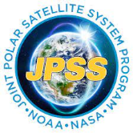
The Development of a New Daily Global Mesoscale Blended Ocean Surface Currents (BOSC) Product
Shaun Eisner [1], James Carton [1], Eric Leuliette [2], Dierdre Byrne [2], Semyon Grodsky [1]
[1] Department of Atmospheric and Oceanic Sciences, University of Maryland, College Park, College Park, MD, USA
[2] Lab for Satellite Altimetry, National Oceanic and Atmospheric Administration, College Park, MD, USA

Slide 2
Blended Ocean Surface Currents - BOSC
Summary:
Resolution – 1/6 deg., daily
Coverage – 2017-2021
2 Depths: 20cm (near-surface), 15m
Collaboration between NOAA NESDIS STAR Satellite Altimetry Lab and UMD Ocean Climate Lab
Builds upon existing multiobservational surface current analyses: OSCARv2 (NASA/ESR), Copernicus-GLOBCURRENT (ESA)
Overview/Datasets:
1. Momentum Balance - NOAA CoastWatch multi-mission gridded Sea Level Anomaly
2. Ekman-Stokes - ERA-5 wind stress
3. Climatology Correction - NOAA AOML Monthly, ¼ deg Drifter-Derived Climatology
4. SST Correction - GHRSST L4 OSPO Nighttime SST

Slide 3
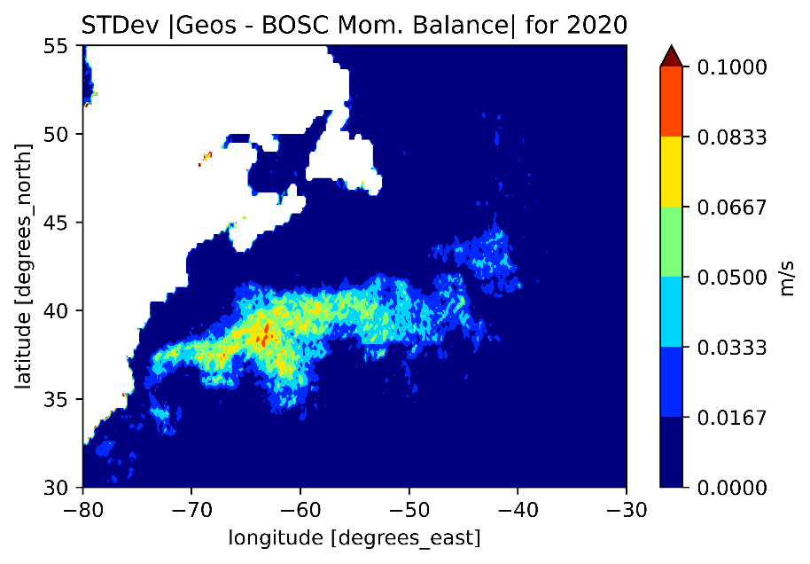
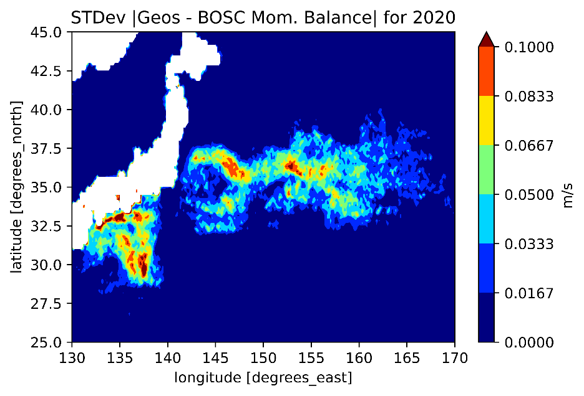
Step 1: Momentum Balance
Traditional Approach: Geostrophic Balance
$$f\hat{k}×\vec{u}=−g∇η$$
Satellite-derived Sea Level Anomaly (SLA)
BOSC Approach: Augment to 3-way momentum balance, including advection
$$f\hat{k}×\overset{⃑}{u}+\left(\overset{⃑}{u}∙∇\overset{⃑}{u}\right)=−g∇η$$
SLA: 0.25 deg., daily NOAA CW/OW Multimission RADS NRT Sea Level Anomaly

Slide 4
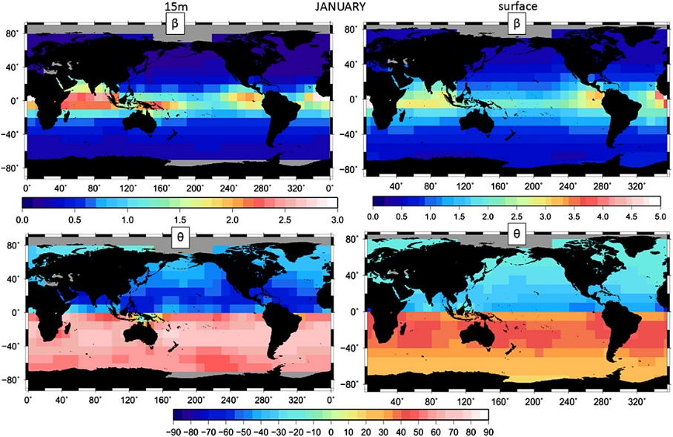
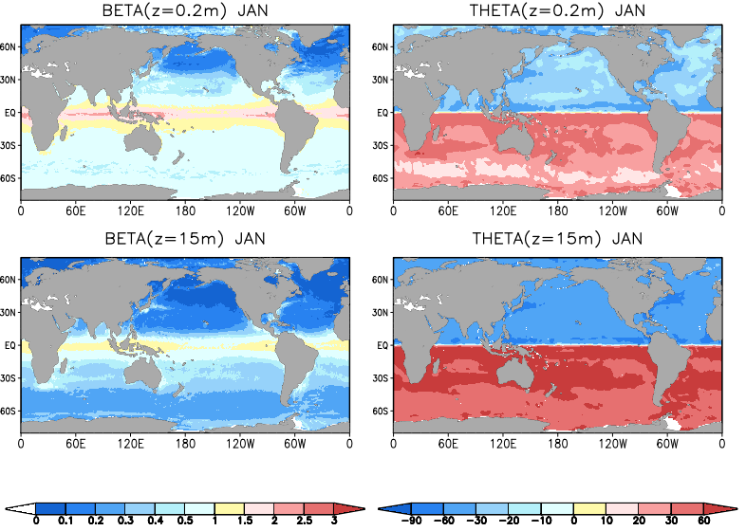
Step 2: Empirical Ekman-Stokes
Builds upon the work of Rio et al. (2014), which regresses the $β$ and $θ$ parameters against a drifter climatology to obtain 4 deg., monthly fields for the parameters at surface and 15m.
Beta and theta parameters from Rio et al. (2014)
$$u_{es}+iv_{es}=β(z)\left(τ_{x}+iτ_{y}\right)e^{iθ(z)}$$
Beta and theta parameters for BOSC
Wind Stress: ERA-5 Daily Wind Stress

Slide 5
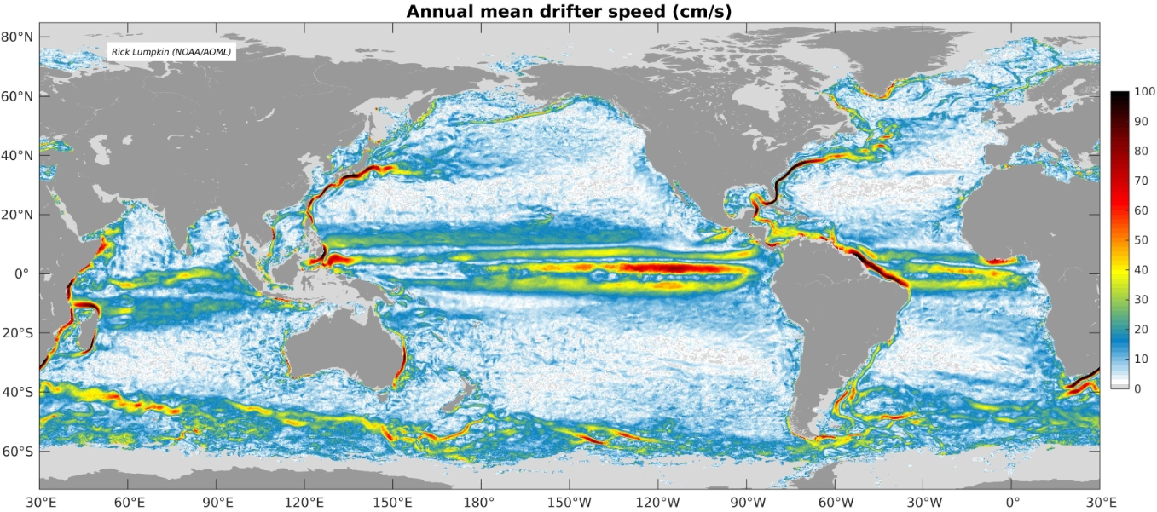
Step 3: Climatological Correction
Removes bias in momentum balance and Ekman-Stokes relative to monthly, 1 deg. Drifter-derived climatology by Laurindo et al., (2017)
$$u_{f}=u_{1}+u_{es}−(\overline{u_{1}+u_{es}}−u_{clim})$$
Mean over 1 month and 1 deg. bin
Climatology: NOAA AOML Monthly, 1 deg, Drifter-Derived Climatology
Photo Credit: Rick Lumpkin (NOAA/AOML)

Slide 6
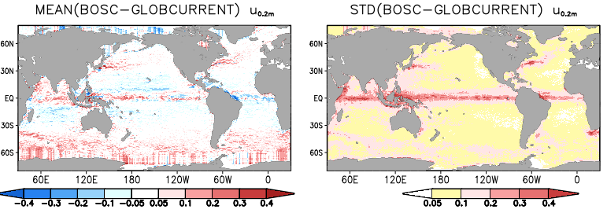
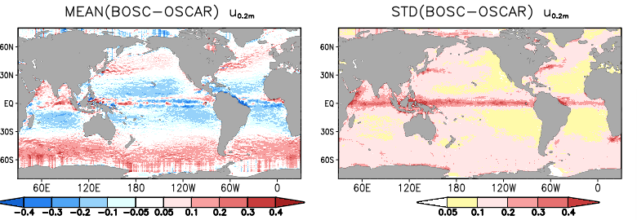
Statistical Comparison – Existing Products

Slide 7
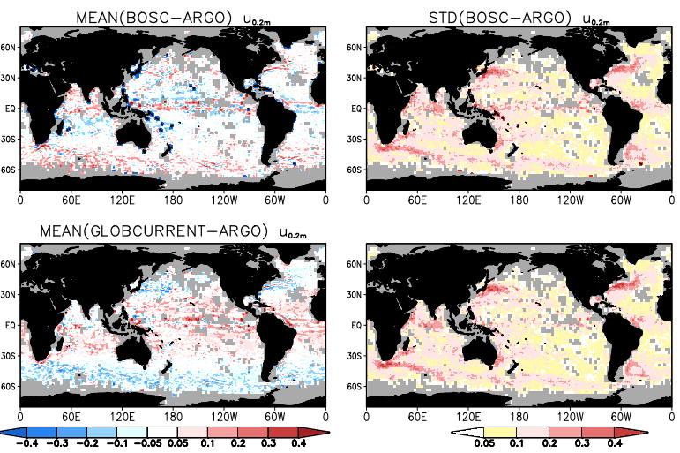
Statistical Comparison – In Situ Observations

Slide 8
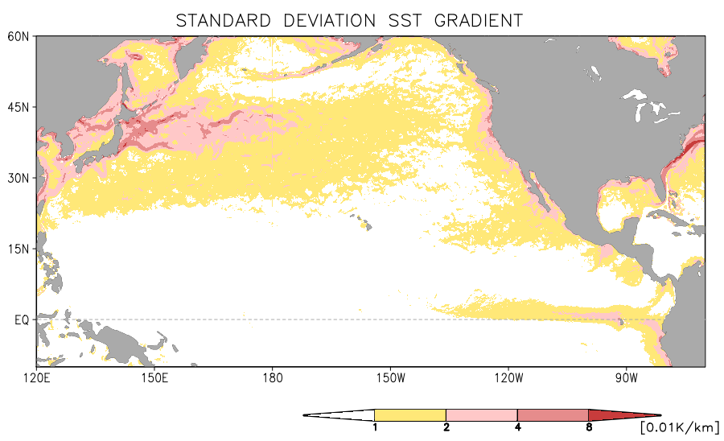
SST “Feature-Tracking”
Rio & Santoleri (2018) Showed that the Diabatic heating Equation could be partially inverted to constrain surface currents, if given a time series of SST imagery:
|$∇T|$ in North Pacific
Result of steps 1-3
SST: GHRSST L4 Geopolar Nighttime SST Analysis

Slide 9
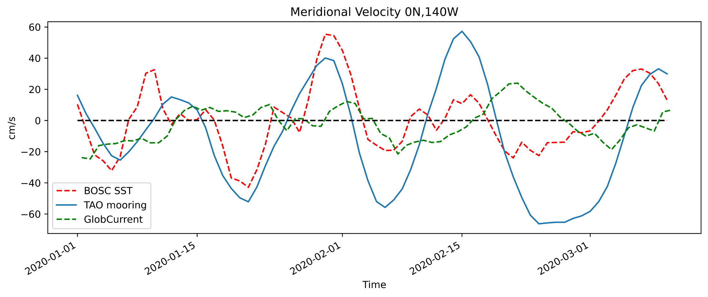
TAO Moorings Time Series
Tropical Instability Waves (TIW)

Slide 10
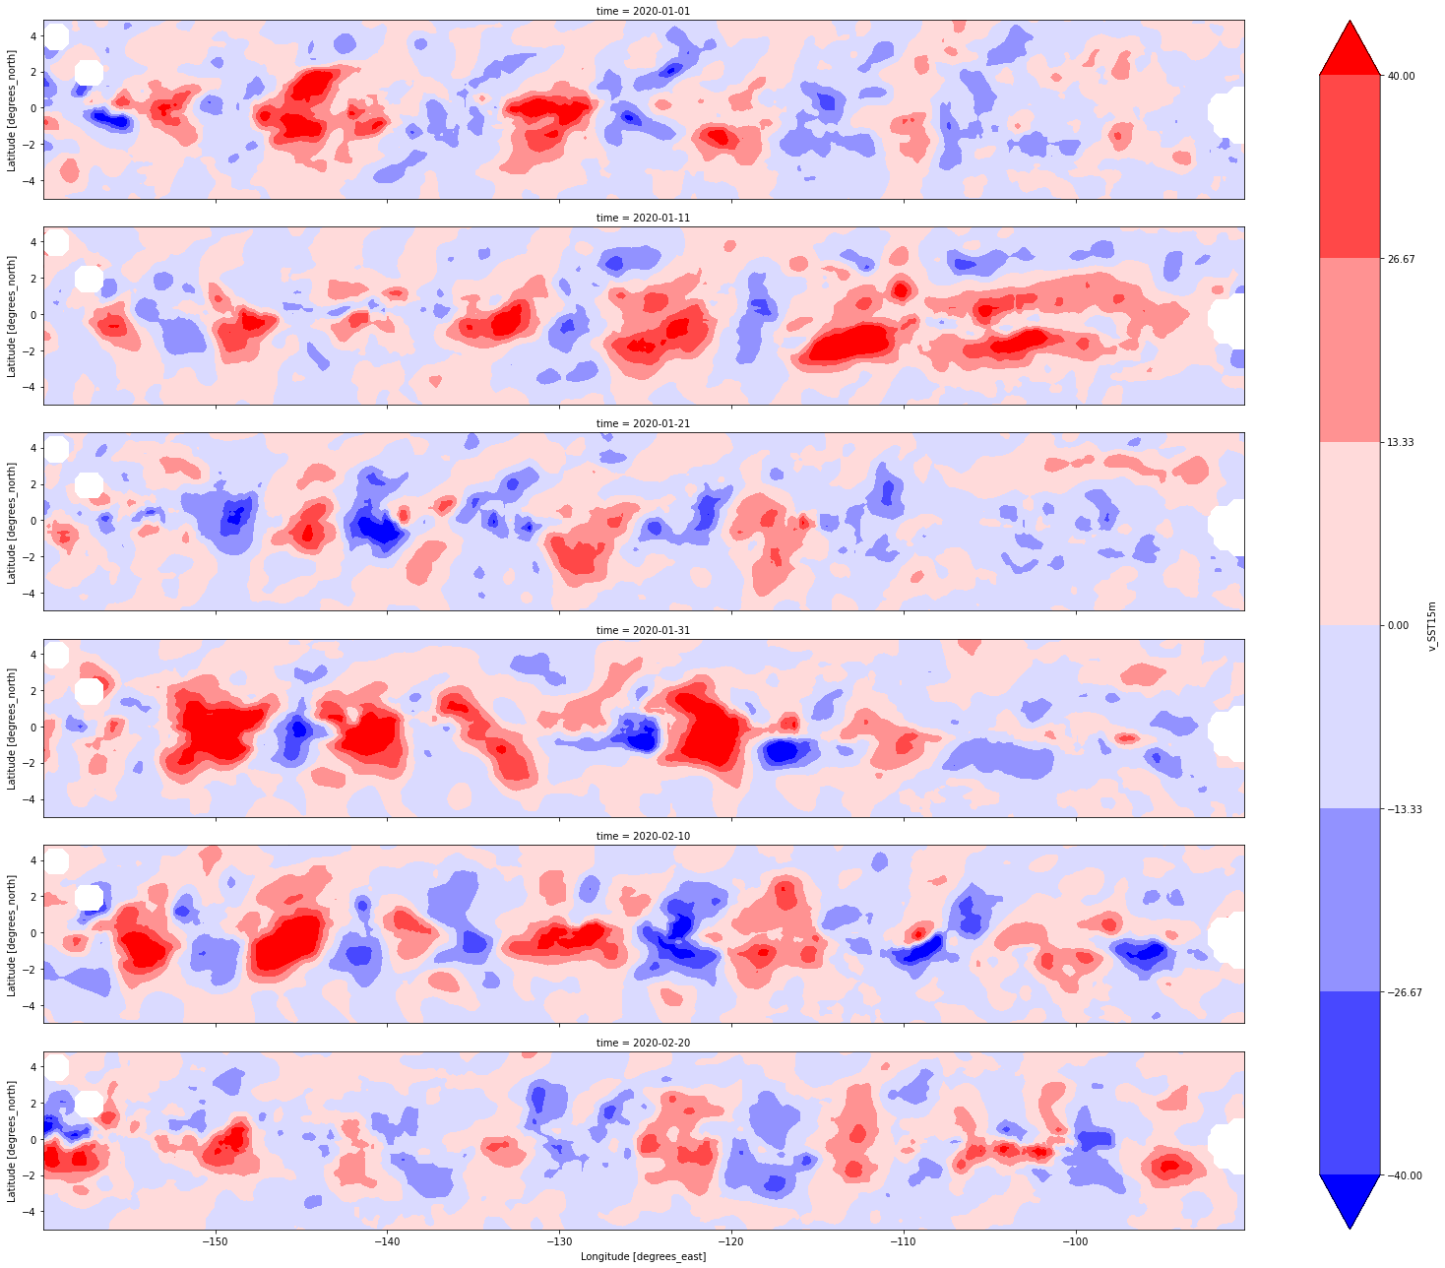
Equatorial Pacific: Tropical Instability Waves
1 Jan. 2020
Estimated Wave Statistics:
$λ≈1205$ km
$T≈28$ days
$C≈0.57$ m/s
Time
-40 -26 -13 0 13 26 40
V (cm/s)
Expected Wave Statistics (Willett et al., 2006):
$λ≈1000−2000$ km
$T≈20−40$ days
$C≈0.5$ m/s
-160 -140 -120 -100
Lon (deg east)
20 Feb. 2020

Slide 11
Future Work & Availability
Incorporation of NSIDC Sea Ice Motion dataset
Error propagation analysis with MITGCM dataset
Further refining of SST correction weighting
Extension of temporal coverage
Availability: BOSCv0.1 (beta release: 2017-2021) will available mid 2023 through NOAA CoastWatch/OceanWatch

Slide 12
References & Acknowledgements
ESR; Dohan, Kathleen. 2022. Ocean Surface Current Analyses Real-time (OSCAR) Surface Currents - Interim 0.25 Degree (Version 2.0). Ver. 2.0. PO.DAAC, CA, USA. Dataset accessed 2023-02-15 at https://doi.org/10.5067/OSCAR-25I20 Laurindo, L., A. Mariano, and R. Lumpkin, 2017: An improved near-surface velocity climatology for the global ocean from drifter observations Deep-Sea Res. I, 124, pp.73-92, doi:10.1016/j.dsr.2017.04.009 Office of Satellite Products and Operations. 2015. GHRSST Level 4 NOAA/OSPO Global Nighttime Sea Surface Foundation Temperature . Ver. 1.0. PO.DAAC, CA, USA. Dataset accessed 2023-01-21 at https://doi.org/10.5067/GHGPN-4FO02 This study has been conducted using E.U. Copernicus Marine Service Information; https://doi.org/10.48670/moi-00049 Altimetry data are provided by the NOAA Laboratory for Satellite Altimetry.

