Slide 1
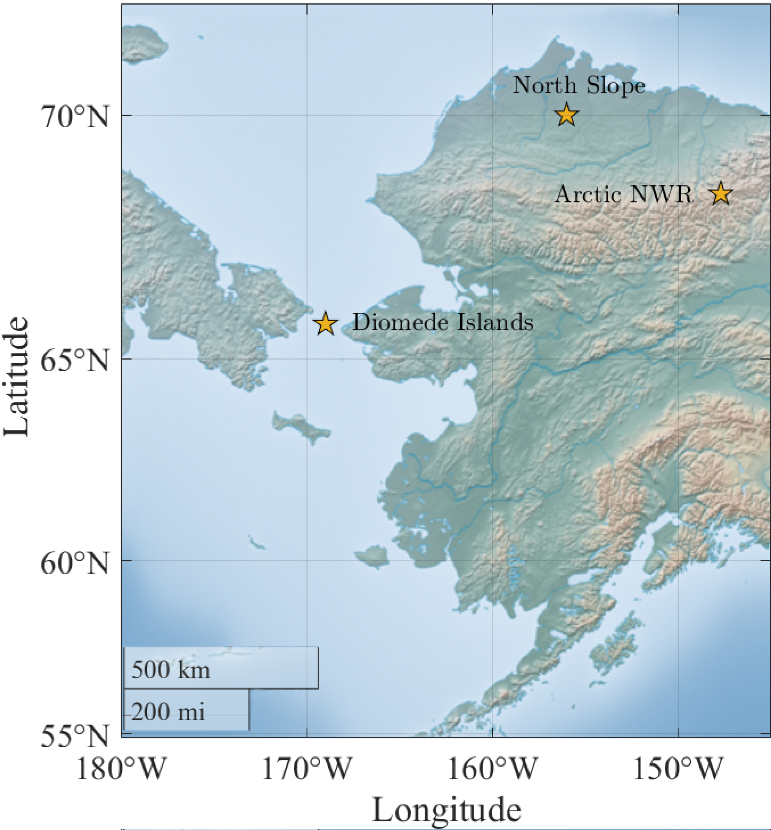
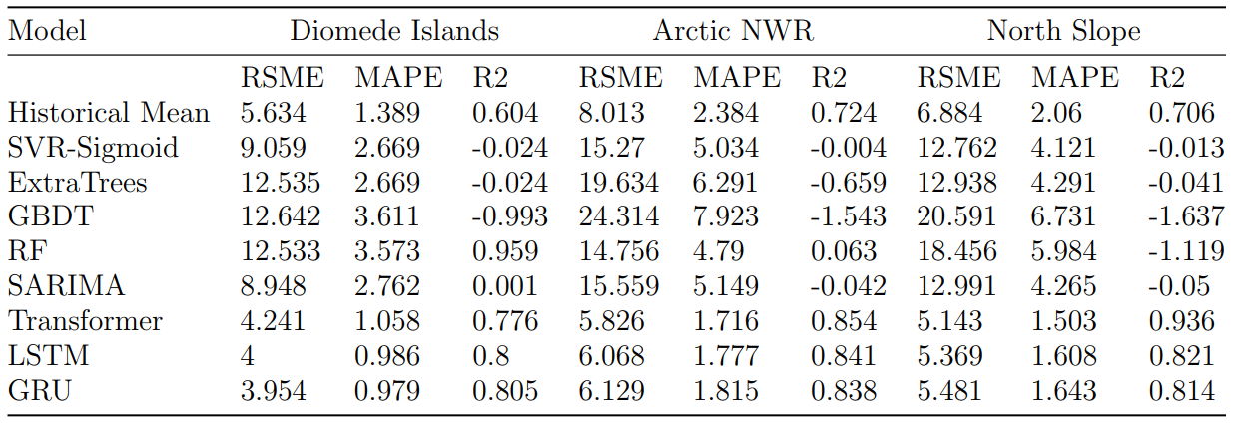
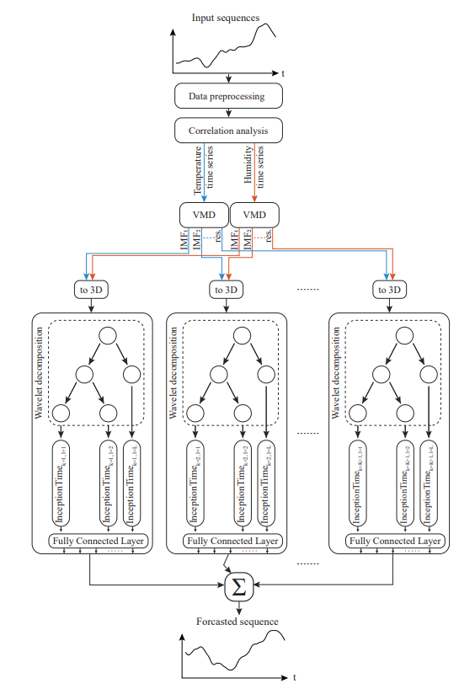
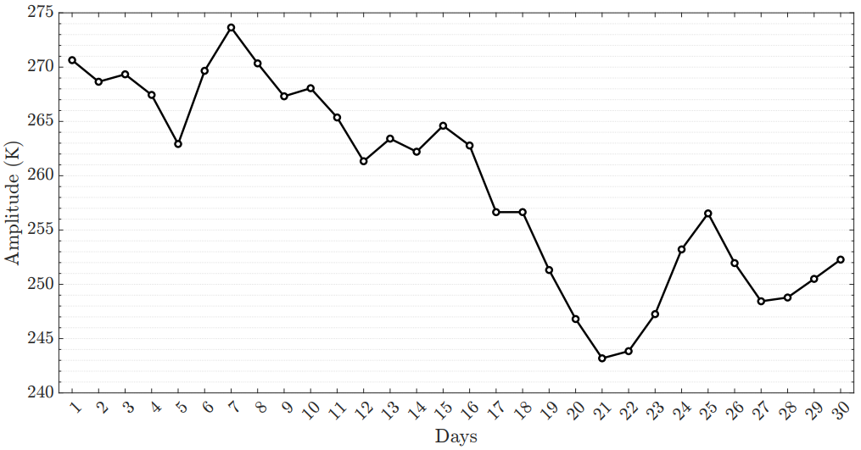
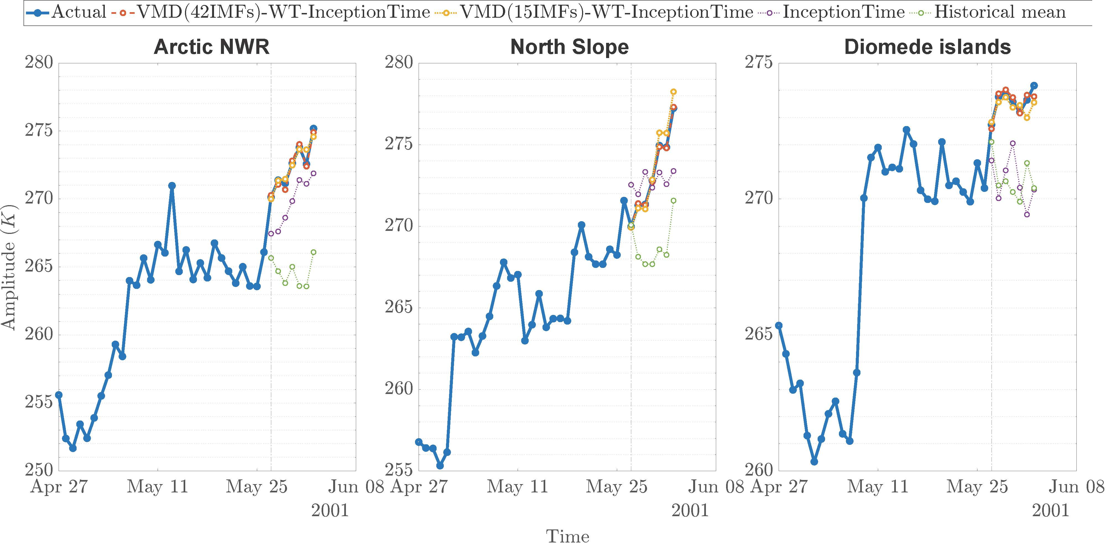
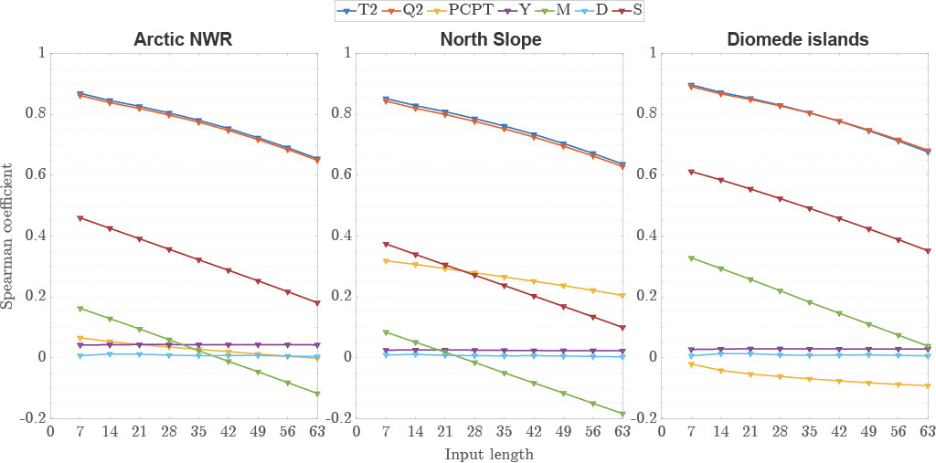
Poster Session: ITS1.13/AS5.2
Poster number: vAS.8
A hybrid VMD-WT-InceptionTime model for multi-horizon short-term Air Temperature forecasting in Alaska
Introduction and Study Area
The lack of ground level meteorological observation stations outside of settlements makes monitoring and forecasting local weather and permafrost challenging in the Arctic.
Accurate weather forecasts are essential to help prepare for potentially hazardous weather conditions, especially during winter.
We propose VMD-WT-InceptionTime model for short-term air temperature forecasting.
Our study sites were three locations in Alaska: North slope, Arctic National Wildlife Refuge (Arctic NWR) and the Diomede Islands region.
Jaakko Putkonen¹, Aymane Ahajjam², Timothy J. Pasch³, Robert Chance¹
Results
Arctic NWR
North Slope
Diomede Islands
Methods:
Figure 1. Map of study sites in Alaska.
Figure 3. Examples of forecasts plotted against actual sequences
Discussion
Extreme weather events that are not seen in the training set are poorly predicted by the deep learning algorithm. Traditional methods such as numerical modeling perform better in these scenarios.
The research project represents our first step toward medium range forecasting using machine learning techniques in the arctic.
We expect our research on forecasting the air temperatures to help us better understand the expected degradation of the permafrost in Alaska and the related adverse effects on soil stability.
Figure 2. Diagram of the proposer method: Time series meteorological data was retrieved from the University of Alaska, Fairbank’s SNAP data set (Bieniek, 2019). Next, the data was preprocessed to ensure all data is well behaved. Next, Temperature (T2), specific humidity (Q2), precipitation (PCPT), year (Y), month (M), day (D), season (S), and input length were correlated using the Spearman correlation coefficient. With T2 and Q2 found to be most correlated, Variational mode decomposition (VMD) was performed on the data, and the dataset was split with a divide and conquer approach. Next, wavelet decomposition was used for each divided problem before an InceptionTime model was subsequently applied. Lastly, the forecast produced by each subproblem was summed to produced the real forecasted sequence.
Conclusion
Overall, this research highlights the potential of the decomposition techniques and deep learning to:
Address the complexity of original air temperature and specific humidity data by revealing intrinsic and simpler patterns hidden within.
Effectively learn the underlying cyclicity of air temperatures at varying temporal steps that allow for accurate predictions without any knowledge of the governing physics.
¹ Harold Hamm School of Geology and Geologic Engineering, University of North Dakota, Grand Forks, ND, US
² School of Electrical Engineering and Computer Science, University of North Dakota, Grand Forks, ND, USA
³ Department of Communication, University of North Dakota, Grand Forks, ND, USA
References:
P. A. Bieniek, “Downscaled climate data for alaska,” International Arctic Research Center, University of Alaska Fairbanks, Tech. Rep., 2019, https: //registry.opendata.aws/wrf-alaska-snap
Acknowledgement:
This material is based upon work supported by the Broad Agency Announcement Program and the Cold Regions Research and Engineering Laboratory (ERDC-CRREL) under Contract No. W913E522C0001

