Slide 1
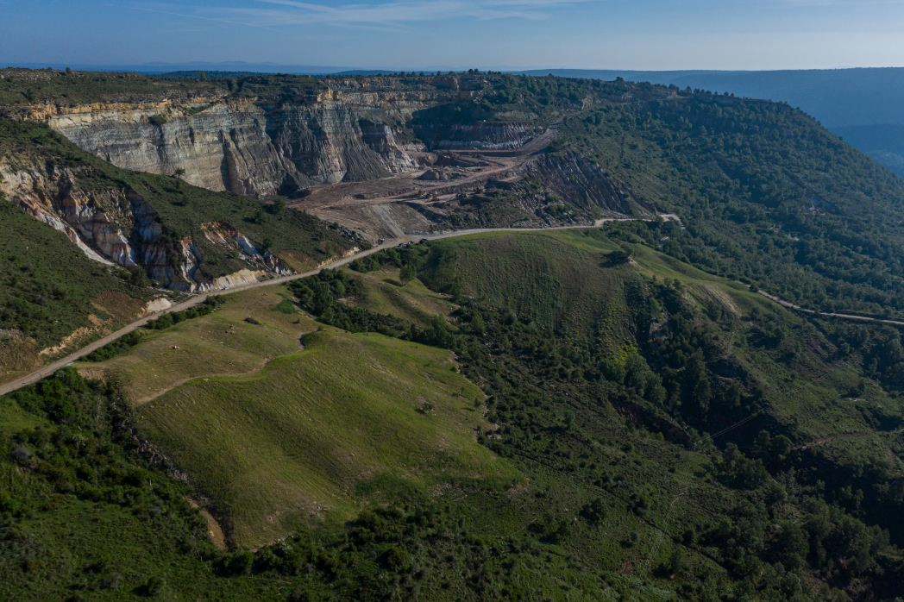


Using geomorphology to design, build and assess a post-mining landscape: a case study of the Santa Engracia mine, Spain
Greg Hancock and Jose F Martín-Duque
School of Environmental and Life Sciences, The University of Newcastle, Callaghan, Australia
Universidad Complutense de Madrid, Spain

Slide 2
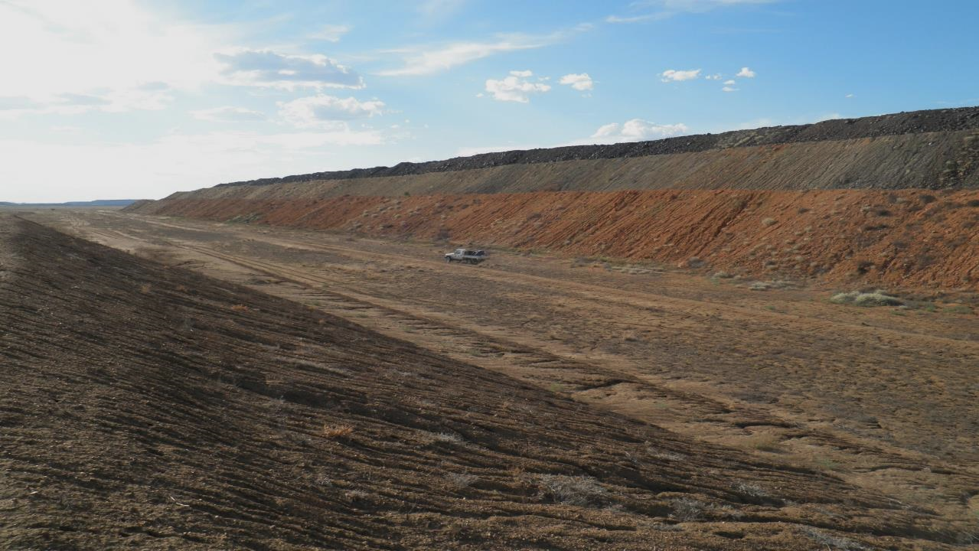
Introduction
Innovative solutions for post-mining land restoration are needed
Traditional reconstruction approaches still used and often appropriate (i.e. benches & linear slopes)
Recognition that geomorphology can provide improved environmental outcomes

Slide 3
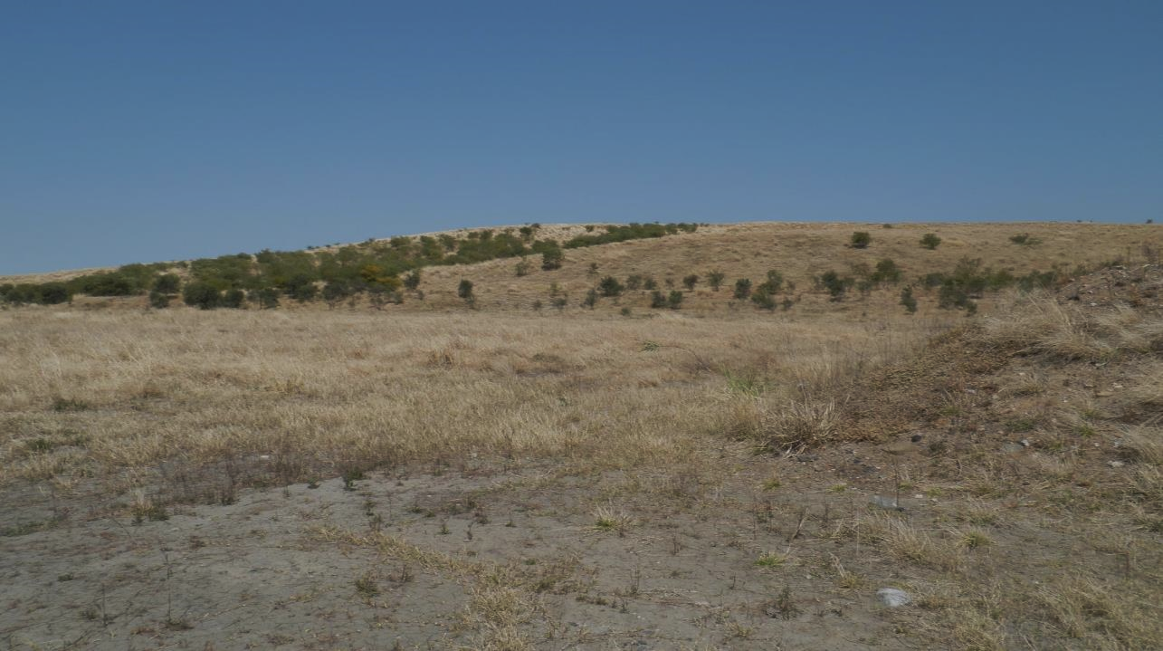
Introduction
Geomorphic solutions provide hydrological, ecological and visual integration and connectivity with the unmined surrounds
Growing demand by the public and government requiring landscapes to geomorphically and visually integrate with surrounds

Slide 4
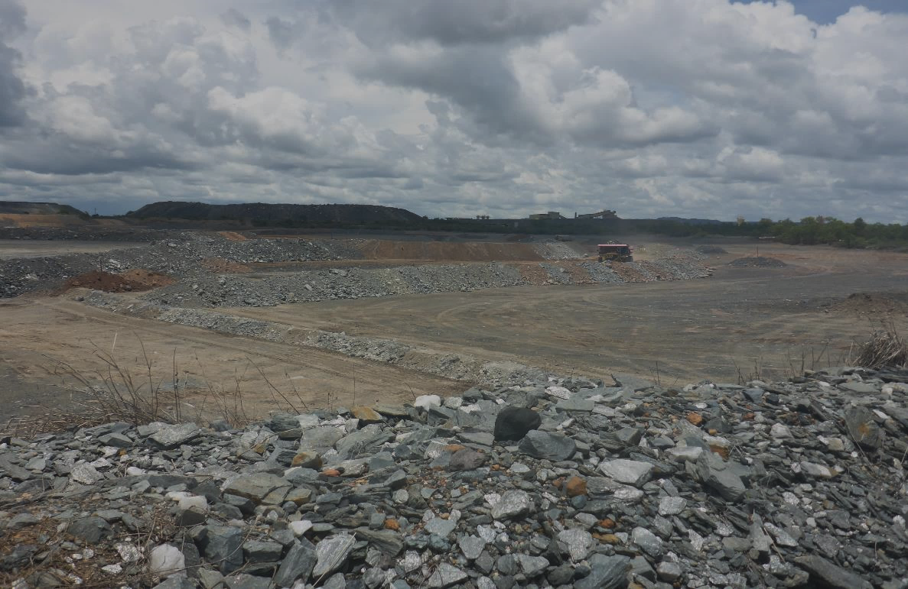
Introduction
Using geomorphology to design a landscape is not new, conceptually straightforward
Capabilities for designing such complex 3D landforms is non-trivial
Only recently become possible with the development of geomorphic design software

Slide 5
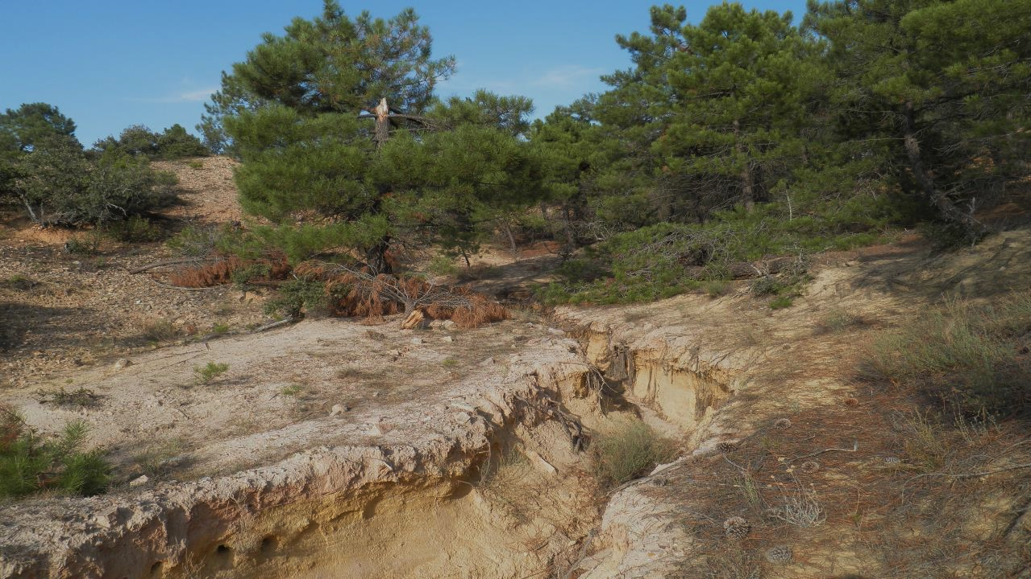
Introduction
Designing a landscape is one half of the process
A new landscape should be robustly evaluated for its erosional stability
Numerical soil erosion and landscape evolution models provide a tool to evaluate designs

Slide 6
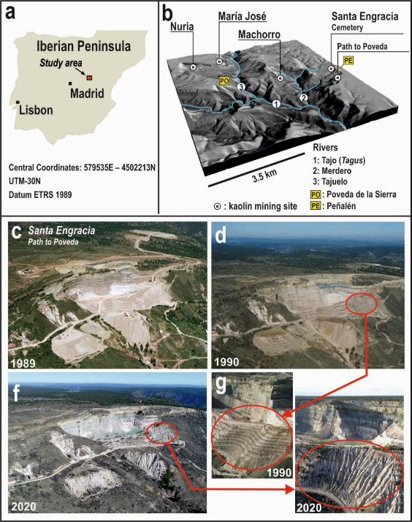
Study site
Alto Tajo Natural Park, Iberian Mountain Range, East-Central Spain
Landscape is characterised by plateaus and mesas (circa 1400 m asl)
Sandy sediment that holds high quality kaolin
Climate is temperate Mediterranean with dry, mild summers with a noticeable continental influence
Mean annual precipitation is 780 mm and mean annual temperature is 10°C

Slide 7
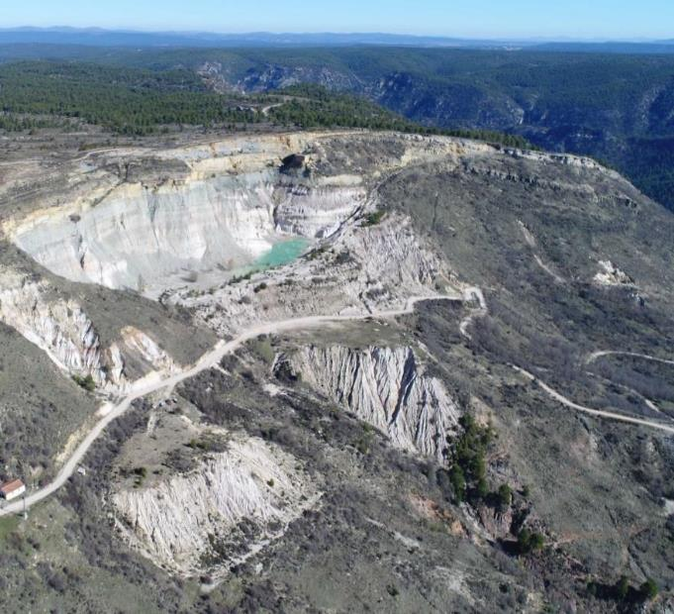
Study site
Project part of a EU LIFE RIBERMINE project - Spain and Portugal
Heavily gullied hillslope (erosion rate of 353 t ha⁻¹ yr⁻¹)
Sediment delivered to the Tajo River - poor water quality
Project goal was to remove the source of sediment entering the Tajo River
March 2020
Santa Engracia kaolin mine
(https://liferibermine.com/en/homepage_en/)

Slide 8

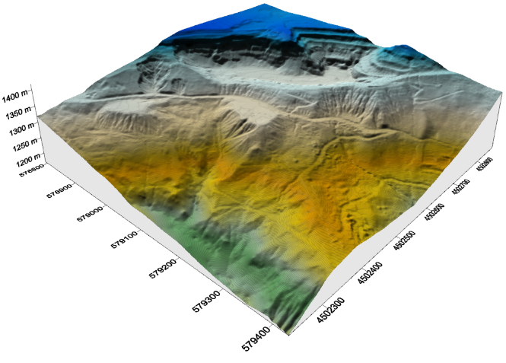
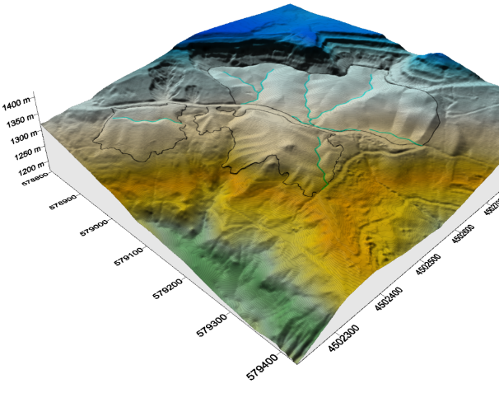
Landscape design
Design used the GeoFluv method, through the Natural Regrade software
Iterative process with the SIBERIA LEM
Outcome – a series of catchments with natural hillslope curvature and constructed drainage lines

Slide 9
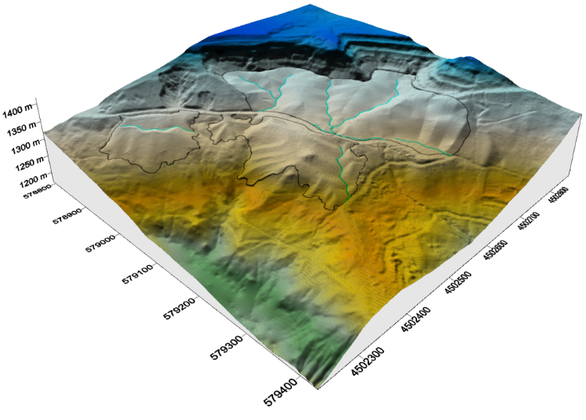
Landscape design
WWRD
EWRD

Slide 10
Landscape design
EWRD
WWRD
Landforms have subcatchments with defined drainage lines
WWRD was dominated by a transverse catchment
EWRD consisted of smaller longitudinal catchments
Hillslope length, slope (average slope = 37%), curvature optimised –reduce erosion
Result – a more natural, visually appealing and functional landscape

Slide 11
Both landforms had mature hypsometric curves
Result – a more natural, visually appealing and functional landscape
WWRD
EWRD

Slide 12
Landform erosion assessment
SIBERIA Landform Evolution Model (LEM) used
SIBERIA - well accepted and is the industry standard
LEMs evolve a landform (erosion and deposition)
Predict type of erosion (sheet, rill, gully), erosion rate and location
Incision by gully erosion which results from concentrated flow
Risk assessment of a design

Slide 13
EWRD modelling (SIBERIA) results
10 years
50 years
100 years

Slide 14
WWRD modelling (SIBERIA) results
10 years
50 years
100 years

Slide 15
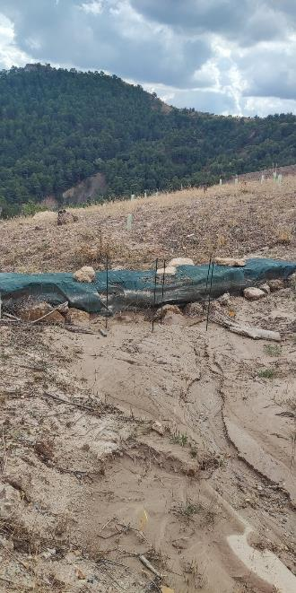
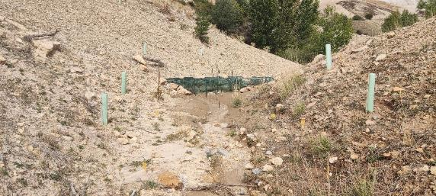
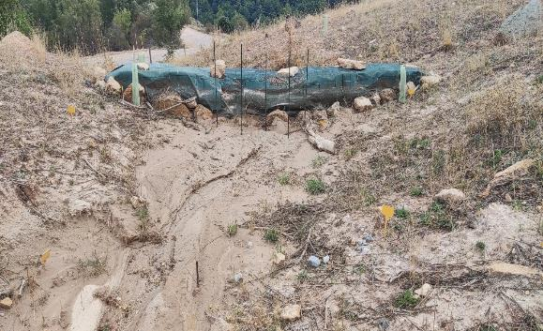
Results – field monitoring
Low erosion and minor rilling occurring
Erosion rates
~5 t ha⁻¹ yr⁻¹
Learn from this site and transfer to other sites

Slide 16
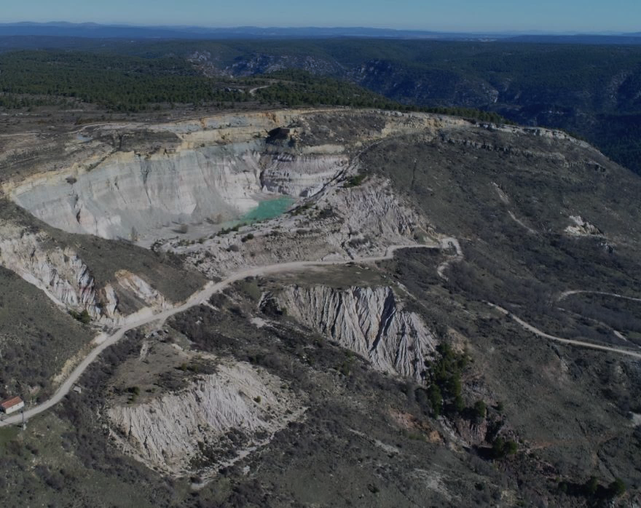
Conclusion
Design approach aims to emulate landforms based on an understanding of the surrounding landscape, the surface materials and climate
For all sites there are design constraints such as lease boundaries, infrastructure such as roads and power lines as well as physical features such as watercourses
Any design will be a compromise between what is ideal and what is possible to construct

Slide 17
Conclusion
Demonstrate that geomorphic designs can reduce erosion
No site will be erosion free
All sites will erode
Question of what is acceptable
Some gullying is inevitable
Erosion in keeping with the surrounding landscape

Slide 18
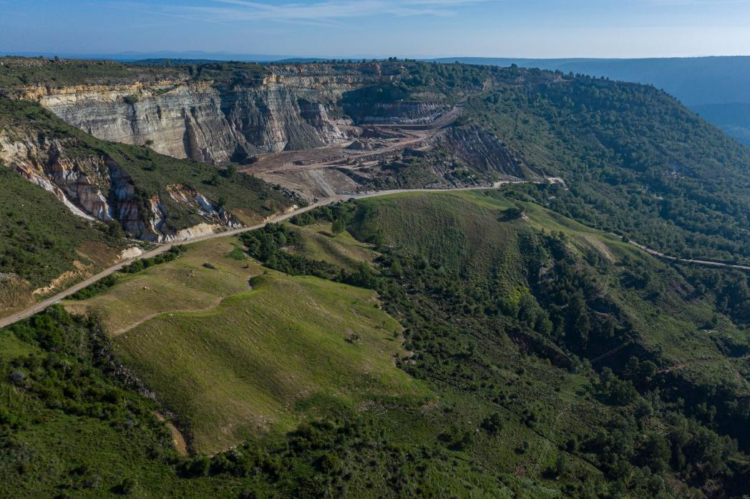

Slide 19
Acknowledgments
This paper is an outcome of the LIFE RIBERMINE project (LIFE18 ENV/ES/000181). Maria Tejedor is responsible of part of the geomorphic landform designs. Specifically, of the development of the new method for sidehill waste dumps. We thank Javier de la Villa and Cristina Martín for their constant commitment and leadership of the LIFE RIBERMINE project. Paisajes Españoles, DIEDRO, Fotolanga and DGDRONE transferred us different sets of aerial photos. Ignacio Zapico provided information for the calibration (Nuria mine), helped at the staking out process and, along with David Gutiérrez (DGDRONE), provided the topography from photogrammetry for the External waste rock dumps.

