Slide 1




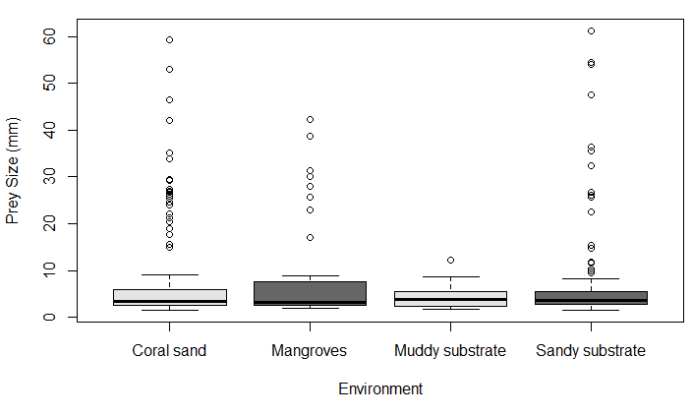
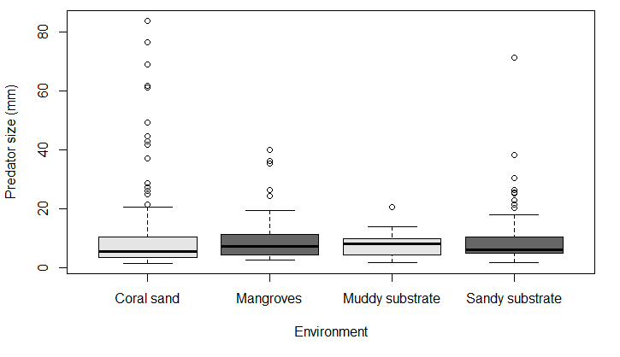
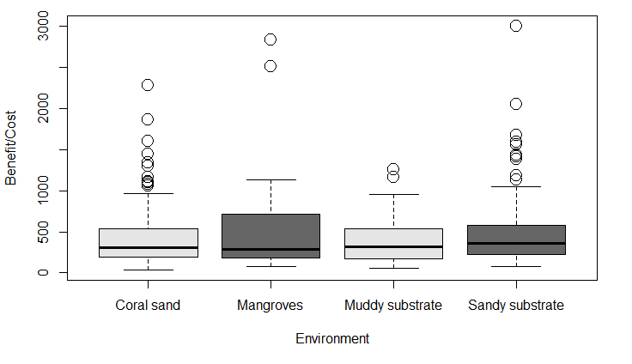
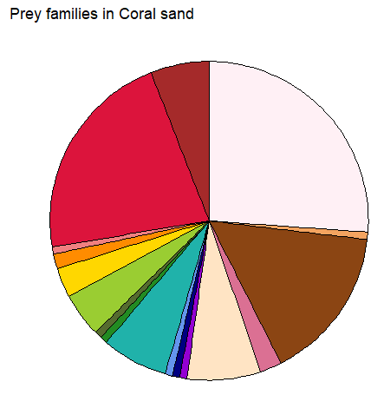
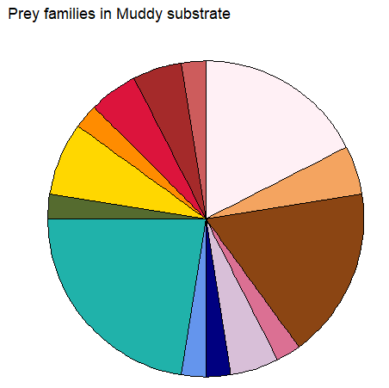
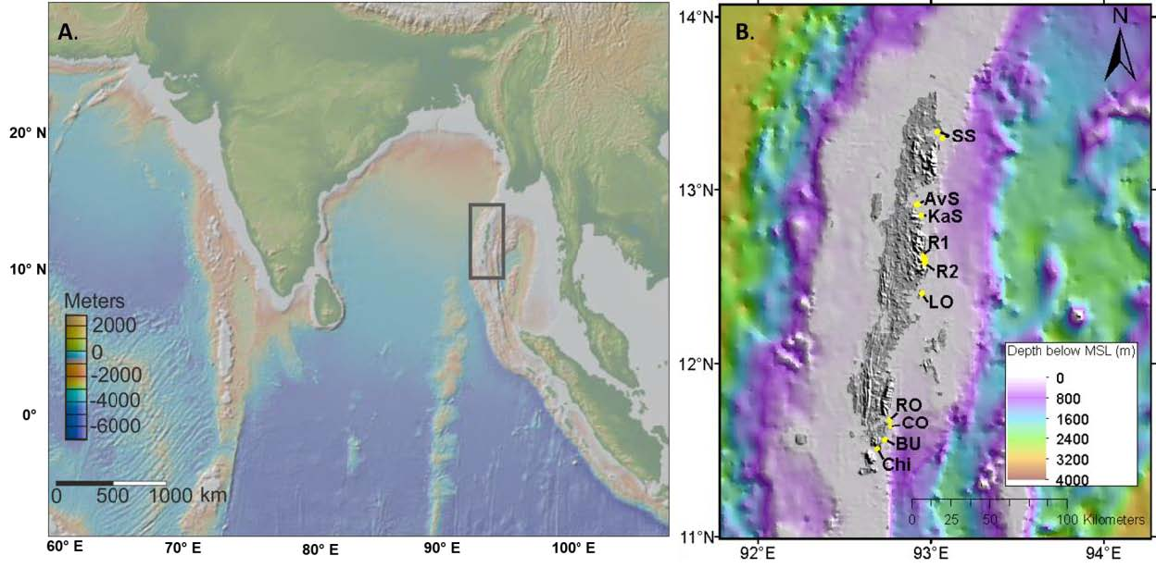
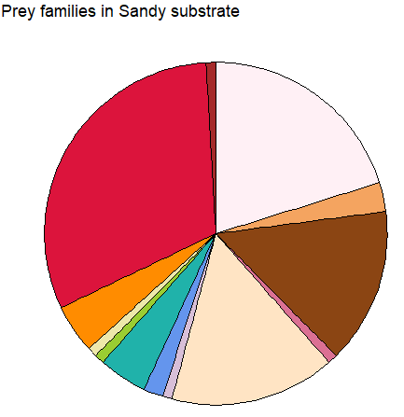
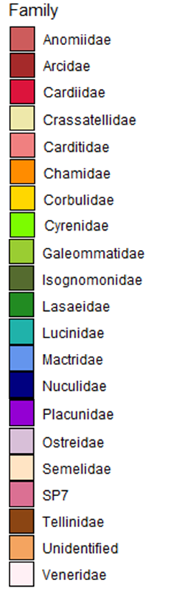
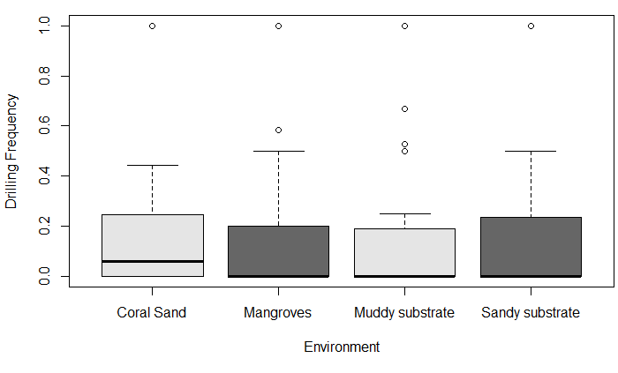
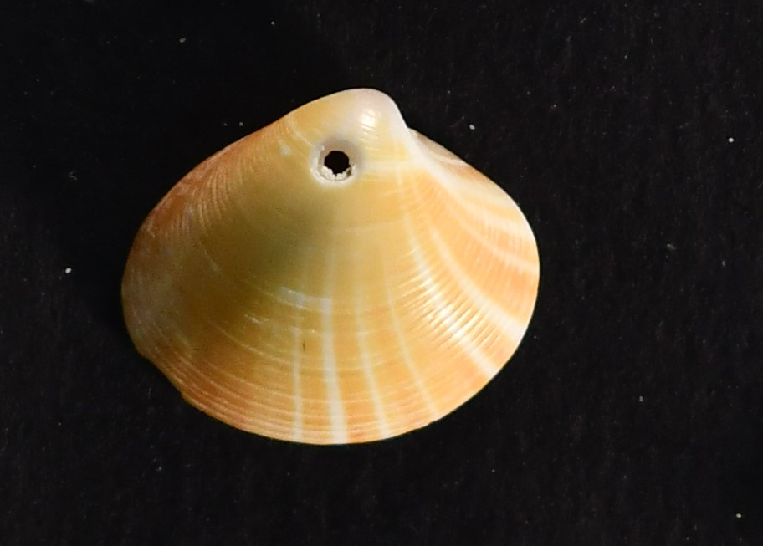
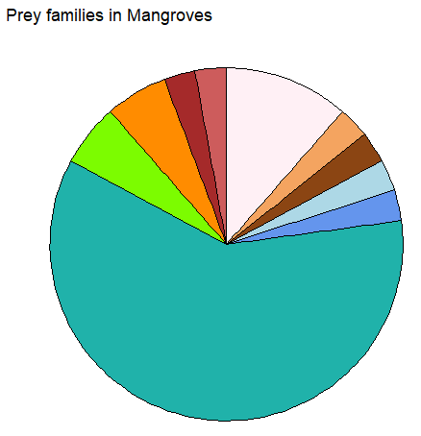
Spatial variation in marine predation pattern across depositional environments: Insights from the drilling predation records of the recent bivalve fauna of Andaman Islands, India.
Avinash Dahakey¹, Om Adarsh¹, Vedanth Prasanna Kumar¹ Devapriya Chattopadhyay¹
¹Indian Institute of Science Education and Research Pune, Pune, India
Introduction
Results
In shallow marine environments, biotic interactions, such as predation, are an important evolutionary force in reshaping the ecology of the community. Benthic mollusks are ideal groups to study the deep time record of predation because they preserve the predation record (drilling and durophagous) on the shell and are known to respond to evolutionary triggers. The physical environment also influences shallow marine molluscan communities. This study tried to evaluate the effect of abiotic factors on biotic interaction in the marine realm. The shallow marine bivalve community of Andaman Island provides a conducive setting since it provides a distinct environmental pattern inhabited by a diverse community with recognizable biotic interactions
We characterized the drilling frequency (DF) and prey selectivity across environments, families, and depth. Drilling predator–prey systems have been explored using cost–benefit models in modern and fossil assemblages. This study also tried to establish a relationship between the benefit-to-cost ratio (BCR) of drilling attempts across depositional environments and compared them with global data.
We studied ~3000 bivalve specimens.
291 individuals have drill holes.
Overall, DF ranges from 0 to 0.5
Coral Sands show the highest DF among all environments.
Mean prey and predator size is almost same.
BCR across all the environments is almost equal.
The Andaman BCR is lower than the global average for the shallow marine environment. In contrast, the BCR is higher for the mangrove community of the Andaman compared to the global data.
BCR declines with increasing predator size.
Changing proportion of prey families across environments except for a few families.
Discussion
Declines in BCR with increasing predator size for both Andaman and global data implies a possible role of increasing metabolic cost of larger predators.
Average BCR across all environments remains the same, along with the fact that the contribution of prey families across different environments changes suggests that the predators are choosing prey such that they achieve the same BCR. Predators might change their prey family and size preference to gain the optimum BCR.
The mean BCR for Andaman and global data is almost the same, but the variance is high, suggesting the addition of more data sets for future work.
Study area
Andaman Island is situated NE of the Indian Ocean.
The East Coast has a well-developed reef system.
Diverse molluscan fauna.
References
Chandroth, A. & Chattopadhyay, D. Micromorphy Offers Effective Defence Against Predation: Insights From The Cost-Benefit Analyses Of Micro Gastropod Predation Record. (2021). doi:10.1101/2021.05.30.446364.
Kamesh Raju, K. A., Ramprasad, T., Rao, P. S., Ramalingeswara Rao, B. & Varghese, J. New insights into the tectonic evolution of the Andaman basin, northeast Indian Ocean. Earth and Planetary Science Letters 221, 145–162 (2004).
Srivastava, D. K., Dave, A. & Dangwal, V. Sequence stratigraphy of the Andaman Basin, northern Indian Ocean. Marine and Petroleum Geology 133, 105298 (2021).
Materials and Methods
Samples collected from 19 localities along the east coast, cover Muddy, Sandy, Mangroves and coral sand environments. We collected beach and grab samples from water depth between 1-15m.
We characterized the drilling frequency (DF) and prey selectivity across environments, family and depth. Drilling predator–prey systems have been explored using cost–benefit models in modern and fossil assemblages. In this study, we also tried to establish a relationship between the benefit to cost ratio (BCR) of drilling attempts across depositional environments and compared them with global data.
Acknowledgements
Science & Engineering Research Board (SERB) for funding this project.
Indian Institute of Science Education and Research, Pune

