Slide 1
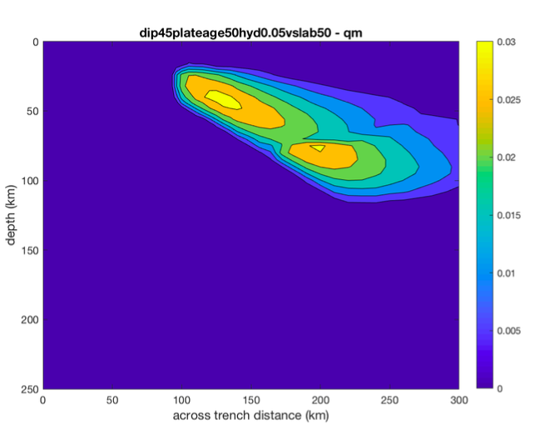
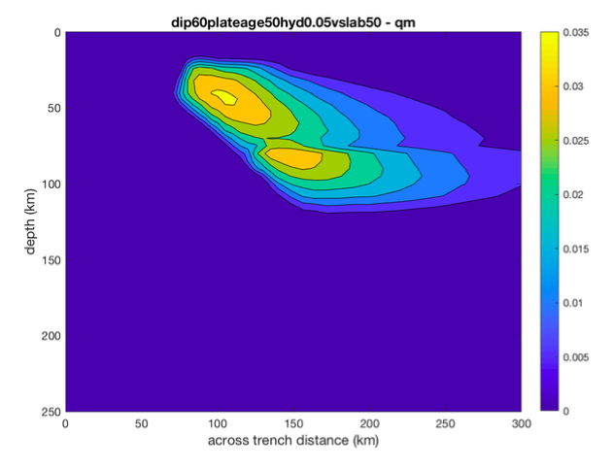
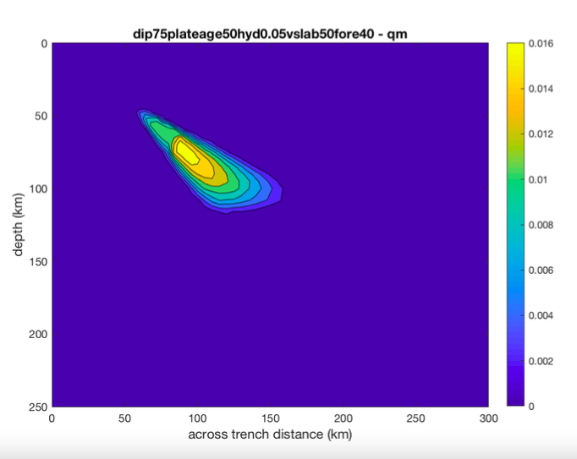
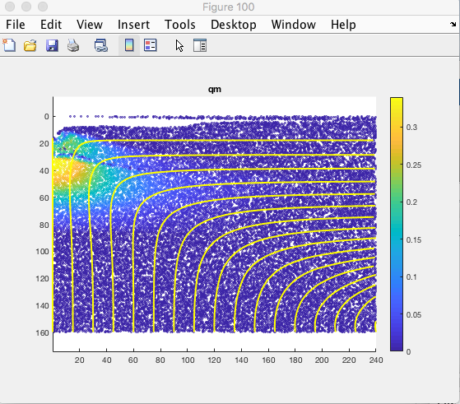
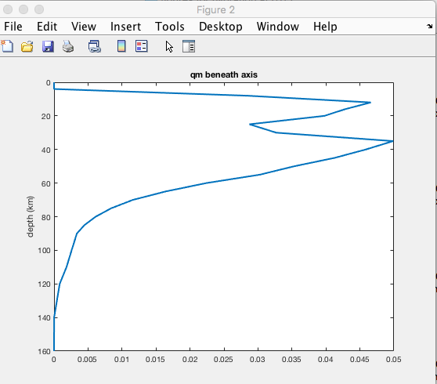
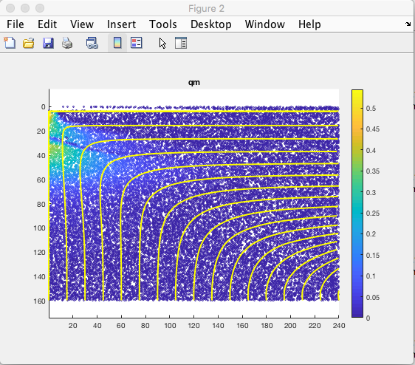
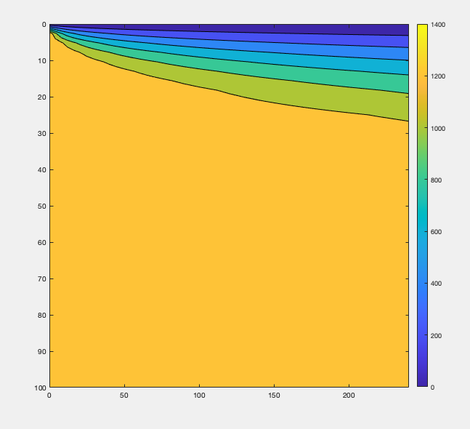
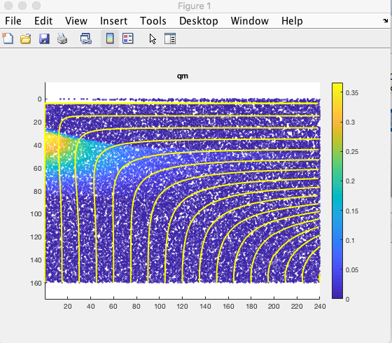
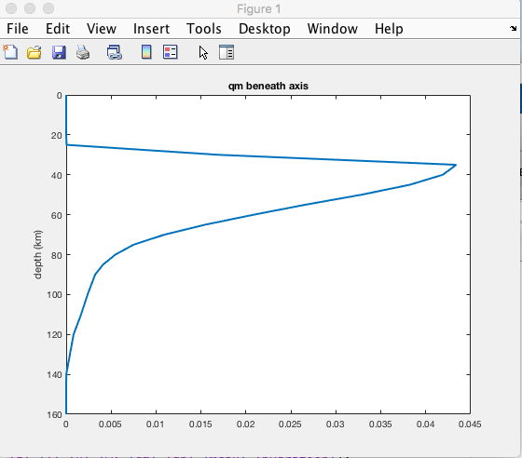
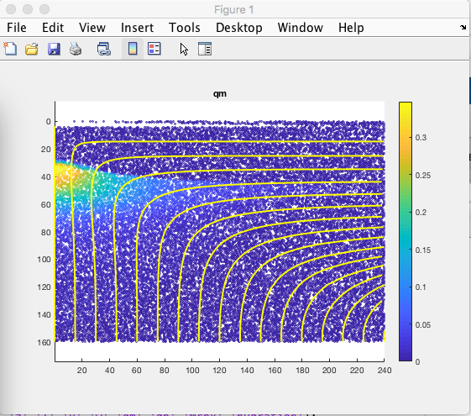
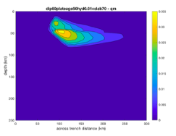
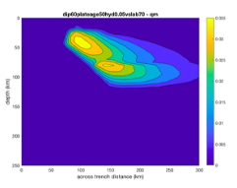
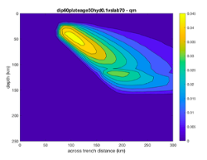
Developing Community-Accessible Numerical Models to Evaluate Geodynamic Processes
Francesca Burkett and Dr. James Conder
School of Earth Systems and Sustainability
Introduction
Results
Graphs/Figures
Ninety-nine percent of all volcanism on earth occurs at Mid Ocean Ridge systems and Subduction zones. 2-D numerical computer models based on thermodynamic and kinematic principles have become invaluable tools for simulating geodynamic processes at these systems. Numerical models have proven effective allowing for the examination and computation of multiple factors at the same time, providing scientists with an important resource with which to study complex systems. For example, numerical models have been used for examining different factors involved in magma production at subduction zones and mid ocean ridges by modelling the influence and interplay of factors affecting volcanism. In addition to research, 2D numerical models are also valuable as teaching tools, for both professors and teachers for middle and high schools.
Sample Matlab code for Figure 1
[T] = midoceanridge2D(x,z,50)
Contourf(x,z,T)
Ylim([0 100])
Axis ij
Colorbar
Figure 1: 2D plot of Temperature
This project created numerical models and utilized the developed models to explore different factors involved in magma production at subduction zones and mid ocean ridges by modelling the influence of factors such as the effect of hydration, etc. While previous studies have demonstrated the importance and value of numerical computer models in geodynamic research, few are user-friendly, and those that exist are built by and targeted specifically towards the geodynamic/modelling community.
For the mid-ocean ridge models:
We ran models that shifted the solidus (0-200 degrees) with varying mantle hydration: 0.01, 0.05, and 0.10.
Melting started at around 70 km and peaking more shallowly before exhausting its supply of the mineral clinopyroxene (Mcpx), which lowers melt output. A second smaller melting region develops more shallowly without Mcpx.
Increasing hydration led to melting at greater depths, which depleted Mcpx faster, rather than increasing overall melt. Observed that the greater the shift in solidus, the less upper melt occurs.
For subduction zone models:
Ran models investigating Melt production at subduction zones depends on numerous variables, including mineral composition, water content, age of the plate, dip angle of the plate subducting, rate of convergence, age of the slab, and forearc dimensions.
We calculated spatial extent and degree of melting as parameters were altered.
The slab age and initial modal cpx levels are held constant throughout all the trials at 60 Myr and 15%, respectively. ​
Under batch melting conditions, the dip angle of the slab was varied from 30 to 75°, rate of the slab between 20 and 90 km/Myr, age of the plate between 20 and 90 Myr, forearc depth between 40-60 km, and hydration between 0.01 and 0.1 wt%. ​
Under fractional melting conditions, the dip of the slab was varied from 45 to 75°, rate of the slab between 20 and 70 km/Myr, age of the plate between 20 and 70 Myr, forarc depth between 40-50 km, and hydration between 0.00 and 0.1 wt%.
.
Figures 10-12: Melt production for different slab dips (above)
Figure 4: Melt for 0 hydration/shift Figure 5: Melt Profile Figure 6: Melt for 0.1 hydration/0 shift
Figure 7: Melt for 0 hydration/200 shift Figure 8: Melt Profile Figure 9: Melt for 0.1 hydration/200 shift
Methodology
Conclusion
Developed 2D numerical finite difference models for mid-ocean ridge systems and subduction zone systems.
Constructed 2D numerical models of temperature, mantle flow, and melt production.
Melting is calculated on the tracers.
Each tracer is identified by location and is used to track the hydration, amount of magma present, temperature, and clinopyroxene present at that particular location.
Both models have demonstrated how melt production is affected by differing parameters. In subduction zones, the models allow for both batch and fractional melt conditions to be explored, investigating hydration, dip angles, convergence rates, forearc depths, etc.
Project will continue modelling how different parameters influence total melt in a subduction zones under both fractional melting conditions and batch melting conditions. We will explore effect of permeability, integrating sediment and flux melting, different viscosities, and incompatible elements, in order to determine how each affects melt production, well as how each influences the location of the volcanic arc and the chemistry of the lavas.
Acknowledgements
This work was supported by a Masters Fellowship funded by the SIU Graduate School.
Melt production with varying hydration
Figure 2: 2D plot of Melt (qm) Figure 3: 2D plot of Temperature

