Slide 1
Sources and sinks of atmospheric nitrous acid (HONO) in the megacity of Shanghai during COVID-19
Dianming Wu ,Yue Wang, Zhiwei Gao
East China Normal University · School of Geographic Sciences

Slide 2
Overview
changes in human behavior
COVID-19
Air quality
?
precursor
atmospheric
oxidization capacity
HONO
hydroxyl radicals (OH)
Notes:
前面加一页 小方向

Slide 3
Overview
Suburban Site
31.03°N，121.45°E，height ~50 m
May 2020 (P1)
August ~ September 2020 (P2)
April ~ May 2021 (P3)
the same season
but different control phases
the same prevention and control stage during COVID-19
but different seasons
Notes:
前面加一页 小方向

Slide 4
Background
来源：Nature Education Knowledge, 2010
1.1
HONO sources and sinks in different environments
① Direct emissions from the combustion process
vehicle emission, biomass burning
① Photolysis of HONO
② Homogeneous reaction of NO and OH
HONO + hv → NO + OH
NO + OH → HONO
09:00~12:00, 94%
③ Heterogenous conversions of NO₂ to HONO
on aerosol surfaces, ground surfaces
(dark or photo-enhanced)
② Deposition of HONO
major loss way in the morning
④ Photolysis of deposited nitric acid
HNO_{3(ad)} + hv (λ < 320nm) → HONO
③ HONO + OH → NO₂ + H₂O
⑤ Photolysis of particulate nitrate
contributing a little
⑥ Soil emission
chemical equilibrium between NO₂‐ and H⁺
direct emission from Ammonia oxidizing bacteria
Gu, R., et al. Sci. Total Environ, 2022;
Su, H., et al. Science, 2011;
Wu, D. M., et al. ISME J, 2019
Notes:
前面加一页 小方向

Slide 5
Background
来源：Nature Education Knowledge, 2010
1.2
Machine learning in atmospheric chemistry
new sources
sources
sinks
sources
sinks
Unknown Sources
Notes:
前面加一页 小方向

Slide 6
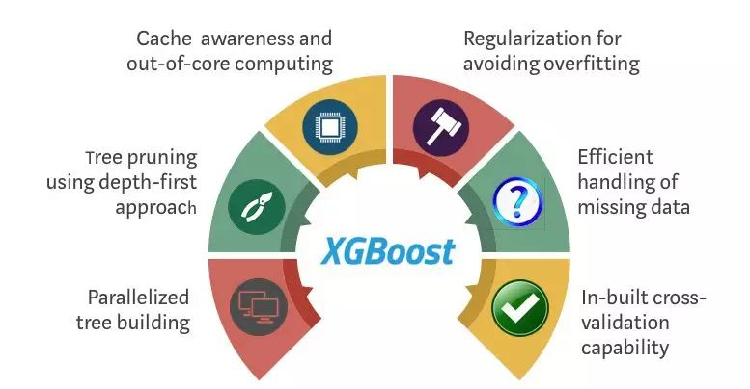
Methods
来源：Nature Education Knowledge, 2010
1.3
EXtreme Gradient Boosting & SHapley Additive exPlanation
Based on CART regression tree, XGBoost uses Boosting algorithm to integrate many weak classifiers into a powerful classifier.
This method distributes the total payoff among players according to Game Theory.
Sources of graphic : https://zhuanlan.zhihu.com/p/62670784
Notes:
前面加一页 小方向

Slide 7
Results
来源：Nature Education Knowledge, 2010
2.1
Concentrations of HONO showed increasing trends.
① The average concentrations of HONO in P1, P2 and P3 are 0.29, 0.36 and 0.42 ppb, showing an increasing trends.
② According to the standards, the air quality in observation periods was identified as ‘good’.
Notes:
前面加一页 小方向

Slide 8
Results
2.2
Different periods showed sharp discrepancy.
① HONO peaked at 8:00~9:00 in the morning, with peaks of 0.39, 0.75 and 0.66 ppb, respectively.
② Considering the conversion from NO₂ to HONO, higher value of HONO/NO₂ could be expected for an aged air mass in the night.
Li, X., et al. Atmos. Chem. Phys, 2012

Slide 9
Results
2.3
Basic HONO budgets
$\frac{d_{HONO}}{d_{t}}=($P_{NO+OH} + $P_{{NO}_{2}_g}$ + $P_{{NO}_{2}_a }$ + P_{unknown}) － (L_{HONO+OH} + L_{pho} + L_{dep}) + T_{v}
$\frac{d_{HONO}}{d_{t}}$= (HONO_{t2}-HONO_{t1}) / (t₂-t₁)
P_{OH+NO =}K_{OH+NO} × [OH] × [NO]
L_{HONO+OH =}K_{HONO+OH} × [OH] × [HONO]
$${\text{P}\text{NO}\text{2_}\text{a}=K}_{a}\text{×}\left[NO2\right] , Ka=\frac{A×γ_{{NO}_{2},aerosol}}{4}×\sqrt{\frac{8RT}{πM}}$$
L_{pho} = J_{HONO} × [HONO]
$\text{P}\text{unknown}=\frac{d_{HONO}}{d_{t}} −($P_{NO+OH} + $P_{{NO}_{2}_g}$ + $P_{{NO}_{2}_a }$ +) + (L_{HONO+OH} + L_{pho} + L_{dep}) - T_{v}
$$\text{P}\text{NO}\text{2_}\text{g}=Kg\text{×}\left[NO2\right] , Kg=\frac{γ_{NO2，ground\sqrt{\frac{8RT}{πM}}}}{4.2\text{×}BLH}$$
L_{dep}=Vd × [HONO] / BLH
T_{v} = K_{dilution} × ([HONO] - [HONO]_{background})
Cui, L. L., et al. Sci. Total Environ, 2018;
Gu, R. R., et al. Atmos. Environ, 2020
Notes:
前面加一页 小方向

Slide 10
Results
2.4
Unknown sources contributed the most in all periods.
① Whether it is seasonal changes or changes in epidemic response levels, unknown sources contributed the most.
② The homogeneous reaction of NO was the main pathway during the day.
③ Heterogeneous reaction of NO₂ on the surface and aerosol (dark conditions) contributed little to the HONO formation.
Notes:
前面加一页 小方向

Slide 11
Results
2.5
The model simulations are consistent with the measurements.
Meteorological parameters
Air pollutants
Time
XGBoost
train set and test set data of P1
train set and test set data of P2
train set and test set data of P3
Notes:
前面加一页 小方向

Slide 12
Results
2.6
Photolysis reactions and soil emission may be large sources of HONO.
Feature importance by SHAP
① Photo-enhanced heterogeneous reactions of NO₂ on aerosol and land surfaces → [P1 P2 P3]
② Photolysis of HNO_{3(ad)} and pNO₃ → [P2 P3]
③ Soil emission → [P2 P3]
Notes:
前面加一页 小方向

Slide 13
Results
2.7
Unknown sources sharply decrease after adding photolysis reactions and soil emission.
93%
P3: HONO budgets came to balance after adding all the new sources.
P2: There were still large unknown sources in the summer period.
P1: Unknown sources were fully explained during strict control policy.

Slide 14
Conclusions & Implications
③ Machine learning and SHAP technology combined can be used to optimize existing atmospheric chemical models.
① As the prevention and control policy became less strict and more regular, the increase in human activities will significantly promote HONO's direct emissions.
② Soil emission sources in summer are significantly strengthened in the early morning, while the contributions of photo-enhanced heterogenous reactions of NO₂ and photolysis of pNO₃ is only half of spring.

Slide 15
Any corrections and comments are appreciated!
Thank you!

