Slide 1
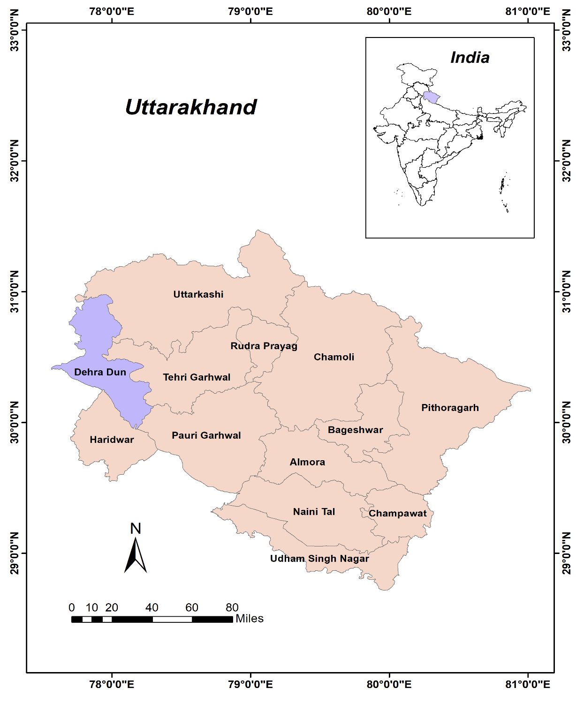
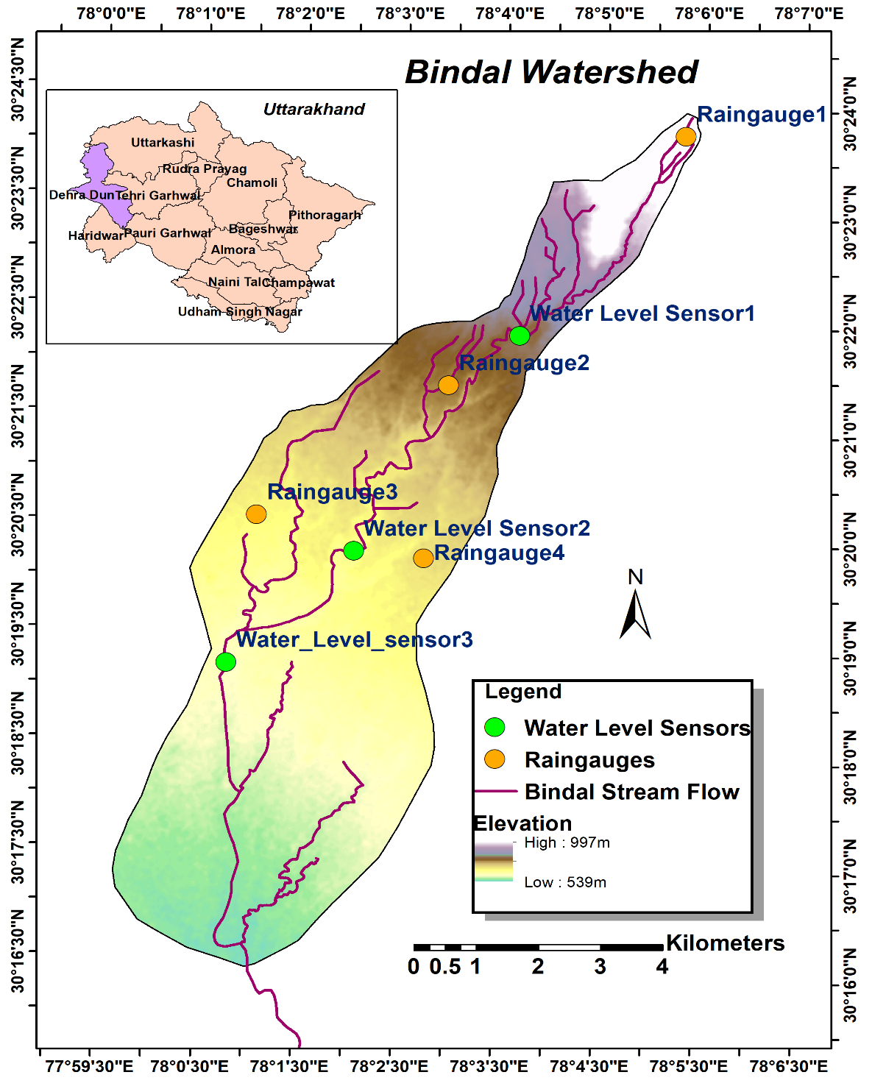
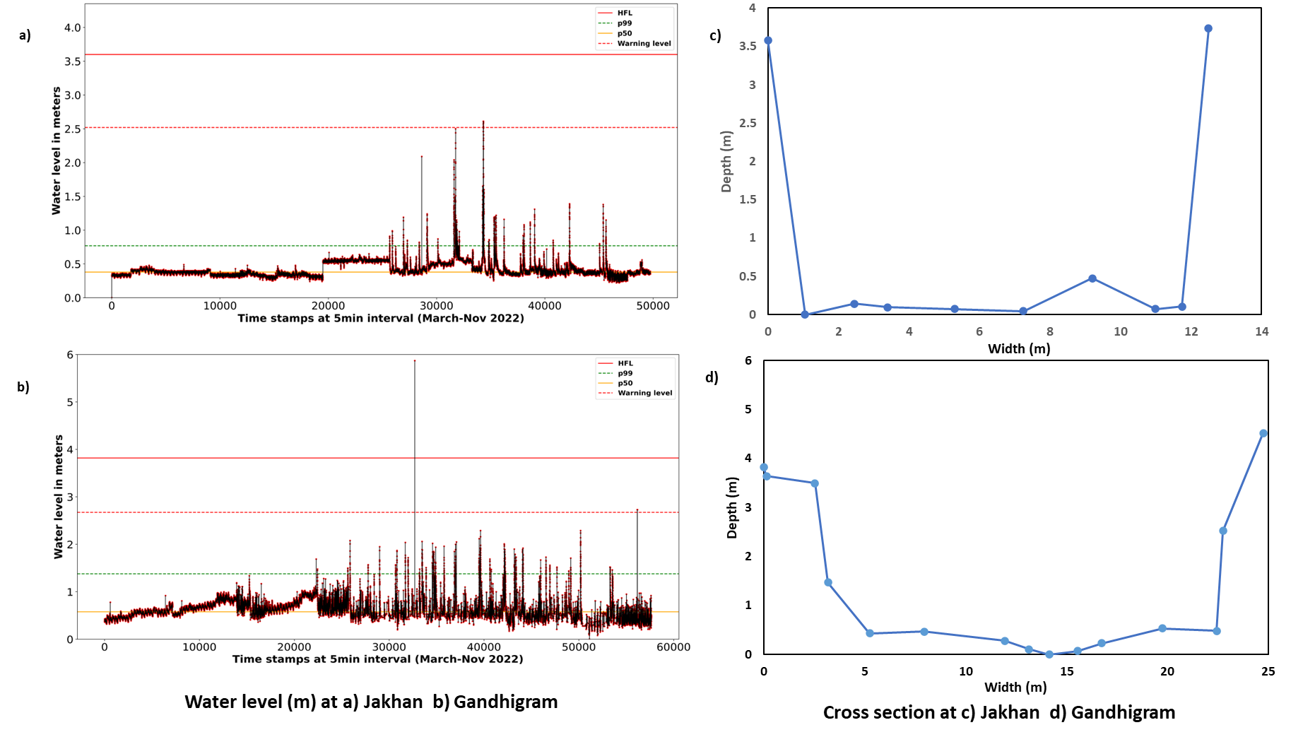
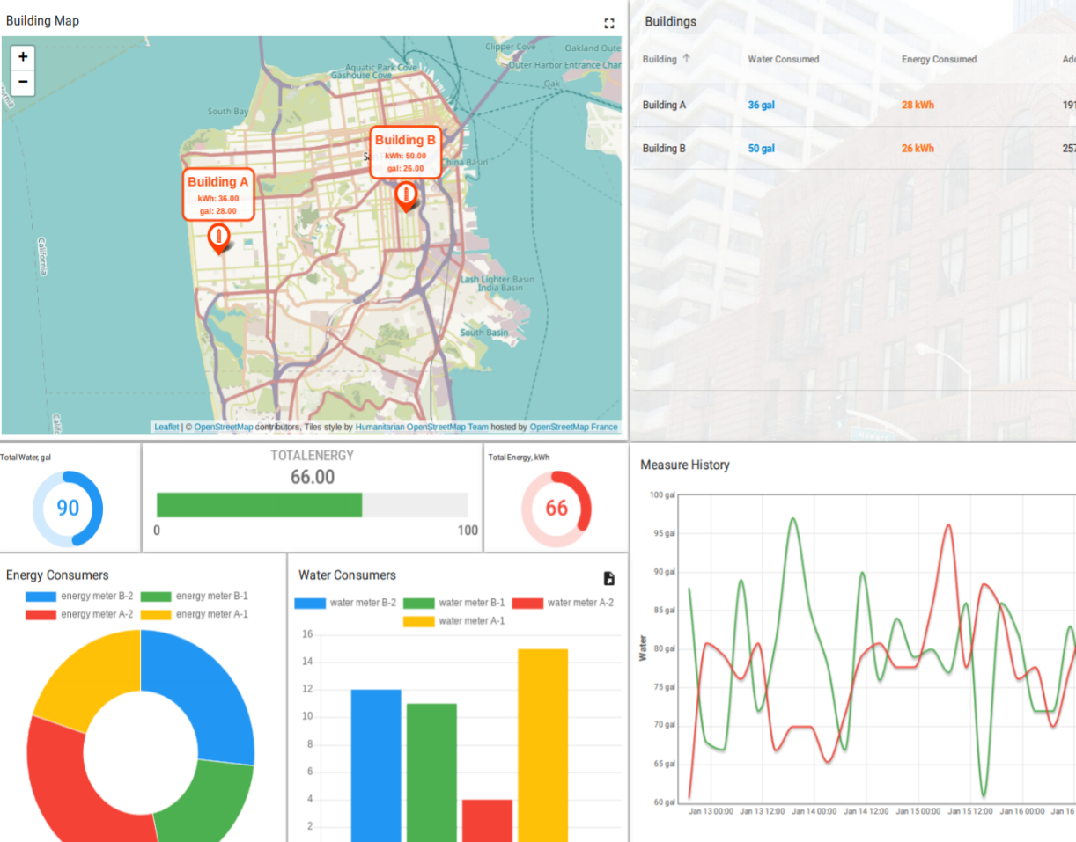
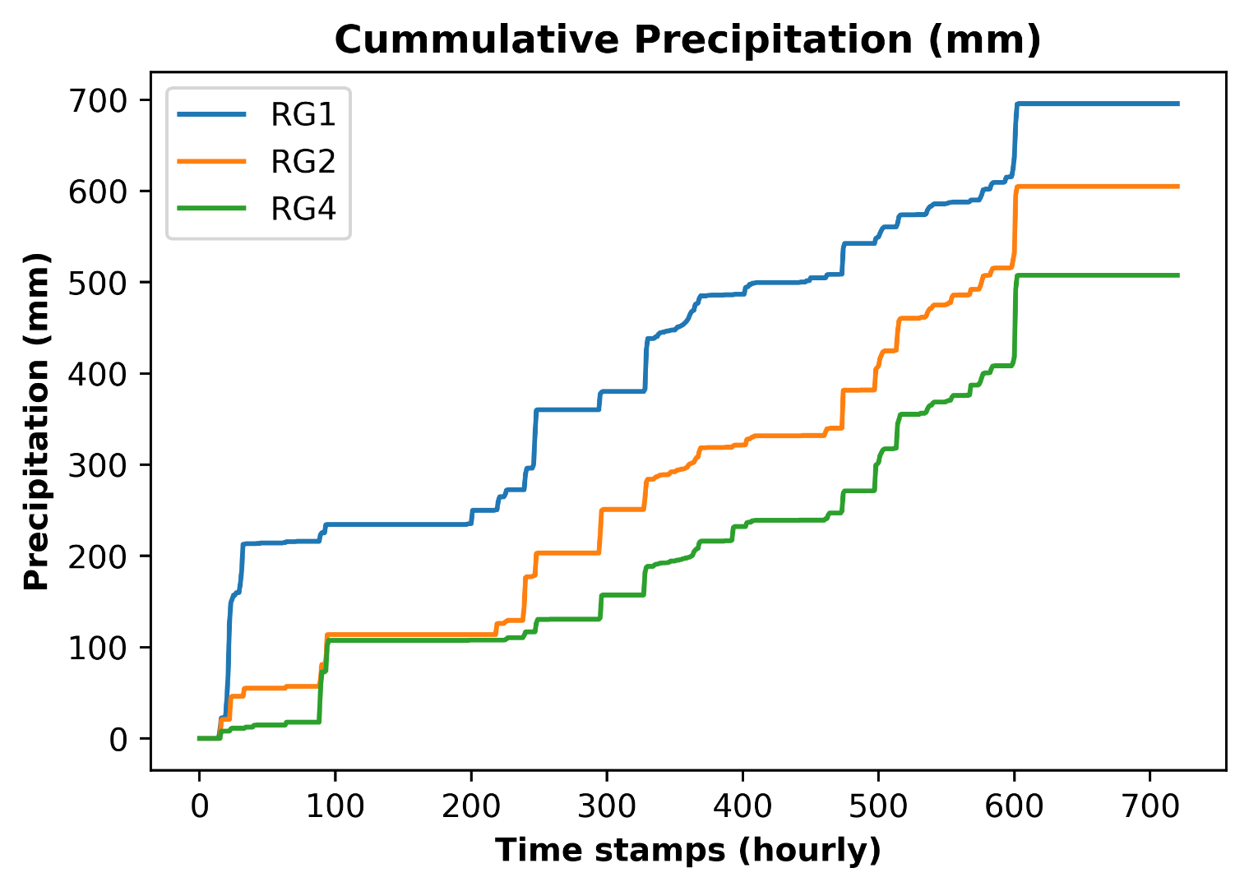
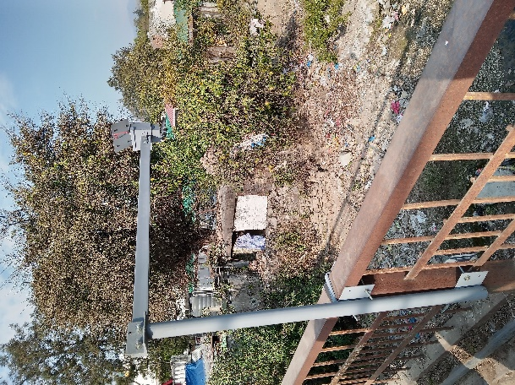
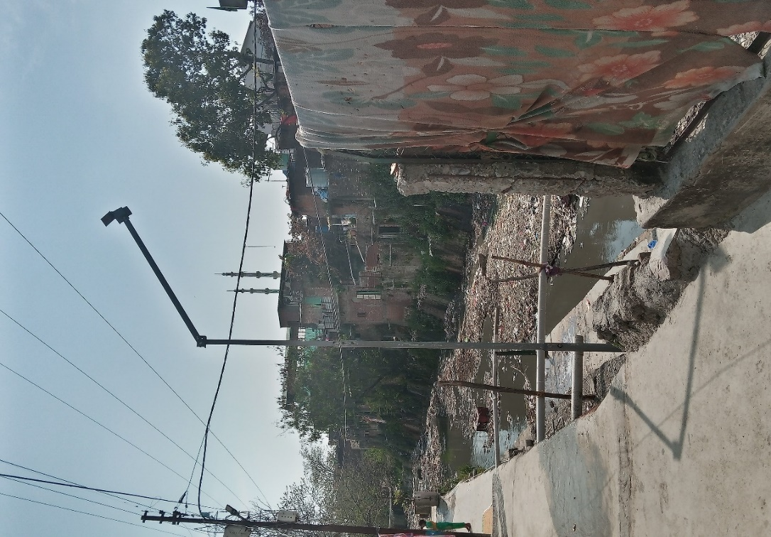
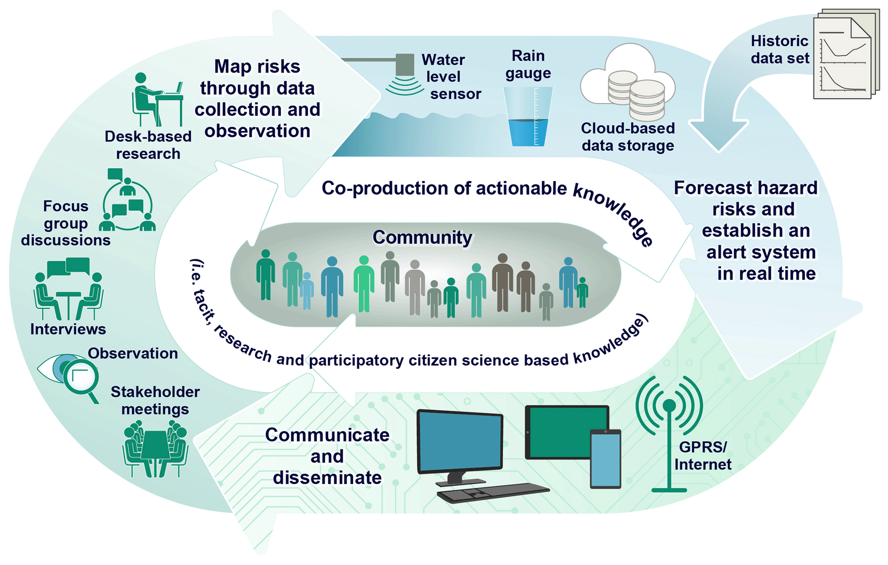
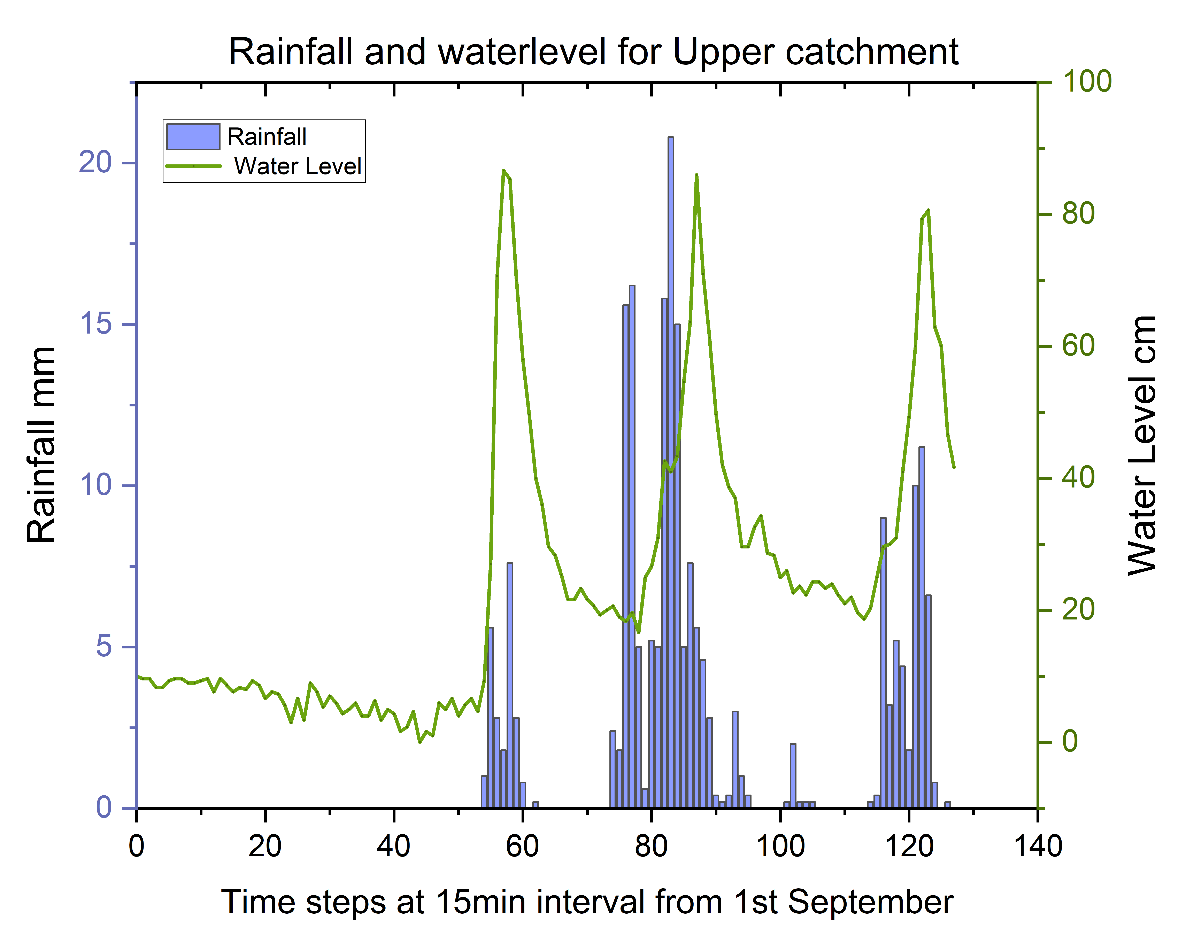
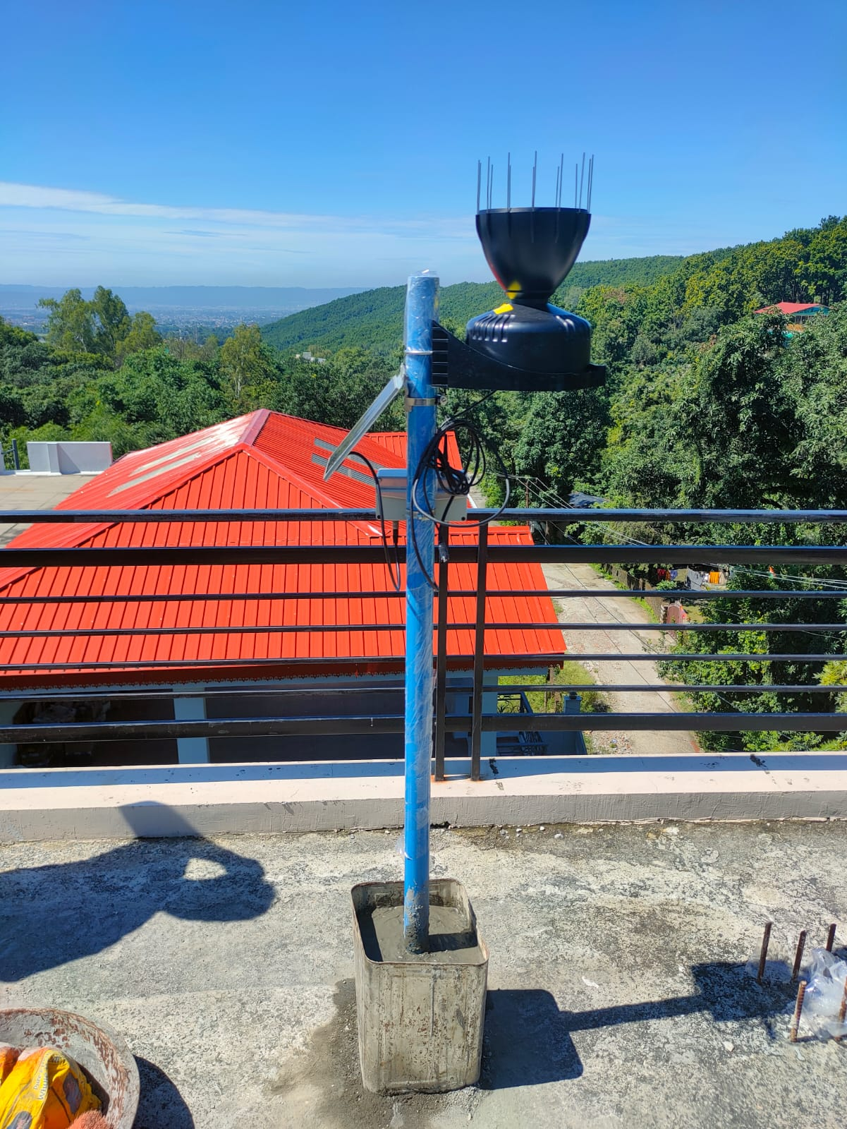
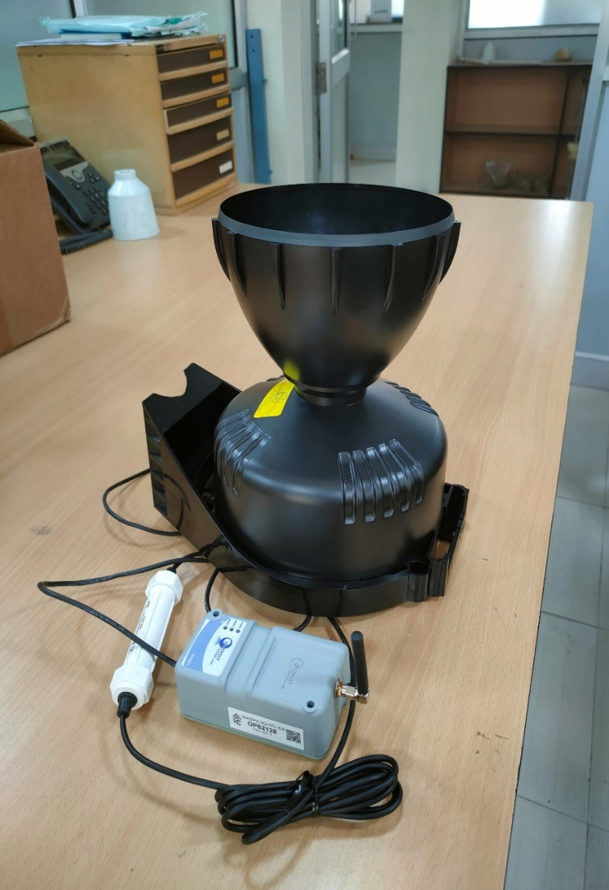
Developing a SMART flood early warning system for a mountain watershed: experiences from the Lesser Himalayas
Sudhanshu Dixit ¹, Tahmina Yasmin², Kieran Khamis², Anthony Ross³, Subir Sen¹, Debashish Sen⁴, Wouter Buytaert ³ , David M. Hannah², Sumit Sen¹ EGU General Assembly 2023, Vienna, Austria
Motivation
Study Area
Observed Catchment Behaviour
Information Delivery Platform
The Lesser Himalayas region is highly vulnerable to climate change, and extreme weather events such as floods and landslides are becoming more frequent and severe
During high-intensity rainfall events in the catchments, due to hilly terrain and steep slopes, headwater streams cause flash floods and destroy life and property downstream.
The development of an early warning system (EWS) is critical to reducing the risks and impacts of these events.
Traditional EWS technologies may lack local engagement and real time data coverage.
Adequate hydrometeorological monitoring is a key element to generate knowledge on catchment/watershed characteristics
New approaches of developing EWS engaging local communities are needed to enhance their effectiveness.
Open-source IoT platform
Collects and visualizes data from devices in real time
Analyses and processes incoming data
Aggregate rainfall to hourly or daily timescales
Compute statistics (e.g., long-term averages)
Trigger alarms based on a set of predefined thresholds
Representative Visualization
Summary
Background
Figure 2: Study area and the positions of water level sensors and rain gauges
Community involvement is crucial in building resilience.
Himalayan habitat is vulnerable and requires SMART approaches to develop management strategies.
Proposed SMART approach implemented in Bindal catchment, builds on the idea of uniting science with community.
Bindal river shows a significant variability in rainfall at both spatial and temporal scales.
Correlation ranges from 0.82 to 0.20 with the gauging stations located 2.74 and 8.24km apart respectively.
Response time of river catchment is 15-30 minutes.
We implemented SMART approach to develop a flood EWS on Bindal river basin near Dehradun in Uttarakhand.
Our work emphasizes the implementation of the bottom-up approach (SMART approach) that involves local communities in the development of the flood EWS.
We aim to leverage and test a low-cost sensor network to provide information of hydrological variability and runoff response.
To understand the catchment behavior, we analyzed water level and rainfall characteristics.
The SMART sensor network consists of 3 LiDAR river water level sensors and 4 tipping-bucket rain gauges at 15-minute intervals.
The water level (WL) sensors were installed in three different regions (Jakhan –WL1, Neshvilla-WL2 and Gandhigram –WL3) from March 2022.
The rain gauge (RG) were installed in September 2022 at four regions (RG1, RG2, RG3, RG4 in Figure 2).
Our work contributes to establishing effective and low-cost flood warning systems for vulnerable riverine communities, particularly in developing countries.
Originates in the foothills of Himalayas near Mussoorie, Bindal river flows through Dehradun - capital city of Uttarakhand.
It has significant elevation difference of 450m with an area of 44.4 km²
Due to high intensity rainfall events in hilly terrain and steep slopes, headwater streams cause flash floods downstream during monsoon (June-Sept)
Increased encroachment and unplanned urban settlements along riverbanks expose the financially distressed communities to elevated risk of floods
Table 1: Rainfall Statistics observed at different RGs
 | RG1 | RG2 | RG4
Mean intensity (mm/hr) | 0.964 | 0.839 | 0.704
Maximum (mm) | 56.6 | 63 | 73.8
Std. Deviation (mm) | 4.396 | 4.18 | 4.04
Urban settlements in the downstream receive heavy rainfall within a short duration, while upper- catchment regions receive low intensity rainfall for longer duration.
Real Time Data Collection
The correlation coefficient (p<0.05) between the rainfall observations at different stations varied from 0.82 to 0.20 with distance between their locations varying from 2.74 to 8.24km)
Shared understanding of the risks
Authors
To position the sensor for water level and rainfall.
To know about the frequency and intensity of the flood.
To know about the nature and extent of damage.
To know who and how the people are affected by flood.
¹ Centre of Excellence in Disaster Mitigation and Management, Indian Institute of Technology Roorkee, India
² School of Geography, Earth & Environmental Sciences, University of Birmingham, Birmingham, UK
³ Department of Civil and Environmental Engineering, Imperial College London, London, UK
⁴ People’s Science Institute, Dehradun, India
Participatory Rural Appraisal
Focus Group Discussion
Approach
Lidar based water level sensor
References
Shared understanding, Monitoring , Awareness of the associated risks for preplanning Response actions on Time
Low cost of purchase (~US$300)
Low maintenance
Low cost of installation
Lower cost of power supply (6W solar panel)
State-of-the-art telemetry – less travel costs and labor cost
1. Yasmin, T., Khamis, K., Ross, A., Sen, S., Sharma, A., Sen, D., & Hannah, D. M. (2023). Brief communication: Inclusiveness in designing an early warning system for flood resilience. Natural Hazards and Earth System Sciences, 23(2), 667-674.
The difference in total monthly rainfall recorded in two rain gauges 8.24 km apart in September is 187 mm
Clear pattern intraday variation is observed in Precipitation. The pattern is similar in all three locations (RG1, RG2, RG3)
Acknowledgements
Tipping bucket rain gauge
Sensor Type: Tipping spoon with magnetic switch.
0.2 mm per tip.
For a rainfall of 50mm/hr., error in reading is 2mm.
Can be configured for sub-hourly telemetry.
Logging interval: 15 min.
214 cm² collection area.
The response time in the upper catchment (RG1) is 15-45minutes
Sudhanshu Dixit
Research Scholar
Centre of Excellence in Disaster management and Mitigation
Indian Institute of Technology, Roorkee, Uttarakhand, India
Email: s_dixit@dm.iitr.ac.in
Figure 1: Schematic representation of our SMART approach ¹
Link to abstract and OSPP voting tool

Slide 2
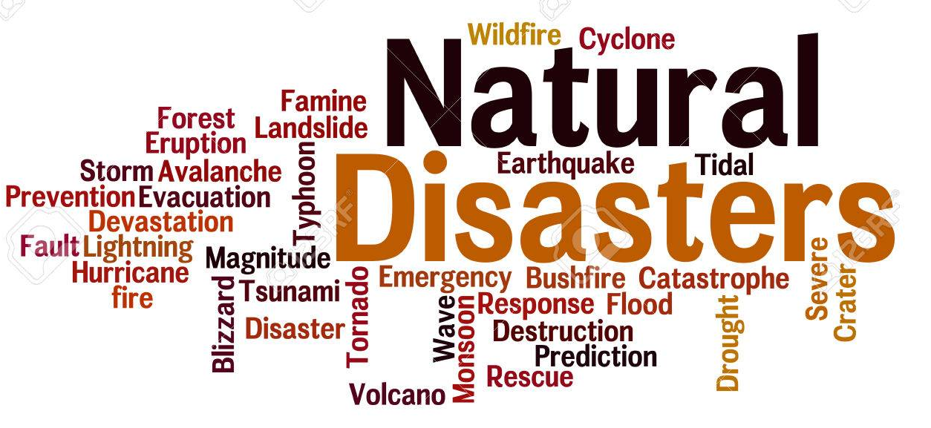
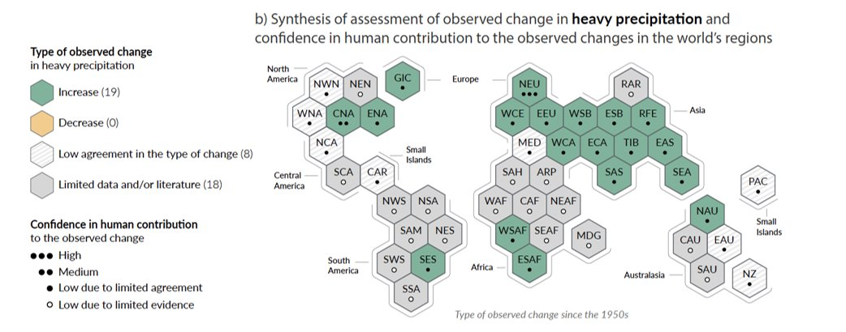
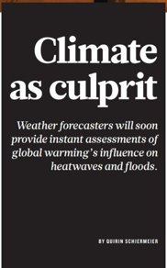
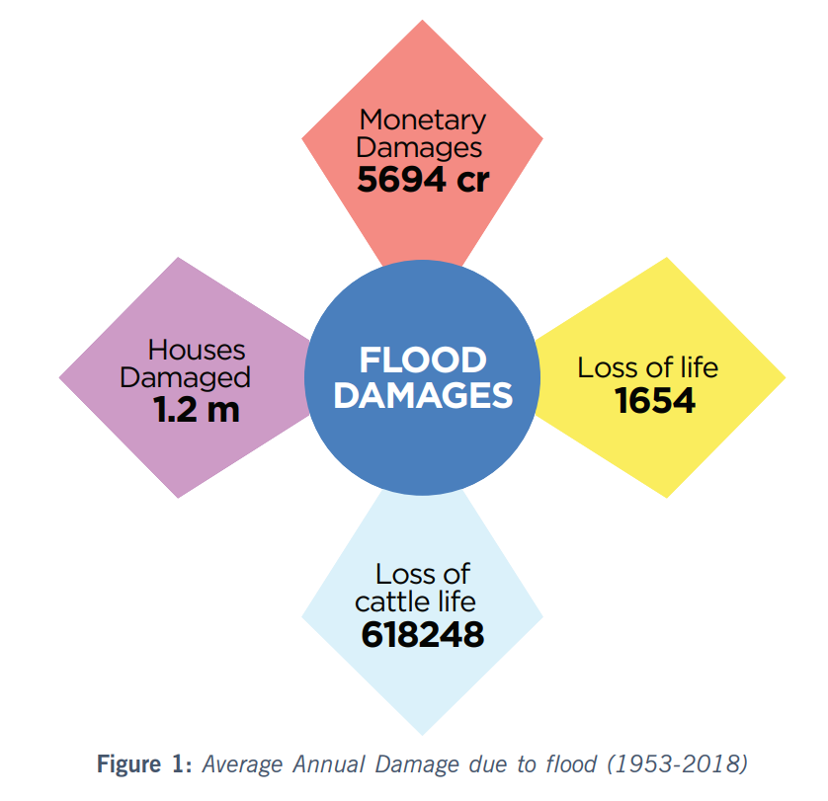
Motivation
Can't afford to ignore climate change anymore, as the cost of inaction is becoming too clear in the form of escalating natural disasters
IPCC 2021
Average annual damage due to flood (1953-2018) Niti aayog report 2021
Notes:
It not new that we are witnessing increase in frequency and magnitude of natural disasters. They are becoming severe. Extreme rainfall in a place or no rainfall both are threat to life. These events are due to fast changing climate mainly influence by human activities. IPCC in its recent report says "wett is getting wetter" highligtning extreme ppt globally including in India. this figure shows the average annual damage due to flood 1953-2018 reported by niti aayog, Govt of India. Yes!! We cant affort to ignore........... Lot of efforts are put to analyze and mitigate disaster globally. Sendai ….and sustainble goals are to name few. india devised ITS national disaster management plan in 2016.

Slide 3
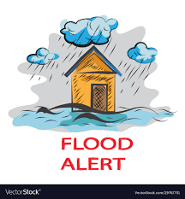
Need of the hour
An early warning system to reduce flood risk and improve disaster resilience for vulnerable communities.
Role of citizens on Disaster Management and Mitigation
Increased likelihood of an effective response to disasters.
Provide valuable local knowledge and expertise about the community and the potential hazards.
Increased sense of ownership and responsibility for their own safety and that of their community lead to greater resilience and preparedness
Build trust between communities and the authorities responsible for disaster response.
Better understanding of the environmental and social processes that determine flood hazard, exposure and vulnerability.
Co-creation and co-production of Knowledge and delivery with local partners and communities.
Uniting science and community: The key to effective disaster management
Notes:
In order to reduce flood risk and improve disaster resillience we need to develop efficient early warning system. I requires sound knowledge about the technical details like regional climate, hydrology along with society and other social information exposer and vulnerability. So, citizens play an important on DMM. Uniting science and community is key to effective dm.

Slide 4
Our SMART Approach
Shared understanding, Monitoring , Awareness of the associated risks for preplanning Response actions on Time
Yasmin. T et.al., 2023

Slide 5
Case Study : Bindal River
Location: Dehradun, Uttarakhand
Watershed Area: 45 sq.km
Notes:
We implemented smart approch to set up a low coSt efficient flood ews for bindal river catchmenet in India. Its Originates in the foothills of Himalayas near Mussoorie, Bindal river flows through Dehradun - capital city of Uttarakhand.
It has significant elevation difference of 450m with an area of 44.4 km2. It is situated in Lesser Himalayas.

Slide 6
Bindal River
Originates in the foothills of Himalayas near Mussoorie, Bindal river flows through Dehradun - capital city of Uttarakhand.
It has significant elevation difference of 450m with an area of 44.4 km²
Due to high intensity rainfall events in hilly terrain and steep slopes, headwater streams cause flash floods downstream during monsoon (June-Sept)
Increased encroachment and unplanned urban settlements along riverbanks expose the financially distressed communities to elevated risk of floods
A reliable warning system is required for better preparedness for flood hazards​
Notes:
The region experiences high rainfall events and due to hilly and steep l=slope, the flash floods have become very common. The unplanned urban settlement along the banks have made the conditions more worse. There fore, its urgent to devel a low cost efficinet EWS in bindal river cathcment.

Slide 7
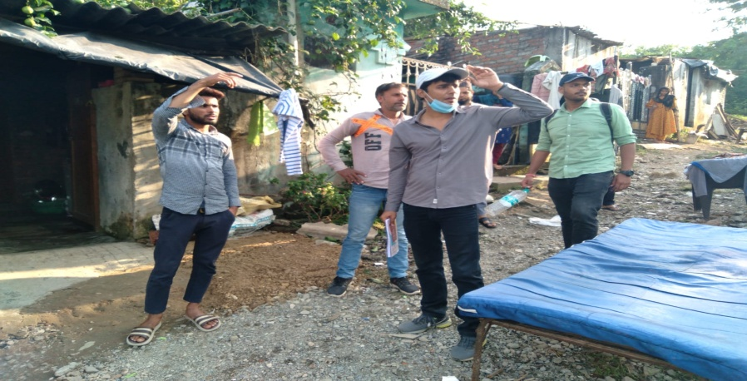
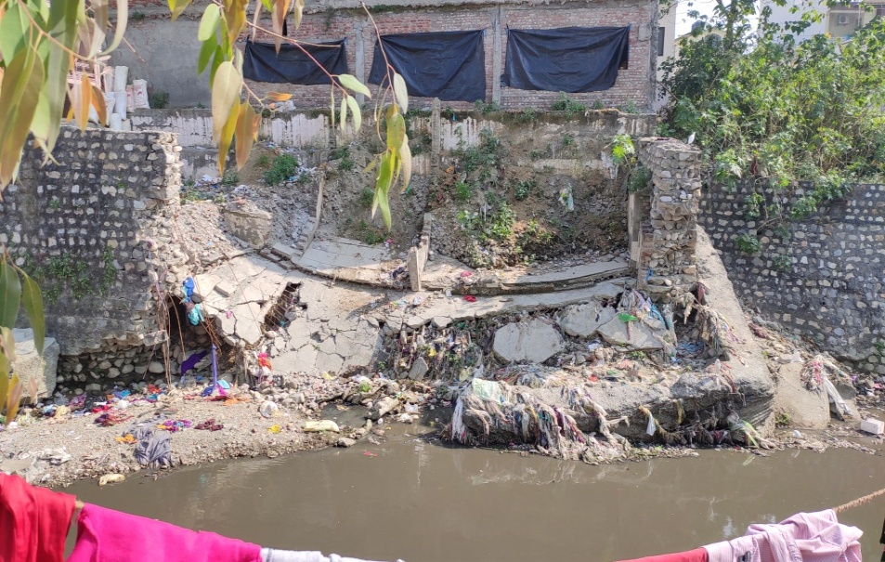
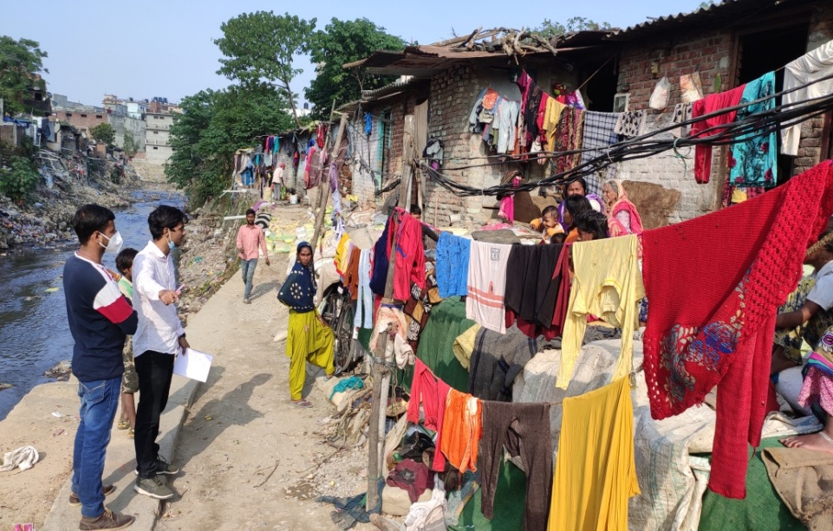
Community Involvement
Shared understanding of the risks
Involving community helped us
To position the sensor for water level and rainfall
To know about the nature and extent of damage
To know who and how the people are affected by flood
To know about the frequency and intensity of the flood
Participatory Rural Appraisal
Focus Group Discussion
Notes:
With this objecive, and a smart apporch we started with our first step. That is involving community in our work. We caried ou a survey to collect necessary information like who and how thw ppl are effeted, what is the natur and extent of damage. Here you can see some pictures of the same
Then we finalised few location to install water level and rainfall measuring stations for contious data collection and flood monitoring.

Slide 8
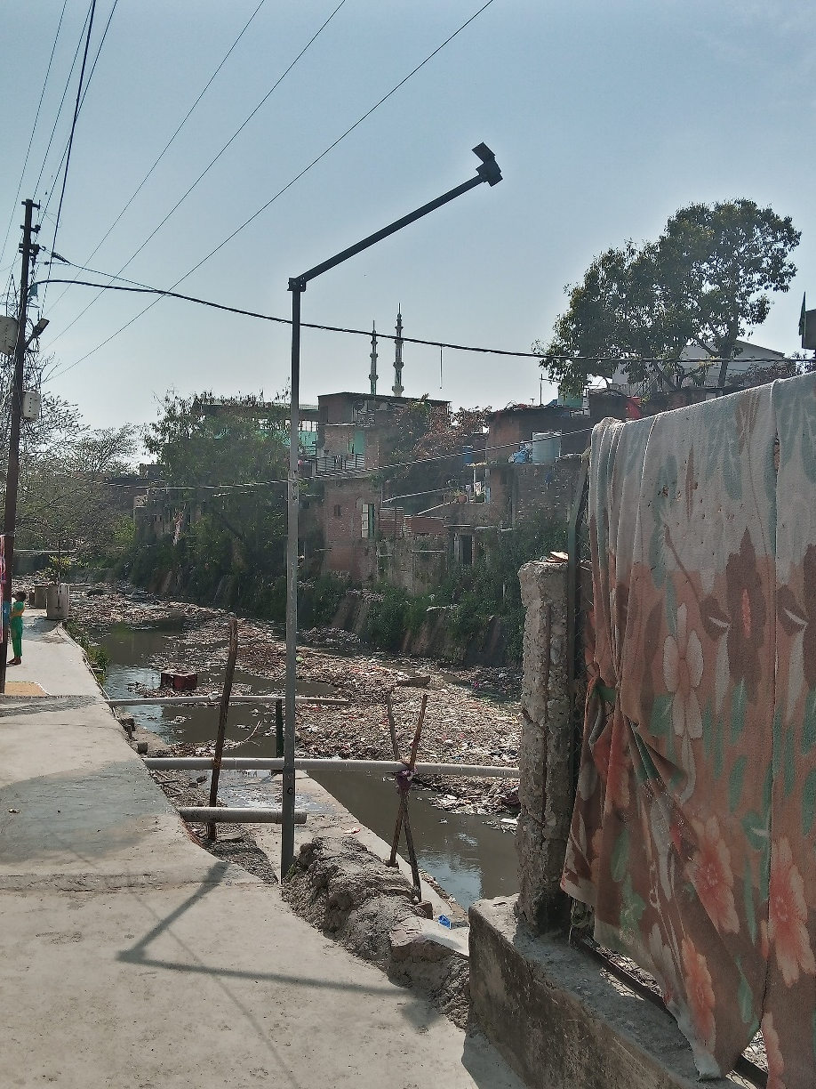
Real Time Data Collection
Lidar based water level sensor
Low cost of purchase (~US$300)
Low cost of installation
Low maintenance
Lower cost of power supply (6W solar panel)
State-of-the-art telemetry – less travel costs and labor cost
Davis tipping bucket rain gauge
Sensor Type: Tipping spoon with magnetic switch
0.2 mm per tip.
214 cm² collection area
For a rainfall of 50mm/hr., error in reading is 2mm.
Logging interval: 15 min.
Can be configured for sub-hourly telemetry.
Notes:
We have installed Lidar based water level sensor at 3 locations and rainguages at 4 locations as it is shown in the right figure.

Slide 9
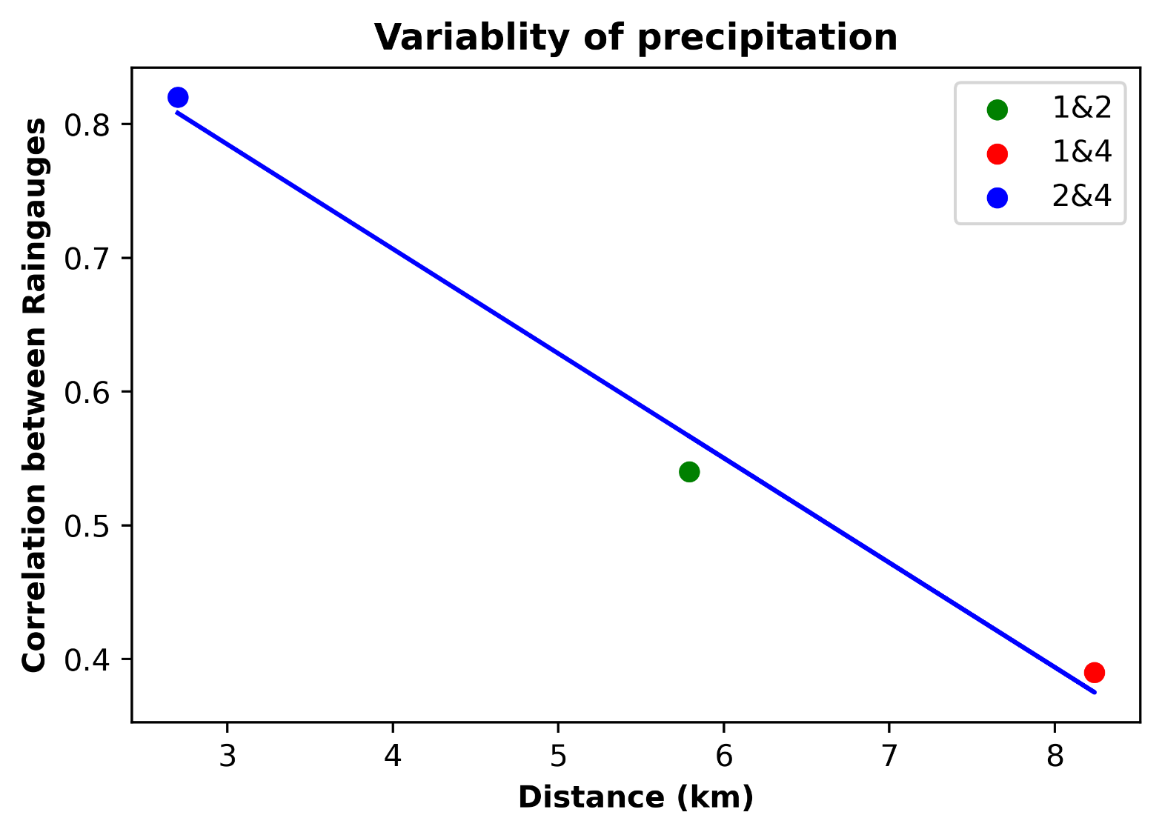
Analysis of Catchment Behavior
Significant variability at both spatial and temporal scale within the small catchment of Bindal was observed.
 | RG1 | RG2 | RG4
Mean (mm/hr) | 0.964 | 0.839 | 0.704
Max (mm) | 56.6 | 63 | 73.8
SD | 4.396 | 4.18 | 4.04
Urban settlements in the downstream receive heavy rainfall within a short duration, while upper- catchment regions receive low intensity rainfall for longer duration.
The difference in total monthly rainfall recorded in two rain gauges 8.24 km apart in September is 187 mm
Clear pattern intraday variation is observed in Precipitation. The pattern is similar in all three locations (RG1, RG2, RG3)
The response time in the upper catchment (RG1) is 15-45minutes
The correlation coefficient (p<0.05) between the rainfall observations at different stations varied from 0.82 to 0.20 with distance between their locations varying from 2.74 to 8.24km)
*The results shown are for September 2022

Slide 10
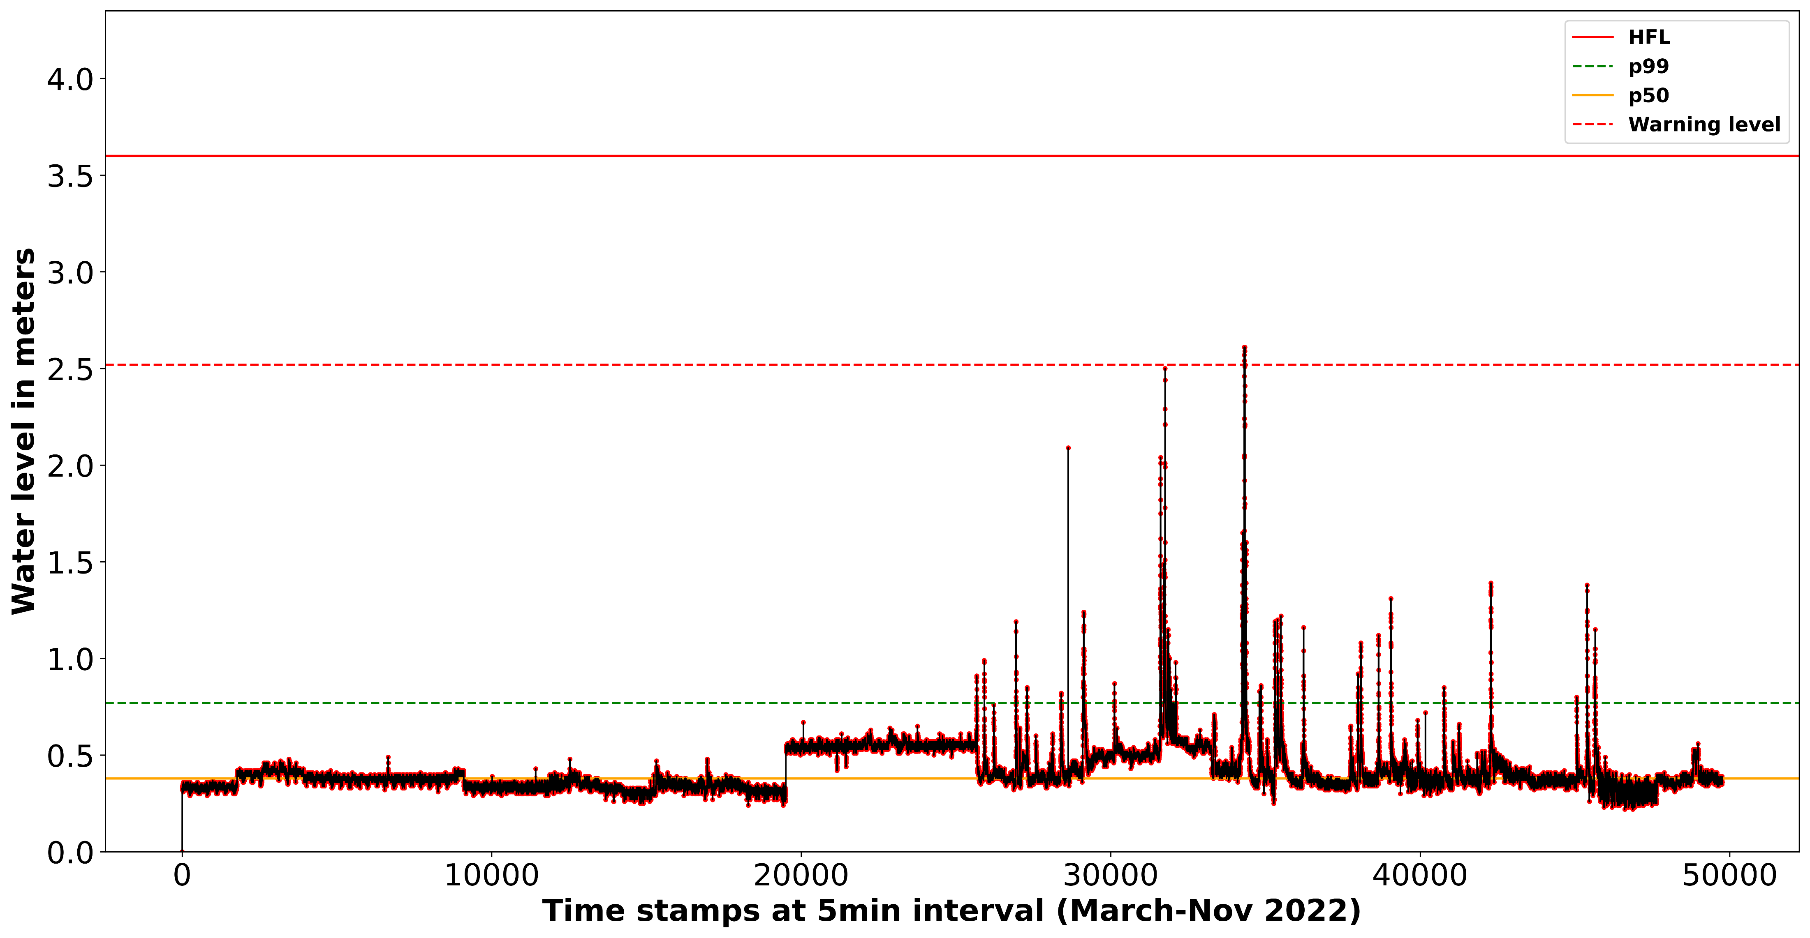
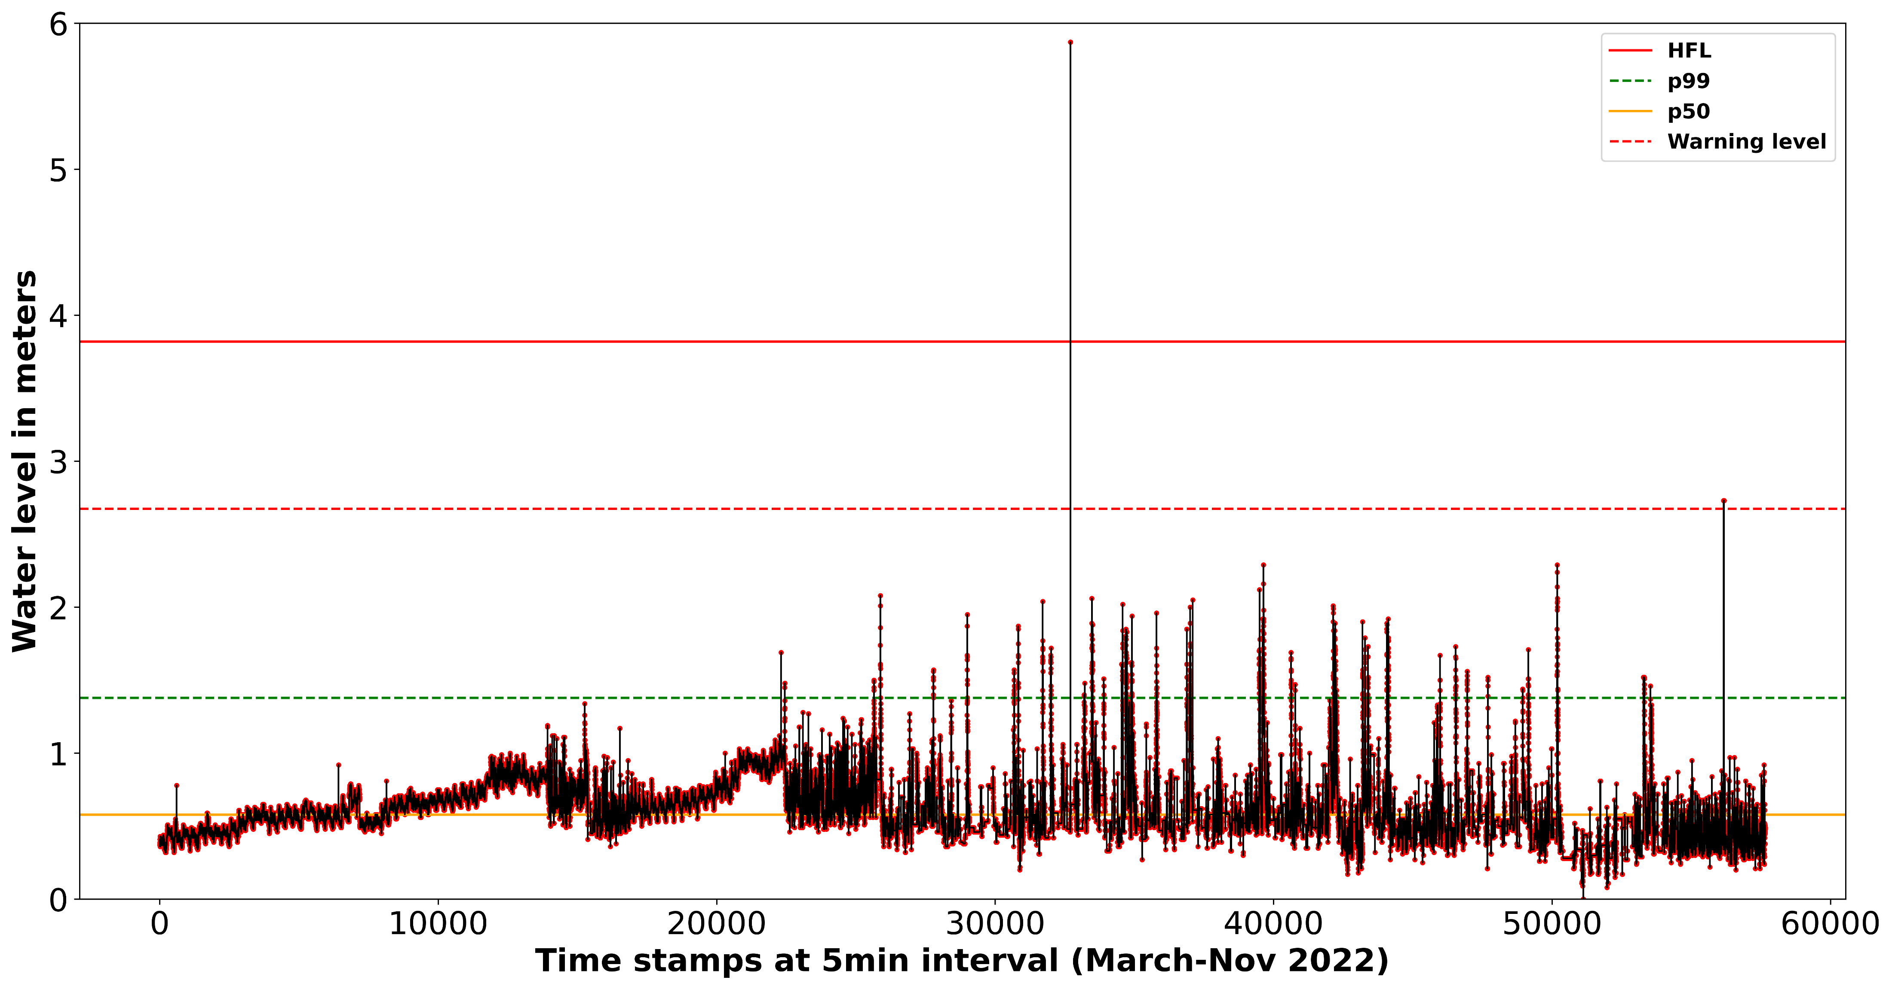
Cont.
a)
c)
b)
d)
Water level (m) at a) Jakhan b) Gandhigram
Cross section at c) Jakhan d) Gandhigram
Notes:
River cross-section and water level with different threshold

Slide 11
Visualization on ThingsBoard
Open-source IoT platform
Collects and visualizes data from devices in real time
Analyses and processes incoming data
Aggregate rainfall to hourly or daily timescales
Compute statistics (e.g., long-term averages)
Trigger alarms based on a set of predefined thresholds
Representative Visualization

Slide 12
Summary
Community involvement is crucial in building resilience.
Himalayan habitat is vulnerable and requires SMART approaches to develop management strategies.
Proposed SMART approach implemented in Bindal catchment, builds on the idea of uniting science with community.
Bindal river shows a significant variability in rainfall at both spatial and temporal scales.
Correlation ranges from 0.82 to 0.20 with the gauging stations located 2.74 and 8.24km apart respectively.
Response time of river catchment is 15-30 minutes.
Notes:
We can summarize

Slide 13
Acknowledgements

Slide 14
Stay ahead of the flood with our SMART early warning system!

Slide 15
For more details on SMART approach
Yasmin, T., Khamis, K., Ross, A., Sen, S., Sharma, A., Sen, D., & Hannah, D. M. (2023). Brief communication: Inclusiveness in designing an early warning system for flood resilience. Natural Hazards and Earth System Sciences, 23(2), 667-674.

