Slide 1
Time-dependent Seismic Hazard Parameters Evaluation with SHAPE MATLAB Package
Kostas Leptokaropoulos
EGU23-11178 | Orals | NH4.2
26th April 2023, 08:45-08:55|Room 2.17

Slide 2
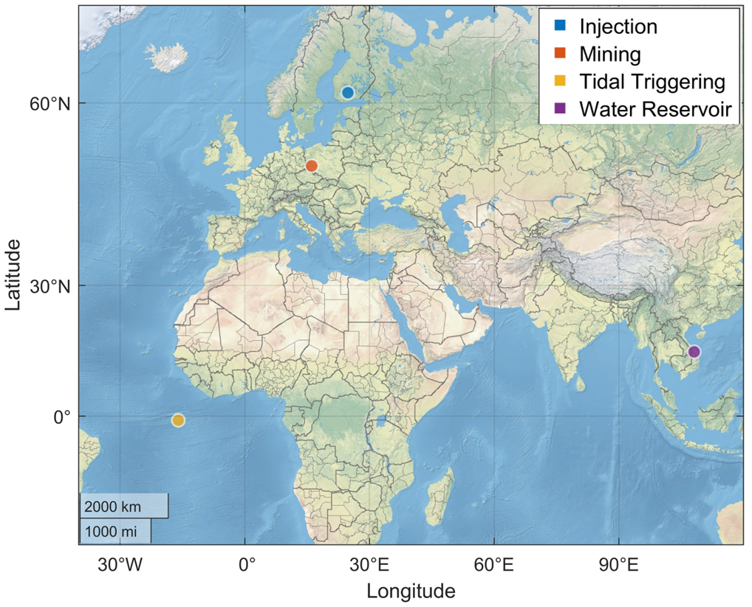
Overview
Time-dependent Seismic Hazard
Introduction to SHAPE
Case Studies
Seismicity triggered by water reservoir impoundment in Song Trahn 2 artificial lake, Vietnam.
Mining induced seismicity at Rudna Mine, Poland.
Tidal triggering of microseismicity recorded by an ocean bottom seismometer network in the equatorial mid-Atlantic ridge.
Seismicity associated with hydraulic stimulation performed in geothermal site St1 in Helsinki, Finland.
Summary
Resources
TDSH
SHAPE
Case Studies
Vietnam, Dam
Rudna, Mine
MAR, Tidal
Summary
Resources

Slide 3
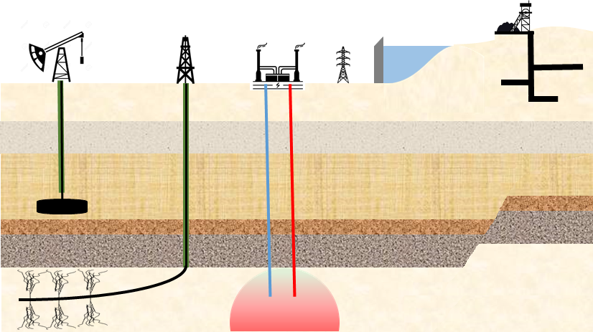
Time-dependent Seismic Hazard
Anthropogenic Seismicity
Long-term changes in tectonic seismicity
Aftershock sequences
Detection of anomalous activity
Tidal triggering
Volcanic/geothermal areas
Seasonal effects
TDSH
SHAPE
Case Studies
Vietnam, Dam
Rudna, Mine
MAR, Tidal
Summary
Resources
Hazard: Source, Path, Site
Time-dependent

Slide 4
SHAPE
TDSH
SHAPE
Case Studies
Vietnam, Dam
Rudna, Mine
MAR, Tidal
Summary
Resources

Slide 5
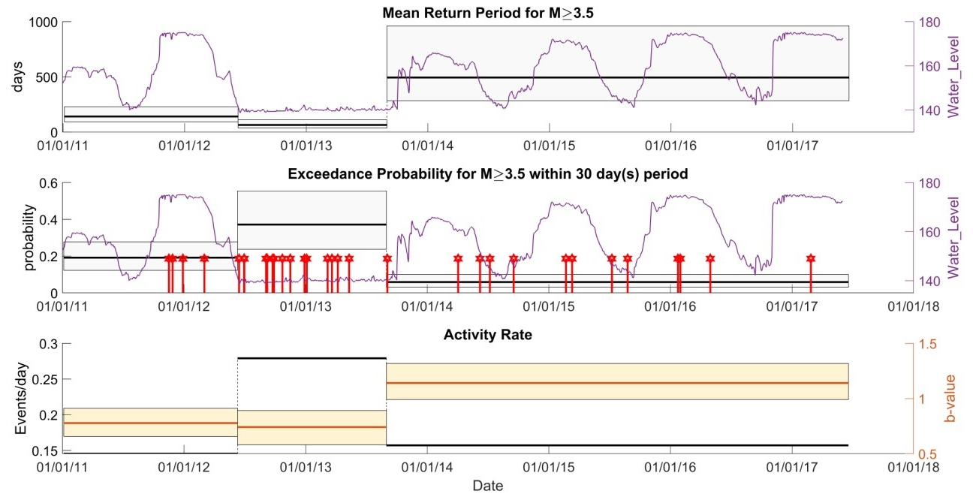
Song Tranh 2 reservoir, Vietnam Lizurek et al., 2021
TDSH
SHAPE
Case Studies
Vietnam, Dam
Rudna, Mine
MAR, Tidal
Summary
Resources
The gap increases the EP, (or equivalently, decreases the mean return period) for events with M≥3.5
The rate of M≥1.9 events doubles during the gap and returns roughly to the pre-gap level in the post-gap period
b-value does not change during the gap, it rises significantly after the gap, resulting together with the decreased seismicity rate, to a substantial exceedance probability drop

Slide 6
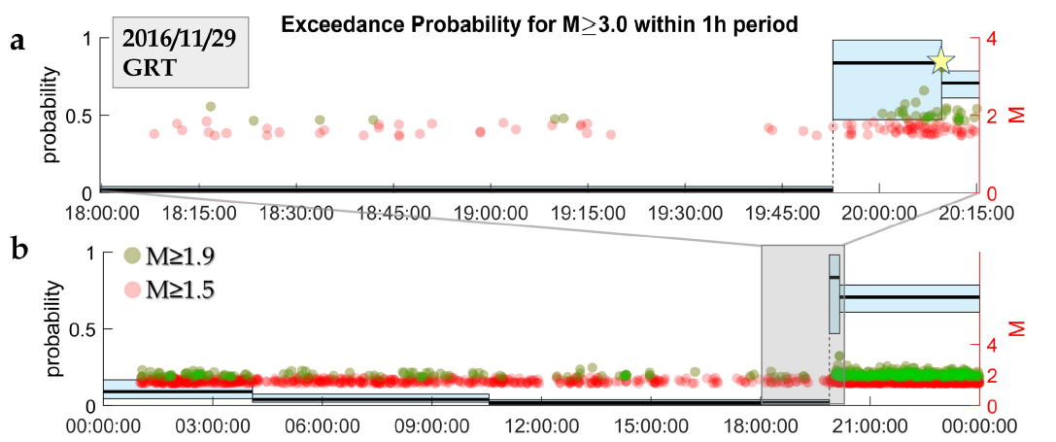
Rudna Mine, Poland Sobiesiak et al., 2022; Sobiesiak et al., under preparation
M_{w}=3.4 collapse
TDSH
SHAPE
Case Studies
Vietnam, Dam
Rudna, Mine
MAR, Tidal
Summary
Resources
Relative quiescence some hours before the collapse
No events detected for ~20 minutes, 1 hour before the collapse
30 min before the collapse an accelerated activity initiated, with increasing event rates and magnitudes (i.e., increasing p_{E})

Slide 7
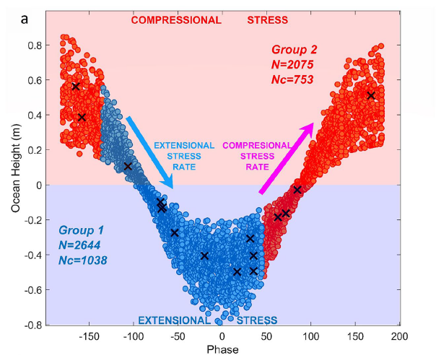
Mid-Atlantic Ridge, Tidal triggering Leptokaropoulos et al., 2021
Tidal triggering is investigated for a microseismicity data set from a small seimogenic volume at the equatorial Mid-Atlantic Ridge
Seismicity rates are increased and b-values are decreased during and towards low tides
Exceedance Probabilities (p_{E}) for T=1yr:
TDSH
SHAPE
Case Studies
Vietnam, Dam
Rudna, Mine
MAR, Tidal
Summary
Resources
 | Group 1 | Group 2
p_{E}: M>5.0 | 0.19 | 0.11
b-value | 0.81 | 0.86
λ (events/day) | 6.2 | 4.2
X events with M≥2.5
However, the 95% CIs exhibit a considerable overlap

Slide 8
Summary
SHAPE is an open-source, MATLAB software package, for estimation of time-dependent probabilistic parameters of the source component of seismic hazard
SHAPE is developed in two versions:
SHAPE_ver1: interactive parameter selection and data filtering (GUI)
SHAPE_ver2: fast implementation and fine-tuning of the parameters
SHAPE requires MATLAB 2017b + Statistics and Machine Learning Toolbox. SHAPE_ver1 also requires Image Processing Toolbox.
User guide and sample files are also available
TDSH
SHAPE
Case Studies
Vietnam, Dam
Rudna, Mine
MAR, Tidal
Summary
Resources

Slide 9
Resources
EU Horizon 2020, GA: 730900
SHAPE can be freely downloaded from SERA repository:
https://git.plgrid.pl/projects/EA/repos/sera-applications/browse/SHAPE_Package
SHAPE can be freely accessed in the EPOS TCS-AH platform:
https://episodesplatform.eu/
References
Leptokaropoulos, K. and S. Lasocki (2020), SHAPE: A Matlab software package for time-dependent seismic hazard analysis, Seismol. Res. Lett., 91, 1867-1877, https://doi.org/10.1785/0220190319.
Leptokaropoulos et al., (2021), Tidal Triggering of Microseismicity at the Equatorial Mid-Atlantic Ridge, Inferred from the PI-LAB experiment, J. Geophys. Res.: Solid Earth, 126, e2021JB022251, https://doi.org/10.1029/2021JB022251.
Lizurek, G. et al., (2021), Seasonal trends and relation to water level of reservoir-triggered seismicity in Song Trahn 2 reservoir, Vietnam, Tectonophysics, 820, 229121, https://doi.org/10.1016/j.tecto.2021.229121.
Poiata, et al., (2016), Multiband array detection and location of seismic sources recorded by dense seismic networks, Geophys. J. Int.,205, 1548 – 1573, https://doi.org/10.1093/gji/ggw071.
Sobiesiak, M., et al., (2022), Enhancing Data Sets From Rudna Deep Copper Mine, SW Poland: Implications on Detailed Structural Resolution and Short-Term Hazard Assessment, EGU General Assembly 2022, Vienna, Austria, 23–27 May 2022, EGU22-10209, https://doi.org/10.5194/egusphere-egu22-10209.
TDSH
SHAPE
Case Studies
Vietnam, Dam
Rudna, Mine
MAR, Tidal
Summary
Resources

Slide 10
Thank you for your attention!
Contact author:
K.Leptokaropoulos@soton.ac.uk
kleptoka@mathworks.com
ResearchGate
LinkedIn
emails

