Slide 1
Supplimentary materials
Characterizing CO₂ enhancements at major hotspots in South Korea using OCO-3 XCO₂ retrievals
by Sung-Bin Park¹ , Yeri Kang² , Young-suk Oh³ , Chang-Keun Song^{1,2}, Sang Seo Park¹

Slide 2
Dataset
OCO-3 XCO2 L2 (bias-corrected XCO2, Retrospective processing v10.4r). Only good quality (qc_flag = 0) is used.
FTS-XCO2 at Anmyeondo, South Korea (TCCON measurement version GGG2020
TROPOMI NO2 L2 (S5P_OFFL_L2__NO2). Only qa_value > 0.75 is used.
Gridded fossil fuel emission inventories: ODIAC, EDGAR, FFDAS
Wind fields from local weather stations from Korea Meteorological Agency

Slide 3
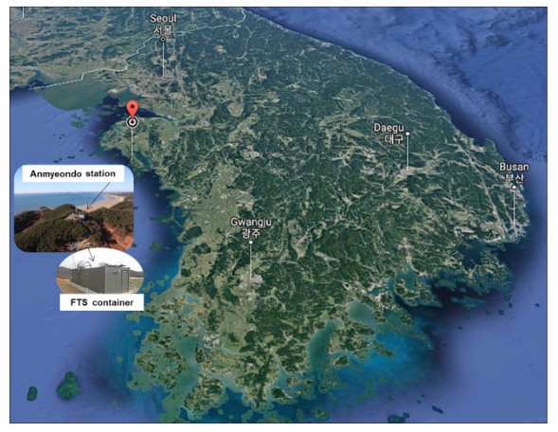
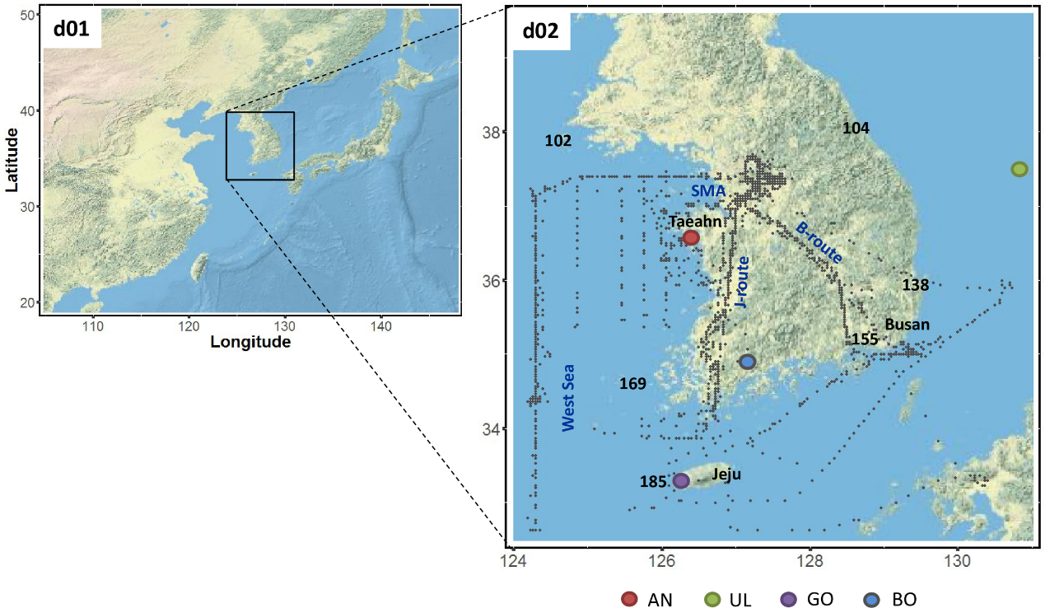
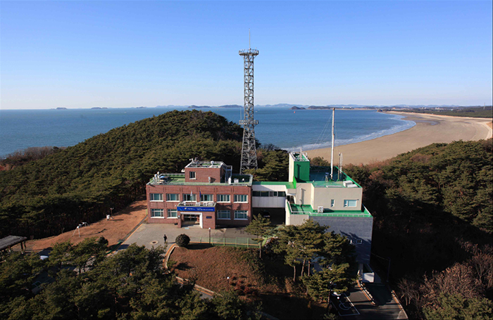
Anmyeondo g-b FTS site in South Korea
Anmyeondo WMO/GAW
Park et al. (2020, Plous One)
Courtesy: KMA
Oh et al. (2018, ATM)
The official TCCON site in South Korea
Co-located with the WMO-GAW station
TCCON measurement version GGG2020
Notes:
Left, Kiel et al. (2021, RSE) -- Fig. 1. Location of the NCEP (black) and SCAQMD (red) wind stations within the LA Basin. The positions of the Caltech and AFRC TCCON instruments are indicated in blue. (For interpretation of the references to colour in this figure legend, the reader is referred to the web version of this article.)
Left, Park et al. (2020, Numerical simulation of atmospheric CO2 concentration and flux over the Korean Peninsula using WRF-VPRM model during Korus-AQ 2016 campaign)
Center, Oh et al. (2018, https://doi.org/10.5194/amt-11-2361-2018)
Right: Anmyeondo WMO/GAW (photo by KMA)

Slide 4
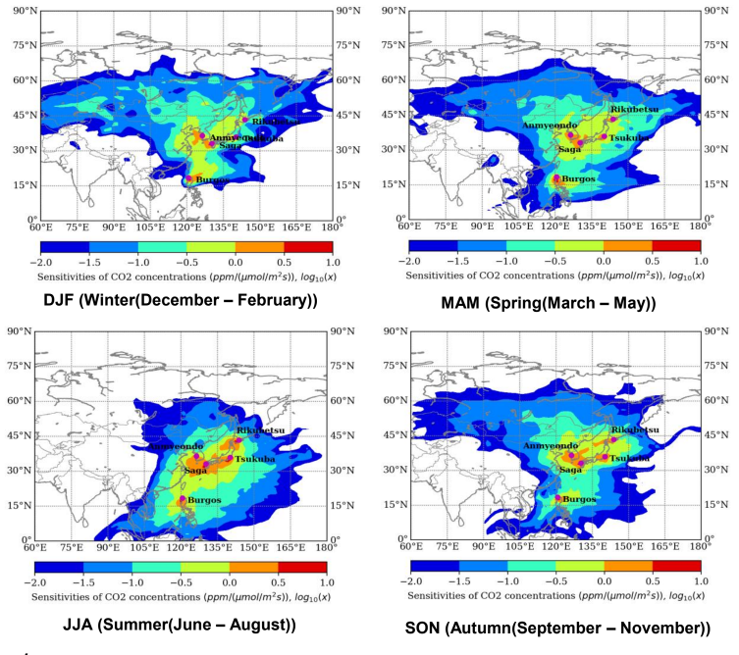
Seasonal footprints of FTS-XCO2 at TCCON sites in East Asia
The sensitivity of CO2 concentrations (ppm(μmol(m2s)-1)-1) with the calculated using the FLEXPART model with the Anmyeondo in 2014.
AMY FTS-XCO2 measurements are representative of whole South Korea.
courtesy: Oh et al. 2(2019, GGMT meeting, NIMS Climate Research Department)

Slide 5
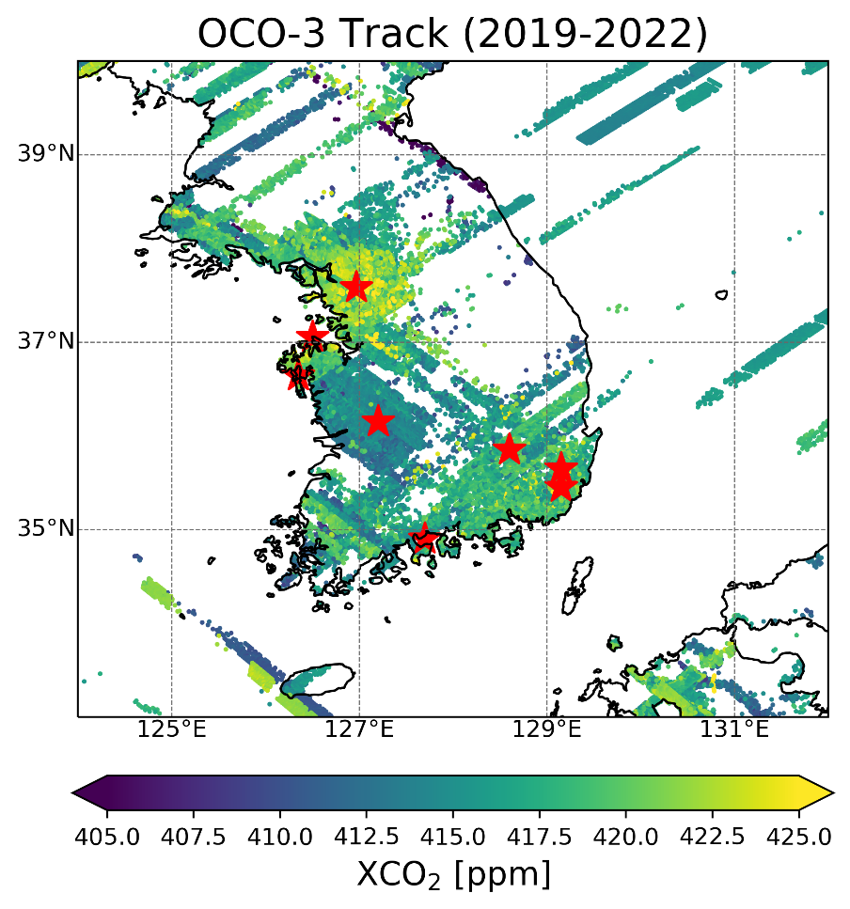
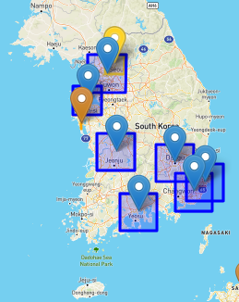
OCO-3 Tracks overpassing SAMs in South Korea
L2 (10.2019~12.2022)
Snapshot Area Maps
https://ocov3.jpl.nasa.gov/sams/

Slide 6
Snapshot Area Maps (SAMs) in South Korea
Site Name | Target ID | Site Type
Seoul | fossil0001 | Fossil
Dangjin-Yonghungdo-Taean powerplants | fossil0194 | Fossil
Taejeon | fossil0122 | Fossil
Taegu | fossil0112 | Fossil
Gwangyang_powerplant | fossil0227 | Fossil
Ulsan (Tropomi_2_powerplant) | fossil0225 | Fossil
Pusan | fossil0049 | Fossil
Anmyeondo | tccon100 | Validation
https://ocov3.jpl.nasa.gov/sams/

Slide 7
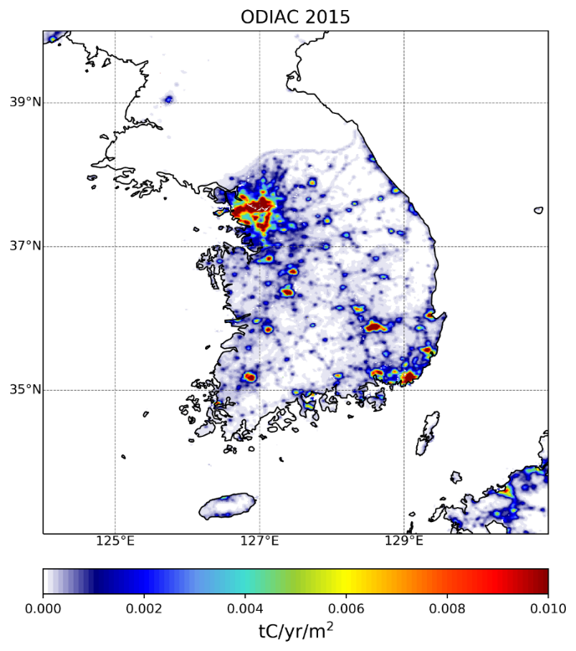
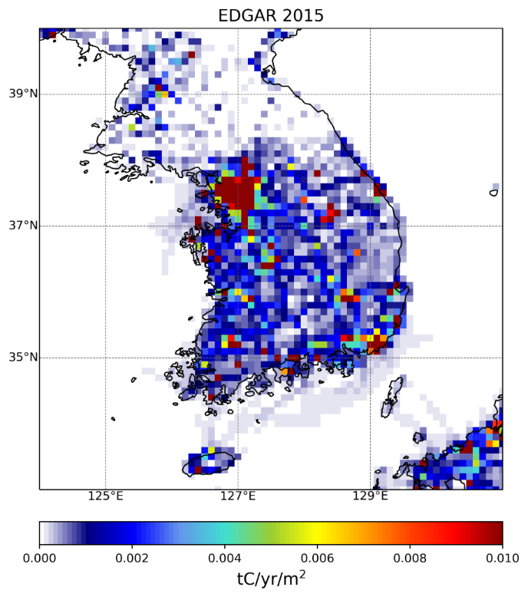
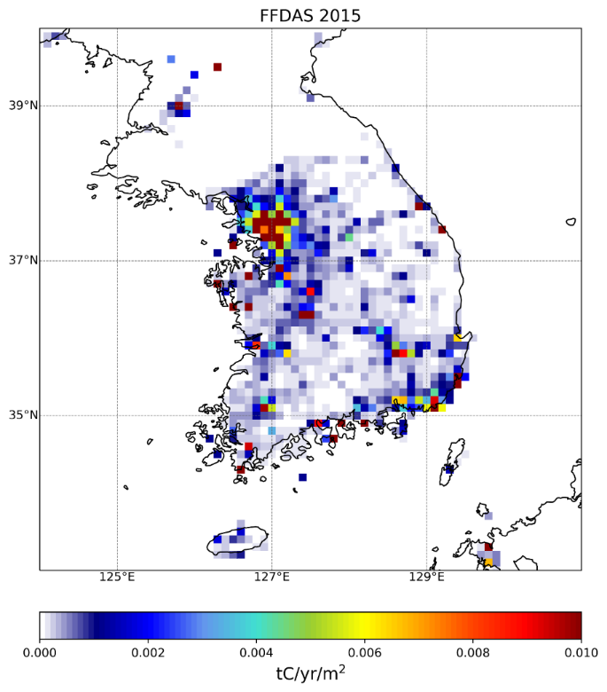
Fossil fuel emissions hotspots seen from inventories
1km x 1km
$0.1°×0.1°$
$0.1°×0.1°$
Open-Data Inventory for Anthropogenic Carbon dioxide (ODIAC) 2020B (Oda et al. 2019) https://db.cger.nies.go.jp/dataset/ODIAC/DL_odiac2020b.html
Emissions Database for Global Atmospheric Research (EDGAR) v7.0 https://edgar.jrc.ec.europa.eu/dataset_ghg70#p2
Fossil fuel data assimilation system (FFDAS) v2.0
https://ffdas.rc.nau.edu/About.html

Slide 8
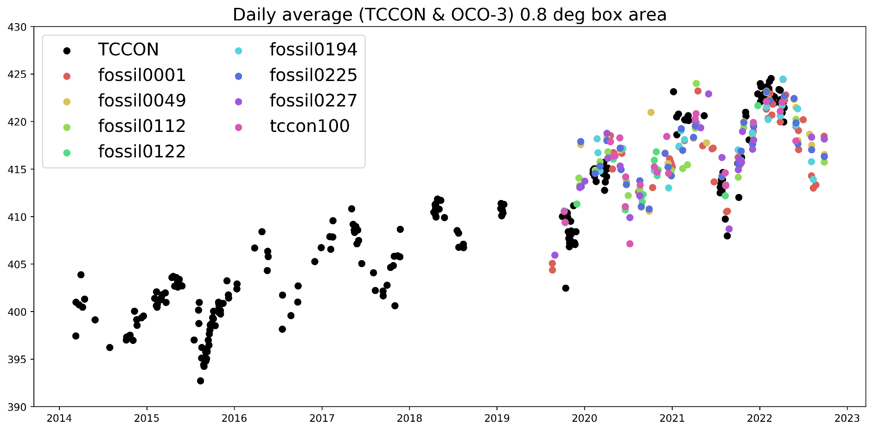
Daily mean XCO2 from 2014-2022
Column-averaged CO2 (ppm)

Slide 9
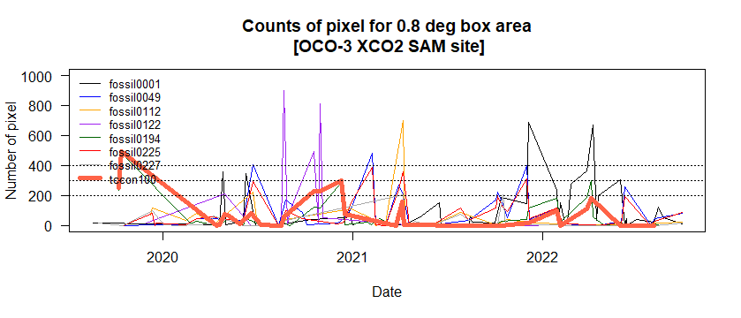
Select the case dates from OCO-3 L2
Calculate number of pixels for 0.5 and 0.8 degrees.
By visual inspection, identify the dates when data is evenly distributed within the SAMs

Slide 10
Different dXCO2 estimates depending on background value selection method

Slide 11
Methodology to quantify dXCO2 sensitivities with different background concentrations
Searching background values
from the 2 domains
FTS-XCO2 data is available
M2
NO
M3
Searching background values from the multi-hotspot areas
Yes
M4
M1
Searching background values by rotating satellite data along the main wind direction
Use daily or monthly
FTS-XCO2 data
Notes:
Thus, in such cases, we can alternatively determine the baseline values from the specific pixels of the single overpass.
In this study, we employed four methods to calculate CO2 enhancements and examined the sensitivities how these approaches in producing stable and reliable CO2 enhancements values.
(시간없으면 skip ; Method 1 is applied when in-situ ground XCO2 measurements are available. Method 2-4 are utilized when we can only rely on OCO-3 XCO2 retrievals.)
We are pleased to show results with supplementary materials during the discussion session.

Slide 12
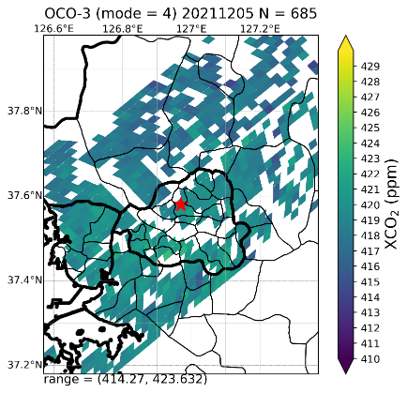
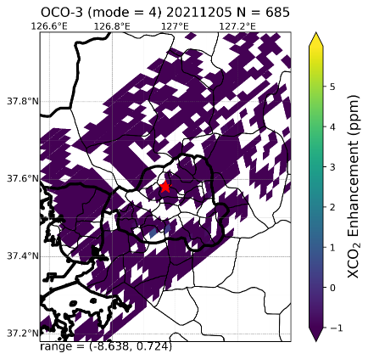
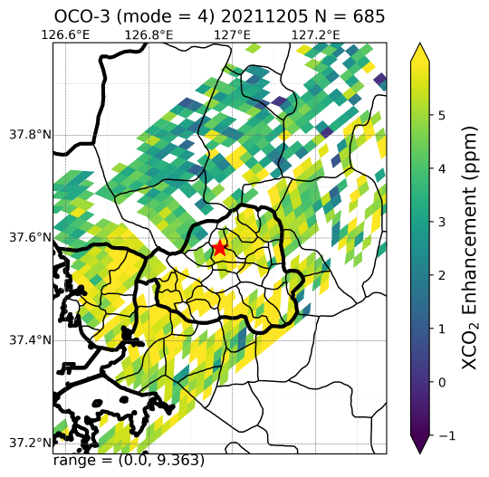
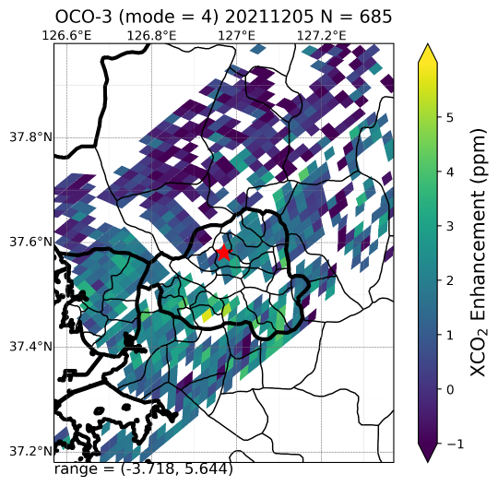
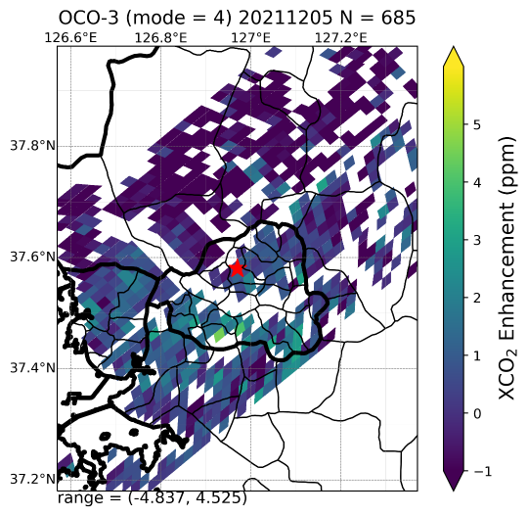
M1) Use FTS-XCO2 data as background values
XCO₂
XCO₂-AMY FTS
Domain 0.8⁰ x 0.8⁰
Fossil0001 Seoul
2021.12.05 03:37~03:39 UTC
422.9 ppm
414.3 ppm
418.0 ppm
417.1 ppm
419.0 ppm
XCO₂ - XCO_{2[min]}
XCO₂ - XCO_{2[1Q]}
XCO₂ - XCO_{2[med]}
XCO₂ - XCO_{2[mean]}

Slide 13
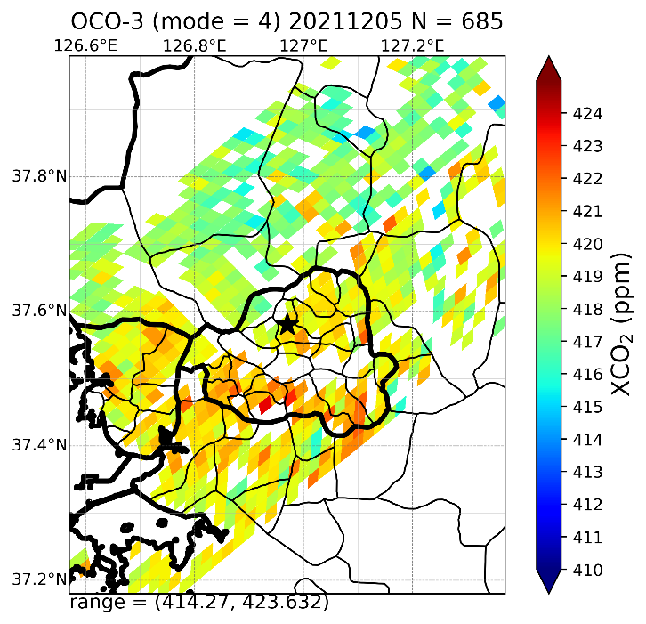
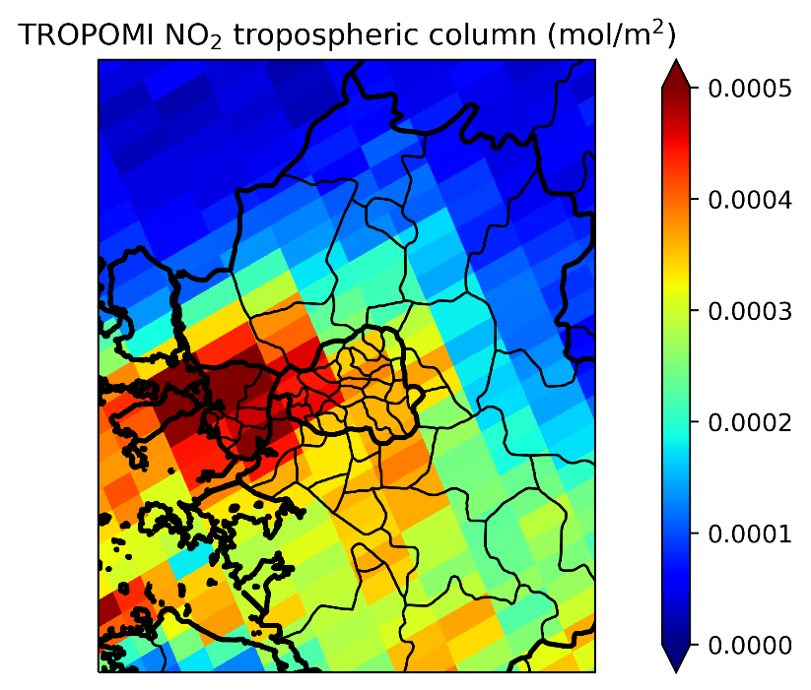
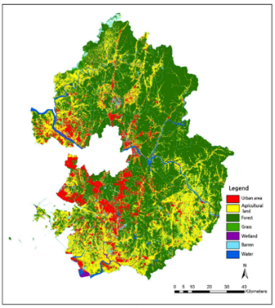
Forested area in northern Seoul shows low XCO2
XCO2 mean field
Tropospheric NO2
(TROPOMI)
Land cover type
(30m x 30m)
Kim et al. (2021, Land)
2018 Land cover map by the Environmental Geographic Information Service
Notes:
land cover paper: Kim J-H, Kwon O-S, Ra J-H. Urban Type Classification and Characteristic Analysis through Time-Series Environmental Changes for Land Use Management for 31 Satellite Cities around Seoul, South Korea. Land. 2021; 10(8):799. https://doi.org/10.3390/land10080799

Slide 14
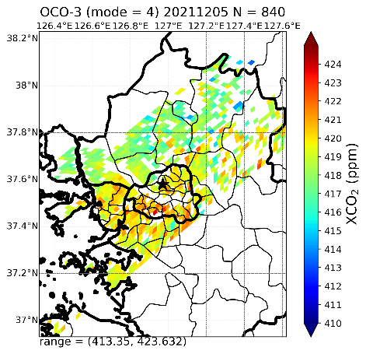
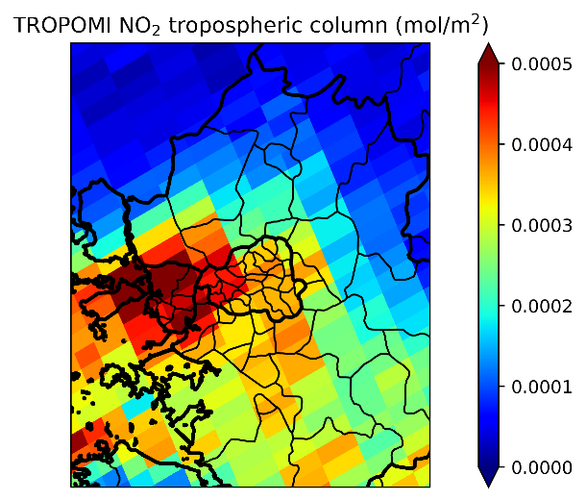
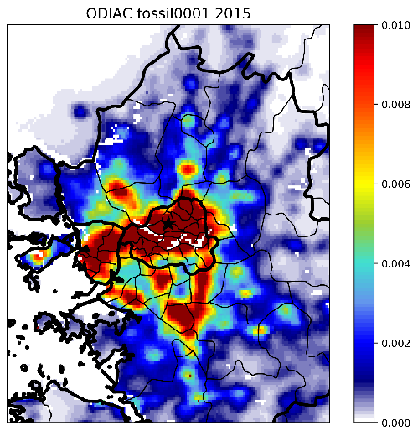
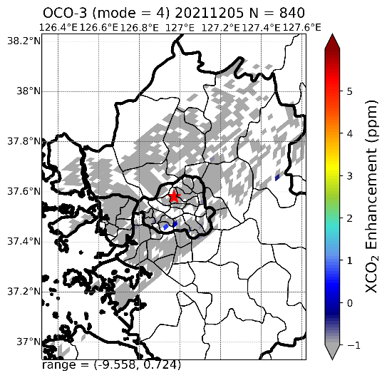
Negative dXCO2 is possible?
Case 2021.12.05 03:37~03:39 UTC (F0001)
1.3⁰ x 1.3⁰
XCO₂ mean field
XCO₂ - XCO_{2[min]}
If the background values is the minimum values within 1.3 deg. domain, most of pixels have dXCO2 < 0 → difficult to recognize enhancement hotspots

Slide 15
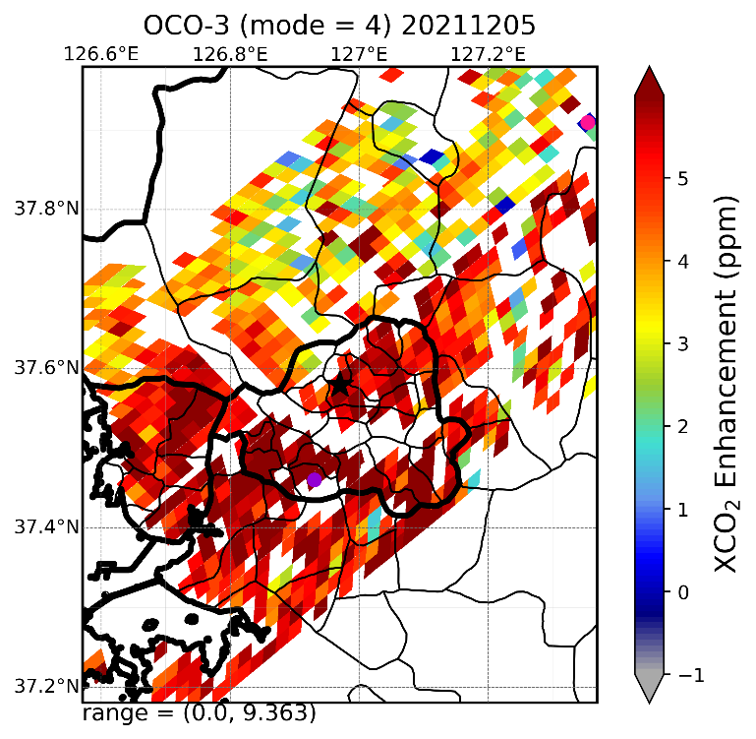
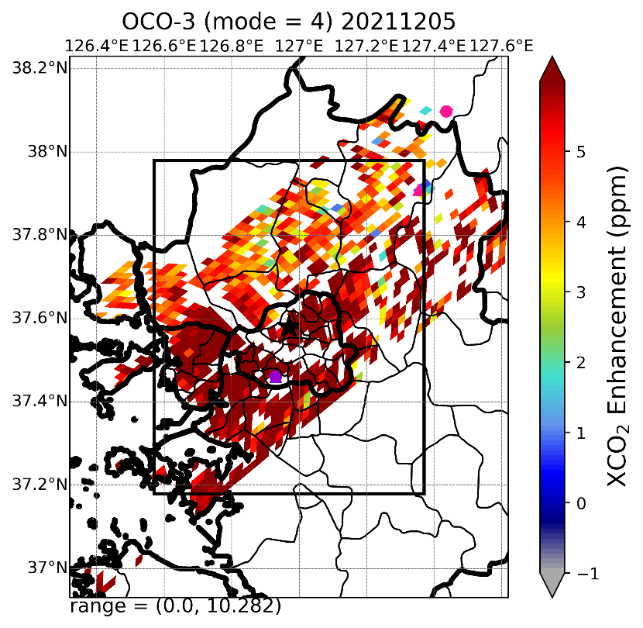
M2) Baseline values from 2 domains
Case 2021.12.05 03:37~03:39 UTC (F0001)
Inner box: 0.8⁰ x 0.8⁰
Outer box: 1.3⁰ x 1.3⁰
Min. location for 1.3⁰
Min. location for 0.8⁰
Max. location for 1.3⁰
Max. location for 0.8⁰
Take XCO2_{min} from outer box (1.3⁰) instead of values from inner box (0.8⁰) → no change in XCO2_{max}, but change in XCO2_{min} → ut marginal increased of dXCO2 range

Slide 16
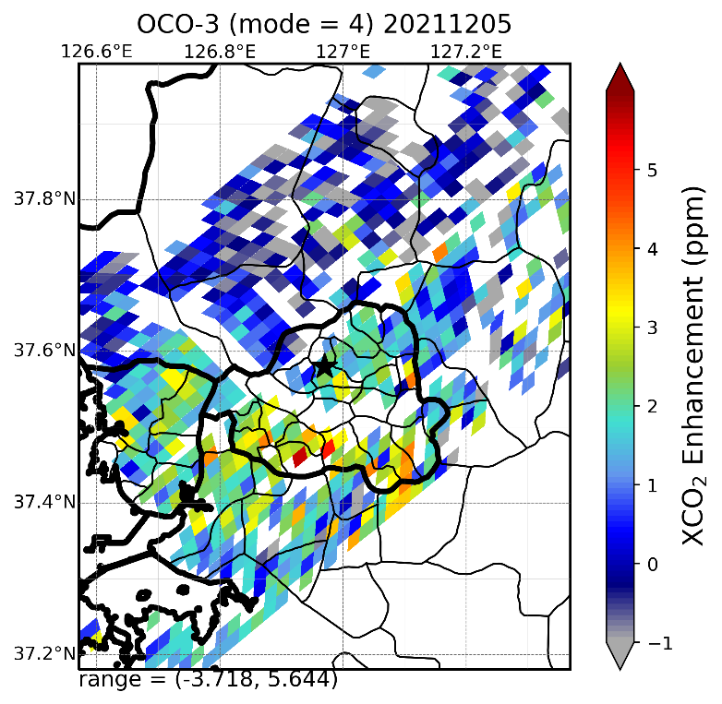
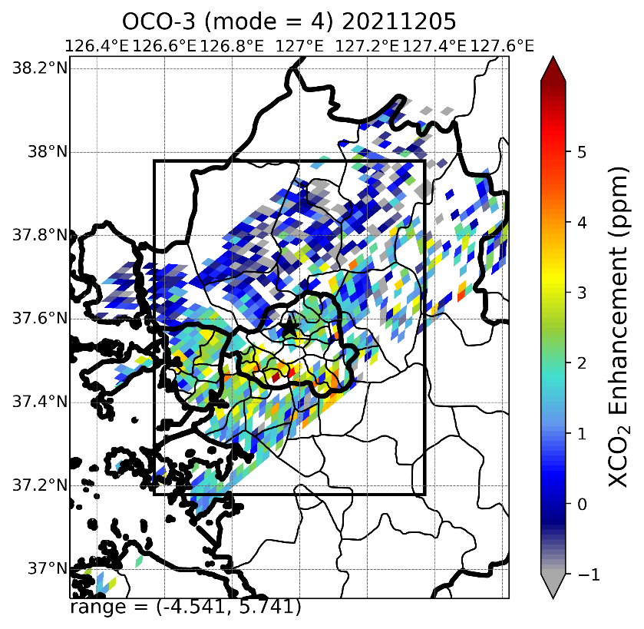
M2) Baseline values from 2 domains
Case 2021.12.05 03:37~03:39 UTC (F0001)
Inner box: 0.8⁰ x 0.8⁰
Outer box: 1.3⁰ x 1.3⁰
Take more realistic baseline values (1st quantile) than the previous slide
→ marginally reduced of dXCO2 range

Slide 17
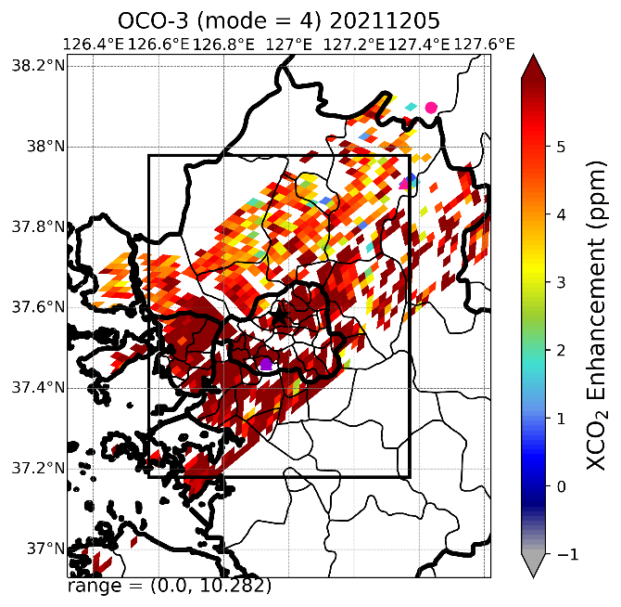
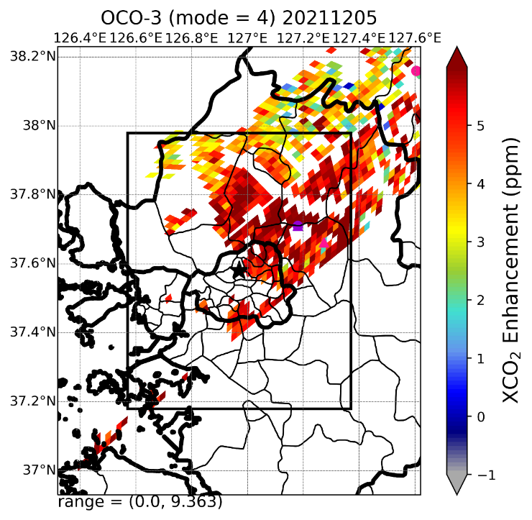
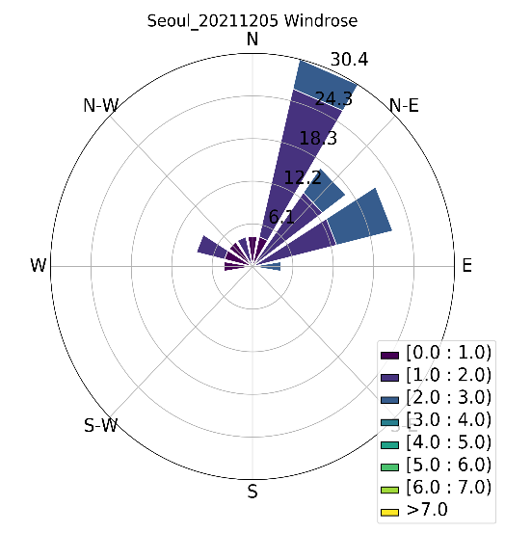
M3) Rotating data along the prevailing wind
Case 2021.12.05 03:37~03:39 UTC (F0001)
If prevailing wind direction is at 45$°$ and assume no transport XCO2 → upwind 0.25$°$ → marginal decrease of dXCO2

Slide 18
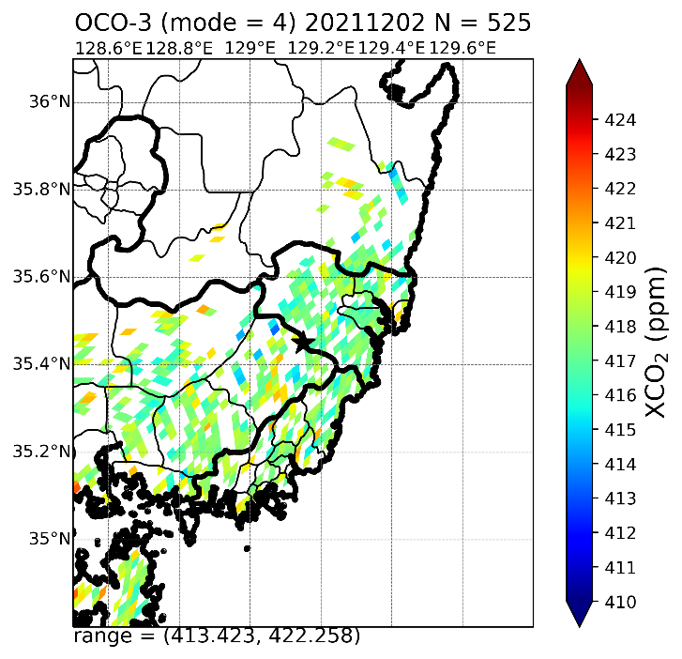
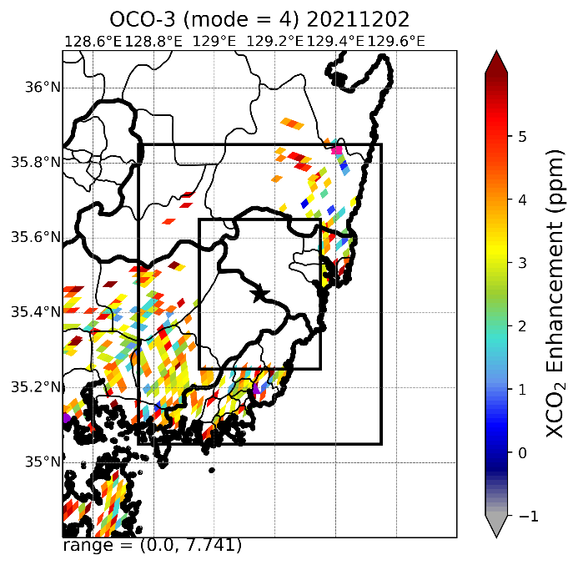
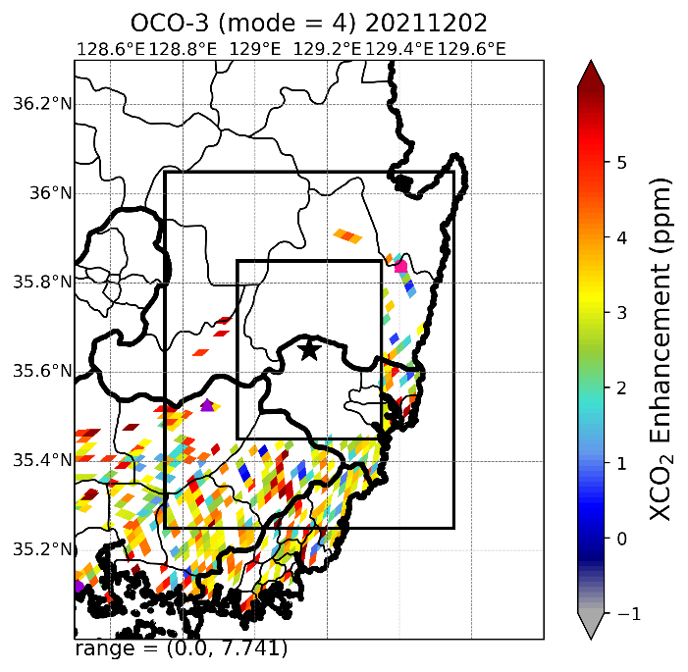
M4) Consider multi-hotspot area
Case 2021.12.02 04:22~04:24 UTC (Pusan & Ulsan)
Masking a box of 0.2 $°$ radius from the center
Pusan 35.45, 129.15
Ulsan 35.65, 129.15
Original SAMs locations at Pusan and Ulsan were only marginal (0.2 $°$) difference in latitude, thus it is difficult to recognize differerence in dXCO2

Slide 19
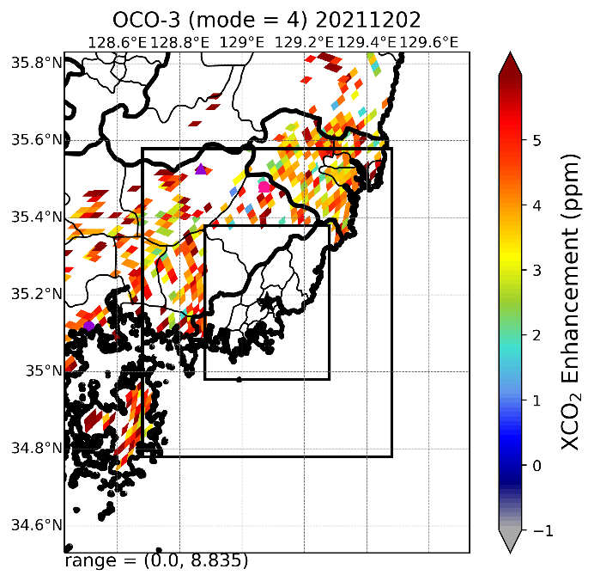
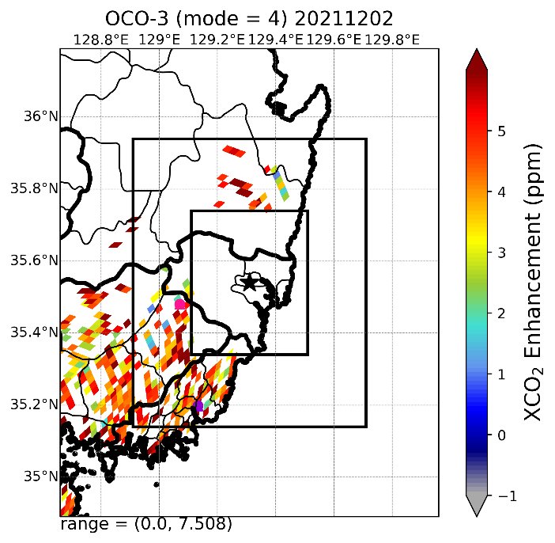
M4) Consider multi-hotspot area
Case 2021.12.02 04:22~04:24 UTC (Pusan & Ulsan)
Masking a box of 0.2 $°$ radius from the center
Pusan 35.18, 129.08
Ulsan 35.54, 129.31
Masking of emission hotspots in Pusan and Ulsan (both in city centre) instead of original SAMs locations --> reduced of 0.75 ppm dXCO2 range

Slide 20
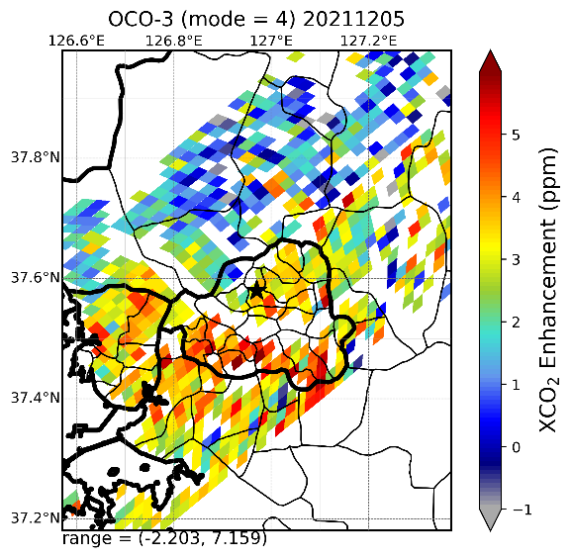
Only rely on OCO-3 data
Case 2021.12.05 03:37~03:39 UTC (F0001)
a)
b)
c)
d)
XCO₂ mean field
XCO₂ - XCO_{2[min]}
XCO₂ - XCO_{2[Q0.05]}
XCO₂ - XCO_{2[Q0.25]}
Different dXCO2 estimates depending on background value selection method
XCO₂ - XCO_{2[min]}
Notes:
그림설명) 2021.12.5 서울지역을 지나는 OCO3-Snapshot Area Maps (SAMs) Level 2 영상. SAMs 중심 위경도 좌표를 중심으로 0.4도 반경 영역에 대한 XCO2 자료의 공간분포. 까만별표 SAMs 영역 중심좌표
OCO3 operation mode is 4 (SAMs), 가로세로 0.8도상자 내의 총 픽셀수는 685개, XCO2 농도 범위는 최소 414.27, 최대 423.63ppm. 산림이 많은 서울북쪽(경기북부) XCO2농도가 서울과 경기이남지역보다 낮음
각픽셀 XCO2농도에서 0.8도 영역내 최소값을 빼서 계산한 dXCO2의 공간분포. 최소값을 갖는 픽셀이 몇개 없고 너무 낮은값이라 dXCO2가 9ppm 까지 나올 수 있음.
각픽셀 XCO2농도에서 0.8도 영역내 하위5% 농도값을 빼서 계산한 dXCO2의 공간분포. dXCO2 범위는 최소 -2.2 ~ 최대 7.2 ppm 임. 음수값을 가지는 픽셀은 거의 없음.
각픽셀 XCO2농도에서 0.8도 영역내 하위25% 농도값을 빼서 계산한 dXCO2의 공간분포. dXCO2 범위는 최소 -3.7 ~ 최대 5.4 ppm 임. 하위25% 값을 배경값으로 선택하면 c보다 음수dXCO2 영역이 늘어남

Slide 21
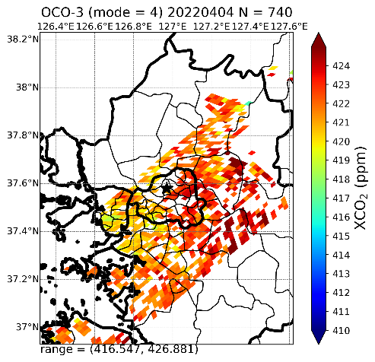
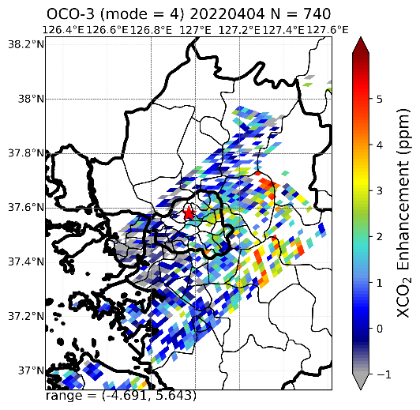
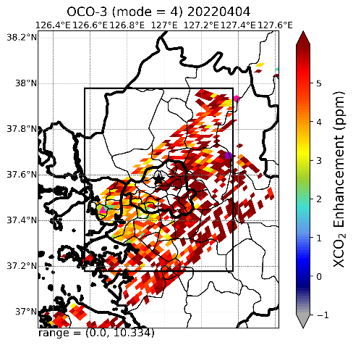
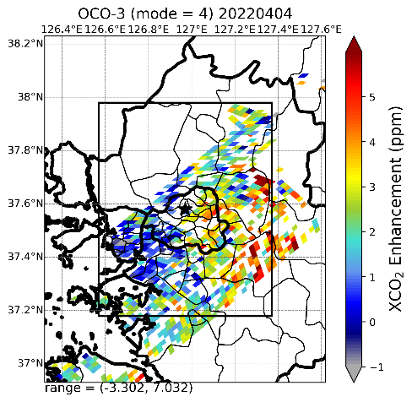
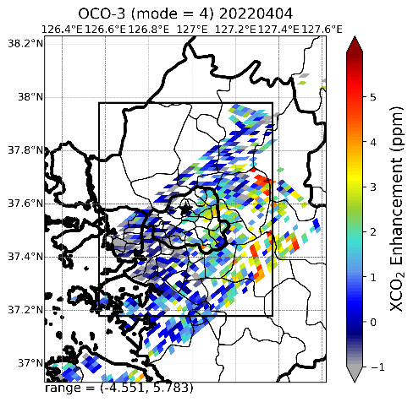
Only rely on OCO-3 data
Case 2022.04.04 04:05~04:06 UTC (F0001)
XCO3 mean filed
XCO2-XCO2_{FTS[mon]}
XCO2-XCO2_{FTS[min]}
XCO2-XCO2_{FTS[Q0.05]}
XCO2-XCO2_{FTS[Q0.25]}

Slide 22
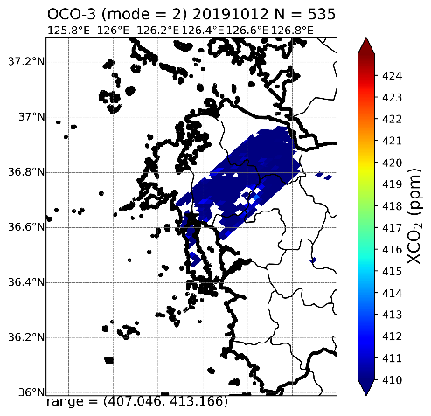
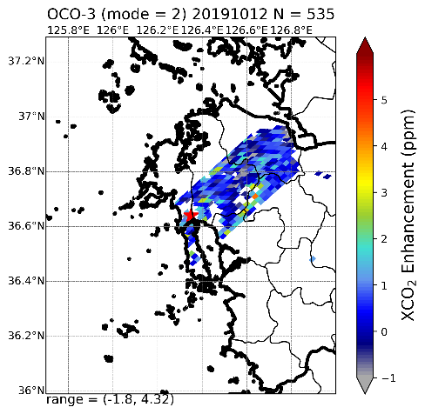
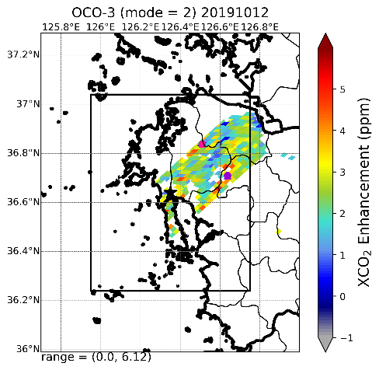
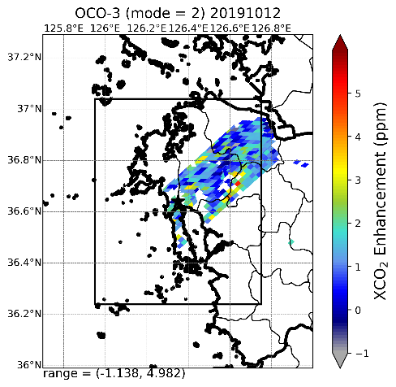
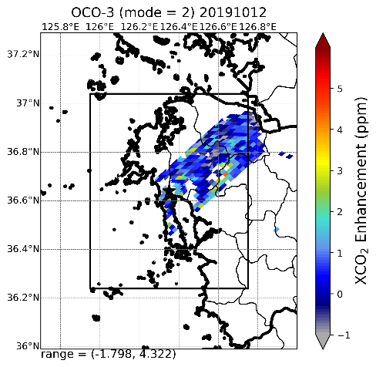
Only rely on OCO-3 data
Case 2019.10.12 01:57~01:58 UTC (TCCON100)
XCO2 mean filed
XCO2-XCO2_{FTS[mon]}
XCO2-XCO2_{FTS[min]}
XCO2-XCO2_{FTS[Q0.05]}
XCO2-XCO2_{FTS[Q0.25]}

Slide 23
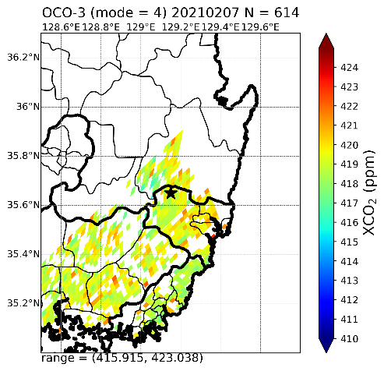
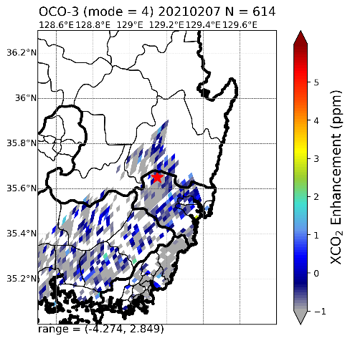
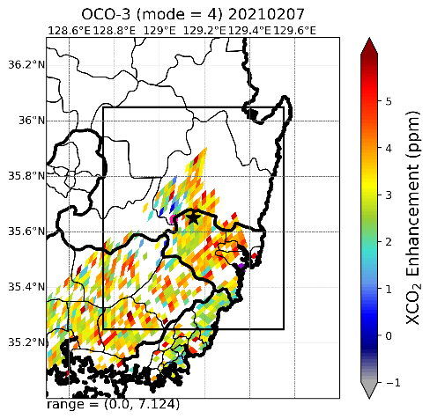
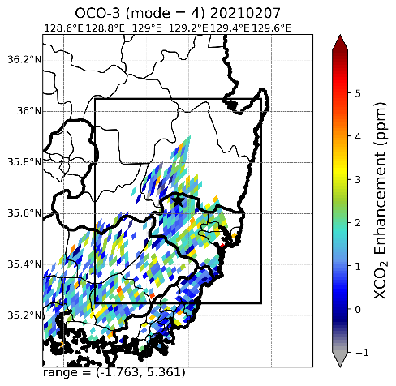
Only rely on OCO-3 data
Case 2021.12.02 04:22~04:24 UTC (Pusan & Ulsan)
XCO2 mean filed
XCO2-XCO2_{FTS[mon]}
XCO2-XCO2_{FTS[min]}
XCO2-XCO2_{FTS[Q0.05]}
XCO2-XCO2_{FTS[Q0.25]}

