Slide 1
Greenhouse Gases Validation and Monitoring over the East Asia by Satellite-based Observation
EGU 2023-11281(AS3.17 PICO 5.7)
Byung-il Lee, Eunha Sohn, Junhyung Heo, Youngsuk Oh, Sangwon Joo, Junyeob Choi, Hyein Park, Myunghee Lee, Yoonjae Kim
bilee01@korea.kr
April 26, 2023, NMSC/KMA

Slide 2
Introduction
Global Warming
Observation of Greenhouse Gases
Satellite- and ground-based GHGs
Display of GHGs
Validation of Greenhouse Gases
Spatial & temporal distribution
Analysis of Greenhouse Gases
Spatial & temporal distribution
Summary

Slide 3
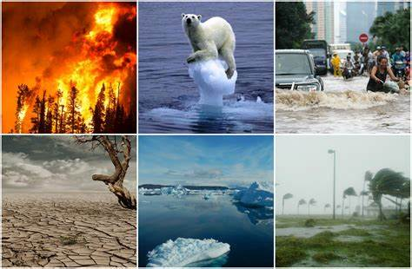
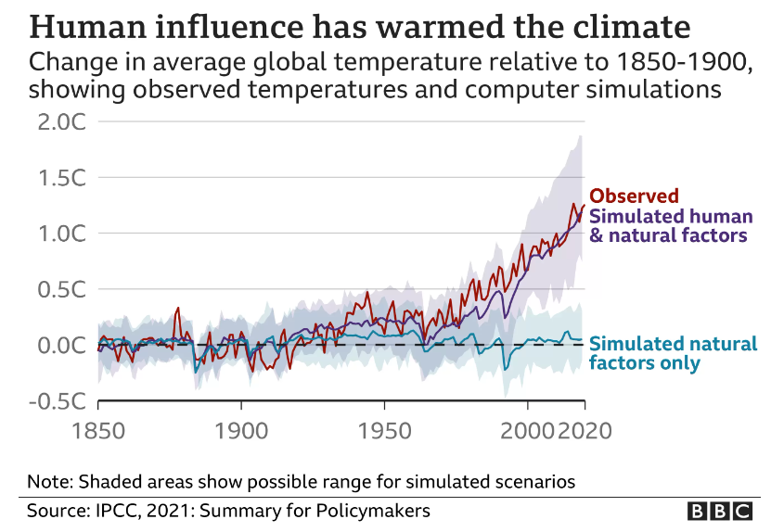
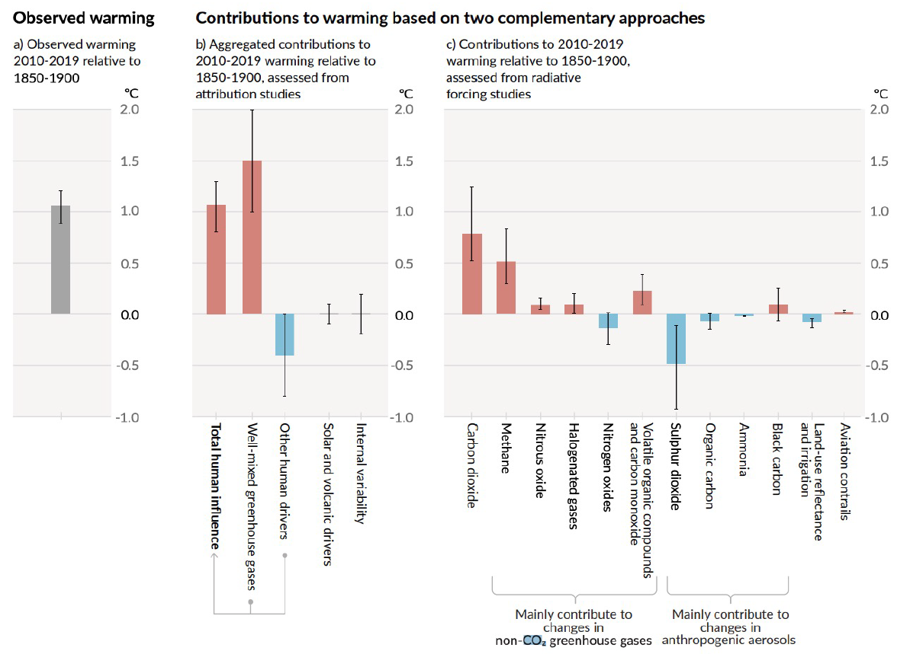
Introduction
Human influence has warmed climate
The concentration of GHGs has increased about 20% since pre-industrial revolution (IPCC, 2021)
  South Korea Declared to be Net-zero country: Reducing 40% of national greenhouse gas emissions compared to 2018” (2030 NDC*) by 2030
  ➔ The NMSC/KMA began monitoring GHGs using satellite data to monitor climate change and support government police.
[Download from google]
[Download from google]
[GHG Monitoring from Space, Joint report by the Group on Earth Observations (GEO), Climate TRACE and the World Geospatial Industry Council (WGIC), Nov2021]

Slide 4
Monitoring of Greenhouse Gas
Satellite Data
Greenhouse Gas: CO₂, CH₄, O₃
GHGs | Satellite/Senor | Periods | Spatial Resolution | Temporal Resolution | Source
Carbon Dioxide (CO2) | OCO2 | 2014. 9. ~ Current | 2.25 X 1.29 km | Global/1Month | NASA Earth Data
 | OCO3(ISS) | 2019. 8. ~ Current | 2.25 X 1.29 km | Global/1month
 | GOSAT/TANSO-FTS | 2009. 4. ~ 2022. 11. | 10.5 X 10.5 km | Global/3Days | NIES
 | GOSAT2/TANSO2-FTS2 | 2019. 3. ~ 2022. 11. | 10.5 X 10.5 km | Global/2Days | NIES
Methane (CH4) | METOP-B/IASI | 2013. 02. 01 ~ 2021. 01. 31 | 4 x 12 km | Global/3Days | IASI Portal
 | GOSAT/TANSO-FTS | 2019. 4. ~ 2022. 10. | 10 X 10 km | Global/3Days | NIES
 | GOSAT2/TANSO2-FTS2 | 2019. 3. ~ 2022. 11. | 10.5 X 10.5 km | Global/3Days | NIES
Ozone (O3) | METOP-B/IASI | 2020. 1.1 ~ Current | 4 x 12 km | Global/2Days | IASI Portal
 | METOP-C/IASI | 2019. 12. 4 ~ Current | 4 x 12 km | Global/2Days
 | METOP-B/GOME2 | 2022. 03. 01 ~ Current | 40 x 80 km | Global/3Days | ACSAF
 | METOP-C/GOME2 | 2022. 03. 01 ~ Current | 40 x 80 km | Global/3Days
 | SNPP/OMPS | 2017. 07. 01 ~ Current | 15 x 25 km | Global/4Days | NASA Earth Data
 | SENTINEL5p/TROPOMI | Ver. 1: 2019. 08. 06 ~ 2020. 07. 12 Ver. 2: 2020. 07. 13 ~ Current | 7 x 7 km | Global/1Day | COPERNICUS Projects

Slide 5
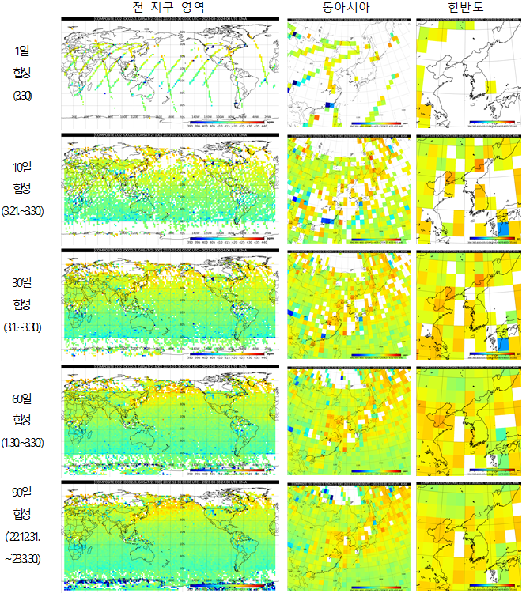
Monitoring of Greenhouse Gas
Data Collection & Analysis
Global
East Asia
Korea
NMSC/KMA is using satellite data to monitor climate change and support the government's achievement of net zero countries.
  CO2: OCO2/OCO, OCO3/OCO, GOSAT/FTS, GOSAT2/FTS2
  CH4: GOSAT/FTS, GOSAT2/FTS2
  O3: Sentinel-5p/TROPOMI, Metop/IASI, Metop/GOME2, SNPP/OMPS
  Sources: NASA, NIES, ACSAF and IASI website.
1 day
Composited
10 days
Composited
30 days
Composited
60 days
Composited
90 days
Composited

Slide 6
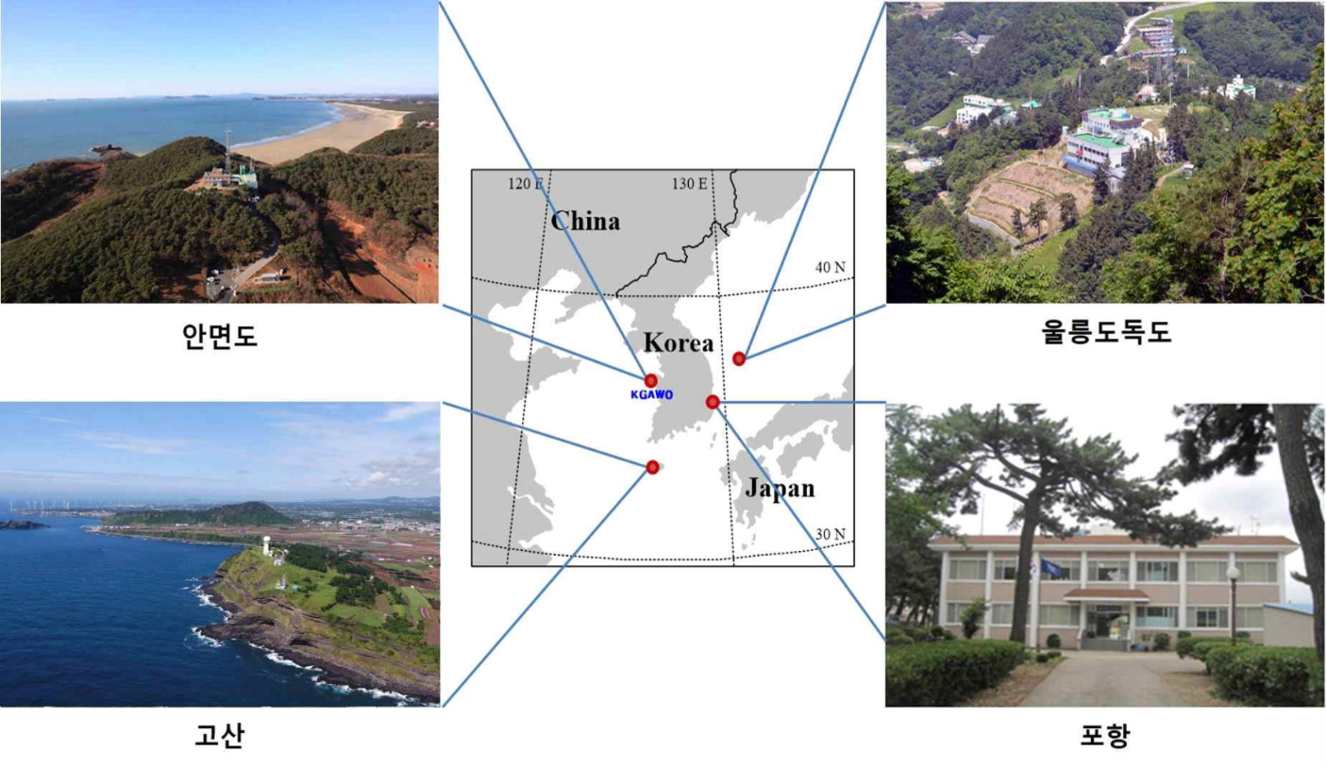
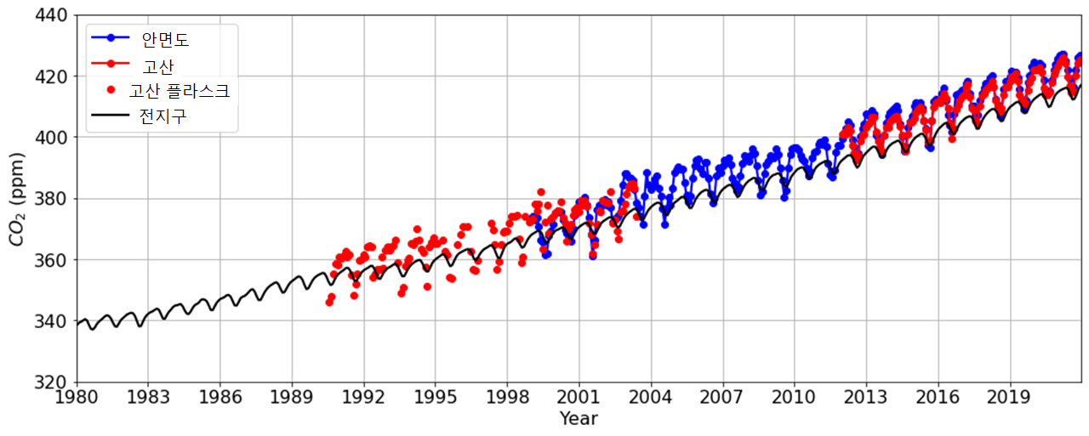
Monitoring of Greenhouse Gas
Operate 4 regional GAW sites in South Korea
In-situ: CO₂, CH₄, O₃ ….
Observe 37 kinds of air pollutants or GHGs and quality control of the data according to international standards and then shared domestically and internationally.
Anmyeondo
Ulleungdo/Dokdo
Gosan, Jeju
Pohang
< Average for 2021(ppm) >
(Global Average:414.7)
* Anmyeno(AMY): 423.1 * Gosan(JGS): 421.5
* Ulrungdo(ULD): 420.8 * Dockdo(DOK): 419.6
All four stations are higher than the global average CO₂
The difference between Korea's CO₂ and the global average concentration has increased significantly in the last 10 years.

Slide 7
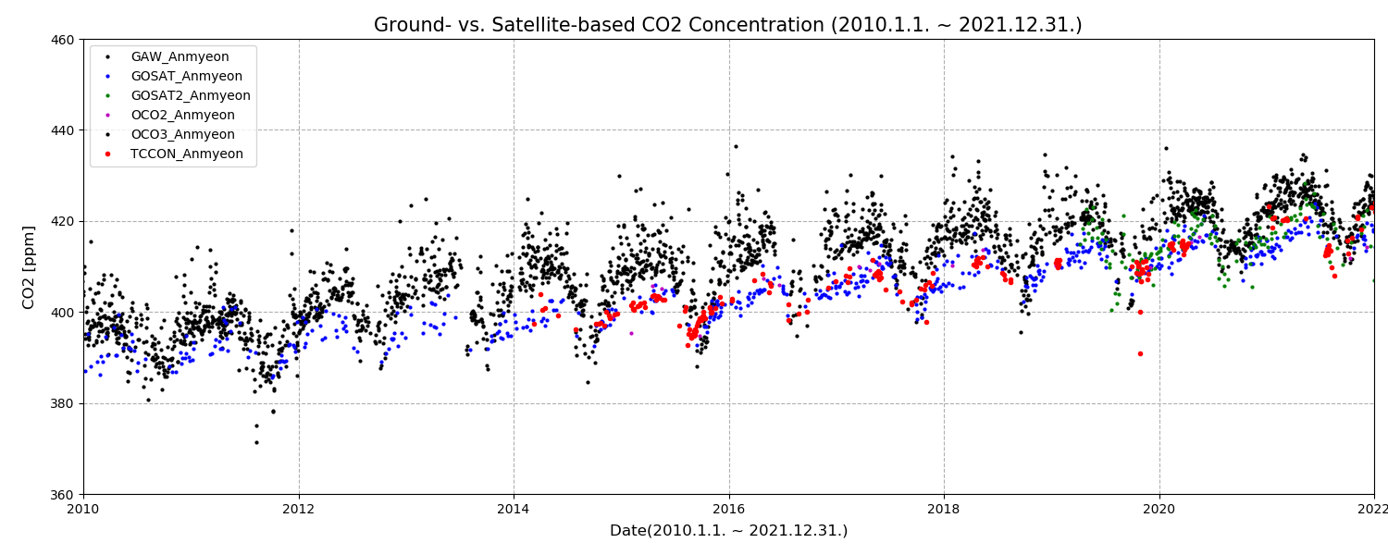
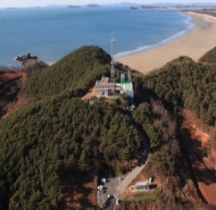

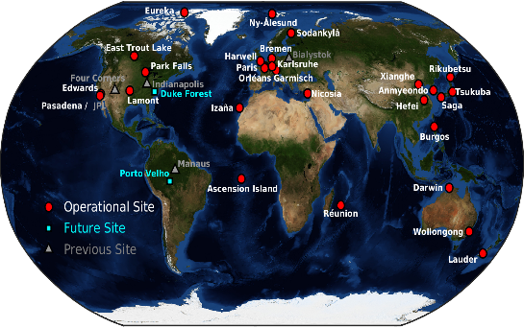
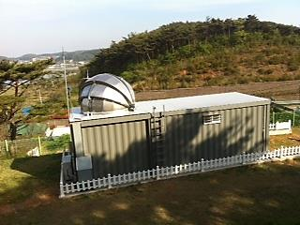
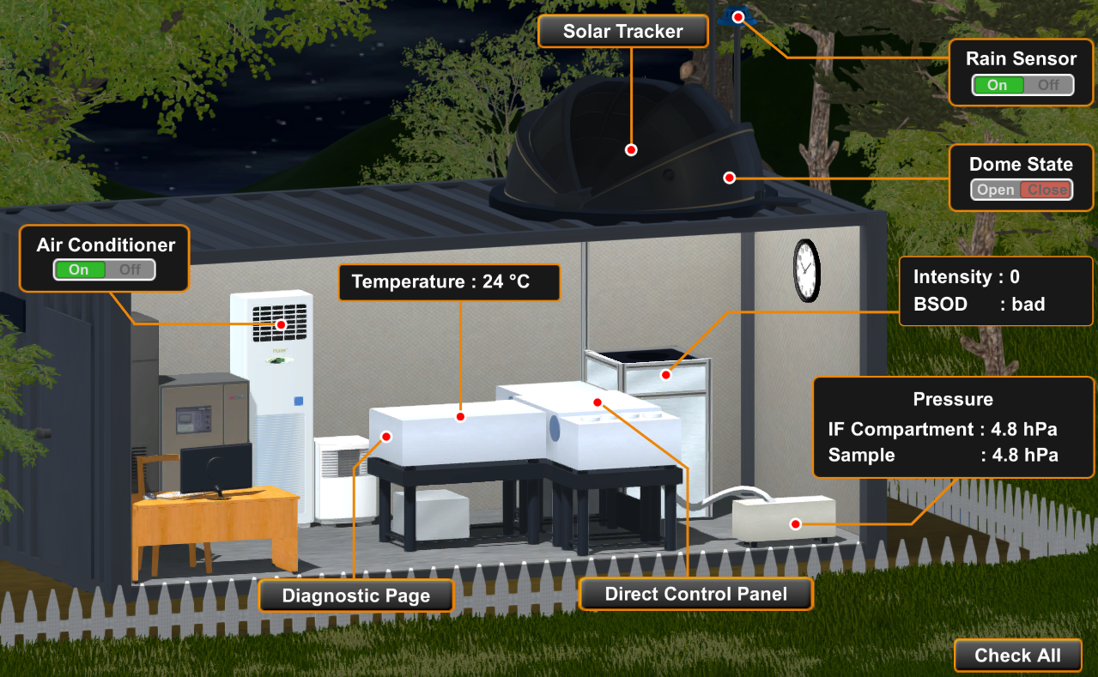
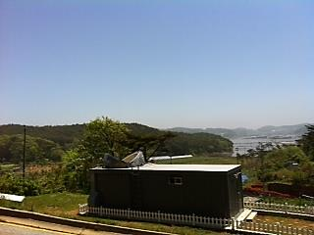
Validation of GHGs
Comparison with GAW(in situ) and TCCON
NMSC/KMA has validated the satellite derived GHGs with CO2 observed in situ and retrieved TCCON (Total Carbon Column Observing Network) in Anmyeon, South Korea.
  KMA operate 4 regional GAW sites(Anmyeondo, Gosan, Pohang, Ulleungdo/Dokdo).
    GAW(CRDS(Cavity Ring Down Spectroscopy), 1999.1.~2021.12.), TCCON(FTS, 2014.1.~2022.10.)
Ground- and satellite-based CO2 shows good agreement in their increasing trends with seasonal variations from 2010 to 2021.
<Time series of CO2 concentration (2010 ~ 2021, Anmyeon)>
<TCCON in Anmyeon site>
Anmyeondo
GAW
N₂O
CH₄
CO
TCCON
HDO
CO₂
FTS
H₂O
HF
FTS laboratory
https://tccon-wiki.caltech.edu

Slide 8
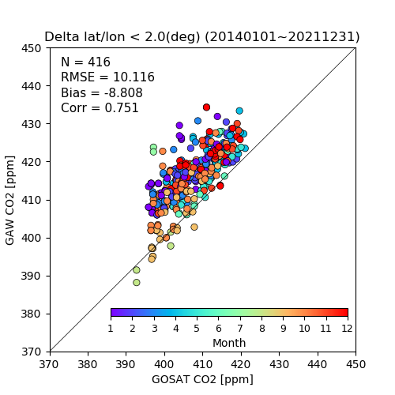
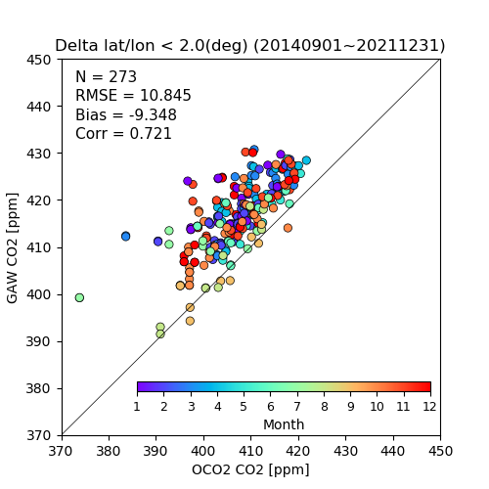
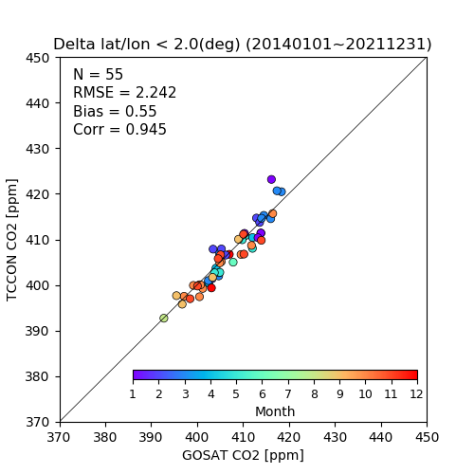
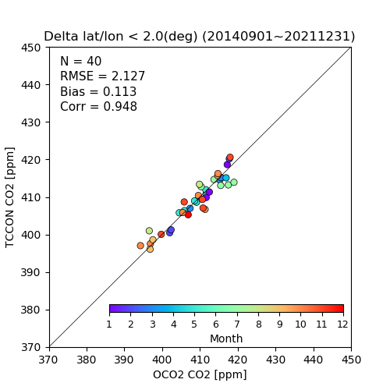
Validation of satellite-based GHGs
Comparison with GAW(in situ) and TCCON
Scatter plot of Ground- & satellite-based daily mean CO2 concentration
  The concentrations of CO2 observed by GOSAT and OCO2 were, on average, 8.8 ppm and 9.3 ppm lower than those of the ground-based one, respectively. the CO2 emitted or transported by various sources on the ground remains in the lower atmosphere, so there is a difference in concentration.
GOSAT vs. GAW
OCO2 vs. GAW
GOSAT vs. TCCON
OCO2 vs. TCCON

Slide 9
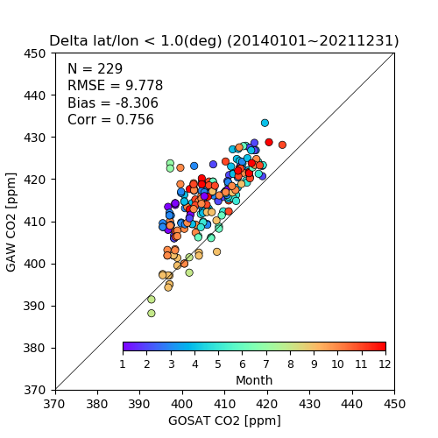
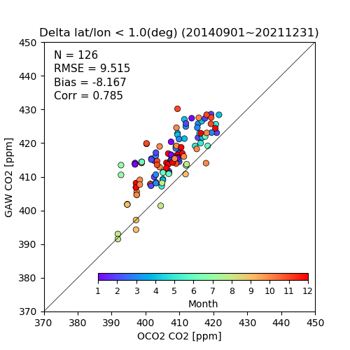
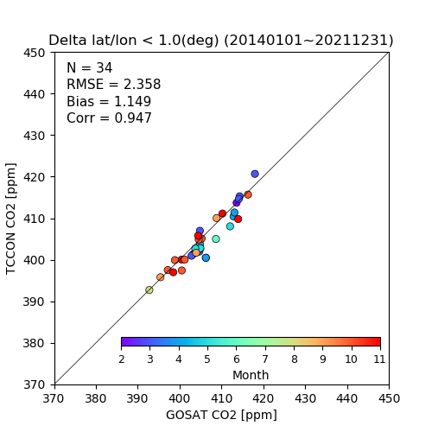
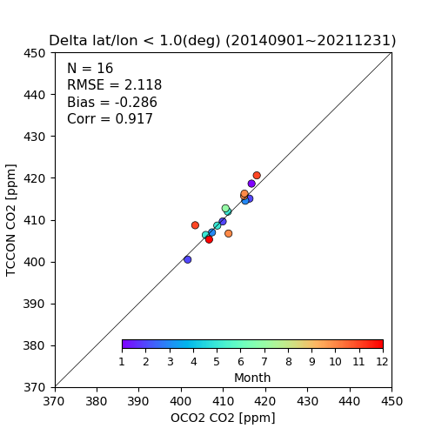
Validation of satellite-based GHGs
Comparison with GAW(in situ) and TCCON
Scatter plot of Ground- & satellite-based daily mean CO2 concentration
  The concentrations of CO2 observed by GOSAT and OCO2 were, on average, 8.3 ppm and 8.1 ppm lower than those of the ground-based one, respectively. the CO2 emitted or transported by various sources on the ground remains in the lower atmosphere, so there is a difference in concentration.
GOSAT vs. GAW
OCO2 vs. GAW
GOSAT vs. TCCON
OCO2 vs. TCCON

Slide 10
Validation of satellite-based GHGs
Comparison with GAW(in situ) and TCCON
 | OCO2 vs. GAW |  |  |  | GOSAT vs. GAW
 | N | RMSD | BIAS | Corr | N | RMSD | BIAS | Corr
2.50deg | 368 | 10.304 | -9.024 | 0.774 | 429 | 10.069 | -8.779 | 0.769
2.00deg | 273 | 10.845 | -9.348 | 0.721 | 416 | 10.116 | -8.8.8 | 0.751
1.50deg | 214 | 10.072 | -8.704 | 0.770 | 305 | 9.959 | -8.557 | 0.750
1.00deg | 126 | 9.515 | -8.167 | 0.785 | 229 | 9.778 | -8.306 | 0.756
0.50deg | 36 | 10.303 | -9.095 | 0.703 | 192 | 9.537 | -8.100 | 0.741
0.25deg | 24 | 11.372 | -10.121 | 0.598 | 112 | 9.245 | -8.094 | 0.759
2.50deg | 44 | 2.368 | 0.129 | 0.936 | 55 | 2.210 | 0.503 | 0.946
2.00deg | 40 | 2.127 | 0.113 | 0.948 | 55 | 2.242 | 0.550 | 0.945
1.50deg | 28 | 1.867 | 0.090 | 0.948 | 40 | 1.960 | 0.729 | 0.961
1.00deg | 16 | 2.118 | -0.286 | 0.917 | 34 | 2.358 | 1.149 | 0.947
0.50deg | 9 | 2.052 | 0.238 | 0.943 | 30 | 2.401 | 1.311 | 0.947
0.25deg | 6 | 2.931 | -0.366 | 0.8559 | 14 | 1.594 | -0.058 | 0.972

Slide 11
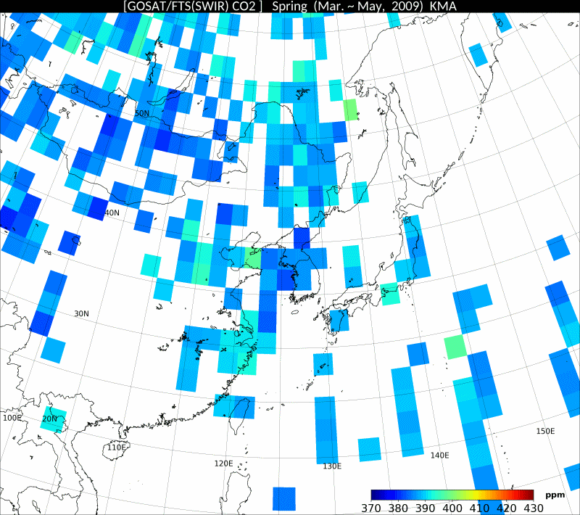
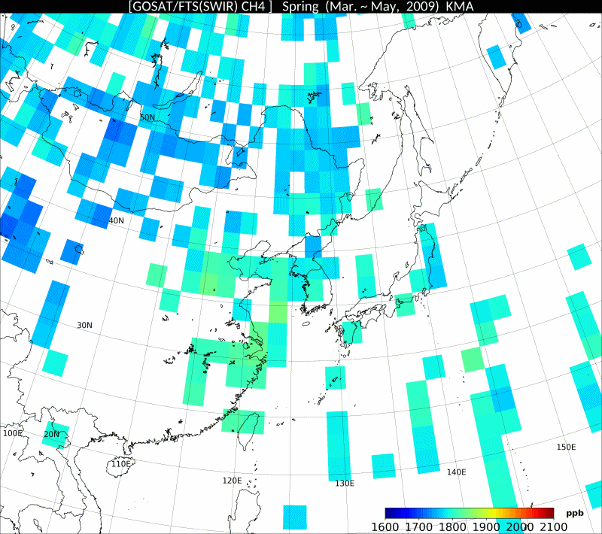
Spatial and temporal distribution of Greenhouse Gas
Spatial distribution and variability of GHGs by GOSAT
2009~2022 Spring East Asia CO2, CH4 Concentration Change (GOSAT/TANSO-FTS)
Daily data(10km * 10km) ➔ Season(Spring, March~May) Average (100km* 100km)
CO2 (393ppm ➔ 422ppm)
CH4 (1803ppb ➔ 1901ppb)
Raw data: https://data2.gosat.nies.go.jp/index_en.html

Slide 12
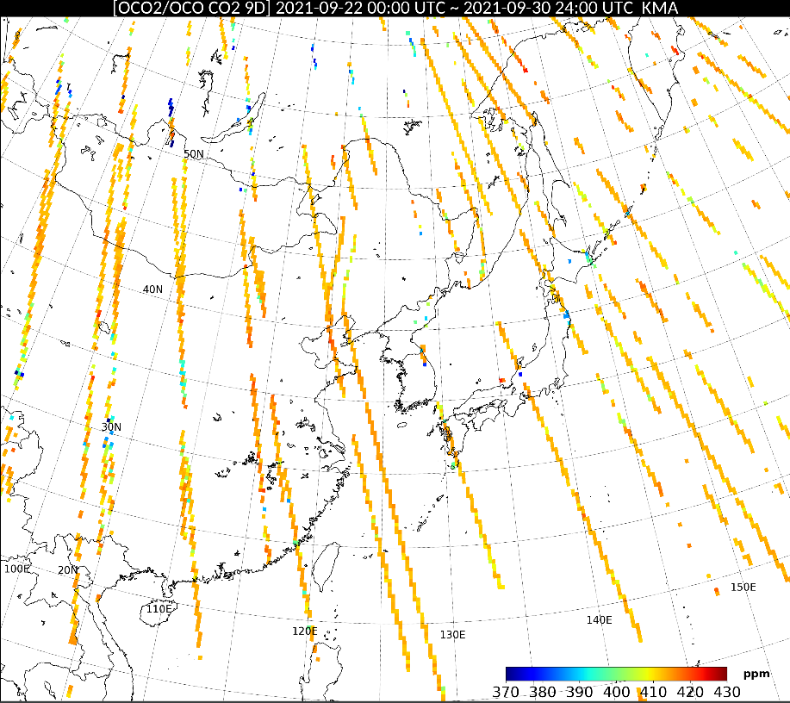
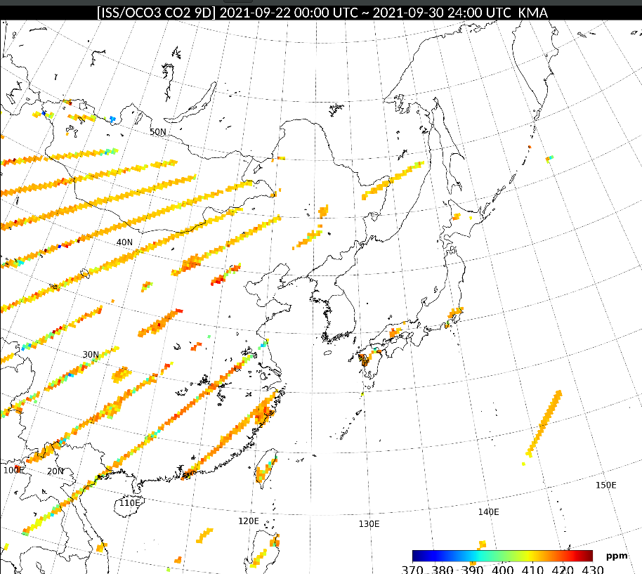
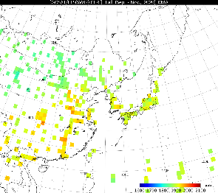
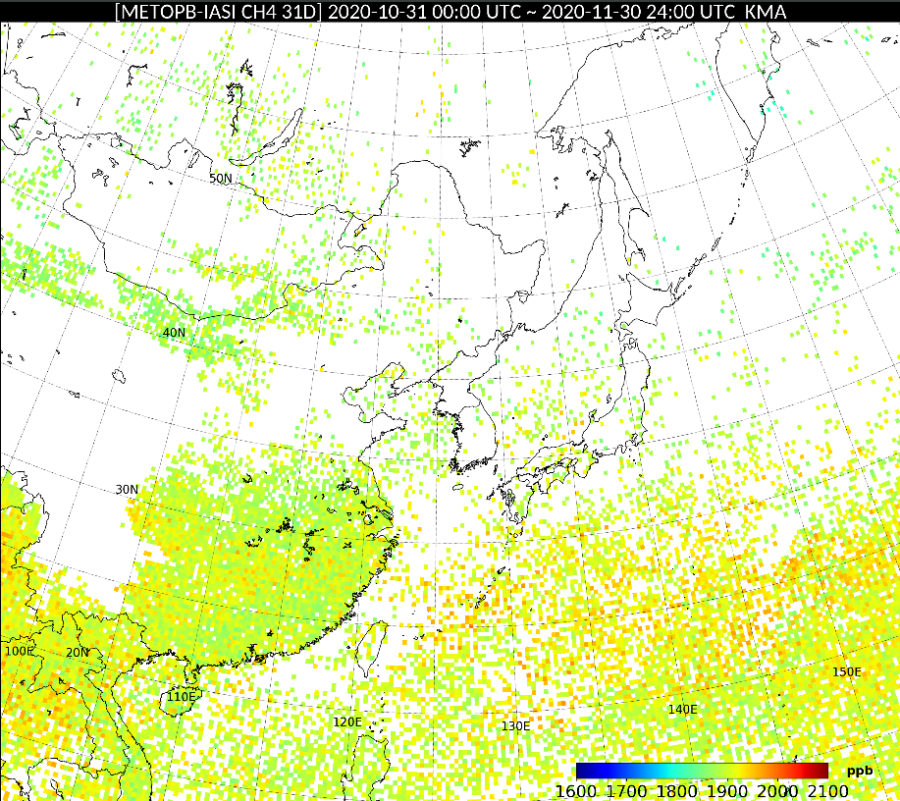
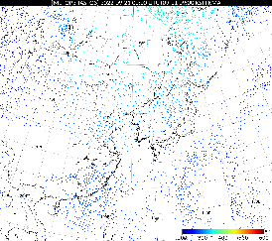
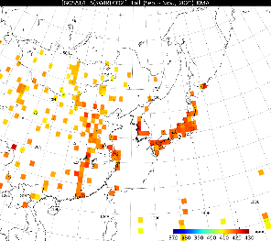
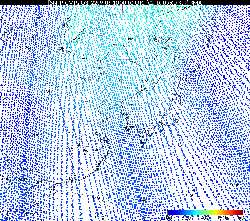
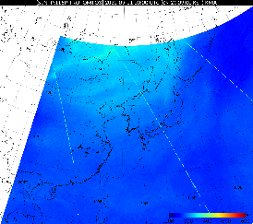
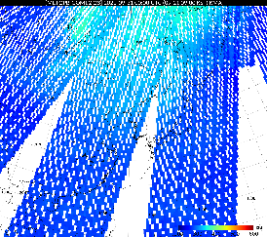
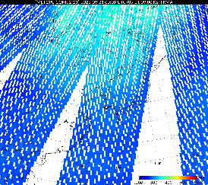
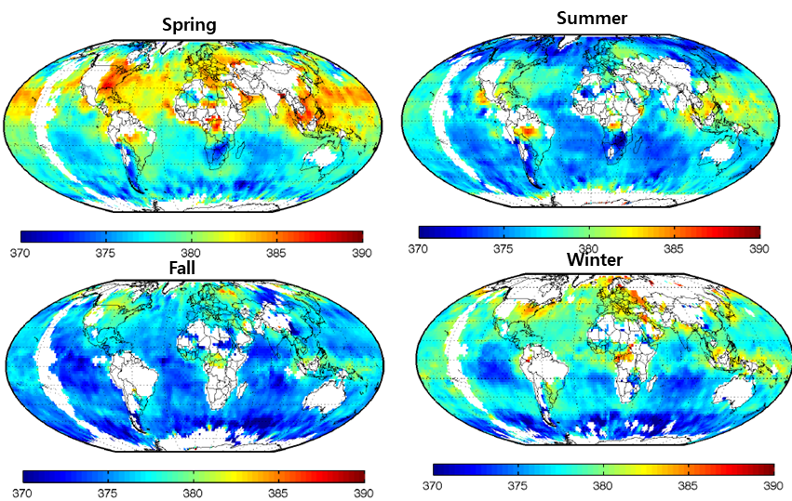
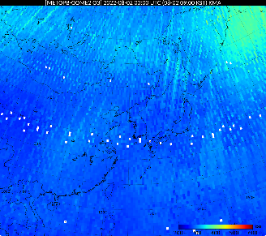
Spatial and temporal distribution of Greenhouse Gas
Weighted composition using accuracy of each satellite
Carbon Dioxide(CO2)
Methane(CH4)
Ozone(O3)
OCO2
OCO3
GOSAT
MetopB/IASI
MetopB/IASI
GOSAT2
MetopC/IASI
GOSAT
GOSAT2
SNPP/OMPS
S5P/TROPOMI
MetopB/GOME2
MetopC/GOME2
Month/Season
Season, day/night
Daily/Weekly
IASI CH4, RAL Space ATBD, 2021
출처: Imbiriba et al., 2010, AIRS Science Team Meeting

Slide 13
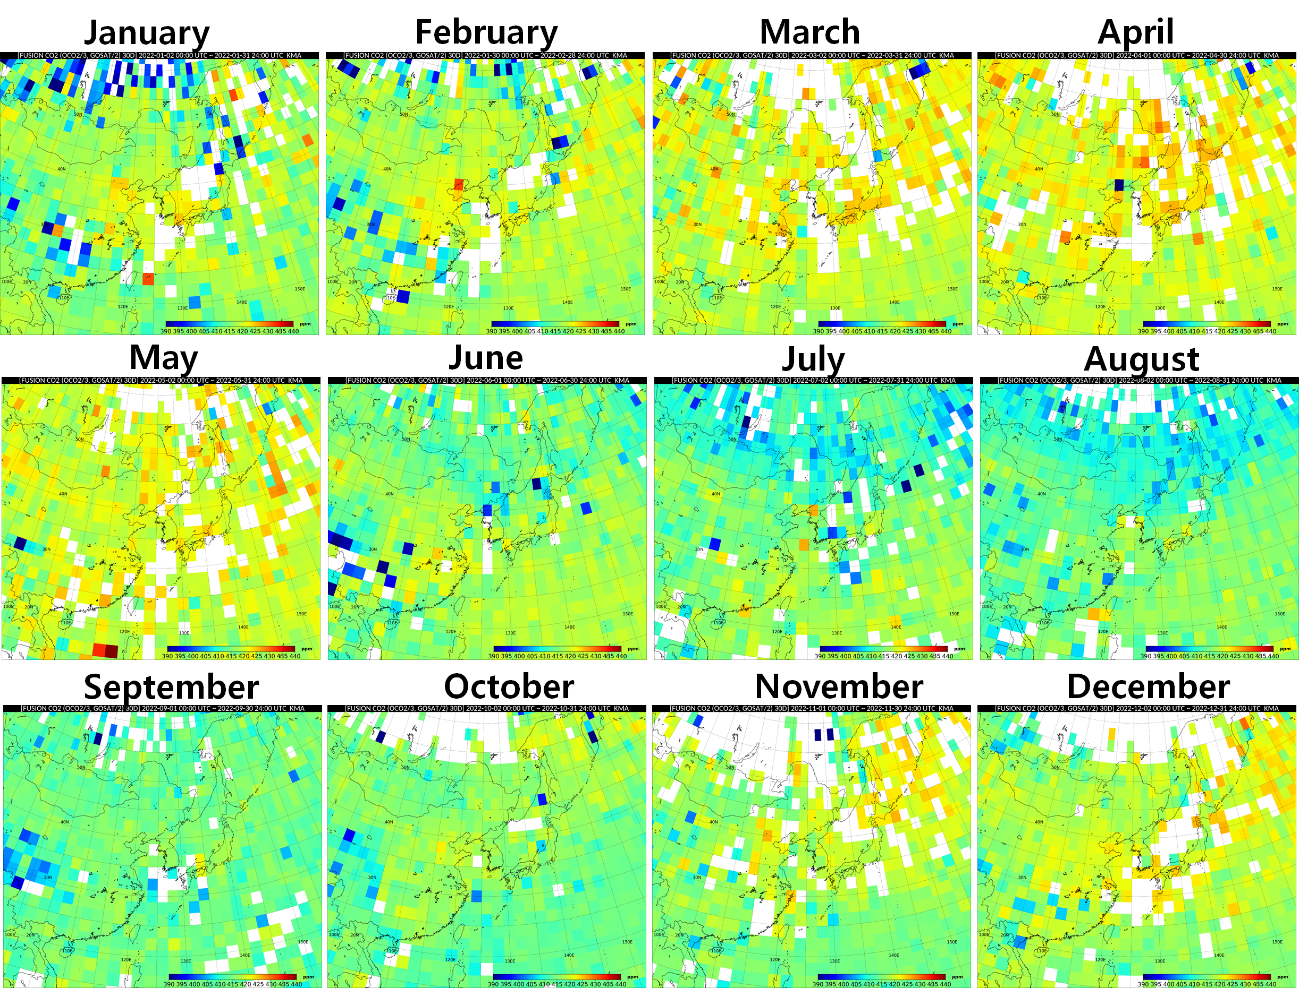
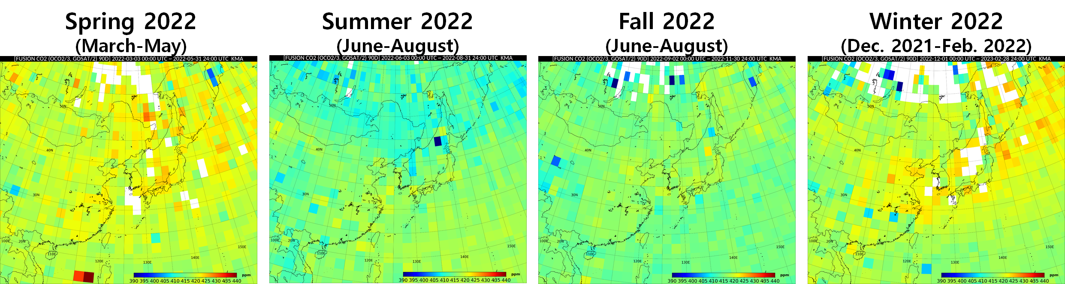
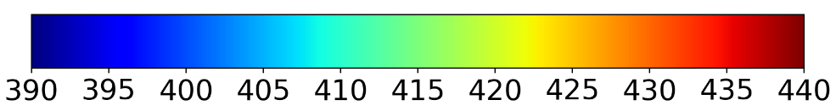
Spatial and temporal distribution of Greenhouse Gas
Composited: GOSAT, GOSAT2, OCO2, OCO3
The CO2 concentrations in East Asia are highest in April and lowest in July.
Could be inferred…
  The CO2 from heating during winter season might be accumulated in the atmosphere
  and the concentration of CO2 is decreased as the vegetation begins to grow
<Monthly variation of CO2 in 2022>
<Seasonal variation of CO2 in 2022>

Slide 14
Summary
KMA has begun to collect and analyze GHGs using satellite data to monitor climate change and support the government's achievement of net zero countries.
  Data: (CO2) OCO2/OCO, OCO3/OCO, GOSAT/FTS, GOSAT2/FTS2, (O3) Sentinel-5p/TROPOMI, Metop/IASI, Metop/GOME2, SNPP/OMPS
  Validation: GAW(in situ) and retrieved TCCON
Ground-based and satellite-based CO2 showed a good agreement in their increasing trends with seasonal variations.
The concentrations of CO2 observed by GOSAT and OCO2 satellites were
  8.8 ppm and 9.3 ppm lower than those of the ground-based one, respectively, but the correlations were higher than 0.75 and 0.72.
  The correlation coefficient shows 0.95, and the RMSD is less than 1ppm between the satellite and TCCON, which observes the total column for 2.0 × 2.0 degrees in spatial resolution on a daily time scale from January 2014 to December 2021.
  ➔ The CO2 emitted or transported by various sources on the ground remains near the lower atmosphere, so it appears to have a higher concentration in situ measurement.
The monthly averaged CO2 in 2022, composited using four satellites, GOSAT, GOSAT2, OCO2, and OCO3 shows that CO2 concentrations in East Asia are highest in April and lowest in July.
  Therefore, it can be inferred that vegetation begins to grow from May and absorb CO2 maximally in July and August, so the CO2 concentration is minimum in July to August.
  Further analysis is needed, for example, correlation between CO2 concentration and SIF(solar-induced fluorescenc).

Slide 15
Thank you!!

