Slide 1
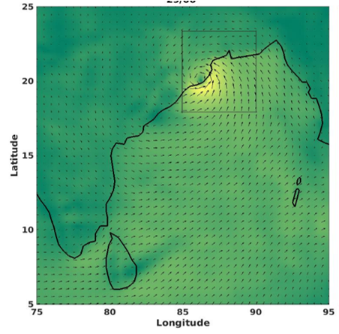
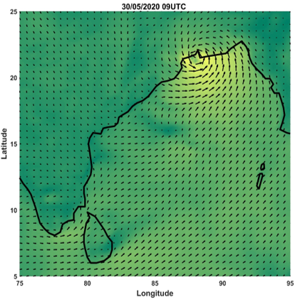
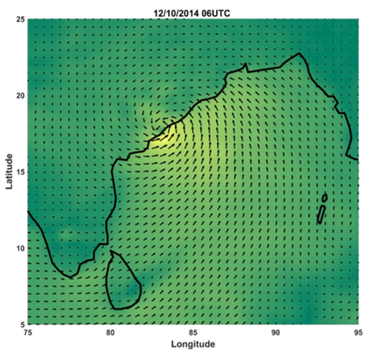
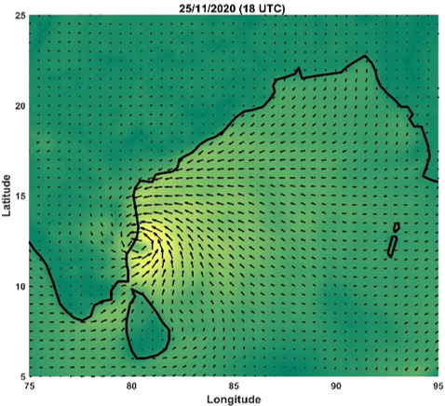
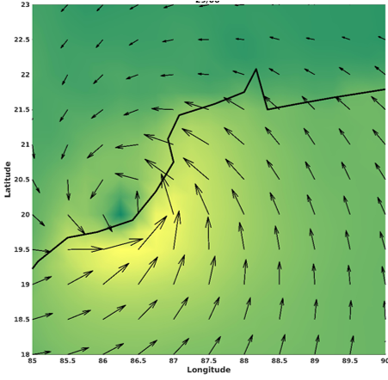
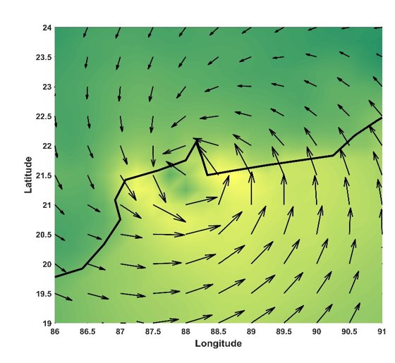
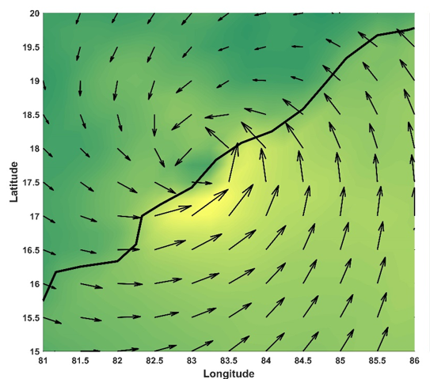
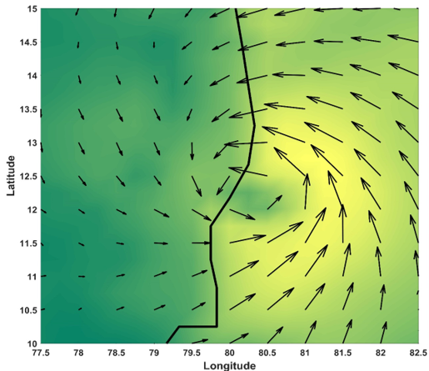
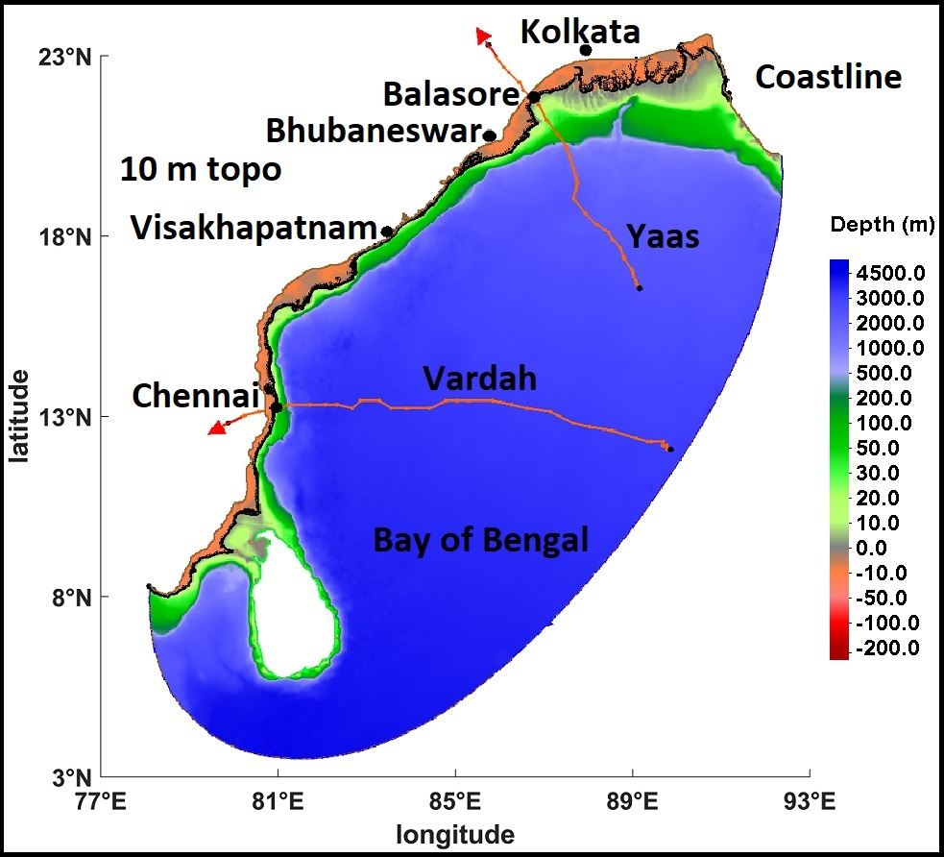
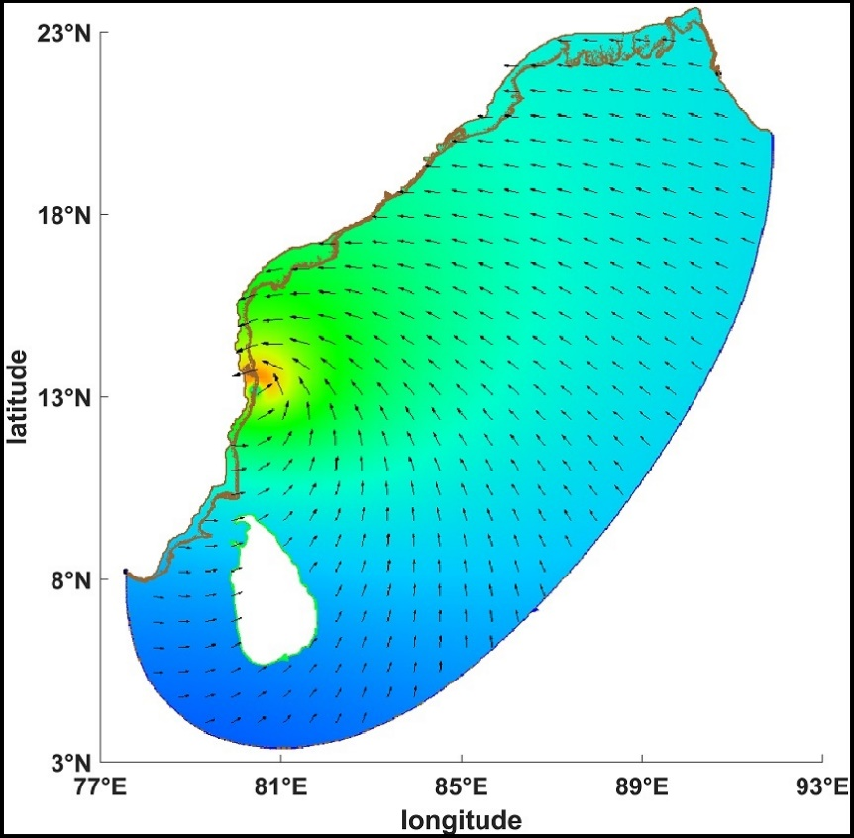
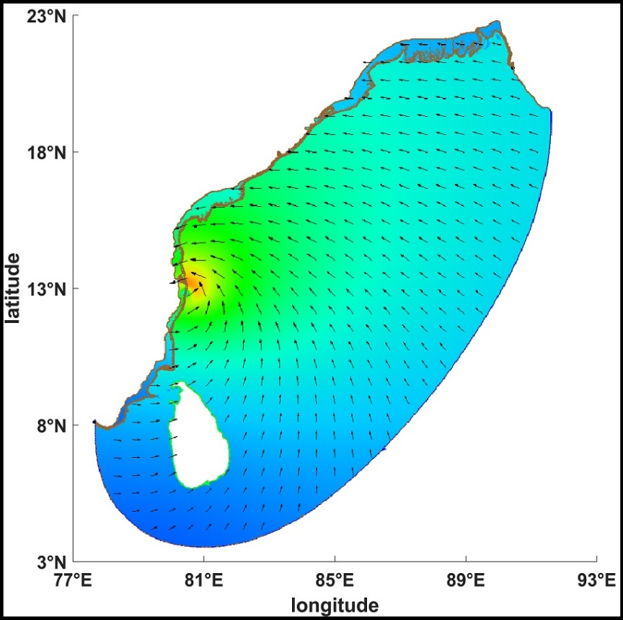
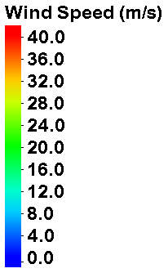
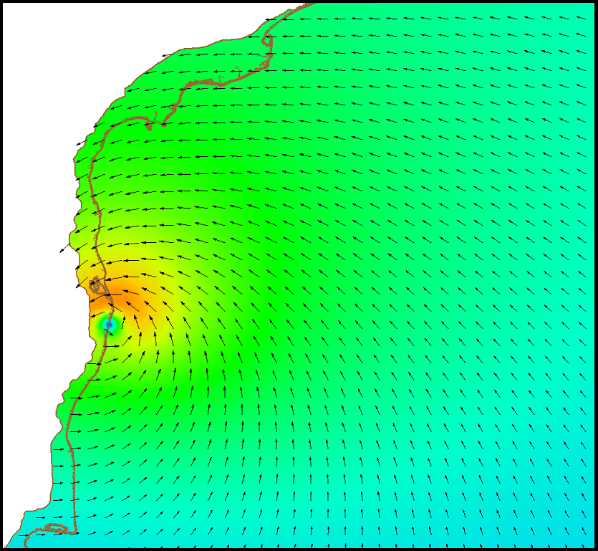
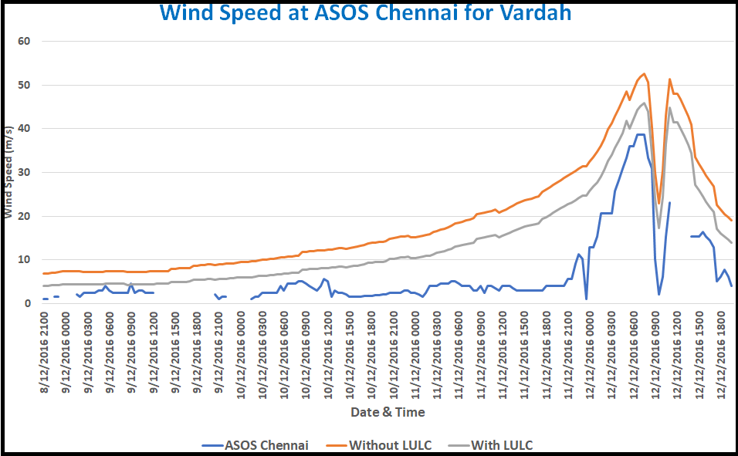
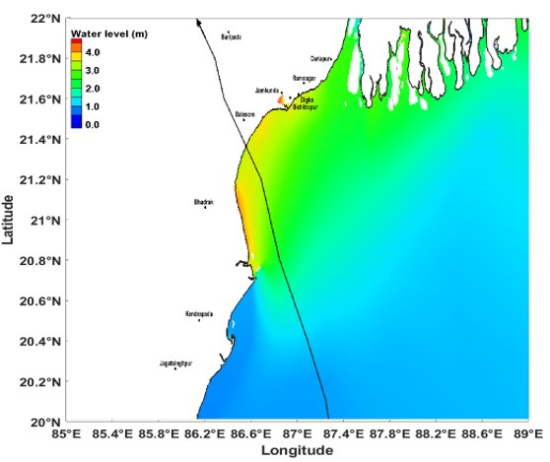
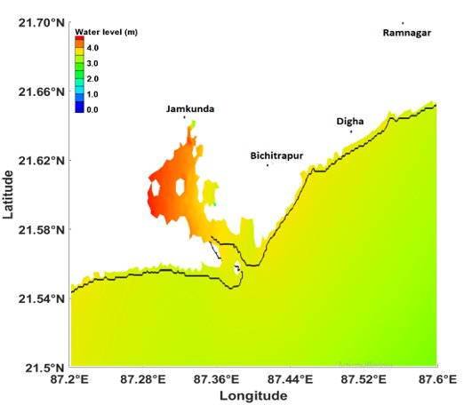
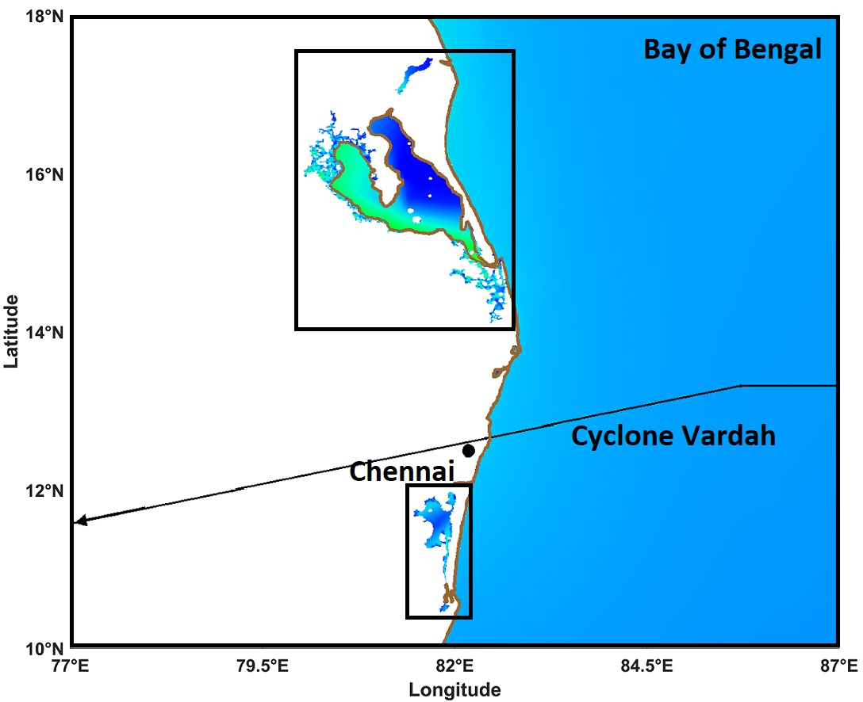
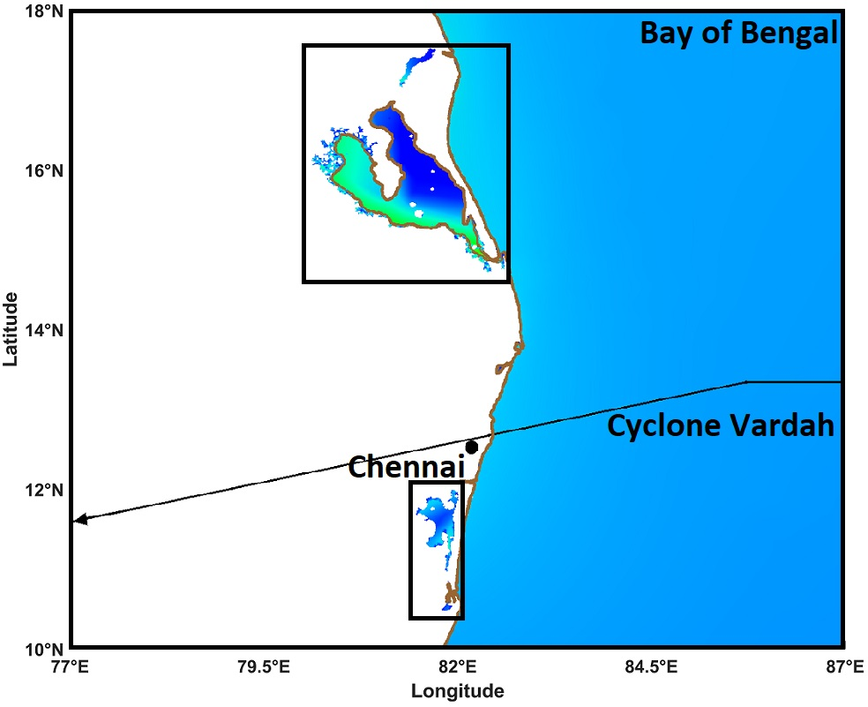
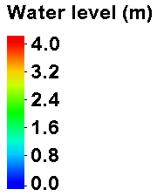
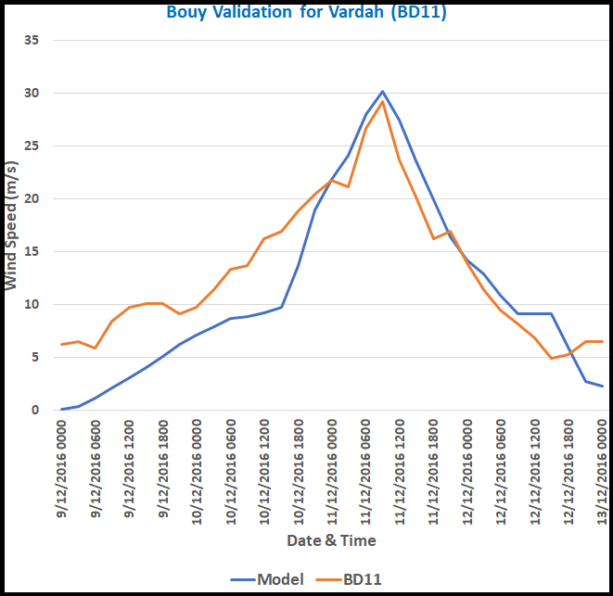
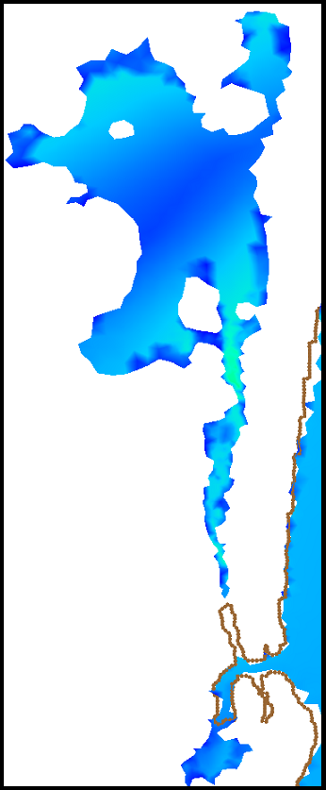
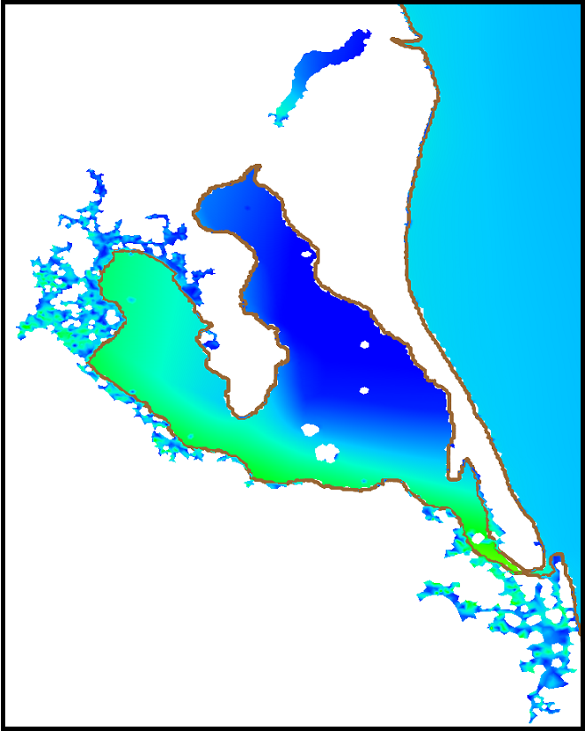
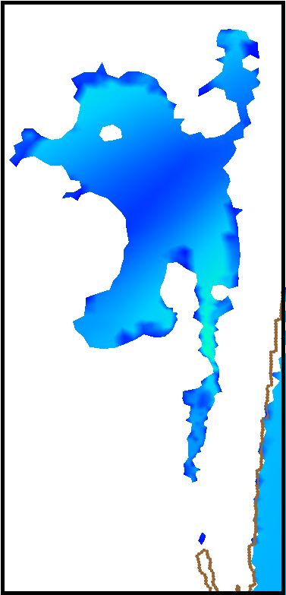
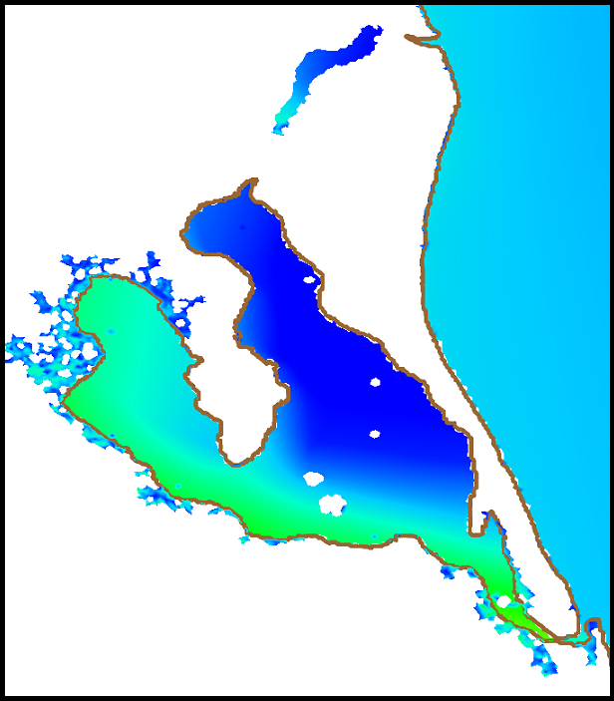
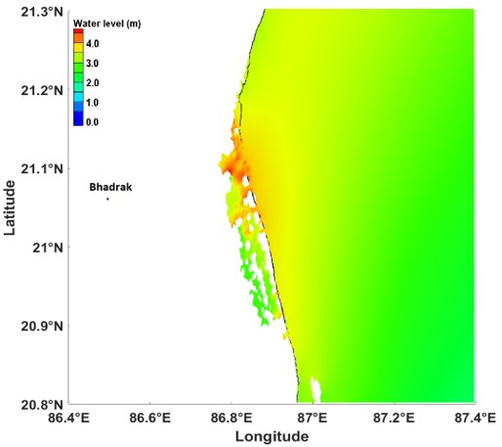
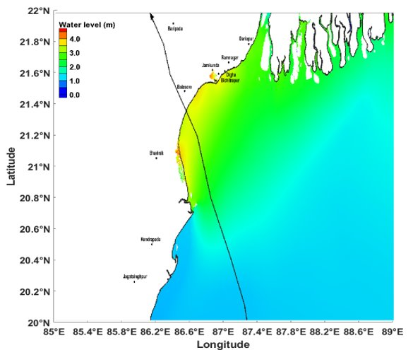
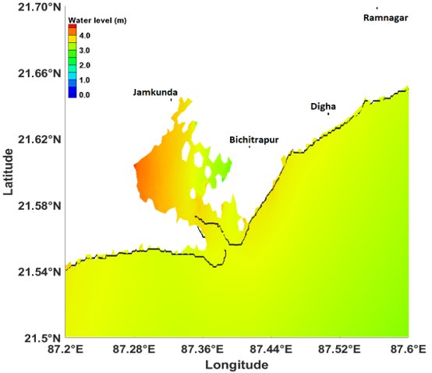
Effect of roughness length using LULC on the wind intensity of tropical cyclones and its associated inundation
Tiwari, P., Rao, A. D., Pandey, S., and Pant, V.
Centre for Atmospheric Sciences, Indian Institute of Technology, Hauz Khas, Delhi,
Email: asz208732@cas.iitd.ac.in
Abstract
Objectives
1999 Odisha Cyclone
Amphan Cyclone
Hudhud Cyclone
Nivaar Cyclone
India is frequently affected by coastal flooding due to storm surges that significantly effects human lives, coastal infrastructure, and marine ecosystems. Tropical cyclones (TCs) are the most severe storms, especially over the Bay of Bengal (BoB) and the Arabian Sea (AS). The vulnerability from the TCs occurs in many ways, which include coastal inundation by extreme water levels, damage of coastal properties caused by strong cyclonic winds, and additional flooding caused by cyclone-induced heavy precipitation. The destruction along the coast due to inundation enhances if the cyclone makes landfall near the estuaries, river deltas, or any adjoining rivers in the coastal area. Simulation of inland flooding requires an accurate representation of topography and surface roughness over the floodplain. Incorporating Land Use/ Land Cover (LULC) data in numerical simulations help in introducing roughness which alters the cyclonic wind speed over land. This also enhances model capabilities to represent accurate wind during the cyclone period. In the present study, experiments are carried out to simulate extreme water elevations and associated coastal inundation for the recent TC, Yaas (2021), that occurred over the BoB using stand-alone ADCIRC (Advanced circulation) model coupled ADCIRC and SWAN (Simulating Wave Nearshore) model. High-resolution mesh is used to incorporate significant river systems and water bodies. Various datasets like Airborne DEM, CARTOSAT-DEM, SRTM-DEM, MIKE-CMAP, and ETOPO-2 are used to prepare the model mesh. The results show that total inundation calculated by the coupled model is higher since the SWAN model gives an extra momentum flux to the ADCIRC model in the form of a radiation stress gradient. This results generation of maximum water elevations in the coupled model. As the TC approaches over the land, wind intensity gets reduced due to the presence of different land covers, which have specific roughness lengths. The more the roughness length, the higher will be the reduction in the wind speed. To observe modifications in the wind speed over the land and ocean, ERA5 reanalysis data is used for the 1999 Orissa super cyclone, Hudhud (2014), Amphan (2020), and Nivaar (2020). The results show a reduction of 38.2%, 35.62%, 16.35%, and 29.58% in wind speed at the time of landfall over the land compared to that of over the ocean for the above cyclones, respectively. Using ADCIRC model, the simulations are made for TC Vardah (2016) to study the impact of roughness length over the wind intensity based on LULC. The results suggest that there is a significant decrease in the wind intensity and inundated area over land after modifying the roughness length.
(a)
(b)
(c)
(d)
(a)
Simulation of TC Yaas (2021) to test the working of coupled Advanced Circulation (ADCIRC) and Simulating Wave Nearshore (SWAN) model over the east coast of India.
Effect of LULC on the distribution of cyclonic winds for generating SS and associated coastal inundation by using high-resolution datasets through modeling.
Wind Speed (m/s)
Data and Methodology
The objective is carried out using coupled ADCIRC-2DDI hydrodynamical circulation model and SWAN model. ERA5 reanalysis data is used for observation. For mesh preparation, various high-resolution datasets are used.
Datasets | Spatial resolution
Airborne DEM | 1 m
CARTOSAT-DEM | 10 m
SRTM-DEM | 30 m
MIKE-CMAP | Scale ranging from 1:20 for selected ports to 1:200 for the coastal region
ETOPO-2 | 2 min interval
Fig. 3 Maximum wind speed during landfall for the cyclone (a) 1999 Odisha cyclone, (b) Amphan cyclone, (c) Hudhud cyclone and (d) Nivaar cyclone
Table.2 wind speed during landfall for the cyclone (a) 1999 Odisha cyclone, (b) Amphan cyclone, (c) Hudhud cyclone and (d) Nivaar cyclone
(a)
(b)
Cyclone | Average speed over ocean (m/s) | Average wind speed over land (m/s) | Change in wind speed
1999 Odisha Cyclone | 14.58 | 9.01 | 38.2%
Amphan | 15.54 | 13 | 16.35 %
Hudhud | 15.16 | 9.75 | 35.62 %
Nivaar | 12.26 | 8.63 | 29.58 %
(a)
Fig.1 Model domain with cyclone Yaas and Vardah track.
Table.1 Datasets used in creating mesh.
Results
Fig. 4 Wind speed during landfall for the Vardah cyclone (a) Without LULC and (b) With LULC
2 (a)
(a)
(b)
(b)
Introduction
Storm Surges (SS): It is the abnormal rise of seawater level during any storm, measured as the height of the water above the normal predicted tide. The SS is the main contributor to the total water elevation. Depending on the local tide's amplitude and phase, the surface elevation may get modulated such that it may increase or decrease above the surge (Johns et al., 1985).
Coastal Inundation: It is the flooding of a coastal zone resulting from an increased river discharge from the upstream, storm tides and precipitation due to TCs along with storm tides from the sea.
Mandal et al.(2020) used east Indian coast mesh incorporating topography of the coastal land region by merging data from the airborne DEM with that from Indian satellite CARTOSAT-2 derived CARTO2DEM and SRTM DEM.
Yoon et al. (2014) carried out an experiment to investigate the impact of land-dissipated wind on SS and waves using the three-dimensional, unstructured grid, Finite Volume Coastal Ocean Model (FVCOM).
Due to the loss of coastal wetlands, low-intensity storms may have more considerable flood impacts in the future than high-intensity storms, which might result in coastal areas regularly flooding and suffering significant damage even during relatively light storms (Rezaie et al., 2021).
Pandey et al. (2021) computed coastal inundation due to Orissa's (1999) and Phailin's (2013) TCs using LULC data and found significant reductions in SS and coastal inundation
Fig. 5 (a) Wind validation for Vardah at ASOS Chennai and (b) Buoy validation at BD11. Black dot is landfall time
2 (b)
References
Johns, B., Rao, A.D., Dubinsky, Z. and Sinha, P.C., 1985. Numerical modelling of tide-surge interaction in the Bay of Bengal. Philosophical Transactions of the Royal Society of London. Series A, Mathematical and Physical Sciences, 313(1526), pp.507-535.
Mandal, A. K., Ramakrishnan, R., Pandey, S., Rao, A.D.,(2020) , & Kumar, P. “An early warning system for inundation forecast due to a tropical cyclone along the east coast of India”, Natural Hazards , 103(2), 2277-2293.
Pandey, S., Rao, A. D., and Haldar Raktim (2021). Modeling of coastal inundation in response to a tropical cyclone using a coupled hydraulic HEC-RAS and ADCIRC model. Journal of Geophysical Research: Oceans 126.
Rezaie, A. M., Ferreira, C. M., Walls, M., & Chu, Z. (2021). Quantifying the impacts of storm surge, sea level rise, and potential reduction and changes in wetlands in coastal areas of the Chesapeake Bay region. Natural Hazards Review, 22(4), 04021044.
Yoon, J. J., Shim, J. S., Park, K. S., and Lee, J. C., (2014). Numerical experiments of storm winds, surges, and waves on the southern coast of Korea during Typhoon Sanba: the role of revising wind force. Nat. Hazards Earth Syst. Sci., 14, 3279–3295.
Fig. 6 Inundated area for Vardah cyclone using (a) Without LULC and (b) With LULC. Inset images are zoomed in to highlight the inundated area.
Summary and Conclusions
Generation of mesh for the east coast of India by taking various topography and bathymetry datasets.
Coupled model simulation show an increase in coastal inundation compared to that of a standalone ADCIRC model for the Yaas cyclone.
During landfall time, ERA5 reanalysis wind data shows a significant reduction of the winds over the land due to different land covers.
Incorporation of LULC in the model results in the reduction of wind intensity and the extent of coastal inundation by about 20% and 36% respectively.
Fig.2 Inundation due to TC Yaas (a) using ADCIRC alone and (b) using coupled ADCIRC and SWAN model.
In Fig. 2 (a), Inundation is seen over the right side of the cyclone. Maximum water elevation is around 4.6 m, and maximum inundation is 49.07 sq. km. The maximum extent of inundation is computed about 8 km away from the coastline. In (b), The maximum water elevation is around 5.2 m since the inclusion of the wave model (SWAN) increases maximum water elevation as well as associated inundation. The maximum extent of inundation is found to be about 8.5 km. Total inundation over both sides of the cyclone is about 130 sq. km. Total difference in the inundation observed was 80 sq. km after including the wave model. Zoomed inset images to highlight the inundation

