Slide 1
Gravitational and topographic observations of basins on Mercury: implications on impact formation and crustal structure
Notes:
Mercury‘s surface is characterized by well-preserved impact structures, that represent important records of the “Late Heavy Bombardment”
Yet the formation and evolution processes are not fully understood .This uncertainty has been partially caused by the lack of understanding towards the surface and subsurface processes.

Slide 2
Preliminary work
Previous studies mapped and characterized impact basins on Mercury using MESSENGER data (Fassett et al., 2012; Orgel et al., 2018)
Using image data (166m/px & colour enhanced 665m/px) Hawkins et al.,2007; Chabot et al., 2016
Using topography DTM (665m/px) Becker et al. 2016
Using topography from laser altimeter (250m/px) Cavanaugh et al., 2007
Orgel et al., 2018
Notes:
recognition of details typically depends on resolution and illumination conditions. Hence, the search for impact basins is likely to suffers from biases.
Recent studies have presented gravity models, that promise insights of subsurface structures
These information may help to understand the topography of basins and their related subsurface structures.

Slide 3
Introduction
Gravity data in combination with surface morphology of the basins may help improve our understanding of their formation processes and their alterations with time.
Using the complementary data sets, we study the morphology and gravity signature of the basins more in detail
Notes:
This study focuses on the analysis of the topography and gravity field data focusing on the characteristics of impact basins

Slide 4
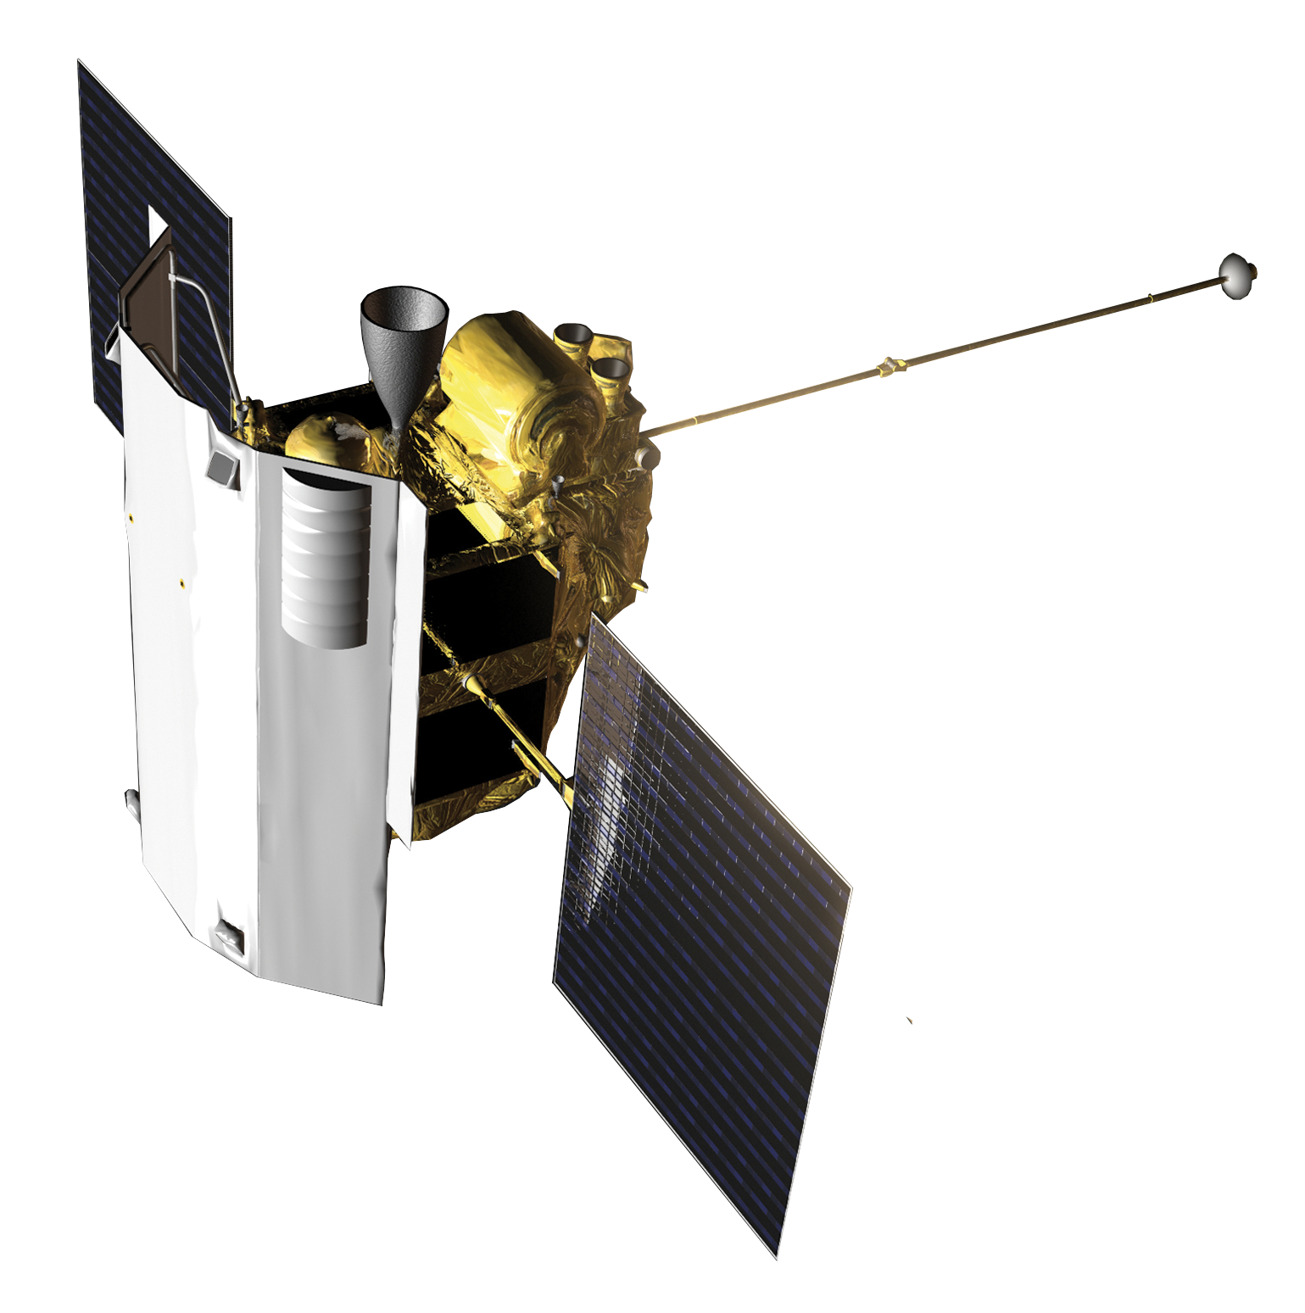
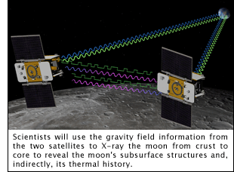
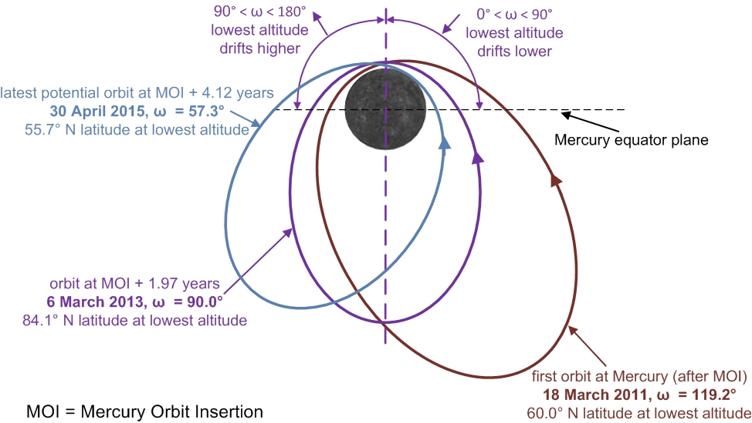
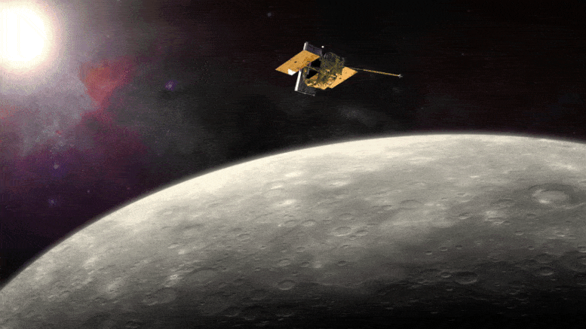
MESSENGER data (2004-2015)
- MDIS (Mercury Dual Imaging System)
- MLA (Mercury Laser Altimeter)
https://messenger.jhuapl.edu/About/Mission-Design.html
Notes:
llows the measurement of the distance between a transmitter from space and a receiver by observing how the frequency changes, ( moves away, pulled toward)

Slide 5
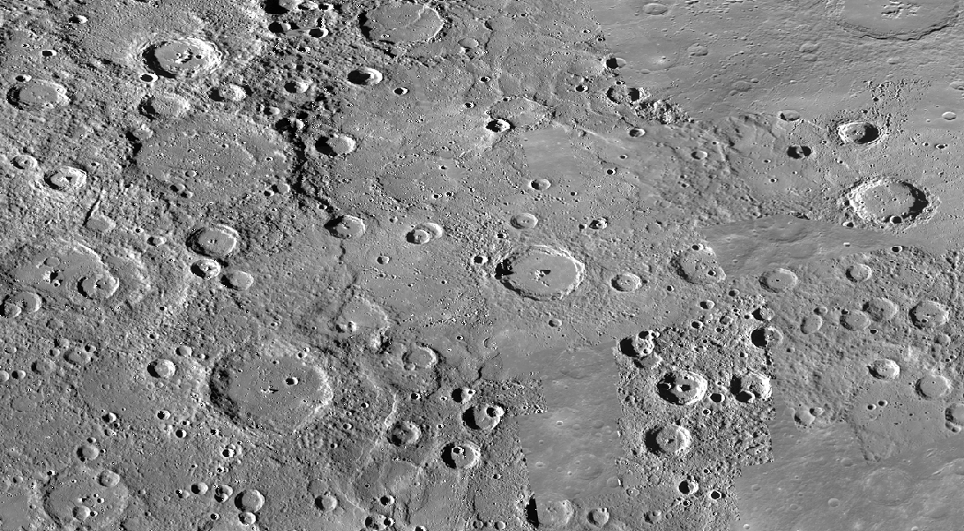
Optical image data MDIS
USGS Basemap
Solar incidence & illumination azimuts mosaiced images 166m/px
(Chabot et al., 2016; Hawkins et al., 2007)
Notes:
of imaging conditions optimized for morphological analysis. These images have been mosaiced to a global data set (166px/m) available on USGS.

Slide 6
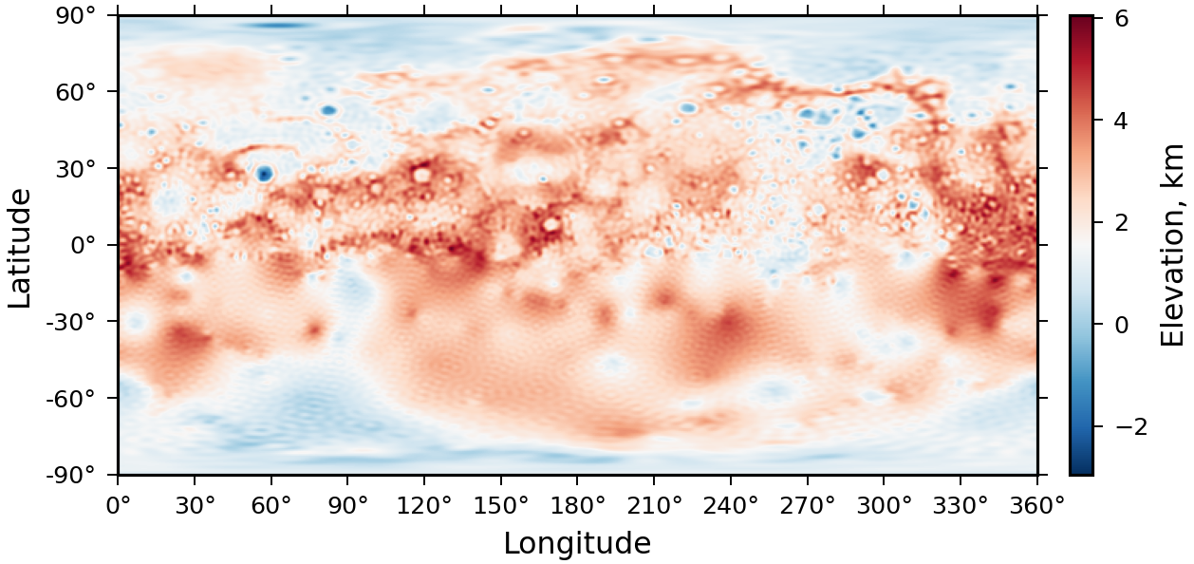
Topography data sets MLA
Topography
in spectral domain of degree and order 150 / 25,49km per sample/px
(Neumann et al., 2016)
Notes:
Topography spherical harmonics degree and order 150 (MLA) Owing to the character of the orbit, MLA could not cover the southern hemisphere of the planet

Slide 7
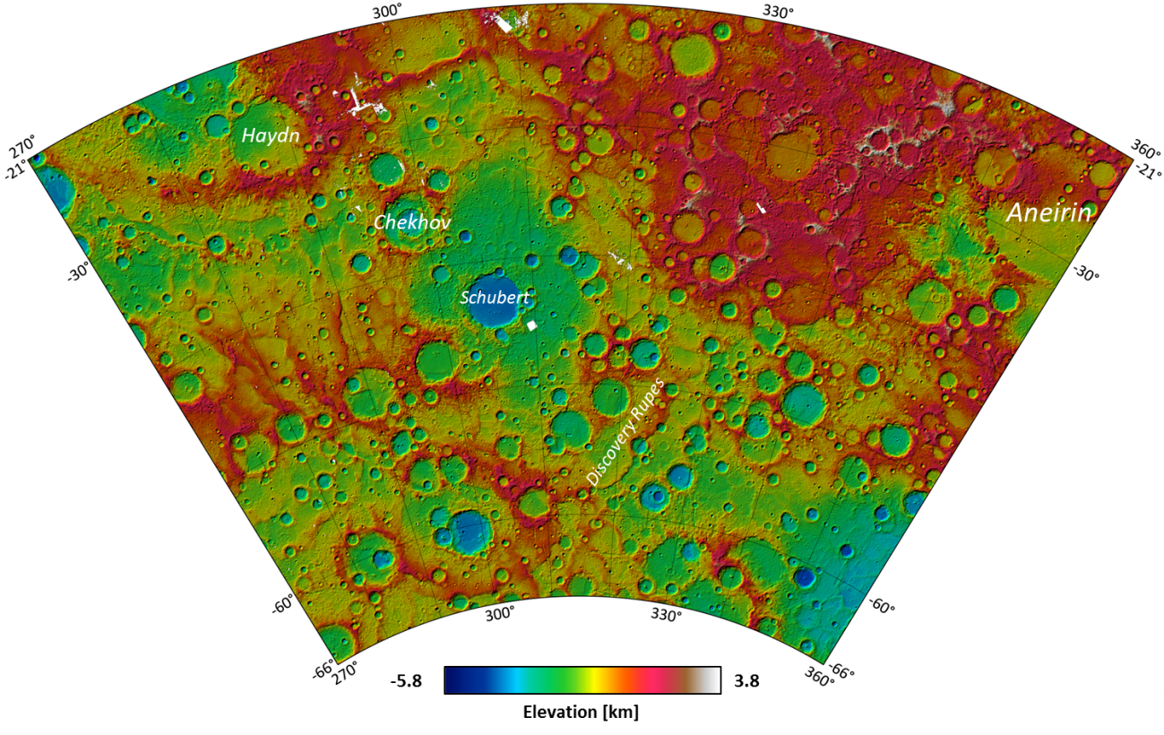
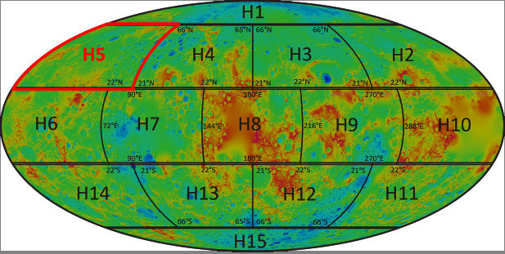
Topography data sets MDIS & MLA
Topography
From stereo Images DTMs, 150m/px
Preusker et al., 2017
Notes:
. Instead, techniques of stereo-photogrammetry

Slide 8
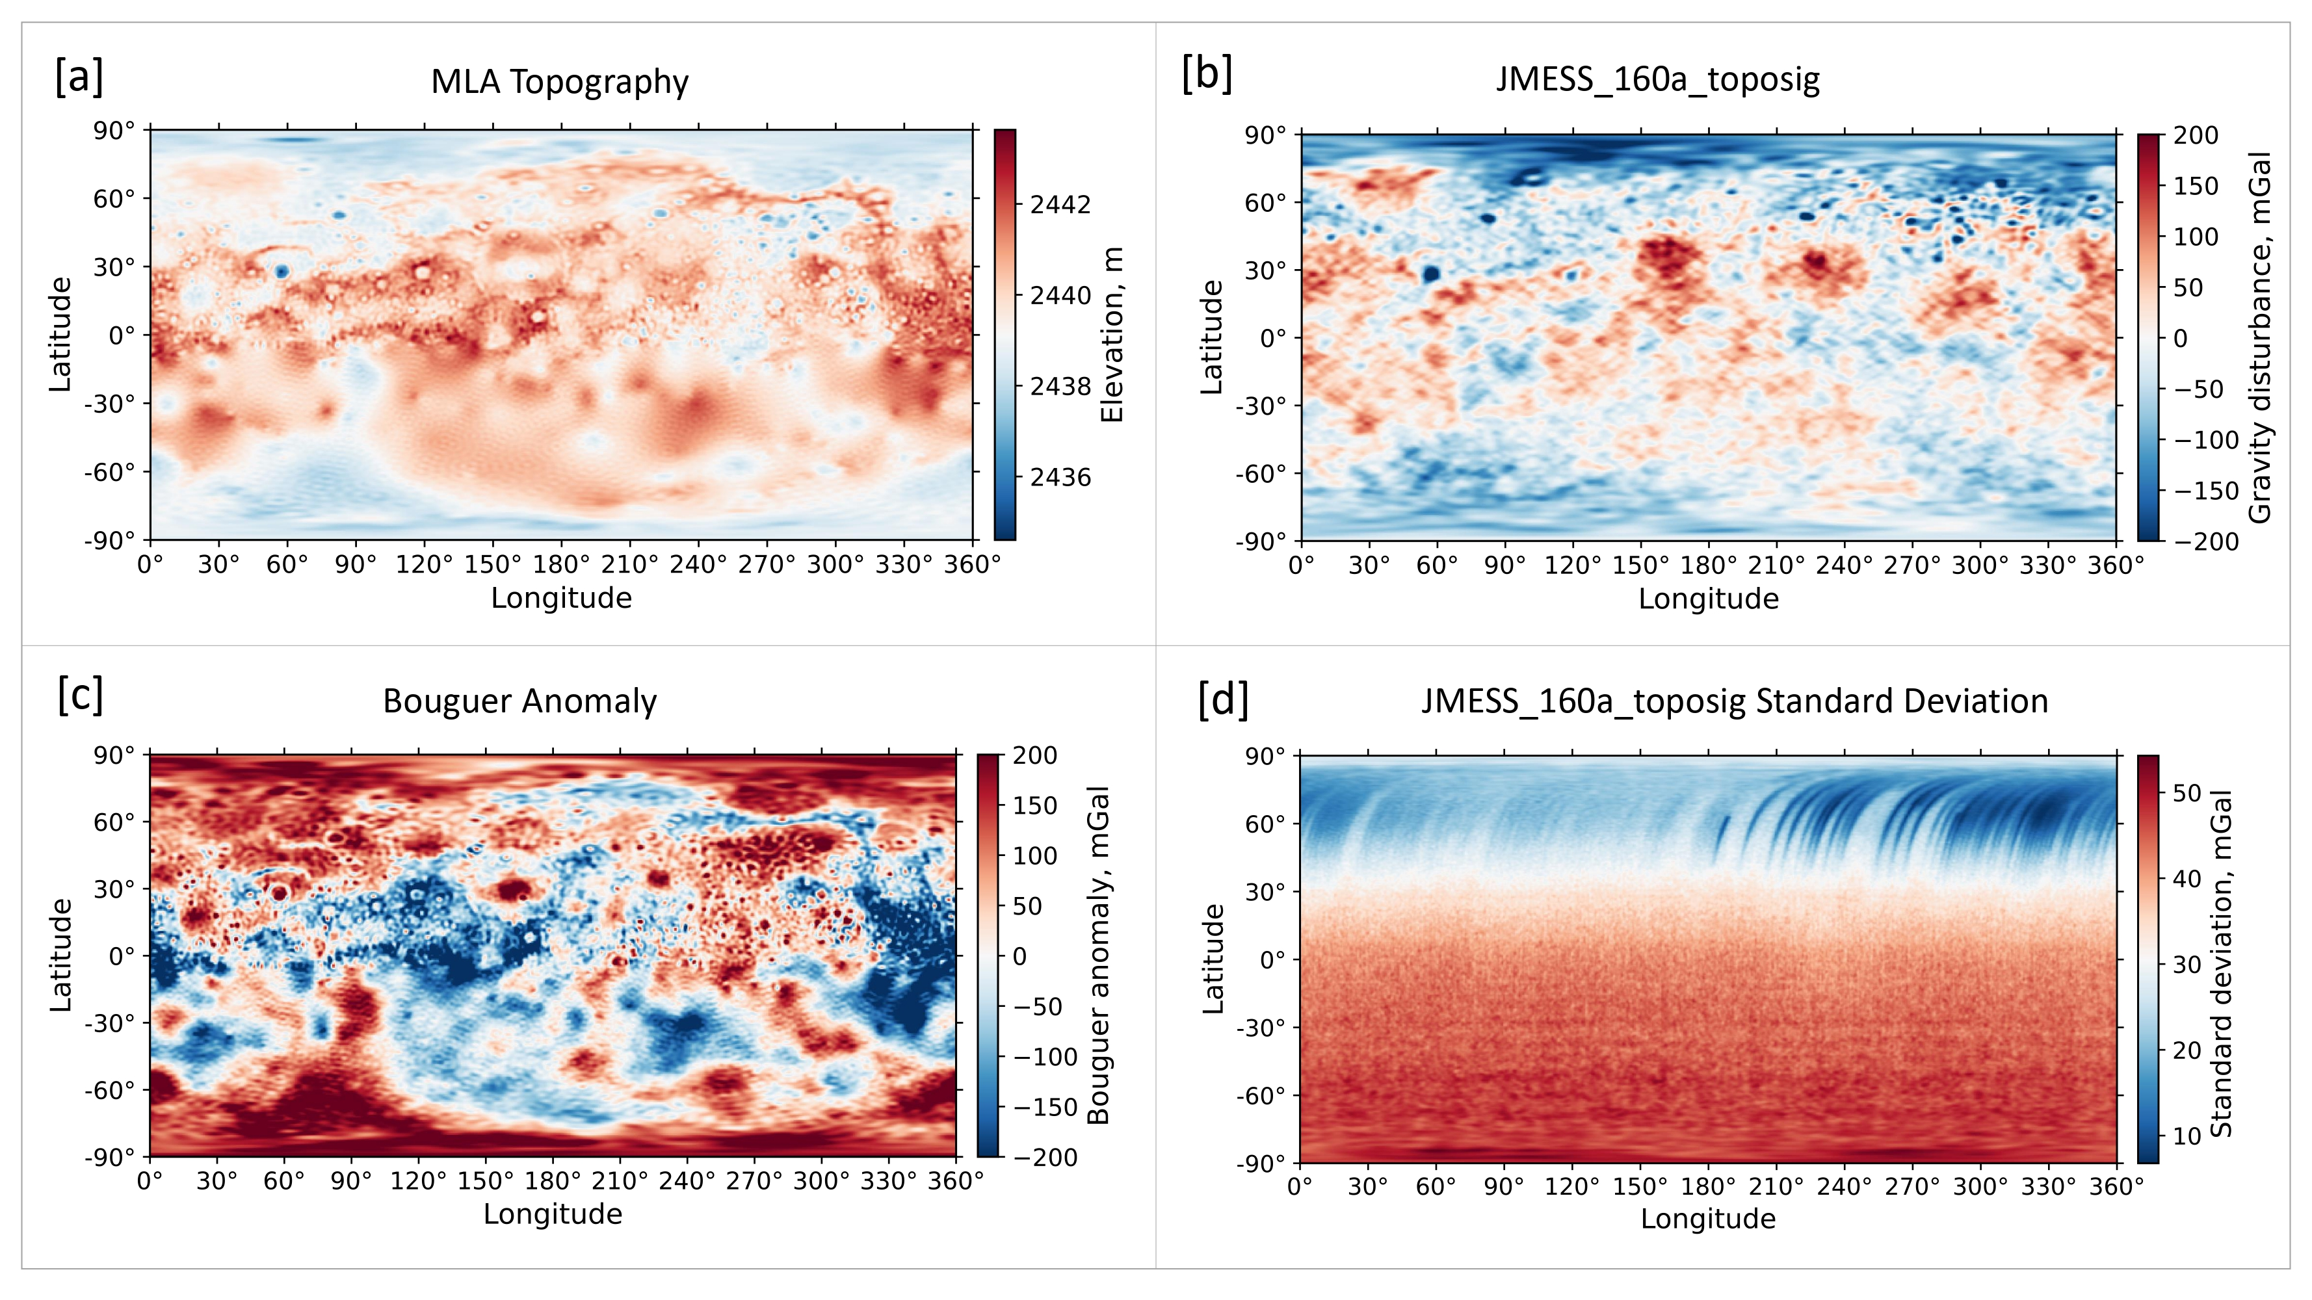
Gravity data sets
Konopliv et al., 2020
[c]
Notes:
23,8 km /ppx sample
Due to high eccentricity of the orbiter data lost its resolution towards the south
To apply them on spherical body you need to add constrait to it which usually done suing the Kuala Law (empirical consequence of probabilities
topography values od const. Desity (2700) and are limiting grav values to tehse (kaula law limiting agaist 0)

Slide 9
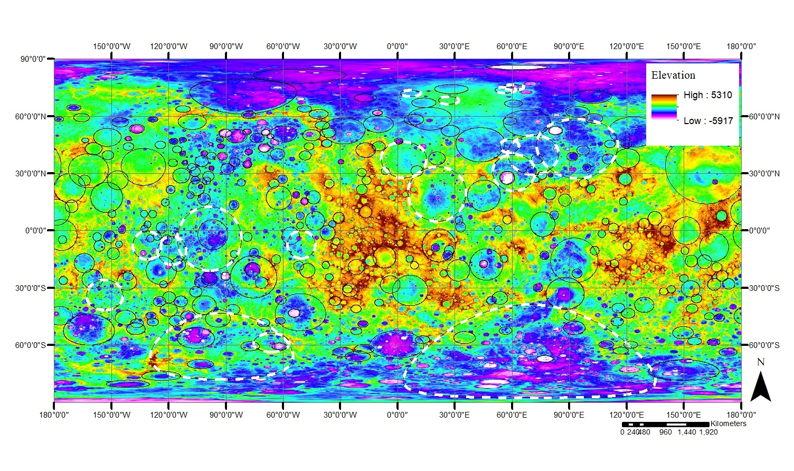
Results: Mercury’s basin inventory
Catalogue of basins (>150km) with 298 certain (solid line) and 21 tentative (dashed line)
Certainty, morphological class, position, diameter, rim preservation, terraces, depth measurements, filling, Gravity disturbance (centre & rim), Bouguer anomaly (centre & rim)
Notes:
Catalogue basins bigger 150km diameter (total 320)

Slide 10
Results: Mercury’s basin inventory
Orgel et al., 2018
 | Orgel et al., 2018 (D ≥ 300 km) | Mercury‘s basin inventory (D ≥ 150 km)
Certain | 49 | 298
Probable | 31
Tentative | 14 | 21
225 basins added in total
13 could be verified as certain
9 do not show a significant signal in topography and gravity
2 remained tentative
10 newly discovered tentative
Notes:
We compared our mapped basins to previous work (Fassett et al., 2012; Orgel et al., 2018) and re-examined the identified basins. We were able to verify 13 of the probable and tentative basins and improved the accuracy.
Example of tentative basin Basin ID433, is a special basin candidate, that was already suggested by previous studies (Fassett et al., 2017; Orgel et al., 2018). It is localized in the southern hemisphere very close to the south pole. Complete DTM data is not available yet. However, a corresponding depression was recognized in the available quadrangles and in the MLA topography data as well as a strong Bouguer anomaly. Since the circular structure measures ~2080km in diameter, it would imply that Mercury was hit by a very big impactor in its early history, creating such structures. With respect to other impact structures, this basin would represent Mercury’s larges impact, overtrumping Caloris.

Slide 11
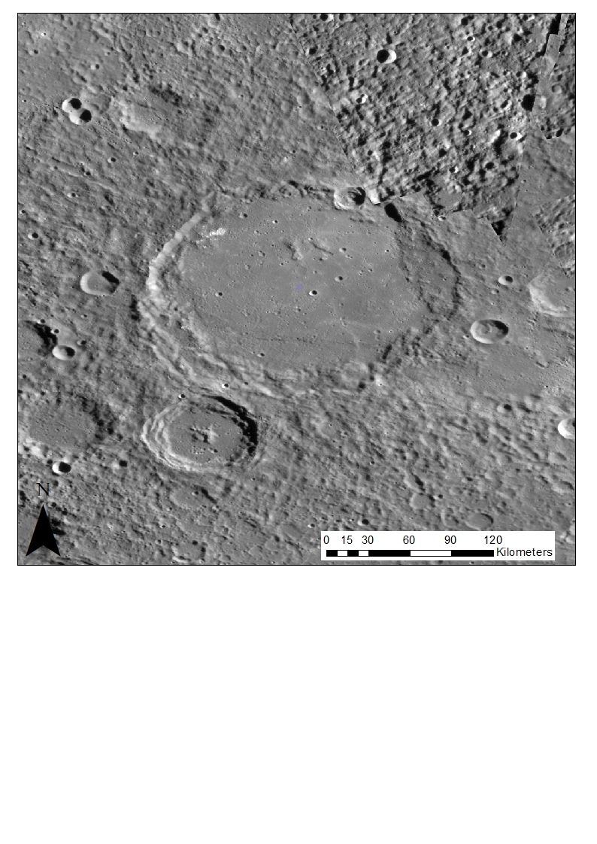
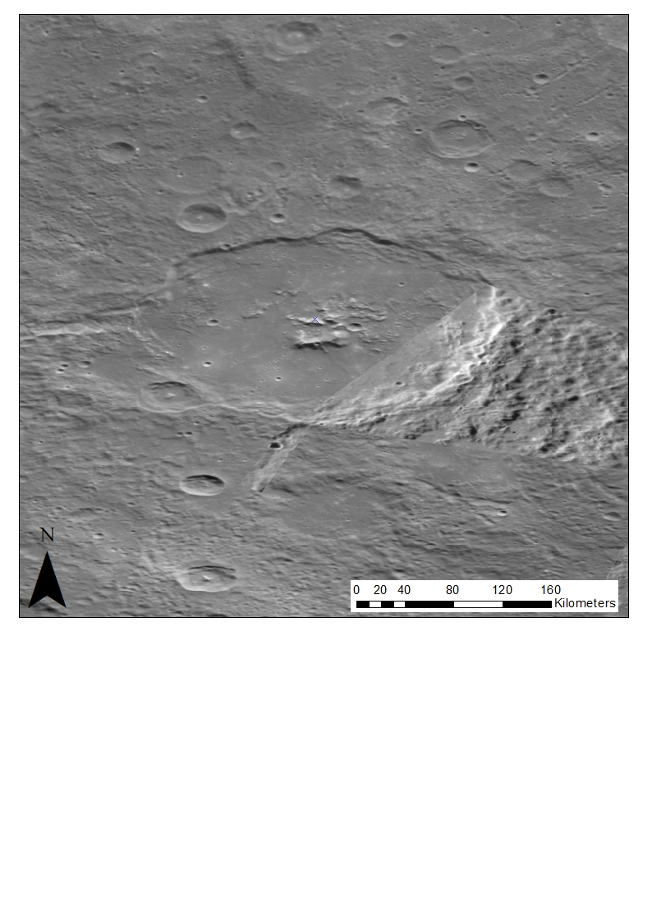
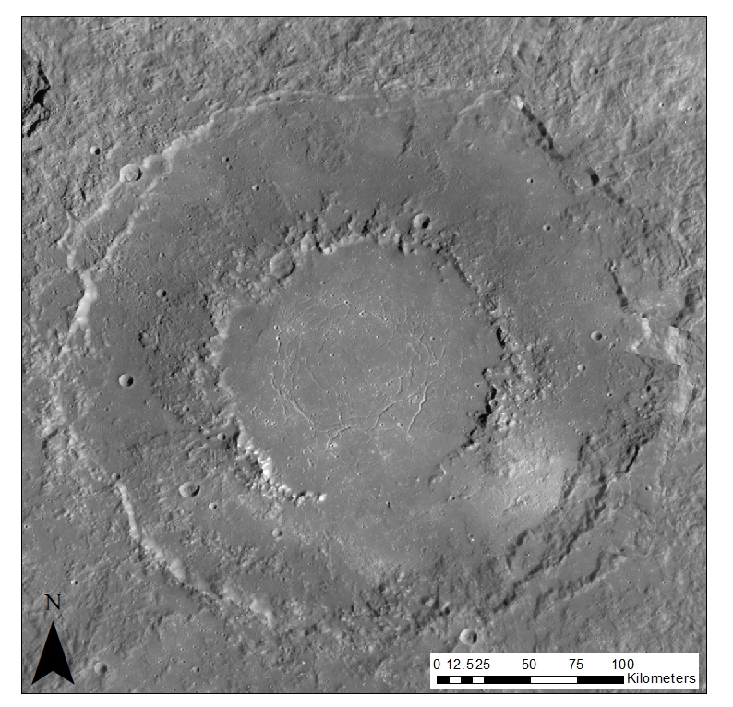
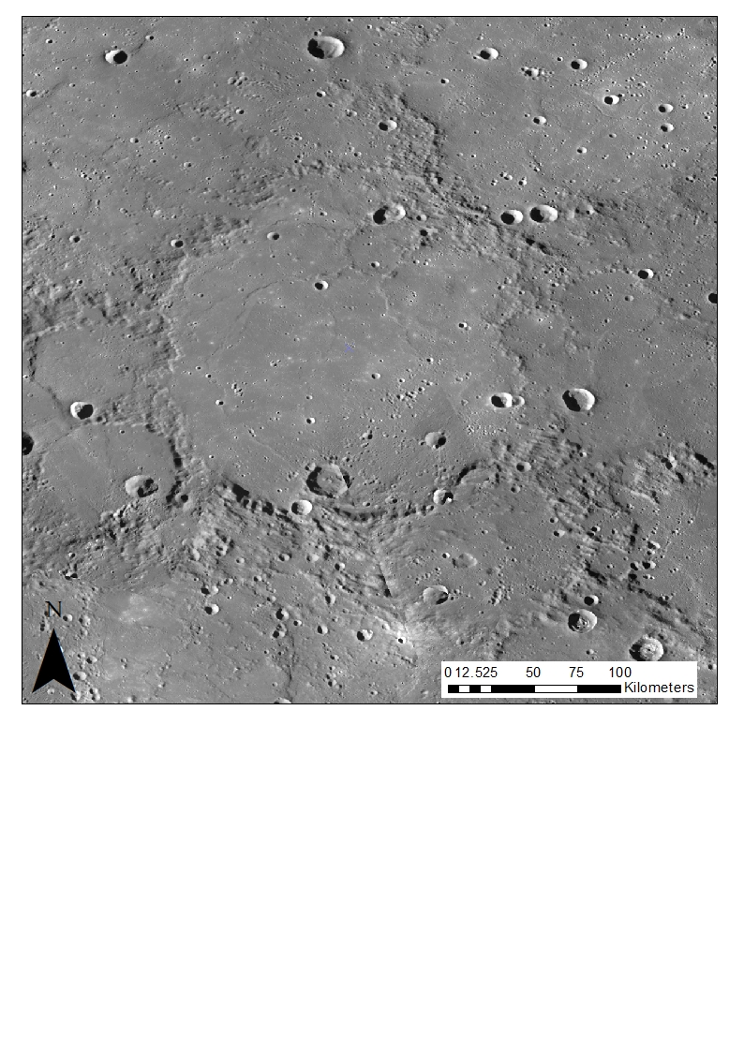
Results : Classification of impact basins by topography
Complex Basin
150 km
Central Peak Basin
150 km
Peak Ring Basin
295 km
Multiring Basin
1550 km
Diameter
Modified Basin
<50 % rim
325 km
Notes:
formation of impact basins is strongly affected by diameter, velocity, impact angle and material of the impactor as well as composition, porosity and temperature properties of the target.
Large amount highly modified basins, partially or fully fill in parts on floor or complete basin floor (no structures visible)
. Most of these filled basins are abundant on the norther hemisphere, where smooth plains are mostly present.

Slide 12
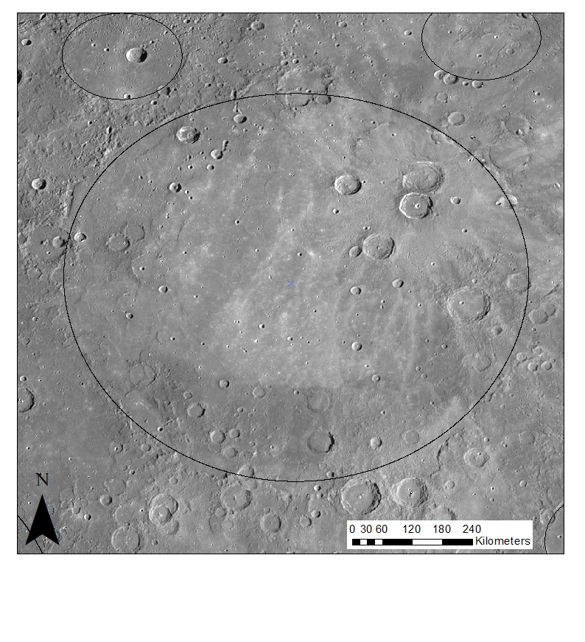
Results : Modified basins
High abundance of modified basins → modification of basins due to
Impact melt of impact itself
Flood volcanism
Ejecta displacement of younger impacts
Ejecta displacement
(volcanism& impact melt)
Impact melt
Flood volcanism
Notes:
1. And some basins display smooth filling in basin floor, probably caused by impact melt during the impact itself. .
2. Volcanism is a dominated process that occurred on Mercury displayed by flood lavas and was already observed by several studies . Flood volcanism is the major driving force for regional infilling of topographic depressions, e.g. basin floors resulting in modification of the basin interiors, changing basin morphological characteristics
3. younger impacts causing ejecta displacement in the basin floor, covering portions of rim and the surroundings
as noticed nearly not possible to classify these basins according to type
Assumed to be at elast central peak /peak ring according to diameter
Large amount highly modified basins, partially or fully fill in parts on floor or complete basin floor (no structures visible)
. Most of these filled basins are abundant on the norther hemisphere, where smooth plains are mostly present.
sins(majority of mlarger basins) lot of post impact modification

Slide 13
Results : Morphology of basins
Complex Basin with flat basin floor
Peak ring basin with visible teracess and an inner ring structure
Modified Basin
Lots of surface modification that affected basins
Notes:
Meaurements of depth for each basin even though flooded some slighty elevated features
. It is suggested that some of the basins which were classified as complex indeed possess an even more complex morphology for example a central peak or even a peak ring.
However, post impact cratering is mostly visible, youguer craters formed after bains was generated, makes difficult to measure therefore depth average value but porves that basins underwent surface modification

Slide 14
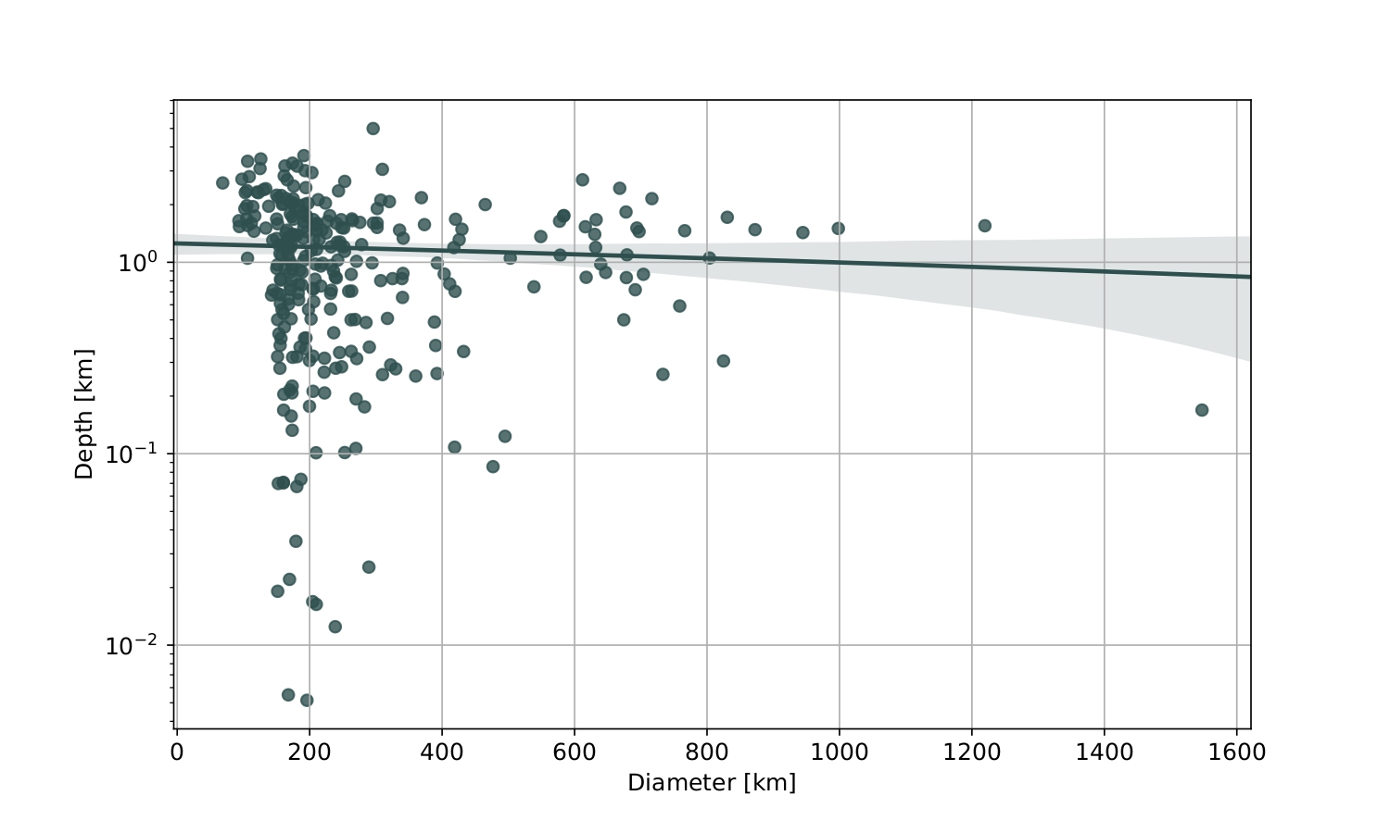
Results : Morphometry of basins
Smaller basins show a higher d/D ratio
→ Characterized having smaller diameters but deeper
interiors
Larger basins display lower d/D ratio
→ Characterized by shallower interiors and larger
diameter
The modification process is much more proceeded in larger basins
This may imply that basins with lower depth- to-diameter ratio have to be much older compared to ones with higher ratio
Notes:
Morphometrical measurements, such as depth-to-diameter ratios, are one commonly used technique to investigate the evolution of basin morphology with increasing diameter ranges. Smaller basins use to show a higher ratio. They are characterized having small diameters but deep interiors, which is also mostly common for recently formed basins. In contrast, larger basins display shallower interiors, due to modification processes, resulting in smaller values in the depth to diameter ratio. It proves that the modification process is proceeded in larger basins. This may imply that basins with lower depth- to-diameter ratio have to be much older compared to ones with higher ratio

Slide 15
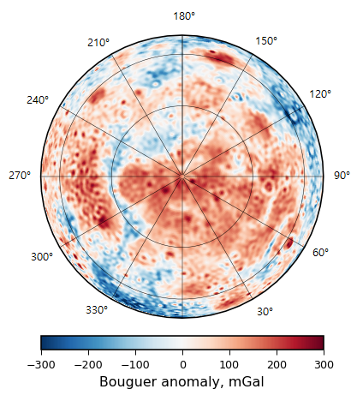
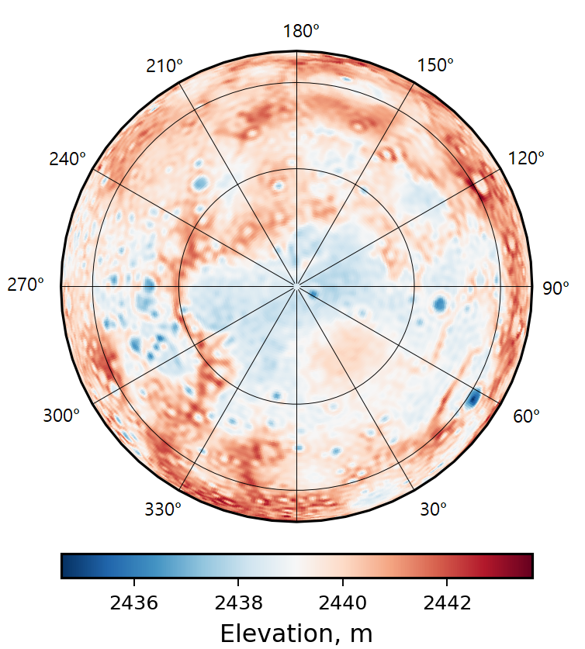
Results : Gravity and topography
Gravity anomalies hint complicated interior structures and mass distribution in subsurface
Discover new basins that have been highly degraded and modified
Bains correlate within gravity anomalies and topography data
Notes:
BA calculated using gravity signal corrected for heigth where it was measured and terrain signal = only anomay that comes from subsurface
See topographic surface features that are corresponding to gravity anomaly

Slide 16
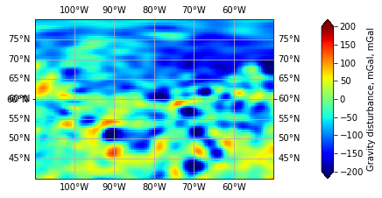
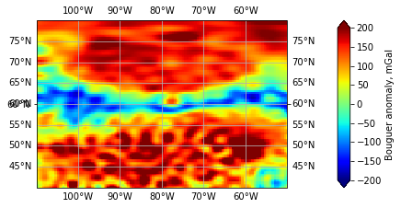
Results : Gravity anomalies
Gravity disturbance:
The difference of the normal gravity and the gravity on the geoid at the same point of the reference spheroid
→ Mostly negative
Bouguer Anomaly:
Corrected for the height at which it is measured and the attraction of terrain assuming a uniform crustal density ( 2950 kg / m³)
→ Mostly positive for basins
Notes:
. Impact craters of different sizes possess distinct characteristics in geophysical properties.
Gravity anomalies in geophysics are defined as the difference between the observed gravity value and the gravity value of the reference ellipsoid
In this study the gravity disturbance is referred as the difference of the normal gravity and the gravity on the geoid at the same point of the reference ellipsoid. In calculating the Bouguer anomalies we get an insight into the subsurface structure of a planet. Gravity disturbance and the Bouguer anomalies display a distinct circular shape that is directly connected to a depression in topography data.
Most basins, classified as complex and central peak basins, are displayed with a negative gravity disturbance. However, basins were found to show strong positive gravity disturbance signals, especially basins that clearly show a more complex morphological structure. These are not associated with a central elevation in their topography profiles. The positive structure is occurring mostly in more complex basins, since the central maxima is increasing with increasing diameter

Slide 17
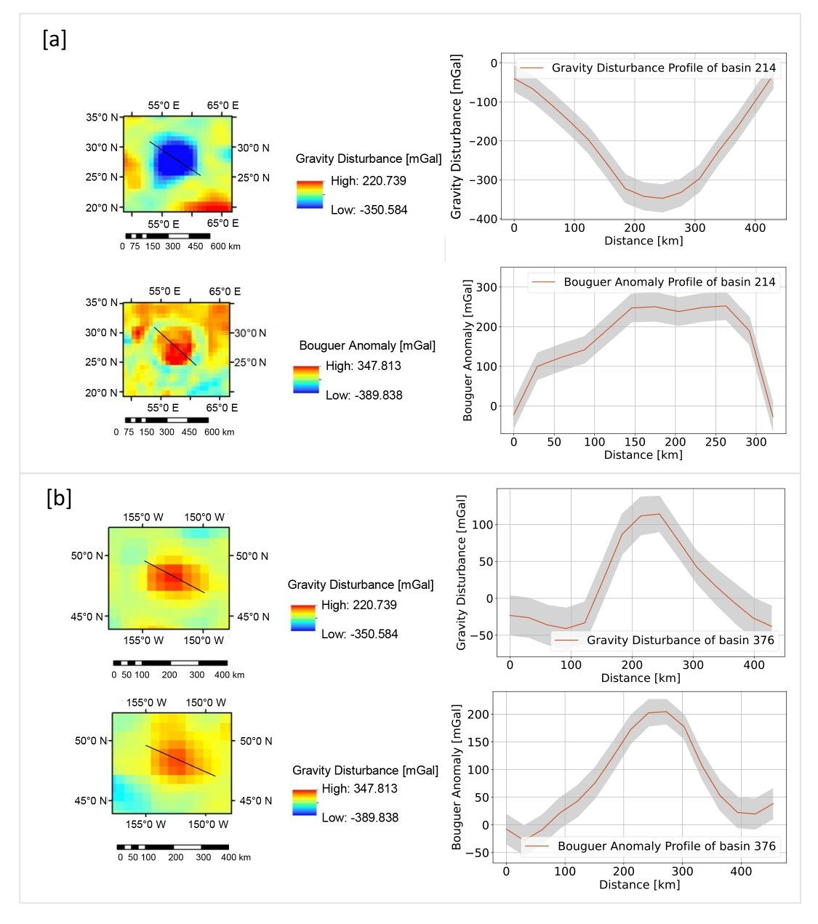
Results : Gravity anomalies
Most basins show a negative gravity disturbance ( classified as complex or central peak basins) & positive Bouguer anomaly
However, basins were found with strong positive gravity disturbance
These are not associated with a central elevation in their topography profiles
Especially basins that are bigger in diameter
Notes:
Most basins show a negative gravity disturbance. The majority of these basins are classified as complex or peak ring basins. In comparison, these basins show a positive Bouguer anomaly. However, basins were found to display strong positive gravity disturbance signals (Fig ~\ref{GDBAprofile}).
These are not associated with a central elevation in their topography profiles. Especially basins that are bigger in diameter are showing these positive values.Basin with higher complexity of their morphology are mos
Also basins with a class affiliation determined as \textit{modified} show a positive gravity disturbance. These positive central signals are assumed to be located within the peak ring of these impact structures, that are not visible in the topography. Therefore, basins with positive gravity disturbances in their centre are suggested to have a more complex morphologic class than \textit{complex} and \textit{central peak}. tly displaying a positive gravity disturbance.

Slide 18
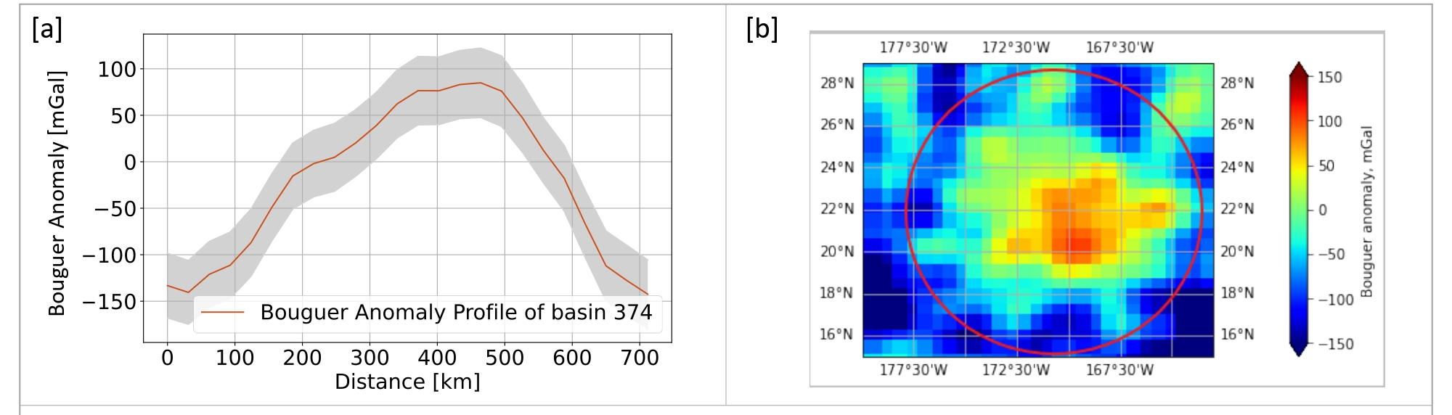
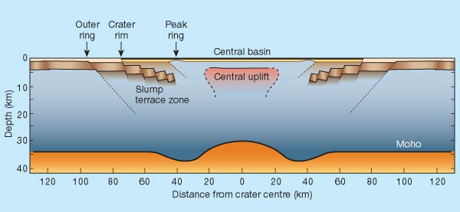
Results : Bouguer anomaly of basins
→ Consequence of crater excavation followed by an isostatic adjustment due to cooling and contraction of a melt pool in the basin center due to an uplift of the mantle
Melosh et al.,, 2001
Notes:
The observed gravity trends have important implications for formation processes of basins. Basins show large positive bouguer anomalies in centre surrounded by negative BA in rim area (refered as bullseye pattern)
Due to uplift of mantle material.
Consequence of crater excavation followed by an isostatic adjustment due to cooling and contraction of a melt pool in the basin center

Slide 19
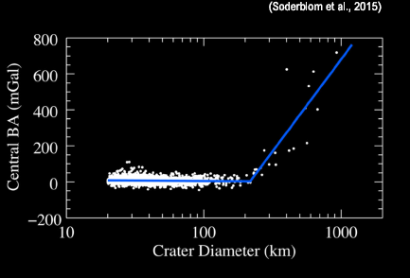
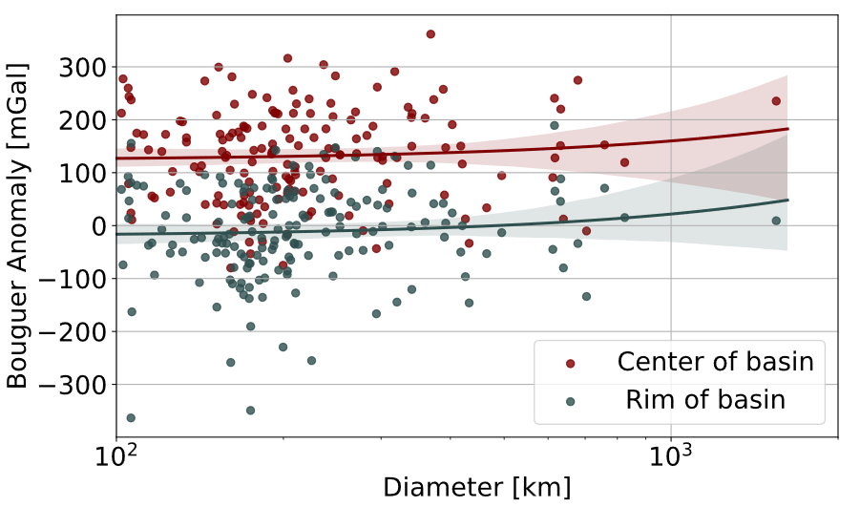
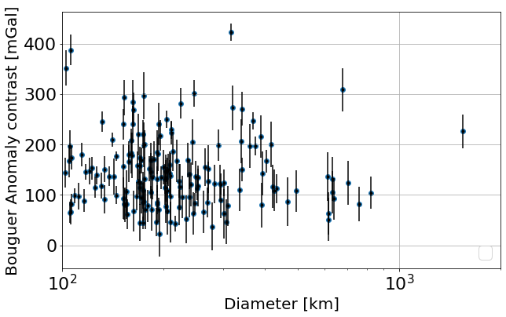
Results : Bouguer anomaly of basins
Bouguer anomlay in centre and rim was measured
→ Increasing with increasing basin diameter
Moon studies studies impact structures → break in slope at D = 218 +/- 17km Marks treshold for Bouguer Anomaly rise → mantle uplift = crustal thinning
Bouguer contrast = measure basin relaxation state
→strong contrast = limited relaxation due to high viscosity of a cooler planet
→small contrast = higher relaxation due to lower viscosity and a hotter crust (planet’s earlier history)
Notes:
We investigated the amplitude of Bouguer anomalies in the basin centres and surroundings as a measure of basin relaxation state.
A low contrast between the minima and the maxima of Bouguer anomaly magnitude would represent an already relaxed basins, in comparison to a relatively higher contrast. Subsequently, basins with a high relaxation state formed in earlier history of the planet are likely to be older in age compared to basins that display low relaxation states and therefore low contrast values. According to this, the relaxation state, and therefore the bouguer anomaly contrast could be a measure for relative age of basins. However, no distinct dependency was found
Moon studies studies impact structures → break in slope at D = 218 +/- 17km was found
Marks treshold for Bouguer Anomaly rise = mantle uplift
Also increase in diameter

Slide 20
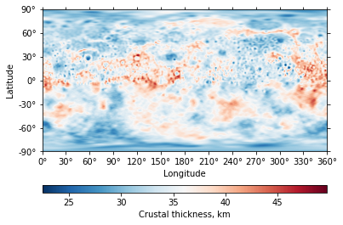
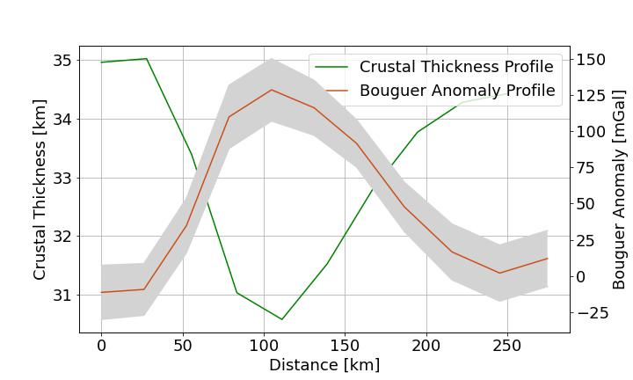
Implications on crustal structure: Lateral variations in density?
measured the profiles of crustal thickness in the basin
Magnitudes in centre (minimum) and its rim (maximum)
Average crustal thickness of 35km (Model U0 ,Beuthe et al., 2020)
Notes:
previous studies suggested that gravitational signal are likely to be the result of the lateral density variations in the crust
To support the understanding of Bouguer anomaly trends, we analysed recent crustal thickness model
(assume average density by bouguer anmaly 2950, give assumed average crustal thickenss, porosity parameter 12% (similar to moon since heavily cratered as well)
Similar to the gravity anomalies we measured the magnitudes of crustal thickness in the basin centre and its rim area
The minimum crustal thickness value is always found in the centre. In contrast, the maxima are located near the rim.

Slide 21
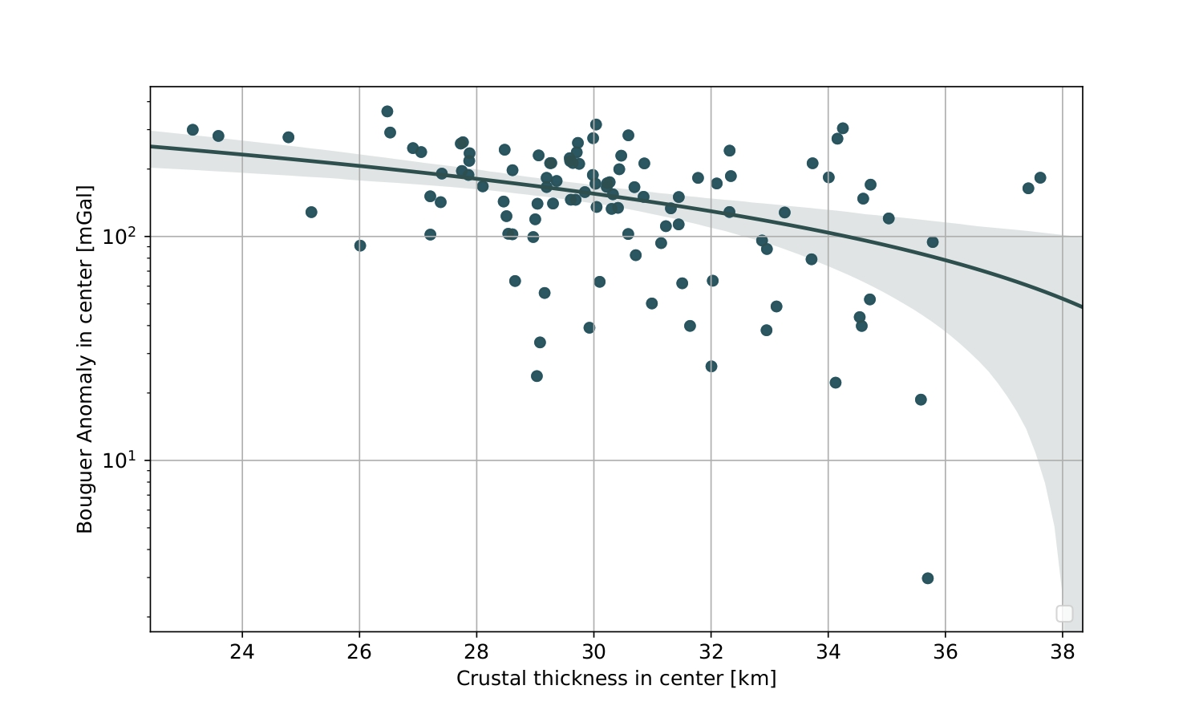
Implication on crustal structure
Bouguer anomaly is correlating and decreasing with crustal thinning
Bouguer anomaly likely to be the result of the relief along the crust-mantle boundary rather than lateral density variations in the crust
Notes:
Crust is expected to be thinner where bouguer anomaly high
Therefore rather a reflection crust-mantle boundary rather than lateral density variations in the crust

Slide 22
Comparison with the Moon
Mercury and the Moon, similar bombardement history (Fassett et al., 2012; Orgel et al., 2018)
BUT multiring basin are not predominant on Mercury ( surface modification ) compared to the large abundance on the moon; strong discrepancy to the Moon, where 52% of impact basins possess at least one interior ring (Baker et al., 2012; Baker et al., 2017)
Differences In basin formation / planets interior structure
Relaxation processes driven by crustal and mantle lateral stress flow could have modified larger features initially
widespread volcanic emplacement might occur unrelated to the impact process or possible be even triggered by the impact itself or driven by crustal and mantle lateral stress flow (Head et al., 2011)
stronger gravity acceleration (3.7 m/s² ) compared to the Moon (1.62 m/s²), could consequence in enhanced surface loading by surroundings of the basins. In the following, these loads could also influence other processes, such as volcanism (Head et al., 2011; Fassett et al., 2012)
a combination of these factors forces an early viscoelastic stage, that would favour early relaxation of basins
Notes:
However, Mercury’s impactor rates are higher
population of large impact basins (>300km) is less abundant on Mercury
surface modification on Mercury is more proceed and affecting geomorphological basin features, such as rims and basin floors
multiring basin, that are supposed to form in larger diameters, are not predominant compared to the large abundance on the moon. This lack of multiring basins is a strong discrepancy to the Moon, where 52\% of impact basins possess at least one interior ring
where does these discrepancies come from?

Slide 23
Conclusion
Detailed new inventory of impact basins on Mercury using high resolution topography data combined with gravity data
Majority of basins classified as highly modified instead of a morphological classification indicating
(I) fast relaxation of topography after formation
(II) volcanic flooding of the interior and /or surroundings of basins
(III) enhanced obscuration by younger impacts
Bouguer Anomaly bullseye pattern was found = similar to moon (Mascons)
A clear correlation between crustal thinning and basin formation was found
Bouguer Anomalies (contrast) were interpreted as measure for basin relaxation
→ lower contrast= higher relaxation = lower viscosity of target material = formed during planet’s early history?
BUT: formation of impact basins strongly influenced by projectile properties (velocity, diameter)
Notes:
Still, the gravitational resolution of Mercury is not strong enough to reveal such ambitious results.

Slide 24
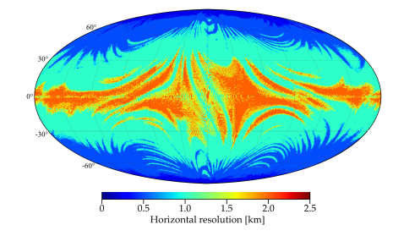
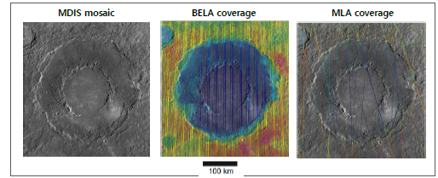
Outlook
Detailed catalogue presents potential areas of interest for BepiColombo
→ will provide accurate measurements of Mercury’s gravity (MORE) and topography (BELA)
→ BELA aiming to achieve a global coverage with finer spacing (not larger than 2.5
km to a few hundred of meters at poles)
Horizontal resolution of the topographic map based on BELA profiles obtained after two years of operation in Mercury orbit (Steinbrugge et al. 2018).
Horizontal resolution of the topographic map of Rachmaninoff basin based on BELA profiles obtained after two years of operation in Mercury‘s orbit (Steinbrugge et al. 2018)
Notes:
Converted into spherical harmonics the spatial coverage will support the expansion of the topography up degree and order 1100. Simulations on expected coverage of BELA operations on impact structures showed, that BELA profiles can be sampled with much higher spatial resolution compared to the existing data from MLA
Also Bepicolombo will provide new detailed gravity solutions by radio tracking with Mercury Orbiter Radio-science Experiment (MORE)

