Slide 1
Inputs of reactive nitrogen from wet deposition and fertilization in a tropical montane catchment characterised by smallholder farming
Authors:
Miriam Kasebele
Suzanne Jacobs
Lutz Breuer

Slide 2
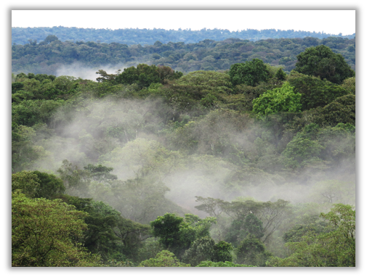
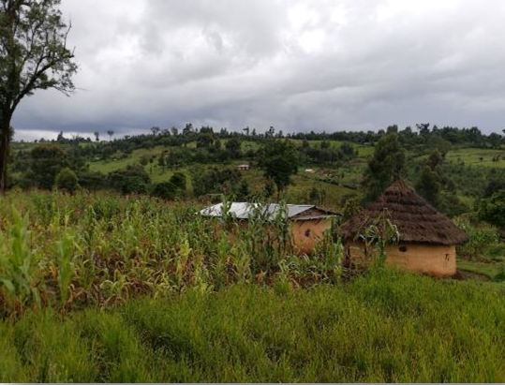
Introduction
The Mau Forest Complex has lost 25% of its cover due to land use change such as agriculture (Swart 2016).
Land use change may alter balance, transport and fate of reactive nitrogen in its catchment.
Anthropogenic nitrogen inputs through fertilization and atmospheric deposition are considered to be important derivers.
In the Mau Forest Complex in Kenya, the annual export of nitrogen from a catchment dominated by smallholder agriculture was reported to be almost double those from the native forest (Jacobs et al. 2018).
Tropical montane forest
Smallholder agriculture

Slide 3
Background and objective
The contribution of the nitrogen wet deposition through rainfall and throughfall and its fluxes to the nitrogen balance has not been quantified yet.
This study aims to quantify the nitrogen wet deposition and fluxes towards estimation of catchment nitrogen balance.

Slide 4
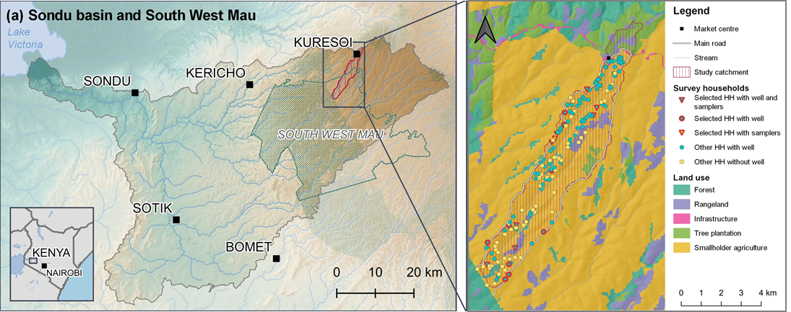
Methods
Study area
Headwater catchment (27 km²) of the Sondu river, western Kenya.
Part of the South West Mau block of the Mau Forest Complex.
Characterised by smallholder farms with median farm size of 1.2 ha.
Location of the study catchment and sampling points

Slide 5
Data Collection
Study area
Rainfall and throughfall samples were collected from precipitation collectors (n=10).
Collection was done within 24 hours after 11 rainfall events for 9 weeks.
All samples were analyzed for total dissolved nitrogen.
Inputs from fertilization were estimated from a household survey (n=185).

Slide 6
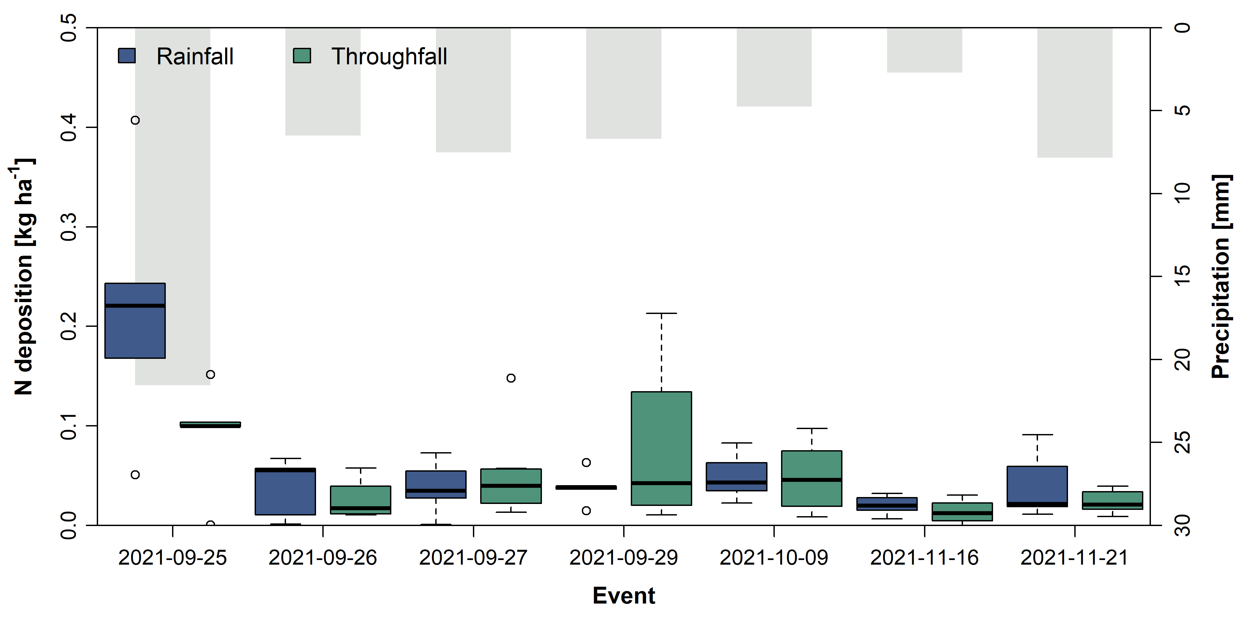
Results – wet deposition
Highest wet nitrogen wet deposition occurred during the largest rainfall event with a median of 0.2 kg N ha⁻¹.
Wet deposition of total dissolved nitrogen during sampled rainfall events.
Median concentrations of total dissolved nitrogen (TDN) and the estimated annual wet deposition were slightly higher in rainfall than in throughfall.
Median (IQR) total dissolved nitrogen (TDN) concentrations and estimated annual wet deposition
 | TDN concentration | Annual wet deposition
 | mg N L⁻¹ | kg N ha⁻¹ yr⁻¹
Rainfall | 0.7 (0.4–0.9) | 11.7 (9.5–12.5)
Throughfall | 0.6 (0.4–0.8) | 6.4 (5.7–9.6)

Slide 7
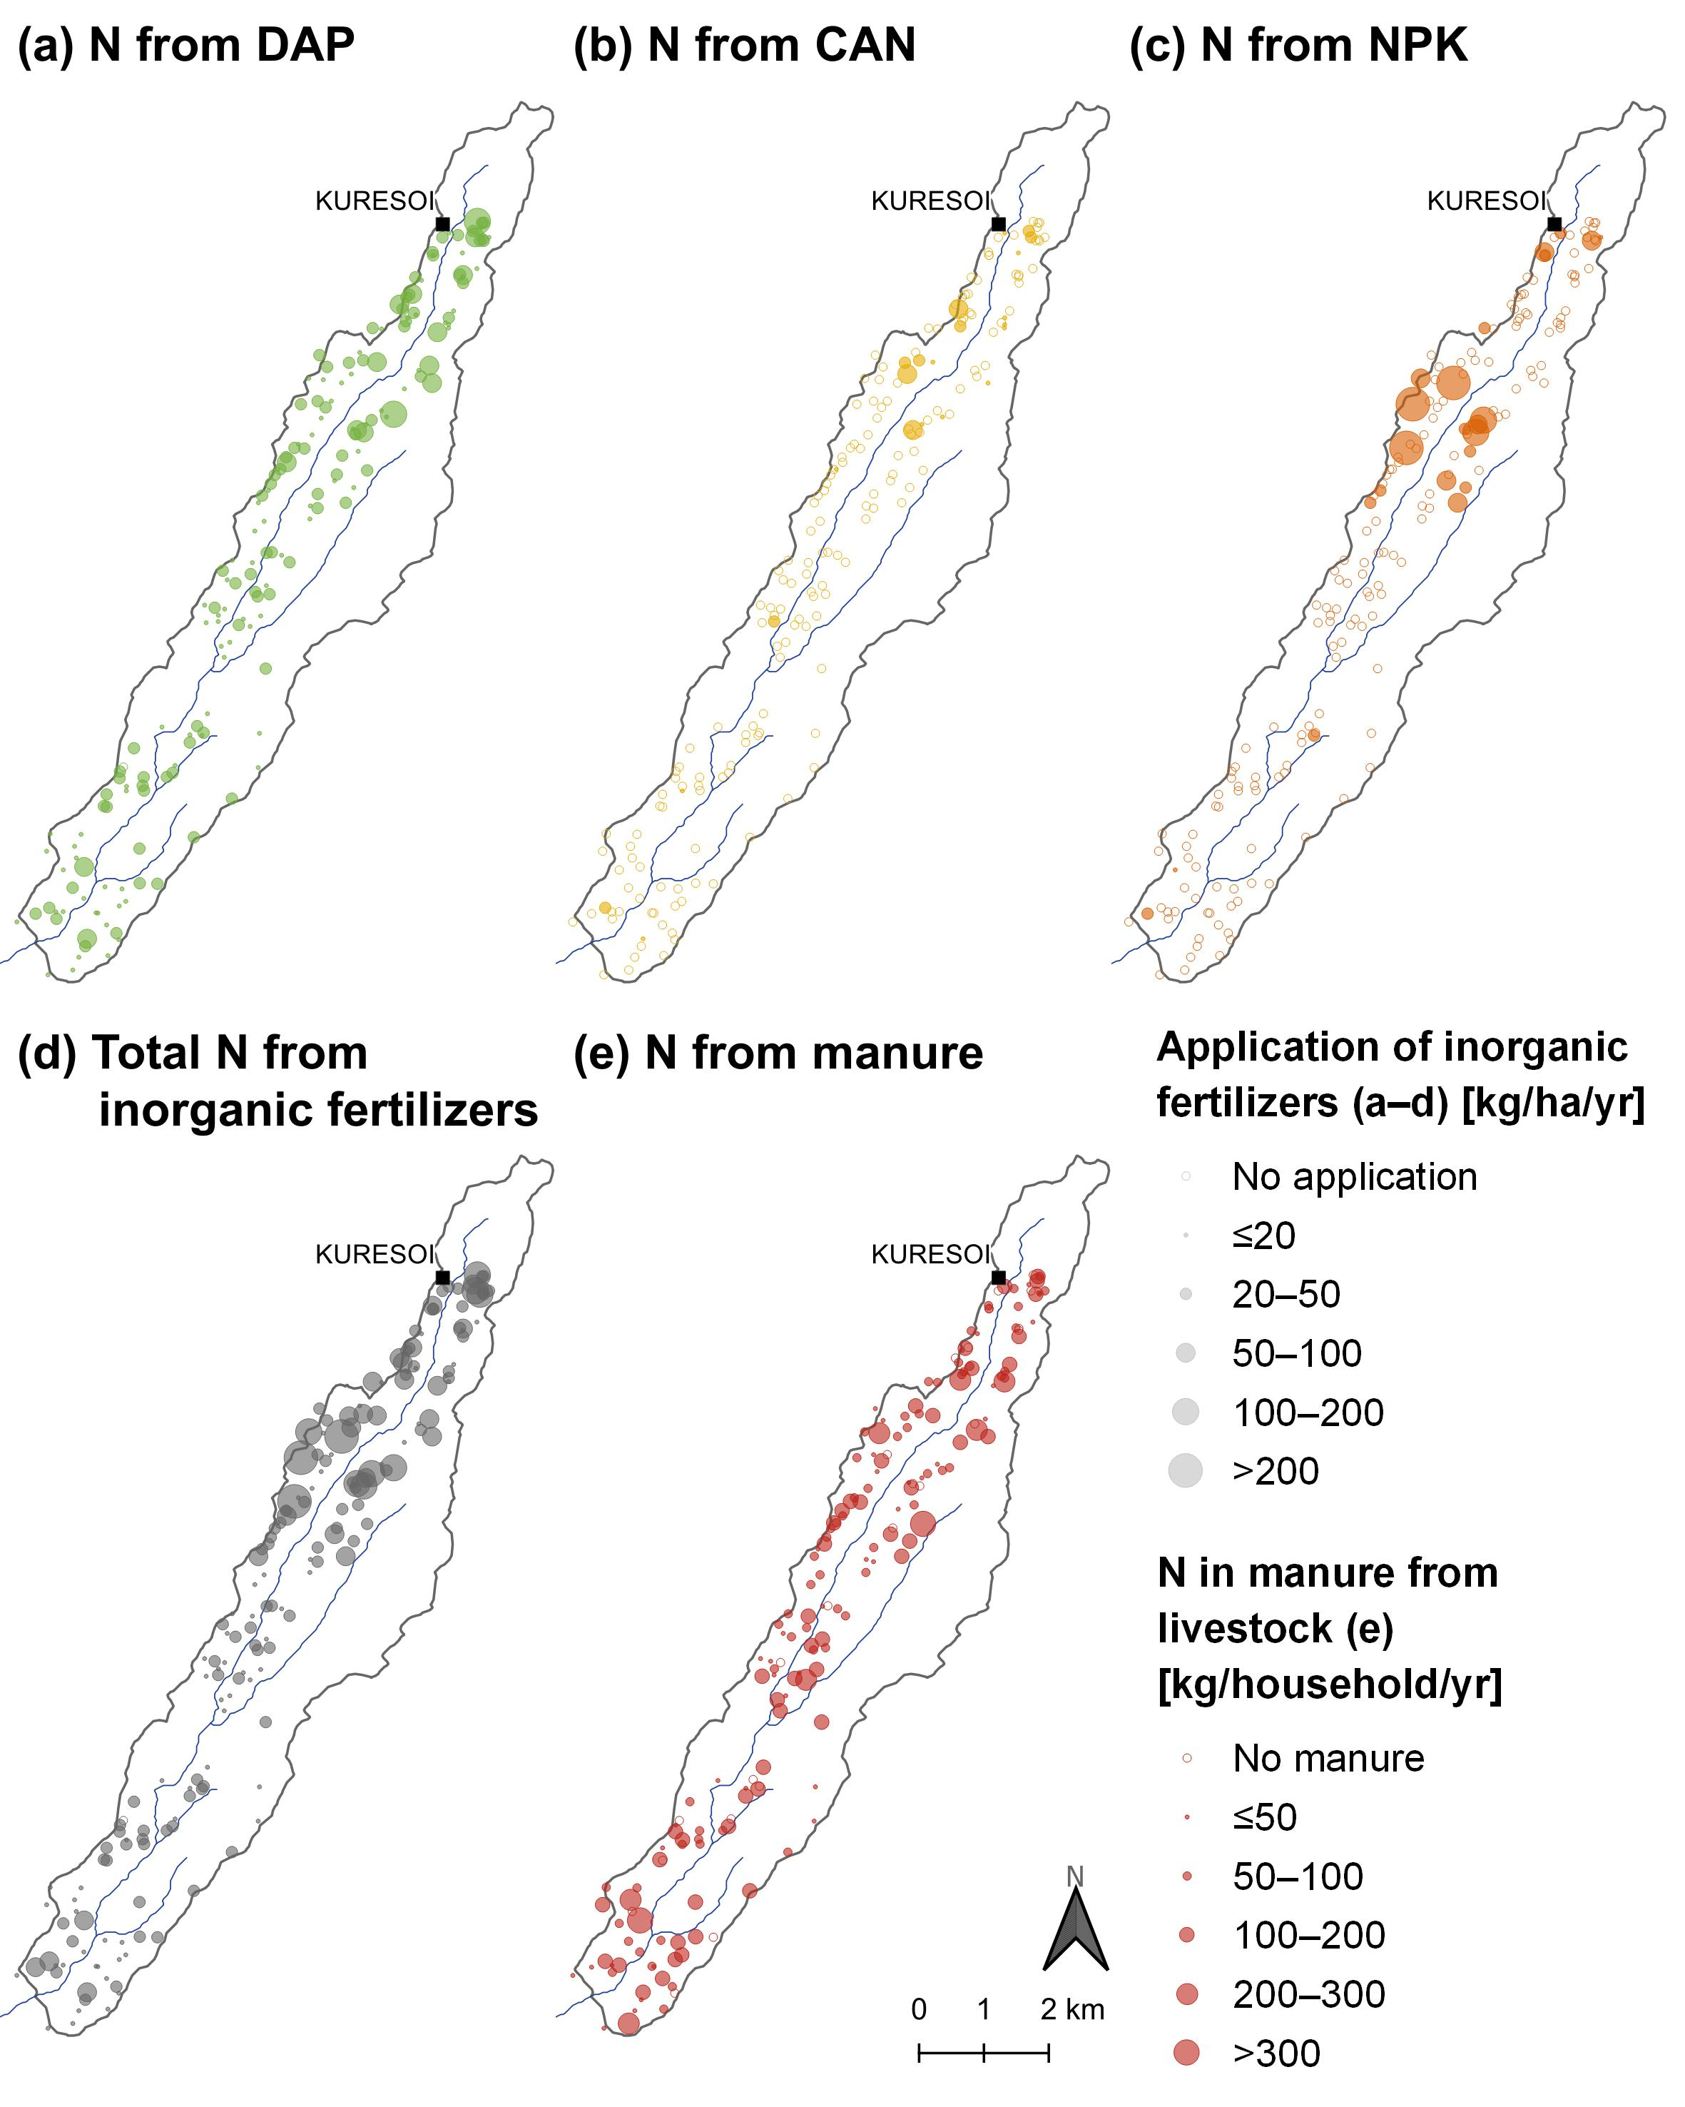
Results – inputs from fertilizer and manure
N inputs from inorganic fertilizer were 25 (15.2–40.2) kg N ha⁻¹ yr⁻¹
N inputs from livestock were 76 (49–125) kg N ha⁻¹ yr⁻¹.

Slide 8
Conclusion
The average nitrogen input through wet deposition into smallholder catchment of Mau forest is generally low, especially compared to inputs from fertilizer and manure.
Continuation and increase of nitrogen emission through for instance uncovered storage of livestock manure, fertilization with inorganic fertilizers and further forest cover loss for agricultural expansion may lead to future elevated levels of nitrogen wet deposition.
To keep these in check, appropriate manure management strategies, fertilizer application and control of forest conversion cannot be overemphasized.

Slide 9
THANK YOU

Slide 10
References
Jacobs, S.R., Weeser, B., Guzha, A.C., Rufino, M.C., Butterbach-Bahl, K., Windhorst, D., Breuer, L., 2018b. Using high-resolution data to assess land use impact on nitrate dynamics in East African tropical montane catchments. Water Resour Res 54, 1812–1830. https://doi.org/10.1002/2017WR021592
Swart, R., 2016. Monitoring 40 years of land use change in the Mau Forest Complex, Kenya. A land use change driver analysis. (MSc thesis). Wageningen University, Wageningen, the Netherlands

