Slide 1
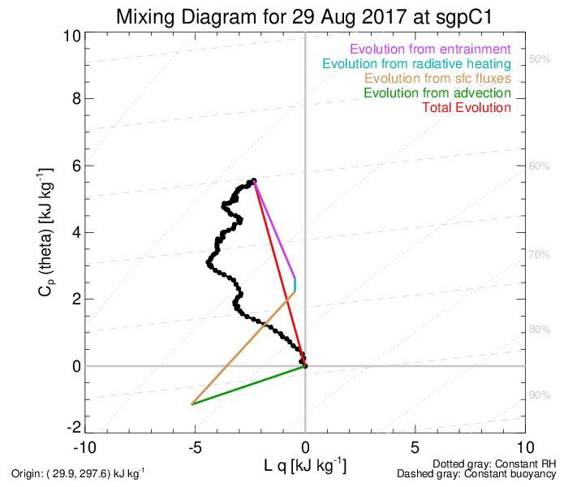
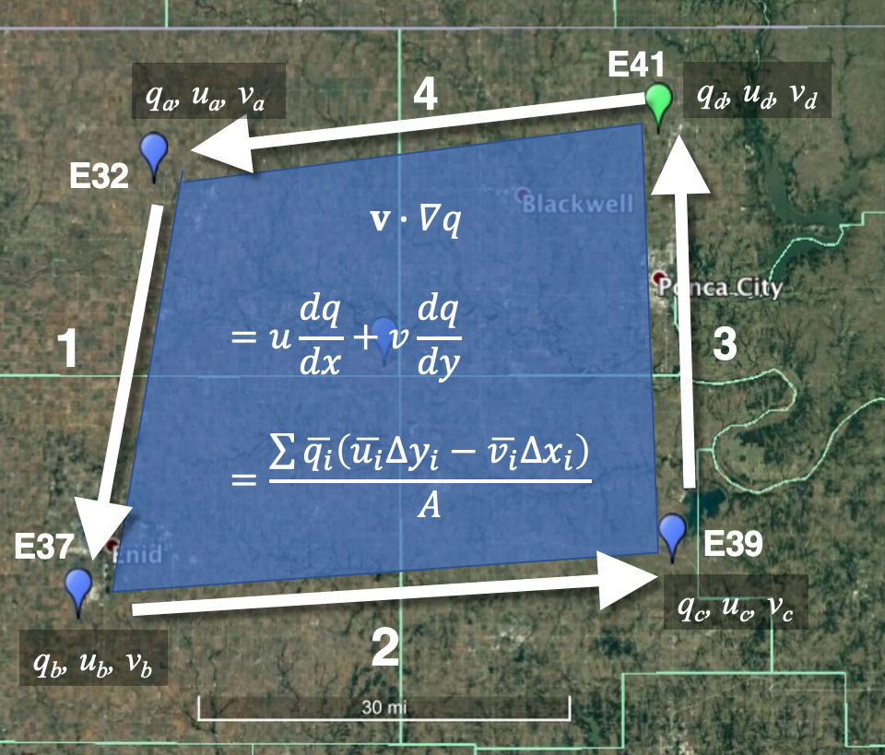
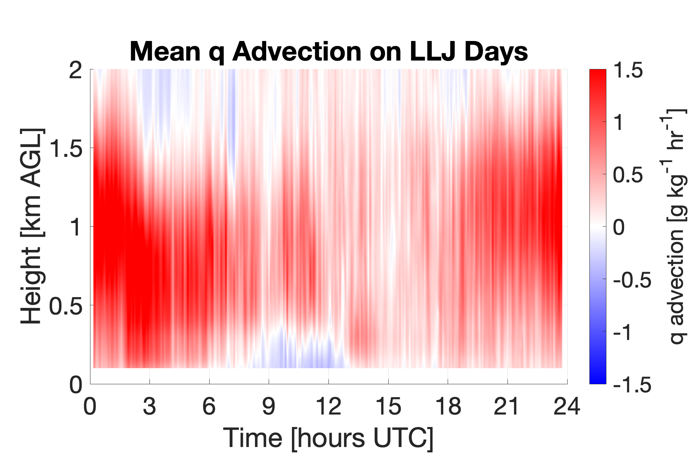
Results III: Budget Analyses and Metrics
L-A feedback metrics
Measurement of advection
Advection can be quantified by using an array of observing sites to approximate a line integral around the domain. Green’s Theorem can then be used to calculate advection.
Results show strong variability of advection depending on atmo-spheric conditions. Good agreement with model output.
Derivations of metrics using remote sensing. These demonstrate the importance of advection (Santanello et al. 2009, Wakefield et al. 2021, 2022).
Measurements of advection with remote sensing systems show high level of accuracy (Wagner et al. 2022).
Notes:
Mixing diagram is basically a water-vapor budget analysis in the PBL. Black line: measurements of water-vapor and temperature profiles. Where did the advection come from? Tim Wagner, Uni MW

Slide 2
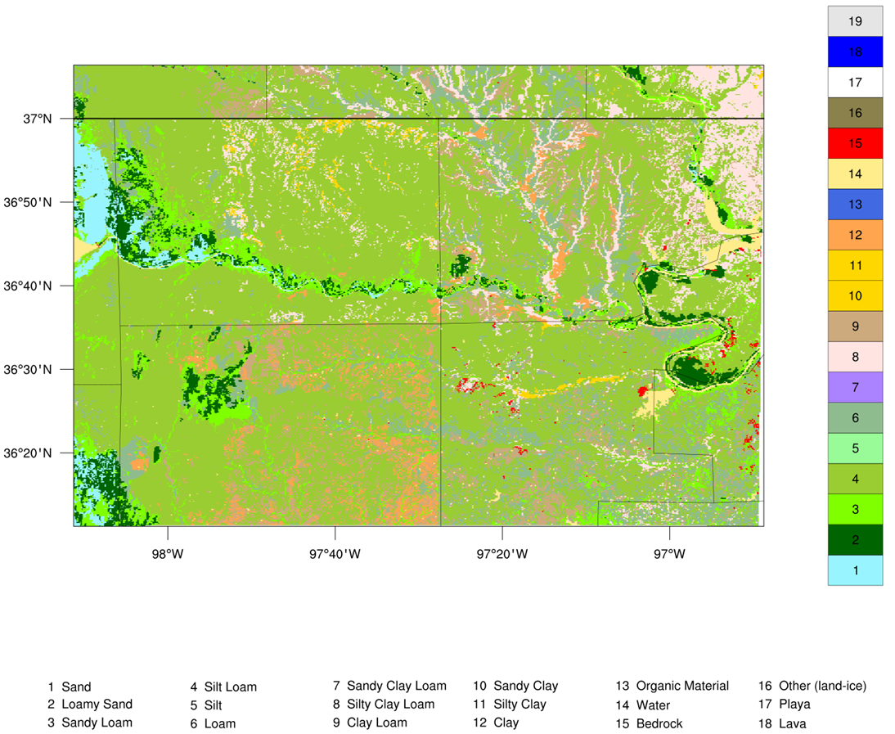
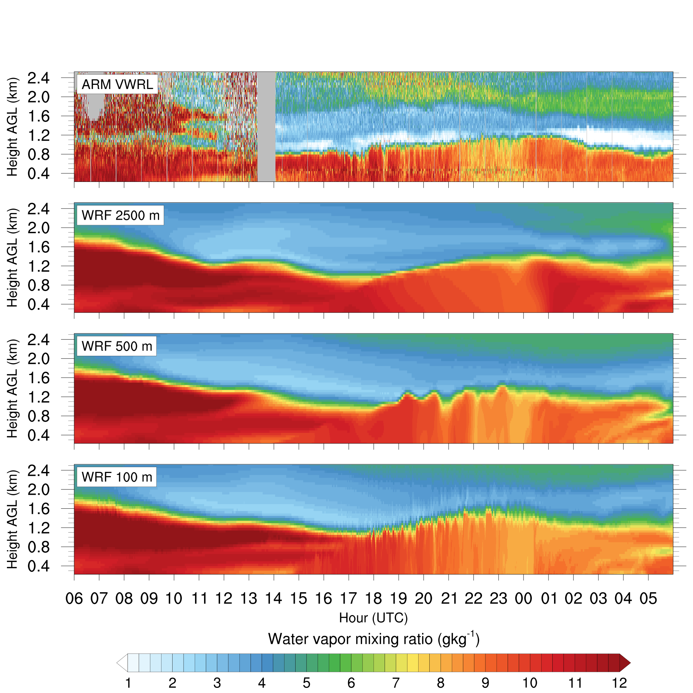
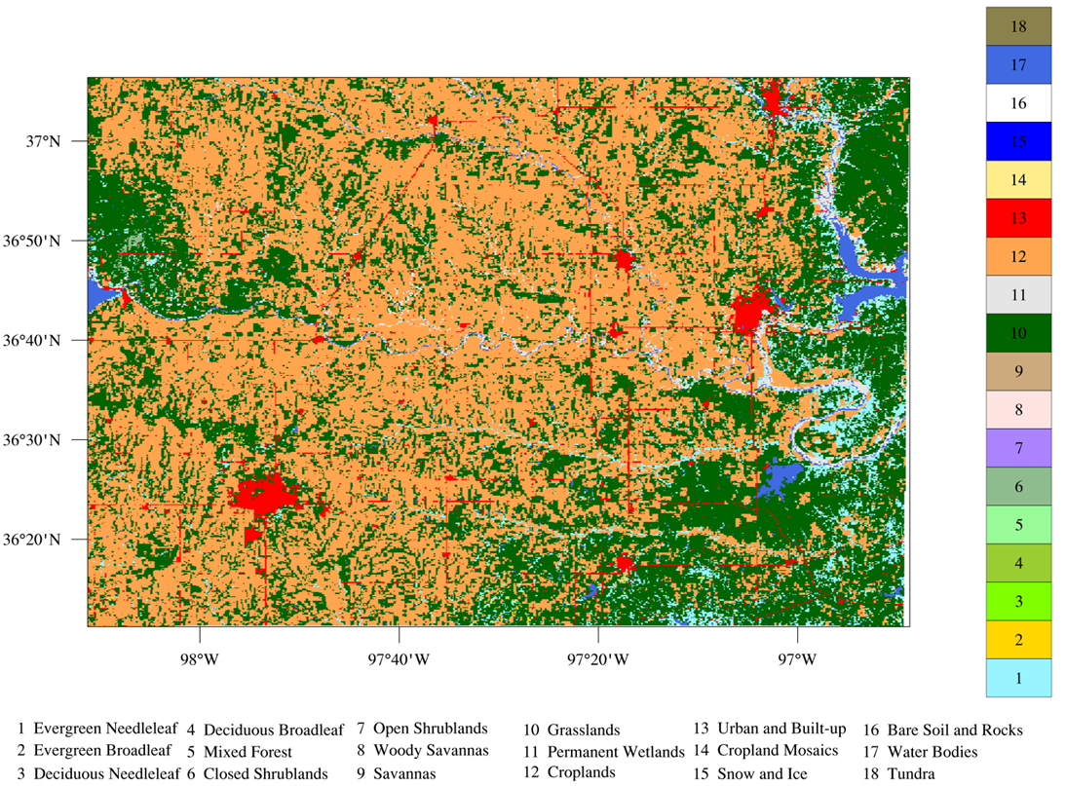
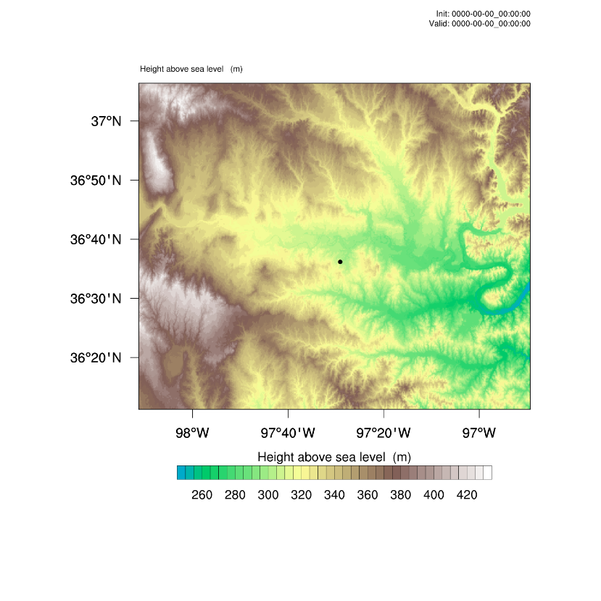
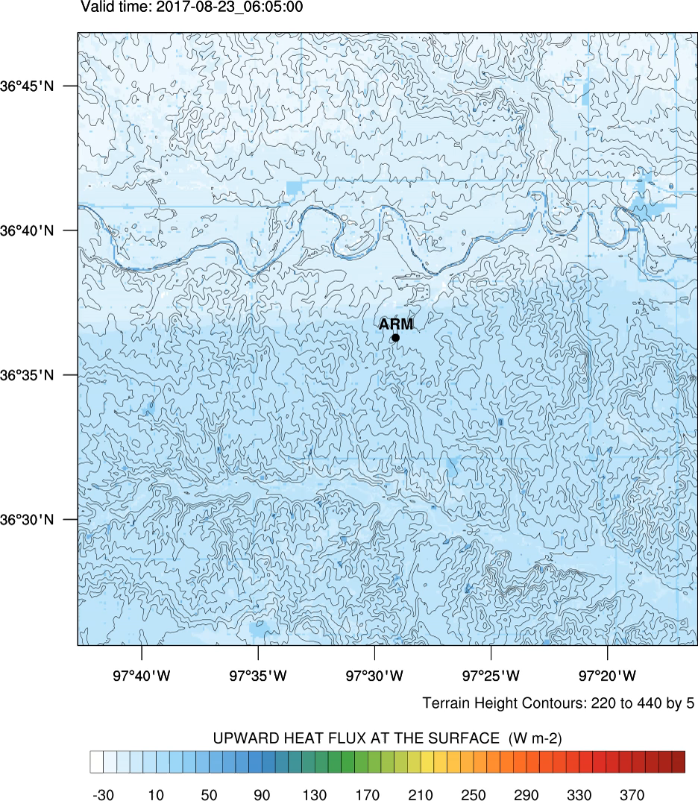
Results IV: Nested WRF-LES
ECMWF forcing
WRF 4.2.1 with NOAH-MP, RRTMG, MYNN-EDMF, Thompson microphysics, no parameterization of deep convection
Resolution chain 2.5 km – 500 m – 100 m (- 20 m)
At least 100 vertical levels (25-30 in the boundary layer)
Orography: National Elevation Dataset (10 m resolution)
National Land Cover Data set (30 m resolution)
Gridded Soil Survey Geographic database (10 m resolution)
LES mode in the innermost two domains
120 km x 100 km, 100 m
August 23, 2017, evolution of surface sensible heat fluxes
LES and LAFE sensor synergy permit new insights in parameterizations and the effects of land-surface heterogeneity (Bauer et al. 2022, in review).
Notes:
LES heterogeneity

Slide 3
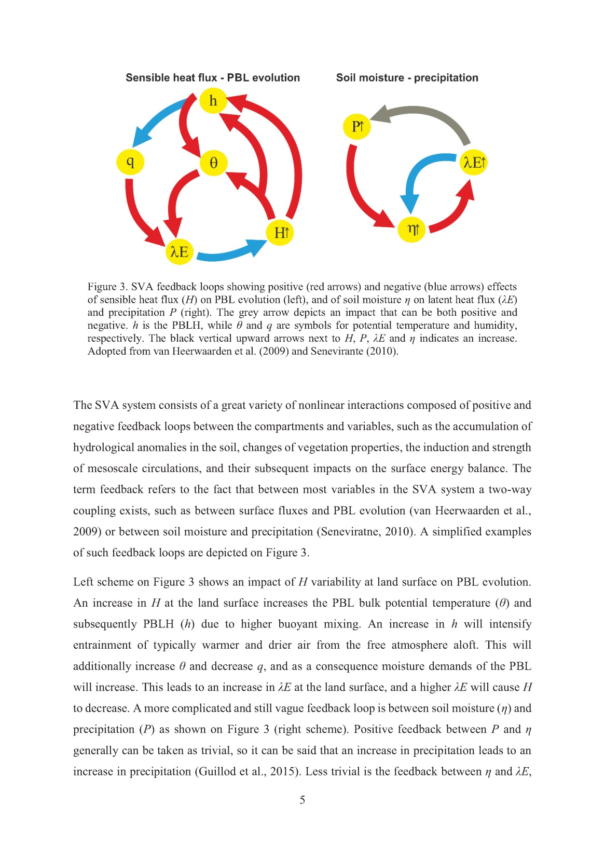
Overarching Scientific Goals
Understand the L-A feedback chains over the regimes of all
compartments in the context of large-scale forcings and
characterize coupling strengths
Quantify the effects of LULCC on regional weather and climate
also in connection with future bio-geoengineering efforts
Observation of surface and entrainment fluxes in complex terrain
Quantify ET and its separation in E and T
Study the EBC in heterogeneous terrain
Advanced parameterizations of surface fluxes and ABL turbulence
Regional water and energy budget analyses
Verification of Earth system models down to the turbulent scales
Impact studies towards operational assimilation of GLAFO data
Climate monitoring
Adopted from van Heerwaarden et al. QJRMS 2009 and Seneviratne et al. ESR 2010
3

Slide 4
GLAFO Hierarchical Design Matrix
Level, costs | Soil | Land cover | Atmosphere |  | Metrics and Process Studies
 | State, variables | State, variables | Variables | Instrument
L1a, $ | Soil texture, T, Θ, Ψ | Type and state, albedo, LST, surface energy balance, snow | z_{i}, m(z), T(z), RH(z), aerosol particles (α_{par}, β_{par}), clouds | Thermodynamic profiler (water vapor (WV) and temperature) | Mixing diagram, CTP-Hi_{low} , HCF, TCI, PBL process studies
L1b, $ | Soil texture, T, Θ, Ψ | Type and state, albedo, LST, surface energy balance, snow | Plus V(z), TKE, momentum flux, ε | L1a + scanning Doppler lidar (DL) | Expansion of TCI, refined metrics including wind
L2, $$$ | Soil texture, T, Θ, Ψ, ground-water level | Type and state, albedo, LST, surface energy balance, snow | Plus w‘(z), <a^{‘k}>, <w‘q‘>, <w‘T‘>, <a‘^{i} b‘^{j}> also for entrainment | L1 + vertical DL, WV and T Raman lidar (RL) and/or WV DIAL | Plus RHT, WV and T budget closures
L3, $$$ | Soil texture, T, Θ, Ψ, ground-water level | Type and state, albedo, LST, surface energy balance, snow, canopy T, m, rad | Plus atmospheric SL profiling for deriving surface fluxes | L2 + scanning DL, RL, and/or DIAL | Plus SL process studies
L4, $$$ | Same as L3 + a triangle of V(z), T(z) and m(z) profiles |  |  | L3 + scanning DL and vertical TD profiler | Plus advection, full budget analyses
TD: thermodynamic, DL: Doppler lidar, TRL: temperature Raman lidar, WVRL: Water vapor Raman lidar, WVDIAL: Water-vapor differential absorption lidar, L: latent heat flux, S: sensible heat flux

Slide 5
GLAFO Proposed Data Sets
Metrics and Processes | Key Data | Postprocessing | Comments
Metrics
Mixing diagram | Surface fluxes, WV and T profiles, z_{i} | z_{i} algorithm, close gaps of profiles to the surface | Profiles more accurate than surface data, advection remains as residual
CTP-HI_{low} | WV and T profiles | Derive CTP and HI_{low} | Choice of pressure range for CTP, choice of pressure levels for HI_{low}
HCF | WV and T profiles | Derive BCL and Θ_{BM} | High accuracy and vertical resolution required
Two-lagged metrics | Soil, vegetation and atmospheric variables | Critical variables, such as z_{i}, their standard deviations, and slopes | Plus advection, full budget analyses
RHT | Surface and entrainment fluxes, WV and T profiles | Derive RH and d/dt RH, entrainment fluxes, and WV and T gradients | Requires high vertical and turbulence resolutions of the WV and T profiles
Process studies
Entrainment | q‘, T‘, w‘ | <w‘T‘>, <w‘q‘>, TKE | Near-operational with DL and WVTRL combi
Turbulence param. | q‘, T‘, w‘, u‘, v‘ | <w‘T‘>, <w‘q‘>, TKE, <u‘w‘>, <v‘w‘>, <q‘²>, <T‘²>, etc. | Requires special GLAFO lidar combi (L2), all tools are routinely available

Slide 6
Turbulence Statistics from LAFO
With GLAFO data it is feasible to provide statistics for turbulence parametrizations.

