Slide 1
Simulating direct and semi-direct effect of aerosols on subseasonal prediction: climatology versus interactive aerosols in the UFS model
Shan Sun¹, Gregory Frost², Georg Grell¹,
Li Zhang^{1,3} Barry Baker⁴, Jessica Meixner⁵ Fanglin Yang⁵, Anning Cheng⁶ & Jiande Wang⁶
¹NOAA Global Systems Laboratory
²NOAA Chemical Sciences Laboratory
³University of Colorado at Boulder, CIRES
⁴NOAA Air Resources Laboratory
⁵NOAA NCEP Environmental Modeling Center
⁶Lynker at NOAA NCEP EMC
Shan Sun & Georg Grell
Earth Prediction Advancement Division

Slide 2
Unified Forecast System (UFS) Components
Components | Models | Resolution
Atmosphere | FV3+GFSv17 | 25km, 127 layers
Ocean | MOM6 | ¼º, 75 layers
Sea Ice | CICE6 | ¼º
Wave | WW3 | ½º x ½º
Aerosol | Climatology or online GOCART | same as atmosphere

Slide 3
Model Configuration: UFS Prototype 8 and its variants
 | Aerosol Source for Atmosphere
Exp.1 | Prescribed MERRA2-Climatology (ClimAer => control)
Exp.2 | Prognosed from GOCART (ProgAer)
Initial condition: 1 Apr 2011 - 1 Mar 2018, monthly
Integration time: 32 days
Global Systems Laboratory

Slide 4
Aerosol Optical Depth (AOD₅₅₀) Monthly Mean 2011-2017
MODIS
ClimAer minus MODIS
ProgAer minus MODIS
May
Sep
AOD from MERRA2 clim is similar to MODIS, except stronger in E Asia in May and weaker in S Africa in Sep.
AOD from GOCART is stronger than MODIS over Sahara in May/Sep and weaker in S Africa in Sep.

Slide 5
Difference in AOD₅₅₀ (ProgAer minus ClimAer) monthly mean 2011-2017
May
Sep
Sep
Differences in AOD between ProgAer and ClimAer can be large, such as in Africa and E Asia
Global Systems Laboratory

Slide 6
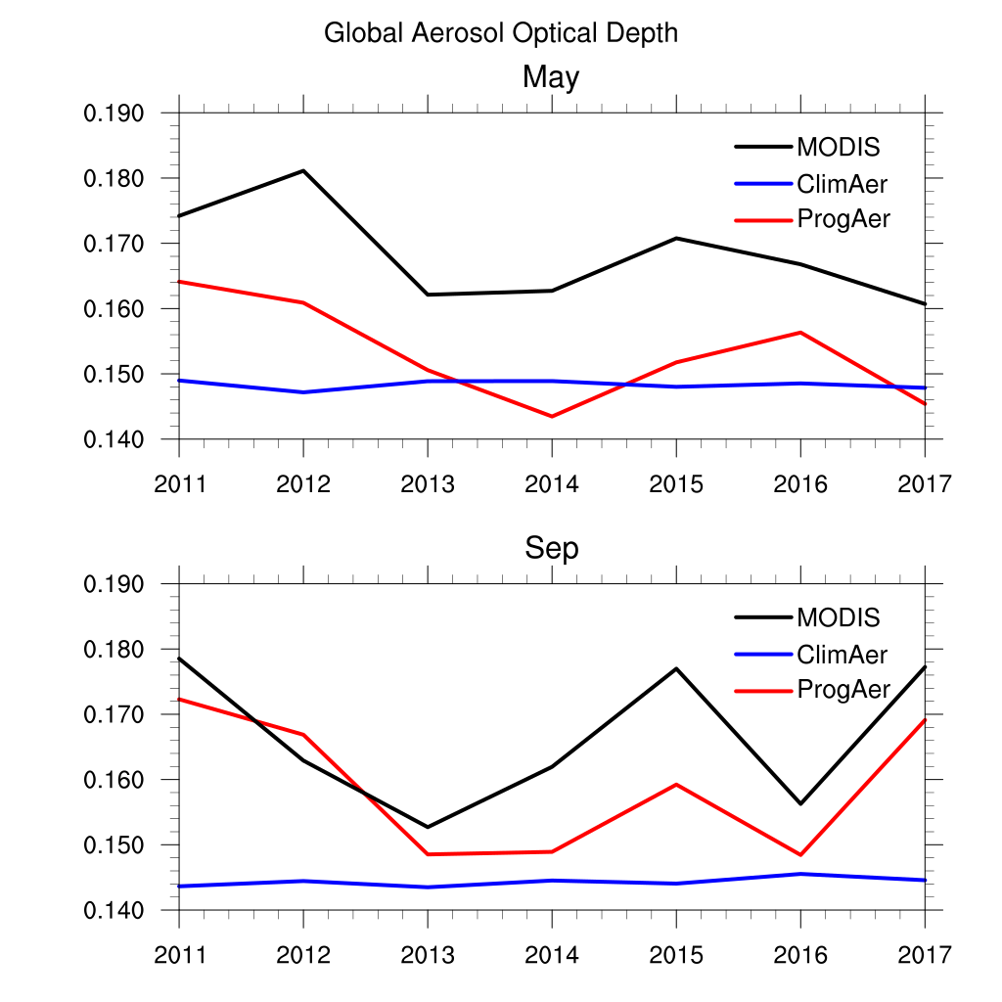
Global Aerosol Optical Depth (AOD₅₅₀) Monthly Mean 2011-2017
AOD from ClimAer runs using MERRA2 climatology (blue) is lower than that of MODIS (black, dashed: multi-year mean)
AOD estimated from ProgAer runs (red) captured the interannual variability shown in MODIS

Slide 7
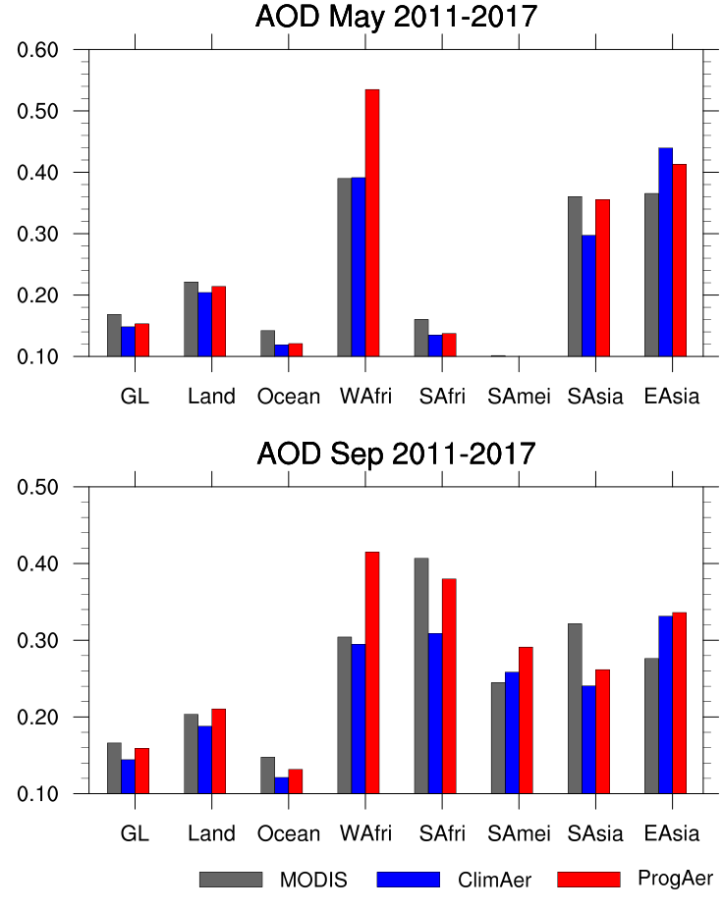
AOD₅₅₀ Mean 2011-2017
Global AOD from two model runs is slightly lower than that of MODIS
The biggest bias is in dust AOD from ProgAer runs
AOD is higher in ProgAer runs than ClimAer runs (MERRA2 climatology) in the wildfire regions

Slide 8
AOD₅₅₀ North Africa Mean 2011-2017
Total AOD Dust AOD Sulfate AOD OC AOD BC AOD
Bias in total AOD in north Africa in ProgAer runs mostly comes from dust AOD both in May and Sept.

Slide 9
AOD₅₅₀ South Africa Mean 2011-2017
Total AOD Dust AOD Sulfate AOD OC AOD BC AOD
Bias in total AOD in south Africa in ProgAer runs mostly comes from OC both in May and Sept.

Slide 10
AOD₅₅₀ South America Mean 2011-2017
Total AOD Dust AOD Sulfate AOD OC AOD BC AOD
Differences in total AOD in east Asia between two runs comes from OC both in May and Sept.

Slide 11
AOD₅₅₀ East Asia Mean 2011-2017
Total AOD Dust AOD Sulfate AOD OC AOD BC AOD
Differences in total AOD in east Asia between two runs comes from sulfate AOD both in May and Sept.

Slide 12
Cloud Cover (%) Monthly Mean 2011-2017
CERES
ClimAer minus CERES
ProgAer minus CERES
May
Sep
Pos bias in cloud cover on land and near EQ; neg bias along east coast of PA and AT ocean. Global mean bias: +5%
Cloud cover bias seen in ProgAer is similar to those in ClimAer.
Global Systems Laboratory

Slide 13
RF TOA (W/m²) Monthly Mean 2011-2017 ( positive)
CERES
ClimAer minus CERES
ProgAer minus CERES
May
Sep
RF TOA pos bias over Sahara and near EQ; neg bias over ocean.
Global mean bias: -0.5 : 2W/m²
RF TOA bias seen in ProgAer is similar to those in ClimAer.
Global Systems Laboratory

Slide 14
Surface SW (W/m²) Monthly Mean 2011-2017
CERES
ClimAer minus CERES
ProgAer minus CERES
SW pos bias on land and near EQ; neg bias along east coast of PA and AT ocean.
Global mean bias: 6 W/m²
SW bias seen in ProgAer
is similar to those in ClimAer.
Global Systems Laboratory

Slide 15
AOD September 2011-2017
E Asia
W Africa
S Asia
S America
S Africa
Global Systems Laboratory

Slide 16
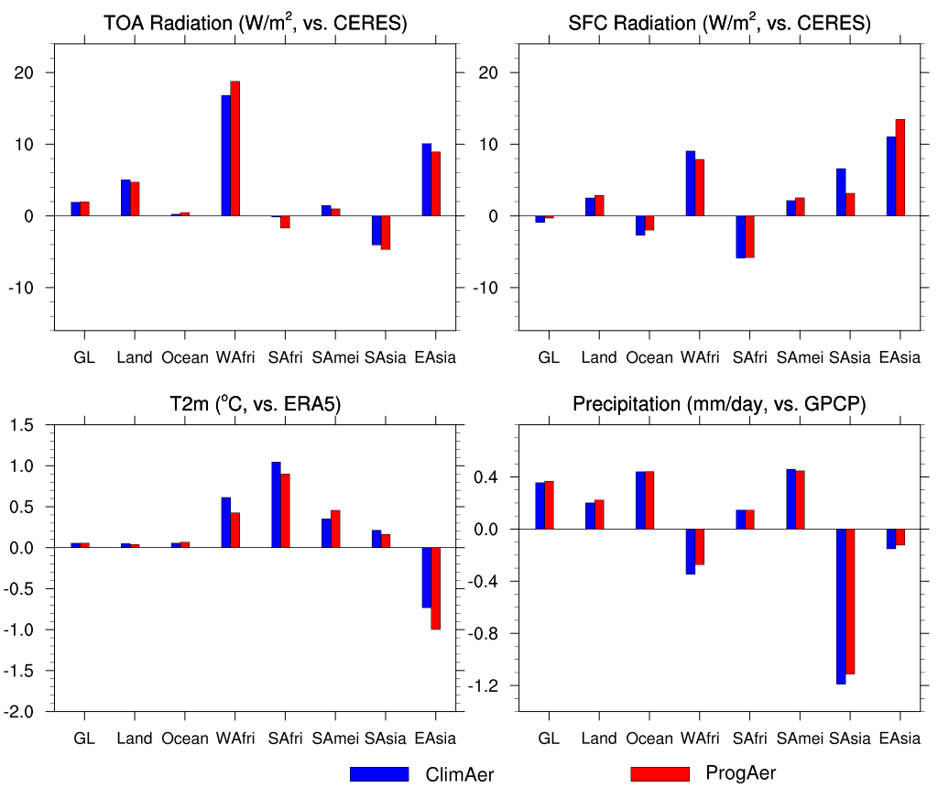
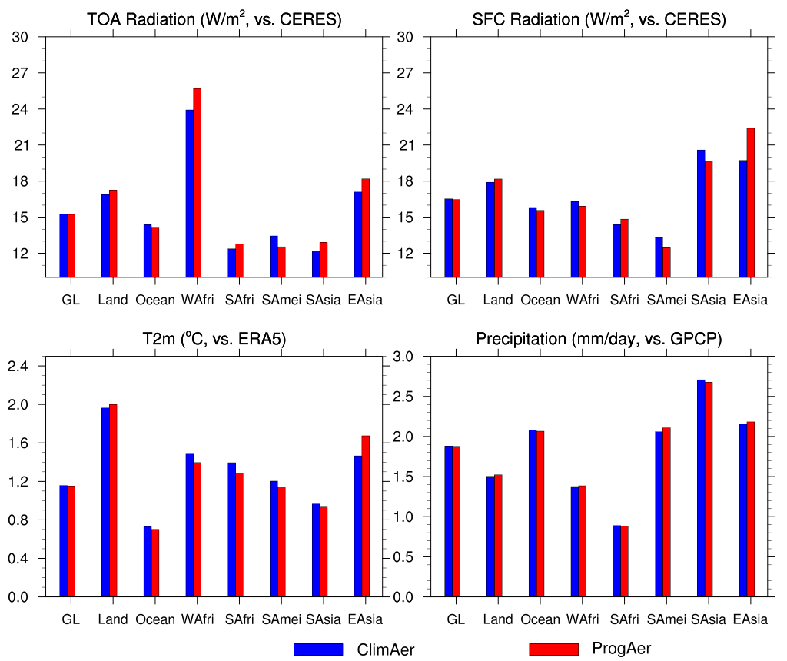
Model Bias and RMSE, May 2011-2017
BIAS
RMSE
RF TOA
RF SFC
RF TOA
RF SFC
T2m
Precip
T2m
Precip
Global Systems Laboratory

Slide 17
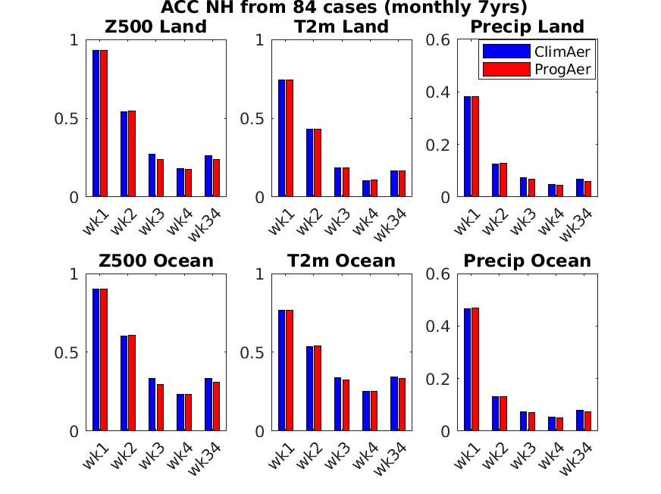
NH ACC 2011-2017
Z500
T2m
Land
Precip
Ocean
Global Systems Laboratory

Slide 18
ACC T2m 2011-2017
Global Systems Laboratory

Slide 19
ACC Precipitation 2011-2017
Global Systems Laboratory

Slide 20
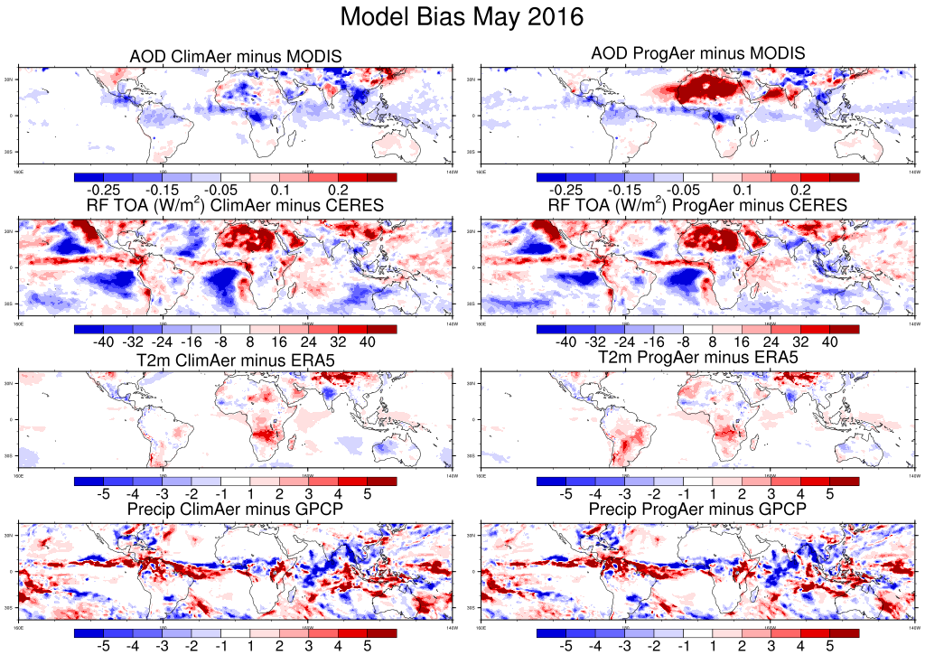
AOD: ClimAer has a neg bias; ProgAer has a pos bias over Sahara;
RF TOA: ProgAer has a lower bias in SH;
T2m: ProgAer has a lower bias except over S America;
Precip: similar

Slide 21
Summary
This is a preliminary study investigating the direct and semi-direct effects of aerosols on subseasonal forecasts with the Unified Forecast System (UFS), utilizing both climatological and prognostic aerosols;
The AOD from ClimAer runs with prescribed MERRA2 aerosol climatology is slightly lower than that of MODIS and lacks the inter-annual variability seen in the latter;
It is promising that the AOD derived from ProgAer runs using the online GOCART model successfully captured the inter-annual variability. Moreover, the mean aerosol-radiation interaction simulated in this run shows similarities with that of ClimAer runs, as both show comparable biases in radiative forcing at TOA and cloud cover;
Aerosol semi-direct effects on precipitation is minimal. Further investigations are being conducted to study the influence of aerosol indirect effects.
Global Systems Laboratory

