Slide 1
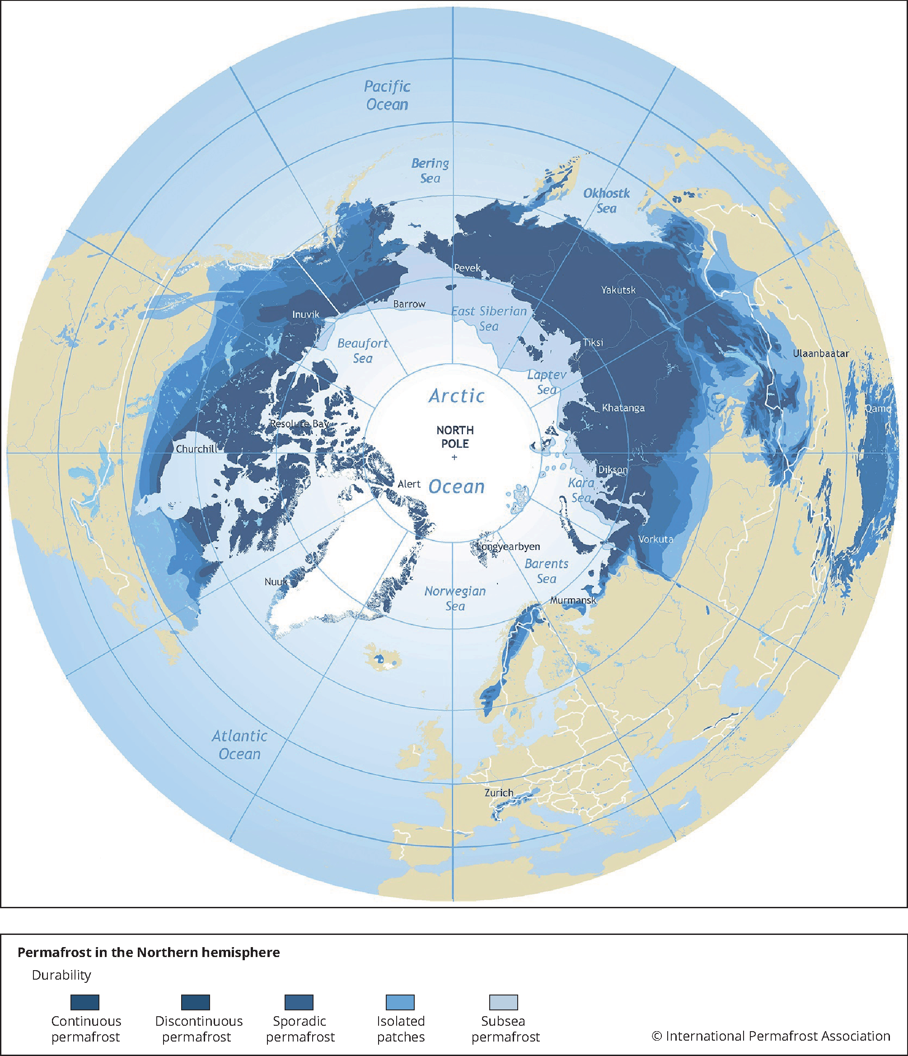
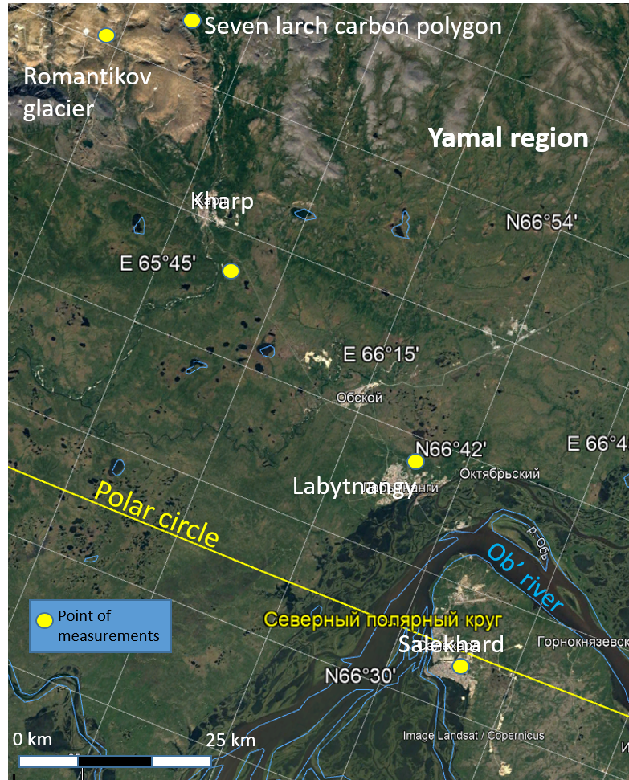
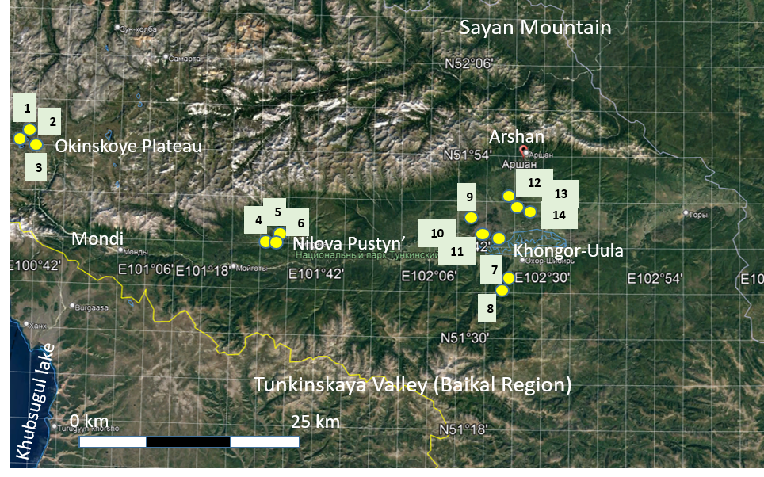
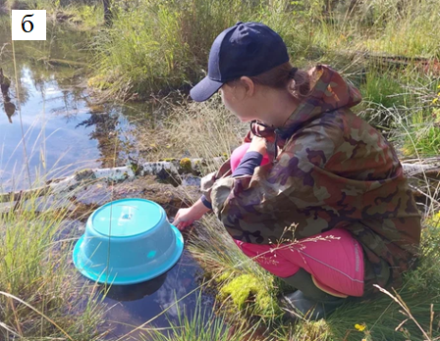
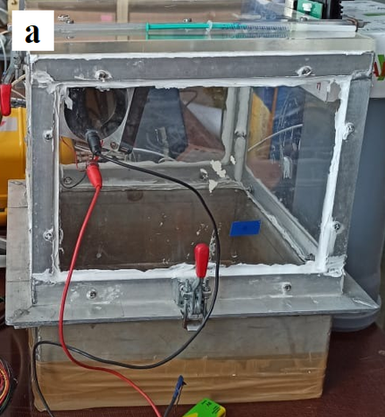
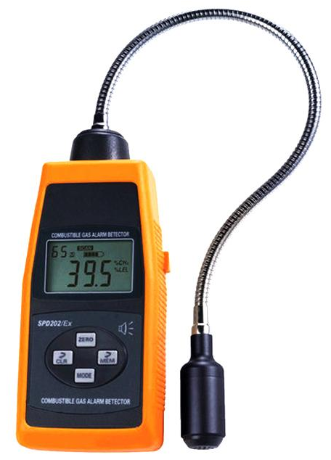
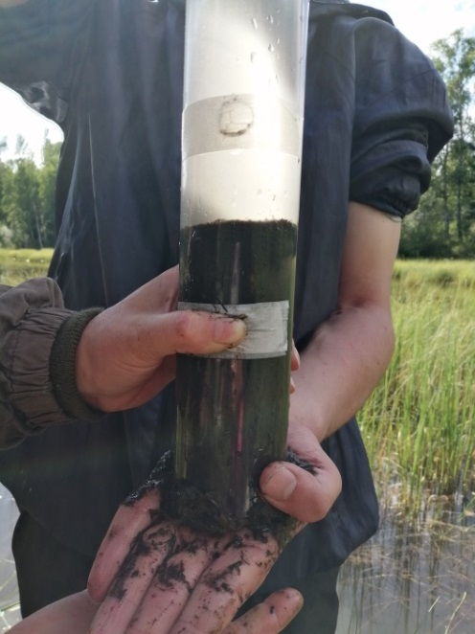
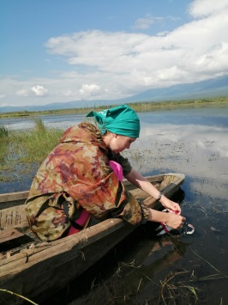
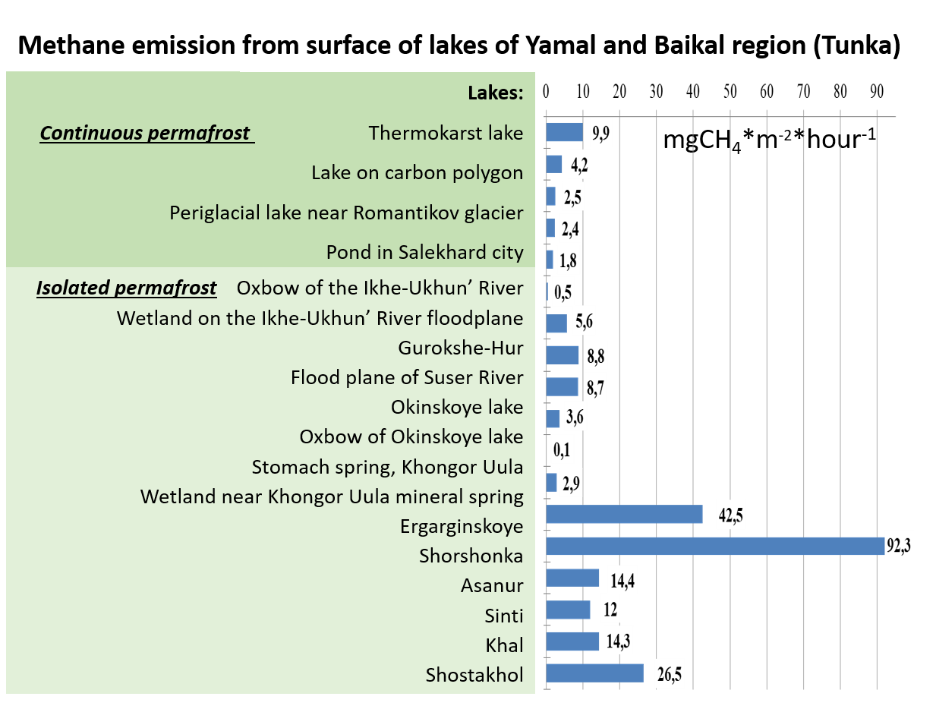
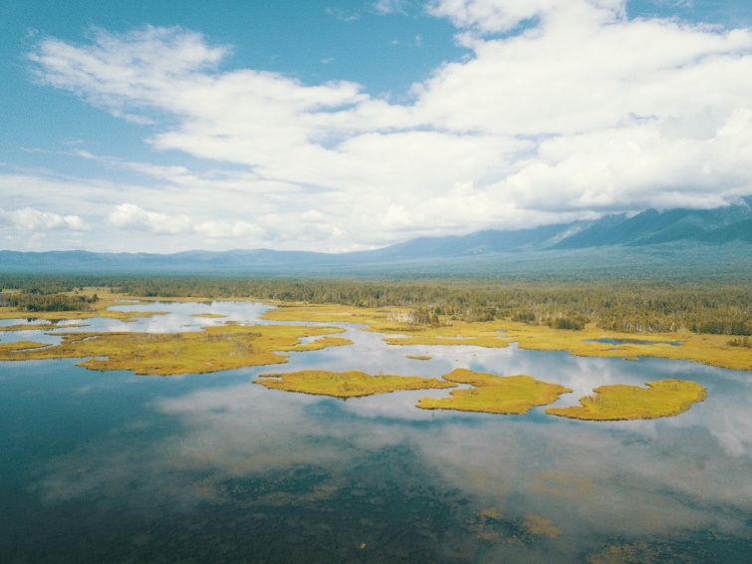
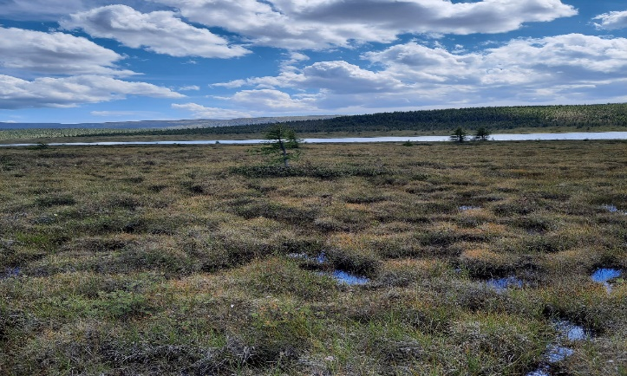
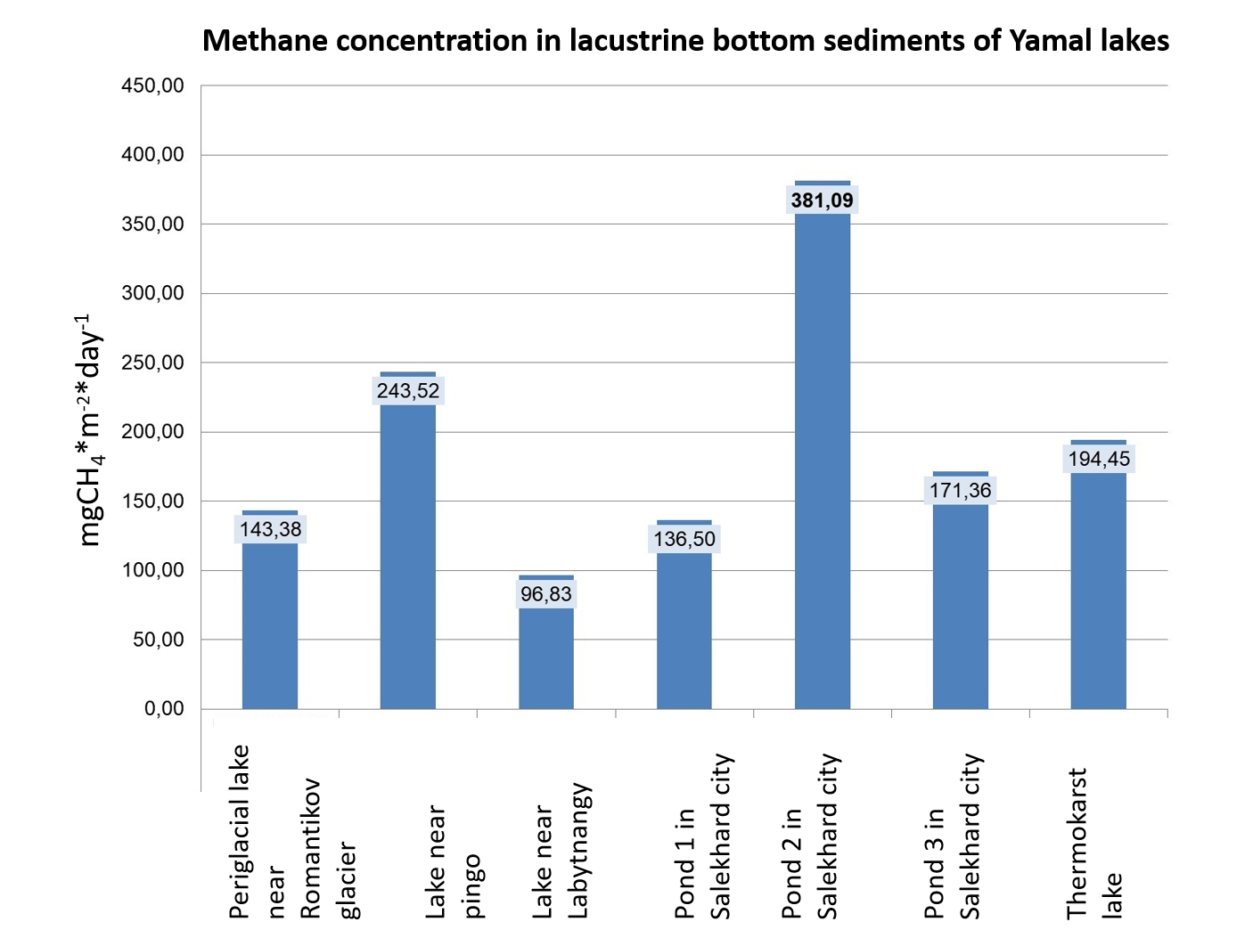
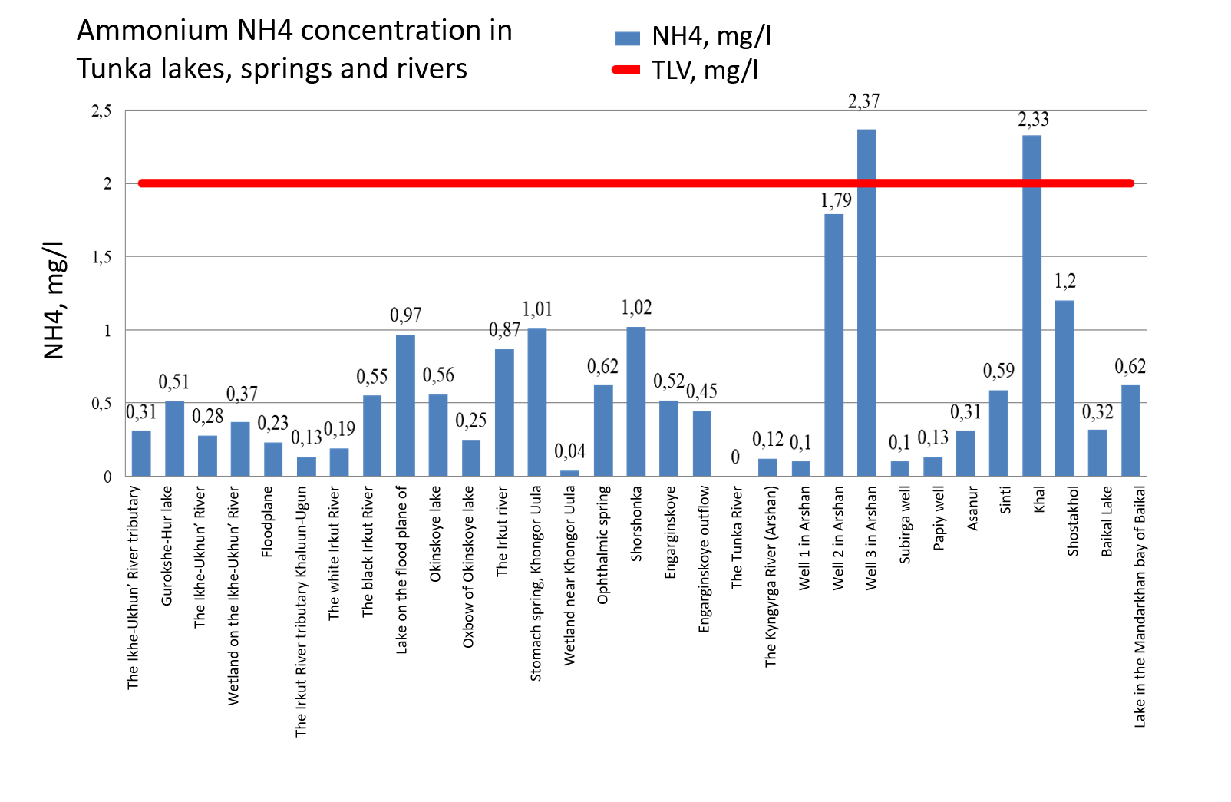
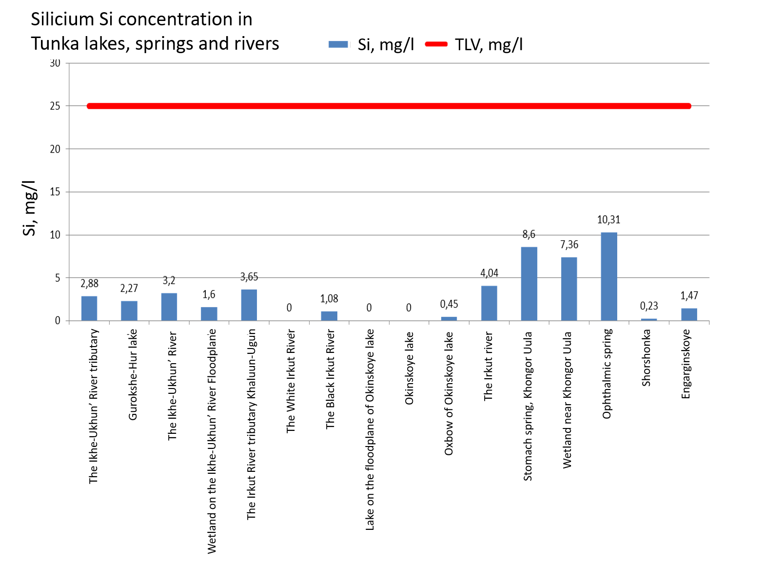
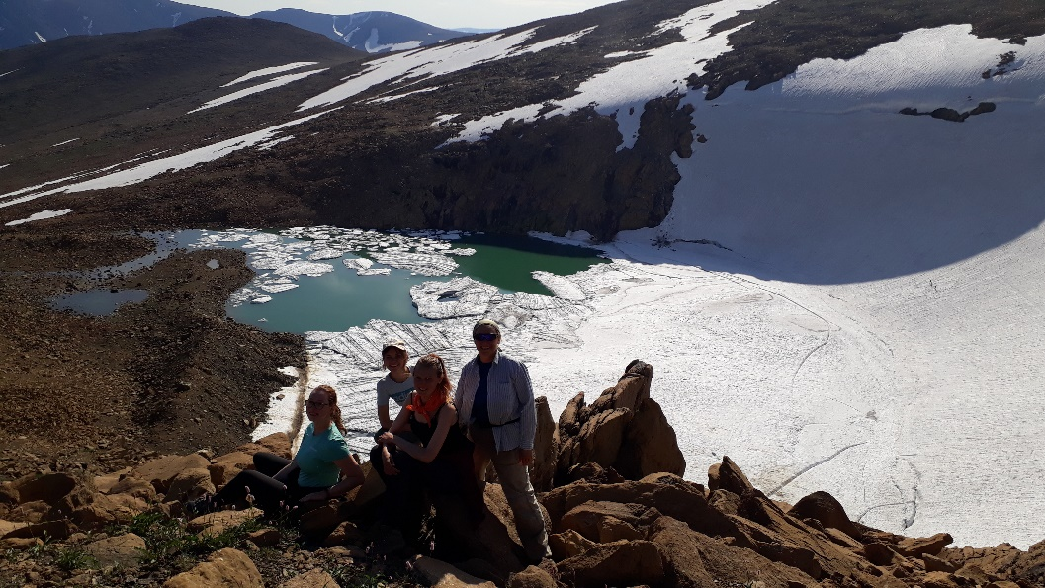
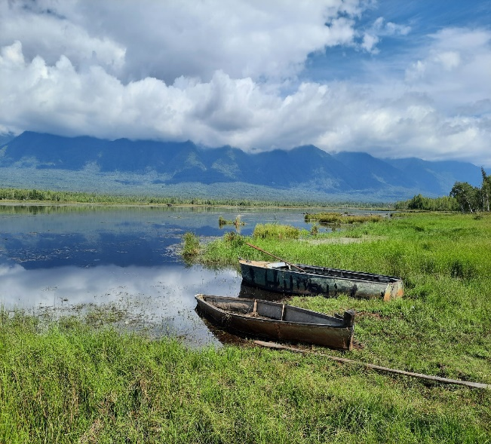
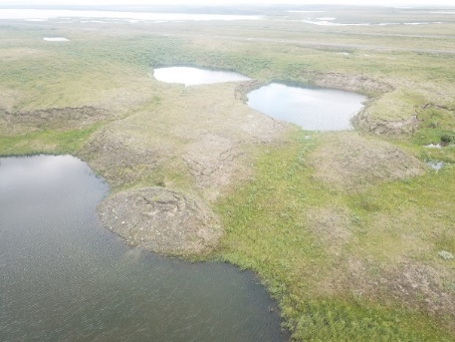
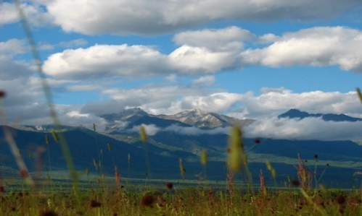
Fedorova Irina, Shornikova Anna, Chulkova Ekaterina, Irina Arestova
Saint Petersburg
State University
Institute of Earth Sciences
Methane Emission from lakes on continuous and isolated permafrost in Russia
Saint Petersburg State University, i.fedorova@spbu.ru
Introduction. Greenhouse gases emission from lakes is quite significant environment question in the cryosphere. Up to know the volume of storage and reason that influence on it are underestimated. If GHG emission for the Arctic landscapes and boreal wetlands are measuring on seldom stations, data from permafrost border is insufficient.
There are continuous and isolated permafrost with many lakes in Russia. Two zones with continuous and isolated permafrost were chosen for investigation – Yamal and Baikal region consequently (Figure 1). In the course of field studies on the territory of the continuous permafrost of Yamal in the period 18-24 July, 2022 and on the territory of the island permafrost of Tunka – 4-19 August, 2022, methane emissions from the lake surface were measured. Measurements carried out on three sites of the lake: the coastal strip, the littoral, the surface of the lake (3 sites).
Figure 1
Map of methane emission measurement points from the surface of lakes in the Yamal-Nenets Autonomous Okrug, the Arctic (Yamal) (continuous permafrost)
Tunka
Yamal
All lakes underline by permafrost
Map of methane emission measurement points from the surface of lakes in the territory of Tunkinskiy National Park (Republic of Buryatia, Baikal Region, Tunka) (isolated permafrost)
a
B
c
d
e
f
1 Okinskoye lake
2 Oxbow of Okinskoye lake
3 Lake on the flood plane of
Suser River, Okinskoye Plateau
4 Gurokshe-Hur lake
5 Wetland on the Ikhe-Ukhun’ River floodplane
6 Oxbow of the Ikhe-Ukhun’ River
7 Stomach spring, Khongor Uula
8 Wetland near Khongor Uula mineral spring
9 Engarginskoye
10 Asanur
11 Sinti
12 Shostakhol
13 Khal
14 Shorshonka
A. Region of studies.
Methane emissions from the lake surface on the territory of the Yamalo-Nenets Autonomous Okrug (Yamal, the Arctic) were measured from four points: 2 thermokarst lakes are located on the territory of the “Seven Larch” carbonate polygone. The site is on the hill peak and slopes made up of glacial deposits on the southern border of the forest tundra. The 3rd point is a periglacial lake near the Romanticov glacier. The 4th point is a eutrophying lake inside the Salekhard city. Yamal is a continous permafrost area.
Measurements of methane emissions from the lake surface in the Tunkinskiy National Park (Tunka, Baikal region) were carried out from sixteen points: Lakes 1, 2, 3 are located on the Okinskoe plateau, points 4, 5, 6 were carried out on the Tunka territory near populated area of balneological resorts Nilova Pustyn’. Measurements of methane flow in the territory of the Khongor-Uula mineral springs were carried out on points 7, 8. Point 9 – Erganginskoye eutrophic lake. Underestimated oxbow lakes near Kharagol village - points 10, 11 and 12, 13, 14 - lakes of Koymorskiye wetlands. Tunka region is underlain by isolated permafrost (active layer had just 0.5 m in summer 2022). Locations of measured lakes are on Figure 2.
Figure 2. Measurements of methane emission from lake surface: a) and b) camber method of measurements, c) Digital combustible gas detector SPD202/EX, d) carying out of bottom sediment samples, e) gas hromatograph, f) sampling on Lake Gurokshe-Nur (Republic of Buryatia).
B. Materials and Methods
Measurements of CN4 flows were carried out using a chamber, which is a plastic basin with a hole on top of 3×5 cm for the input of a gas analyzer sensor. The camera exposure time was 10 minutes. Methane concentration was measured using a digital combustible gas detector SPD202/EX (Figure 2). Sampling of bottom sediment is carried out with a plastic tube 120 cm long and 6.2 cm in diameter. Bottom sediments represent the type of core . As a sampler, plastic (injection) syringes with a capacity of 5 cm3 with a cut bottom are used. The sampler is pressed into the bottom sediment sample so that the volume of the taken aliquot is 1 cm3. The sampling pitch is 10 cm relative to each other. Sample were conserved 3 μl of 50% sulfuric acid solution. The sample is extruded with a piston into plastic jars filled with 30 ml distilled water containing and sealed. Mass fraction of methane is measured by gas chromatographic method and is based on analysis of equilibrium steam above water.
µl/l
Photo of studied lakes
Figure 4. CH4 concentration in lacustrine sediments (recalculation by the volume fraction)
Figure 6. Water Isotope content
C 2. Results
On the territory of the Salekhard city, 7 samples of bottom sediments were taken. Results are presented on Figure 4. Eutrophication tendency were observed along each bank of lake. Bottom sediment samples in the Tunka lakes were taken from 11 locations (24 samples for different layers of the sediment cores). Average methane concentration in lake sediments value from 96.8 to 381.1 µl/l (recalculation by the volume fraction) for lakes in southern Yamal and 1.8 – 832.1 µl/l in Baikal region.
The highest concentration of CH4 381.09 µL in sediments was observed in the eutrophic lake in Salekhard city, the lowest - in the lake of Labytnangi town ‒ 96.83 µg/L. From the surface of the lakes, gas was released to the surface in the form of bubbles (seeps).
The biggest concentration from Tunka lakes Sinti lake had – 33.5 µgCH4/g (in dry sample). The highest concentration of methane was found in the layer from 5 to 15 cm of the core, where the largest amount of methanetrophic bacteria is located. A special peak of concentration increase was noted on Shorshonka Lake 832.12 µL/l from the horizon 17 cm. The lowest concentration was measured on the lake of the Okinskoye Plateau - equal to 1.82 µL from the horizon 3 cm.
Loss on ignition of sediments (temperature 900°C) reaches 9.6 % on peatland lakes of Tunkinskaya valley (Koymorskiye wtlands) - loamy and clay soils.
C 3. Results
Nutrients concentration in all lakes as usual was in the limit. Some peatland and wells lakes on isolated permafrost had nutrients above threshold limit values (TLV) (Figure 5).
Stable water isotopes (δ18O, δD) show the δ18O and δD values content that were plotted on VSMOW (Figures 6). The results of the values were δ¹⁸O = -11,08 ‰…15,87 ‰, δ²H = -95…-114 ‰ for Yamal lakes and δ¹⁸O = -26,42 ‰…-7,70 ‰, δ²H = -207,4 ‰…-63,3 ‰ for Tunka.
The isotope content was a little bit strange (4.67 δ18O, ‰) for eutrophic Shorshonka lake with high CH4 emission.
Figure 5. Nutrients in lakes, rivers, wells and wetlands of Tunka
Figure 3. CH4 emission from surface of Yamal and Tunka lakes
C 1. Results
Emission from the surface of thermokarst and periglacial lakes were measured in Yamal peninsula and Tunka in summer 2022. Results are plotted on Figure 3. Both regions have natural and low anthropogenic changed aquatic ecosystems. Several geochemical, ecological and hydrodynamical features of lakes were consider as well.
Maximal CH4 emission from thermokarst lake near Salekhard city was 237 mgCH4·m-2·day-1. Average volume of CH4 flux was 2.4-9.9 mgCH4·m-2·hour-1 for Yamal and 0.1-92.3 mgCH4·m-2·hour-1 for Tunka. Thermokarst lake Shorshonka in Tunkinskaya valley (Koymorskie wetlands) fluxed more than 2000 mgCH4·m-2·day-1 (the air temperature was equal). Eutrophic lake Erganginskoye near Tunkinskiye Goltsy Ridge (Sayani Mountain ) gave 1020 mgCH4·m-2·day-1 in summer period. Mineral springs in Tunka had high concentration of nutrients and iron (Fe) but low CH4 flux.
CH4 emission from surface of Yamal lakes was similar with references data but measurements for lkes of Tunkinskaya valley had not been done before.
Conclusion. Comparison of two different regions with continuous (Yamal) and isolated (Tunka) permafrost shows higher CH4 emission from surface of underlined by permafrost southern lakes but bigger volume in sediments in northern lakes. Lakes, springs and wetlands of Tunka have wider CH4 emission from the surface than Yamal lakes and was in 2 times more. CH4 flux from thermokars lakes of Tunka was in 7 time higher than measured for Baikal lake (according to references). Lakes in Tunkinskaya valley have wider range of isotopic content than lakes of Yamal. Strong differences for methane emission from thermokarst lakes in continuous and isolated permafrost that flux should be studied more detail.
Acknowledgments. Investigation were supported by Russian Geographical Society and Yamal Government. Analyses had been carried out at the equipment of St. Petersburg State University Research park and Northern Water Problems Institute Karelian Research Centre Russian Academy of Sciences.
Yamal
Tunka
i.fedorova@spbu.ru

