Slide 1
Numerical and Analogue Modelling of Salt-Bearing Rifted Margins ´EGU23-11554´
* Bakhtbidar, M.¹, Ruh, J.B. ², Santolaria, P. ¹, Granado, P. ¹, Gratacós, O. ¹
¹ Institut de Recerca Geomodels, Universitat de Barcelona, Barcelona, Spain
² Geological Institute, ETH Zürich, Zurich, Switzerland
* bakhtbidar@ub.edu
OSPP
Content
Introduction
Methodology
Results
Discussion
Conclusion
Videos

Slide 2
Table of contents
Introduction
Discussion
Salt-bearing passive margins and scientific questions
Interpreting models
Methodology
Conclusion
Model setup and applied parameters
Summarizing the main results
Results
Model Movies
Presenting obtained models with applying different criteria
Movies of the elected models

Slide 3
Salt-bearing passive margins
Introduction
Rationale
Governing mechanisms
Introduction
Page: 1 / 3

Slide 4
Salt-bearing passive margins
Introduction
Brun et al., 2011.
Granado et al., 2023
Introduction
Page: 1 / 3

Slide 5
Governing mechanisms
Introduction
Granado et al., 2022
Vertical loading ➔ Differential loading (Downbuilding)
Tectonic loading ➔ Dominant gliding (Displacement)
Introduction
Page: 3 / 3

Slide 6
Rationale
Introduction
Complex geological systems with significant impact on hydrocarbon exploration and energy transition
Effective parameters that influence behavior and evolution of salt-bearing rifted margins over time
Simulating carbonate diagenesis
Robust models that can be used for prediction and risk assessment
Introduction
Page: 2 / 3

Slide 7
Model setup
Applied parameters
Methodology
Salt flow mechanisms
Salt rheology

Slide 8
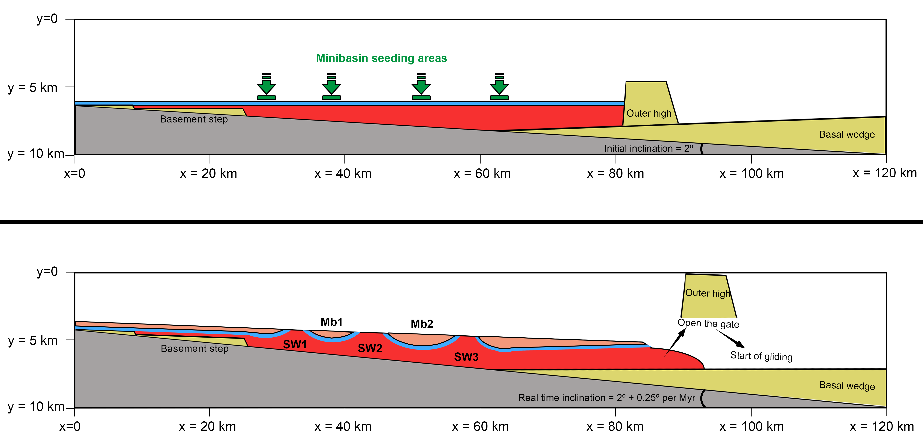
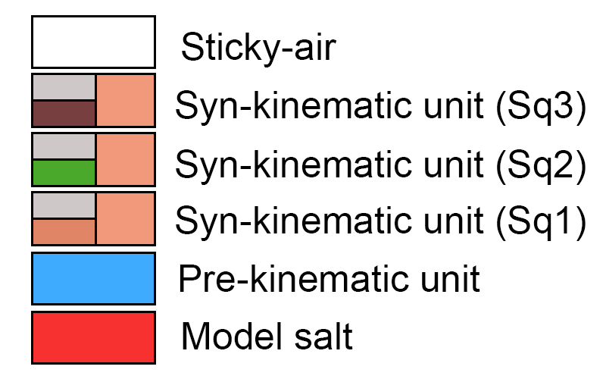
Model setup for numerical modeling
Methodology
Eulerian grids measures: 120 km × 10 km with 1201 × 101 nodes
Initial inclination of the model: 2⁰
Model rotation rate: 0.25⁰ per Ma
Pre-kinematic thickness: 0.2 km
Model salt thickness: from 0.2 km above proximal basement step to 2 km in the deepest part
Methodology
Page: 1 / 4

Slide 9
Applied parameters
Methodology
Parameters | Sticky air | Syn-kinematic unit | Pre-kinematic unit | Salt (Newtonian) | Salt (Non-newtonian)
Density (kg/m³) | 1 | 2500 | 2500 | 2200 | 2200
Angle of friction | - | 30 | 30 | 30 | 30
Cohesion (MPa) | - | 5 | 5 | - | -
Viscosity (Pa.s) | 10¹⁷ | 10²⁵ | 10²⁵ | 10¹⁸, 5×10¹⁸, 10¹⁹ | -
Activation energy (kj/mol) | - | - | - | - | 32.4
Material dependent parameter (Pa^{-n}) |  | 10⁻²⁵ | 10⁻²⁵ | 10⁻¹⁸, 2×10⁻¹⁹, 10⁻¹⁹ | 7.26×10⁻³⁶
Power law exponent | - | 1 | 1 | 1 | 5
Temperature (k) | 273 | 273 | 273 | 273 | 323
Methodology
Page: 2 / 4

Slide 10
Salt flow mechanisms
Methodology
Granado et al., 2023
Model | M-1 | M-2 | M-3
Salt flow mechanism | Downbuilding followed by late dominant gliding | Downbuilding followed by early dominant gliding | Pure dominant gliding
Syn-kinematic (Sq-3) | DG¹ (1.5²) | DG (0.9) | DG (1.5)
Syn-kinematic (Sq-2) | DL (0.3) | DG (1.3) | DG (0.3)
Syn-kinematic (Sq-1) | DL(1.9) | DL (1.9) | DG (1.9)
Duration of modeling | 3.7 Ma | 4.1 Ma | 3.7 Ma
Salt flow mechanism ➔ DL: Differential Loading (Downbuilding) --- DG: Dominant gliding (Displacement)
Duration of surface diffusion (in million years)
Methodology
Page: 3 / 4

Slide 11
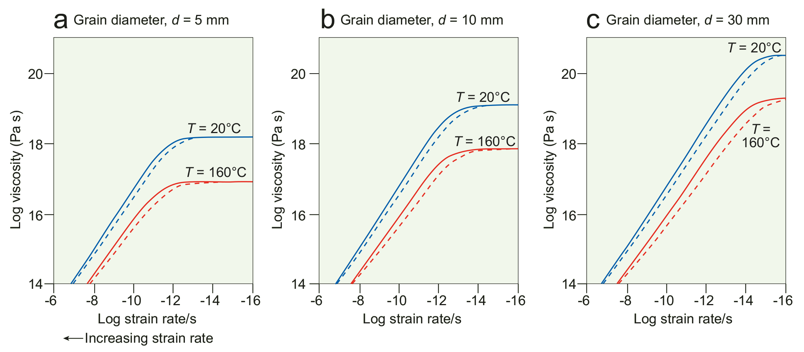
Salt rheology
Methodology
The viscosity of rock salt varies with the deformation mechanism
The viscosity of salt increases roughly tenfold as grain size doubles or as temperature falls from 160 to 20 °C
Dashed lines: Asse diapiric salt; solid lines: West Hackberry diapiric salt
For a grain size of 10 mm, a viscosity of 10¹⁹ Pa s is representative of salt at the surface, and 10¹⁸ Pa s, of salt at depth
Jackson & Hudec, 2017
Model | V-1 | V-2 | V-3 | V-4
Salt Rheology | Newtonian | Newtonian | Newtonian | Non-Newtonian
Salt Viscosity | 10¹⁸ (Pa.s) | 5×10¹⁸ (Pa.s) | 10¹⁹ (Pa.s) | Power Law
Methodology
Page: 3 / 4

Slide 12
Effect of Driving Mechanism
Results
Differential Loading Vs. Dominant Gliding
Effect of Salt Rheology
Newtonian (various viscosities) Vs. Non-Newtonian
Effect of Modeling Approaches
Numerical Modeling Vs. Analogue Modeling

Slide 13
Effect of Driving Mechanism
Result
Differential Loading Vs. Dominant Gliding
V-1
V-2
V-3
V-4
M-1
M-2
M-3
M-1
M-2
M-3
M-1
M-2
M-3
M-1
M-2
M-3
V-00
➔ Constant parameter for each result (Here is the viscosity of model salt)
M-00
➔ Variable parameter for each result (Here is the mechanism of salt flow)
Results
Page: 1 / 14

Slide 14
V-1
Effect of driving mechanism (Constant low-viscosity of salt)
Model: V1_M1
Time: 3.7 Ma
M-1
M-2
M-3
Proximal basin
Isolated-minibasin province
Distal basin and raft system
SW1
MB1
SW2
MB2
SW3 + 2ndryMB
MB3
Model: V1_M2
Time: 4.1 Ma
Proximal basin
Isolated-minibasin province
Distal basin and raft system
Contribution of dominant gliding
SW1
MB1
SW2
MB2
SW3 + 2ndryMB
MB3
Model: V1_M3
Time: 3.7 Ma
Proximal basin
Raft system
Results
Page: 2 / 14

Slide 15
V-2
Effect of driving mechanism (Constant medium-viscosity of salt)
Model: V2_M1
Time: 3.7 Ma
M-1
M-2
M-3
Proximal basin
Isolated-minibasin province
Distal basin and raft system
SW1
MB1
SW2
MB2
SW3
MB3
Model: V2_M2
Time: 4.1 Ma
Proximal basin
Isolated-minibasin province
Distal basin and raft system
Contribution of dominant gliding
SW1
MB1
SW2
MB2
SW3
MB3
Model: V2_M3
Time: 3.7 Ma
Proximal basin
Raft system
Results
Page: 3 / 14

Slide 16
V-3
Effect of driving mechanism (Constant high-viscosity of salt)
Model: V3_M1
Time: 3.7 Ma
M-1
M-2
M-3
Proximal basin
Isolated-minibasin province
Distal basin and raft system
SW1
MB1
SW2
MB2
SW3
MB3
Model: V3_M2
Time: 4.1 Ma
Proximal basin
Isolated-minibasin province
Distal basin and raft system
Contribution of dominant gliding
SW1
MB1
SW2
MB2
SW3
MB3
Model: V3_M3
Time: 3.7 Ma
Proximal basin
Raft system
Results
Page: 4 / 14

Slide 17
V-4
Effect of driving mechanism (Constant Non-Newtonian viscosity of salt)
Model: V4_M1
Time: 3.7 Ma
M-1
M-2
M-3
Proximal basin
Isolated-minibasin province
Distal basin and raft system
SW1
MB1
SW2
MB2
SW3 + 2ndryMB
MB3
Model: V4_M2
Time: 4.1 Ma
Proximal basin
Isolated-minibasin province
Distal basin and raft system
Contribution of dominant gliding
SW1
MB1
SW2 + 2ndryMB
MB2
SW3 + 2ndryMB
MB3
Model: V4_M3
Time: 3.7 Ma
Proximal basin
Raft system
Results
Page: 5 / 14

Slide 18
V-4
Effect of driving mechanism (Constant Non-Newtonian viscosity of salt)
M-1
M-2
M-3
Results
Page: 6 / 14

Slide 19
Effect of Salt Rheology
Result
Newtonian (various viscosities) Vs. Non-Newtonian
M-1
M-2
M-3
V-1
V-2
V-3
V-4
V-1
V-2
V-3
V-4
V-1
V-2
V-3
V-4
M-00
➔ Constant parameter for each result (Here is the mechanism of salt flow)
V-00
➔ Variable parameter for each result (Here is the viscosity of model salt)
Results
Page: 7 / 14

Slide 20
Effect of salt viscosity (Constant driving mechanism – M1)
M-1
Model: M1_V1
Time: 3.7 Ma
V-1
V-2
V-3
V-4
Proximal basin
Isolated-minibasin province
Distal basin and raft system
SW1
MB1
SW2
MB2
SW3 + 2ndryMB
MB3
Model: M1_V2
Time: 3.7 Ma
Proximal basin
Isolated-minibasin province
Distal basin and raft system
Increasing Viscosity
SW1
MB1
SW2
MB2
SW3
MB3
Model: M1_V3
Time: 3.7 Ma
Proximal basin
Isolated-minibasin province
Distal basin and raft system
SW1
MB1
SW2
MB2
SW3
MB3
Model: M1_V4
Time: 3.7 Ma
Proximal basin
Isolated-minibasin province
Distal basin and raft system
SW1
MB1
SW2
MB2
SW3 + 2ndryMB
MB3
Results
Page: 8 / 14

Slide 21
Effect of salt viscosity (Constant driving mechanism – M2)
M-2
Model: M2_V1
Time: 4.1 Ma
V-1
V-2
V-3
V-4
Proximal basin
Isolated-minibasin province
Distal basin and raft system
SW1
MB1
SW2
MB2
SW3 + 2ndryMB
MB3
Model: M2_V2
Time: 4.1 Ma
Proximal basin
Isolated-minibasin province
Distal basin and raft system
Increasing Viscosity
SW1
MB1
SW2
MB2
SW3
MB3
Model: M2_V3
Time: 4.1 Ma
Proximal basin
Isolated-minibasin province
Distal basin and raft system
SW1
MB1
SW2
MB2
SW3
MB3
Model: M2_V4
Time: 4.1 Ma
Proximal basin
Isolated-minibasin province
Distal basin and raft system
SW1
MB1
SW2 + 2ndryMB
MB2
SW3 + 2ndryMB
MB3
Results
Page: 9 / 14

Slide 22
Effect of salt viscosity (Constant driving mechanism – M3)
M-3
Model: M3_V1
Time: 3.7 Ma
V-1
V-2
V-3
V-4
Proximal basin
Raft system
Model: M3_V2
Time: 3.7 Ma
Proximal basin
Raft system
Increasing Viscosity
Model: M3_V3
Time: 3.7 Ma
Proximal basin
Raft system
Model: M3_V4
Time: 3.7 Ma
Proximal basin
Raft system
Results
Page: 10 / 14

Slide 23
Effect of Modeling Approaches
Result
Numerical Modeling (NM) Vs. Analogue Modeling (AM)
M-1
M-2
M-3
NM
AM
NM
AM
NM
AM
M-00
➔ Constant parameter for each result (Here is the mechanism of salt flow)
NM/SB
➔ Variable parameter for each result (Here is the modeling approaches)
Results
Page: 11 / 14

Slide 24
Effect of modeling approaches (Constant driving mechanism – M1)
M-1
NM
AM
Model: M1_NM
Time: 3.7 Ma
Proximal basin
Isolated-minibasin province
Distal basin and raft system
SW1
MB1
SW2
MB2
SW3 + 2ndryMB
MB3
Model: M1_AM
Results
Page: 12 / 14

Slide 25
Effect of modeling approaches (Constant driving mechanism – M2)
M-2
NM
AM
Model: M2_NM
Time: 4.1 Ma
Proximal basin
Isolated-minibasin province
Distal basin and raft system
SW1
MB1
SW2
MB2
SW3 + 2ndryMB
MB3
Model: M2_AM
Results
Page: 13 / 14

Slide 26
Effect of modeling approaches (Constant driving mechanism – M3)
M-3
NM
AM
Model: M3_NM
Time: 3.7 Ma
Proximal basin
Raft system
Model: M3_AM
Results
Page: 14 / 14

Slide 27
Effect of Driving Mechanism
Effect of Salt Rheology
Discussion
Effect of Modeling Approaches

Slide 28
V-1
Effect of driving mechanism (Constant low-viscosity of salt)
Model: V1_M1
Time: 3.7 Ma
M-1
M-2
M-3
Proximal basin
Isolated-minibasin province
Distal basin and raft system
Click to discuss about this result
SW1
MB1
SW2
MB2
SW3 + 2ndryMB
MB3
Model: V1_M2
Time: 4.1 Ma
Proximal basin
Isolated-minibasin province
Distal basin and raft system
Contribution of dominant gliding
SW1
MB1
SW2
MB2
SW3 + 2ndryMB
MB3
Model: V1_M3
Time: 3.7 Ma
Proximal basin
Raft system
Discussion
Page: 1 / 12

Slide 29
V-1
Effect of driving mechanism (Constant low-viscosity of salt)
Model: V1_M1
Time: 3.7 Ma
M-1
M-2
M-3
Proximal basin
Isolated-minibasin province
Distal basin and raft system
SW1
MB1
SW2
MB2
SW3 + 2ndryMB
MB3
Model: V1_M2
Time: 4.1 Ma
Proximal basin
Isolated-minibasin province
Distal basin and raft system
Contribution of dominant gliding
SW1
MB1
SW2
MB2
SW3 + 2ndryMB
MB3
Model: V1_M3
Time: 3.7 Ma
Proximal basin
Raft system
Discussion
Page: 2 / 12

Slide 30
Proximal basin depocenter (Effect of mechanisms)
Discussion
Model: V1_M1
Rollover structures related to the basement offset geometry (Regardless the age)
Younger syn-kinematic sequence unconformably lay over previous layers
Model: V1_M2
Model: V1_M3
Discussion
Page: 3 / 12

Slide 31
Minibasin 1 (Effect of mechanisms)
Discussion
Model: V1_M1
In M2 welding occurs sooner and primary welds are larger than M1
Minibasin in M3 takes more time to be welded in comparison with M1 and M2
Model: V1_M2
Model: V1_M3
Discussion
Page: 4 / 12

Slide 32
Salt Wall 2 and Minibasin 2 (Effect of mechanisms)
Discussion
W
L
T
Welding in M3 is not taking place
M1 and M2 shows a well developed turtle structures charectrized by a thicker core of troughs (Sq1) followed by layers/wedges (Sq1, Sq2, Sq3)
Model: V1_M1
W
T
L
Model: V1_M2
W
Model: V1_M3
Discussion
Page: 5 / 12

Slide 33
Salt Wall 3 and Minibasin 3 (Effect of mechanisms)
Discussion
Model: V1_M1
2ndryMB
Model: V1_M2
2ndryMB
Model: V1_M3
Discussion
Page: 6 / 12

Slide 34
Effect of salt viscosity (Constant driving mechanism – M2)
M-2
Model: M2_V1
Time: 4.1 Ma
V-1
V-2
V-3
V-4
Proximal basin
Isolated-minibasin province
Distal basin and raft system
Click to discuss about this result
SW1
MB1
SW2
MB2
SW3 + 2ndryMB
MB3
Model: M2_V2
Time: 4.1 Ma
Proximal basin
Isolated-minibasin province
Distal basin and raft system
Increasing Viscosity
SW1
MB1
SW2
MB2
SW3
MB3
Model: M2_V3
Time: 4.1 Ma
Proximal basin
Isolated-minibasin province
Distal basin and raft system
SW1
MB1
SW2
MB2
SW3
MB3
Model: M2_V4
Time: 4.1 Ma
Proximal basin
Isolated-minibasin province
Distal basin and raft system
SW1
MB1
SW2 + 2ndryMB
MB2
SW3 + 2ndryMB
MB3
Discussion
Page: 7 / 12

Slide 35
Effect of salt viscosity (Constant driving mechanism – M2)
M-2
Model: M2_V1
Time: 4.1 Ma
V-1
V-2
V-3
V-4
Proximal basin
Isolated-minibasin province
Distal basin and raft system
SW1
MB1
SW2
MB2
SW3 + 2ndryMB
MB3
Model: M2_V2
Time: 4.1 Ma
Proximal basin
Isolated-minibasin province
Distal basin and raft system
Increasing Viscosity
SW1
MB1
SW2
MB2
SW3
MB3
Model: M2_V3
Time: 4.1 Ma
Proximal basin
Isolated-minibasin province
Distal basin and raft system
SW1
MB1
SW2
MB2
SW3
MB3
Model: M2_V4
Time: 4.1 Ma
Proximal basin
Isolated-minibasin province
Distal basin and raft system
SW1
MB1
SW2 + 2ndryMB
MB2
SW3 + 2ndryMB
MB3
Discussion
Page: 8 / 12

Slide 36
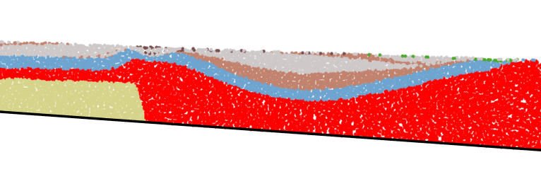
Proximal basin depocenter (Effect of salt viscosity)
Discussion
Model: M2_V1
Model: M2_V2
Increasing Viscosity
Model: M2_V3
Model: M2_V4
Discussion
Page: 9 / 12

Slide 37
Minibasin 1 (Effect of salt viscosity)
Discussion
Model: M2_V1
Model: M2_V2
Increasing Viscosity
Model: M2_V3
Model: M2_V4
Discussion
Page: 10 / 12

Slide 38
Salt Wall 2 and Minibasin 2 (Effect of salt viscosity)
Discussion
Model: M2_V1
Increasing Viscosity
Model: M2_V2
Model: M2_V3
Model: M2_V4
Discussion
Page: 11 / 12

Slide 39
Salt Wall 3 and Minibasin 3 (Effect of salt viscosity)
Discussion
Model: M2_V1
Model: M2_V2
Increasing Viscosity
Model: M2_V3
Model: M2_V4
Discussion
Page: 12 / 12

Slide 40
Conclusion
Conclusion
Geometries of minibasins and related structures in M1 and M2 are strongly different from M3
Proximal basins developed by landward tilted sequences in all models
Number of raft blocks increases with increasing the contribution of dominant gliding in basin evolution
Troughs tend to form in the initial stages of downbuilding when salt evacuation occurs at a rapid rate
Landward wedges are more likely to develop when gliding is the predominant mechanism
Higher viscosity salt leads slower downbuilding and gliding and power-law viscosity promotes asymmetries
Salt walls tend to be more continuous and less fragmented in high viscosity salt
Conclusion
Page: 1 / 2

Slide 41
Recommendations
Conclusion
Further investigate the impact of other parameters on salt-bearing rifted margin evolution, (sedimentation rates, variations in geo-mechanical properties of the different sequences, etc.)
Compare the numerical results with observations from real-world salt-bearing rifted margins to validate the model and gain new insights into the natural system
Expand the scale of the model to cover a larger area or longer time span, which would enable us to study the larger-scale processes and phenomena
Explore the potential use of the numerical models of salt-bearing rifted margins in energy transition and CO₂ storage
Conclusion
Page: 1 / 2

Slide 42
Movies of the selected models
Movies
V-1
V-4
M-1
M-2
M-3
M-1
M-2
M-3

Slide 43
Model: V1-M1
Movies

Slide 44
Model: V1-M2
Movies

Slide 45
Model: V1-M3
Movies

Slide 46
Model: V4-M2
Movies

