Slide 1
Depicting the regime of different aerosol types in NAMEE (North Africa - Middle East - Europe) based on CALIOP-CALIPSO retrievals
Anna Moustaka^{1,4}, Emmanouil Proestakis¹, Vassilis Amiridis¹, Stelios Kazadzis^{2,3},
Kleareti Tourpali⁴ and Antonis Gkikas^{1,5}
¹ Institute for Astronomy, Astrophysics, Space Applications and Remote Sensing, National Observatory of Athens, Athens, Greece
² Physicalisch Meteorologisches Observatorium, Davos, Switzerland
³ Institute of Environmental Research and Sustainable Development, National Observatory of Athens, Athens, Greece
⁴ Aristotle University of Thessaloniki, Department of Physics, Thessaloniki, Greece
⁵ Research Centre for Atmospheric Physics and Climatology, Academy of Athens, Athens, Greece
PICO Navigation icons
Anna Moustaka
PhD Candidate
Department of Applied and Environmental Physics
Aristotle University of Thessaloniki (AUTH)
Home
Return
Previous slide
Next slide
Description
Hyperlink box
annamstk@noa.gr

Slide 2
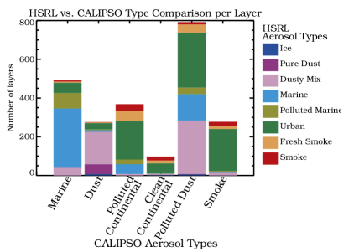
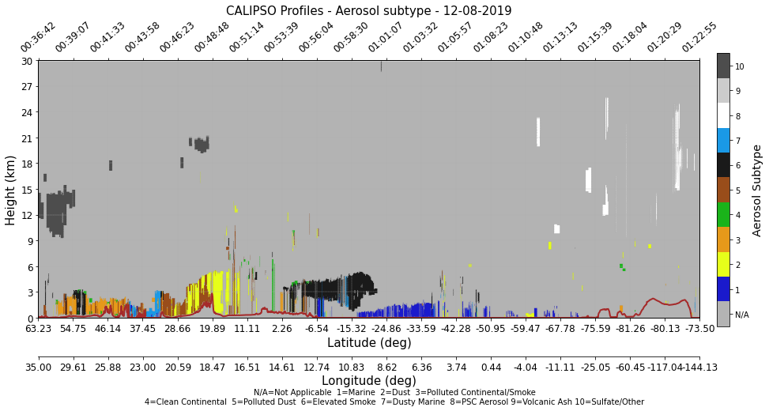
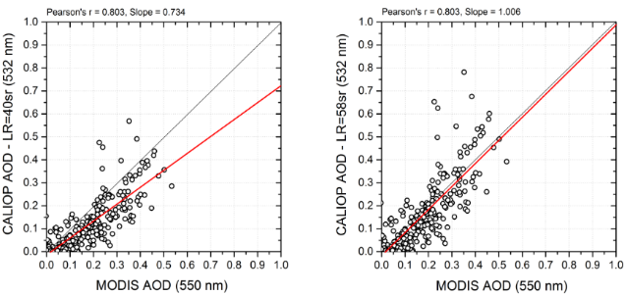
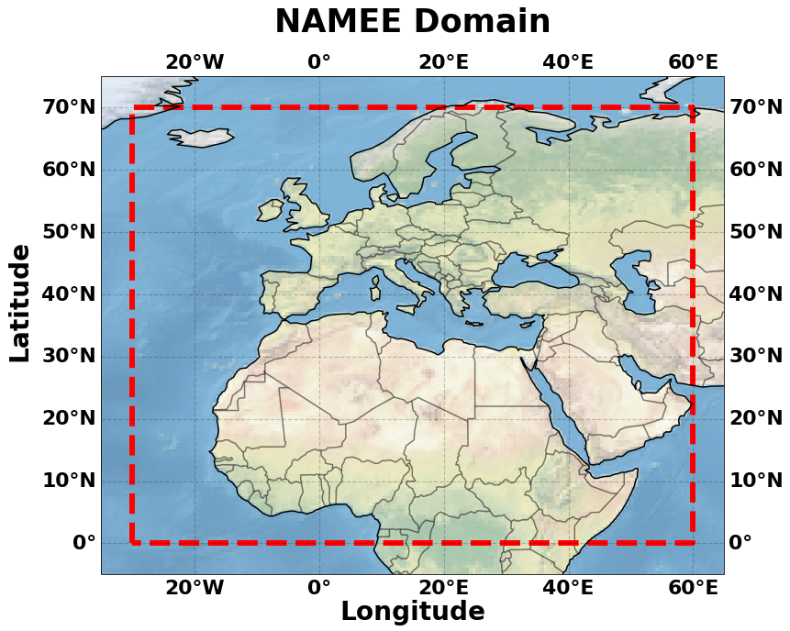
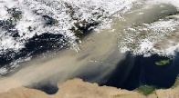
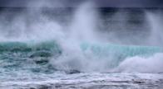
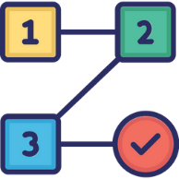
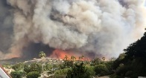
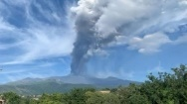
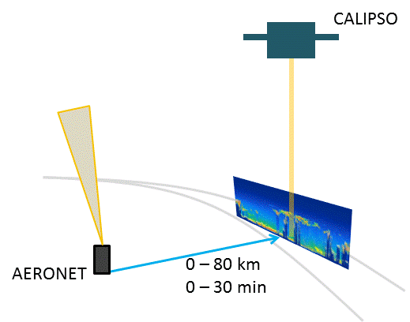
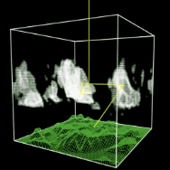
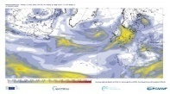
Overview
CALIOP-CALIPSO retrievals
Dataset
QA CALIPSO Level 2 (L2) Version 4.2 (V4) vertically resolved retrievals [2007-2020]
Extracted from the LIVAS database (Amiridis et al., 2015)
Advantages
Vertical profiles of aerosol-speciated optical and macrophysical properties
Depolarization measurements (identification of non-spherical particles)
Drawbacks
Misclassification of aerosol subtypes
Accurate definition of lidar ratio (S/LR)
Burton et al. (2013)
LR=40 sr
LR=58 sr
QA filtering
Elastic lidar !!
Region of Interest [ROI]
Ancillary datasets
RTM
Amiridis et al. (2013)
Aerosol properties
DeLiAn database (Floutsi et al., 2022)
AERONET sun-direct & retrievals
Atmospheric composition and Albedo
MERRA-2 reanalysis products
Radiation
BSRN
GEBA
CERES
libRadtran
UVSPEC model
SW [280-3000nm]
Model outputs for 18 layers
Mayer et al. (2020)
EGU 2023 | Anna Moustaka | Monday, April 24, 2023

Slide 3
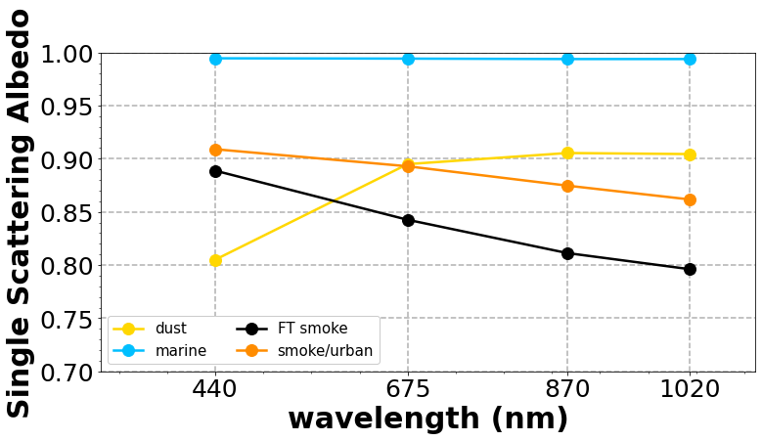
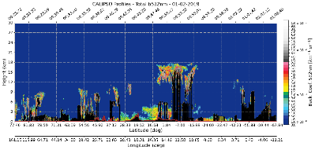
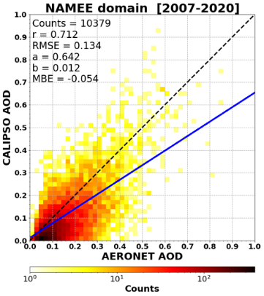
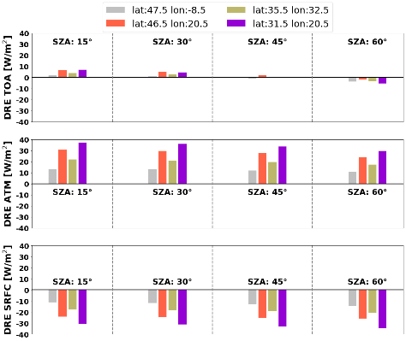
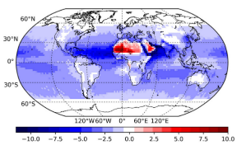
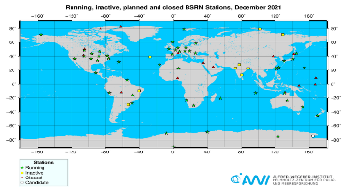
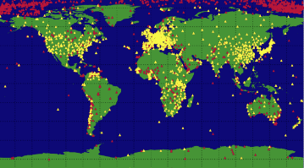
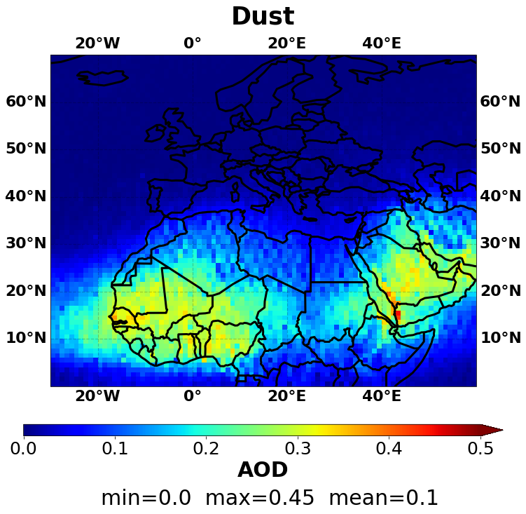
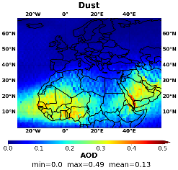
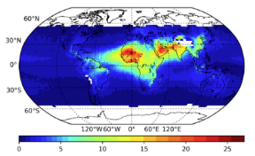
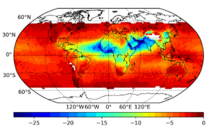
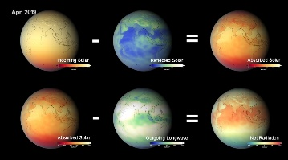
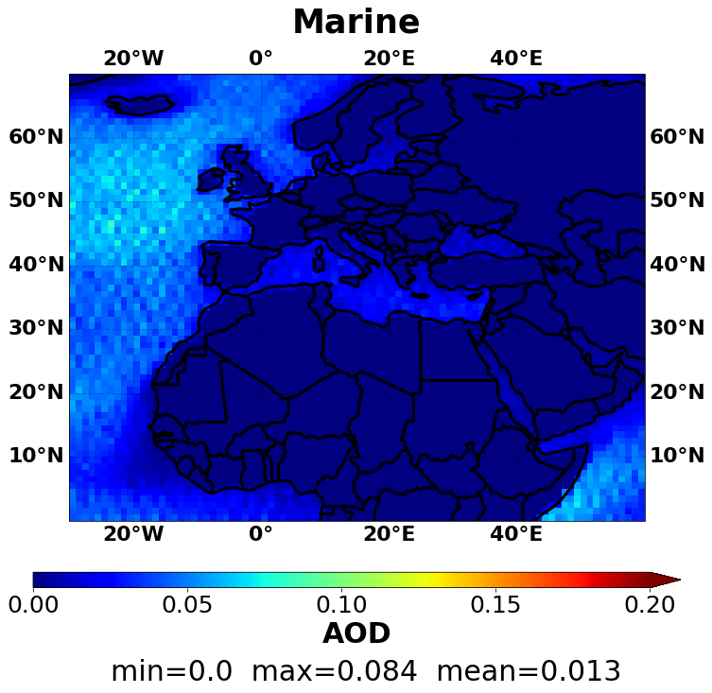
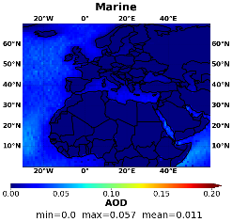
Workflow
Identify CALIPSO deficiencies affecting the assessment of aerosol-radiation interactions
Focus on representative case studies
AERONET-based extensive optical properties
Total attenuation
Misclassified
Clouds?
AOD
underestimation
Perform radiative transfer simulations
Evaluation of radiation fluxes
Long-term analysis over the NAMEE domain
FoO
Driemel et al. (2018)
Revised LR
Wild et al. (2017)
AOD
CALIPSO aerosol types over NAMEE
Korras-Carraca et al. (2020)
https://svs.gsfc.nasa.gov/
EGU 2023 | Anna Moustaka | Monday, April 24, 2023

Slide 4
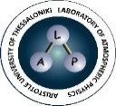
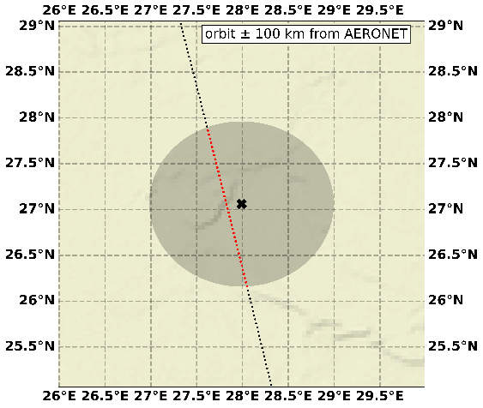
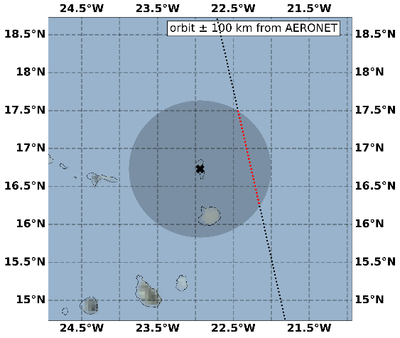
Example case studies
El_Farafra – 26-09-2014
Dust
LR = 44 sr
LR = 53 sr
Capo_Verde – 30-08-2014
Smoke + Dust
Additional case studies:
Dust & Pollution/Smoke
Polluted dust & Dust/Marine
EGU 2023 | Anna Moustaka | Monday, April 24, 2023

Slide 5
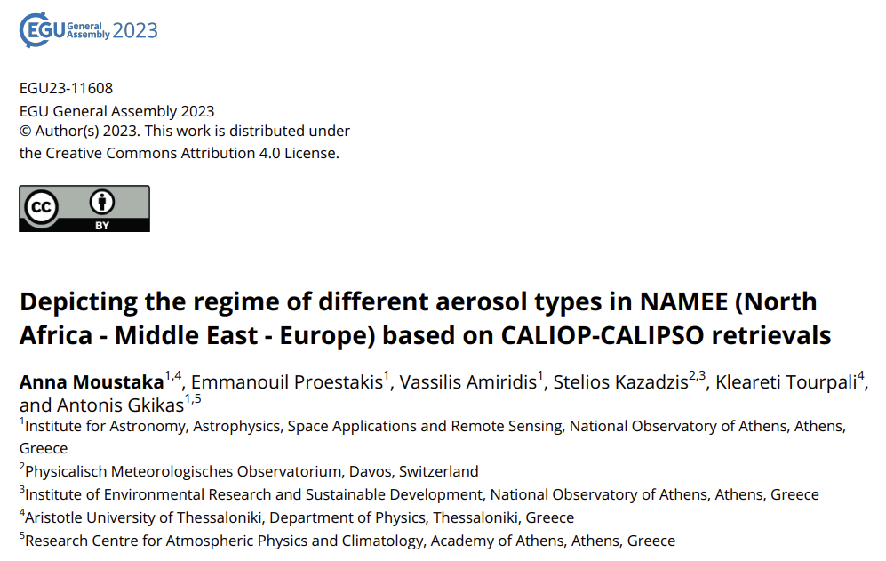
Thank you for your attention!!!
The research project was supported by the Hellenic Foundation for Research and Innovation (H.F.R.I.) under the “2nd Call for H.F.R.I. Research Projects to support Post-Doctoral Researchers” (Project Number:544).
EGU 2023 | Anna Moustaka | Monday, April 24, 2023

Slide 6
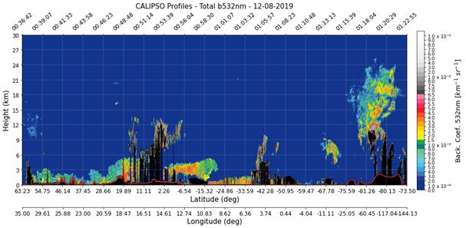
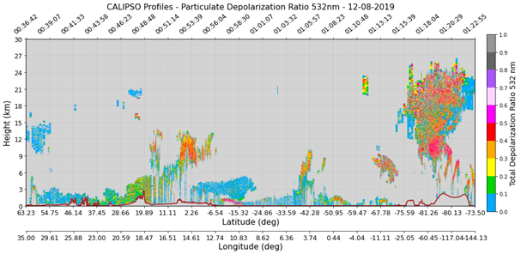
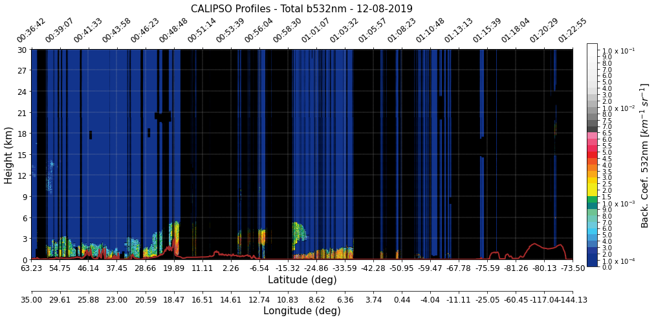
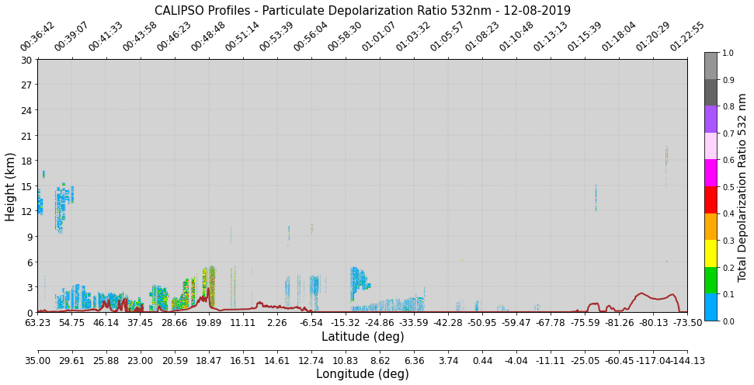
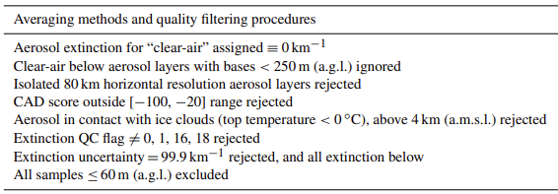
QA Filtering
CALIOP–CALIPSO raw retrievals
Quality assurance control
Tackett et al. (2018)
Proestakis et al. (2018)
Marinou et al. (2017)
EGU 2023 | Anna Moustaka | Monday, April 24, 2023

Slide 7
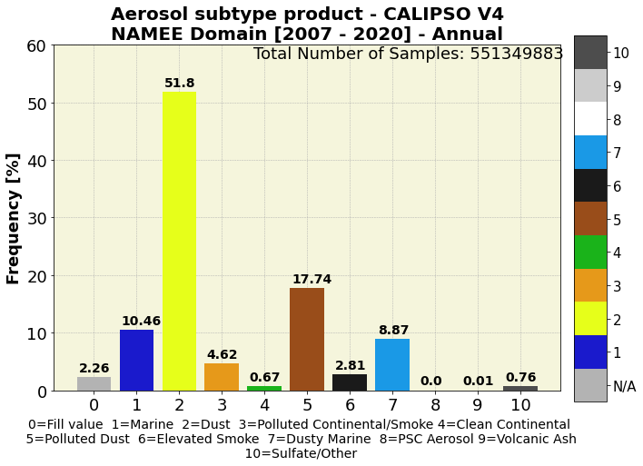
Long-term analysis
CALIPSO aerosol types in NAMEE
EGU 2023 | Anna Moustaka | Monday, April 24, 2023

Slide 8
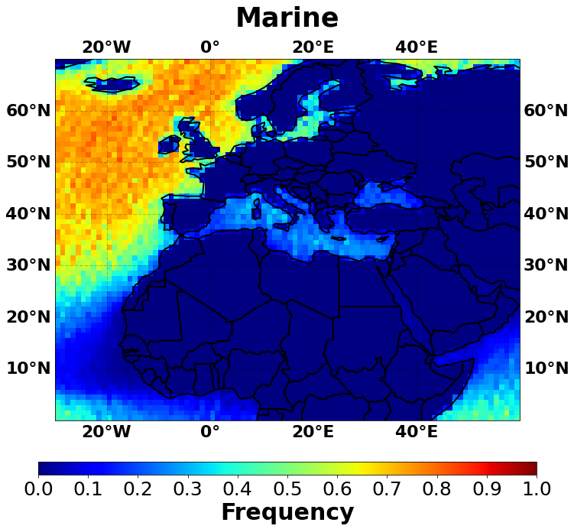
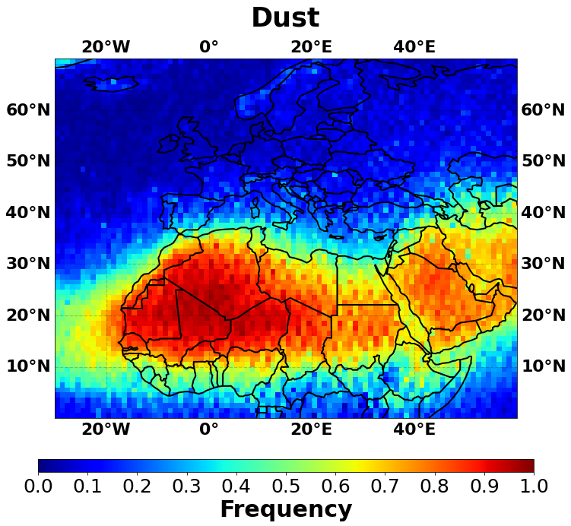
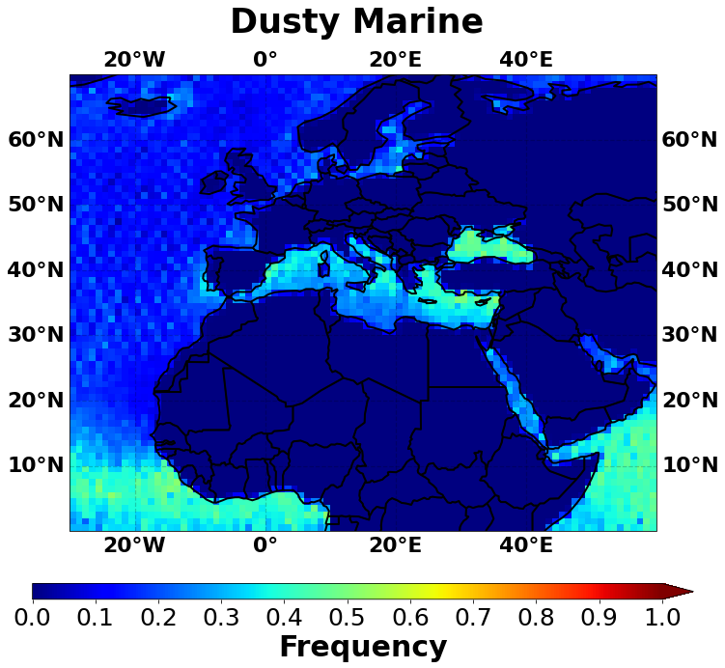
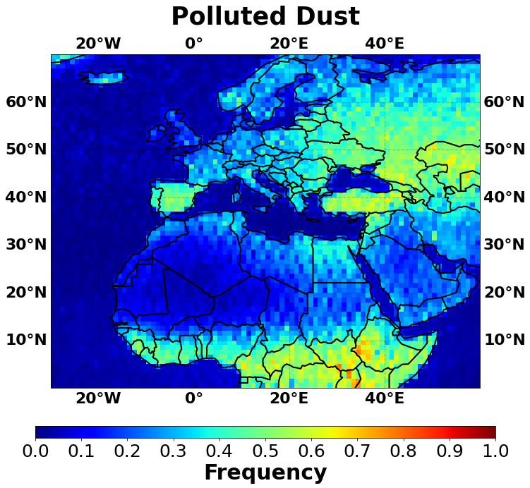
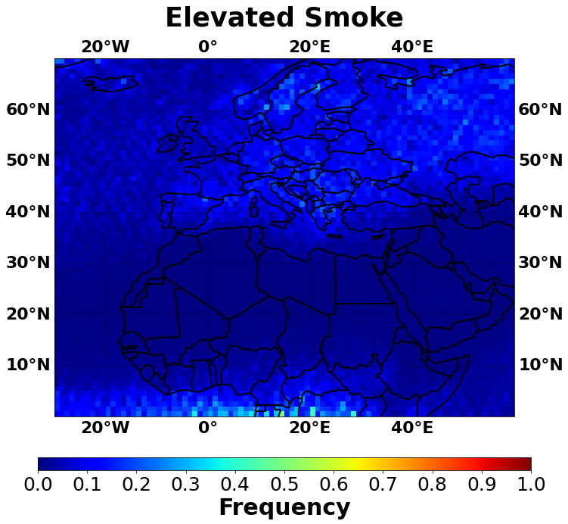
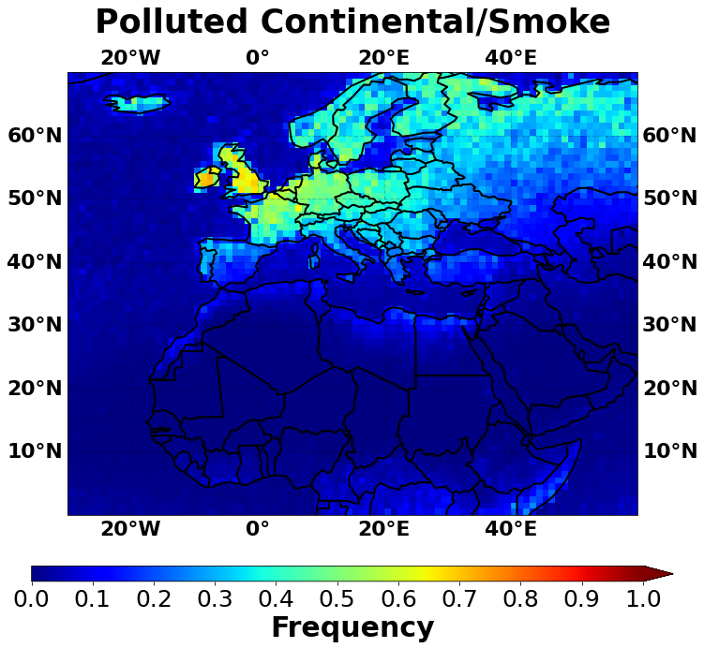
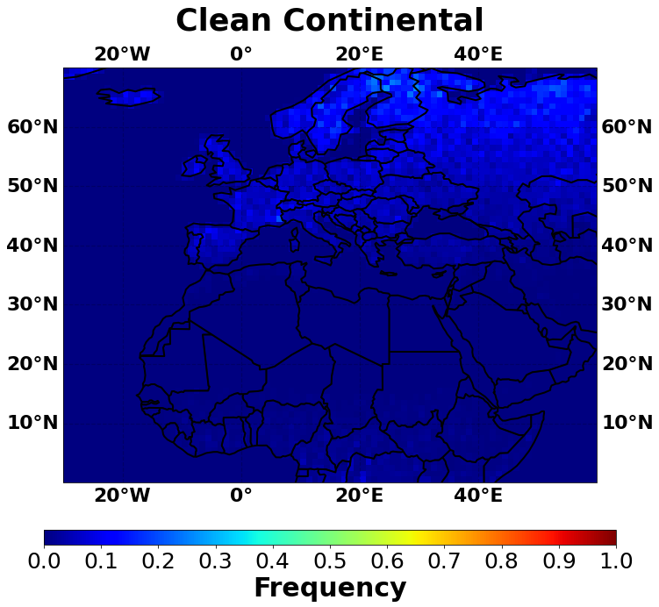
Long-term analysis
Frequency of occurrence per aerosol type
Frequency of Occurrence [FoO]
EGU 2023 | Anna Moustaka | Monday, April 24, 2023

Slide 9
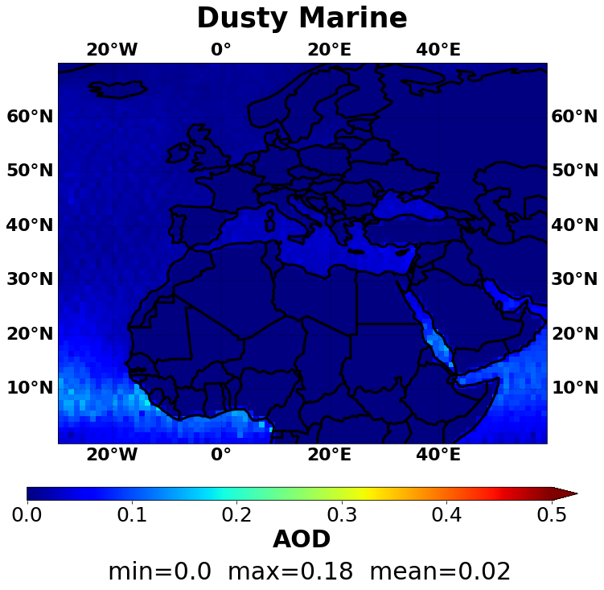
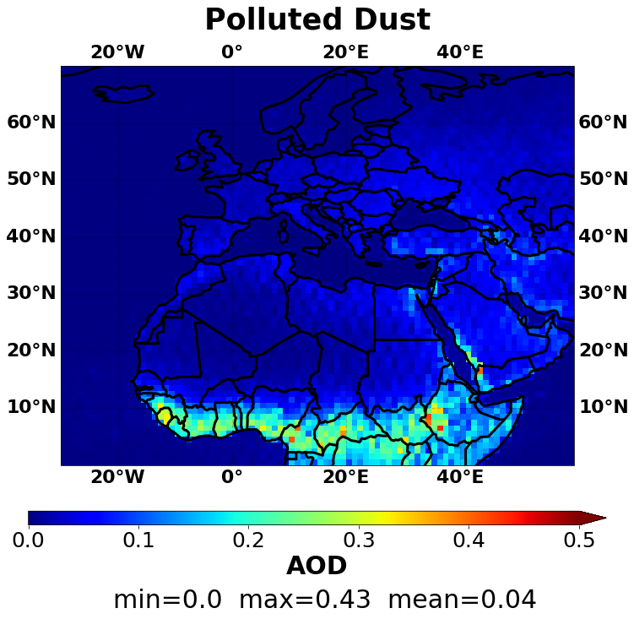
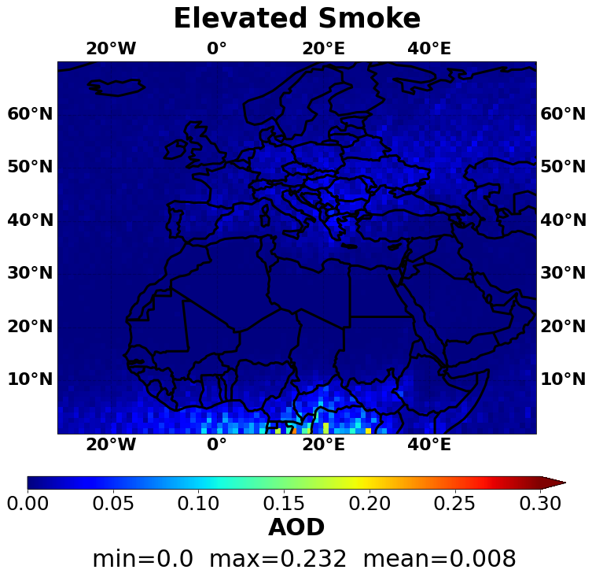
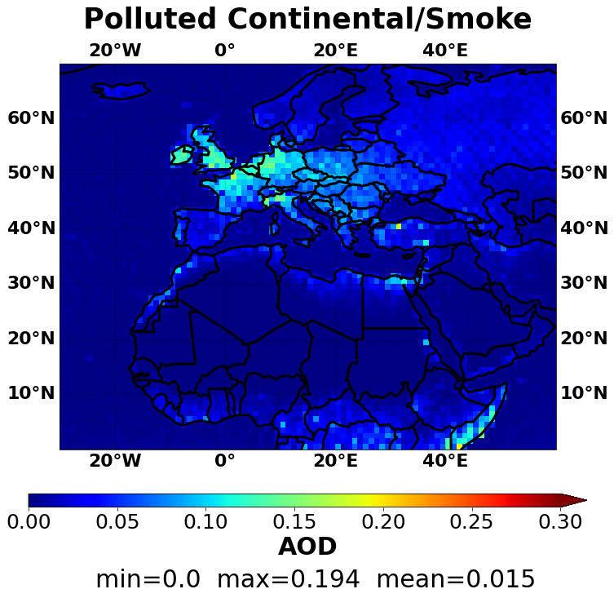
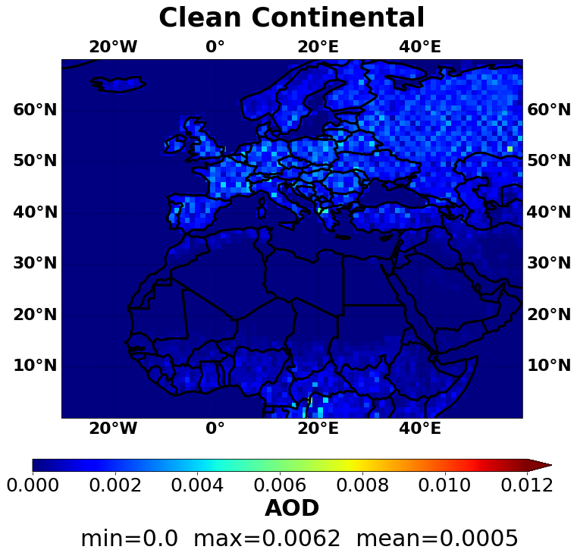
Long-term analysis
Aerosol optical depth per aerosol type
Aerosol optical depth [AOD]
EGU 2023 | Anna Moustaka | Monday, April 24, 2023

Slide 10
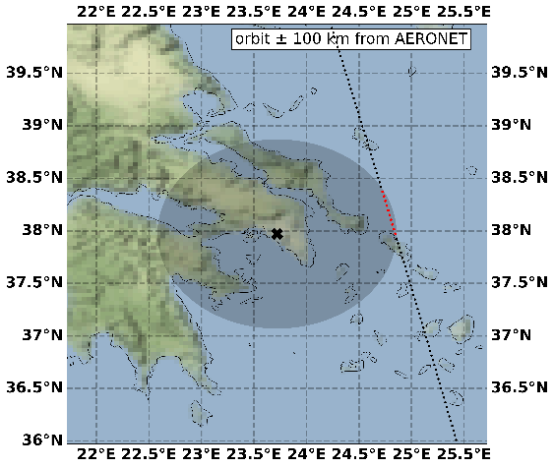
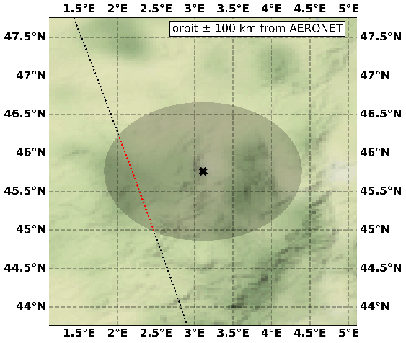
Additional case studies
ATHENS-NOA – 30-06-2017
Dust
LR = 44 sr
LR = 53 sr
Aubiere_LAMP – 13-03-2014
Pollution/Smoke
LR = 70 sr
LR = 72 sr
or
LR = 47 sr
EGU 2023 | Anna Moustaka | Monday, April 24, 2023

Slide 11
Additional case studies
Hyytiala – 20-04-2018
Polluted dust
Dakar_Belair – 21-06-2019
Dust/Marine
EGU 2023 | Anna Moustaka | Monday, April 24, 2023

