Slide 1
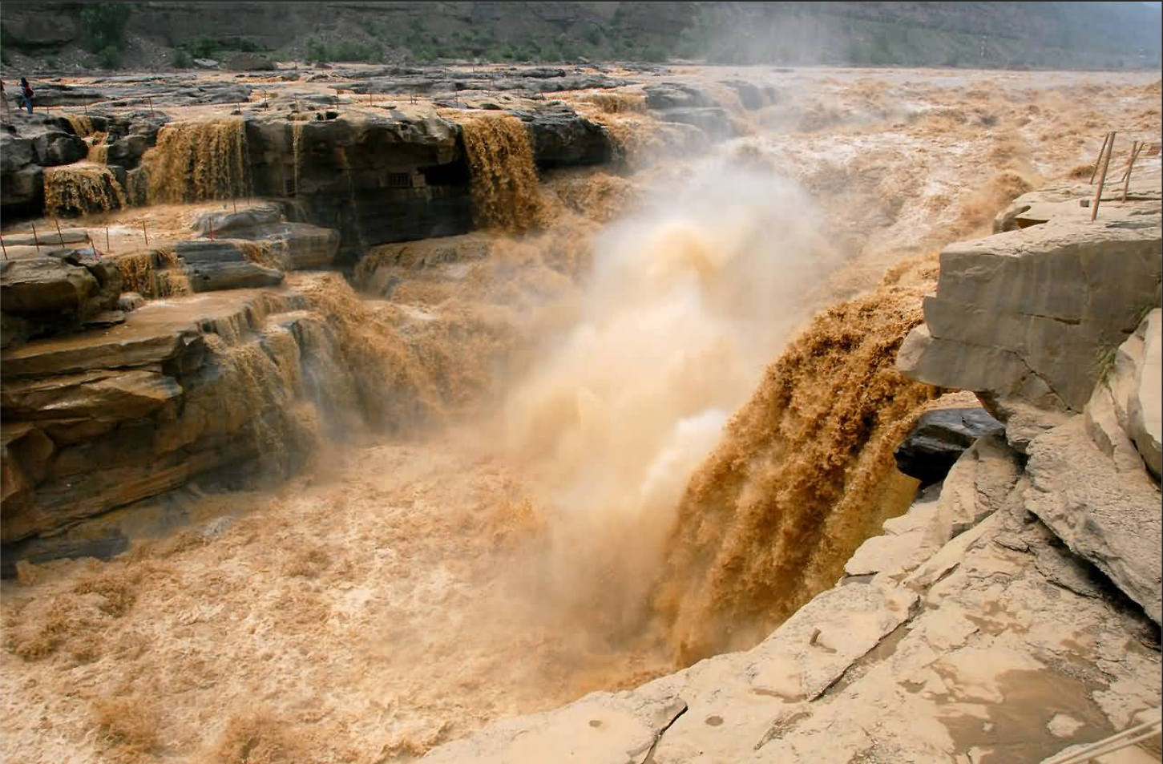
1
Introduction
1.1 background
Suspended sediment is not only an important water quality indicator, but also plays an important role in shaping landforms and regulating water and sediment dynamics. In recent years, an increasing number of studies have shown significant and sometimes sudden changes in river flow and sediment flux due to climate change and intensive human activities. This will lead to significant changes in coastal and marine systems. There are also some literature indicating that human activities have become the dominant factor affecting suspended sediment in some areas.
Therefore, it has long been necessary to quantitatively and accurately monitor the dynamic changes of suspended sediment particles, in order to better understand and understand the impact of human activities on nature.

Slide 2
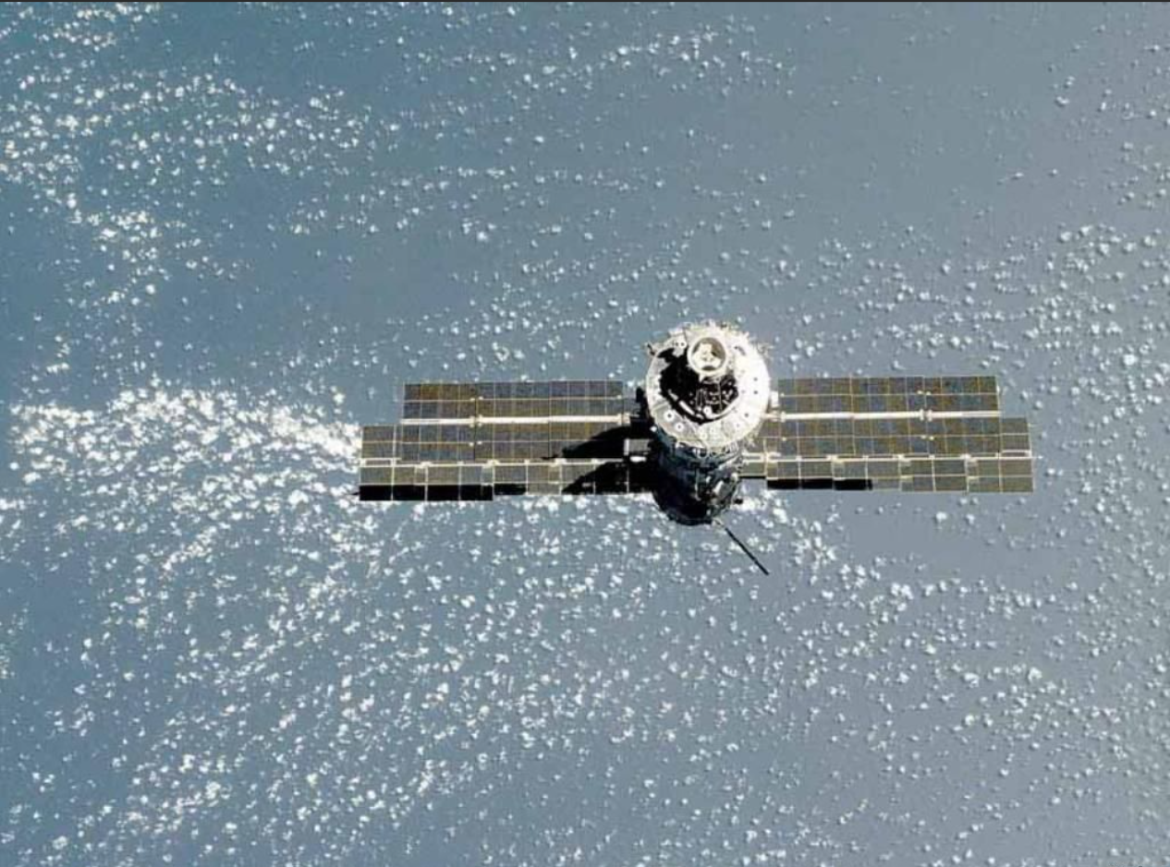
1
Introduction
1.2 remote sensing
Although traditional on-site measurement methods can obtain accurate sediment data through certain sampling points, this method is not only time-consuming, labor-intensive, and costly, but also unable to achieve large-scale measurements in space and continuous measurements in time.
Remote sensing technology has become an important means of monitoring suspended sediment due to its enormous spatiotemporal coverage. More and more scholars have successfully inverted the concentration of suspended sediment in different regions using remote sensing methods.
However, most of the current research is still limited to a single estuarine area and a smaller scope, and there is relatively little research on large spatial and temporal scales. This limits our understanding of the dynamic changes in suspended sediment at the continental and even global scales

Slide 3
1
Introduction
1.3 objective
Based on the Google Earth Engine platform, three typical suspended sediment inversion algorithms were used to select Landsat remote sensing data from 1990 to 2020 to monitor suspended sediment in the coastal waters of the Pacific West Coast. The focus was on analyzing the spatiotemporal dynamic changes of suspended sediment in some important estuaries along the Pacific West Coast, and then evaluating the long-term sediment transport situation along the entire Pacific West Coast.

Slide 4
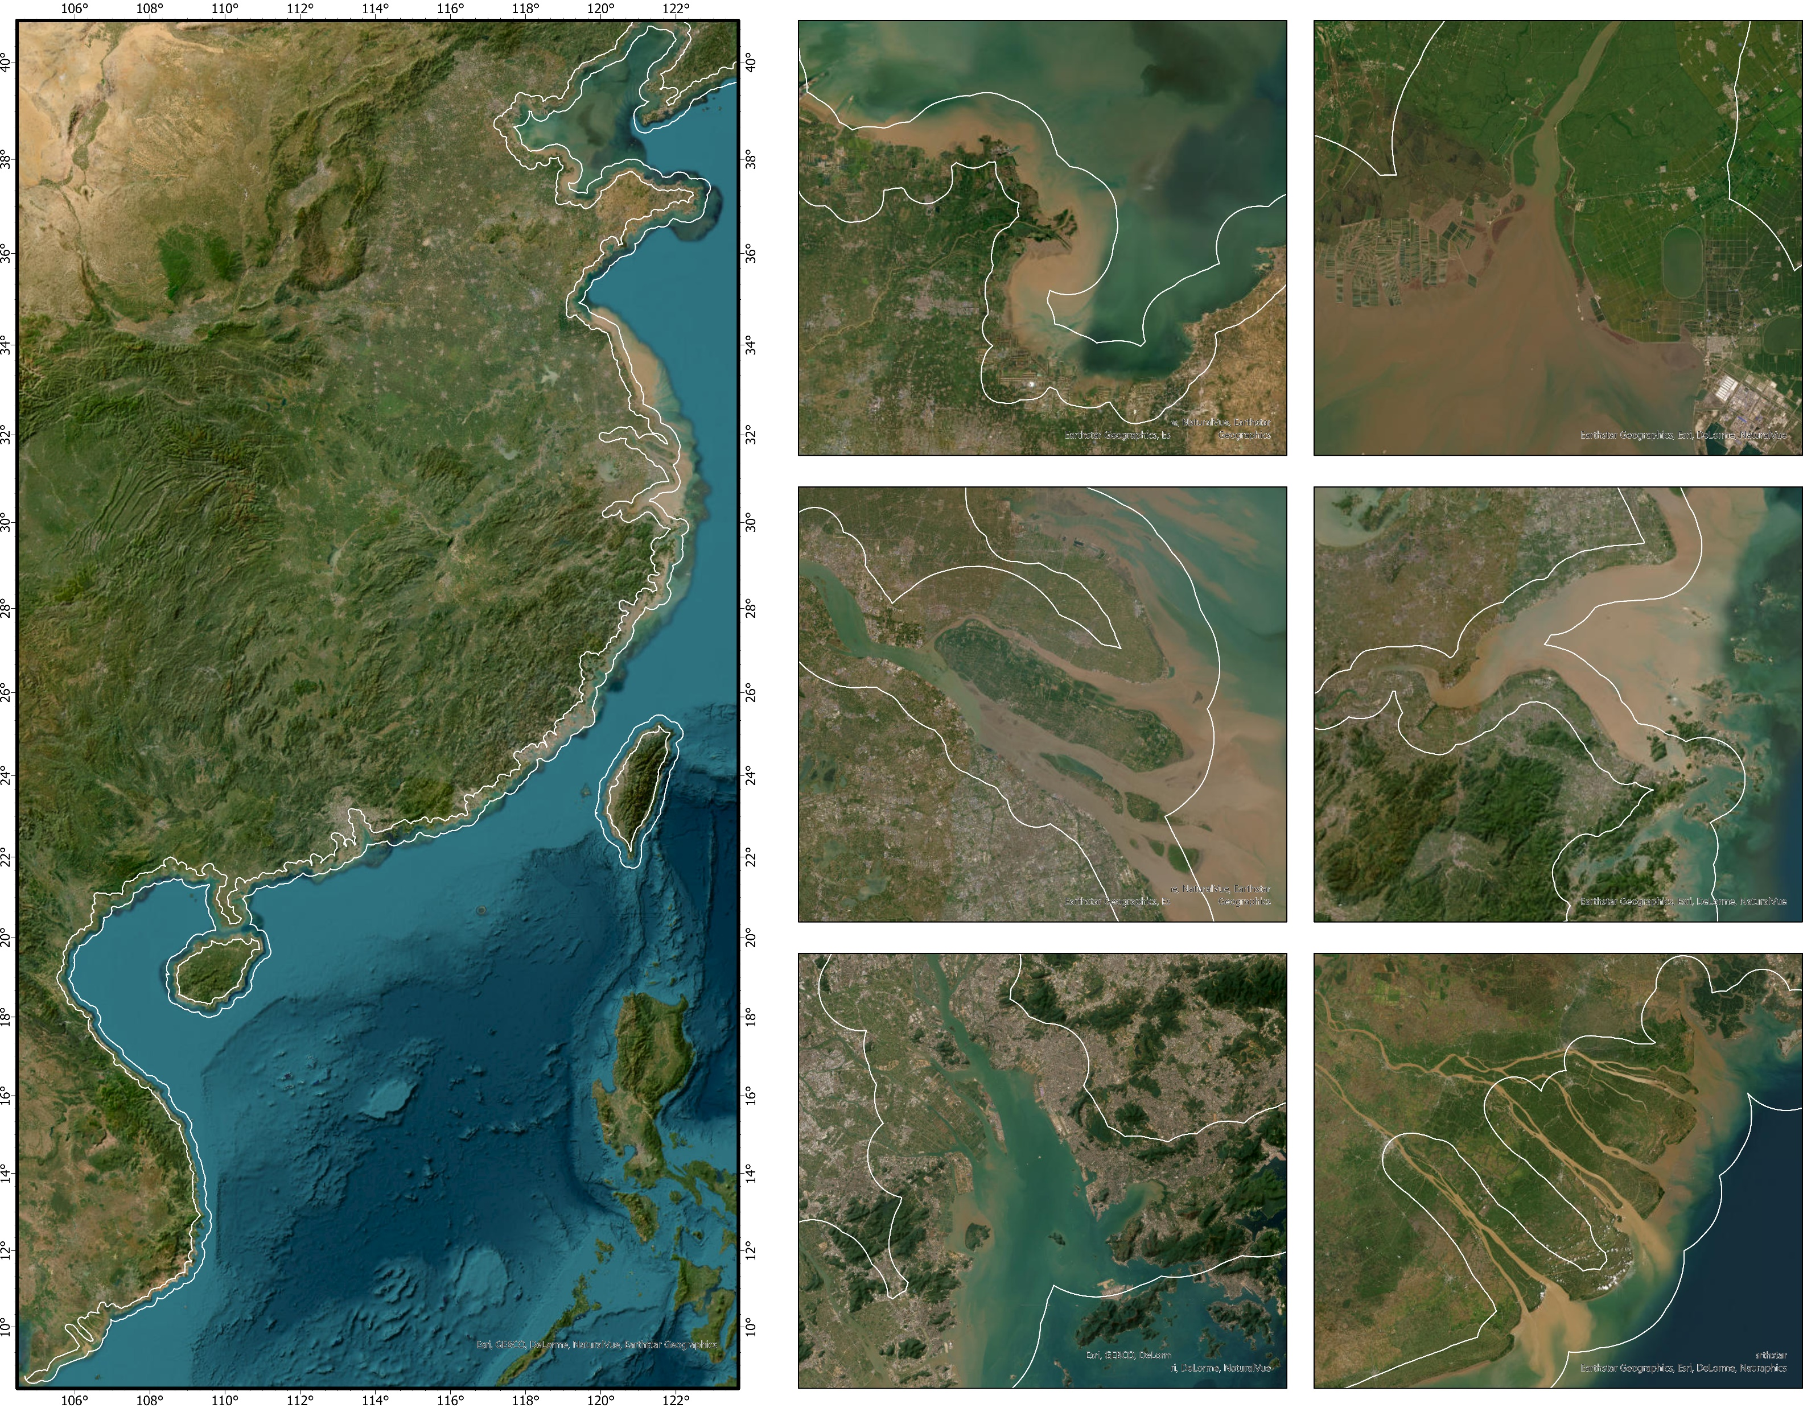
2
Data and Method
2.1 study area
The study area includes six estuaries across the western Pacific coastal zone, including two northern estuaries (Yellow River estuary and Liao River estuary), two central estuaries (Yangtze River estuary and Hangzhou Bay) and two southern estuaries (Pearl River estuary and Mekong estuary).
These estuaries were selected to evaluate their changes in water sediment flux to the ocean. Only the Yellow River, Yangtze River and the Pearl River form a huge delta at the estuary. The flow of the Yangtze River (approximately 900 km³ /yr ⁻¹) and the basin area (179.78 × 104 km2) is the largest in China, and the flow of the Pearl River (283.59 km² /yr ⁻¹) is second only to it. The Yellow River is 5400 km long, the second longest river in China. From the 1950s to 2020, the drainage area was 75000 km², and the maximum sediment discharge was 598.48 Mt/yr⁻¹
2
1
2
1
3
4
3
4
5
5
6
6

Slide 5
2
Data and Method
2.1 study area
2
1
2
The location distribution of the six regions varies greatly, with different climates and varying degrees of human activity.
Against the backdrop of global climate change, the six major river basins are experiencing rapid economic and population development.
It is very important to study the changes in water and sediment fluxes affected by increased human interference.
1
3
4
3
4
5
5
6
6

Slide 6
2
Data and Method
2.2 data source
Remote sensing data:
Landsat series satellite remote sensing reflectance products for all estuaries from 1990 to 2020, including Landsat5 TM, Landsat7 TM+, and Landsat8 OLI. The number of images depends on the cloud cover at each estuary. The reflectivity product is obtained from the Google Earth Engine platform, using the Land Surface Reflection Code (LaSRC) and LEDAPS algorithms for atmospheric correction, and the CFMask algorithm for cloud removal. For Landsat 7 ETM + images after 31 May 2003, data gaps happen due to Scan Line Corrector failure. A focal satatistic algorithm was implemented。

Slide 7
2
Data and Method
2.3 methodology
Mann-Kendall Trend Test
The Mann–Kendall Trend Test (also called the M-K test) is often employed to measure a dataset collected over time for consistently increasing or decreasing changes. The test is a non-parametric test, which means it can perform for all distributions (i.e., the data does not have to meet the assumption of normality). Here we used the M-K test to examine the temporal variation of the SSC at each pixel. The M-K test can be expressed as follows:
where Sgn(Xj − Xk ) is an assignment function that sets the positive or negative values to 1 or −1. UFk(k = 0, 1, 2, 3, . . . , n), E(Sk) is the mean, Var(Sk) is the variance; when UFk is greater than 0, the performance increases; otherwise, it indicates a decreasing trend. UBk represents the reverse time order (k = n, (n−1)), . . . , 1).

Slide 8
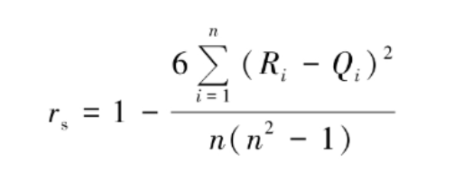
2
Data and Method
2.3 methodology
Spearman correlation coefficient
Pearson correlation coefficient requires that the values of continuous variables follow the normal distribution. The correlation between variables, categories or rank variables that do not follow the normal distribution can be described by Spearman rank correlation coefficient, also known as rank correlation coefficient. It can be described as:
Rank the paired values of two variables in ascending order (or ascending order), where Ri represents the rank of x_{i}, Q_{i} represents the rank of yi, and R_{i} Q_{i} represents the rank difference between x_{i} and y_{i}.

Slide 9
3
Result
3.1 Selection of the SSC algorithms
At present, the models used for sediment retrieve are mainly divided into three categories: empirical models, analytical models, and semi-analytical models. Most of the models are developed based on local regions, and currently there are few unified large-scale models used. Different models have different characteristics, and empirical models are easy to develop but have a small scope of application. Analytical models have relatively better practicality. Meanwhile, due to the spectral characteristics of sediment, the concentration of suspended sediment has different sensitivities in different bands, and even reaches saturation at a certain value.
Based on the above issues, the model used in this study has the following three characteristics: a) both empirical and semi analytical models are used; b) Using different inversion bands; c) Train and validate using Landsat on the GEE platform.
models | Empirical models | bands | original
Cao(Pearl) | SSC=4.6EXP(4.221X) | X=green-red/green+red | Landsat8
Nechad-Novoa(Global) | SSC=(477X)/((1-X)/1.686) | X=red | MODIS Terra
Luo(Yangtze) | SSC=2 x 0.0763 X/11.5306(0.0763-X)² | X=red | Landsat8

Slide 10
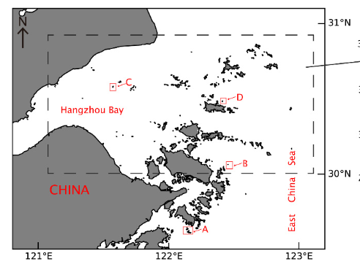
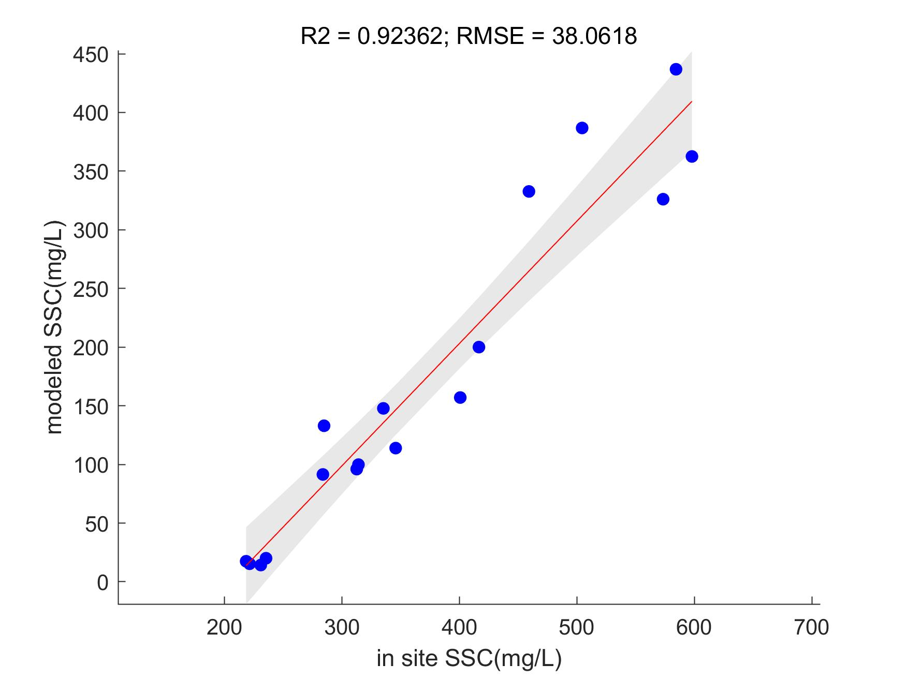
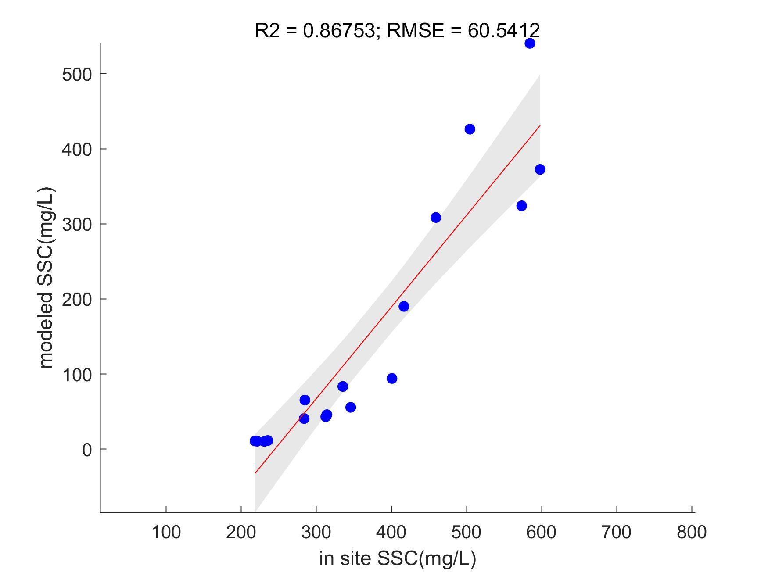
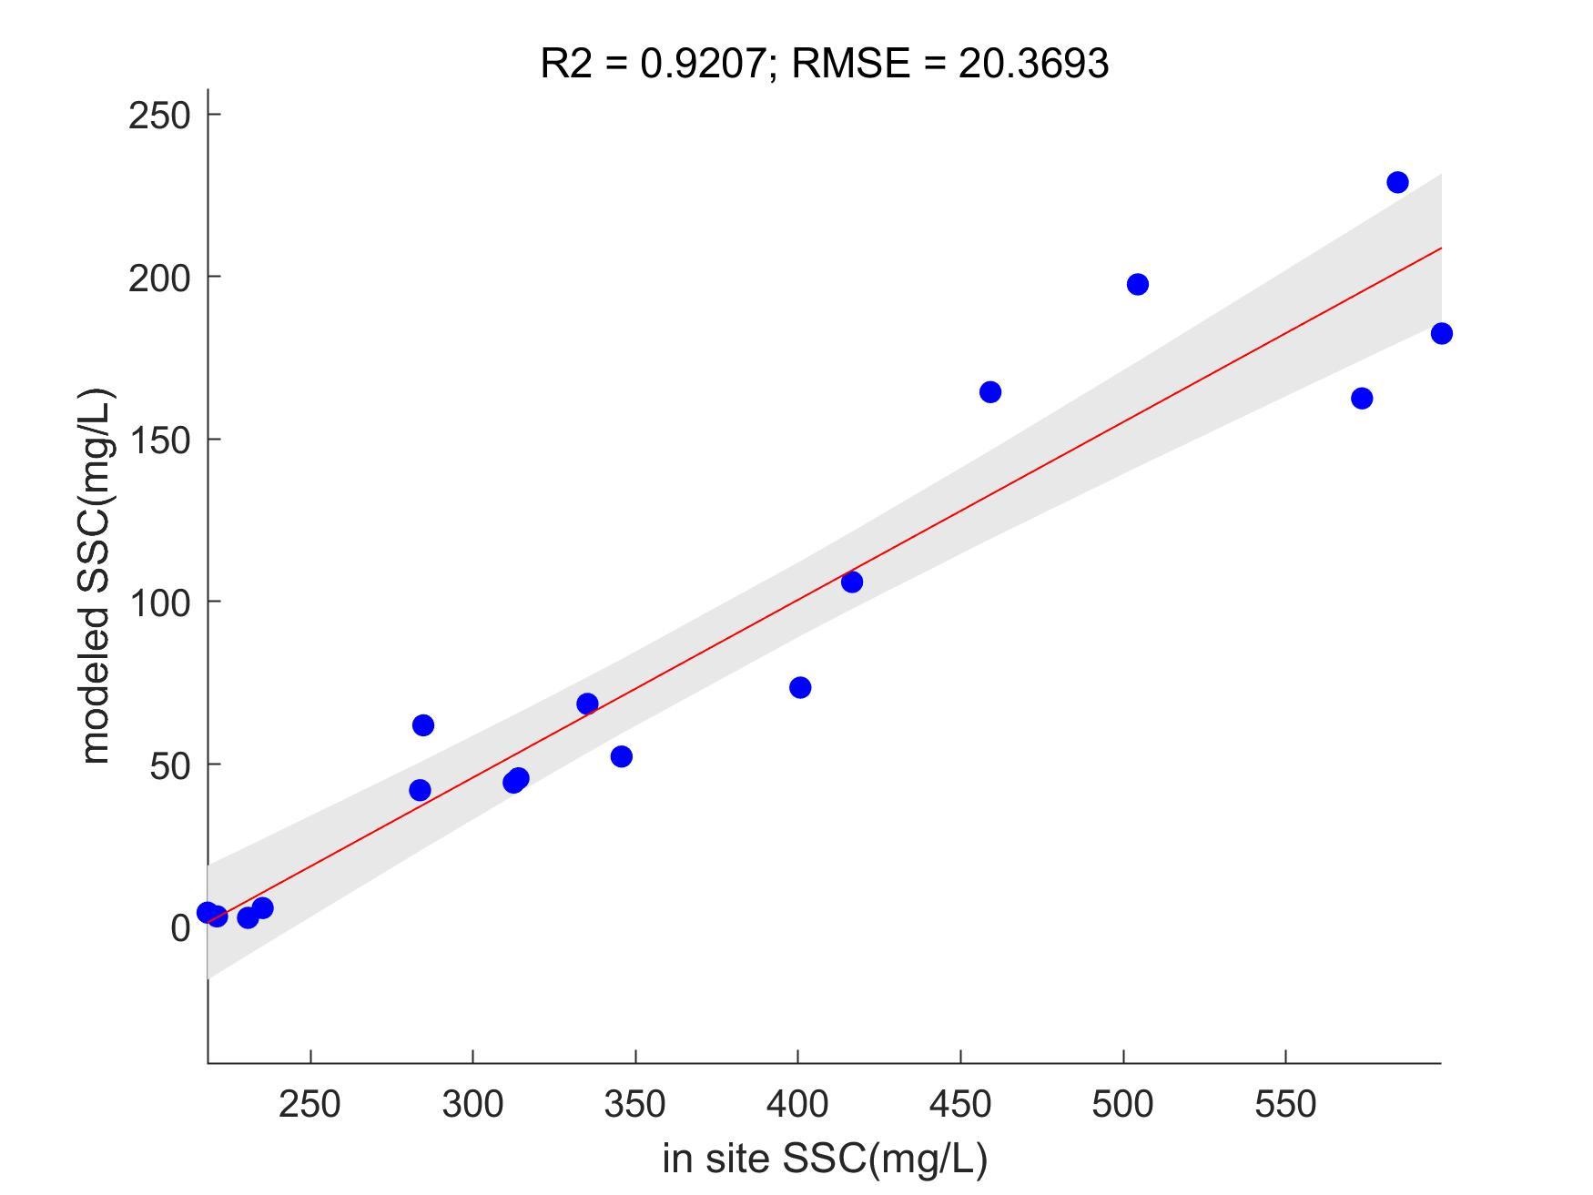
3
Result
3.1 Selection of the SSC algorithms
Uncertainty of retrieve algorithms:
Due to the fact that two of the three models were developed based on the study of estuaries, additional areas were selected for in situ dataset validation. The validation area is located in the outer sea area of Hangzhou Bay, and the in situ SSC data referenced Cai's measured data in 2019. At the same time, Landsat8 satellite data with a time window of plus or minus three hours was selected for pixel matching using a 3x3 window.
Verification area
Sert
Cao
Nechad

Slide 11
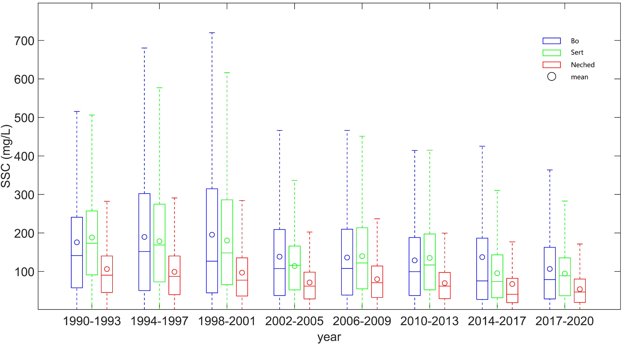
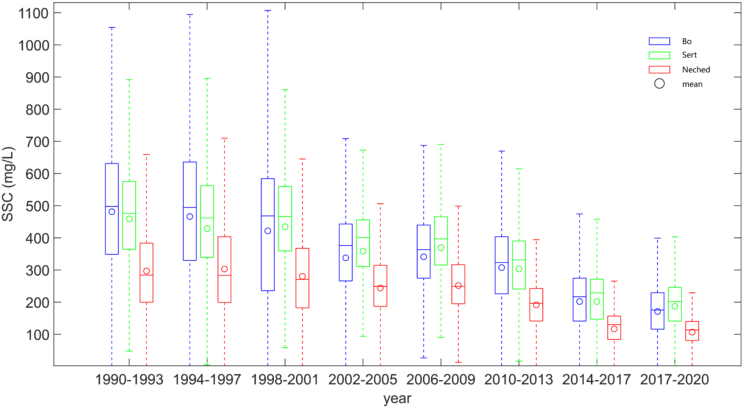
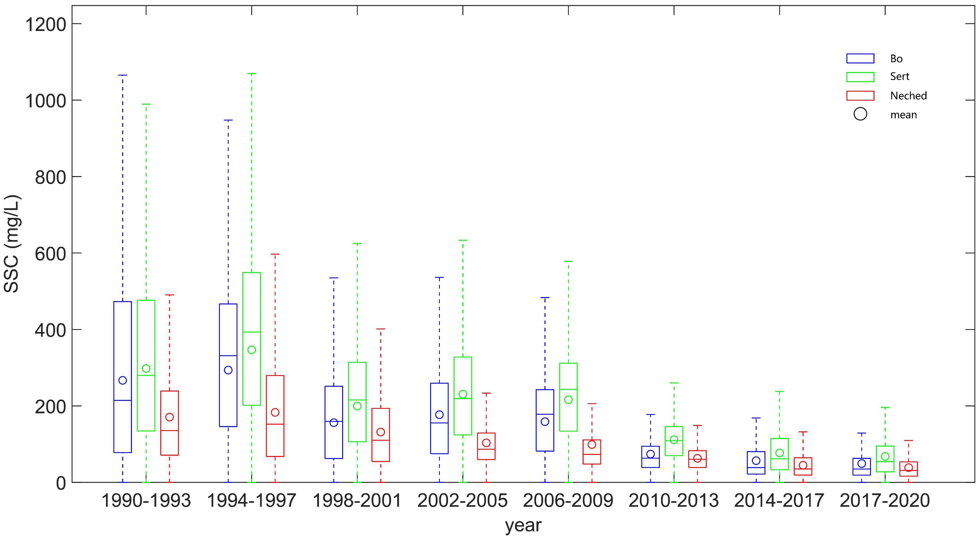
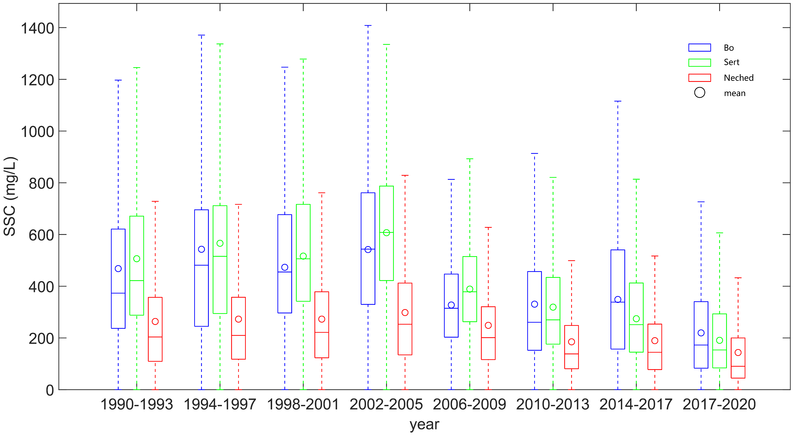
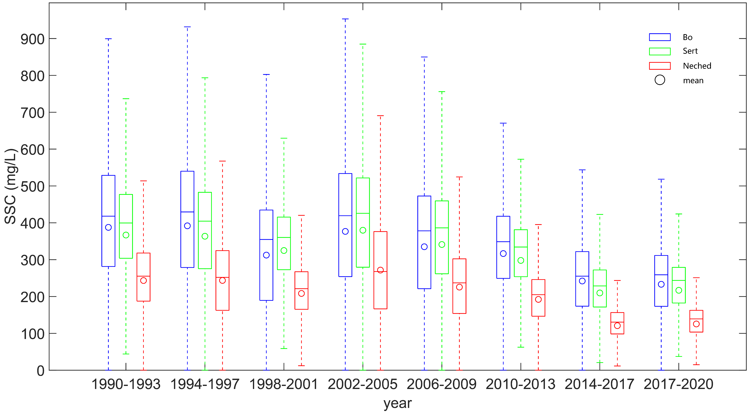
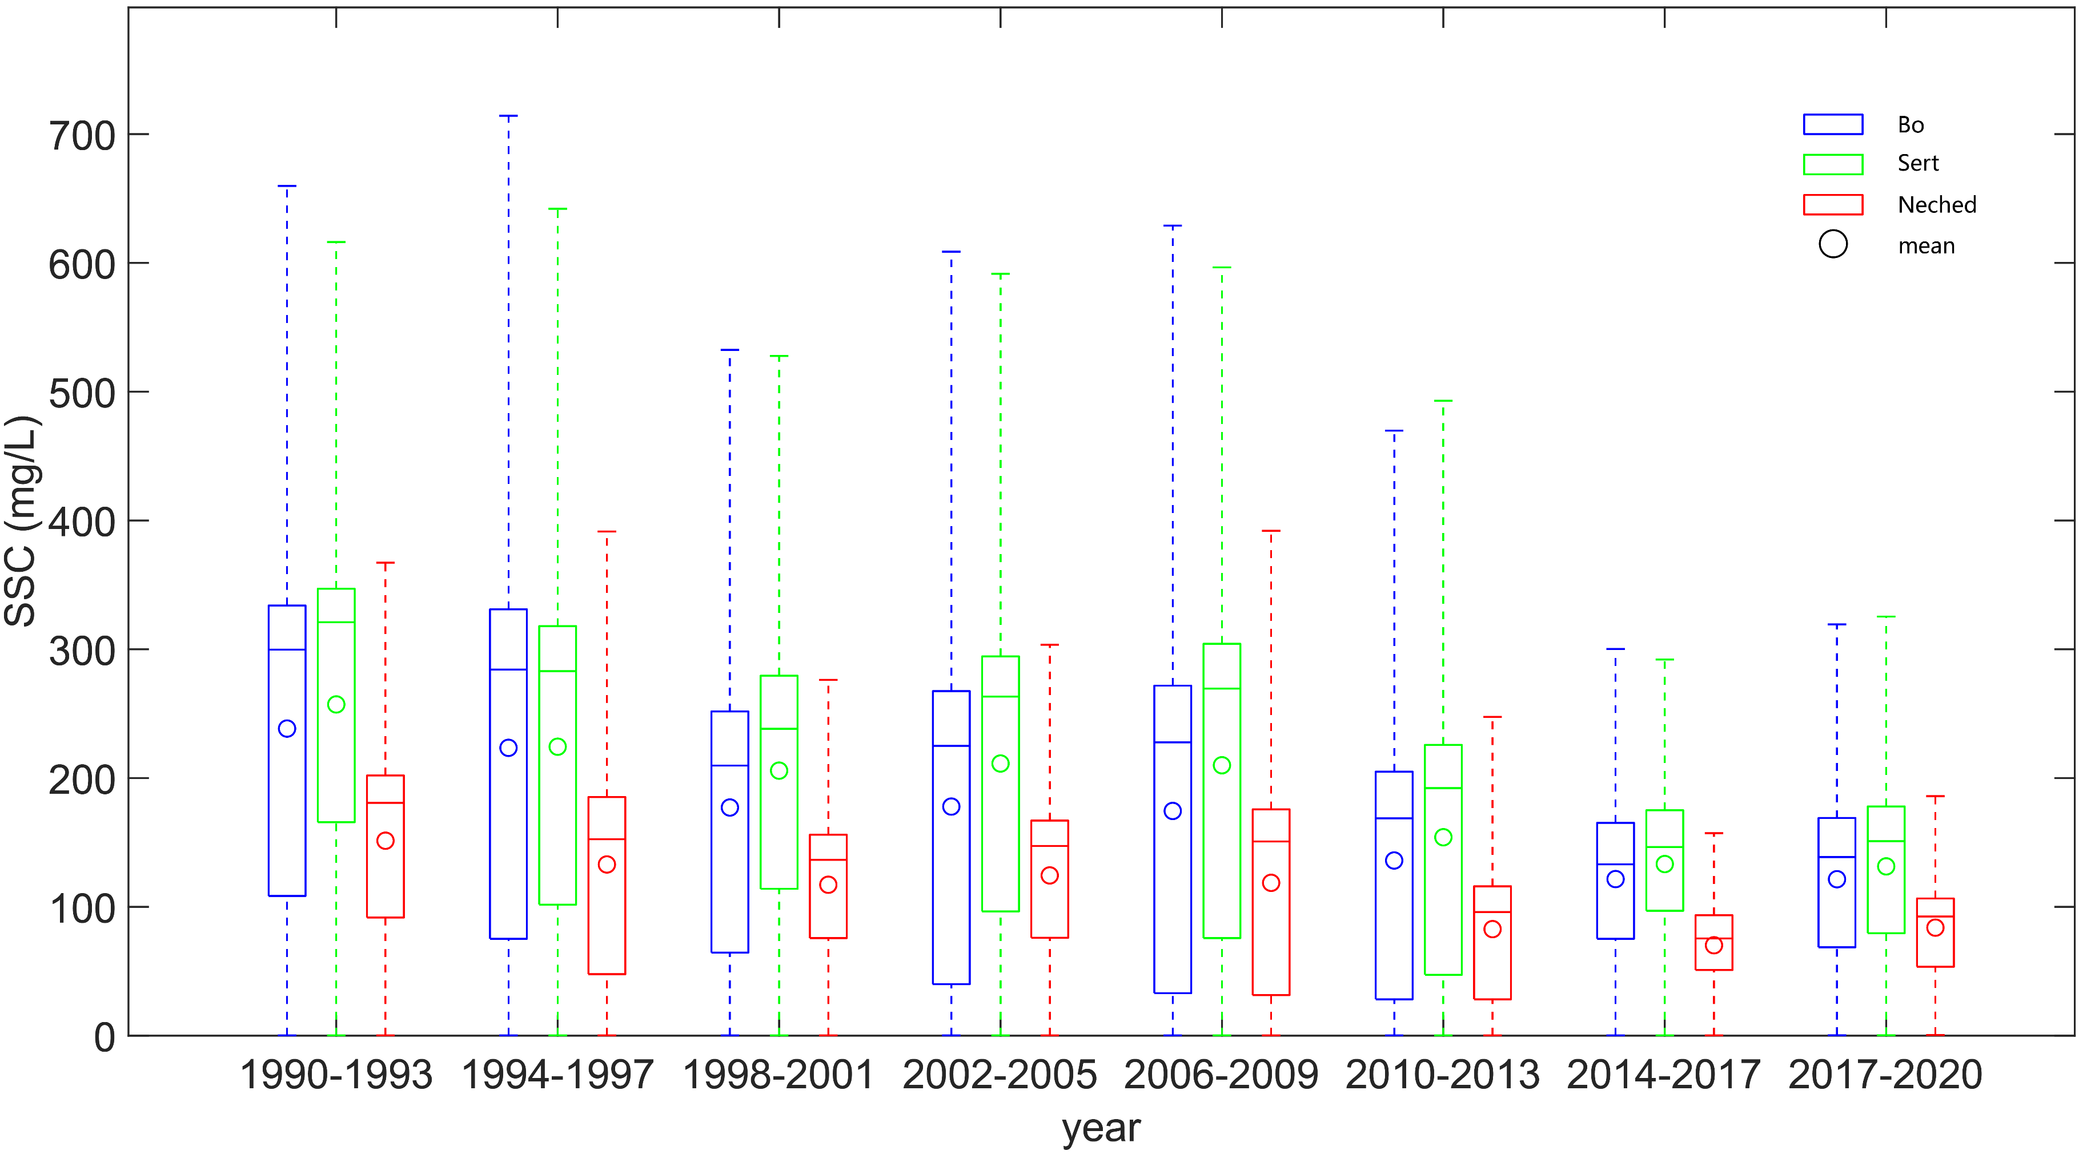
3
Result
3.1 Interannual variation of estuaries
Bo
Sert
Nechad
mean
Mekong estuary
Yangtze River estuary
From the results, it can be seen that all three models indicate a significant downward trend in all six estuaries, which is consistent with some of the results of (Yin et al., 2023) and (Yunus et al., 2022) . And the downward trend of Hangzhou Bay and Liaohe River is relatively stable.
Pearl River estuary
Yellow River estuary
Hangzhou Bay
Liao River estuary

Slide 12
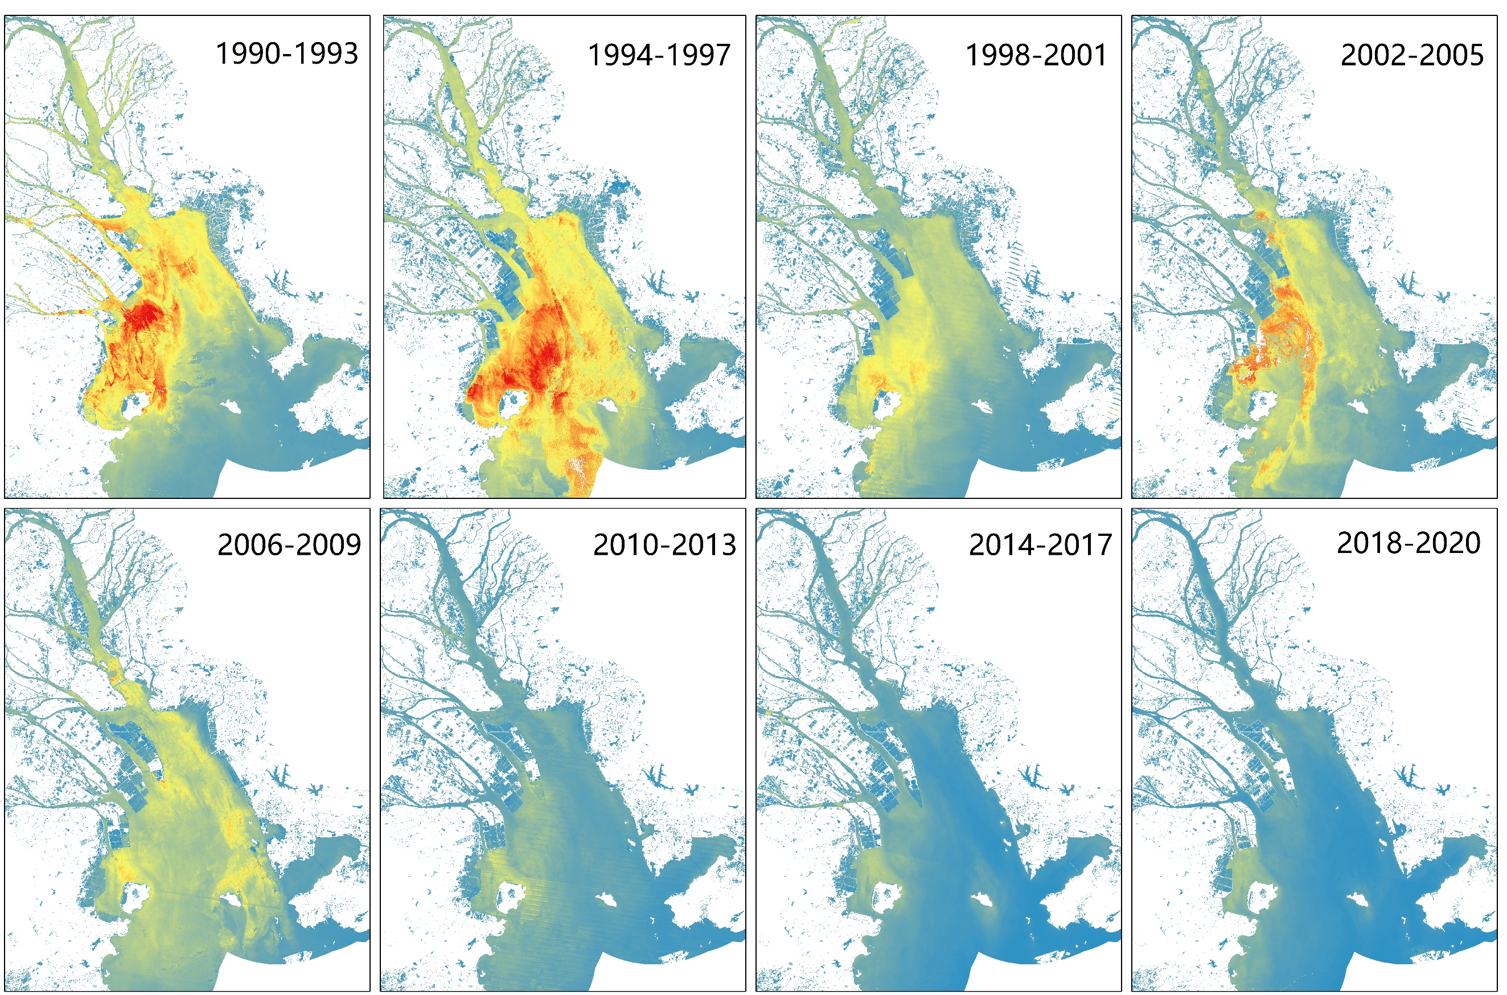
3
Result
3.1 Interannual variation of estuaries
Low : 0
High : 1000 mg/L
Low : 0
High : 1000 mg/L
Low : 0
High : 1000 mg/L
Low : 0
High : 600 mg/L

Slide 13
3
Result
3.2 Seasonal changes in estuaries
Mekong estuary
Pearl River estuary
Hangzhou Bay
From the results, it can be seen that the seasonal changes in most estuaries show a trend of high in winter and spring, and low in summer and autumn; However, the Mekong River is characterized by low in winter and spring, and high in summer and autumn. These results are consistent with (Heege et al., 2014; Yunus et al., 2022; Feng et al., 2014; Zhang al., 2014) . The results of the three models have good consistency.
Yangtze River estuary
Yellow River estuary
Liao River estuary

Slide 14
3
Result
3.3 Spatial distribution characteristics of estuaries
Most estuaries exhibit a decreasing gradient from the inside to the outside, but some estuaries have their unique spatial distribution characteristics. For example, the southern channel of the Yangtze River estuary gradually rises from west to east, while the southern channel gradually decreases from west to east.

Slide 15
3
Result
3.3 Spatial distribution characteristics of estuaries
The gradient of Hangzhou Bay from west to east is relatively stable, and the distribution pattern of the Pearl River Estuary is high in the west and low in the east for a long time.

Slide 16
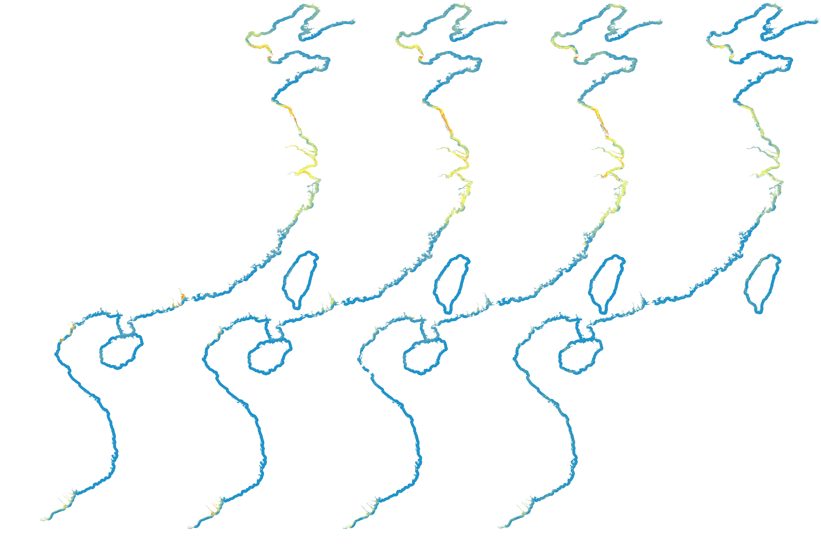
3
Result
3.4 Sediment monitoring in the western Pacific coastal zone
Mapping a suspended sediment distribution map of the western Pacific coastal zone every ten years, as shown in the left picture:
1. Throughout the entire coastal zone, suspended sediment is mainly distributed near the estuary.
2. Over the past 30 years, the suspended sediment in the western Pacific coastal zone has shown an overall downward trend, with a particularly significant decrease in estuarine areas and relatively stable in non estuarine areas.
1990
2000
2010
2020
Low : 0
High : 2500 mg/L

Slide 17
4
Discussion
The applicability of the retrieve model:
At present, most retrieve models are based on local regions, although in recent years there have been research and development of multi-band switching algorithms or methods to establish models by setting proxy parameters to retrieve clear to extremely turbid water. However, due to the complexity of coastal water composition and optical characteristics, no single model can estimate SSC without obvious bias in a large range of turbid waters (IOCCG, 2000). Therefore, the lack of a universal algorithm for comprehensive evaluation of SSCs in coastal waters limits large-scale trend analysis and comparison of SSCs in different estuaries.
Recognizing the lack of a universal algorithm for comprehensive assessment of SSC in coastal waters, we will limit our research to trend analysis and comparison of different coastal estuaries, rather than quantifying the magnitude of changes.

Slide 18
4
Discussion
Discontinuities in sensors:
In this study, one of the main and challenging tasks in processing long-term series datasets is to ensure the consistency of remote sensing reflectance datasets. To calculate the SSC values from 1990 to 2020, images of three satellites were obtained: Landsat 5 TM (1984-2011), Landsat 7 ETM+(2012), and Landsat 8 OLI (2013- 2020). The spectral bands of different sensors are slightly different, resulting in a slight deviation between the surface reflectance and the SSC value obtained. Therefore, it is necessary to calibrate the remote sensing reflectance values between different sensors.
In Landsat-5 TM, the red spectral band range is 0.630 to 0.690 μm. The NIR band range is 0.775 to 0.900 μm. However, in Landsat-8 OLI, the red spectral band range is 0.630 to 0.680 μm. The NIR band range is 0.845 to 0.885 μm. Compared with Landsat-5 and -7, Landsat-8 has a narrower band range, higher radiation resolution, and larger synthesized NDVI values calculated from surface reflectance. (Roy et al.,2016) collected 59 million sensor observations corresponding to 30 meters from 6317 Landsat-7 ETM+and Landsat-8 OLI images in the United States. And the linear relationship between the reflectance values of Landsat7 and Landsat8 was obtained:
Red λ ETM = 0.0123 + 0.9372 OLI

Slide 19
5
Conclusion
We monitored the suspended sediment changes in the western Pacific coastal zone over a period of 31 years using long-term Landsat satellite images based on the GEE platform, and obtained the following conclusions:
1. Focused on analyzing the interannual changes of SSC over time in the six major estuaries, it was found that all estuaries showed a significant downward trend, with relatively small declines in the Liao River mouth and Hangzhou Bay.
2. Analyzed the seasonal changes of SSC in the six major estuaries within the year, the results showed that most estuaries showed higher levels of winter and spring compared to summer and autumn, with only the Mekong River showing higher levels of summer and autumn compared to winter and spring
3. The long-term spatial distribution characteristics of the six estuaries are analyzed. The results show that the Pearl River Estuary, the Yellow River Estuary and the Hangzhou Bay have special spatial distribution patterns.
4. Assessing the overall SSC changes in the western Pacific coastal zone, it was found that the overall trend is decreasing, and the decline is mainly due to the decline in the estuarine area.

