Slide 1
Egu General Assembly
Wien 27 April 2023
Modeling post-fire regeneration patterns under different restoration scenarios to improve forest recovery in degraded ecosystems
Giulia Mantero¹, Nicolò Anselmetto¹, Donato Morresi¹, Fabio Meloni¹, Paola Bolzon²,
Emanuele Lingua², Matteo Garbarino¹, Raffaella Marzano¹
¹ University of Torino, Department of Agricultural, Forest and Food Sciences, Grugliasco (TO), Italy
² University of Padova, Department of Land, Environment, Agriculture and Forestry, Legnaro (PD), Italy.

Slide 2
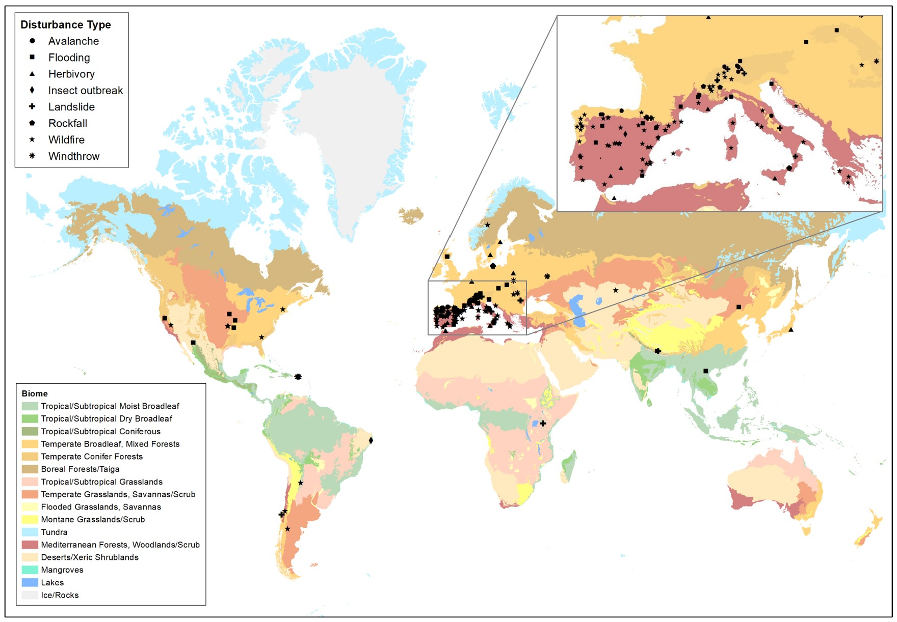
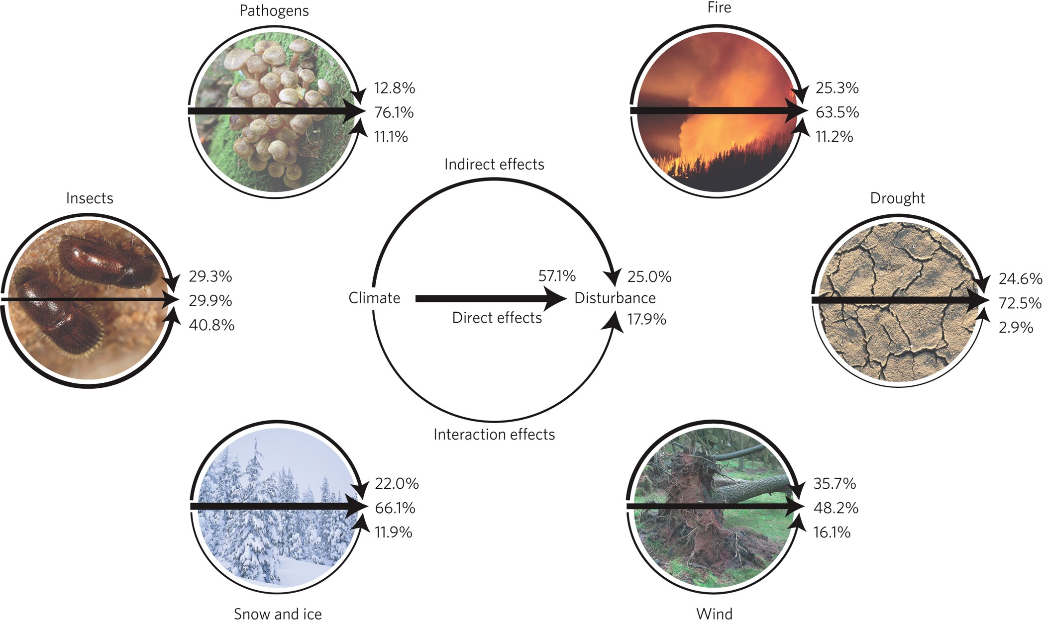
1. Introduction
Disturbances have been shaping forest landscapes for ages, making ecosystems adapted to specific disturbance regimes
Seidl et al.2017
Mantero et al. 2020
Climate and land-use changes → alterations in the ecologically appropriate regimes

Slide 3
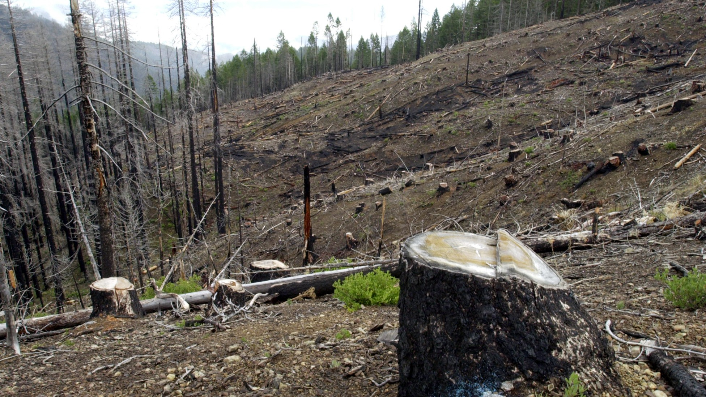
1. Introduction
Mountain ecosystems:
Widespread land abandonment
Higher sensibility to climate change
Post-disturbance management
SALVAGE LOGGING
© Jeff Barnard
Fire regime alterations with potential consequences on regeneration dynamics
Salvage logging operations in Oregon
Need to reconsider current post-disturbance policies to identify strategies that promote and maintain ecosystem functions of degraded forests
Degradation processes
3

Slide 4
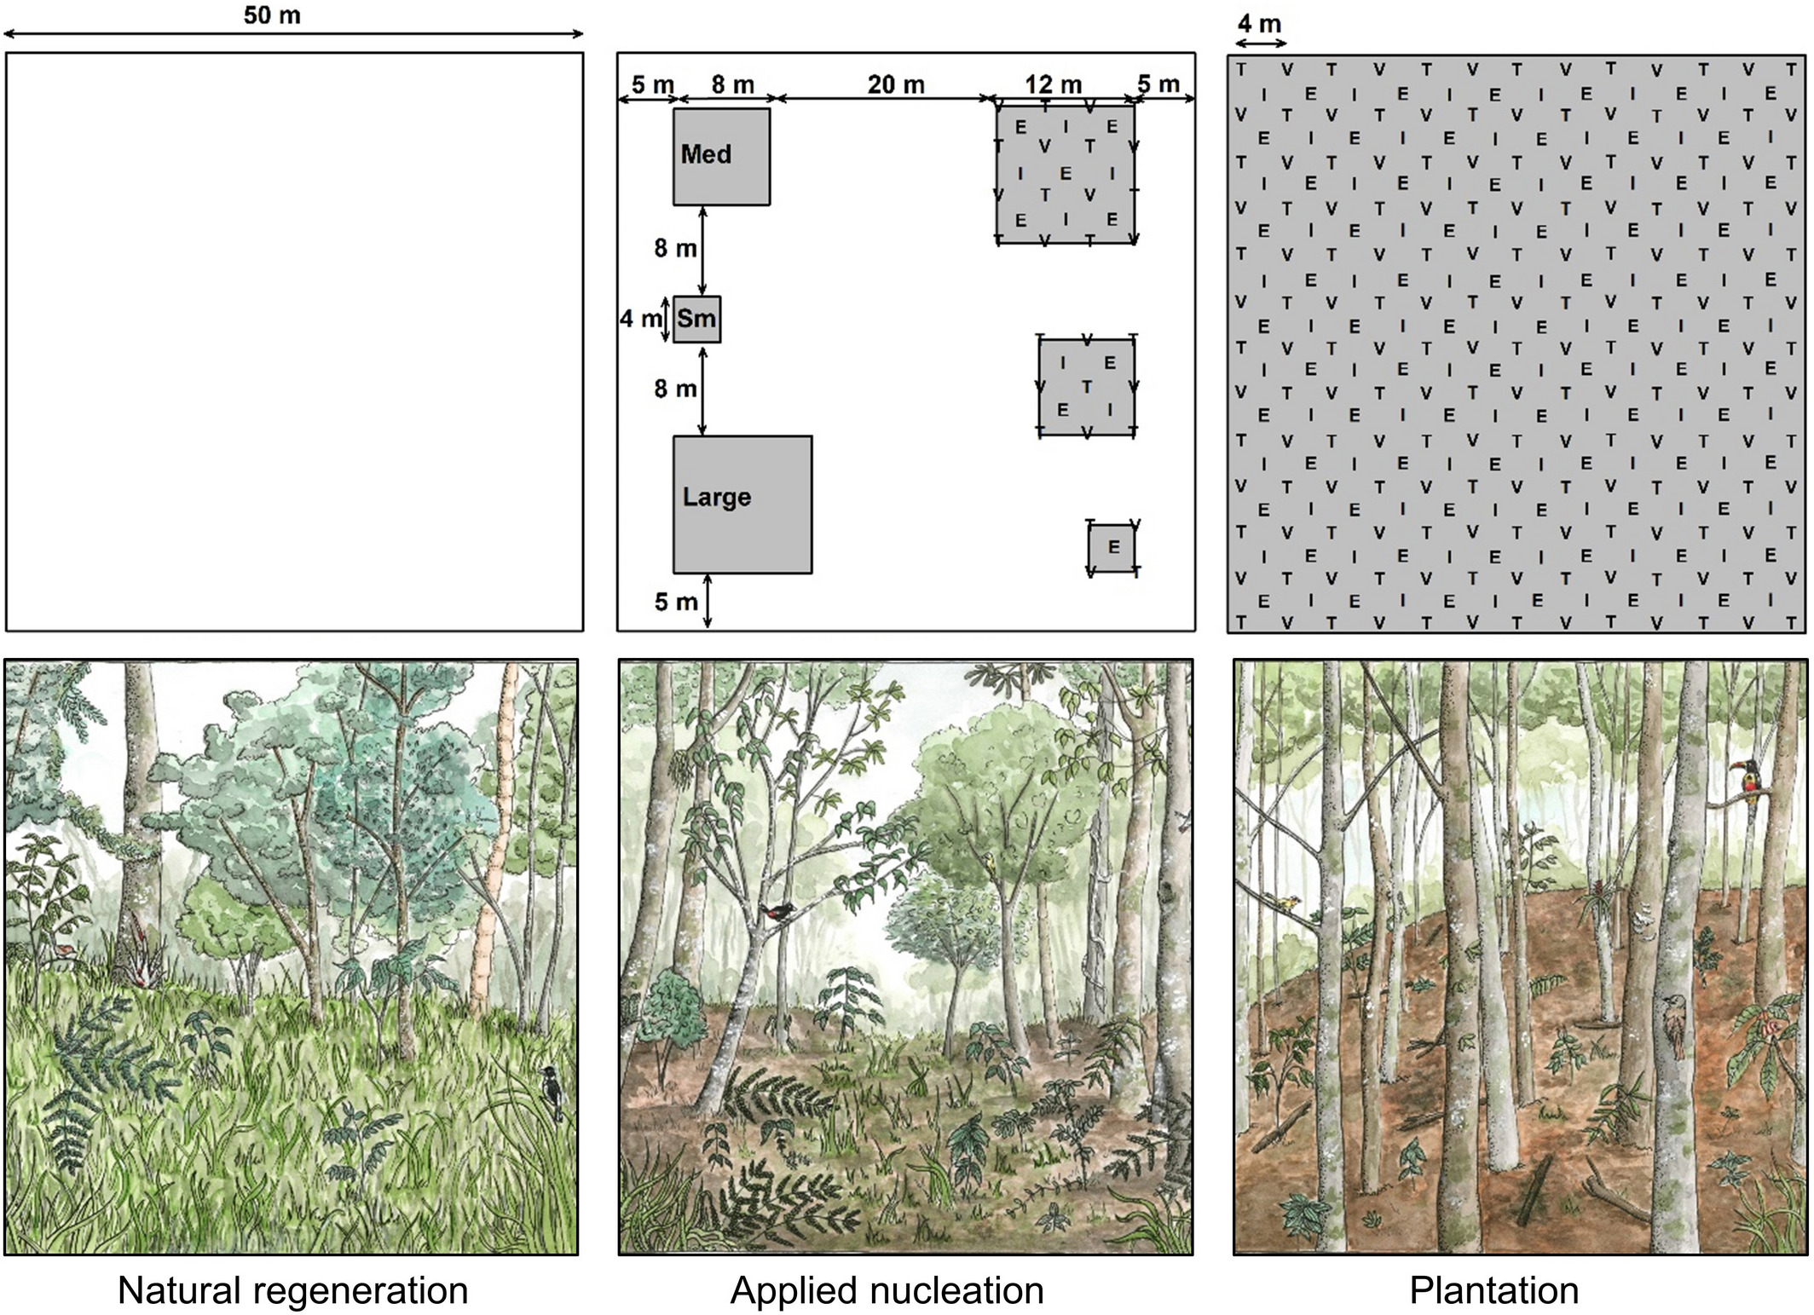
1. Introduction
Ecological restoration is the process of assisting the recovery of an ecosystem that has been degraded, damaged, or destroyed (SER, 2002)
APPLIED NUCLEATION (AN) Planting trees in small groups or nuclei
(Di Sacco et al. 2021)
Holl et al. 2020
Mimics natural successional processes
Improves stressful abiotic conditions
Facilitates seedling establishment
Increases seed availability
4

Slide 5
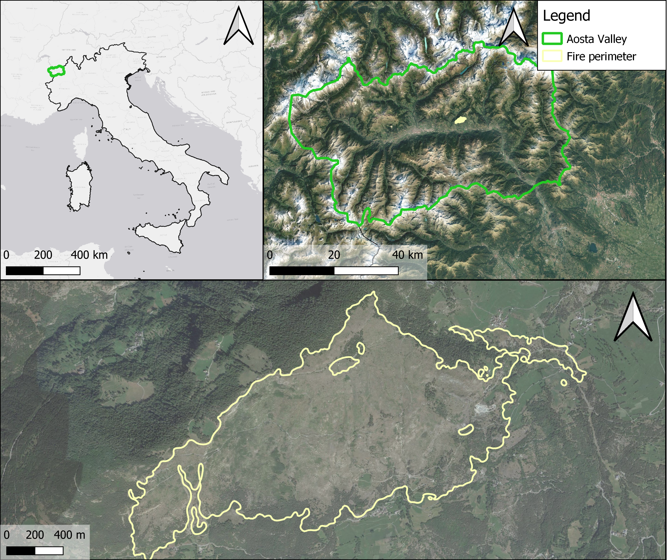
2. Study area
Bourra wildfire (Aosta Valley, Italy)
March 2005 - 257 ha
Salvage logging (SL)
Deadwood retention (DR)
Passive management (PM)

Slide 6
3. Research aims and methods
Evaluate post-fire regeneration dynamics
Species composition, density, ground cover

Slide 7
3. Research aims and methods
Evaluate post-fire regeneration dynamics
Species composition, density, ground cover
II. Assess drivers of post-fire recovery
Correlative regeneration models for Scots pine using Bayesian additive regression trees (BART)

Slide 8
3. Research aims and methods
Evaluate post-fire regeneration dynamics
Species composition, density, ground cover
II. Assess drivers of post-fire recovery
Correlative regeneration models for Scots pine using Bayesian additive regression trees (BART)
III. Define intervention priority sites
Probability of Scots pine presence → binary categorical maps

Slide 9
3. Research aims and methods
Evaluate post-fire regeneration dynamics
Species composition, density, ground cover
II. Assess drivers of post-fire recovery
Correlative regeneration models for Scots pine using Bayesian additive regression trees (BART)
III. Define intervention priority sites
Probability of Scots pine presence → binary categorical maps
IV. Define most effective APPLIED NUCLEATION (AN) scenarios
Probability of Scots pine presence under the current situation and a set of AN scenarios
HIGH PRIORITY (HP) vs RANDOM (R) approach

Slide 10
4. Results and discussion
II. Assess drivers of post-fire recovery
Evaluate post-fire regeneration dynamics
Distance to seed trees
Dominant species: European aspen (seedlings + root suckers)
Sporadic Scots pine seedlings
(close to seed trees)
 | Mean density ha ⁻¹ | SE
All | 1527 | 173
Pinus sylvestris | 94 | 19
Populus tremula | 1103 | 167
Salix caprea | 149 | 25
Larix decidua | 32 | 9
Other species | 148 | 17
Eastness
Distance to ravines
Mantero et al. submitted

Slide 11
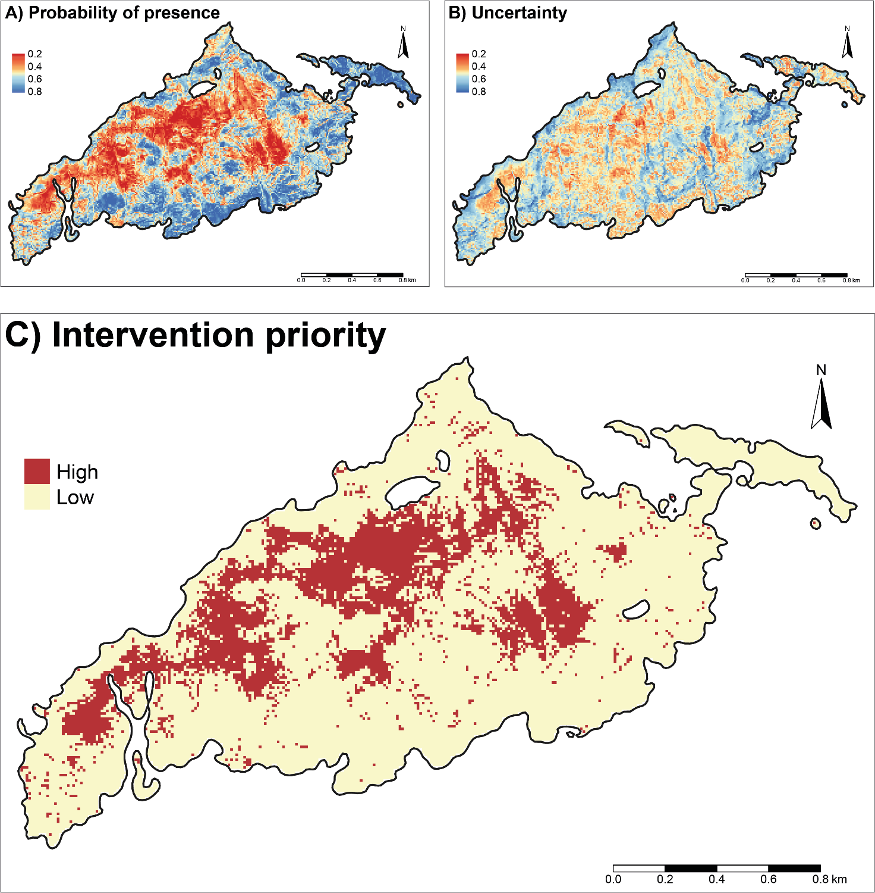
4. Results and discussion
III. Define intervention priority sites
Continuous values (probability of Scots pine presence) to categorical data (binary maps of intervention priority)
Threshold = max TSS criteria
High intervention priority sites: 57.4 ha
Low intervention
priority sites: 184.4 ha
Largest patches of high priority located in the central part of the burnt area
Mantero et al. submitted

Slide 12
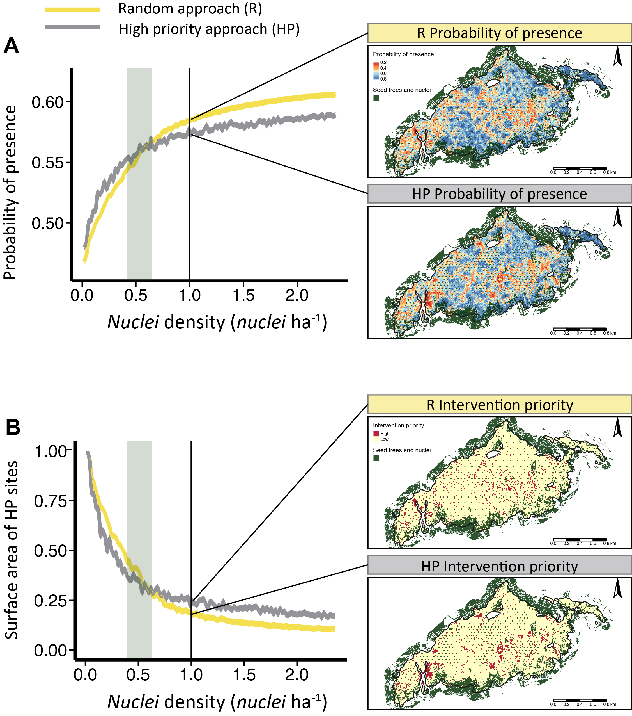
4. Results and discussion
IV. Define most effective AN scenarios
Probability of Scots pine presence with increasing nuclei density
High intervention priority sites with increasing nuclei density
Mantero et al. submitted

Slide 13
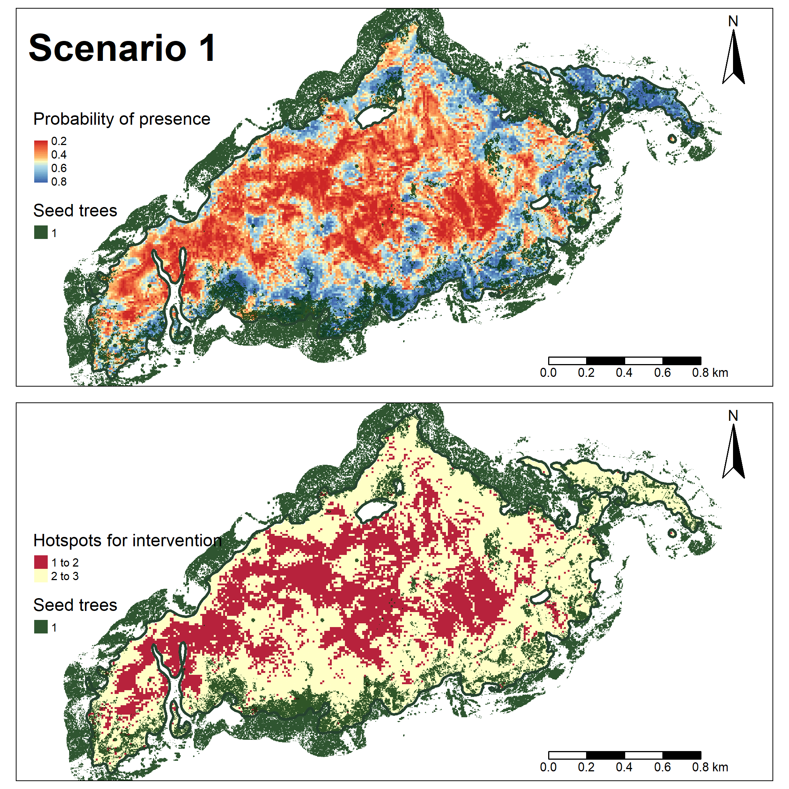
4. Results and discussion
IV. Define most effective AN scenarios
Probability of presence (upper) and intervention priority maps (lower) based on the first 50 different AN scenarios (high priority approach)
Mantero et al. submitted

Slide 14
5. Highlights
Scots pine regeneration density still low 16 years after the wildfire (distance from seed trees + salvage logging)
Distance from seed trees was the most important driver of Scots pine regeneration presence
Potential positive effects of AN and importance of site selection for plantation
Need for an accurate and micro-scale planning, considering the spatial pattern of natural regeneration

Slide 15
Thanks for your attention!

Slide 16
6. References
Di Sacco A, Hardwick KA, Blakesley D, Brancalion PHS, Breman E, Rebola LC, Chomba S, Dixon K, Elliott S, Ruyonga G, Shaw K, Smith P, Smith RJ, Antonelli A (2021) Ten golden rules for reforestation to optimize carbon sequestration, biodiversity recovery and livelihood benefits. Glob Change Biol 27:1328–1348.
Holl KD, Reid JL, Oviedo-brenes RJCF, Rosales JA, Zahawi RA (2020) Applied nucleation facilitates tropical forest recovery: Lessons learned from a 15-year study. J Appl Ecol 57: 2316– 2328.
Mantero G, Morresi D, Marzano R, Motta R, Mladenoff DJ, Garbarino M (2020) The influence of land abandonment on forest disturbance regimes: a global review. Landsc Ecol 35:2723–2744.
Mantero G, Anselmetto N, Morresi D, Meloni F, Bolzon P, Lingua E, Garbarino M, Marzano R. Modeling post-fire regeneration patterns under different restoration scenarios to improve forest recovery in degraded ecosystems. Submitted
Seidl R, Thom D, Kautz M, Martín-Benito D, Peltoniemi M, Vacchiano G, Wild J, Ascoli D, Petr M, Honkaniemi J, Lexer MJ, Trotsiuk V, Mairota P, Svoboda M, Fabrika M, Nagel TA, Reyer CPO (2017) Forest disturbances under climate change. Nat clim change 7(6):395-402.
Society for Ecological Restoration Science and Policy Working Group (2002) The SER primer on ecological restoration. Society for Ecological Restoration, www.ser.org/

