Slide 1





Relevance of using ensemble forecasts of flash-flood impacts for an emergency service: an evaluation for the october 2018 flood event in the Aude River basin, France
Charpentier-Noyer M., Nicolle P., Payrastre O., Gaume E., Bouttier F., and Marchal H.
Notes:
Bonjour à toutes et à tous,
Je vais vous présenter une partie de ma thèse portant sur l’évaluation de prévisions hydrométéorologiques d’ensemble des crues soudaines à partir de données sur les impacts. Ce travail a été dirigé par Eric Gaume et Olivier Payrastre.

Slide 2
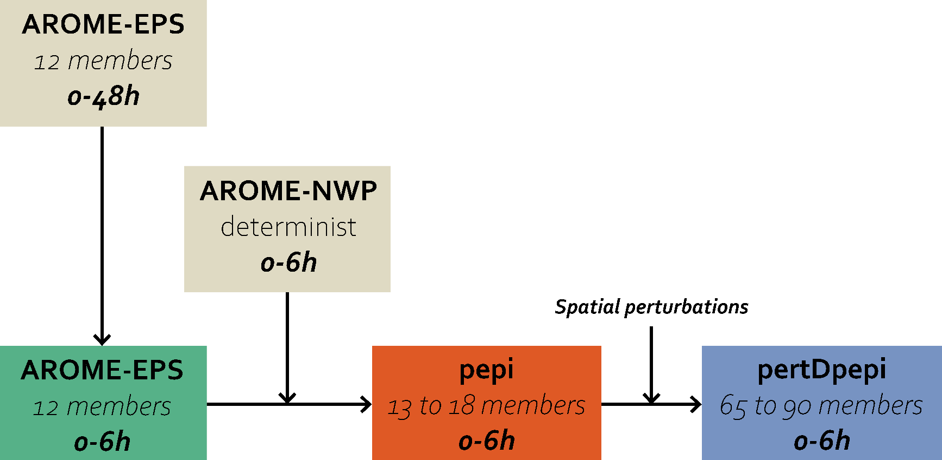
new experimental short range ensemble rainfall forecast products
New short-range rainfall forecast products
A first evaluation based on discharge threshold anticipation
Objectives
Principles of the multi-agent model
Results
Conclusions
Experimental ensemble rainfall products based on the convection permitting Arome EPS and Arome NWP model
2

Slide 3
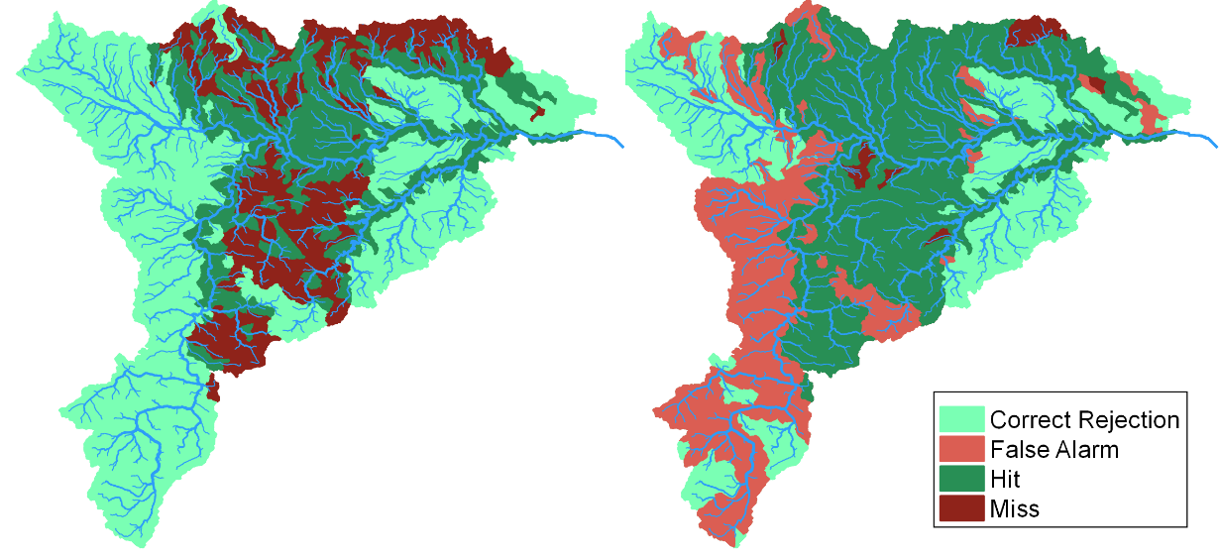
A first evaluation based on the discharge thresholds anticipation
New short-range rainfall forecast products
A first evaluation based on discharge threshold anticipation
Objectives
Principles of the multi-agent model
Results
Conclusions
Anticipation capacity of T=10 years discharge threshold (Example of the Aude River basin: 1174 sub-basins)
Zero future rainfall
pepi ensemble product - 75% percentile
Charpentier-Noyer et al., 2022, NHESSd, https://doi.org/10.5194/nhess-2022-182
What is the best forecast for an user ?
3

Slide 4
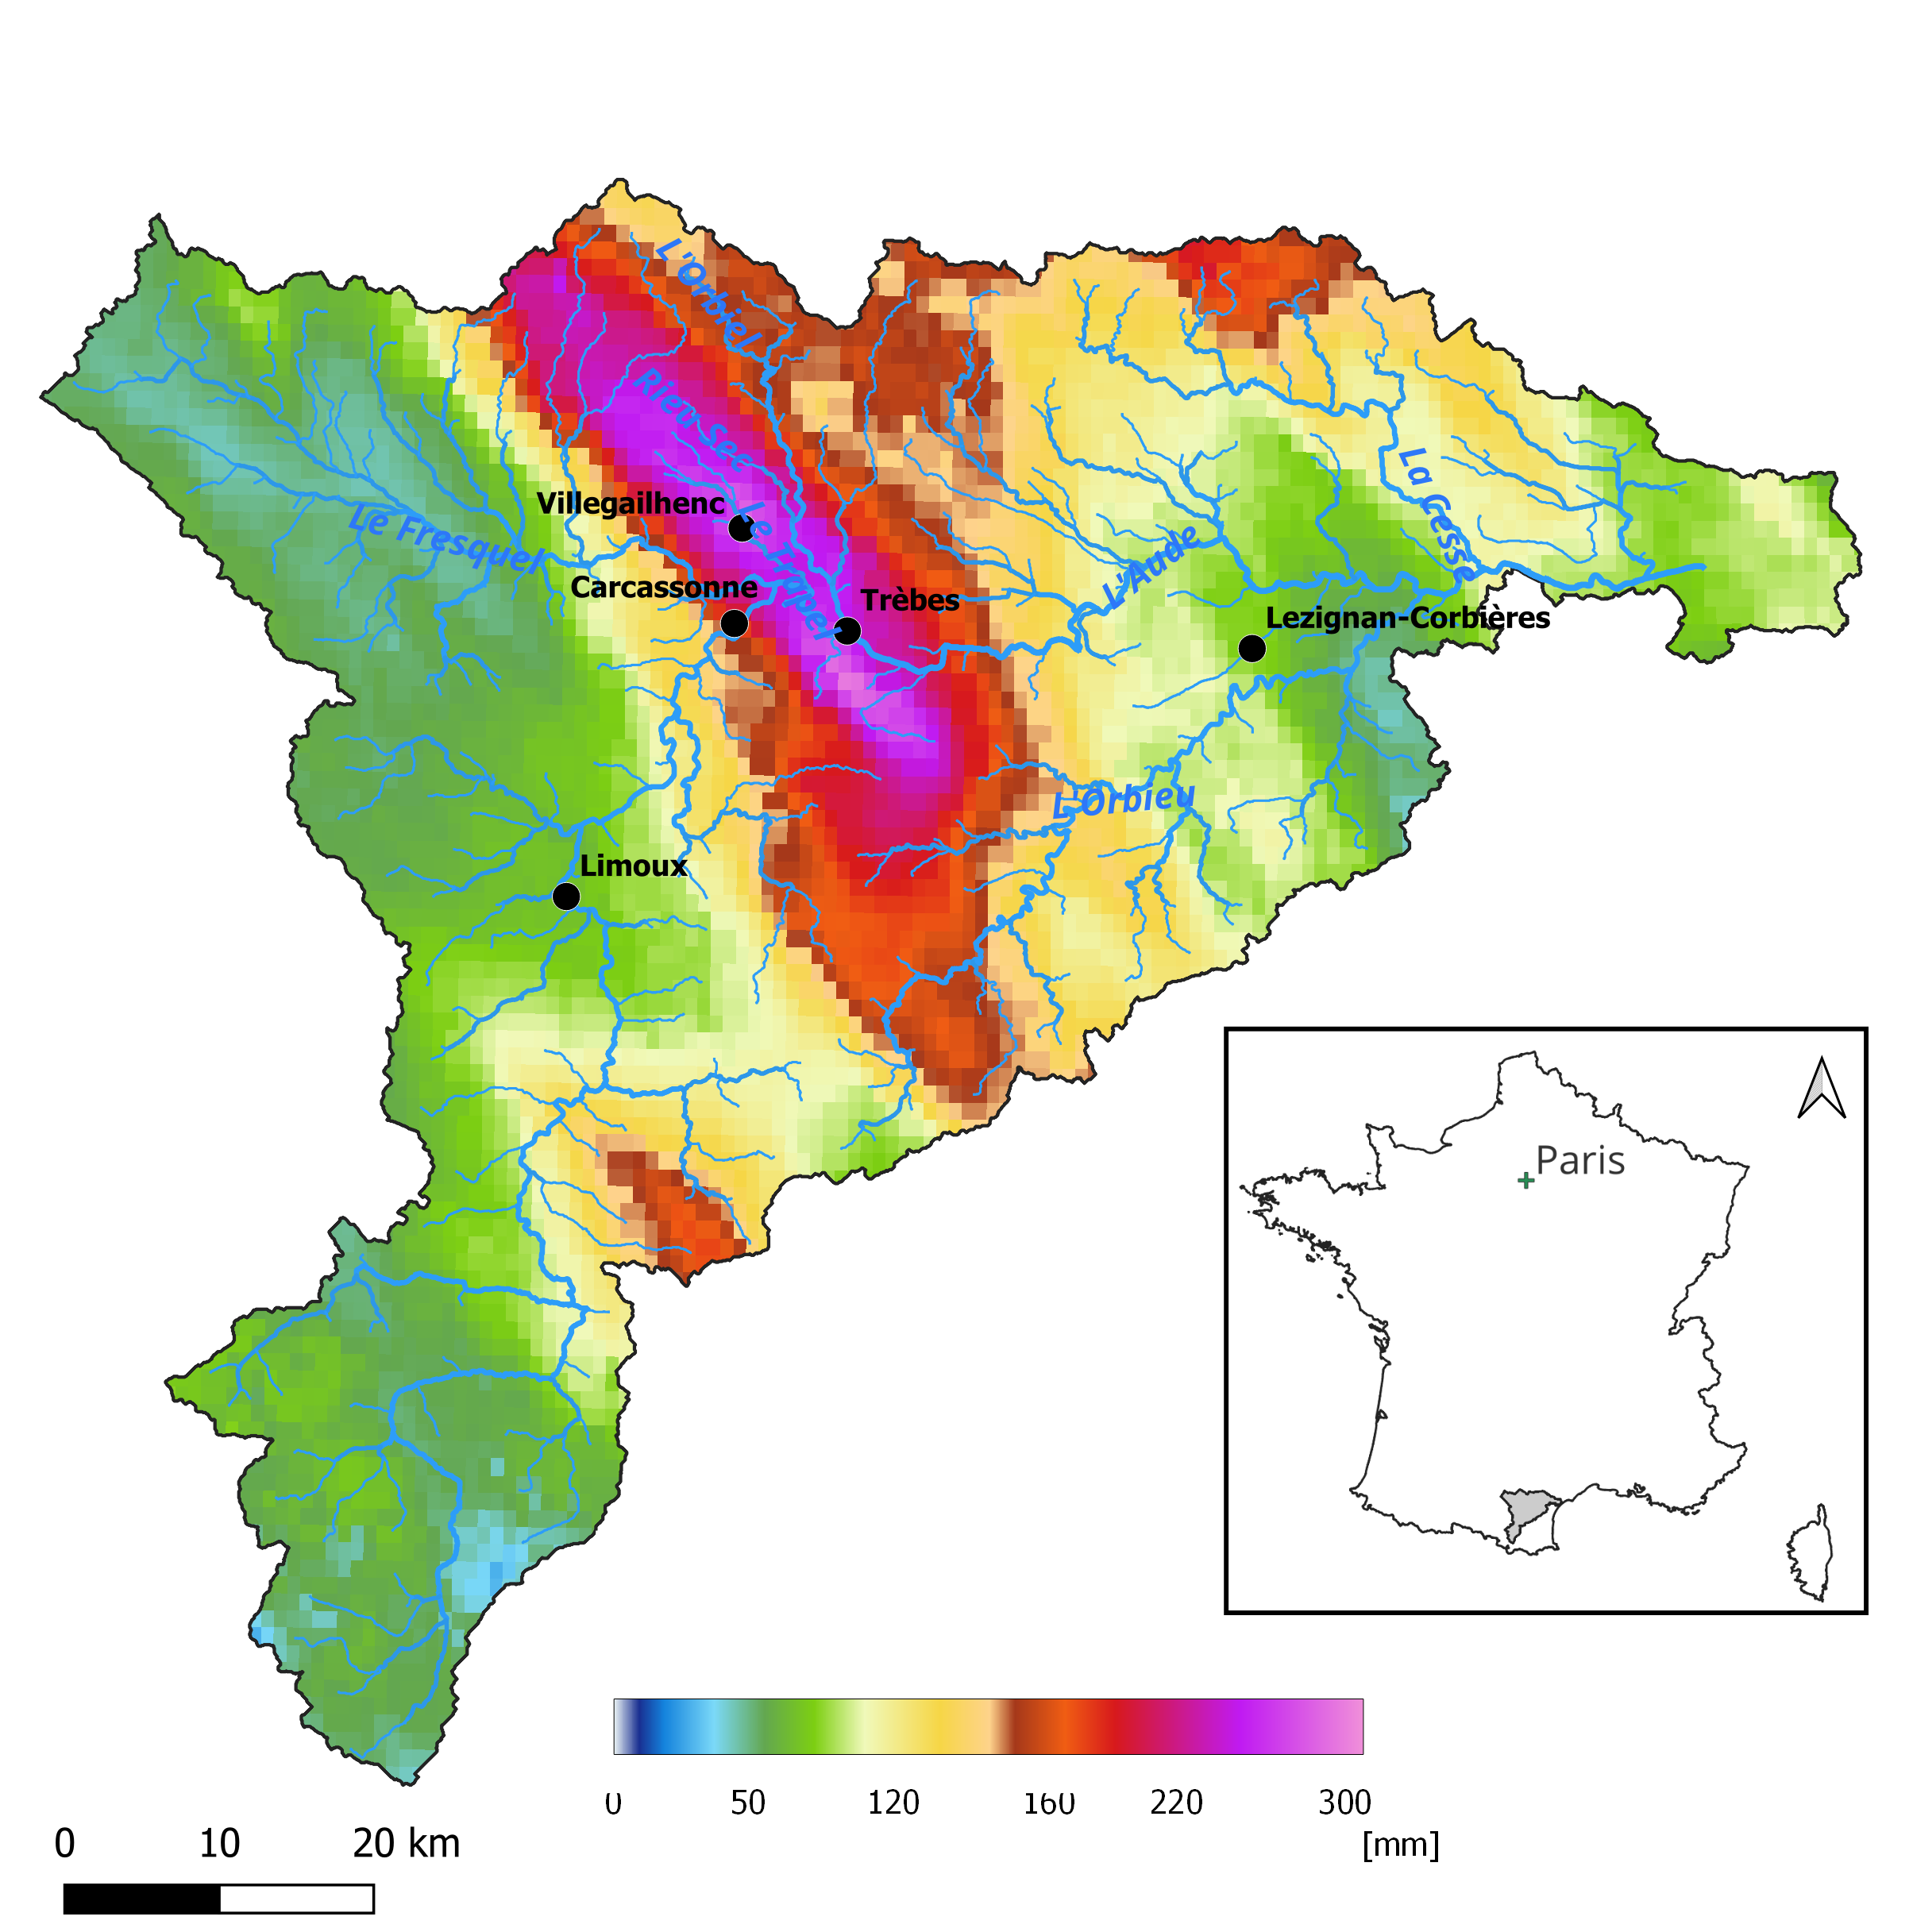





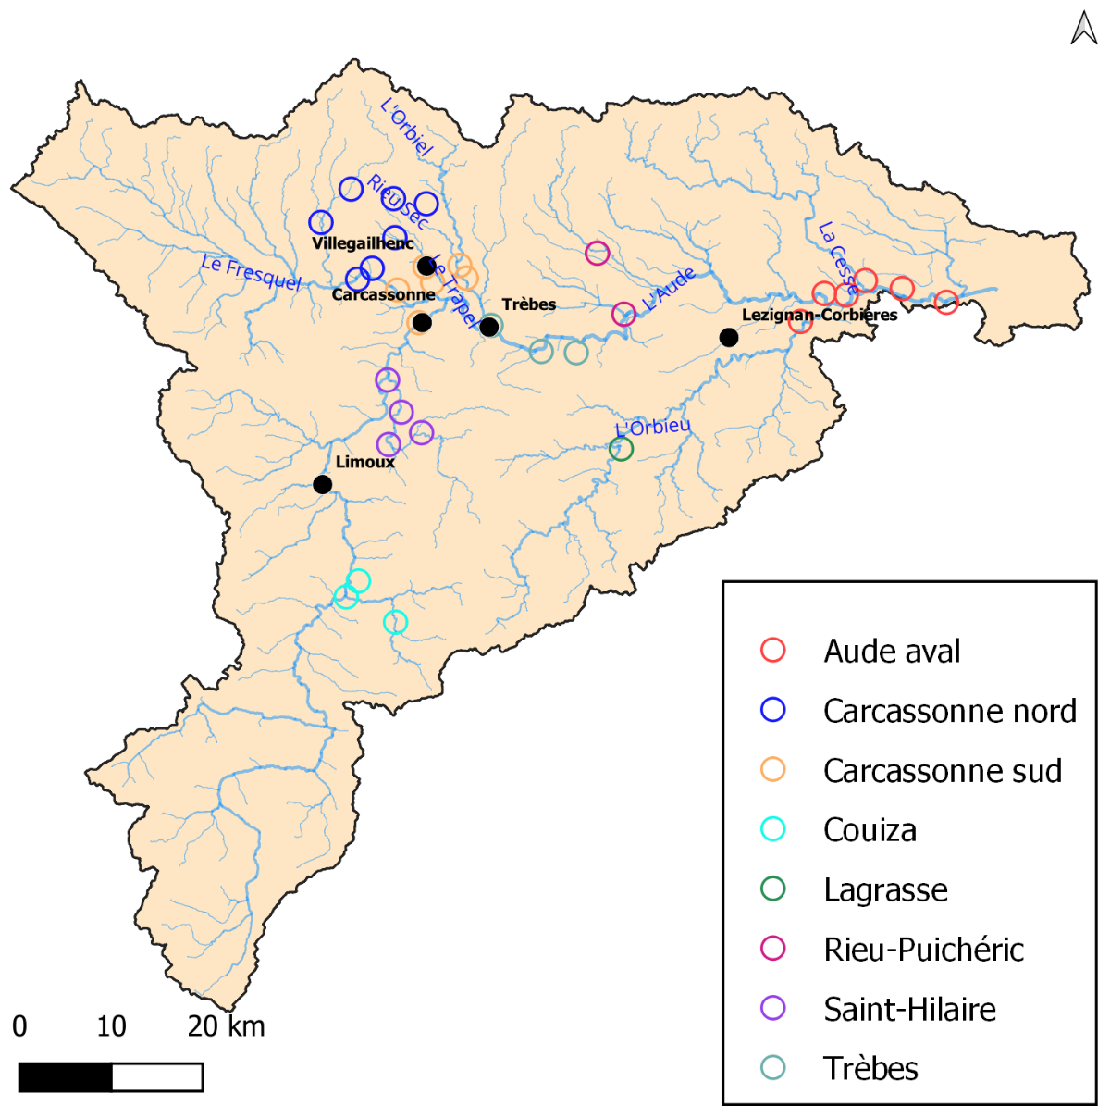
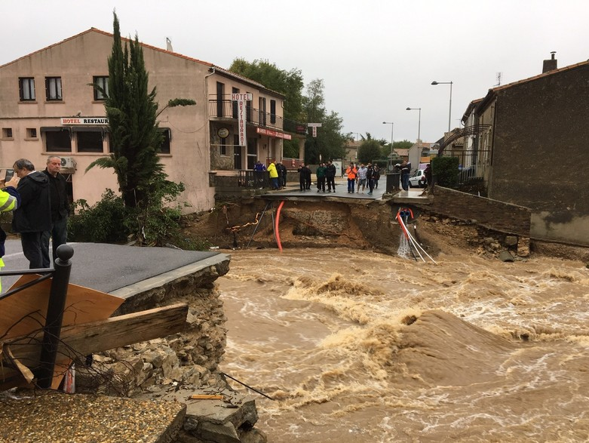
Flash floods in the Aude River basin 14-16 October 2018
New short-range rainfall forecast products
A first evaluation based on discharge threshold anticipation
Objectives
Principles of the multi-agent model
Results
Conclusions
Objective: evaluate the forecasts based on the capacity to take efficient decisions
Case study: Aude October 2018 flood
15 fatalties
200 M€
213 mm in 6 hours
32 municipalities with rescue operations
Interventions triggered by reports of observed impacts
The agents of a fire service are rescuing team
Decisions based on impacts forecasts
4

Slide 5
Overall principles of the multi-agent model
New short-range rainfall forecast products
A first evaluation based on discharge threshold anticipation
Objectives
Principles of the multi-agent model
Results
Conclusions
Forecast of flooded buildings, at the river reach scale and 15 min time resolution
A decision threshold (number of inundated buildings) triggers the decision of sending a rescue team
Maximum number of flooded buildings in oct. 2018
5

Slide 6
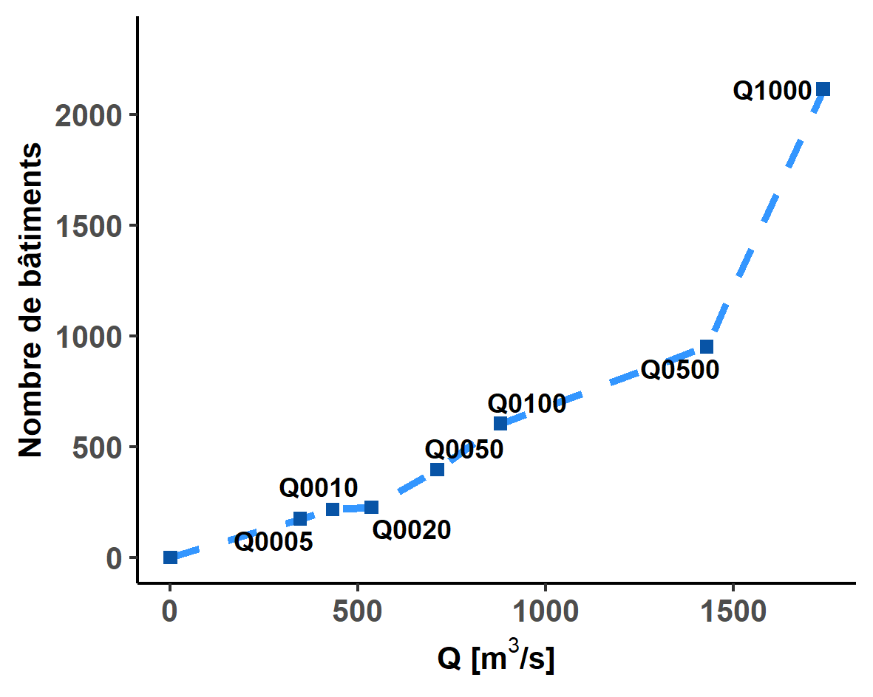
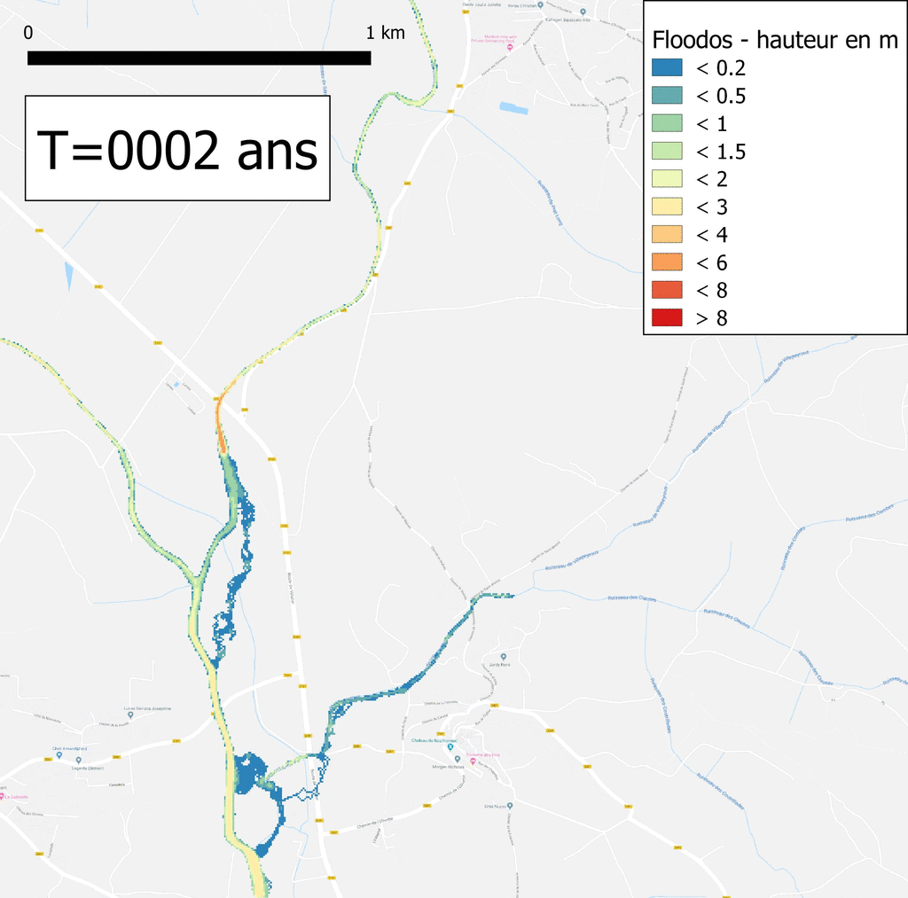

Overall principles of the multi-agent model
New short-range rainfall forecast products
A first evaluation based on discharge threshold anticipation
Objectives
Principles of the multi-agent model
Results
Conclusions
Principle of the impact forecasts used to take decisions
A discharge-impacts relation is built on each river reach (7 flood scenarios, T=5 to 1000 years)
Ensemble discharge forecasts can be direcly translated in terms of impacts
6

Slide 7
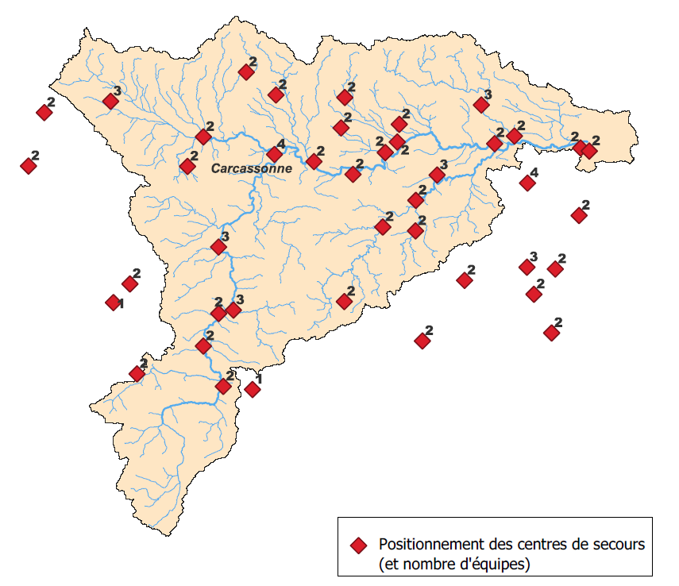
Overall principles of the multi-agent model
New short-range rainfall forecast products
A first evaluation based on discharge threshold anticipation
Objectives
Principles of the multi-agent model
Results
Conclusions
Assumptions & parameters
92 rescue teams (42 firemen centers)
Intervention threshold: minimum number of flooded buildings for sending a rescue team for a river section
Intervention capacity: number of buildings treated by a rescue team
Team displacement: displacement matrix with an average speed of 30 km/h
7

Slide 8
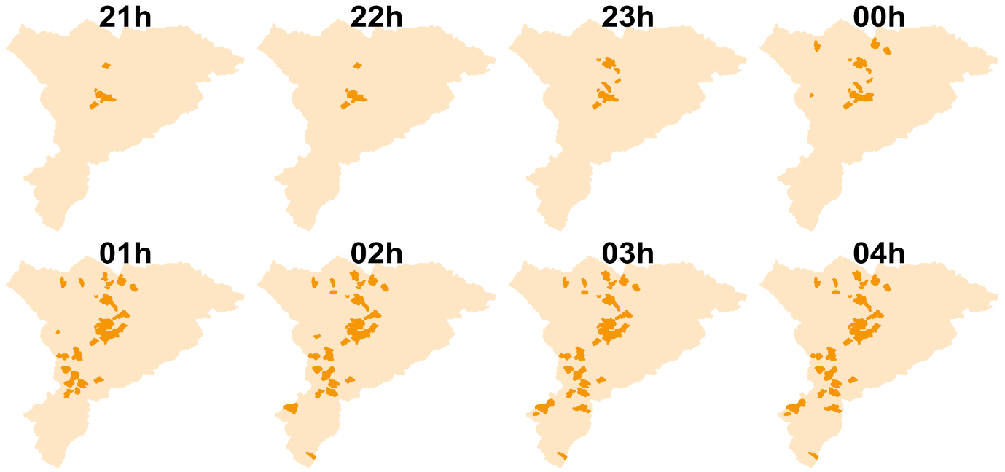
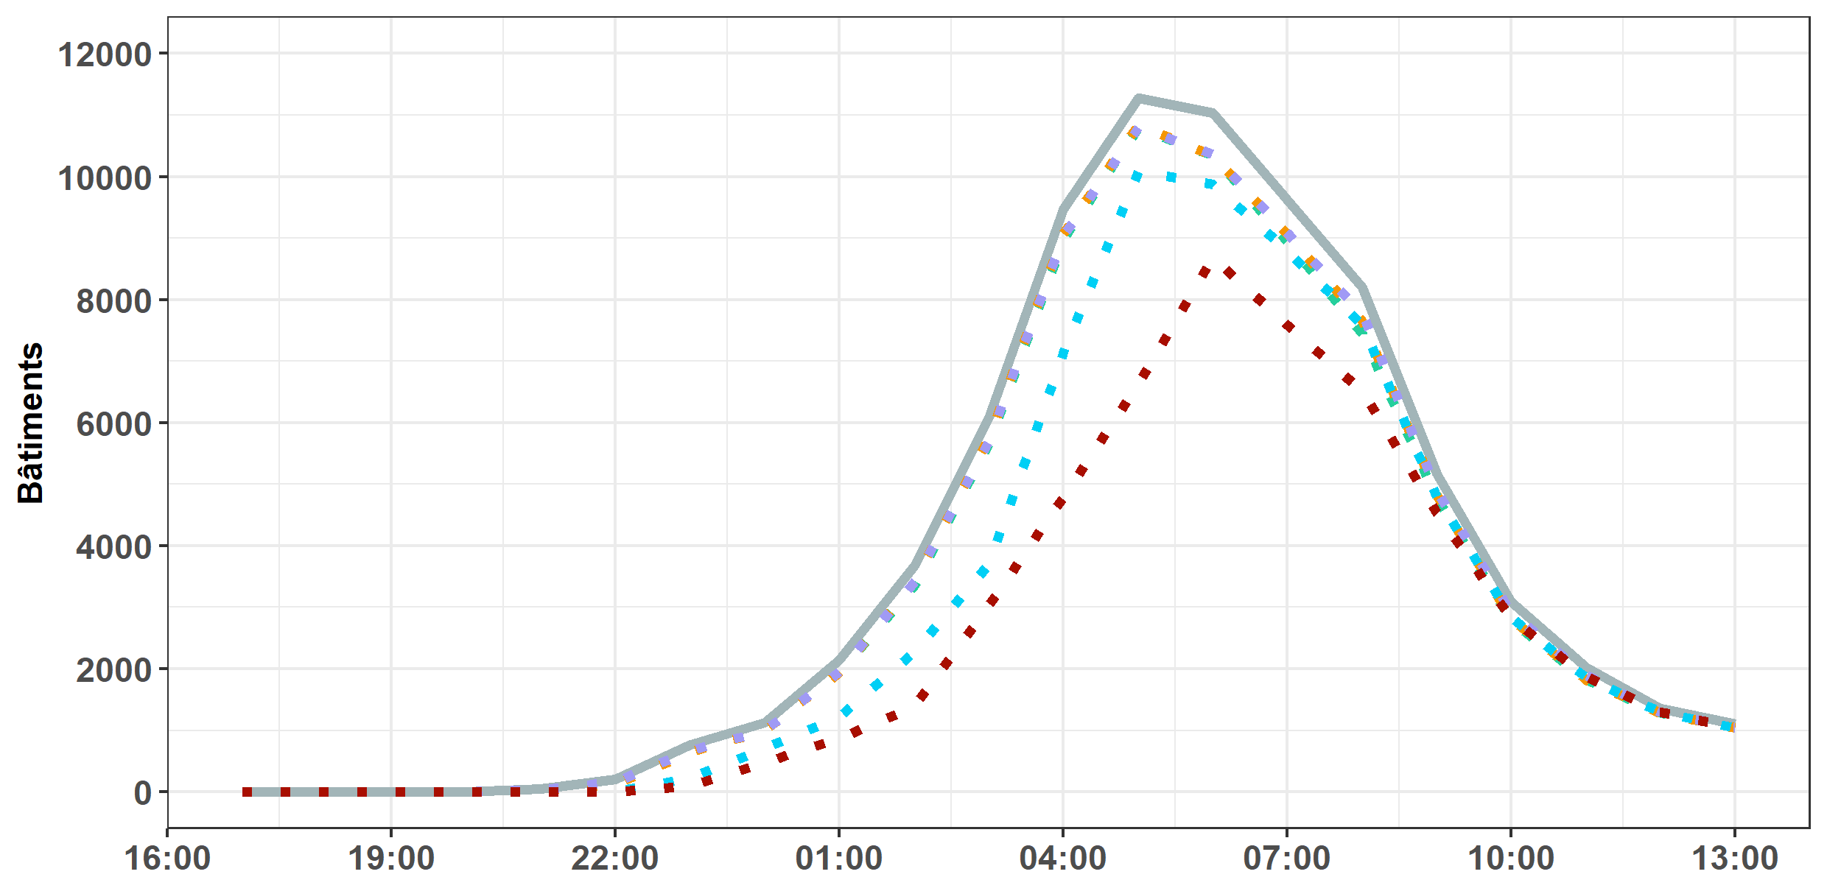
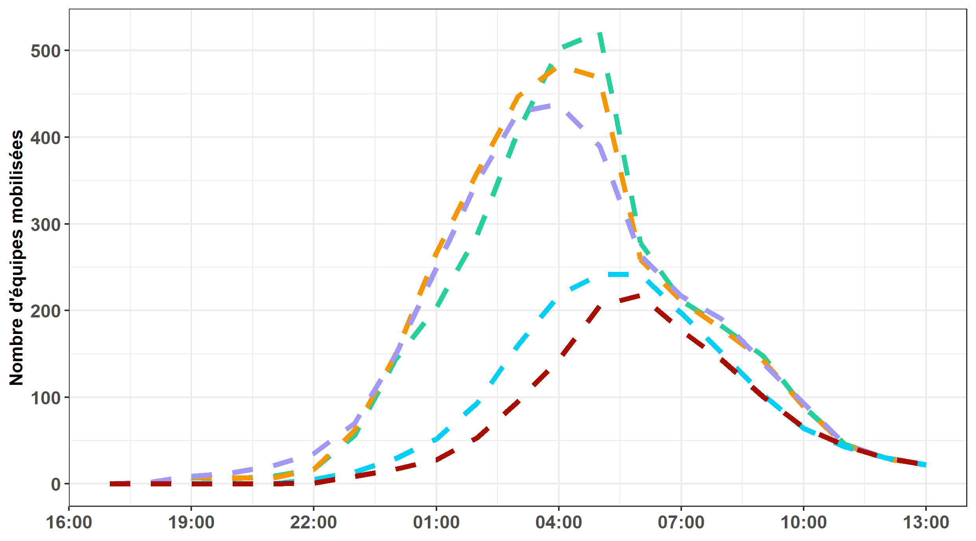
Examples of modelling results
New short-range rainfall forecast products
A first evaluation based on discharge threshold anticipation
Objectives
Principles of the multi-agent model
Results
Conclusions
Location (and number) of rescue teams in operation
Evolution of the number of buildings really rescued
Evolution of the number of rescue teams mobilized
8

Slide 9
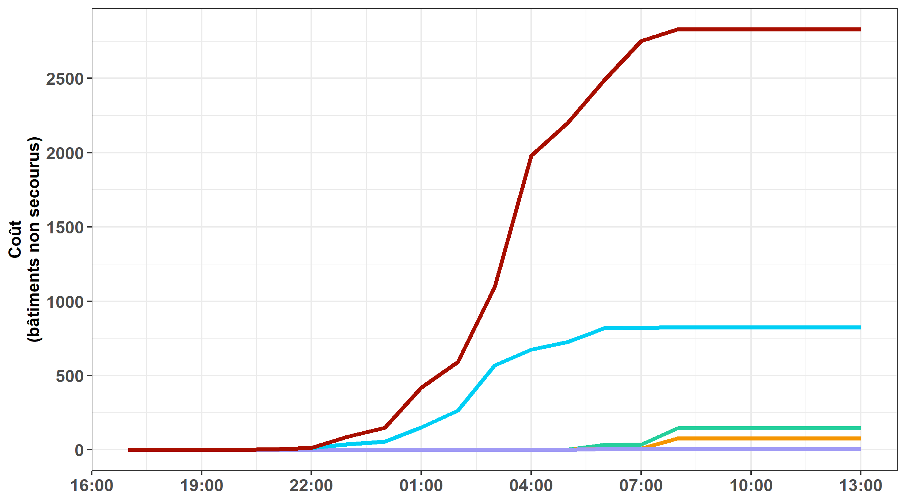




Measurement of the efficiency of decisions
New short-range rainfall forecast products
A first evaluation based on discharge threshold anticipation
Objectives
Principles of the multi-agent model
Results
Conclusions
Computation of a cost function
Cumulative number of buildings for which no rescue team was present during the flood
Before the begining of the flood cost = 0 buildings
Less than 1h after the flood begining cost = 10 % flooded buildings
Between 1h and 3h after the begining of the flood cost = 50 % flooded buildings
More than 3h after the begining of the flood cost = 100 % flooded buildings
9

Slide 10
Comparison of the efficiency of forecasts
New short-range rainfall forecast products
A first evaluation based on discharge threshold anticipation
Objectives
Principles of the multi-agent model
Results
Conclusions
Reference simulation based on observed rainfall: RS (used as reference, decisions based on field observations)
Forecasts based on zero future rainfall: RF0
Forecasts with the 3-ensemble rainfall forecast products (75% percentile):
AROME-EPS
pepi
pertDpepi
10

Slide 11
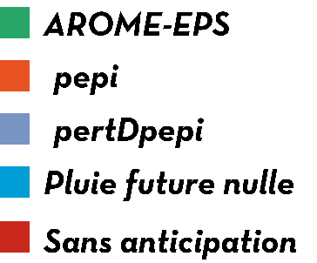
An ideal case with unlimited number of rescue teams
New short-range rainfall forecast products
A first evaluation based on discharge threshold anticipation
Objectives
Principles of the multi-agent model
Results
Conclusions
Number of buildings really rescued
Intervention threshold: 10 buildings
Team number: unlimited
Intervention capacity: 100 buildings/team
11

Slide 12
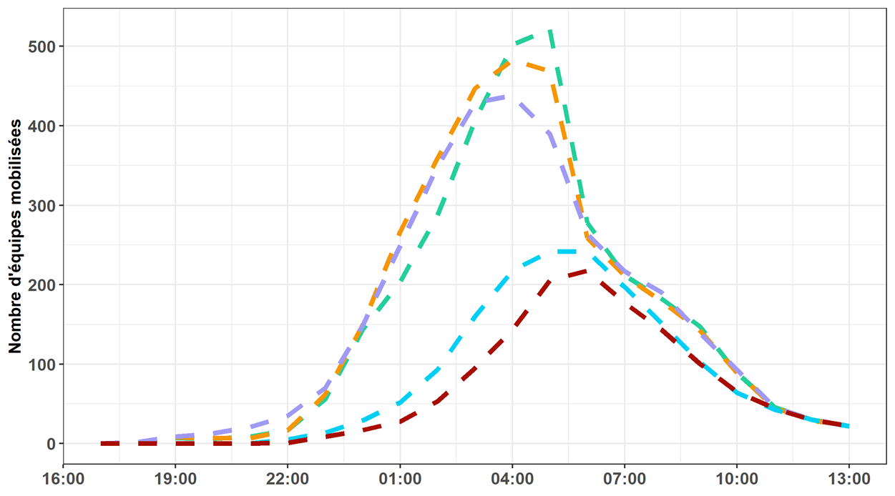
An ideal case with unlimited number of rescue teams
New short-range rainfall forecast products
A first evaluation based on discharge threshold anticipation
Objectives
Principles of the multi-agent model
Results
Conclusions
Number of rescue teams mobilized
Intervention threshold: 10 buildings
Team number: unlimited
Intervention capacity: 100 buildings/team
12

Slide 13
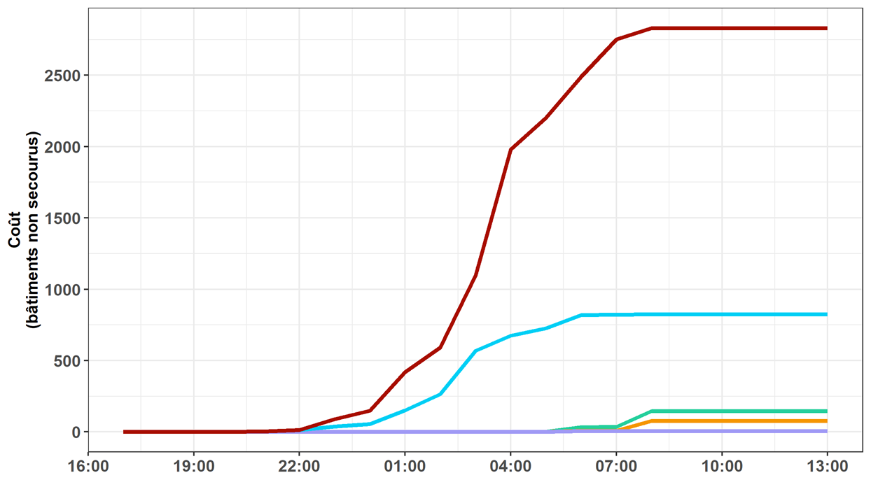
An ideal case with unlimited number of rescue teams
New short-range rainfall forecast products
A first evaluation based on discharge threshold anticipation
Objectives
Principles of the multi-agent model
Results
Conclusions
Cost function: buildings not rescued
Intervention threshold: 10 buildings
Team number: unlimited
Intervention capacity: 100 buildings/team
13

Slide 14
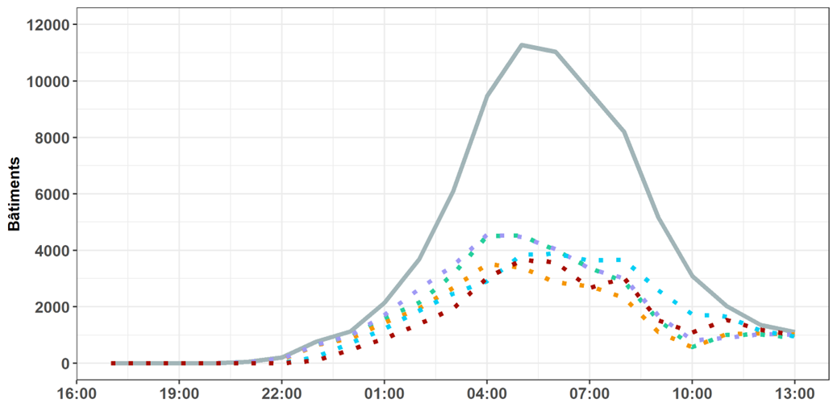
A more realistic case with 92 rescue teams
New short-range rainfall forecast products
A first evaluation based on discharge threshold anticipation
Objectives
Principles of the multi-agent model
Results
Conclusions
Number of buildings really rescued
Intervention threshold: 10 buildings
Team number: 92
Intervention capacity: 100 buildings/team
14

Slide 15
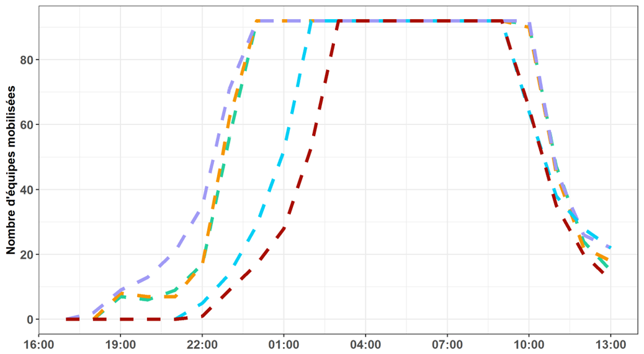
A more realistic case with 92 rescue teams
New short-range rainfall forecast products
A first evaluation based on discharge threshold anticipation
Objectives
Principles of the multi-agent model
Results
Conclusions
Number of rescue teams mobilized
Intervention threshold: 10 buildings
Team number: 92
Intervention capacity: 100 buildings/team
15

Slide 16
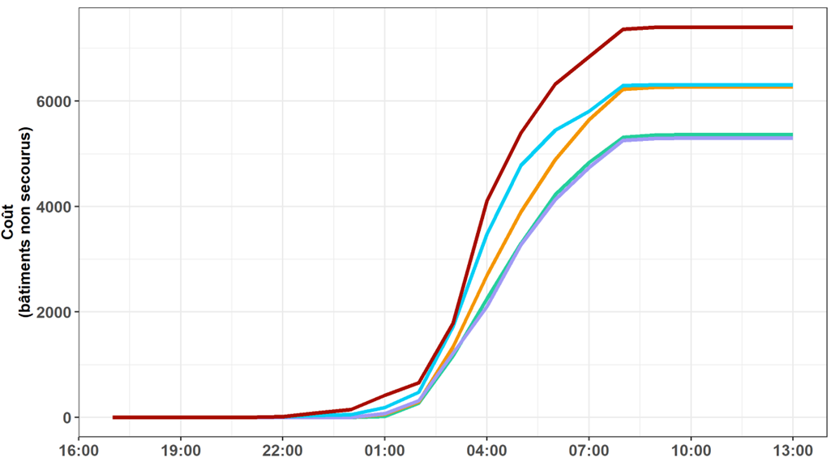
A more realistic case with 92 rescue teams
New short-range rainfall forecast products
A first evaluation based on discharge threshold anticipation
Objectives
Principles of the multi-agent model
Results
Conclusions
Cost function: buildings not rescued
Intervention threshold: 10 buildings
Team number: 92
Intervention capacity: 100 buildings/team
16

Slide 17
Comparison of the efficiency of forecasts
New short-range rainfall forecast products
A first evaluation based on discharge threshold anticipation
Objectives
Principles of the multi-agent model
Results
Conclusions
Performance of the different tested rainfall forecasts
The added value of forecasts can be identified, particularly in case if unlimited means
Forecasts are largely affected by false alarms in case of limited means. Decisions based on zero future rainfall may be better in this case.
Decisions based on forecasts never worse than decisions based on field observations
Realism of the agent-based model - improvements
Impacts model based on affected population rather than buidings
Travel times
Cost function (case of late arrival of rescue)
Duration of rescue operations and reaffectation of rescue teams
17

