Slide 1
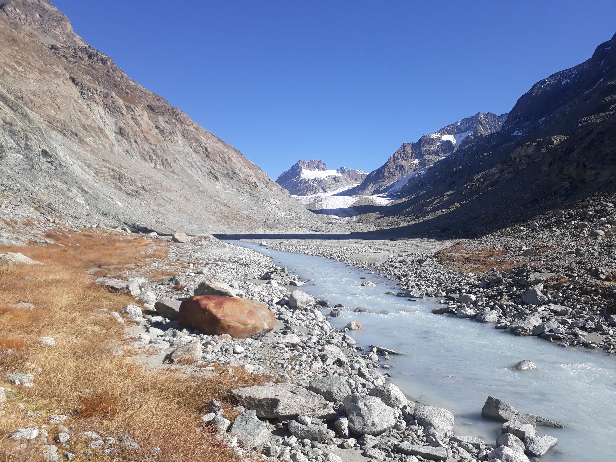




Characterizing the current and future groundwater storages in a highly glaciated catchment :
A synthesis of 3 years of field observations and modelling results
Session HS2.1.7
EGU23-11831
26 April 2023
Tom Müller¹, Bettina Schaefli², and Stuart N. Lane¹
Institute of Earth Surface Dynamics, University of Lausanne, Lausanne, Switzerland
Institute of Geography, University of Bern, Bern, Switzerland

Slide 2
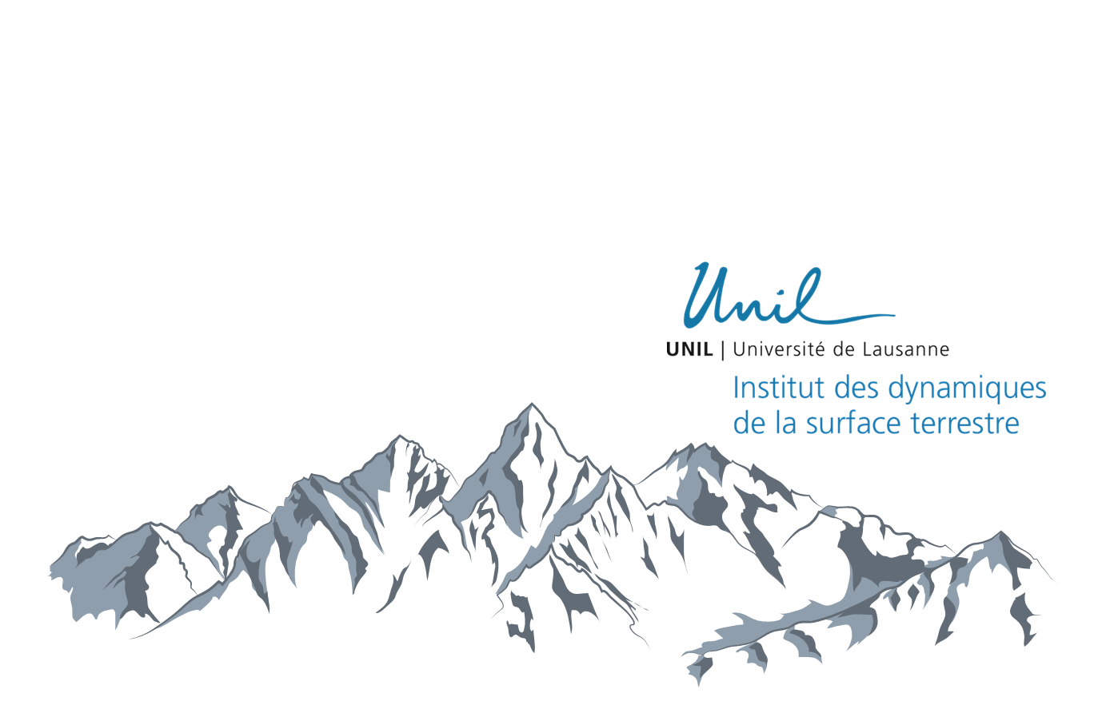
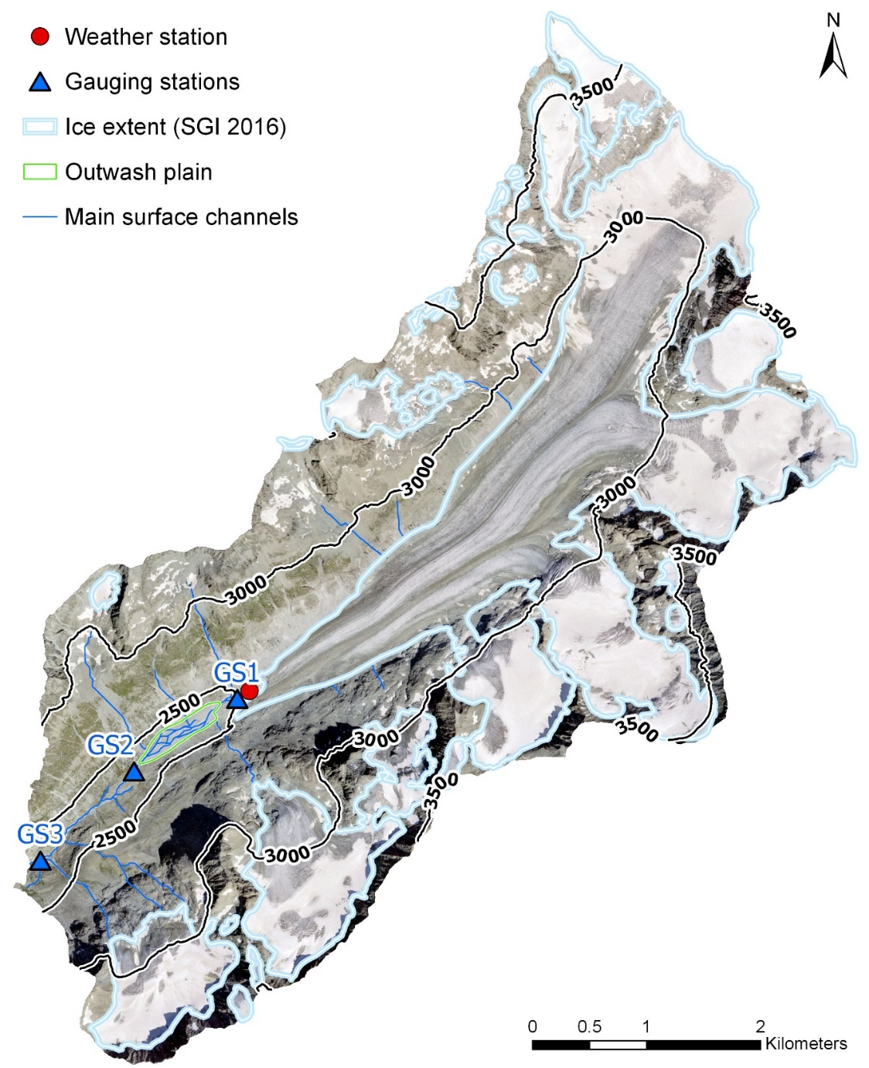
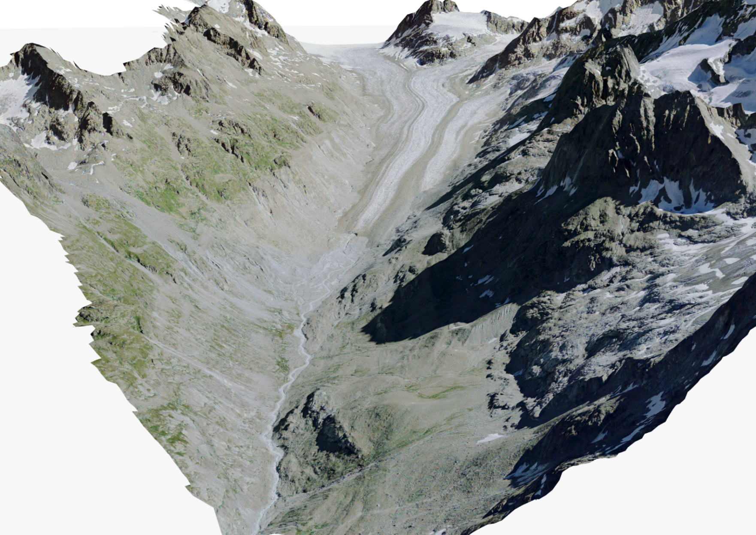
Introduction
The Otemma catchment
30 km² area
Mean elevation 3005 m asl. (2350 m to 3780 m)
45% glaciated (2019) of which about 10% is debris covered
GS1
GS2
GS3

Slide 3
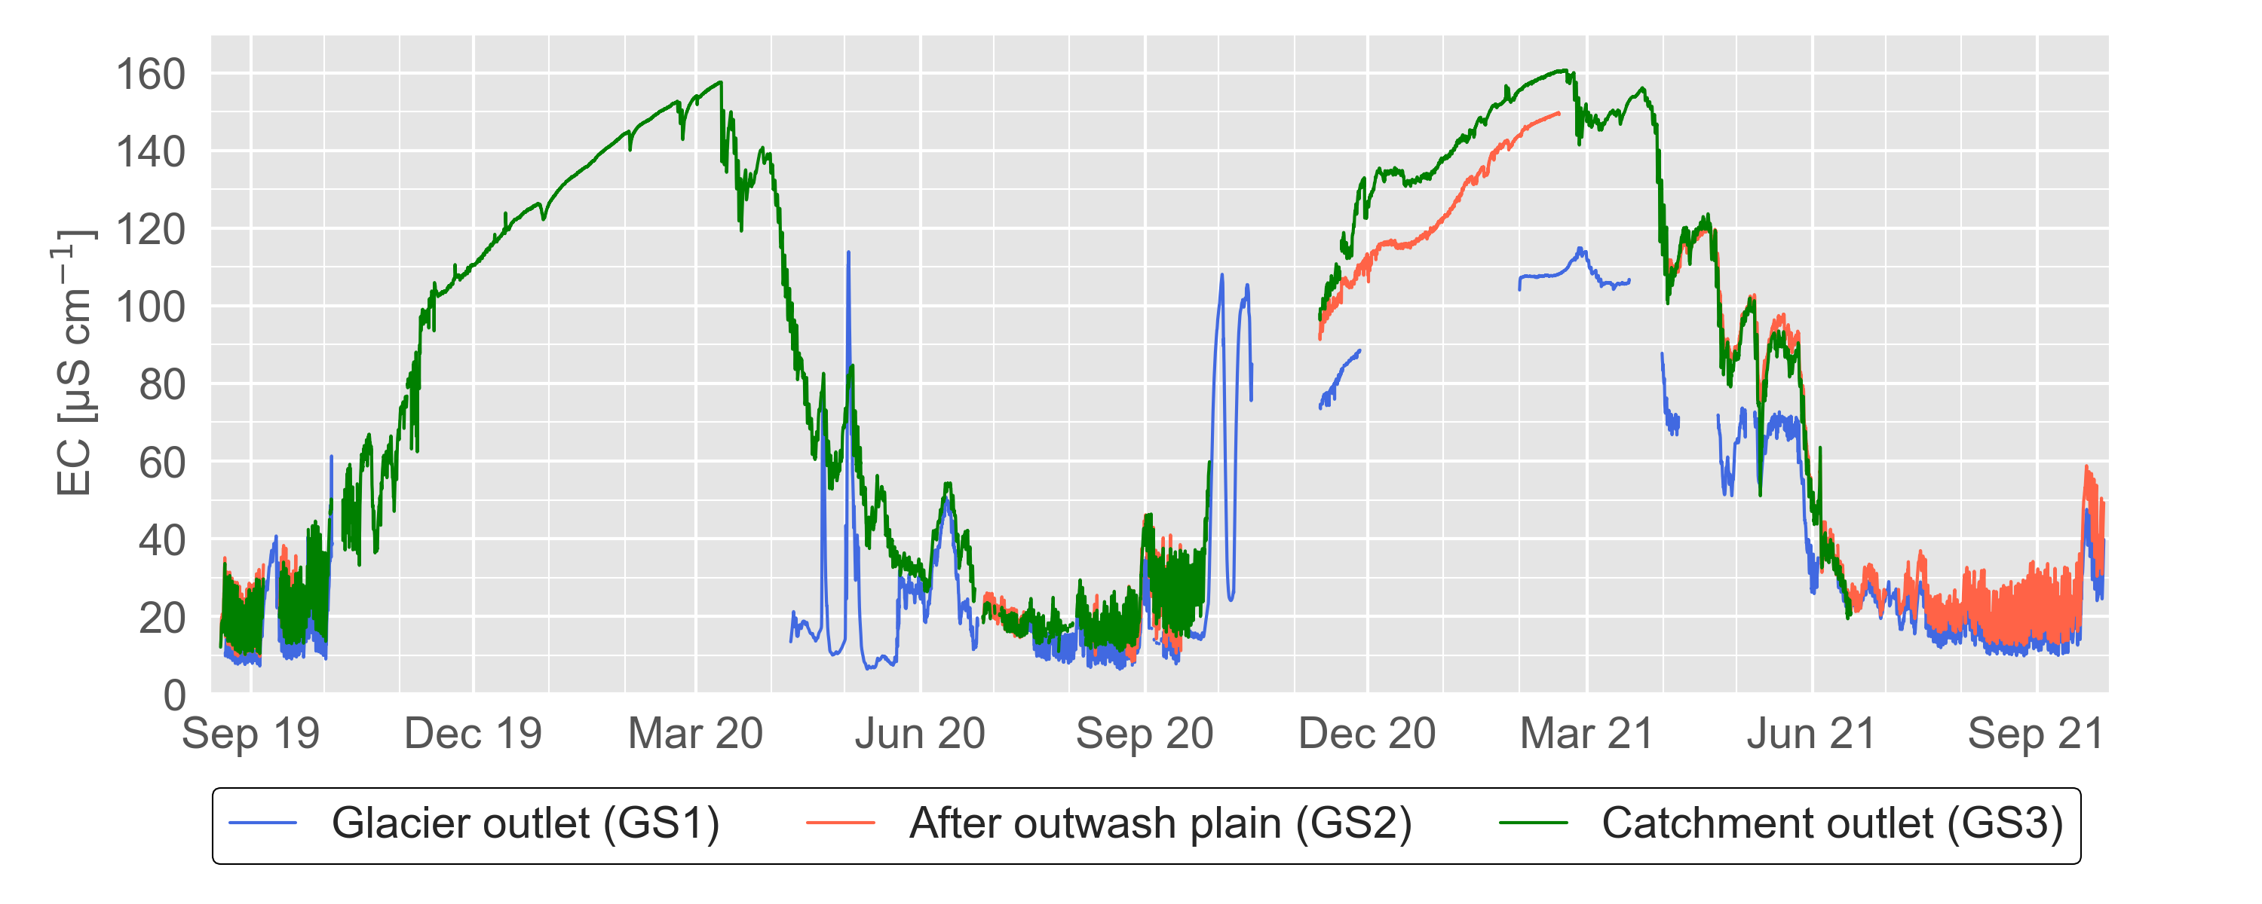

Introduction
Groundwater evidence in Otemma ?!
???
3
Notes:
Introduction
Context of the research
State of knowledge of groundwater storage in proglacial margin
Thesis objective and research questions
Thesis outline
The study site
Description of experimental site
Research collaboration with other groups
Experimental setup
Data availability
Towards a hydrogeomorphological understanding of proglacial catchments : review of current knowledge and assessment of groundwater storage and release in an Alpine catchment
The role of outwash plains to maintain baseflow in future deglaciated proglacial alpine areas
Icemelt-snowmelt contribution in a glaciated catchment: a comparison of water isotope and mass-balance approaches
Towards a sound estimation of water sources and flowpaths of a high alpine glaciated catchment using multiple geochemical methods
Conclusion
Sensor development corner

Slide 4
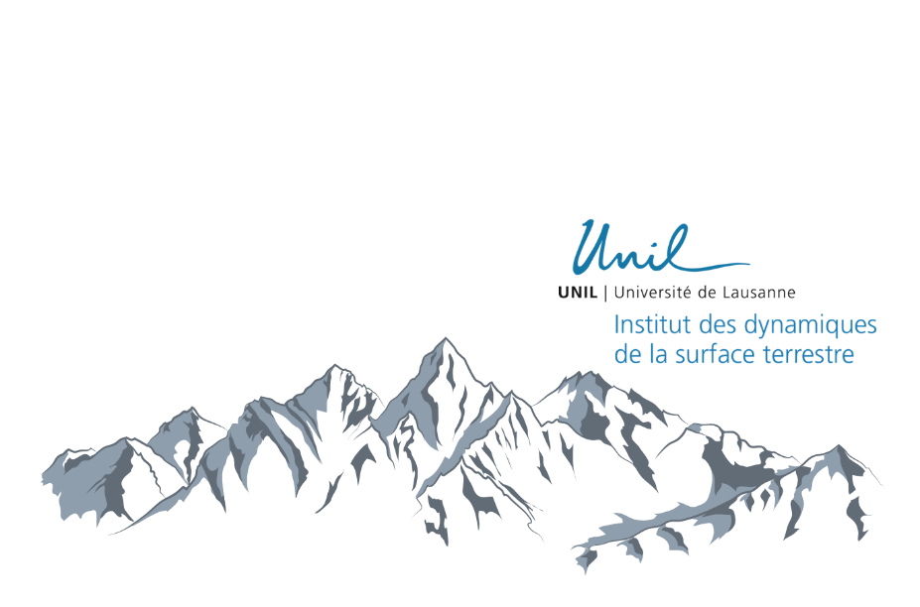
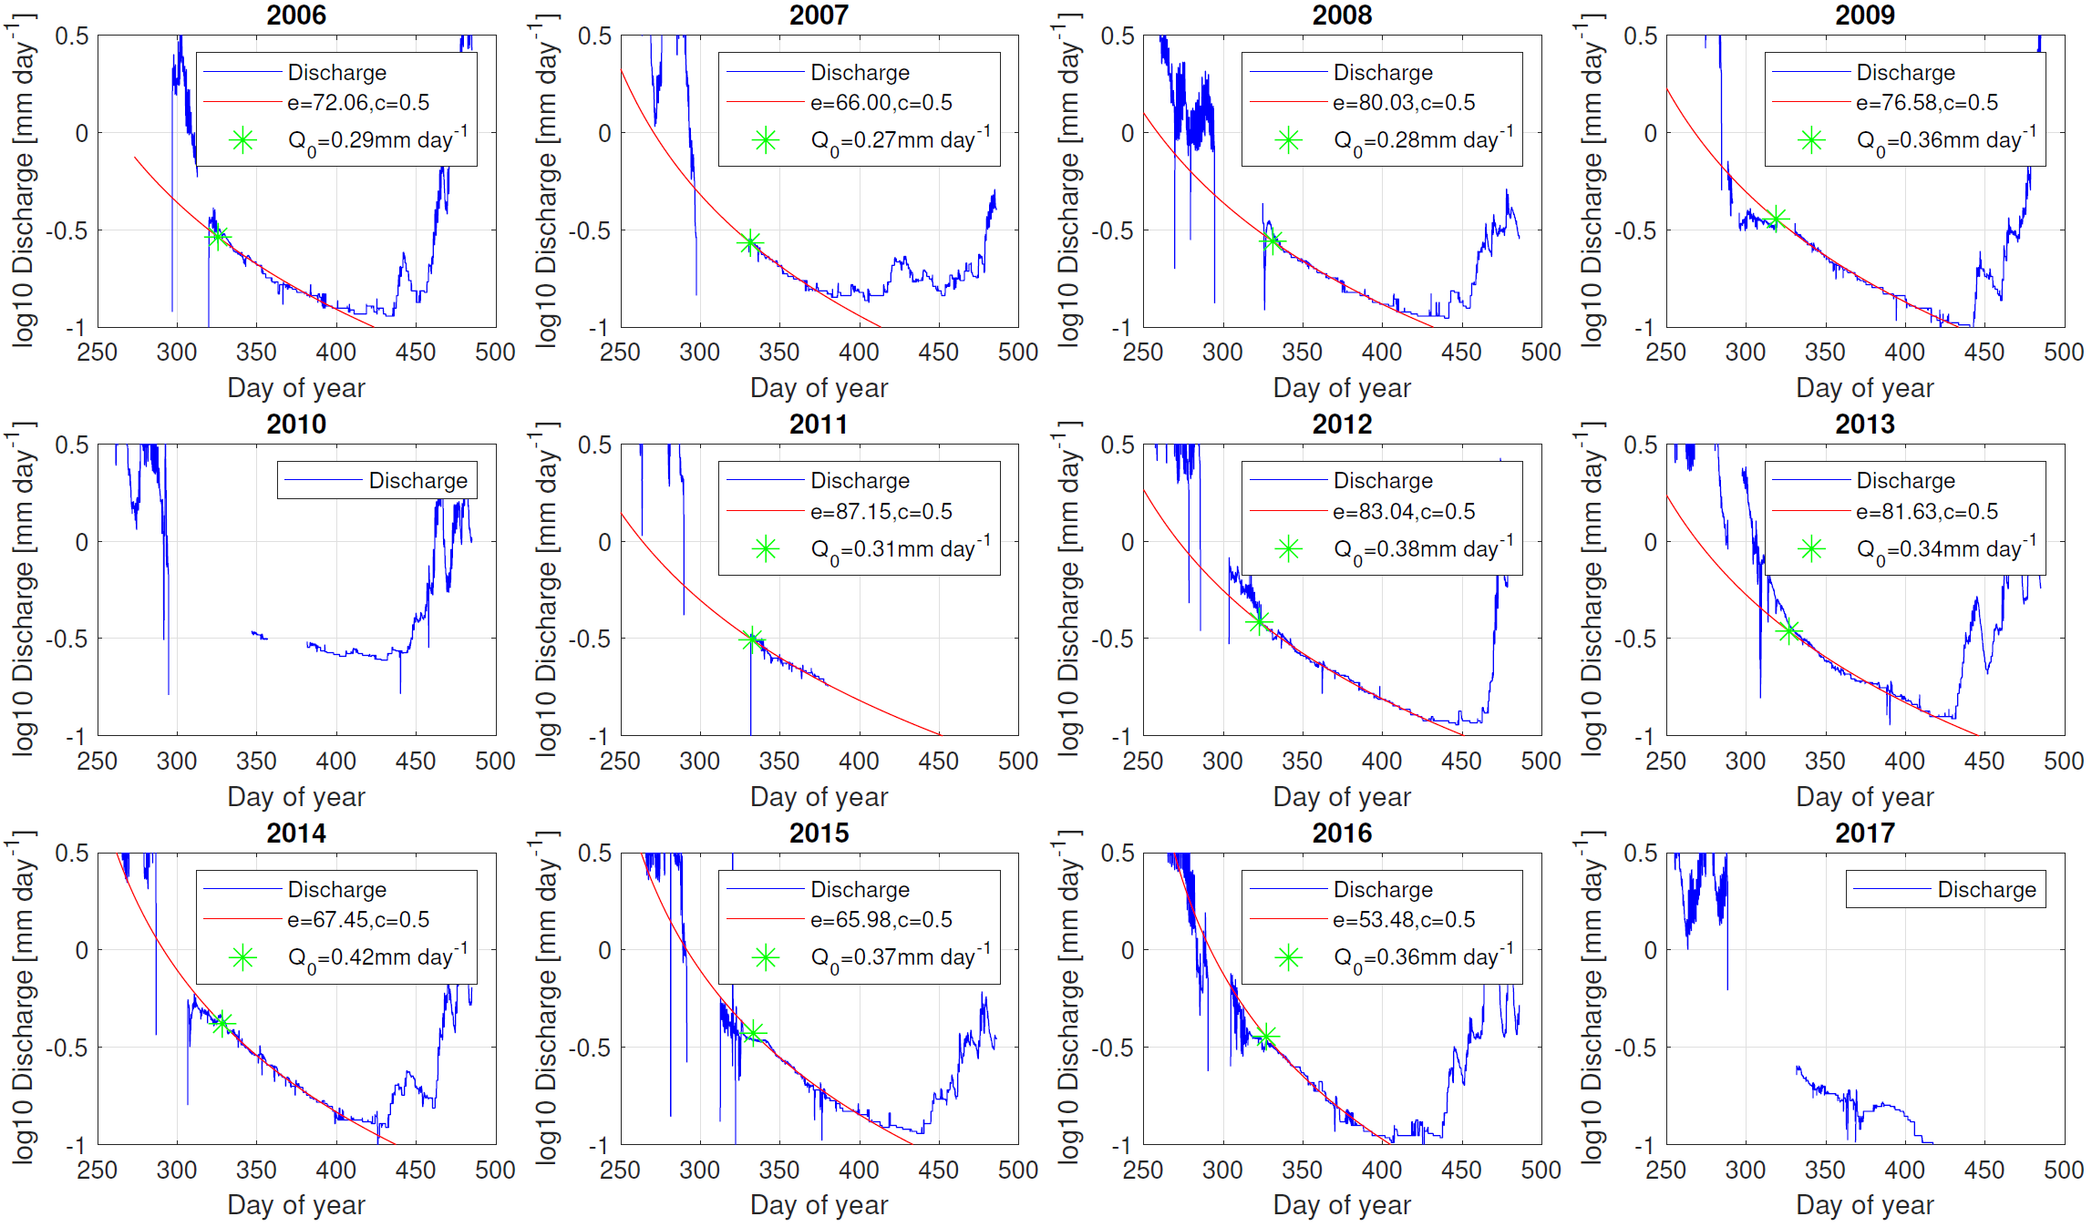
Groundwater at the catchment-scale
Winter discharge recession
c
4

Slide 5
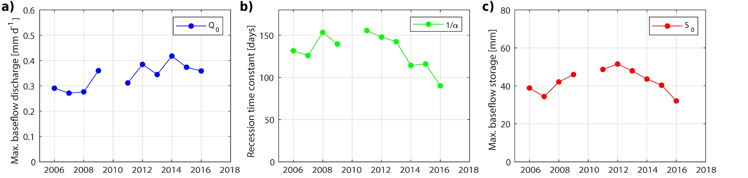
Groundwater at the catchment-scale
Winter discharge recession
Winter baseflow ~0.35 mm d⁻¹
Winter dynamic storage of 40 mm
5

Slide 6
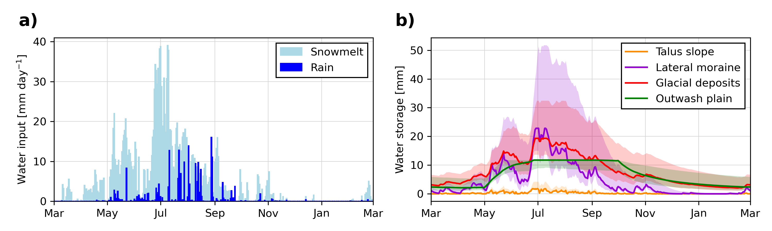
Groundwater in superficial landforms
Single landform analysis
Rain / Snow melt input
Steep landforms = short timescales (days)
Outwash plain = longer recharge & longer recession constant
Winter storage <40 mm
=> missing storage ?!
Landform storage
~ 6-7 mm
Müller, T., Lane, S. N., and Schaefli, B.: Towards a hydrogeomorphological understanding of proglacial catchments: an assessment of groundwater storage and release in an Alpine catchment, Hydrol. Earth Syst. Sci., 26, 6029–6054, https://doi.org/10.5194/hess-26-6029-2022, 2022.
6

Slide 7
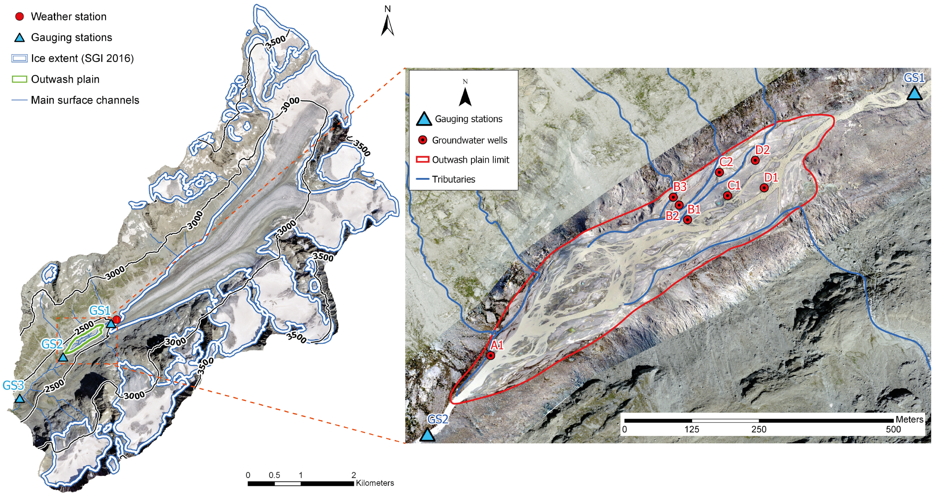
Groundwater in superficial landforms
Landform classes
Hillslope recharge
Input discharge
Hillslope recharge
7

Slide 8
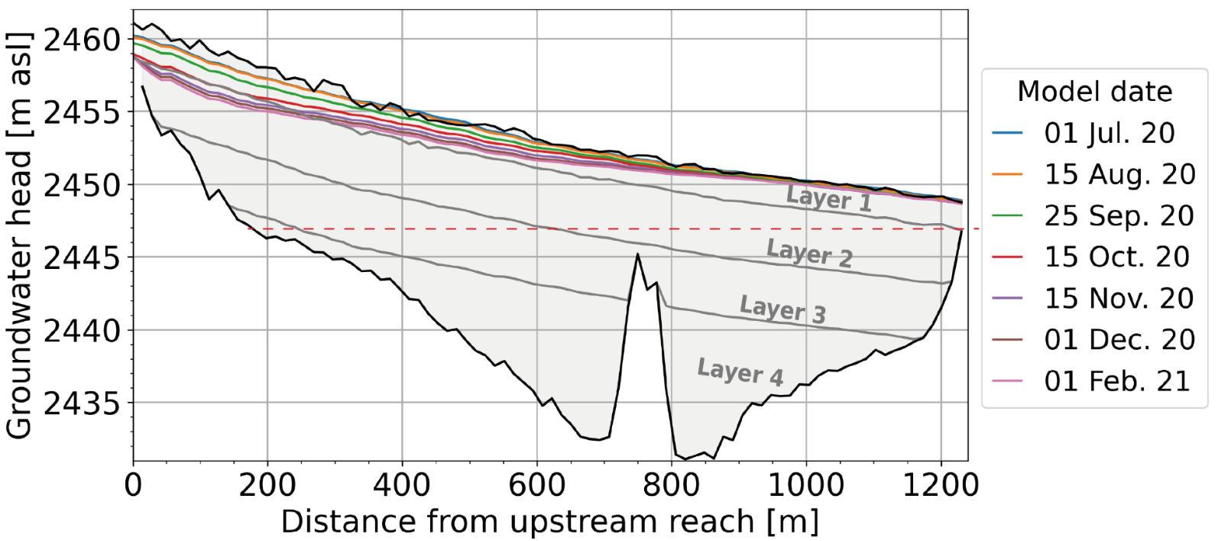
Groundwater in the outwash plain
Yearly groundwater heads (MODFLOW)
Input discharge
Stream infiltration
GW exfiltration
outflow
Yearly storage variation of only 1.2 mm
Aquifer
bedrock
bedrock
ice
Müller, T., Roncoroni, M., Mancini, D., Lane, S. N., and Schaefli, B.: Current and future role of meltwater-groundwater dynamics in a proglacial Alpine outwash plain, EGUsphere, 2023, 1–34, https://doi.org/10.5194/egusphere-2022-1503, 2023
8

Slide 9
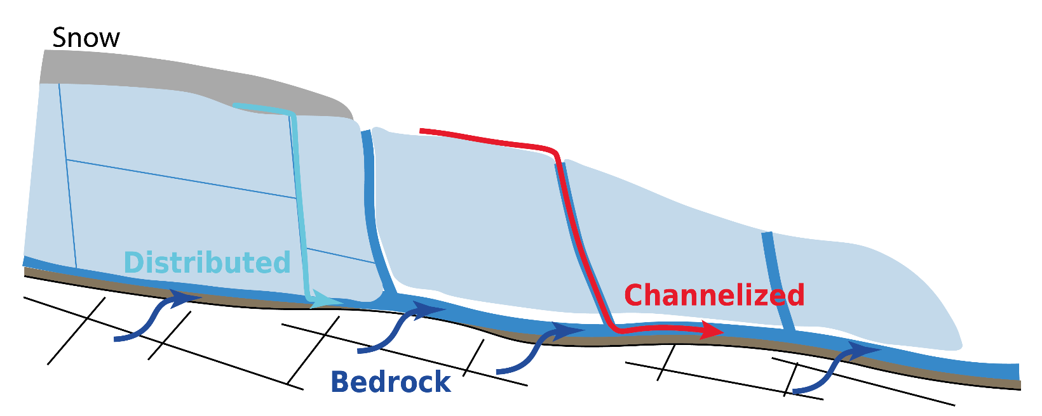
Identifying the missing storage
A simple model of subglacial stream EC
3 components are needed to simulate stream EC:
Fast subglacial flow
Slow subglacial flow
Baseflow discharge
Snow/ice EC: 2-3 μS/cm
EC: 8 μS/cm
EC: 23 μS/cm
EC: 120 μS/cm
Stream EC:
10 - 50 μS/cm
=> Summer baseflow ~ 1 mm day⁻¹
9
Notes:
Introduction
Context of the research
State of knowledge of groundwater storage in proglacial margin
Thesis objective and research questions
Thesis outline
The study site
Description of experimental site
Research collaboration with other groups
Experimental setup
Data availability
Towards a hydrogeomorphological understanding of proglacial catchments : review of current knowledge and assessment of groundwater storage and release in an Alpine catchment
The role of outwash plains to maintain baseflow in future deglaciated proglacial alpine areas
Icemelt-snowmelt contribution in a glaciated catchment: a comparison of water isotope and mass-balance approaches
Towards a sound estimation of water sources and flowpaths of a high alpine glaciated catchment using multiple geochemical methods
Conclusion
Sensor development corner

Slide 10
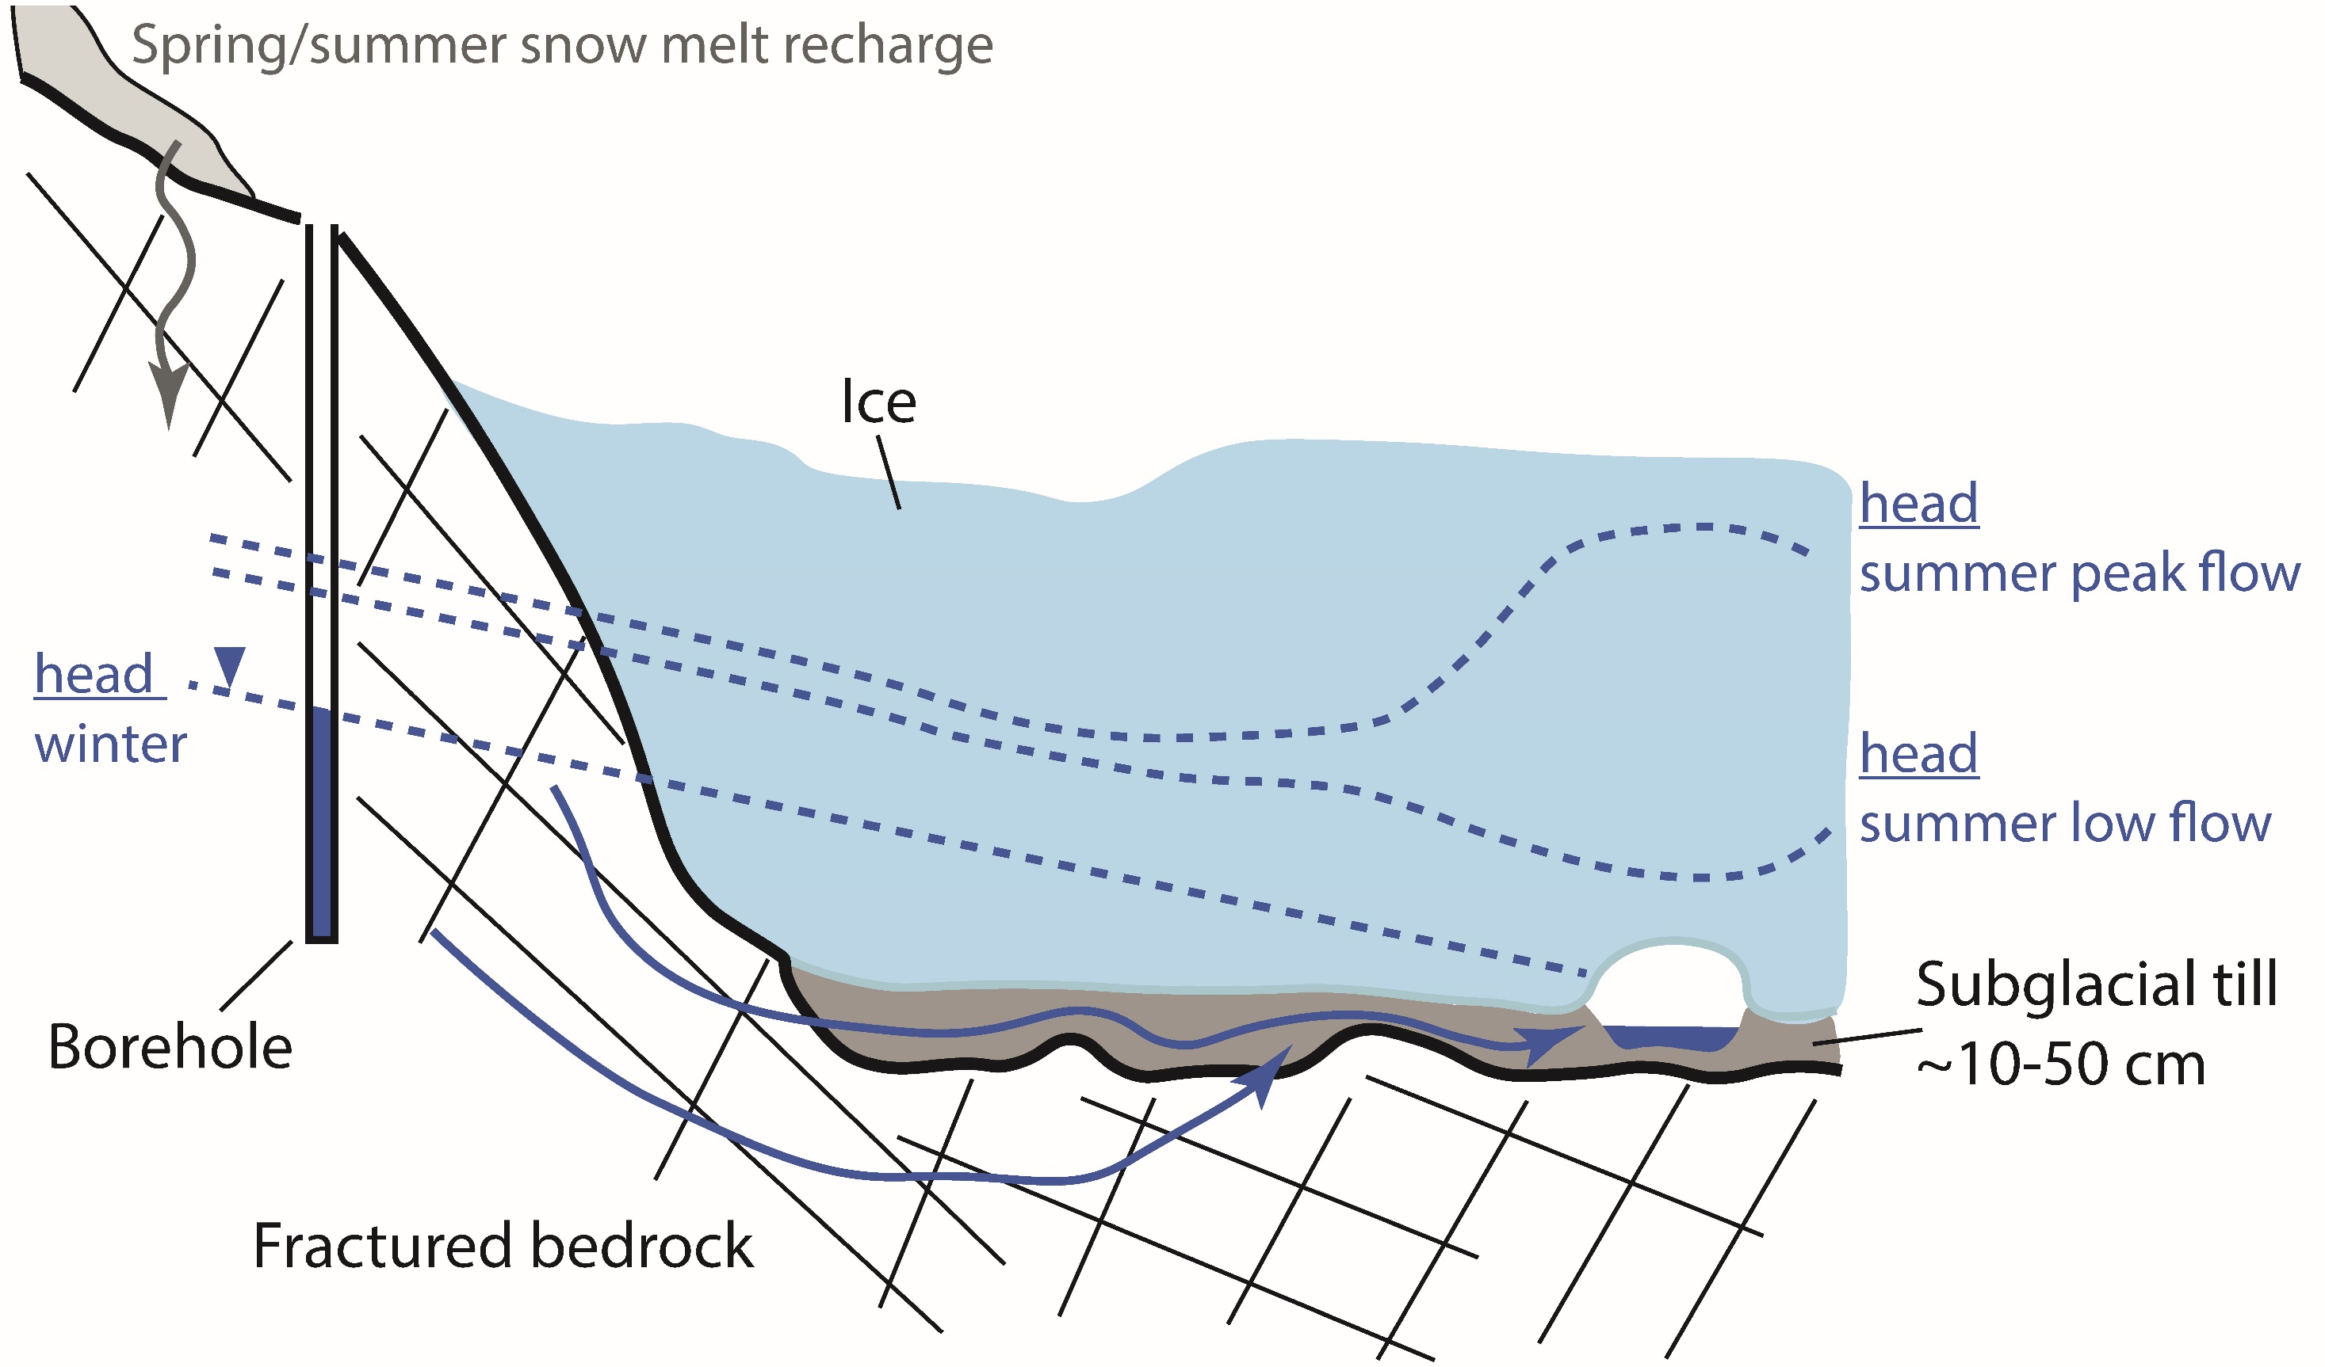
Identifying the missing storage
Bedrock-subglacial connectivity
Based on EC and geochemical data :
=> storage ~75 mm
10
Notes:
Introduction
Context of the research
State of knowledge of groundwater storage in proglacial margin
Thesis objective and research questions
Thesis outline
The study site
Description of experimental site
Research collaboration with other groups
Experimental setup
Data availability
Towards a hydrogeomorphological understanding of proglacial catchments : review of current knowledge and assessment of groundwater storage and release in an Alpine catchment
The role of outwash plains to maintain baseflow in future deglaciated proglacial alpine areas
Icemelt-snowmelt contribution in a glaciated catchment: a comparison of water isotope and mass-balance approaches
Towards a sound estimation of water sources and flowpaths of a high alpine glaciated catchment using multiple geochemical methods
Conclusion
Sensor development corner

Slide 11
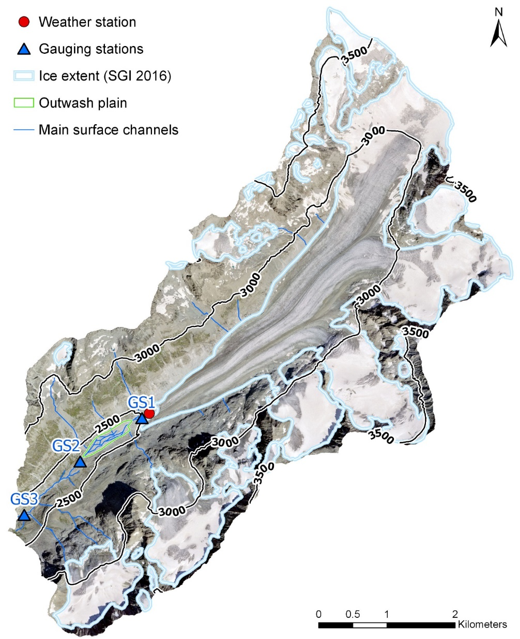
Stream winter EC disentangled !
Deeper bedrock exfiltration in non-glaciated part ?!?
Re-infiltration of subglacial stream water in the outwash plain
EC due to bedrock-subglacial storage
11
Notes:
Introduction
Context of the research
State of knowledge of groundwater storage in proglacial margin
Thesis objective and research questions
Thesis outline
The study site
Description of experimental site
Research collaboration with other groups
Experimental setup
Data availability
Towards a hydrogeomorphological understanding of proglacial catchments : review of current knowledge and assessment of groundwater storage and release in an Alpine catchment
The role of outwash plains to maintain baseflow in future deglaciated proglacial alpine areas
Icemelt-snowmelt contribution in a glaciated catchment: a comparison of water isotope and mass-balance approaches
Towards a sound estimation of water sources and flowpaths of a high alpine glaciated catchment using multiple geochemical methods
Conclusion
Sensor development corner

Slide 12
Key findings
  Superficial landforms have a limited role to store water seasonally
  The outwash plain acts more as a buffer and mainly transmits stream water
  A coupled bedrock-subglacial storage of ~75mm may be responsible for winter baseflow
  => Processes of bedrock recharge, pathways and exfiltration still remains poorly understood
12
Notes:
Introduction
Context of the research
State of knowledge of groundwater storage in proglacial margin
Thesis objective and research questions
Thesis outline
The study site
Description of experimental site
Research collaboration with other groups
Experimental setup
Data availability
Towards a hydrogeomorphological understanding of proglacial catchments : review of current knowledge and assessment of groundwater storage and release in an Alpine catchment
The role of outwash plains to maintain baseflow in future deglaciated proglacial alpine areas
Icemelt-snowmelt contribution in a glaciated catchment: a comparison of water isotope and mass-balance approaches
Towards a sound estimation of water sources and flowpaths of a high alpine glaciated catchment using multiple geochemical methods
Conclusion
Sensor development corner

Slide 13
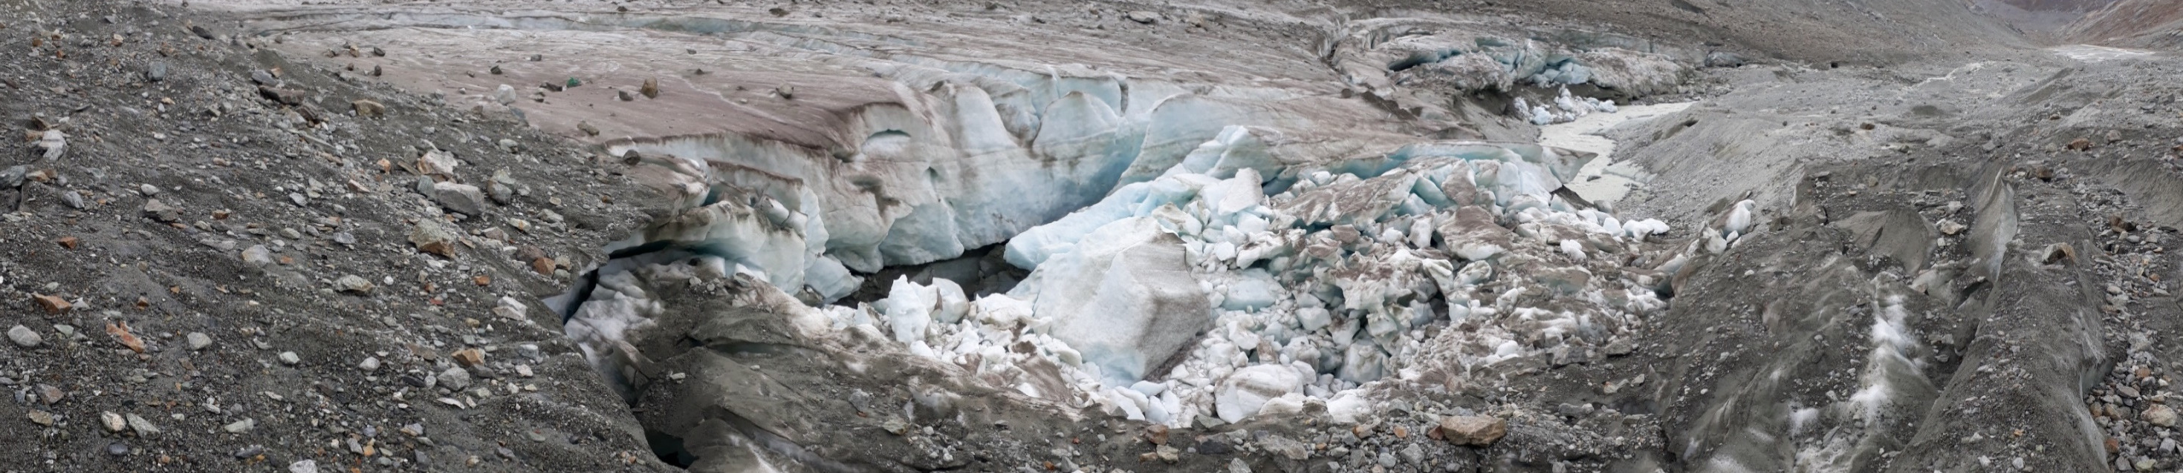

Thank you for your attention !
Don’t hesitate to contact me : tom.muller.1@unil.ch
References:
Müller, T., Lane, S. N., and Schaefli, B.: Towards a hydrogeomorphological understanding of proglacial catchments: an assessment of groundwater storage and release in an Alpine catchment, Hydrol. Earth Syst. Sci., 26, 6029–6054, https://doi.org/10.5194/hess-26-6029-2022, 2022.
Müller, T., Roncoroni, M., Mancini, D., Lane, S. N., and Schaefli, B.: Current and future role of meltwater-groundwater dynamics in a proglacial Alpine outwash plain, EGUsphere, 2023, 1–34, https://doi.org/10.5194/egusphere-2022-1503, 2023
13

Slide 14
Supplementary materials

Slide 15
Introduction - Context of the research
Implications for future alpine hydrology
By 2100, glacier ice volume loss of 63±15% (RCP2.6) to 94±8% (RCP8.5) in the Alps (Zekollari et al., 2019).
Combined with :
More liquid precipitation during cold season
More ephemeral snow
Earlier snow-melt during spring
Shift of hydrological regime in glaciated catchments
Projected runoffs for Mauvoisin catchment
2010
Daily runoff [m³/s]
2100
Source : Gabbi et al., 2012 (Hydrol. Earth Syst. Sci.)

Slide 16
Introduction - Context of the research
Groundwater in high alpine catchments
Large scale groundwater evidence in Himalaya
Groundwater largely simplified in alpine models
Groundwater-fed winter baseflow observed in mountainous catchments
1:1 line
Discharge [mm/d]
Groundwater 10% of annual streamflow
Precipitation [mm/d]
Source : Andermann et al. (2012)

Slide 17
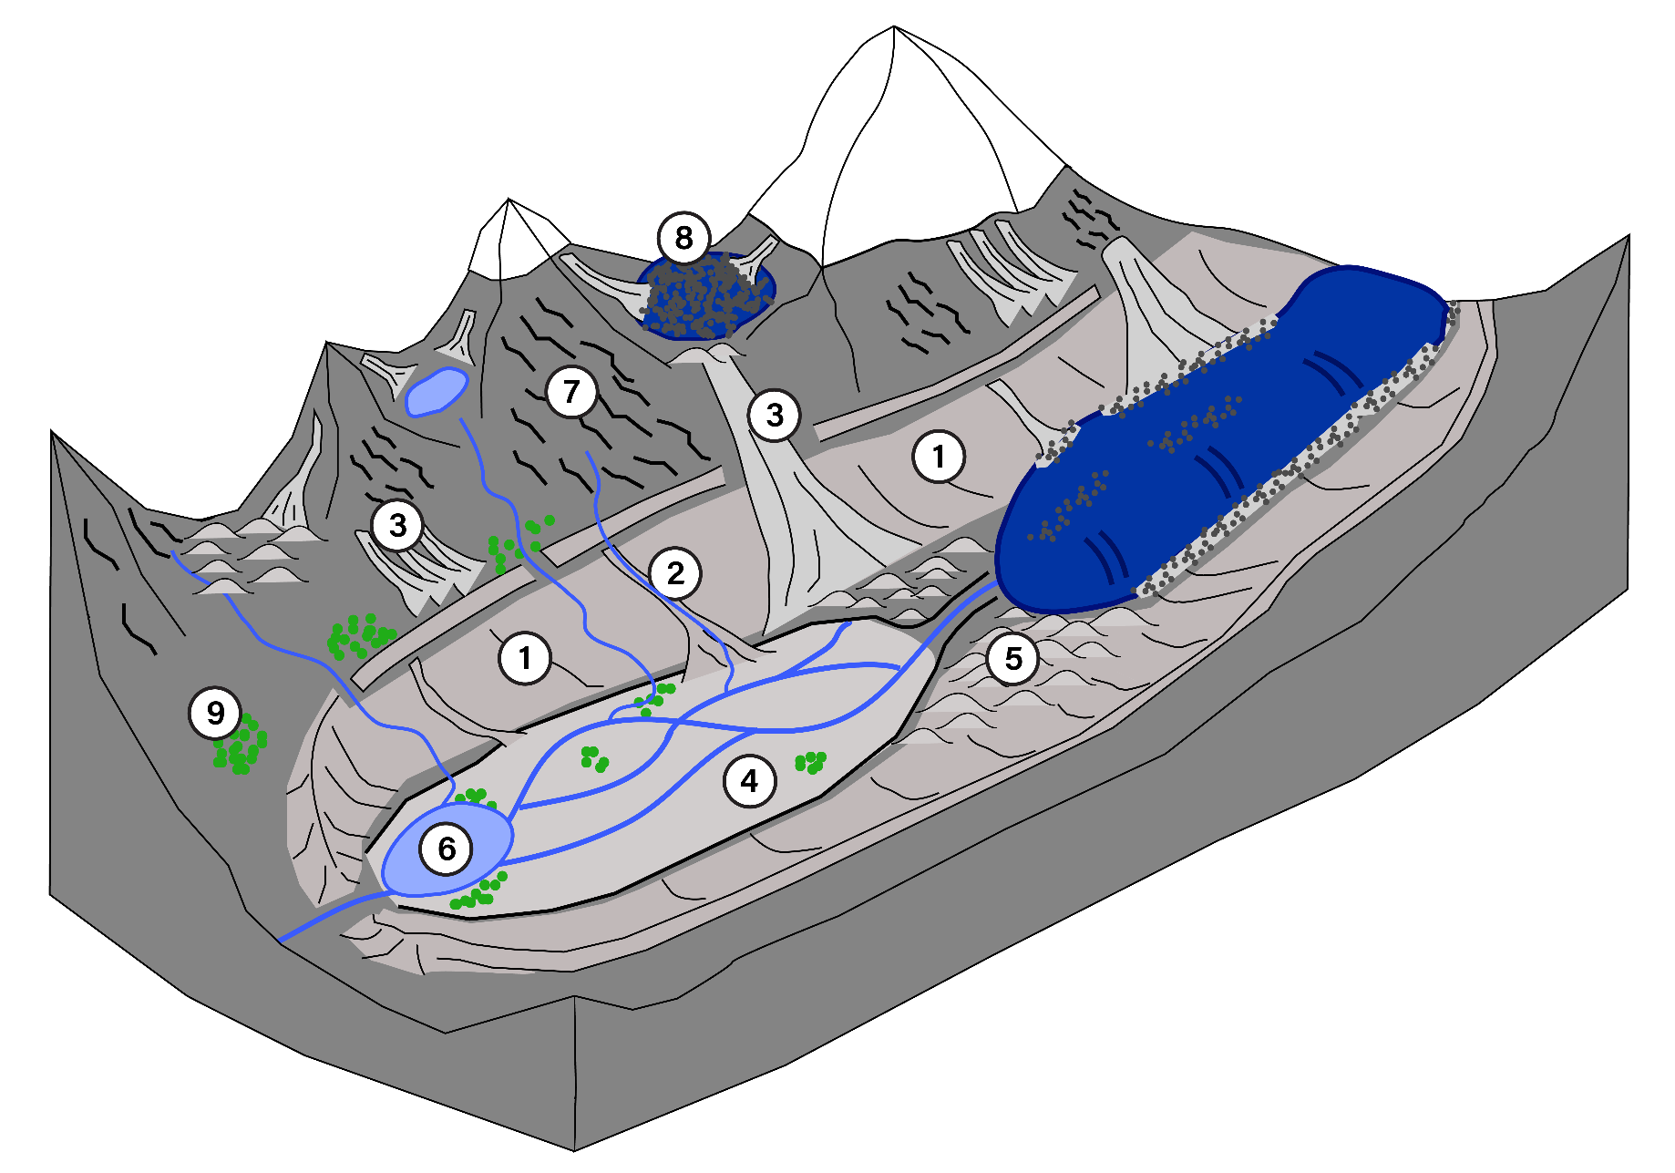
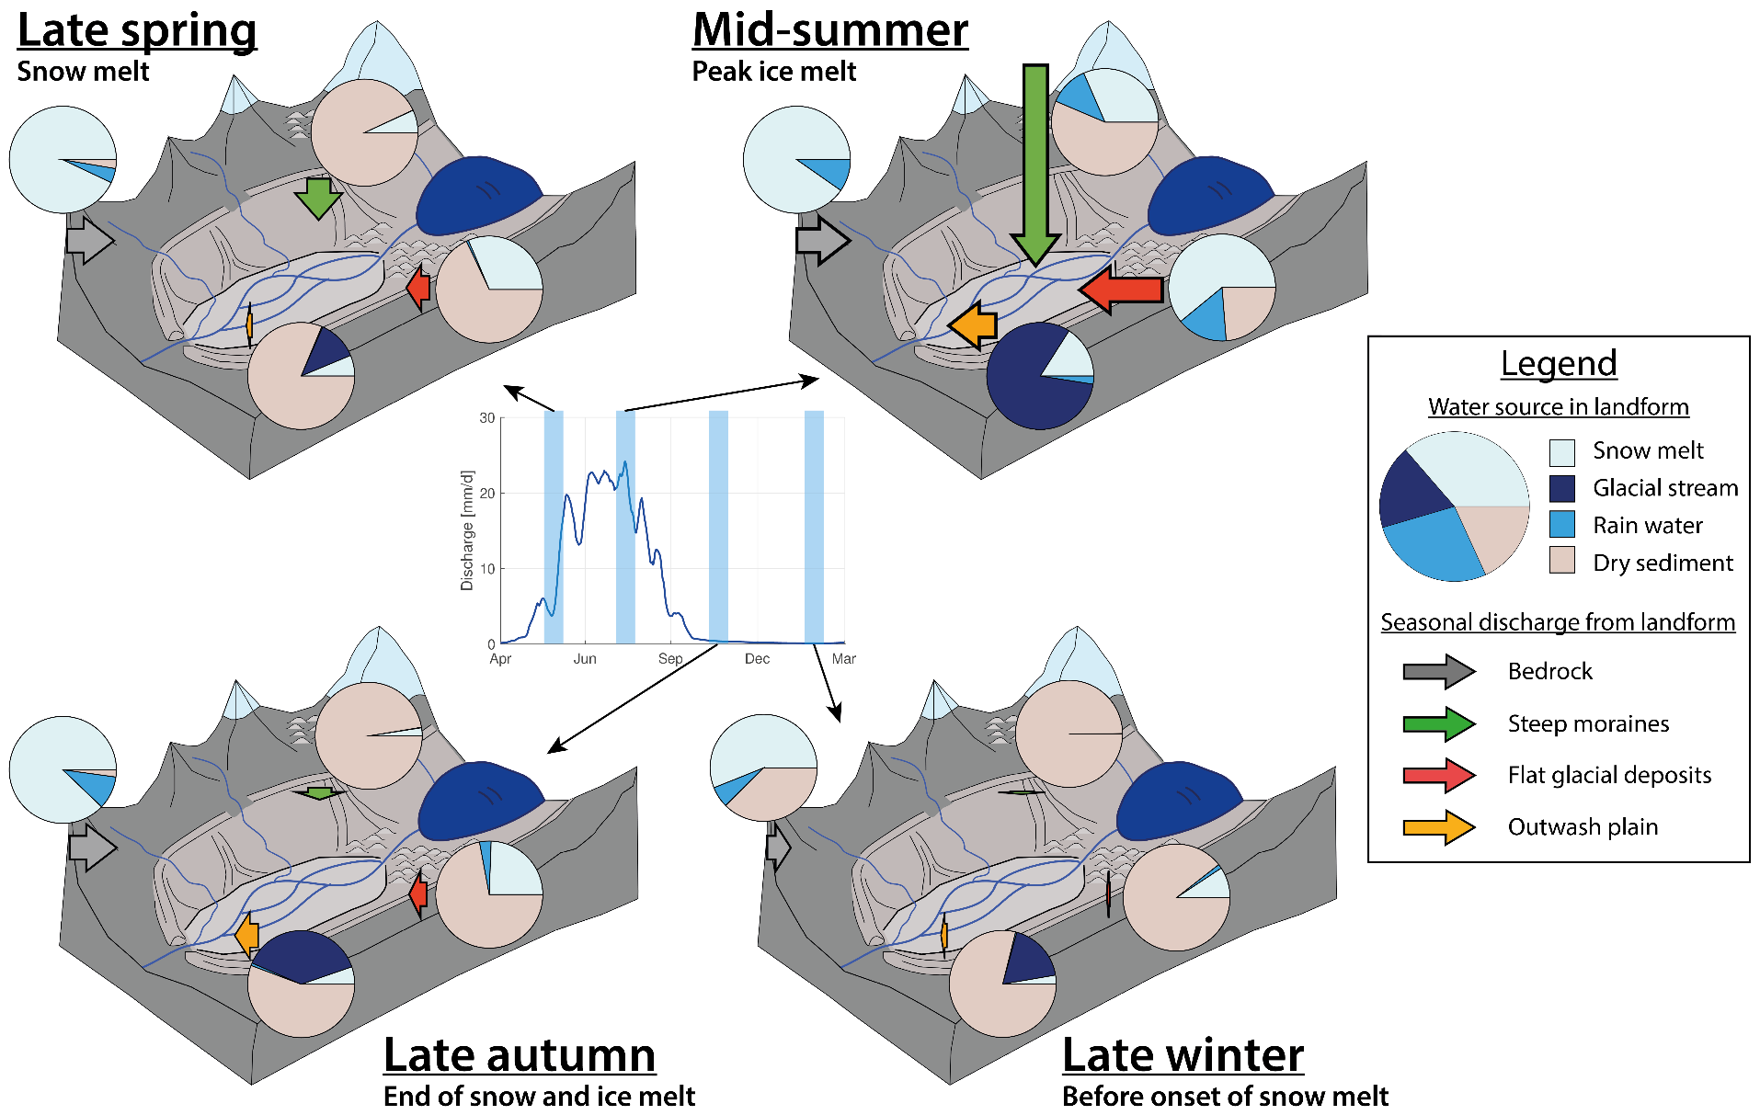
Introduction
Thesis objective and research questions
  Where are the aquifer ?
  What are the timescales and magnitudes
  Which flowpaths
  Which sources of water
What is the hydrogeological functioning of recently deglaciated Alpine catchment ?
Rain
Snow-melt
Rock glacier
Ice-melt
?
Bedrock
Talus slopes
Lateral moraines /
debris cones
Flat glacial deposits / moraine
?
Outwash plain
?

Slide 18
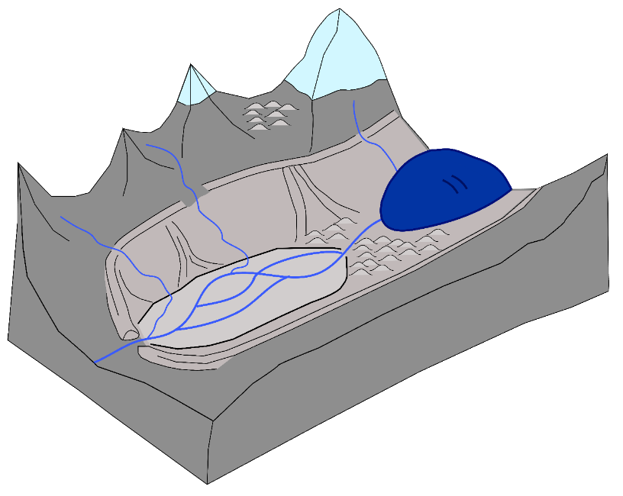
Introduction
Overall methodology
Approach type
Method
Analysis/model
Catchment
Catchment-scale response
River discharge
Recession analysis
Literature review
Precipitation
Snow-melt
Landform mapping
Single landform response
Response time
Storage-release model
Bedrock
Glacier-melt
Aquifer
salt tracing
Groundwater wells
Talus slopes / debris cones
Aquifer structure
3D aquifer model
Stream
Geophysics (ERT)
Outwash plain
Water electrical conductivity
Water stable isotope
Coupled glacio-hydrological model
Water sources
Hydrochemical analysis
Meteorological data
Noble gases
Paper 1:
Hydrogeomorphological assessment of the Otemma catchment
Paper 2:
Groundwater dynamics in the outwash plain
Paper 3:
Snow and ice-melt separation using water isotopes and modeling
Paper 4:
Water connectivity in a proglacial catchment

Slide 19
Snow-melt
Precipitation
Glacier-melt
Snow and ice-melt contribution
Stream

Slide 20
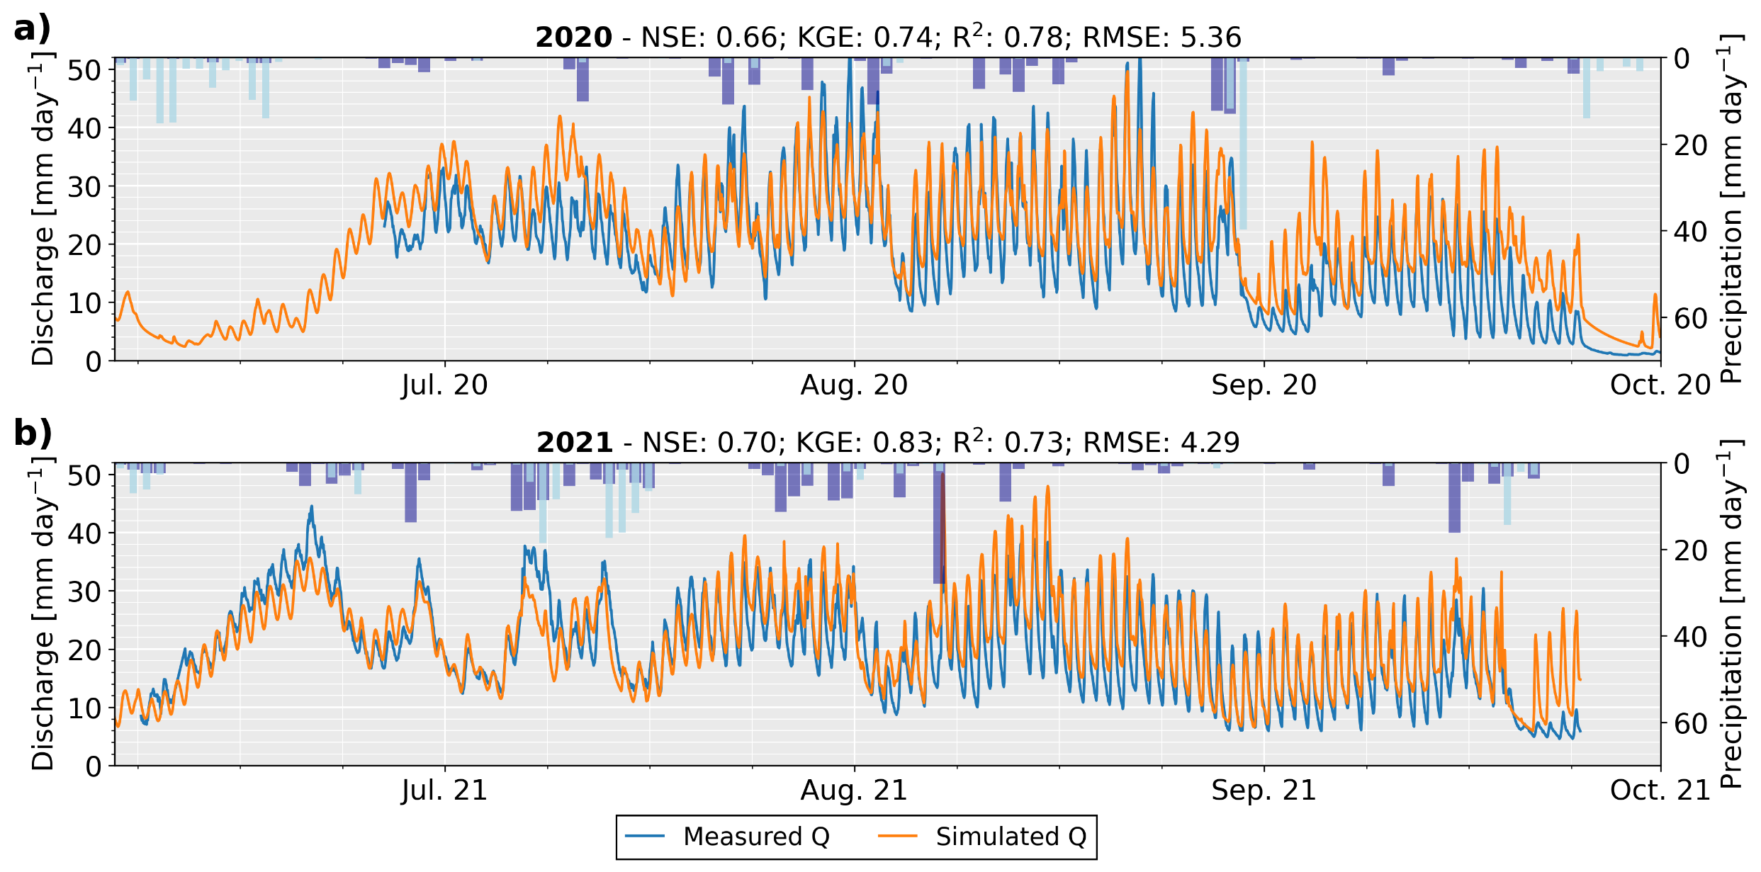
Snow and ice-melt contribution
Modelled vs measured discharge
Discharge
2020
Q simulated
Q measured
Discharge
2021
20
Notes:
Introduction
Context of the research
State of knowledge of groundwater storage in proglacial margin
Thesis objective and research questions
Thesis outline
The study site
Description of experimental site
Research collaboration with other groups
Experimental setup
Data availability
Towards a hydrogeomorphological understanding of proglacial catchments : review of current knowledge and assessment of groundwater storage and release in an Alpine catchment
The role of outwash plains to maintain baseflow in future deglaciated proglacial alpine areas
Icemelt-snowmelt contribution in a glaciated catchment: a comparison of water isotope and mass-balance approaches
Towards a sound estimation of water sources and flowpaths of a high alpine glaciated catchment using multiple geochemical methods
Conclusion
Sensor development corner

Slide 21
Groundwater at the catchment-scale
Stream

Slide 22
Groundwater in superficial landforms
Bedrock
Talus slopes / debris cones
Outwash plain

Slide 23
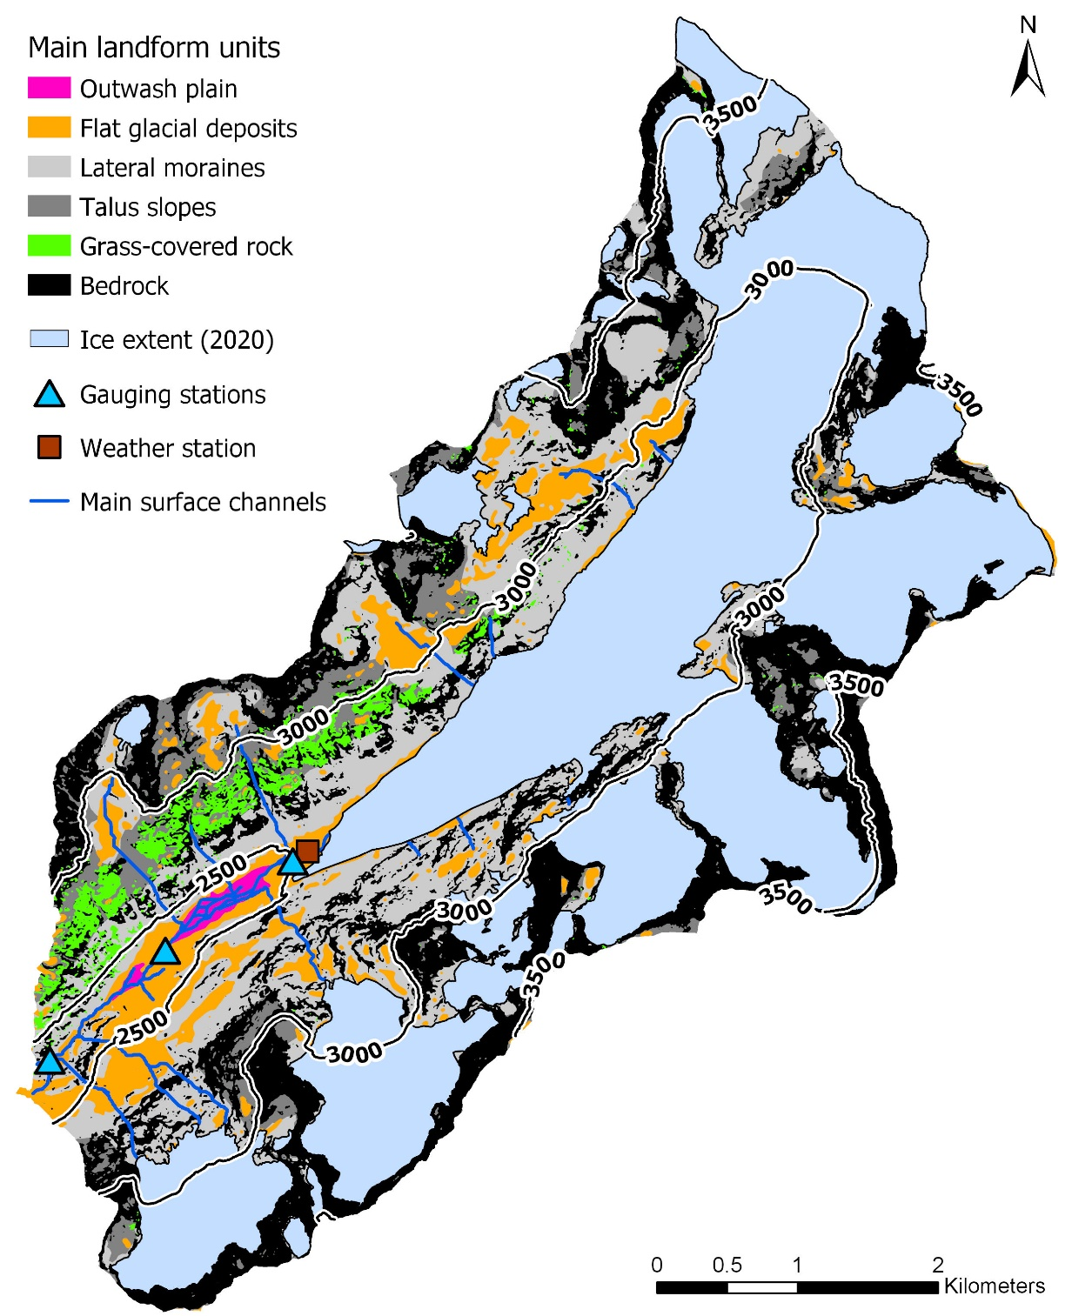
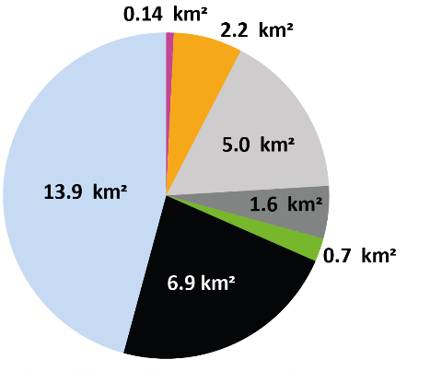
Groundwater in superficial landforms
Landform classes
23

Slide 24
Groundwater in the outwash plain
Outwash plain

Slide 25
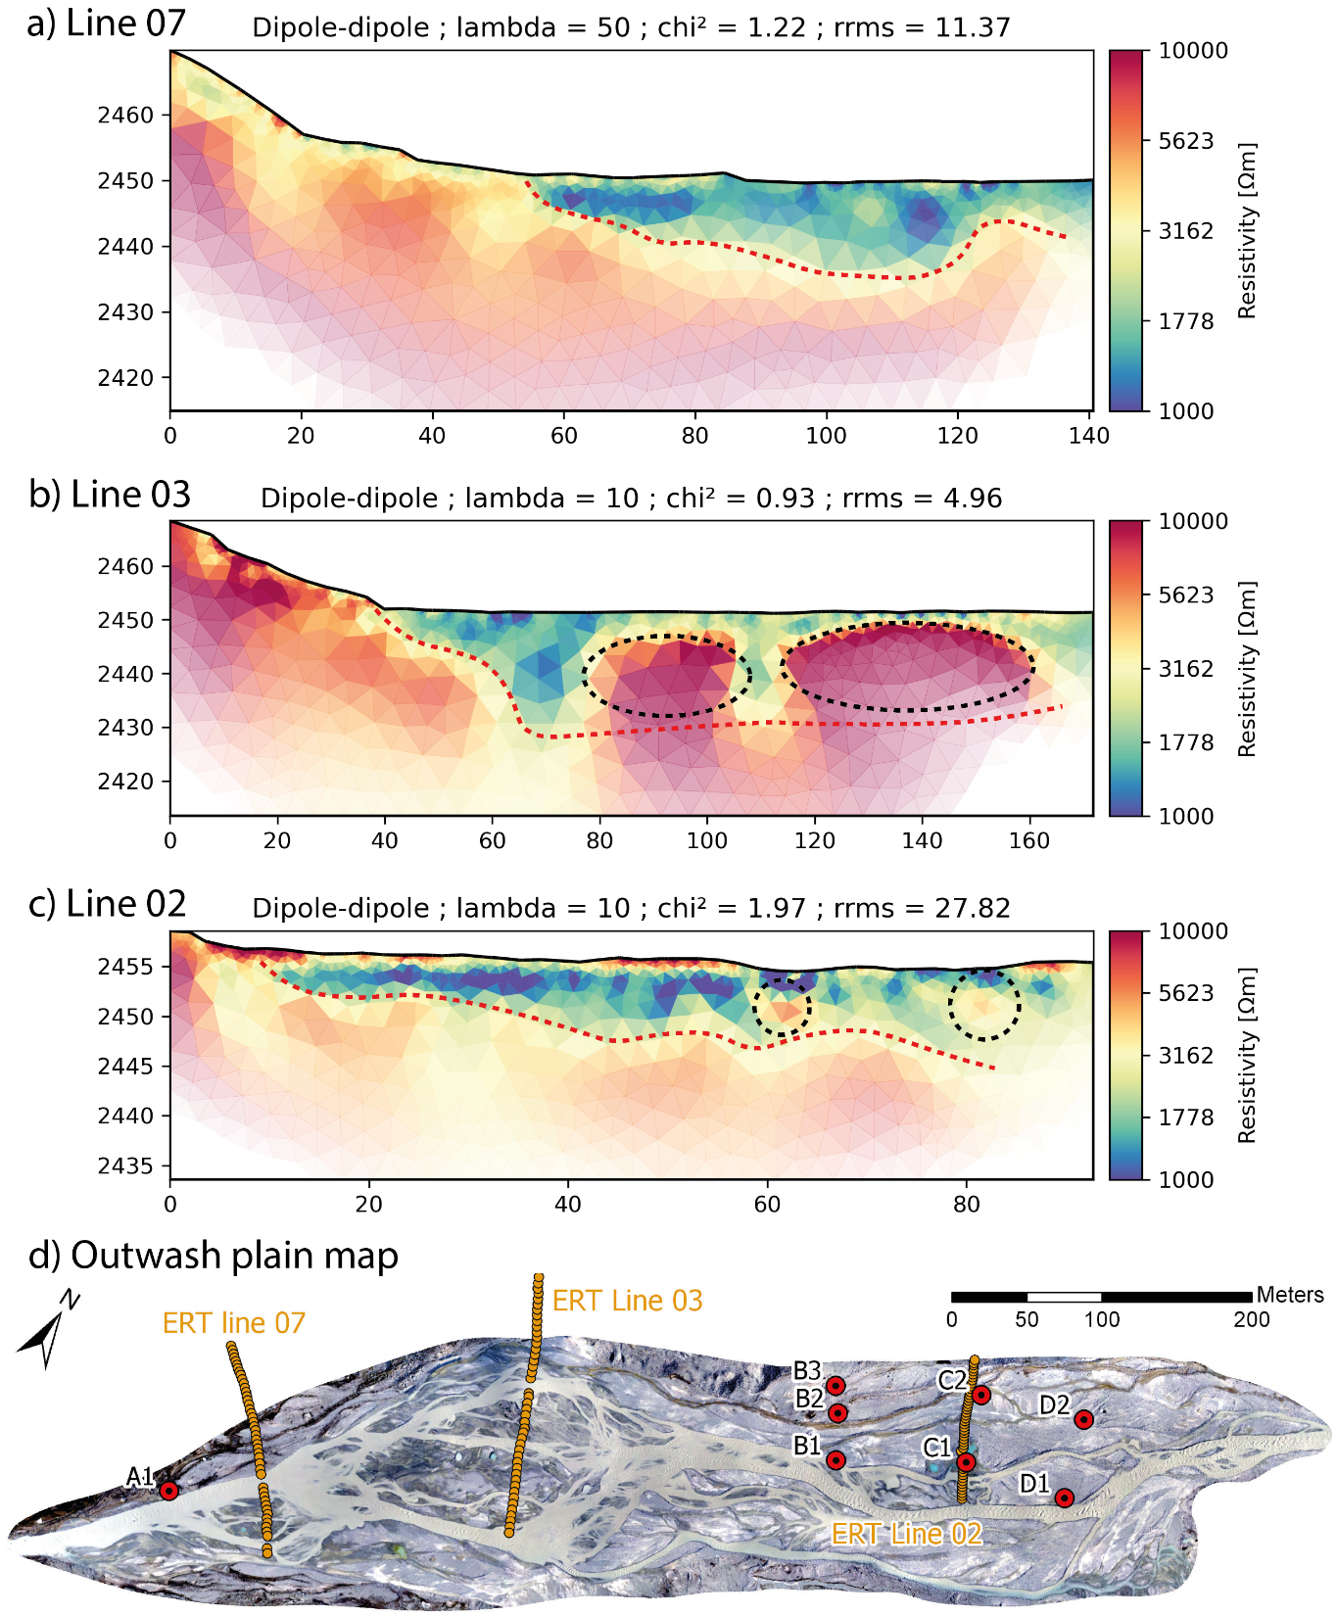
Groundwater in the outwash plain
Electrical resistivity tomography
25
Notes:
Introduction
Context of the research
State of knowledge of groundwater storage in proglacial margin
Thesis objective and research questions
Thesis outline
The study site
Description of experimental site
Research collaboration with other groups
Experimental setup
Data availability
Towards a hydrogeomorphological understanding of proglacial catchments : review of current knowledge and assessment of groundwater storage and release in an Alpine catchment
The role of outwash plains to maintain baseflow in future deglaciated proglacial alpine areas
Icemelt-snowmelt contribution in a glaciated catchment: a comparison of water isotope and mass-balance approaches
Towards a sound estimation of water sources and flowpaths of a high alpine glaciated catchment using multiple geochemical methods
Conclusion
Sensor development corner

Slide 26
Snow-melt
Precipitation
Glacier-melt
Identifying the missing storage
Bedrock
Stream

Slide 27
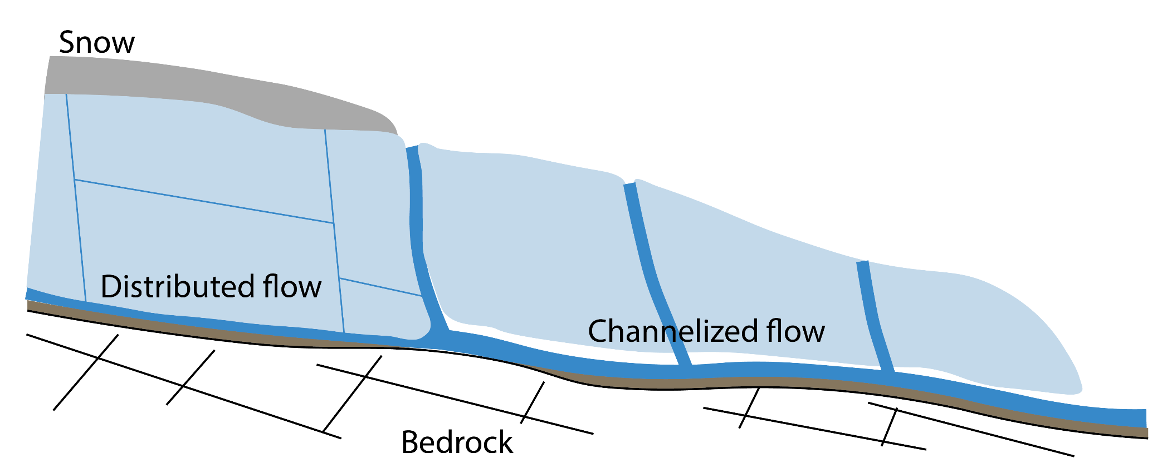
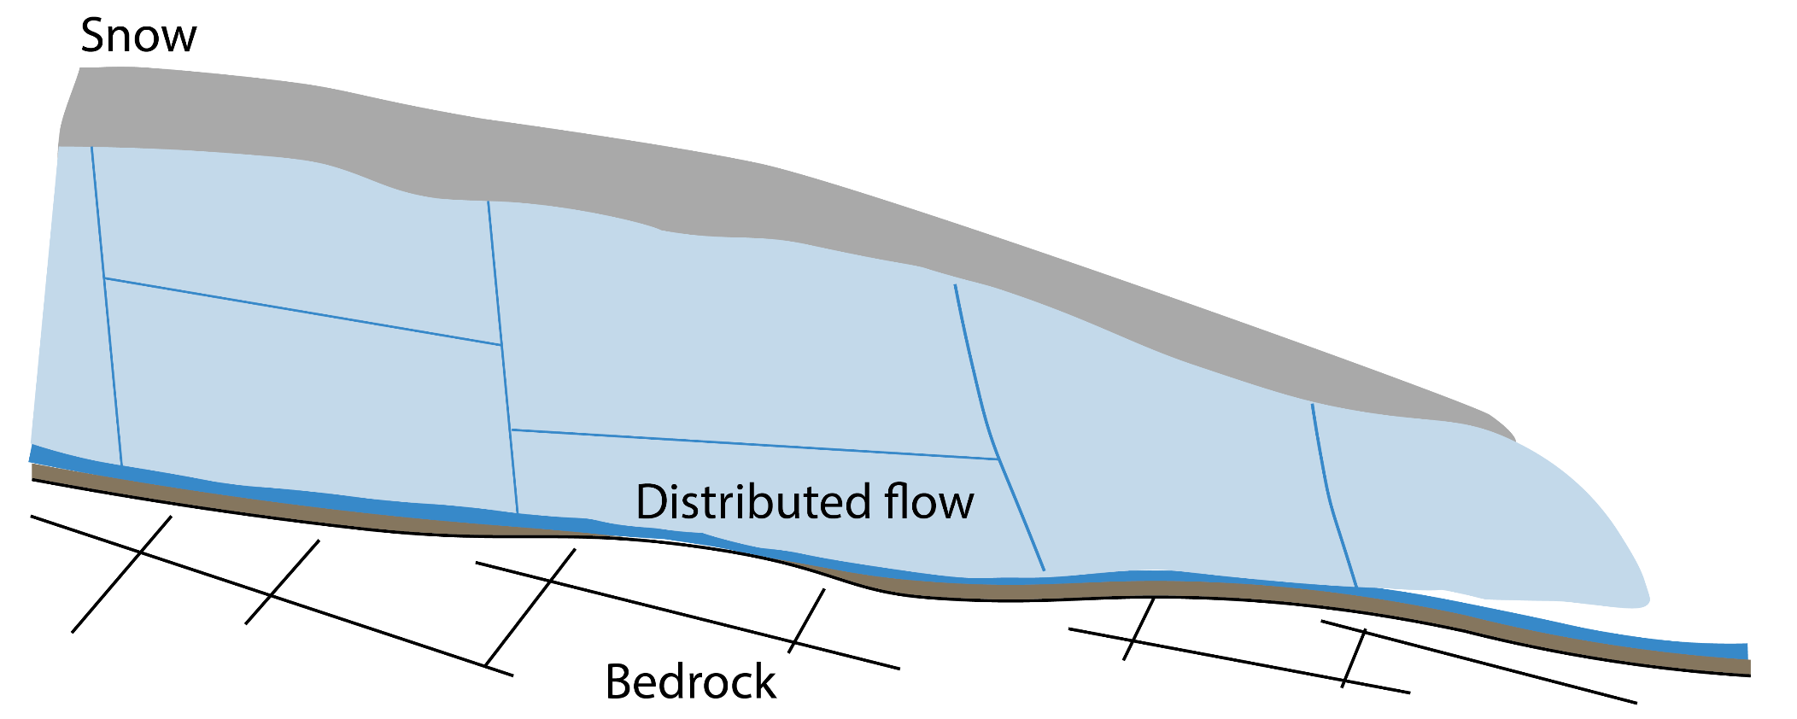

Identifying the missing storage
A simple model of stream EC
Snow line distance as proxy of channelized system
Fraction channelized = $\frac{\text{Snow} \text{line} \text{distance} }{\text{Glacier} \text{length} }$
Winter/Spring
Summer
glacier
Glacier length
Snow line distance
27
Notes:
Introduction
Context of the research
State of knowledge of groundwater storage in proglacial margin
Thesis objective and research questions
Thesis outline
The study site
Description of experimental site
Research collaboration with other groups
Experimental setup
Data availability
Towards a hydrogeomorphological understanding of proglacial catchments : review of current knowledge and assessment of groundwater storage and release in an Alpine catchment
The role of outwash plains to maintain baseflow in future deglaciated proglacial alpine areas
Icemelt-snowmelt contribution in a glaciated catchment: a comparison of water isotope and mass-balance approaches
Towards a sound estimation of water sources and flowpaths of a high alpine glaciated catchment using multiple geochemical methods
Conclusion
Sensor development corner

Slide 28
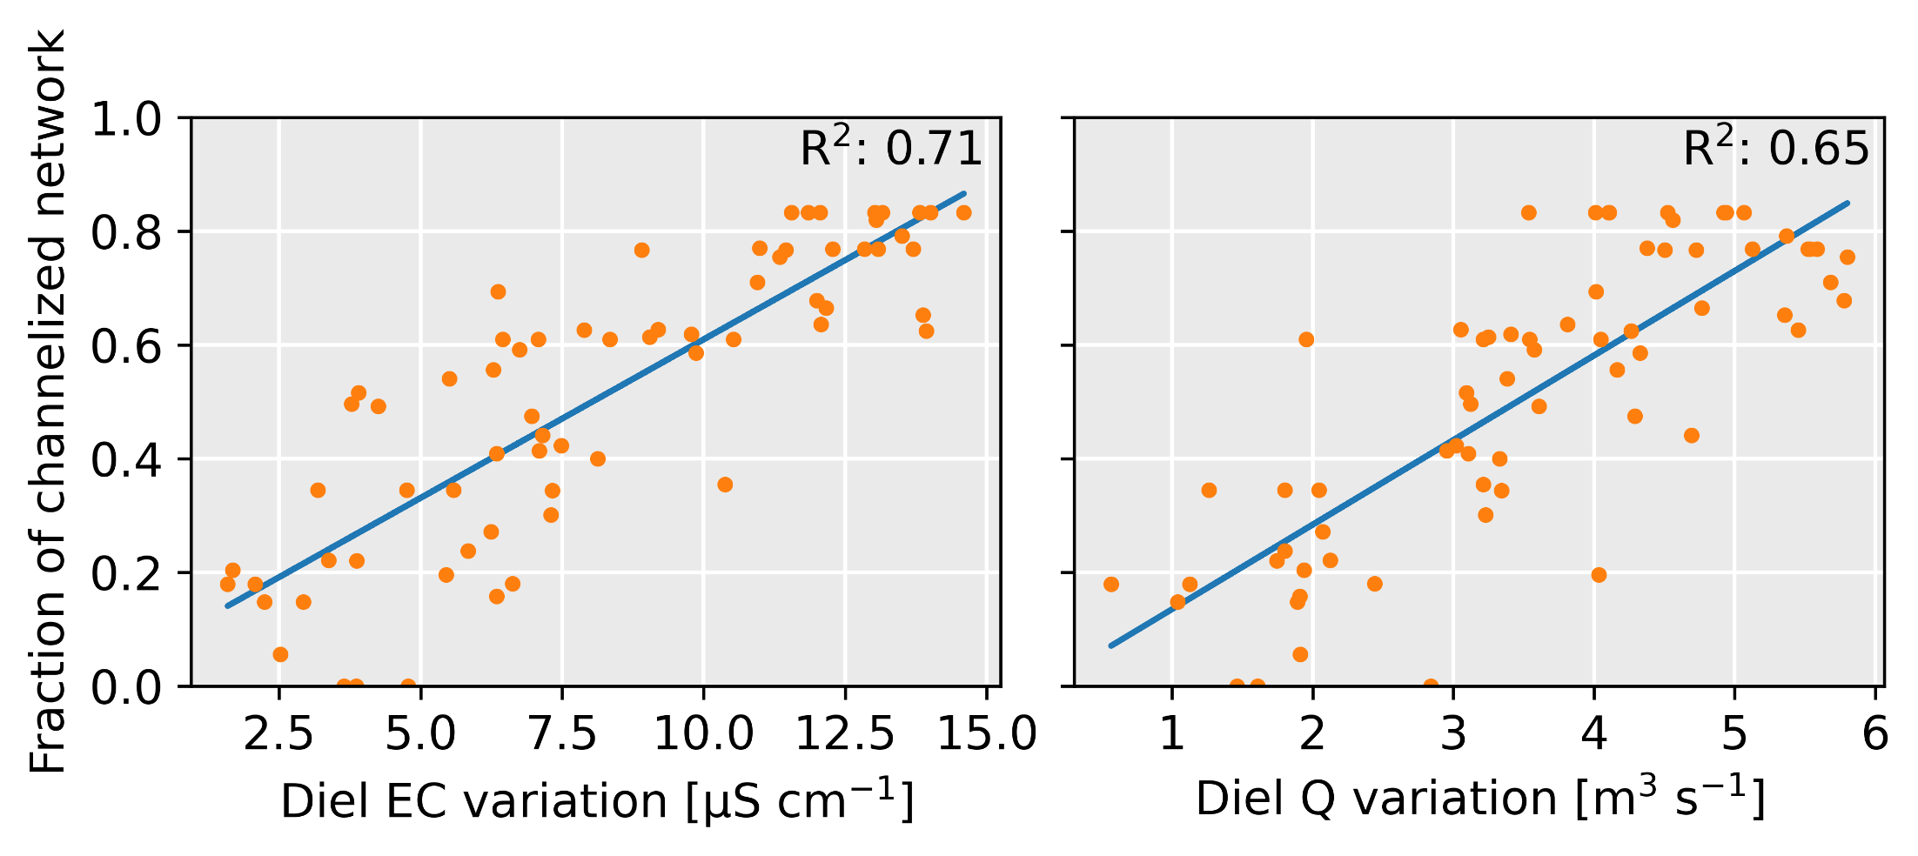
Identifying the missing storage
A simple model of stream EC
Diel EC variation
Diel Q variation
Fraction channelized
μS cm⁻¹
m³ s⁻¹
28
Notes:
Introduction
Context of the research
State of knowledge of groundwater storage in proglacial margin
Thesis objective and research questions
Thesis outline
The study site
Description of experimental site
Research collaboration with other groups
Experimental setup
Data availability
Towards a hydrogeomorphological understanding of proglacial catchments : review of current knowledge and assessment of groundwater storage and release in an Alpine catchment
The role of outwash plains to maintain baseflow in future deglaciated proglacial alpine areas
Icemelt-snowmelt contribution in a glaciated catchment: a comparison of water isotope and mass-balance approaches
Towards a sound estimation of water sources and flowpaths of a high alpine glaciated catchment using multiple geochemical methods
Conclusion
Sensor development corner

Slide 29
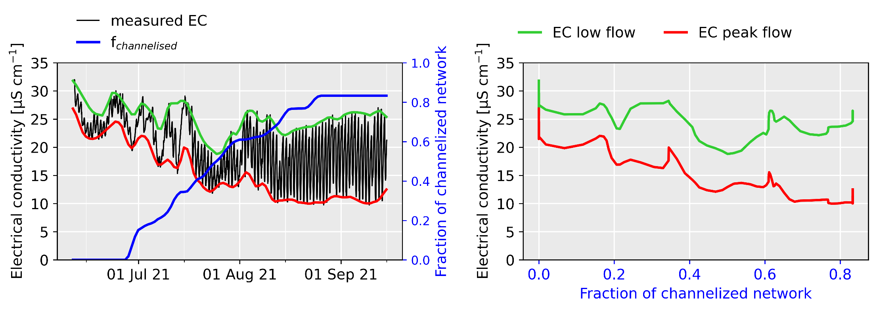
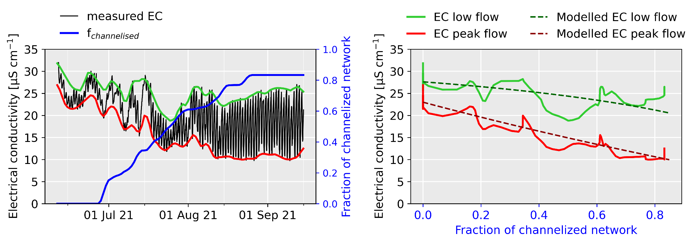
Identifying the missing storage
A simple model of stream EC
Measured
Measured
Modelled EC
Daily peak flow
Daily low flow
Measured EC
[μS cm⁻¹]
Fraction channelized
Fraction channelized
29
Notes:
Introduction
Context of the research
State of knowledge of groundwater storage in proglacial margin
Thesis objective and research questions
Thesis outline
The study site
Description of experimental site
Research collaboration with other groups
Experimental setup
Data availability
Towards a hydrogeomorphological understanding of proglacial catchments : review of current knowledge and assessment of groundwater storage and release in an Alpine catchment
The role of outwash plains to maintain baseflow in future deglaciated proglacial alpine areas
Icemelt-snowmelt contribution in a glaciated catchment: a comparison of water isotope and mass-balance approaches
Towards a sound estimation of water sources and flowpaths of a high alpine glaciated catchment using multiple geochemical methods
Conclusion
Sensor development corner

Slide 30
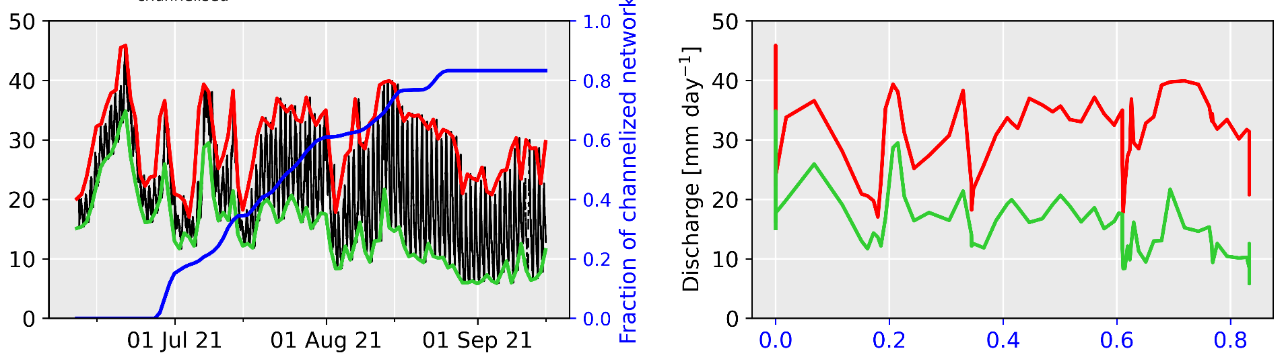
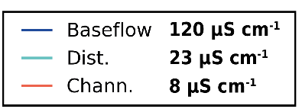
Identifying the missing storage
A simple model of stream EC
Daily peak flow
Daily low flow
Fraction channelized
Measured
Discharge
[mm/day]
Model results
EC calibration
Fraction channelized
Measured EC
[μS cm⁻¹]
Model results
30
Notes:
Introduction
Context of the research
State of knowledge of groundwater storage in proglacial margin
Thesis objective and research questions
Thesis outline
The study site
Description of experimental site
Research collaboration with other groups
Experimental setup
Data availability
Towards a hydrogeomorphological understanding of proglacial catchments : review of current knowledge and assessment of groundwater storage and release in an Alpine catchment
The role of outwash plains to maintain baseflow in future deglaciated proglacial alpine areas
Icemelt-snowmelt contribution in a glaciated catchment: a comparison of water isotope and mass-balance approaches
Towards a sound estimation of water sources and flowpaths of a high alpine glaciated catchment using multiple geochemical methods
Conclusion
Sensor development corner

Slide 31
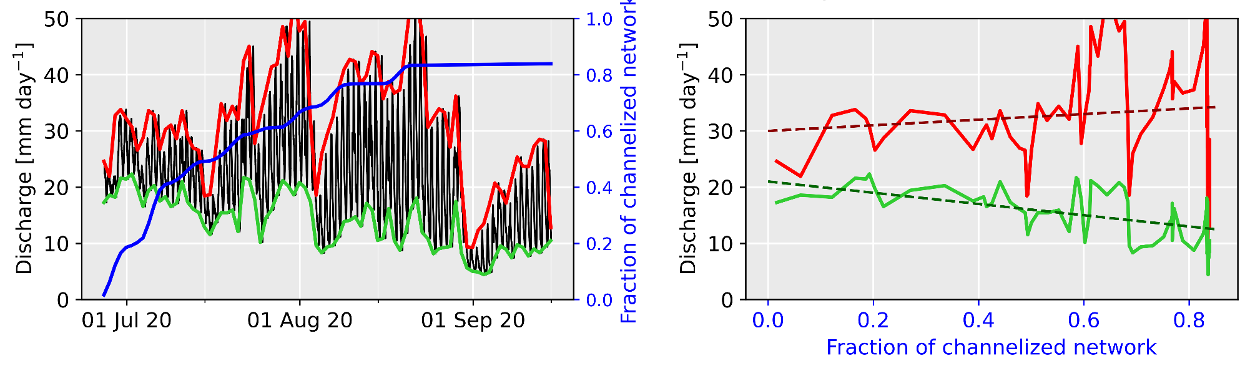
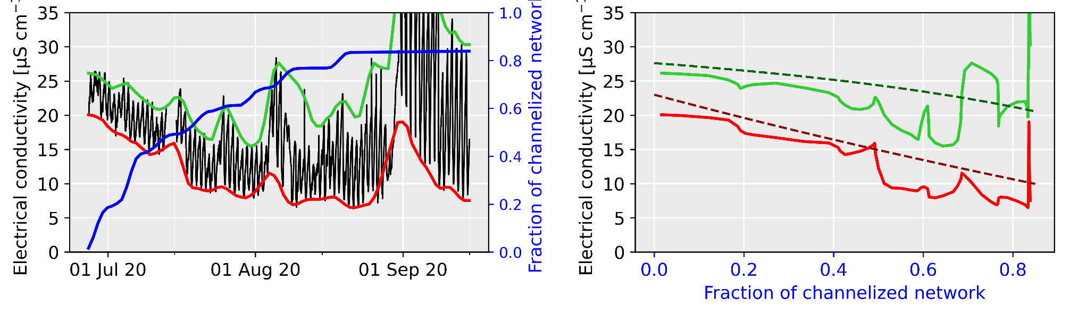
Identifying the missing storage
Evaluation for year 2020
Measured
Discharge
[mm/day]
Modelled
Fraction channelized
Measured EC
[μS cm⁻¹]
Modelled
Fraction channelized
31
Notes:
Introduction
Context of the research
State of knowledge of groundwater storage in proglacial margin
Thesis objective and research questions
Thesis outline
The study site
Description of experimental site
Research collaboration with other groups
Experimental setup
Data availability
Towards a hydrogeomorphological understanding of proglacial catchments : review of current knowledge and assessment of groundwater storage and release in an Alpine catchment
The role of outwash plains to maintain baseflow in future deglaciated proglacial alpine areas
Icemelt-snowmelt contribution in a glaciated catchment: a comparison of water isotope and mass-balance approaches
Towards a sound estimation of water sources and flowpaths of a high alpine glaciated catchment using multiple geochemical methods
Conclusion
Sensor development corner

Slide 32
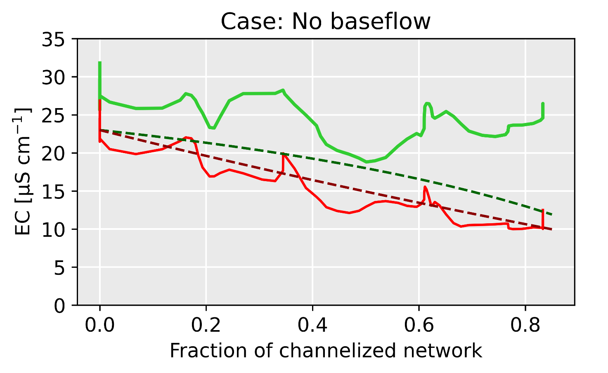
Identifying the missing storage
A simple model of stream EC
Summer baseflow of ~1 mm/d needed to explain EC
32
Notes:
Introduction
Context of the research
State of knowledge of groundwater storage in proglacial margin
Thesis objective and research questions
Thesis outline
The study site
Description of experimental site
Research collaboration with other groups
Experimental setup
Data availability
Towards a hydrogeomorphological understanding of proglacial catchments : review of current knowledge and assessment of groundwater storage and release in an Alpine catchment
The role of outwash plains to maintain baseflow in future deglaciated proglacial alpine areas
Icemelt-snowmelt contribution in a glaciated catchment: a comparison of water isotope and mass-balance approaches
Towards a sound estimation of water sources and flowpaths of a high alpine glaciated catchment using multiple geochemical methods
Conclusion
Sensor development corner

Slide 33
Conclusion
Perceptual model
Moraines
depends on
input
Storage
bedrock
~75 mm
outwash
~2 mm
Discharge
33
Notes:
Introduction
Context of the research
State of knowledge of groundwater storage in proglacial margin
Thesis objective and research questions
Thesis outline
The study site
Description of experimental site
Research collaboration with other groups
Experimental setup
Data availability
Towards a hydrogeomorphological understanding of proglacial catchments : review of current knowledge and assessment of groundwater storage and release in an Alpine catchment
The role of outwash plains to maintain baseflow in future deglaciated proglacial alpine areas
Icemelt-snowmelt contribution in a glaciated catchment: a comparison of water isotope and mass-balance approaches
Towards a sound estimation of water sources and flowpaths of a high alpine glaciated catchment using multiple geochemical methods
Conclusion
Sensor development corner

