Slide 1


Fertilizers as batteries and regulators in the global Water-Energy-Food equilibrium
National Technical University of Athens
School of Civil Engineering
Kirkmalis, G., Sargentis, G.-F., Ioannidis, R., Markantonis, D., Iliopoulou, T., Dimitriadis, P., Mamasis, N., and Koutsoyiannis, D.
April 2023

Slide 2
Some of the paper’s contents:
Introduction
The water-energy-food nexus
Energy production by renewable energy installations -consumption
Energy recovery
Energy recovery inside the nexus
Discussion and conclusions

Slide 3
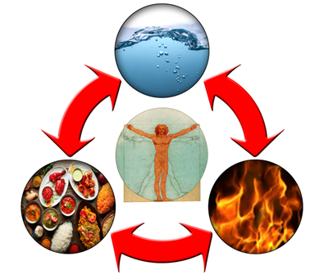
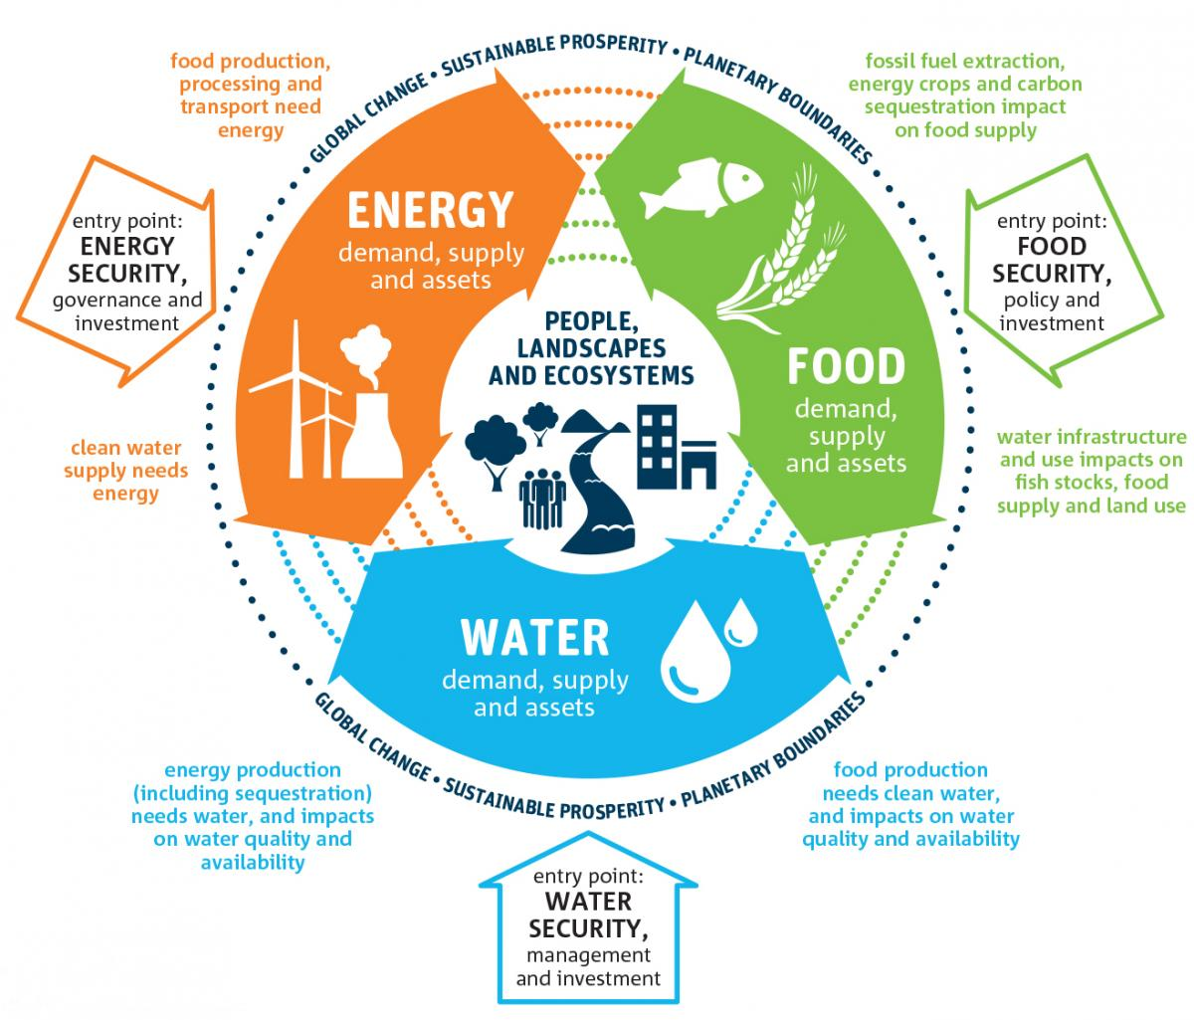
Introduction
The basic human needs related to water, energy and food (WEF) compose a nexus that is not only necessary for the survival of humans, but is able to explain their prosperity as well. This nexus is extended by the addition of land, as land is a fundamental source for the support of water-energy and food.
It is important to note the interactions inside the water-energy-food nexus: water can give energy (hydropower) and multiply the production of food (irrigation), energy inputs produce food but also could pump underground water, food can be assumed as an energy source (for livestock and humans) and contains water.

Slide 4
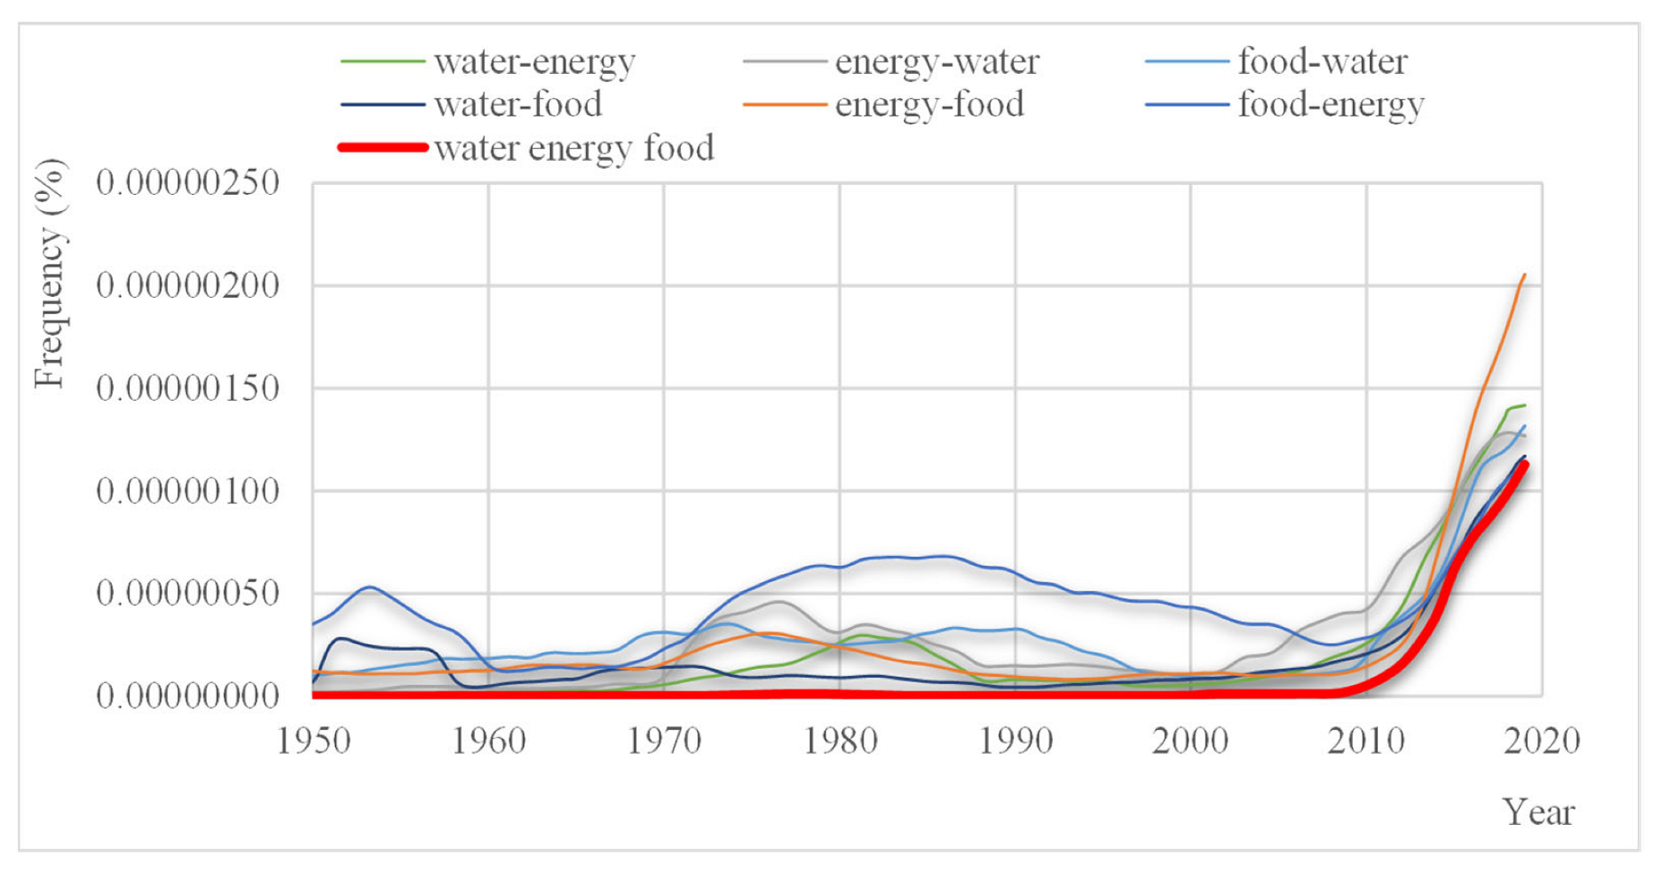

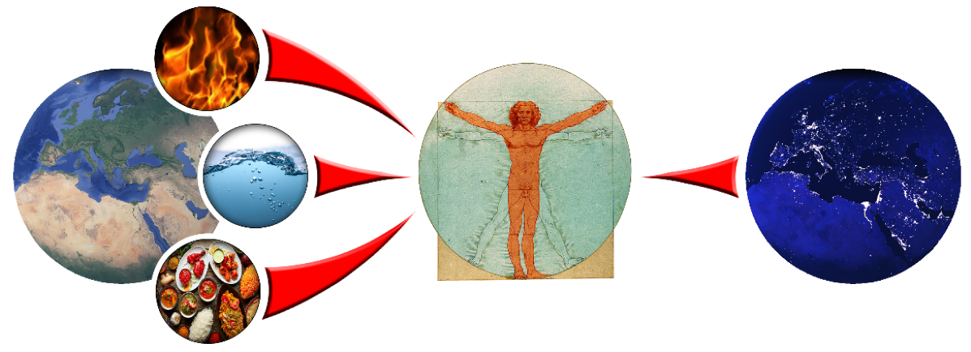
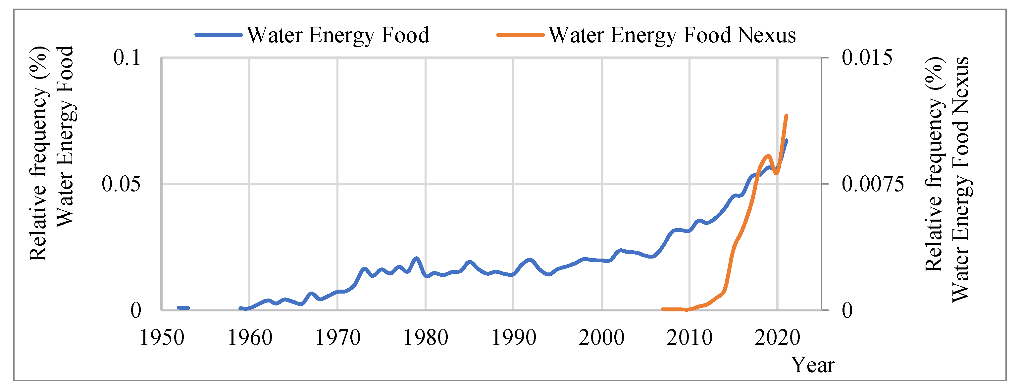
The water-energy-food nexus
Half of the energy provided by the sun is being consumed in the water cycle, and its consumption is a necessary condition for human life. A small part of the other half is being used to convert inorganic matter to organic matter. Humans consume a small part of the organic matter as food (animals, plants) and another part as energy (wood, oil, etc.), which is essential for prosperity.
This fact has emerged in the literature over the last 10 years

Slide 5
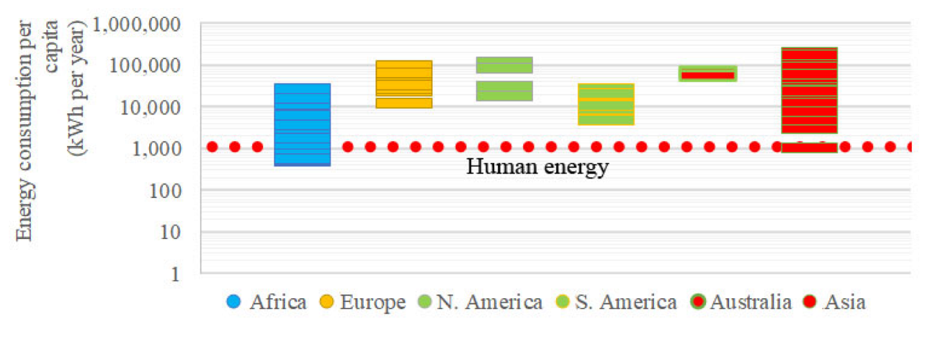
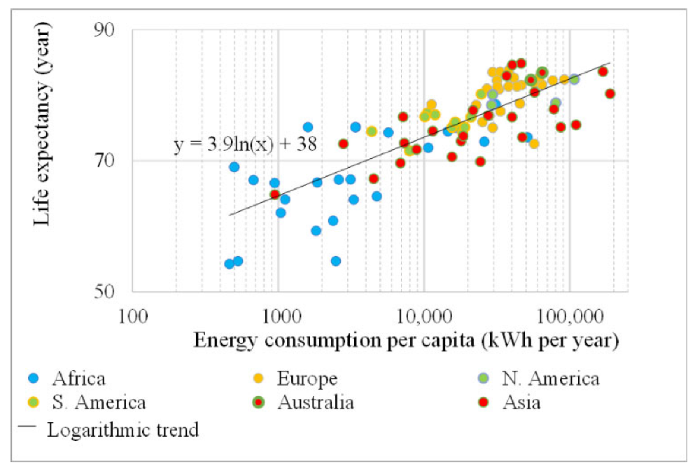
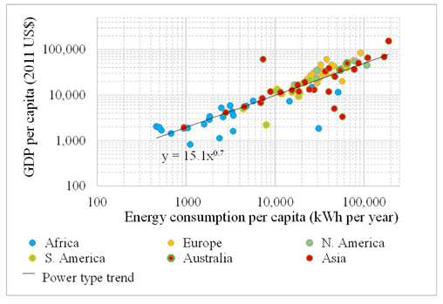
The role of energy in prosperity
Even if the causal link of energy consumption to GDP and life expectancy is questionable according to some researchers, by correlating recent global data on the current energy consumption with GDP per capita and life expectancy, we identify interesting trends
Sargentis, G.F.; Lagaros, N.D.; Cascella, G.L.; Koutsoyiannis, D. Threats in Water–Energy–Food–Land Nexus by the 2022 Military and Economic Conflict. Land 2022, 11, 1569. https://doi.org/10.3390/land11091569

Slide 6
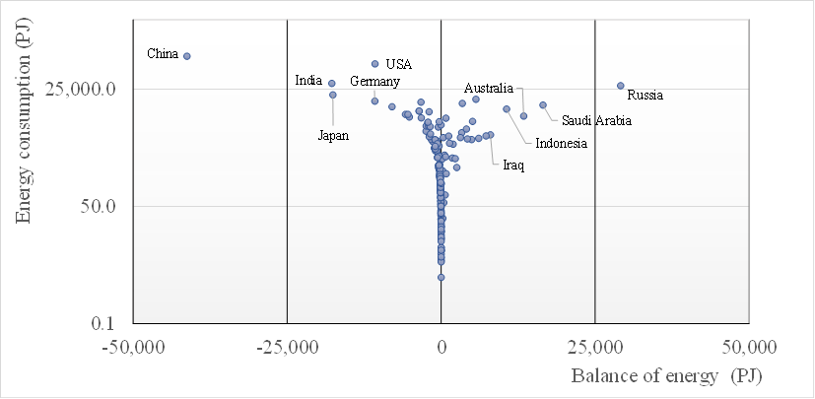
The role of energy (2019)
Sargentis, G.-F.; Koutsoyiannis, D. The Function of Money in Water–Energy–Food and Land Nexus. Land 2023, 12, 669. https://doi.org/10.3390/land12030669

Slide 7
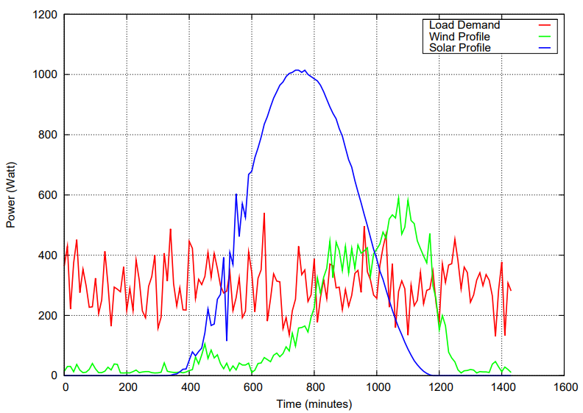
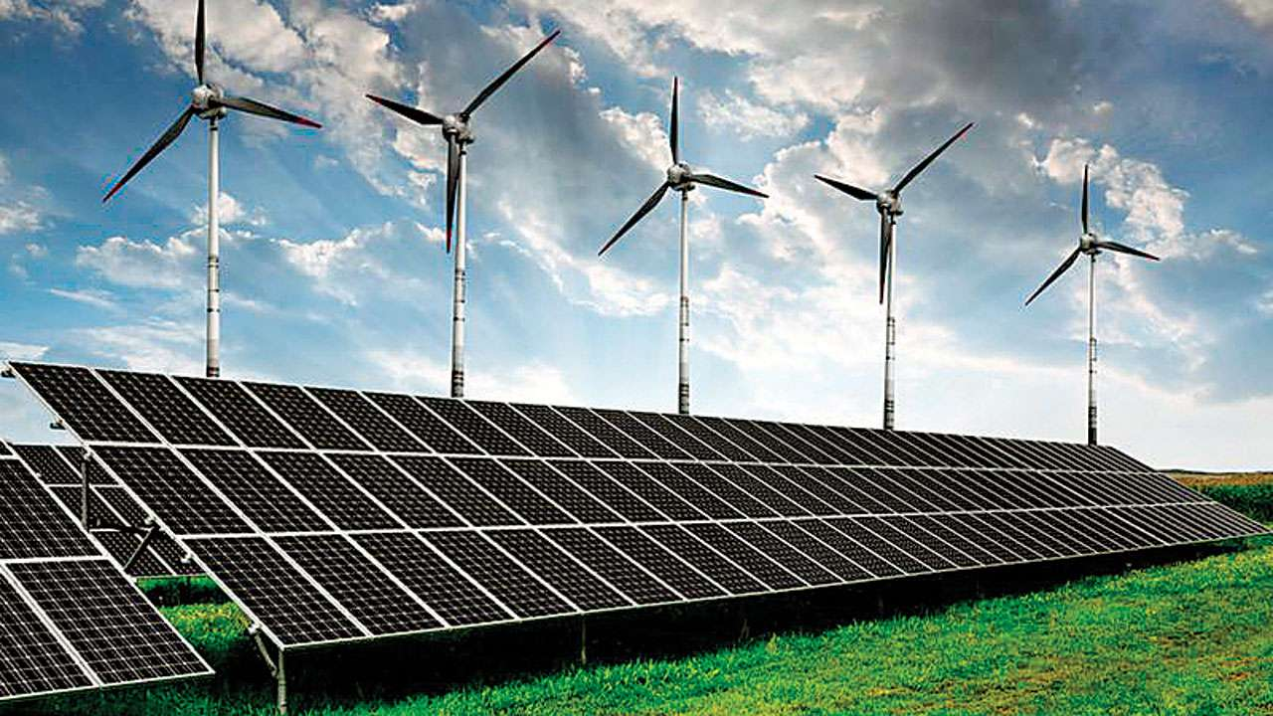
Energy production and consumption
Moath Jarrah, Modeling and Simulation of Renewable Energy Sources in Smart Grid Using DEVS Formalism, Procedia Computer Science, Volume 83, 2016, Pages 642-647, ISSN 1877-0509, https://doi.org/10.1016/j.procs.2016.04.144.
Profiles of load demand, wind, and solar power during one day
System collapses if the demand is higher than production
The examples shows that in some periods, system works with energy surplus.

Slide 8
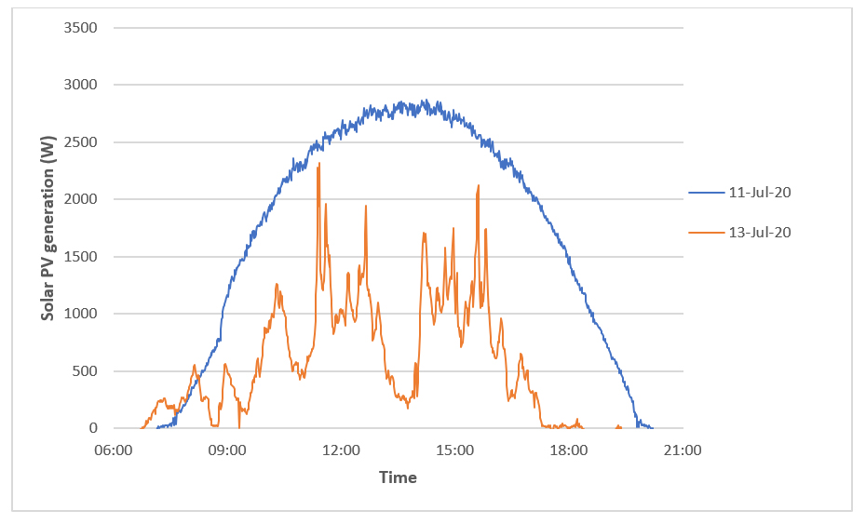
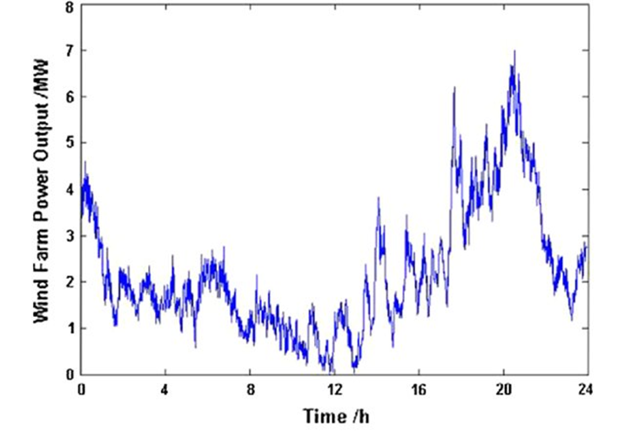
Power outputs by renewable energy installations
PV generation in watts for a solar PV system on 11 July 2020, when it was sunny throughout the day and on 13 July when there was a mixture of sun and cloud.
Daily wind power output profile of one wind farm in China.
Yiming Zhang, Xisheng Tang, Zhiping Qi, Zhaoping Liu, The Ragone plots guided sizing of hybrid storage system for taming the wind power, International Journal of Electrical Power & Energy Systems, Volume 65, 2015, Pages 246-253, ISSN 0142-0615, https://doi.org/10.1016/j.ijepes.2014.10.006.
https://www.nea.org.uk/who-we-are/innovation-technical-evaluation/solarpv/how-much-electricity-solar-produce/

Slide 9
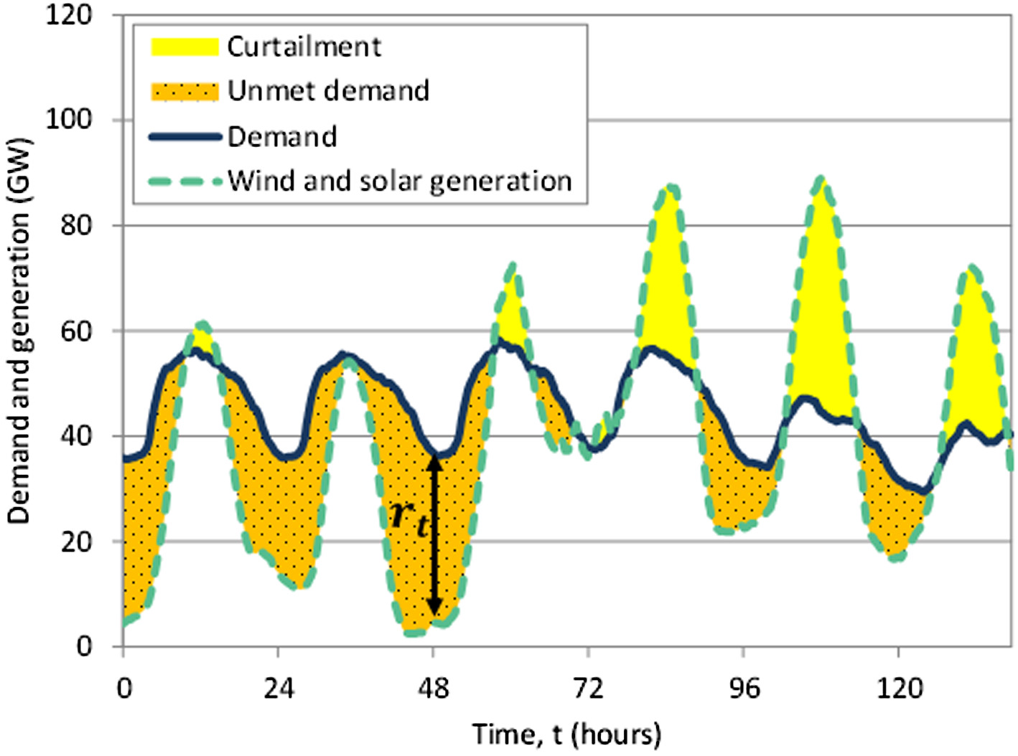
Modeling energy needs
Whereas variations in the dynamics of renewable energy generation are reasonably well studied, a deeper understanding of the variations in consumption dynamics is still missing.
Anvari, M., Proedrou, E., Schäfer, B. et al. Data-driven load profiles and the dynamics of residential electricity consumption. Nat Commun 13, 4593 (2022). https://doi.org/10.1038/s41467-022-31942-9
William Zappa, Machteld van den Broek, Analysing the potential of integrating wind and solar power in Europe using spatial optimisation under various scenarios, Renewable and Sustainable Energy Reviews, Volume 94, 2018, Pages 1192-1216, ISSN 1364-0321, https://doi.org/10.1016/j.rser.2018.05.071.
Example of curtailment and residual demand in a power system (Zappa and van den Broek).

Slide 10
The storage of energy
Batteries
Electric energy → chemical energy → electric energy
Thermal
Electric energy → thermal energy → thermal energy
Mechanical Storage
Electric energy → kinetic energy → electric energy
Hydrogen
Electric energy → Hydrogen → electric energy
Pumped Hydropower
Electric energy → dynamic energy → electric energy
Aziz et all. described how to use Ammonia as effective Hydrogen storage.
Ikäheimo et all. studied energy storage system power to ammonia (P2A) technology.
Batteries – a range of electrochemical storage solutions, including advanced chemistry batteries, flow batteries, and capacitors
Thermal – capturing heat and cold to create energy on demand or offset energy needs
Mechanical Storage – other innovative technologies to harness kinetic or gravitational energy to store electricity
Hydrogen – excess electricity generation can be converted into hydrogen via electrolysis and stored
Pumped Hydropower – creating large-scale reservoirs of energy with water
Aziz, M.; Wijayanta, A.T.; Nandiyanto, A.B.D. Ammonia as Effective Hydrogen Storage: A Review on Production, Storage and Utilization. Energies 2020, 13, 3062. https://doi.org/10.3390/en13123062
Jussi Ikäheimo, Juha Kiviluoma, Robert Weiss, Hannele Holttinen, Power-to-ammonia in future North European 100 % renewable power and heat system, International Journal of Hydrogen Energy, Volume 43, Issue 36, 2018, Pages 17295-17308, ISSN 0360-3199, https://doi.org/10.1016/j.ijhydene.2018.06.121.
  https://energystorage.org/why-energy-storage/technologies/

Slide 11

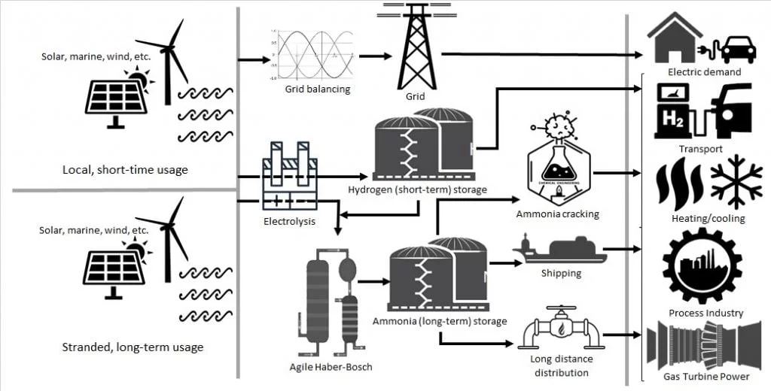

The storage of energy
Cracking of ammonia into its elements in high temperature, followed by combustion of hydrogen seams as the feasible option. The efficiency of ammonia cracking and combustion in CCGT was estimated to be 53% (LHV).
In this presentation we analyze the correlation of ammonias’ surplus in water-energy-food nexus investigating the efficiency of nexus to absorbed it.
A Valera-Medina et al. Ammonia for power, Progress in Energy and Combustion Science, Volume 69, 2018, Pages 63-102, ISSN 0360-1285, https://doi.org/10.1016/j.pecs.2018.07.001.
Ammonia as an Energy Vector https://ammoniaknowhow.com/ammonia-as-an-energy-vector/
NH₃

Slide 12
The storage of energy inside the nexus
Production
For our approach we use the energy needs for NH₃ and the surplus y of the production.
Note: the wheat yield has a big distribution which is described in OurWorldinData: https://ourworldindata.org/grapher/wheat-yields
x
x + y
Food Biodiesel

Slide 13
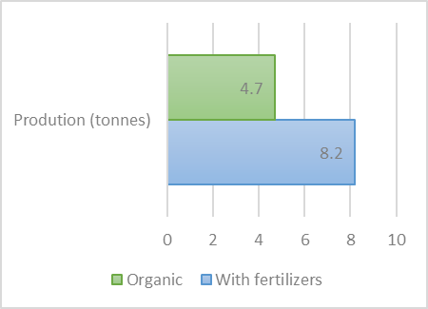
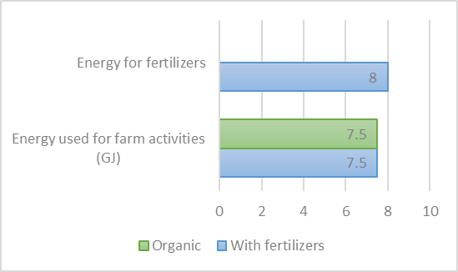
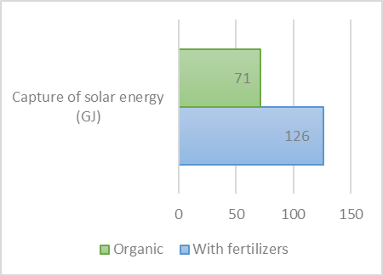
The storage of energy inside the nexus
The use of nitrogen fertilizer enables crops to grow more biomass by helping them to fix additional solar energy. Wheat yields in Europe:
4.7 tonnes/ha without NH₃ fertilizer. Equate to 71 GJ of solar energy captured in the form of biomass.
8.2 tonnes/ha with 170 kg NH₃/ha. Equate to 126 GJ of solar energy captured in the form of biomass.
  Kuesters, J., Lammel, J. Investigations of the energy efficiency of the production of winter wheat and sugar beet in Europe, European Journal of Agronomy, Volume 11, Issue 1, 1999, Pages 35-43, ISSN 1161-0301, https://doi.org/10.1016/S1161-0301(99)00015-5.
  Fertilizers Europe. Harvesting energy with fertilizers. Available online: https://www.fertilizerseurope.com/wp-content/uploads/2019/08/FertilizersEurope-Harvesting_energy-V_2.pdf
  Bhat, M.; English, B.; Turhollow, A.; Nyangito, H. Energy in Synthetic Fertilizers and Pesticides: Revisited, Technical report, Department of Agricultural Economics and Rural Sociology The University of Tennessee, Tennessee 1994

Slide 14
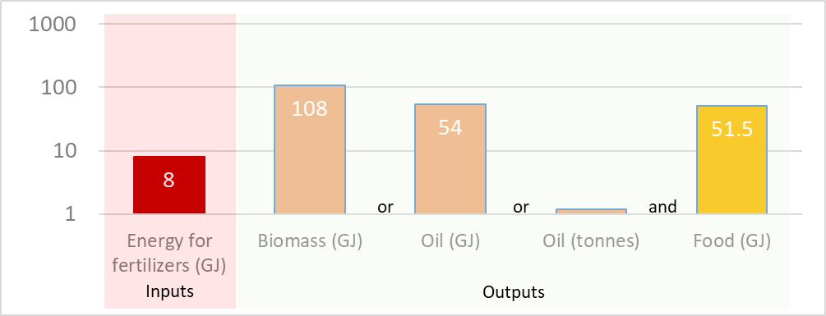
The storage of energy inside the nexus
Considering that half of the production is grain and the other half is straw (biomass) we note that:
Using fertilizers (embodied energy 8 GJ) we gain a surplus of 3.5 tonnes of straw.
This can be converted to ~1 tonne of synthetic oil (equal to 53 GJ of energy).
In addition we gain a surplus of 3.5 tonnes of wheat (12 320 000 kcal or 51.5 GJ) which could cover the daily caloric needs of more than 6800 people (1800 kcal/day).

Slide 15
Discussion and conclusions
In this presentation we showed that
As the production of renewable energy is stochastic a key factor to be useful is the energy storage.
NH₃ can be produced by the surplus of renewable energy.
In our example, we put NH₃ inside the Water-Energy-Food nexus in cultivations and we saw that the coefficient of performance (in energy production) is at least five times as the sun is playing a multiplying role in energy process.
As other concepts which use NH₃ for energy transformation and storage has very lower coefficient of performance, we showed that putting NH₃ inside the nexus, could be considered as more efficient.
In this example, energy was not competitive with food
The limitations are the land use and the availability of water, as the possibility of pumping groundwater for irrigation could minimize the advantages.

Slide 16
Reference
A Valera-Medina et al. Ammonia for power, Progress in Energy and Combustion Science, Volume 69, 2018, Pages 63-102, ISSN 0360-1285, https://doi.org/10.1016/j.pecs.2018.07.001.
Ammonia as an Energy Vector https://ammoniaknowhow.com/ammonia-as-an-energy-vector/
Anvari, M., Proedrou, E., Schäfer, B. et al. Data-driven load profiles and the dynamics of residential electricity consumption. Nat Commun 13, 4593 (2022). https://doi.org/10.1038/s41467-022-31942-9
Aziz, M.; Wijayanta, A.T.; Nandiyanto, A.B.D. Ammonia as Effective Hydrogen Storage: A Review on Production, Storage and Utilization. Energies 2020, 13, 3062. https://doi.org/10.3390/en13123062
Bhat, M.; English, B.; Turhollow, A.; Nyangito, H. Energy in Synthetic Fertilizers and Pesticides: Revisited, Technical report, Department of Agricultural Economics and Rural Sociology The University of Tennessee, Tennessee 1994
Fertilizers Europe. Harvesting energy with fertilizers. Available online: https://www.fertilizerseurope.com/wp-content/uploads/2019/08/FertilizersEurope-Harvesting_energy-V_2.pdf
https://energystorage.org/why-energy-storage/technologies/
https://www.nea.org.uk/who-we-are/innovation-technical-evaluation/solarpv/how-much-electricity-solar-produce/
Jussi Ikäheimo, Juha Kiviluoma, Robert Weiss, Hannele Holttinen, Power-to-ammonia in future North European 100 % renewable power and heat system, International Journal of Hydrogen Energy, Volume 43, Issue 36, 2018, Pages 17295-17308, ISSN 0360-3199, https://doi.org/10.1016/j.ijhydene.2018.06.121.

Slide 17
Reference
Koutsoyiannis, D.; Sargentis, G.-F. Entropy and Wealth. Entropy 2021, 23, 1356. https://doi.org/10.3390/e23101356
Kuesters, J., Lammel, J. Investigations of the energy efficiency of the production of winter wheat and sugar beet in Europe, European Journal of Agronomy, Volume 11, Issue 1, 1999, Pages 35-43, ISSN 1161-0301, https://doi.org/10.1016/S1161-0301(99)00015-5.
Moath Jarrah, Modeling and Simulation of Renewable Energy Sources in Smart Grid Using DEVS Formalism, Procedia Computer Science, Volume 83, 2016, Pages 642-647, ISSN 1877-0509, https://doi.org/10.1016/j.procs.2016.04.144.
Sargentis, G.-F.; Defteraios, P.; Lagaros, N.D.; Mamassis, N. Values and Costs in History: A Case Study on Estimating the Cost of Hadrianic Aqueduct’s Construction. World 2022, 3, 260-286. https://doi.org/10.3390/world3020014
Sargentis, G.-F.; Dimitriadis, P.; Ioannidis, R.; Iliopoulou, T.; Frangedaki, E.; Koutsoyiannis, D. Optimal utilization of water resources for local communities in mainland Greece (case study of Karyes, Peloponnese), Procedia Manufacturing, Volume 44, 2020, Pages 253-260, ISSN 2351-9789, https://doi.org/10.1016/j.promfg.2020.02.229.
Sargentis, G.-F.; Iliopoulou, T.; Dimitriadis, P.; Mamassis, N.; Koutsoyiannis, D. Stratification: An Entropic View of Society’s Structure. World 2021, 2, 153-174. https://doi.org/10.3390/world2020011
Sargentis, G.-F.; Koutsoyiannis, D. The Function of Money in Water–Energy–Food and Land Nexus. Land 2023, 12, 669. https://doi.org/10.3390/land12030669
Sargentis, G.-F.; Koutsoyiannis, D.; Angelakis, A.; Christy, J.; Tsonis, A.A. Environmental Determinism vs. Social Dynamics: Prehistorical and Historical Examples. World 2022, 3, 357-388. https://doi.org/10.3390/world3020020

Slide 18
Reference
Sargentis, G.F.; Lagaros, N.D.; Cascella, G.L.; Koutsoyiannis, D. Threats in Water–Energy–Food–Land Nexus by the 2022 Military and Economic Conflict. Land 2022, 11, 1569. https://doi.org/10.3390/land11091569
Sargentis, G.-F.; Siamparina, P.; Sakki, G.-K.; Efstratiadis, A.; Chiotinis, M.; Koutsoyiannis, D. Agricultural Land or Photovoltaic Parks? The Water–Energy–Food Nexus and Land Development Perspectives in the Thessaly Plain, Greece. Sustainability 2021, 13, 8935. https://doi.org/10.3390/su13168935
William Zappa, Machteld van den Broek, Analysing the potential of integrating wind and solar power in Europe using spatial optimisation under various scenarios, Renewable and Sustainable Energy Reviews, Volume 94, 2018, Pages 1192-1216, ISSN 1364-0321, https://doi.org/10.1016/j.rser.2018.05.071.
Yiming Zhang, Xisheng Tang, Zhiping Qi, Zhaoping Liu, The Ragone plots guided sizing of hybrid storage system for taming the wind power, International Journal of Electrical Power & Energy Systems, Volume 65, 2015, Pages 246-253, ISSN 0142-0615, https://doi.org/10.1016/j.ijepes.2014.10.006.

