Slide 1
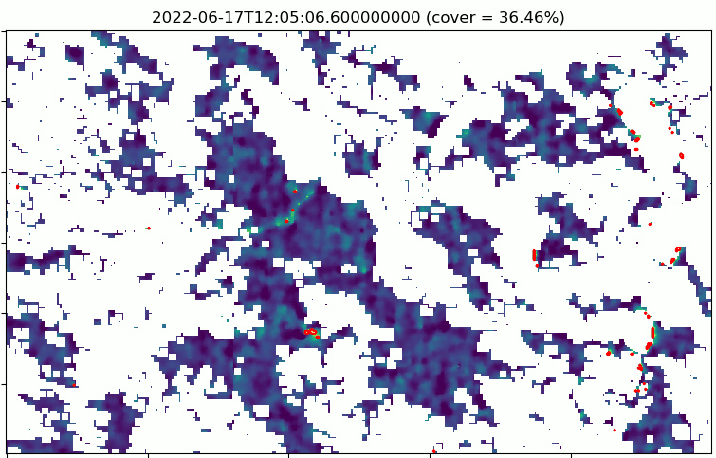
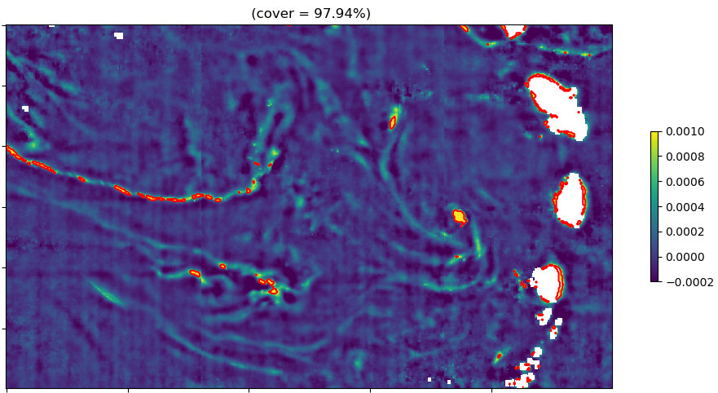
ABI/GOES-16 Sargassum processing overview
Read level1
Apply land mask
Rayleigh and sun glint correction
FAI calculation
Background correction (median filter)
Grid correction (correction tramage)
Sample daily animation (2022-06-17) of Sargassum index (FAI anomaly). Red areas show the boundaries of the detected sargassum.
Daily composite (2022-06-17): major improvement in terms of daily spatial coverage (x2 to 3 compared to MODIS)
Denoising
Additional filter
Sargassum detection
(threshold on FAI anomaly)
GOES Sargassum detection threshold: about 1.3% fractional coverage on a single slot (MODIS threshold : 0.23% fractional coverage)
GOES Sargassum processor flowchart (level 1 → level 2)

