Slide 1
Supplement

Slide 2
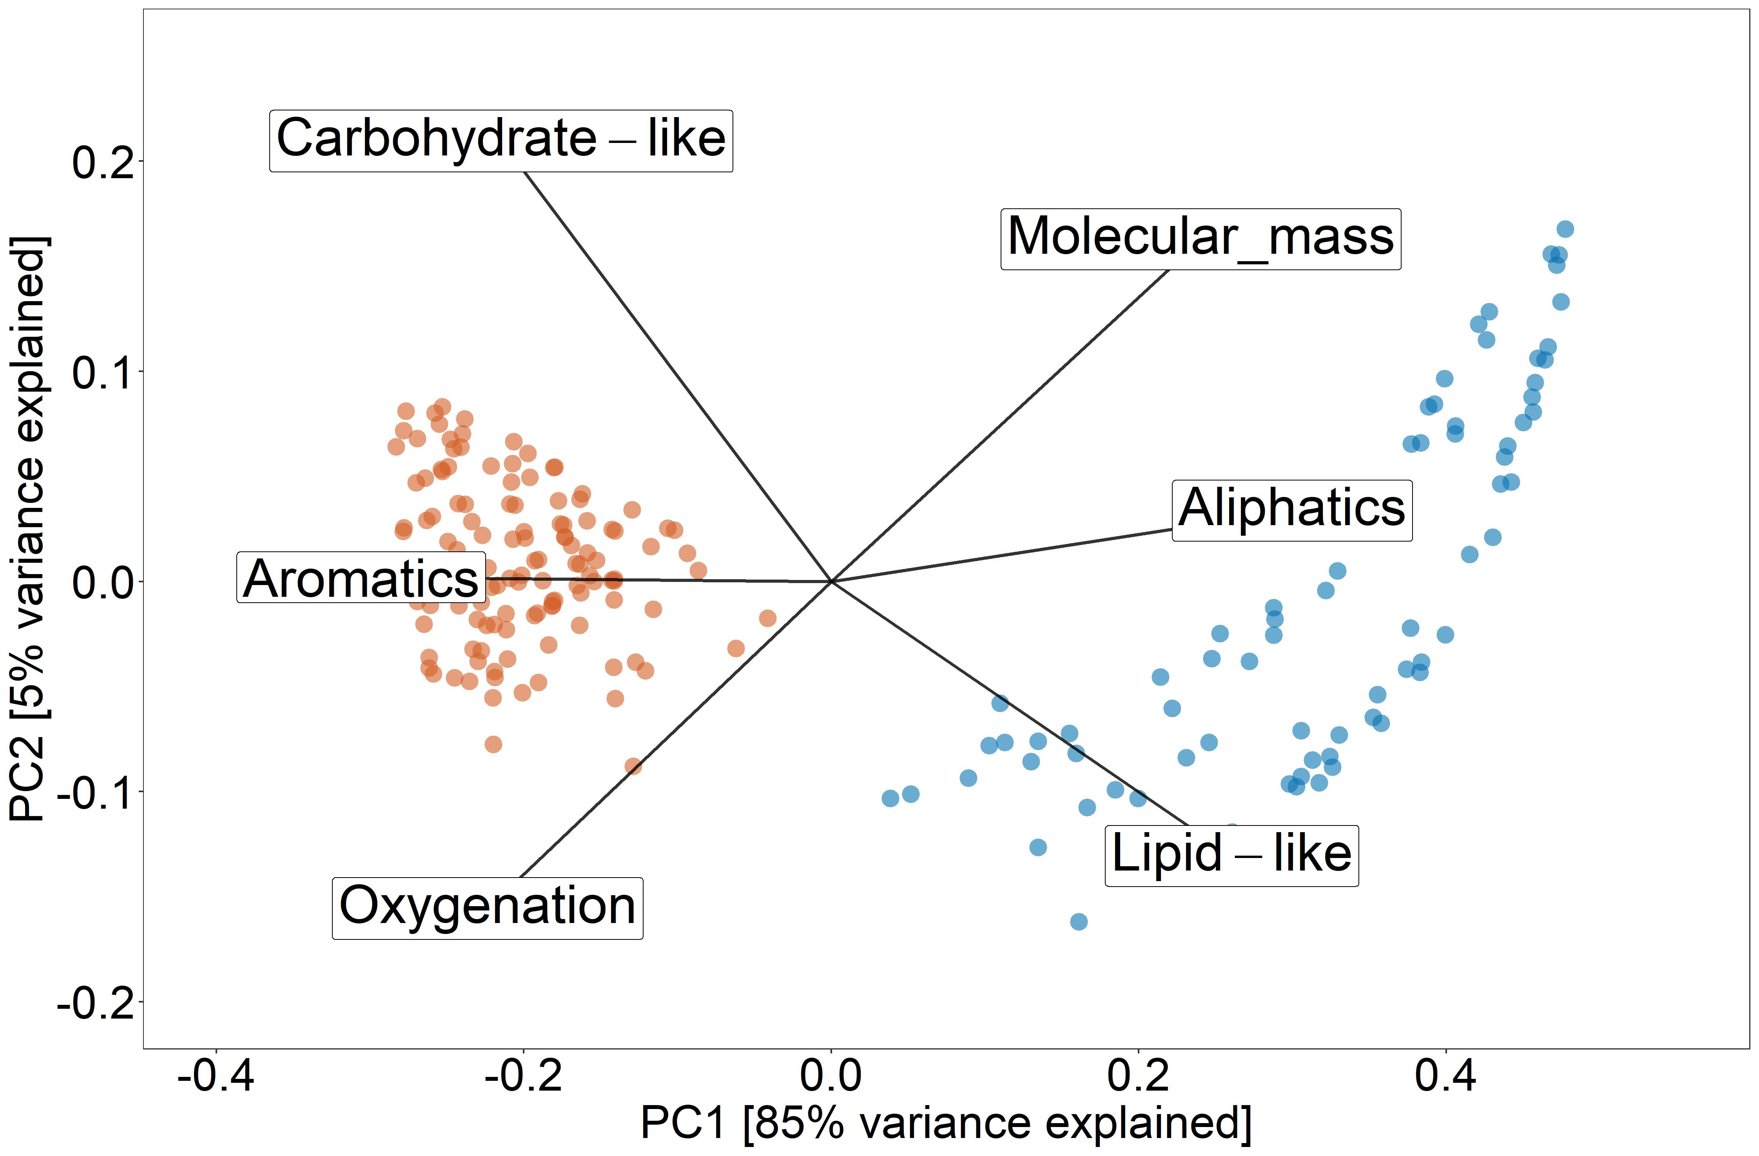
Principal coordinate analysis
Strong separation of molecular DOM composition based by ecosystem type
White-sand forests:
DOM is more indicative of fresh plant-derived material
Terra firme forests: signature of less plant-derived and more microbially reworked material
Roth et al. (2019)
4
Notes:
PCoA showing the compositional differences. White-sand forest plant-DOM, terra firme microbial signature

Slide 3
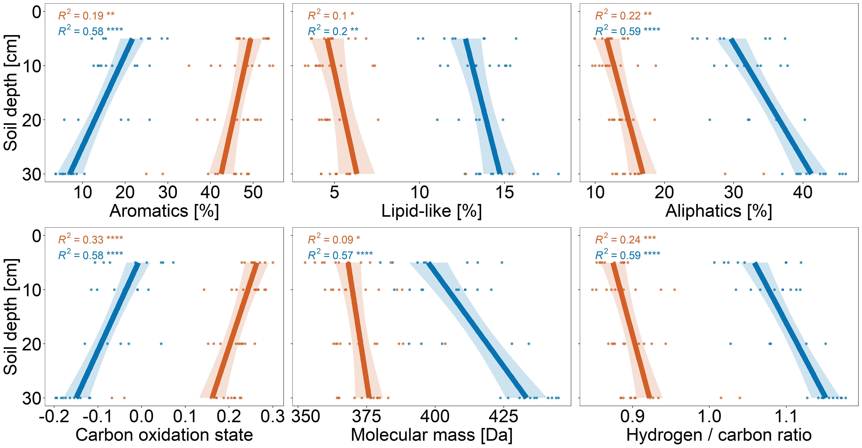
Depth profiles of selected DOM parameters based on all assigned sum formulae

Slide 4
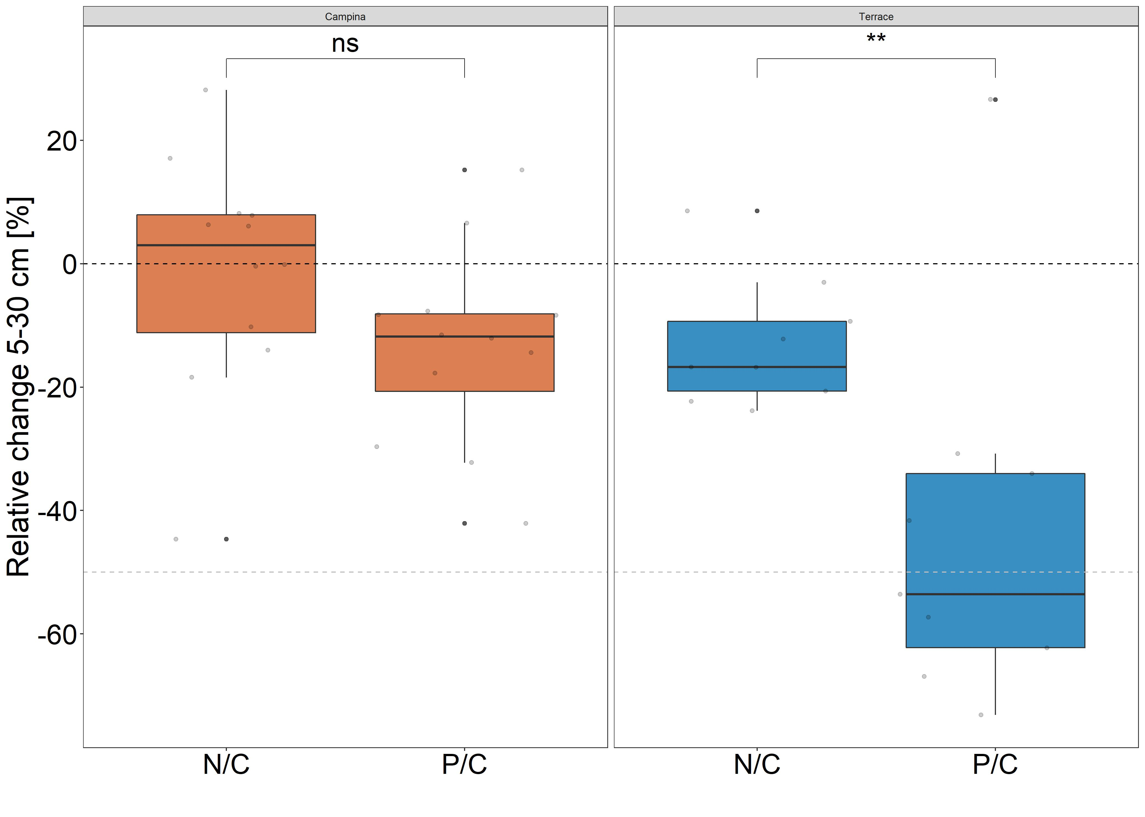
White-sand forest
Terra firme forest

Slide 5
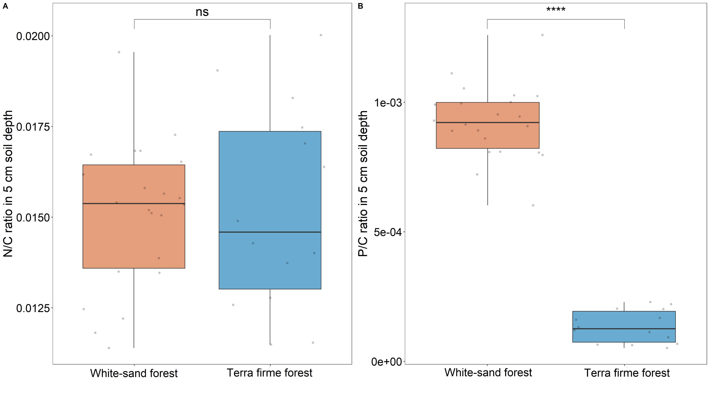
Comparison between N and P over carbon ratios in 5 cm soil depth

Slide 6
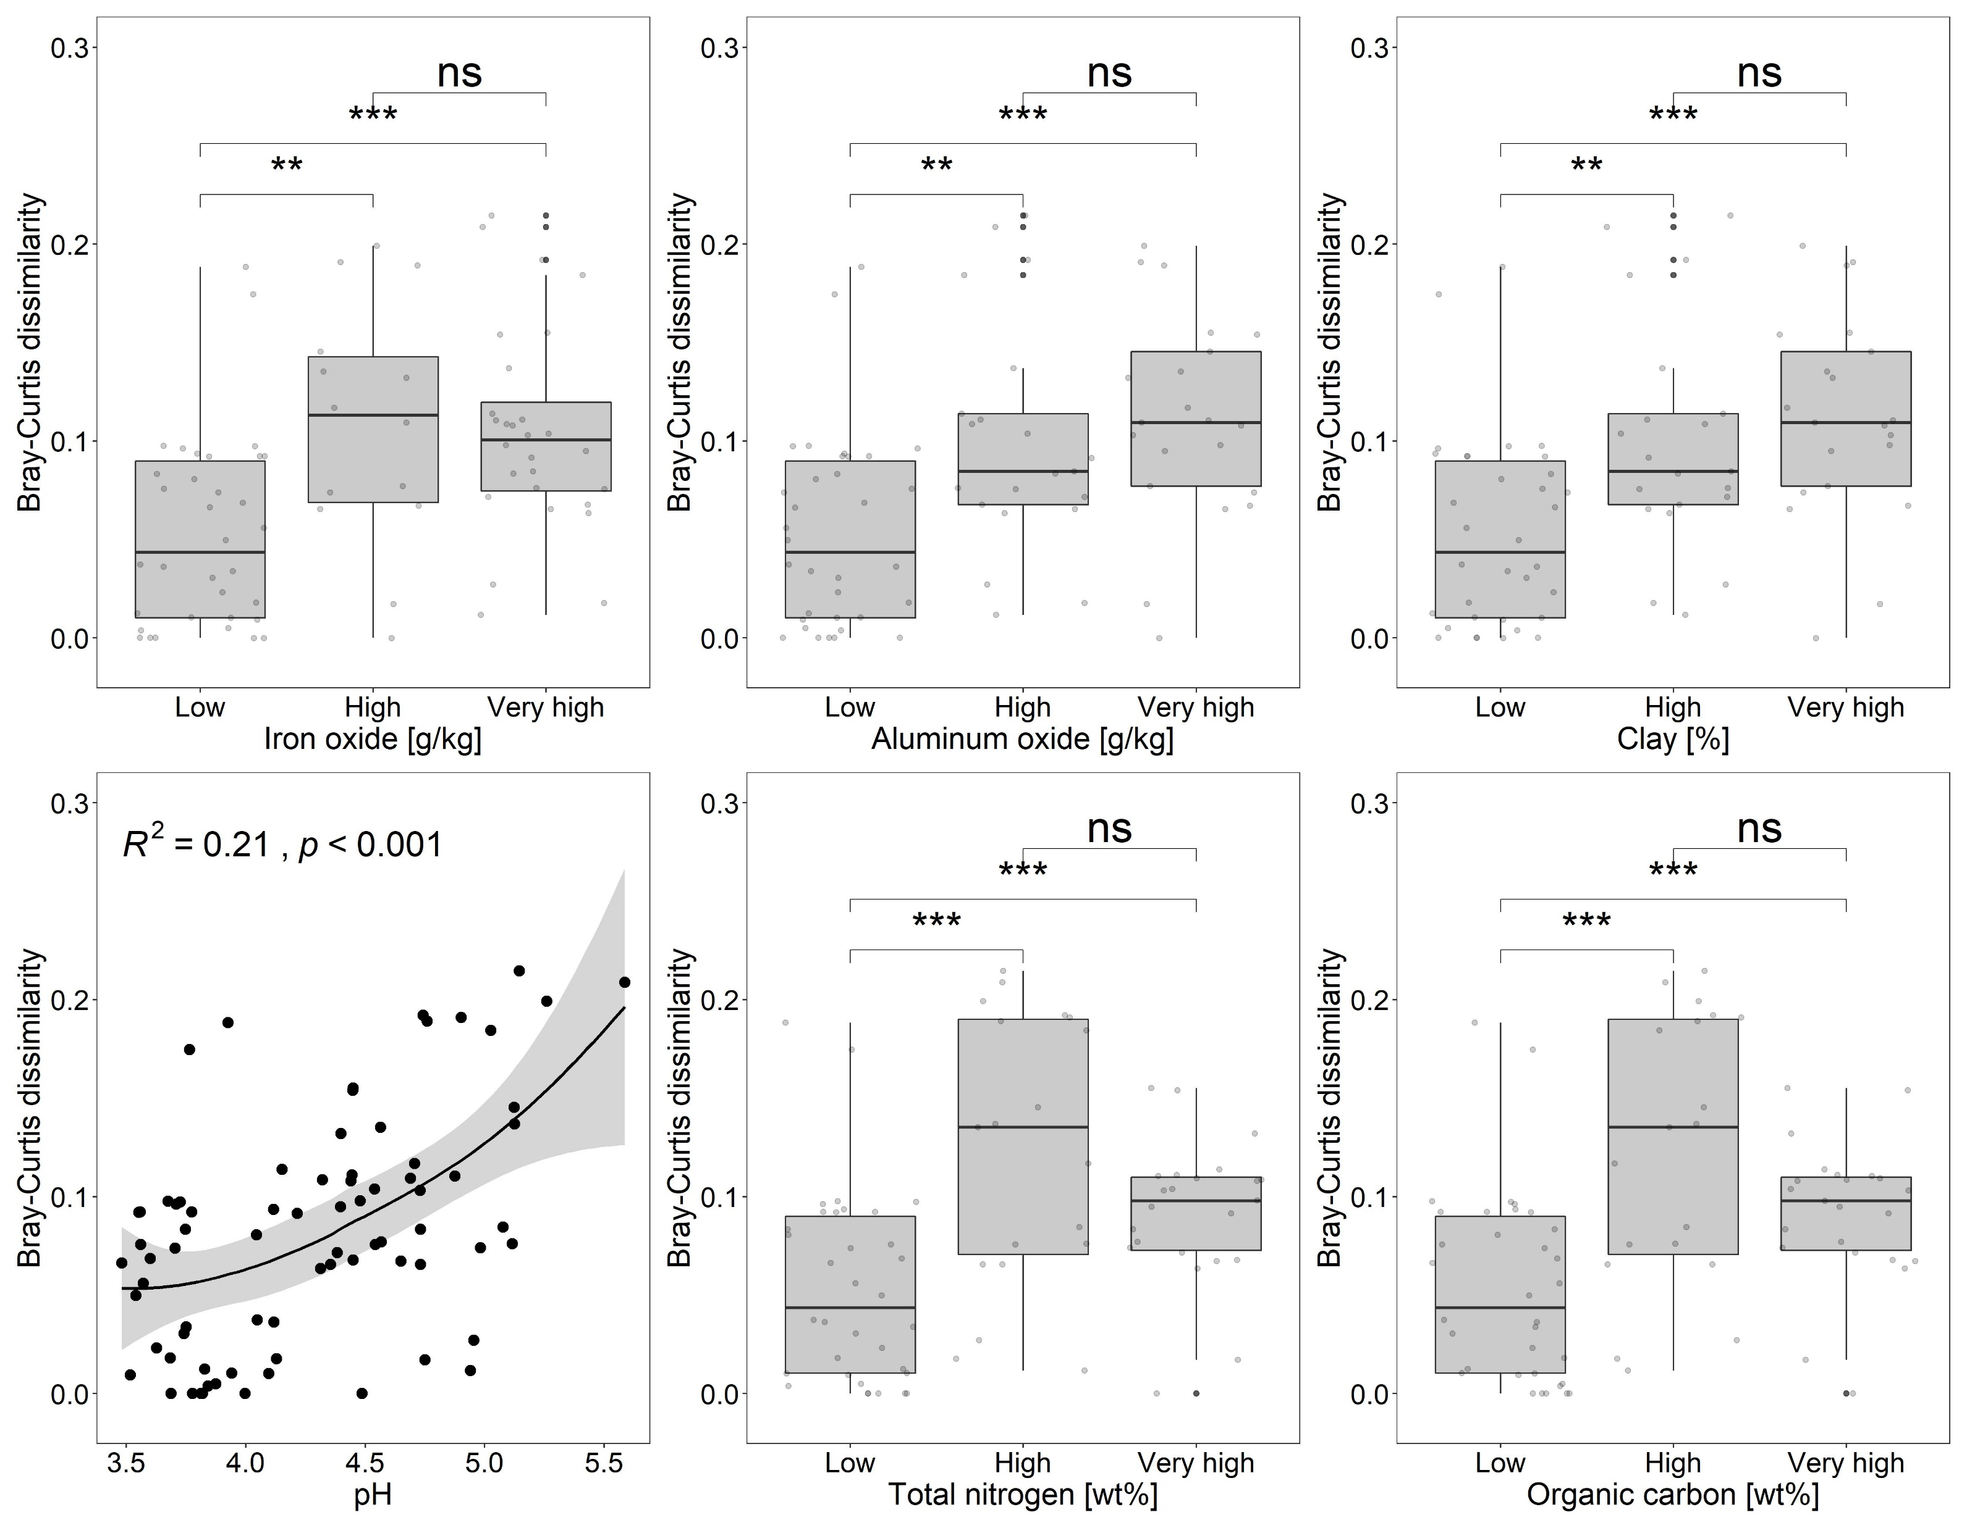
X² = 17.0
X² = 17.8
X² = 17.8
Statistical tests of relationship between DOM transformation and environmental parameters
Terra firme forest only
ρ² = 0.11, p = 0.032
ϱ
ρ² = 0.21, p < 0.001
X² = 17.8
X² = 17.8
X² from Kruskal-Wallis test
ρ² from Spearman’s Rank correlation

