Slide 1
Progressing experimental methods for the hydrological characterization of structural soil substrates
1
2
Federal Ministry for Agriculture, Forestry, Regions and Water Management
Sebastian Rath^{1,2}, Anna Zeiser^{1,2}, Monika Kumpan¹, Peter Strauß¹, Thomas Weninger¹
EGU General Assembly 2023
Vienna, 28.04.2023
Introduction
Objectives
Methods
Results
Conclusions

Slide 2
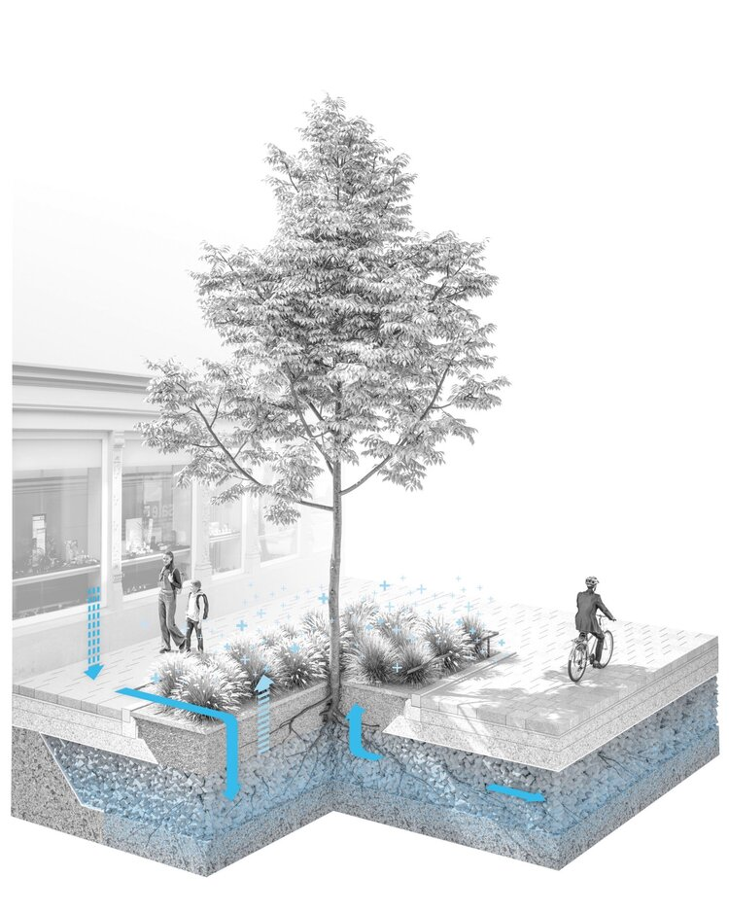
Structural soil substrates
Special urban tree substrates
Main functions:
Extended rooting space for urban trees under sealed surfaces
Nature-based-solution for urban rainwater management
Zeiser et al., 2021; Grimm et al., 2021
3:0 Landschaftsarchitektur
Introduction
Objectives
Methods
Results
Conclusions

Slide 3
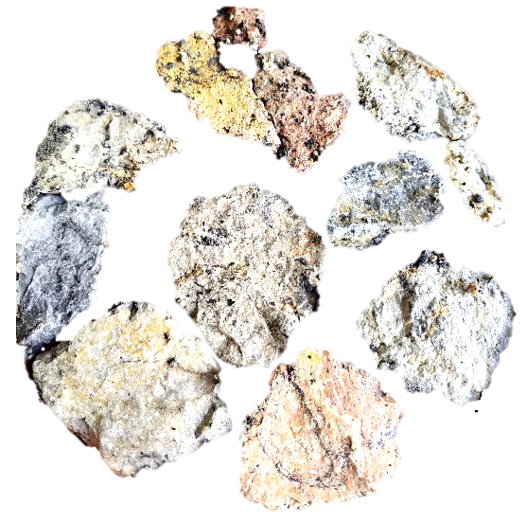
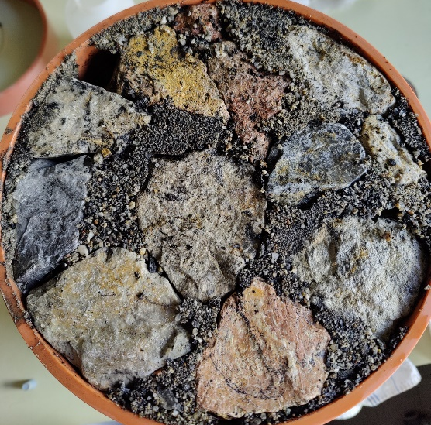
Structural soil substrates
Substrate components:
Coarse gravel (ensuring load bearing capacity)
Fine growing substrate (functioning as rooting space)
Zeiser et al., 2021; Grimm et al., 2021
3:0 Landschaftsarchitektur
Introduction
Objectives
Methods
Results
Conclusions

Slide 4
Structural soil substrates
Water capacity
Hydraulic conductivity
Air capacity
3:0 Landschaftsarchitektur
Introduction
Objectives
Methods
Results
Conclusions

Slide 5
Laboratory method
Phase 1:
Saturation & Free Drainage
Phase 2:
Multi-Step-Outflow
Phase 3:
Evaporation
Introduction
Objectives
Methods
Results
Conclusions

Slide 6
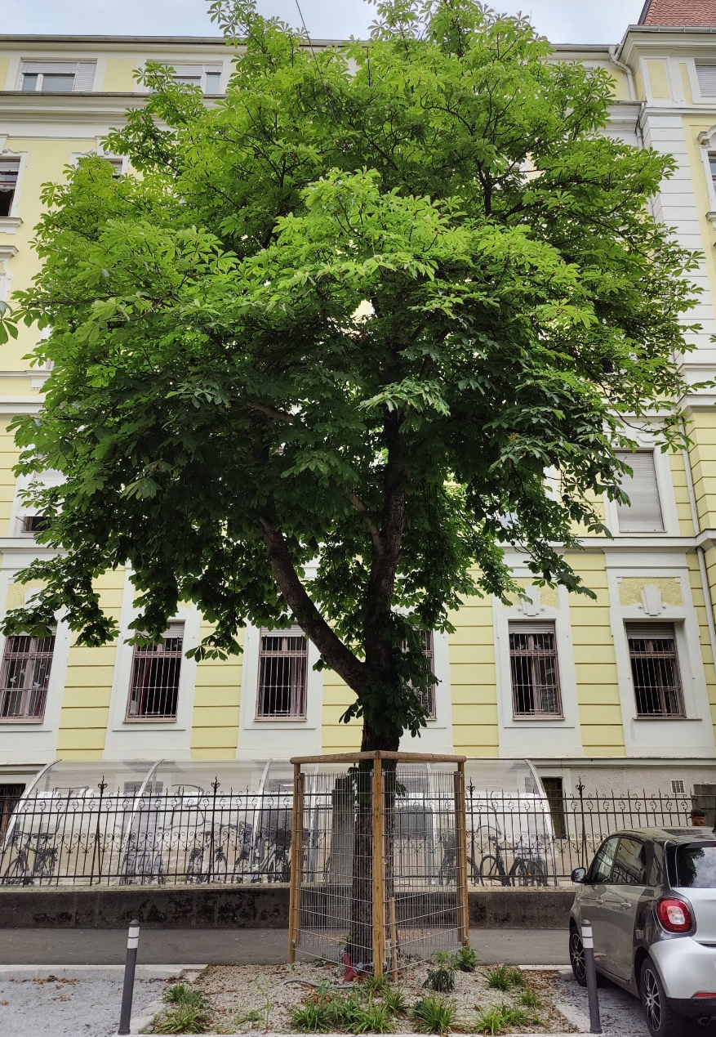
Urban trees
Ecosystem services:
Cooling through shading and transpiration
Carbon sequestration
etc.
Moser-Reischl et al., 2017
To fulfill ecosystem services properly, urban trees must be:
vital
able to grow old
Brandenburg et al., 2015
Introduction
Objectives
Methods
Results
Conclusions

Slide 7
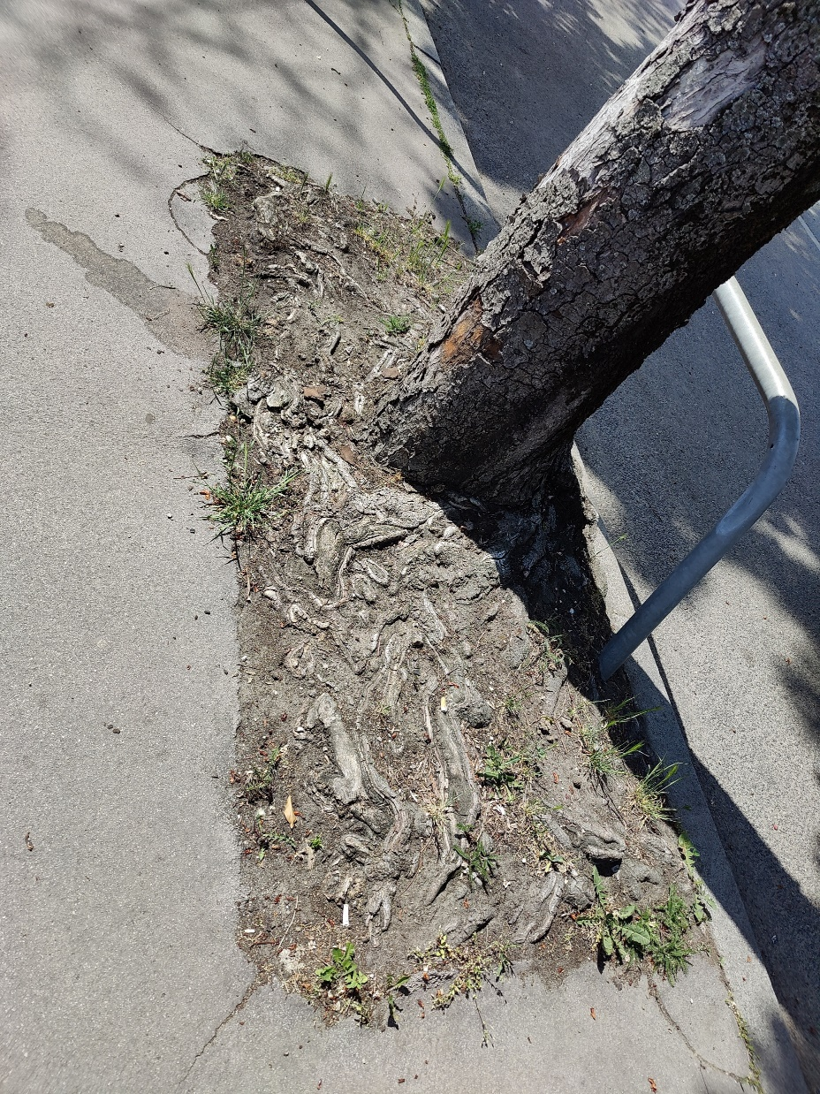
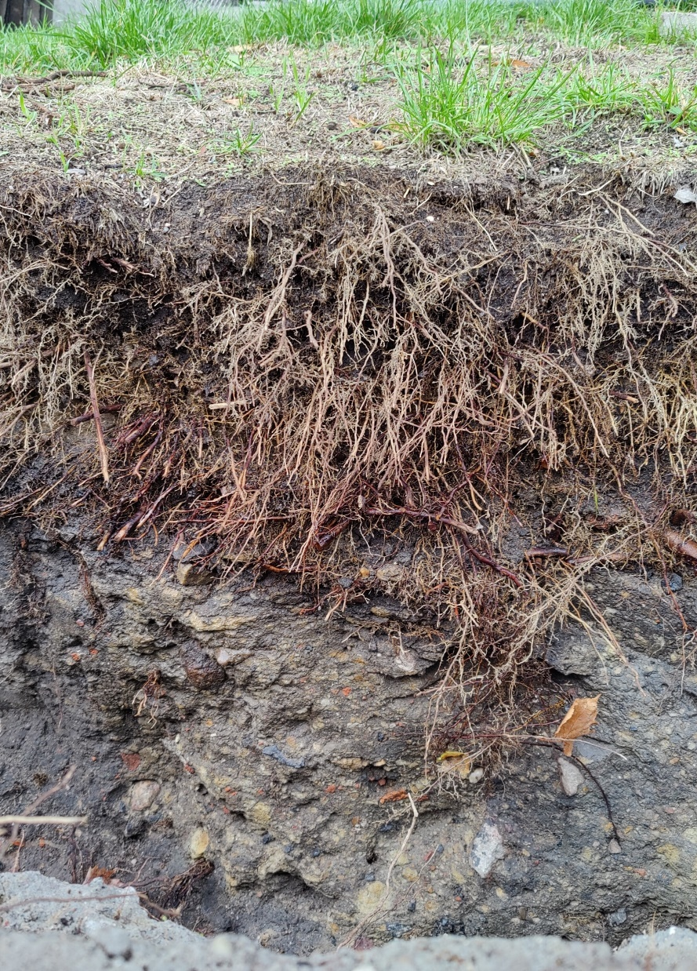
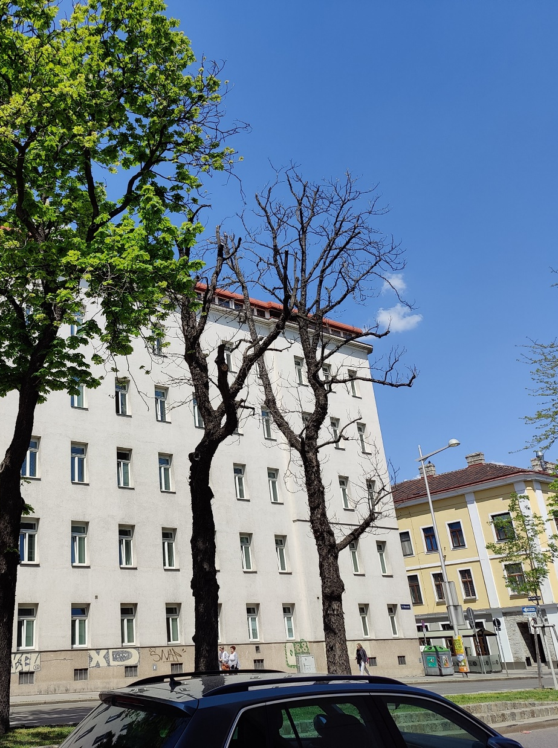
Challenges for urban trees
Low life expectancy in cities
Reasons:
Urban-Heat-Island-Effect
Limited rooting space
Soil sealing
Soil compaction
etc.
Roloff & Kehr, 2013
Brandenburg et al., 2015; Benk et al., 2020
Introduction
Objectives
Methods
Results
Conclusions

Slide 8
Structural soil substrates
3
USA: Structural soils – since 1990s
Sweden: Stockholm system – since 2009
Austria: Sponge city substrate for urban trees – since 2018
Special urban tree substrates under sealed surfaces (streets, pavements etc.)
Systems for stormwater retention and infiltration
Air- or water-filled pores
Fine growing substrate
Coarse gravel
Contact points (load distribution)
Bassuk et al., 2015; Embrén et al., 2009; Grimm et al. 2021
Introduction
Objectives
Methods
Results
Conclusions

Slide 9
Structural soil substrates
Substrate components:
Coarse gravel
ensures load bearing capacity
stable pore volume
Granite or dolomite
Grain size between 3 and 15 cm (in Austria 9 to 15 cm)
Fine growing substrate
Rooting space
Certain storage capacity for water and nutrients
Flushed into the voids of coarse gravel
In Austria mostly Sand (0/4 mm) with compost and biochar
Zeiser et al., 2021; Grimm et al., 2021; Murer, 2022
3:0 Landschaftsarchitektur
Introduction
Objectives
Methods
Results
Conclusions

Slide 10
Structural soil substrates
Main goal: developing a lab method to determine
retention capacities at different matric potential states
saturated hydraulic conductivity
total pore volume
3:0 Landschaftsarchitektur
Introduction
Objectives
Methods
Results
Conclusions

Slide 11
Laboratory method
Phase 1:
Saturation & Free Drainage
Phase 2:
Multi-Step-Outflow
Phase 3:
Evaporation
Saturated hydraulic conductivity
Total pore volume
Water capacity after 2 hours of free drainage
Volumetric water content at matric potential states ranging from -60 to -100 hPa
Volumetric water content at matric potential states ranging from -100 to -700 hPa
Introduction
Objectives
Methods
Results
Conclusions

Slide 12
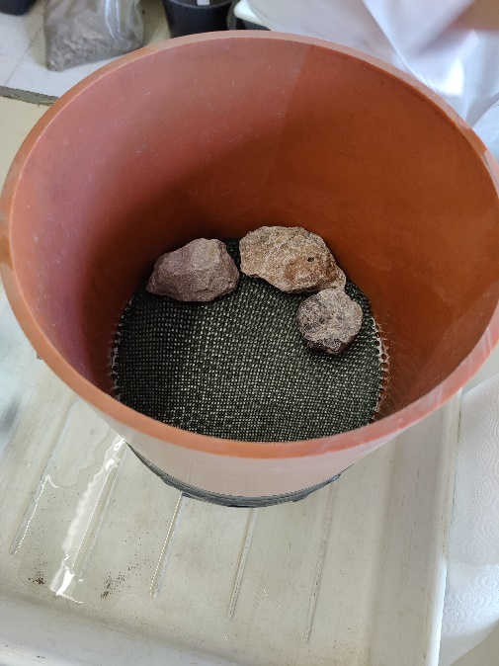
Laboratory method
Sample preparation
Introduction
Objectives
Methods
Results
Conclusions
Conclusions

Slide 13
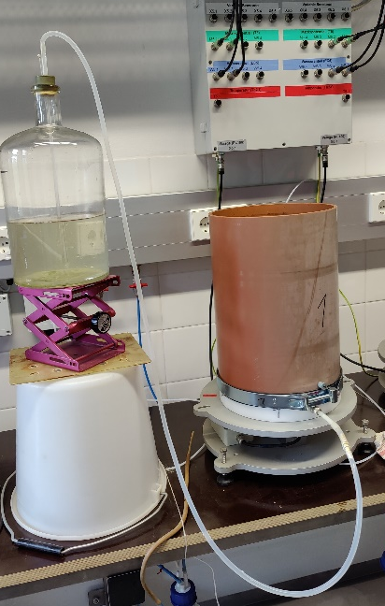
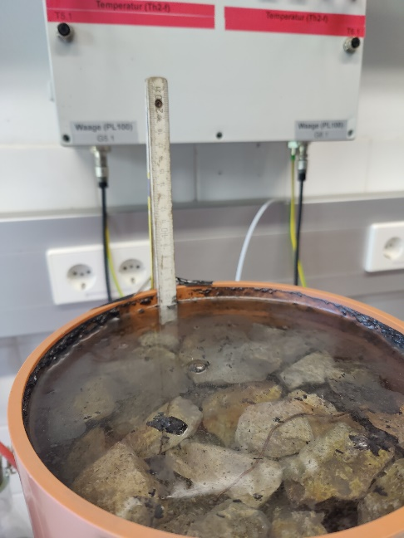
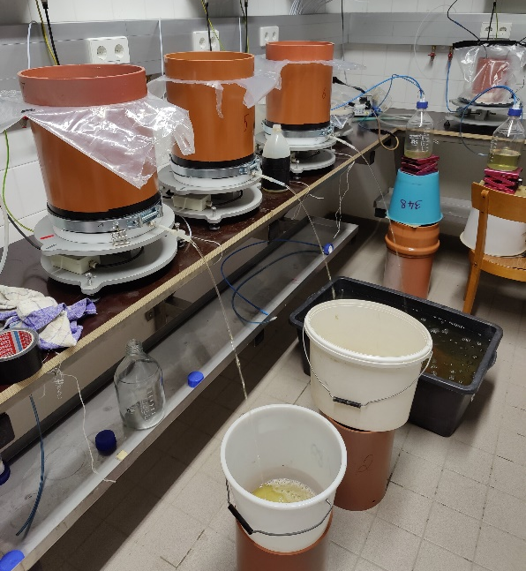
Laboratory method
Phase 1:
Saturation & Free Drainage
Saturated hydraulic conductivity
Total pore volume
Water capacity after 2 hours of free drainage
Introduction
Objectives
Methods
Results
Conclusions

Slide 14
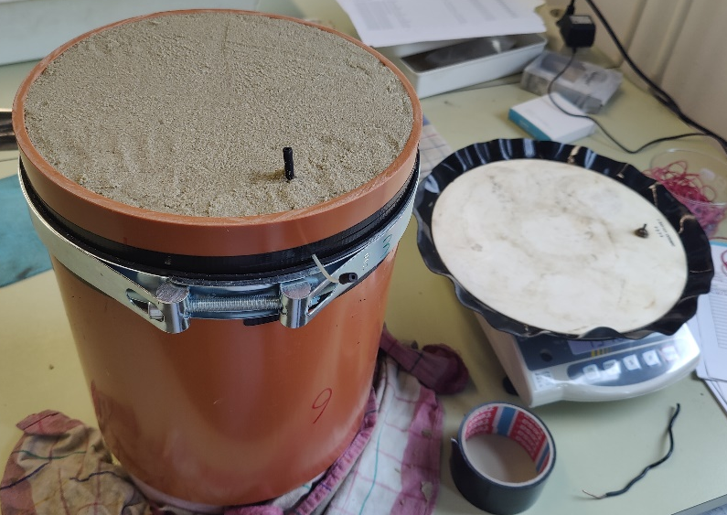
Laboratory method
Phase 2:
Multi-Step-Outflow
Volumetric water content at matric potential states ranging from -60 to -100 hPa
Introduction
Objectives
Methods
Results
Conclusions

Slide 15
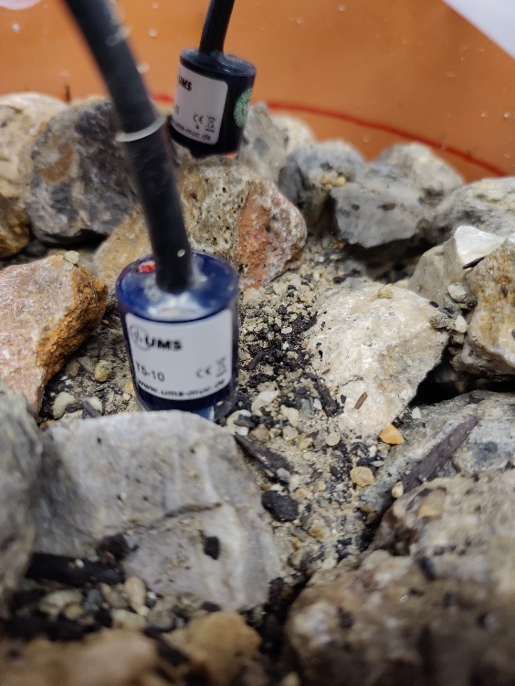
Laboratory method
Phase 3:
Evaporation
Volumetric water content at matric potential states ranging from -100 to -700 hPa
Introduction
Objectives
Methods
Results
Conclusions

Slide 16
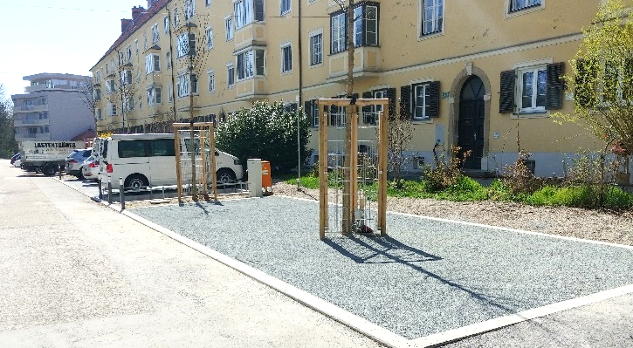
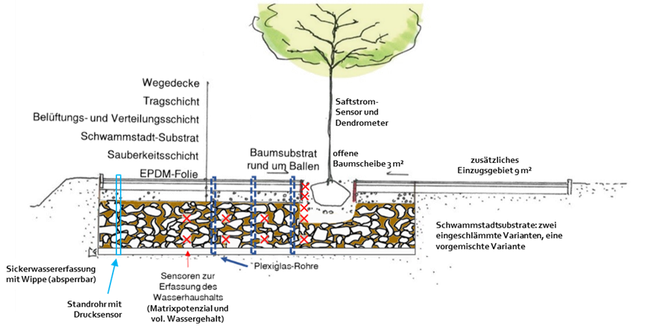
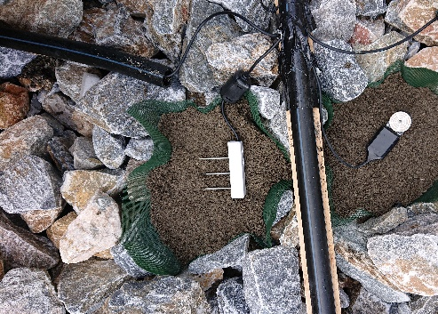
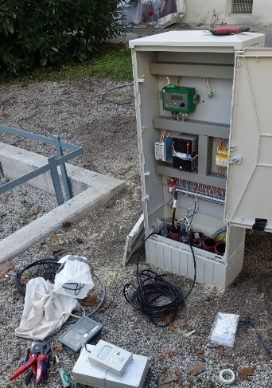
Connected field monitoring sites
Open air laboratory, Graz
Street tree lysimeters, Vienna
Introduction
Objectives
Methods
Results
Conclusions

Slide 17
First results
Hydrological properties of structural soil substrates with growing substrates A (sand, compost, biochar, silt) and B (sand, compost, biochar) flushed into 25% of volume constantly.
Abbreviations:
BD = bulk density,
K_{s} = saturated hydraulic conductivity,
TPV = total pore volume,
WC_{2h} = water capacity after 2 h drainage,
AC_{2h} = air capacity after 2h draining,
WC_{1.8} = water capacity at pF = 1.8,
AC_{1.8} = air capacity at pF = 1.8,
CV = coefficient of variance (CV = standard deviation / mean).
Significant differences between growing substrates were calculated by two-sided Student´s t-test at significance level α = 0.05.
growing substrate |  | BD | K_{s} | TPV | WC_{2h} | AC_{2h} | WC_{1.8} | AC_{1.8}
 |  | g cm⁻³ | m d⁻¹ | cm³ cm⁻³ | cm³ cm⁻³ | cm³ cm⁻³ | cm³ cm⁻³ | cm³ cm⁻³
 | A | 1,98 | 20,8 | 21,7 | 9,8 | 12,0
 | A | 1,98 | 29,3 | 21,0 | 10,2 | 10,8
 | A | 1,98 | 33,8 | 23,1 | 10,3 | 12,8
 | A | 1,94 | 24,7 | 25,3 | 11,6 | 13,6 | 5,9 | 19,4
 | A | 1,99 | 22,8 | 26,1 | 14,3 | 11,8 | 4,7 | 21,4
 | B | 2,02 | 23,1 | 24,0 | 11,5 | 12,6
 | B | 2,04 | 23,8 | 23,2 | 11,6 | 11,7
 | B | 2,01 | 42,2 | 25,1 | 9,9 | 15,2 | 6,4 | 18,7
 | B | 2,01 | 39,8 | 25,9 | 9,7 | 16,2
 | B | 2,02 | 48,7 | 26,3 | 9,4 | 16,9 | 7,5 | 18,9
mean | A,B | 2,00 | 30,88 | 24,2 | 10,8 | 13,35 | 6,3 | 18,3
mean | A | 1,97 | 26,3 | 23,5 | 11,2 | 12,2 | 5,7 | 17,8
 | B | 2,02 | 35,5 | 24,9 | 10,4 | 14,5 | 6,9 | 18,8
standard deviation | A | 0,019 | 5,23 | 2,21 | 1,84 | 1,07 | 0,57 | 2,62
 | B | 0,011 | 11,51 | 1,29 | 1,03 | 2,29 | 0,76 | 0,14
CV | A | 0,010 | 0,20 | 0,09 | 0,16 | 0,09 | 0,10 | 0,15
 | B | 0,005 | 0,32 | 0,05 | 0,10 | 0,16 | 0,11 | 0,01
significant difference | Yes/No | Y | N | N | N | N | N | N
Introduction
Objectives
Methods
Results
Conclusions

Slide 18
First results
Percolating water (pF < 1,8)
Plant available water (pF = 1,8 to 4,2)
Bonded water (pF > 4,2)
Introduction
Objectives
Methods
Results
Conclusions

Slide 19
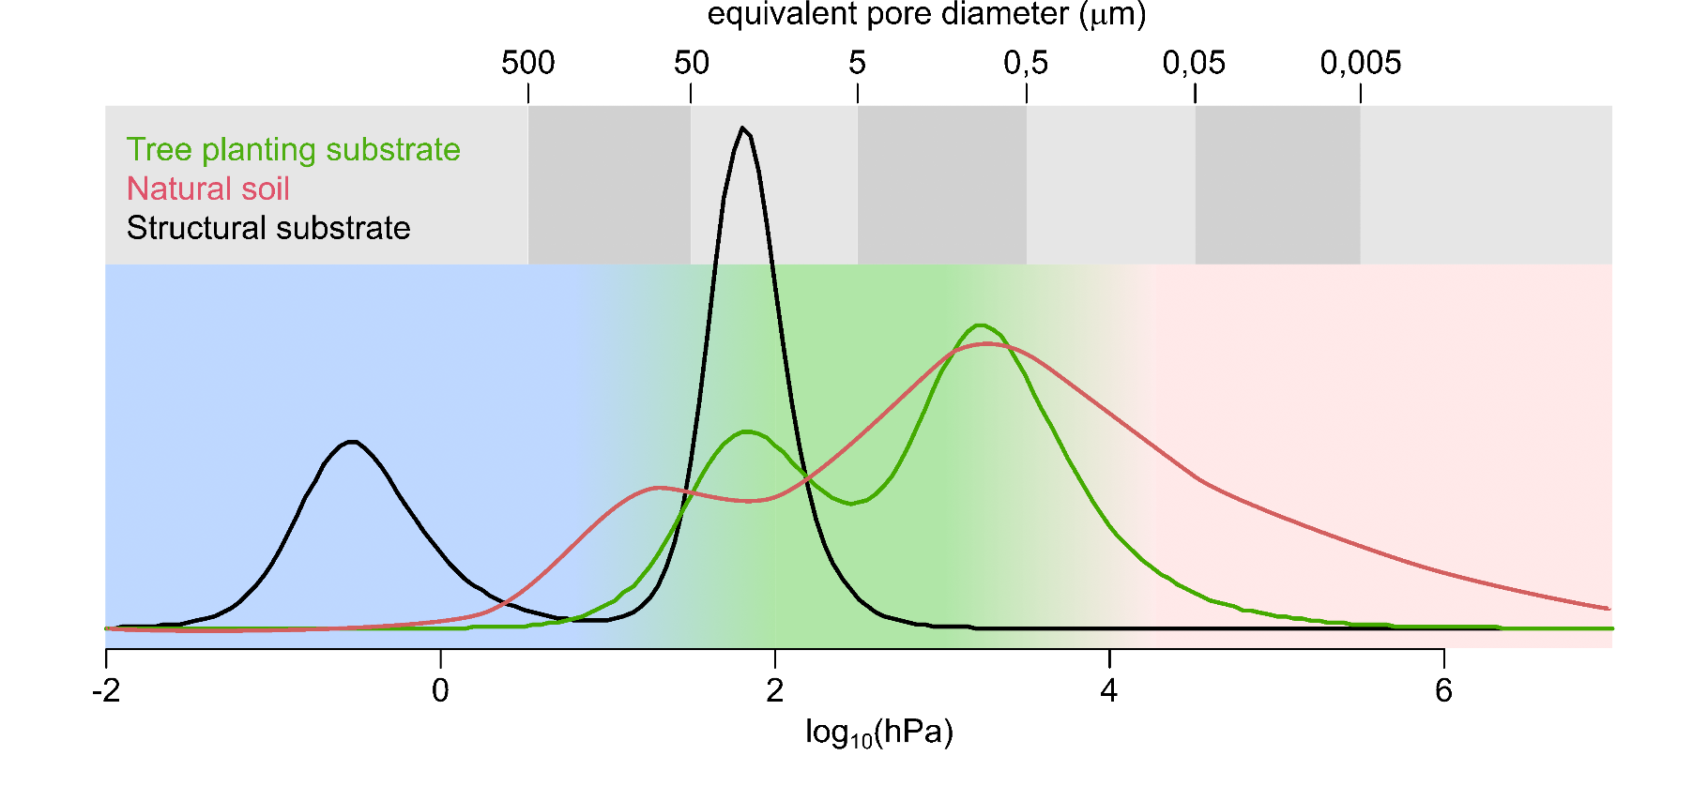
First results
Percolating water (pF < 1,8)
Plant available water (pF = 1,8 to 4,2)
Bonded water (pF > 4,2)
Introduction
Objectives
Methods
Results
Conclusions

Slide 20
Conclusions and Outlook
This study represents a first step for developing appropriate methodology for a practicable hydrological characterization of structural substrates for urban tree sites. Several theoretical and methodological questions were solved, multiple others came up in the study and therefore remain open.
Further results from already established monitoring field sites will improve knowledge. In this study, the focus was on testing and progressing methodology which is broadly applicable in engineering practice.
Open question: selection of appropriate model(s) for parametric hydraulic characterization and modeling; e.g. dual-porosity, dual-permeability, gravity-driven module …?
Introduction
Objectives
Methods
Results
Conclusions

Slide 21
References
3:0 Landschaftsarchitektur. (n.d.). Das Schwammstadt-Prinzip für Bäume. Retrieved from: https://www.schwammstadt.at/. 10.8.2022.
Bassuk, N., Denig, B. R., Haffner, T., Grabosky, J., Trowbridge, P. (2015). CU-Structural Soil - A Comprehensive Guide. Ed. Denig, B. R. Urban Horticulture Institute, Cornell University. Retrieved from: http://www.hort.cornell.edu/uhi/outreach/pdfs/CU-Structural%20Soil%20-%20A%20Comprehensive%20Guide.pdf. 9.3.2022.
Benk, J., Artmann, S., Kutscheidt, J., Müller-Inkmann, M., Streckenbach, M., Weltecke, K. (2020). Praxishandbuch Wurzelraumansprache. Möhnesee: Arbeitskreis Baum im Boden.
Brandenburg, C., Damyanovic, D., Reinwald, F., Allex, B., Gantner, B., Czachs, C. (2015). Urban Heat Islands. Strategieplan Wien. Vienna: Magistrat der Stadt Wien, Umweltschutzabteilung - MA 22. Retrieved from: https://www.wien.gv.at/umweltschutz/raum/uhi-strategieplan.html. 26.3.2022.
Grabosky, J., Haffner, E. & Bassuk, N. (2009). Plant Available Moisture in Stone-soil Media for Use Under Pavement While Allowing Urban Tree Root Growth. Arboriculture & Urban Forestry, 35 (5): 271–278. doi:10.48044/jauf.2009.041.
Grimm, K., Murer, E., Schmidt, S. (2021). Das Schwammstadtprinzip für Stadtbäume in Österreich. Entstehung, Funktionsweise, Herausforderungen, Umsetzungen. Schwammstadt - Versickerung 2.0? (S. 51–55). Conference paper from Aqua Urbanica 2021, Innsbruck: Österreichischer Wasser- und Abfallwirtschaftsverband (ÖWAV).
Moser-Reischl, A., Rötzer, T., Pauleit, S. (2017). Stadtbäume: Wachstum, Funktionen und Leistungen – Risiken und Forschungsperspektiven. ALLGEMEINE FORST UND JAGDZEITUNG, 188 (5–6): 94–111. doi:10.23765/afjz0002006.
Murer, E. (2022, March 15). Schwammstadt für Stadtbäume. Erfahrungen & Herausforderungen. PowerPoint-Präsentation at Workshop Jägerhausgasse, Vienna.
Roloff, A., Kehr, R. (2013). Bäume in der Stadt: Besonderheiten - Funktion - Nutzen - Arten - Risiken ; 12 Tabellen. Stuttgart (Hohenheim): Ulmer.
Rose, B. (2020). Tree Pits with Structural Soils - Practice Note (Version 1.2). Retrieved from: https://www.researchgate.net/publication/341343983_Tree_Pits_with_Structural_Soils_-_Practice_Note_Version_12. 16.12.2022.
Zeiser, A., Murer, E., Schmidt, S., Kumpan, M., Strauss, P., Weninger, T. (2021). Schwammstadt für Stadtbäume. Funktionsorientierte Substratentwicklung am Beispiel des multifunktionalen Wurzelraums. Schwammstadt - Versickerung 2.0? (S. 92–96). Conference paper from Aqua Urbanica 2021, Innsbruck: Österreichischer Wasser- und Abfallwirtschaftsverband (ÖWAV).
Introduction
Objectives
Methods
Results
Conclusions

