Slide 1
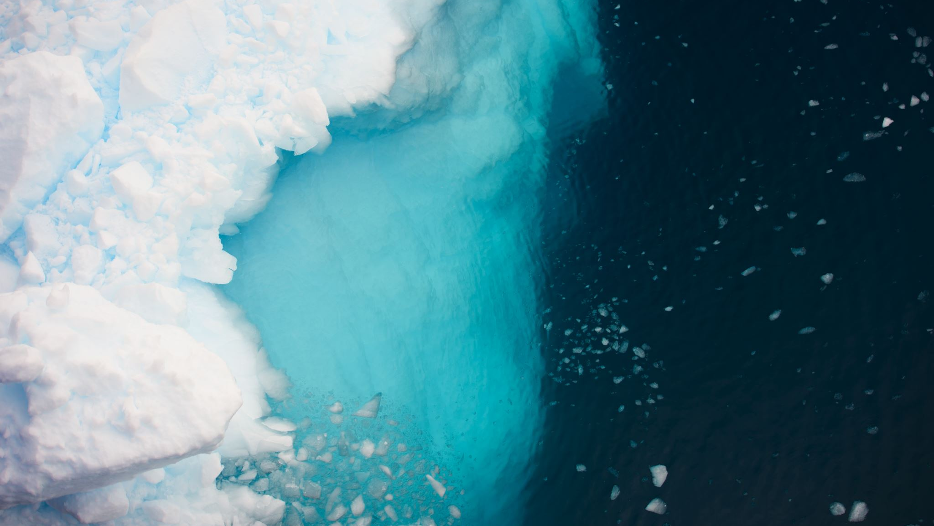
The Partitioning Processes of Sea Ice Associated Marine Ice Nucleation Particles Impacting the Arctic Clouds
Lasse Z. Jensen^{1,2,3}, Eva R. Kjærgaard⁶, Luisa Ickes, Maria E. Cifarelli¹, Rosella Di Pompeo¹, Martina D’Agostino¹, Jennie Spicker Schmidt¹, Corina Wieber¹, Jane T. Skønager⁶, Dorte Søgaard⁵, Bernadette Rosati⁶, Merete Bilde⁶, Lars C. Lund-Hansen^{2,4}, Kai Finster¹, Tina Šantl-Temkiv^{1,2,3}

Slide 2
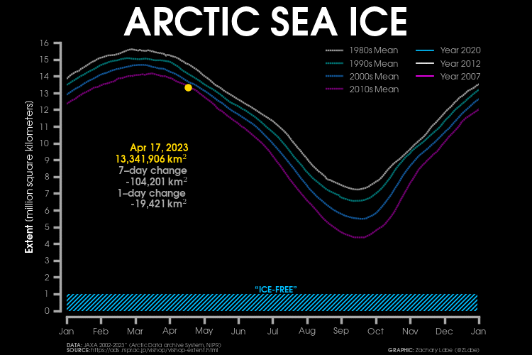

Slide 3
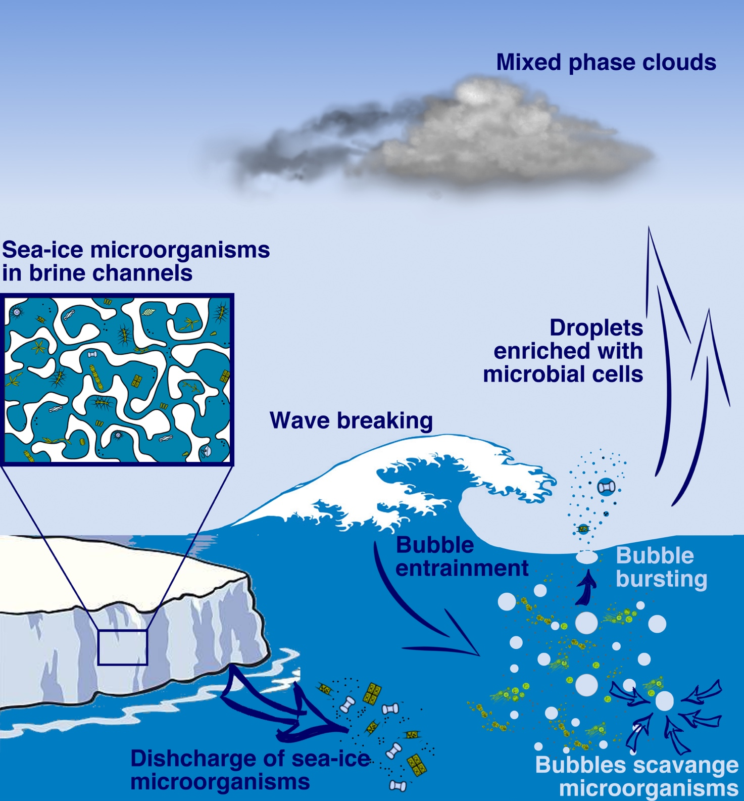
Research questions
Does sea ice act as a reservoir for atmospheric INPs?
Where do the INP come from?
  partitioning vs production
What is the temporal and spatial dynamics of INPs
  In Arctic sea ice?
What is the potential contribution of sea ice to the
atmospheric INP pool in the Arcitc?

Slide 4
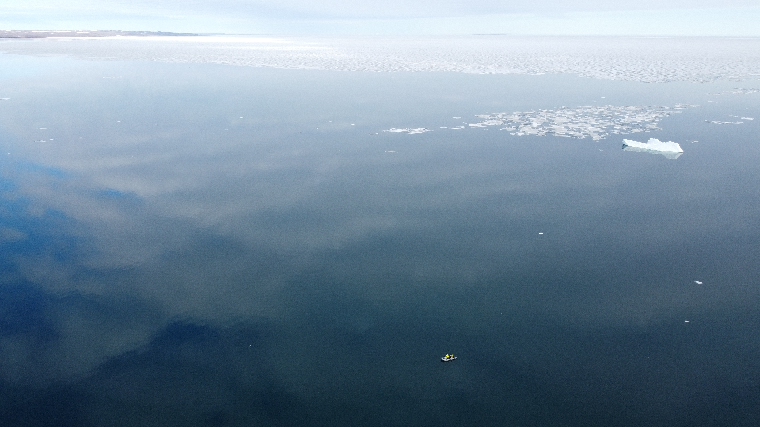

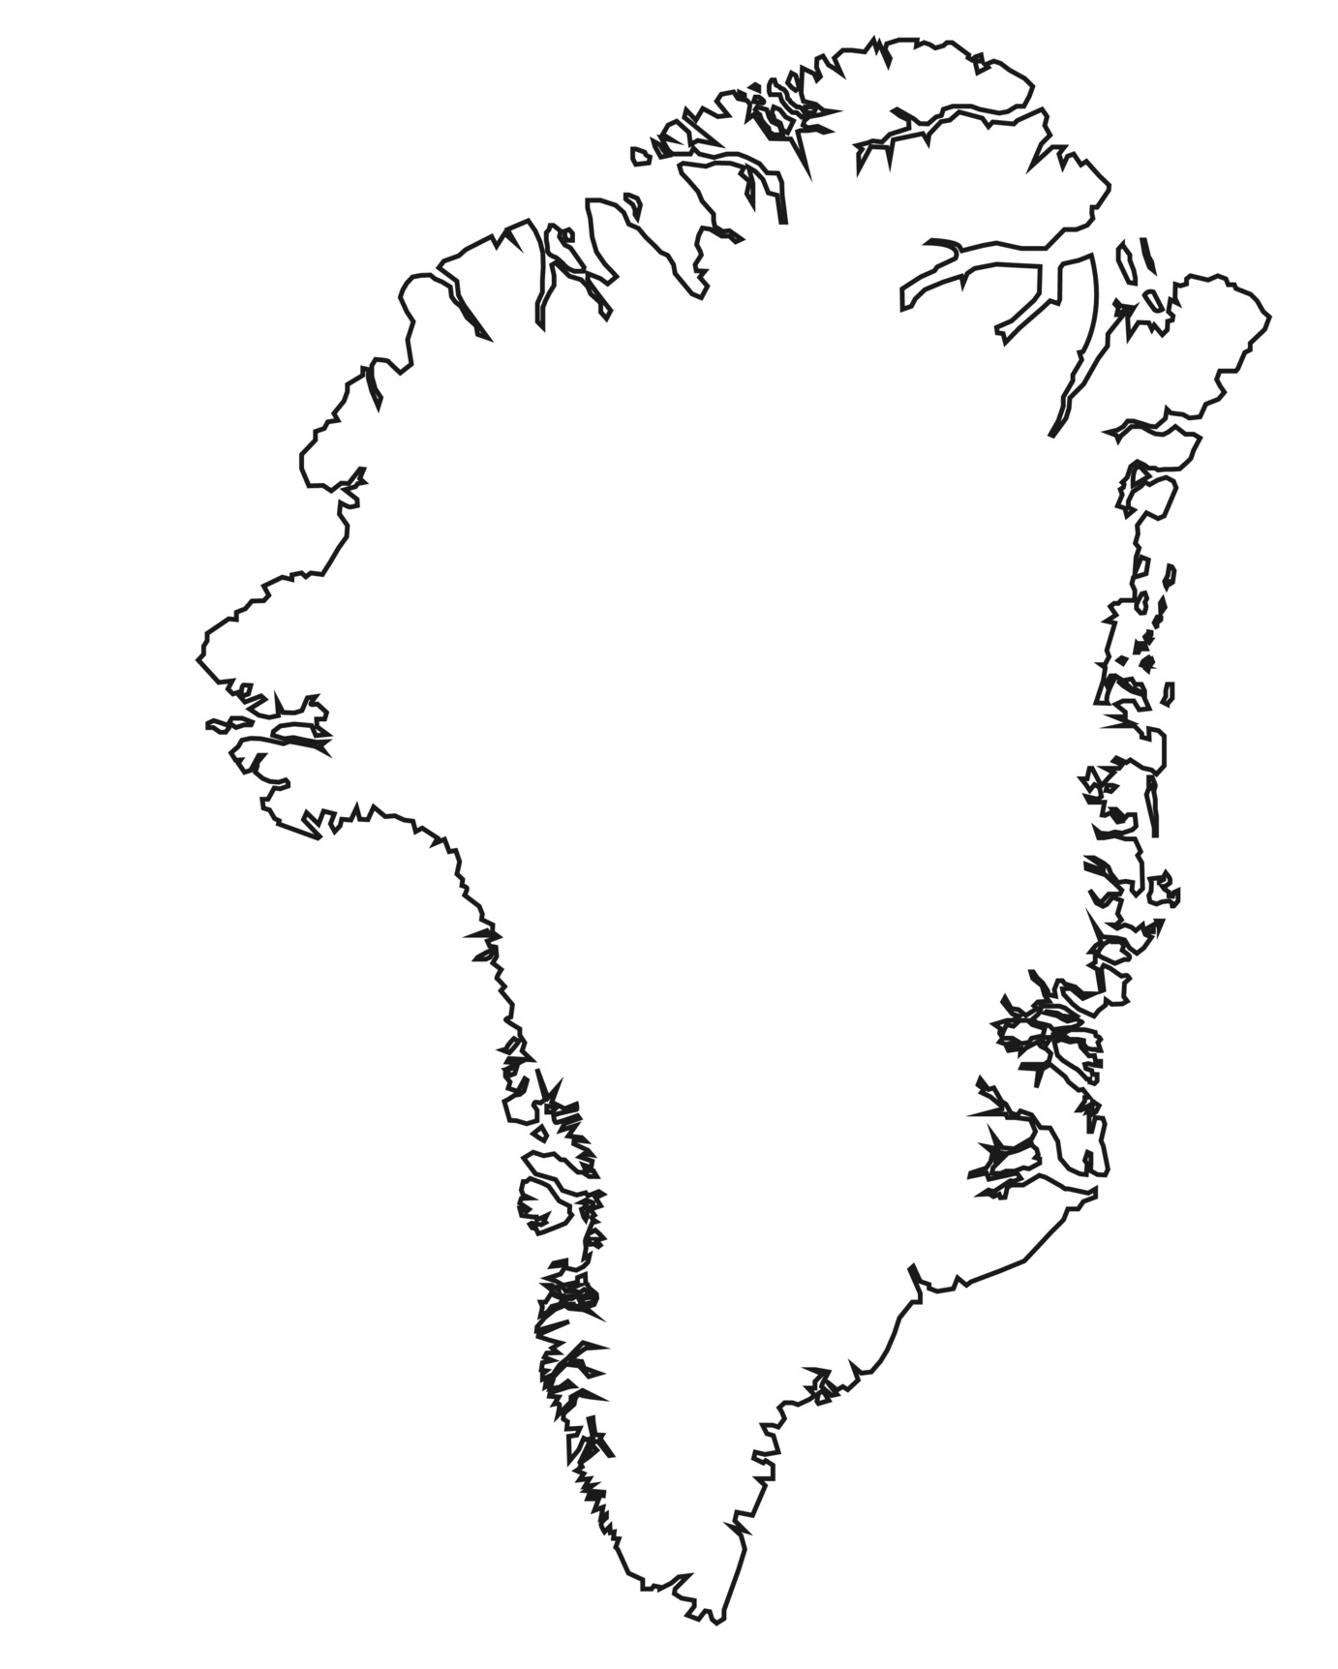
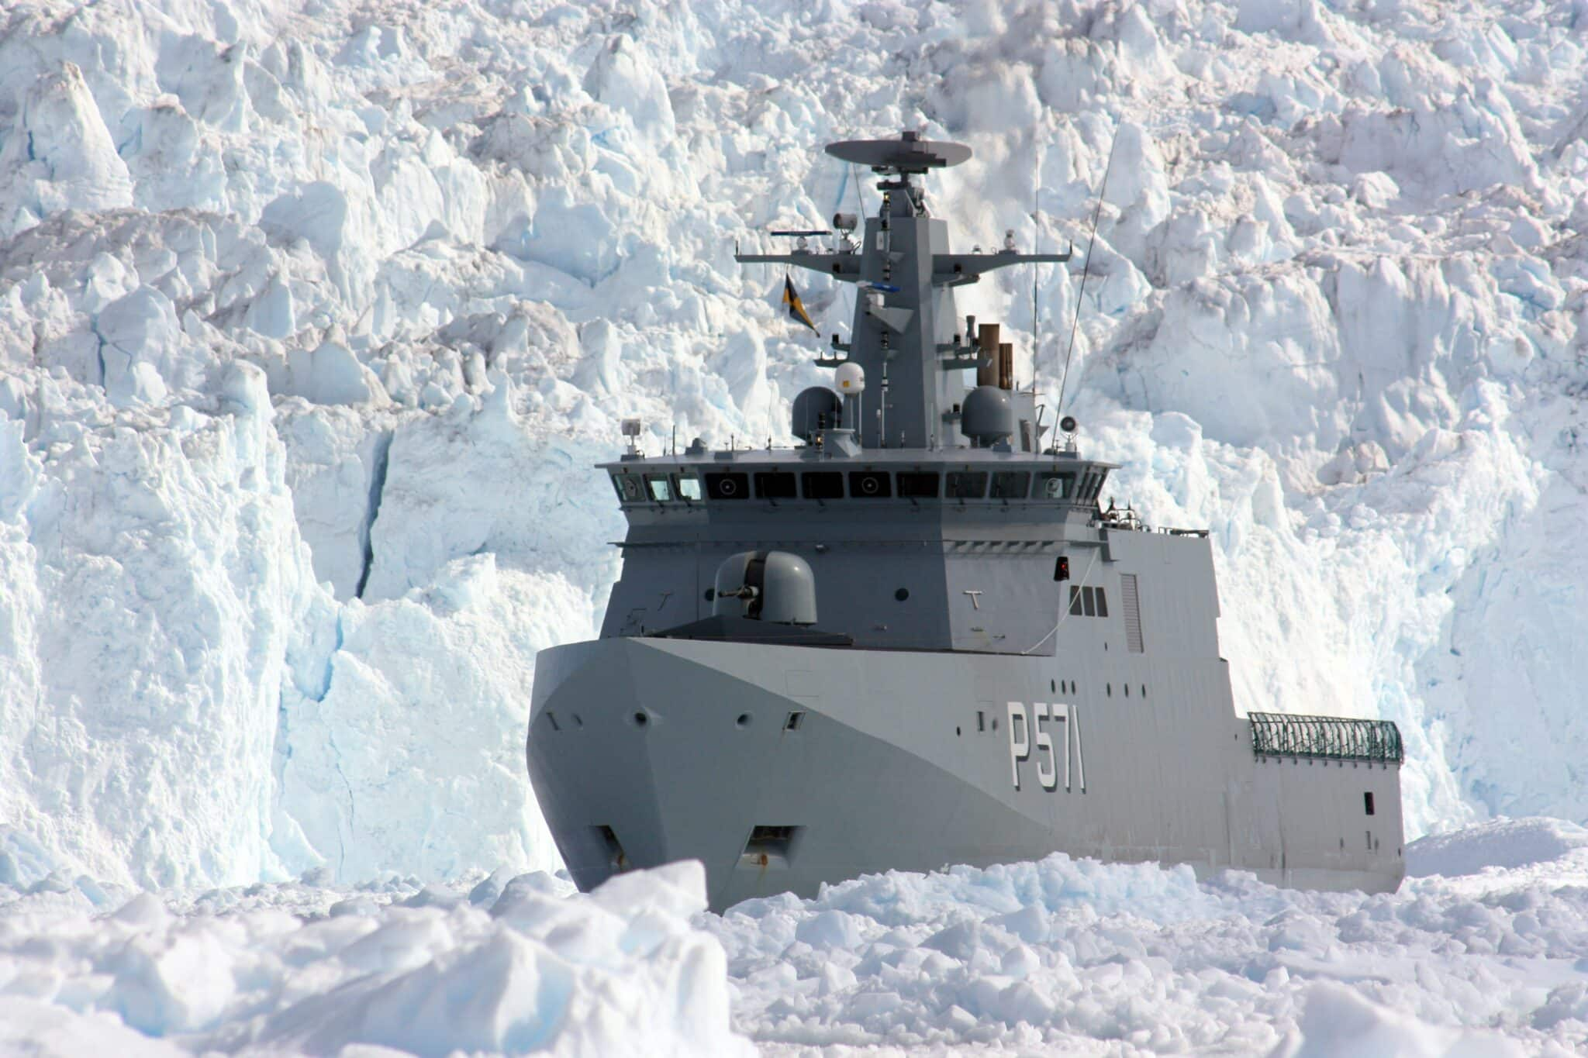
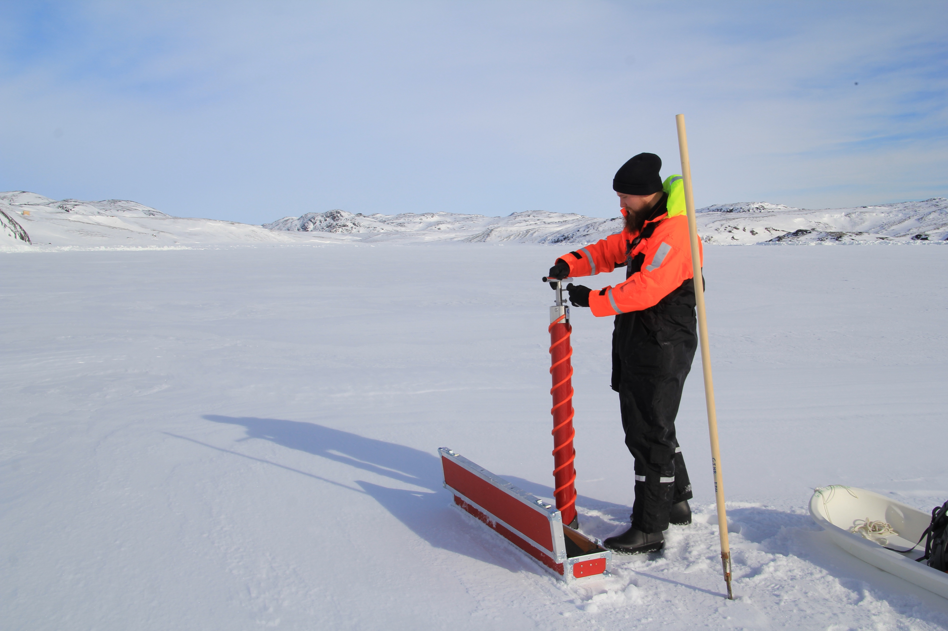
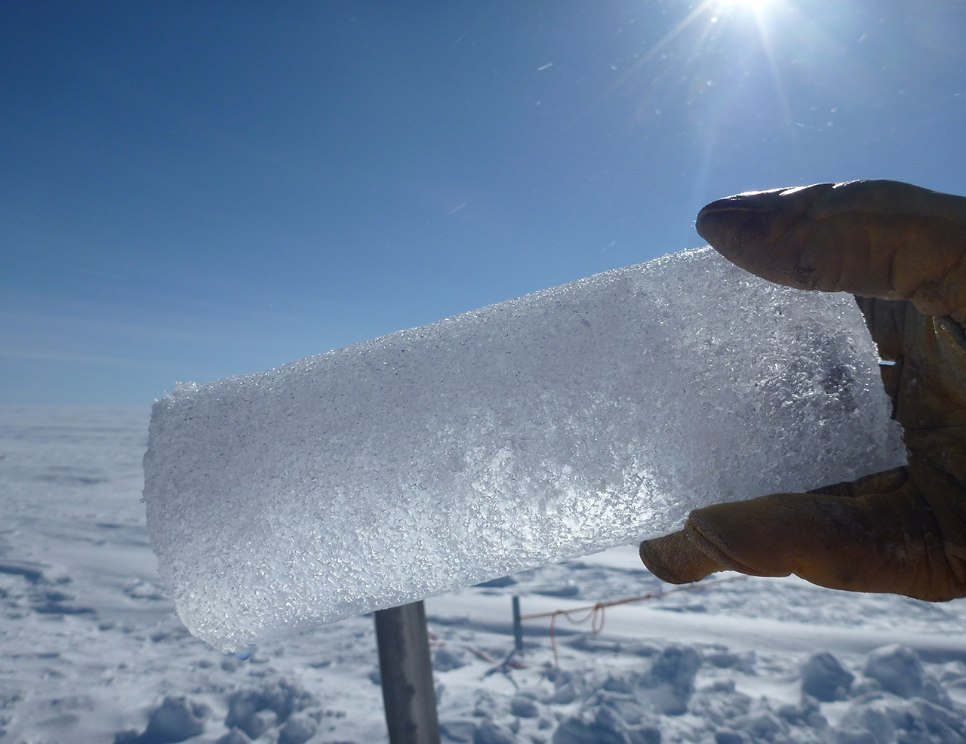
Sample collection
Bulk water samples
Station Nord Summer 2021
Bulk water samples
Baffin bay summer 2016
Sea ice samples and bulk water
Nuuk spring 2022
Sea ice samples
Spring 2016 +2018

Slide 5
Experimental flow
BB – Baffin Bay
STN – Station Nord
SBW – Sea bulk water
Where do the INP come from?
Partitioning or production
What is the potential contribution of sea ice
to the atmospheric INP pool in the Arcitc?
2016 & 2018
Ice cores
Sea ice time series
Nuuk 2022
Modified ice finger
SBW samples BB and Nuuk
Sea spray experiments
Ice cores and SBW from Nuuk and STN
Does sea ice act as a
reservoir for atmospheric INPs?
What is the temporal and spatial dynamics of INPs In Arctic sea ice?

Slide 6
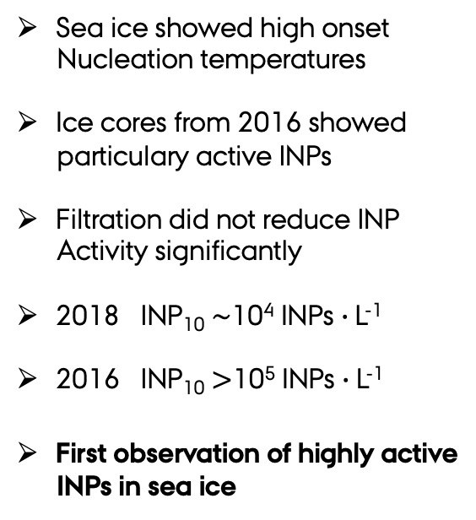
Does Sea ice act as a reservoir for INPs?
Sea ice showed high onset
Nucleation temperatures
Ice cores from 2016 showed
particulary active INPs
Filtration did not reduce INP
Activity significantly
2018 INP₁₀ $\sim$10⁴ INPs $∙$L⁻¹
2016 INP₁₀ $>$10⁵ INPs $∙$L⁻¹
First observation of highly active
INPs in sea ice

Slide 7
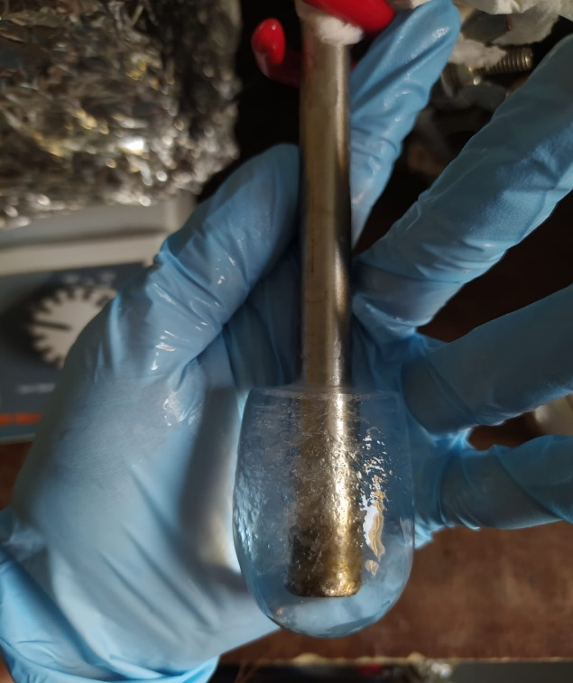
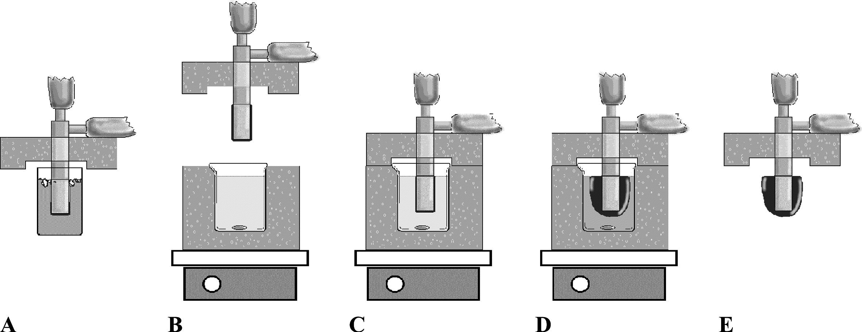
Where do the INPs come from? Partitioning or production
Example of ice
after 4 hours
Modified ice finger with double cooling
Ice finger -10 °C insulation -5 °C
3 SBW samples from Nuuk 2022
4 SBW samples from BB 2016
3 sample types obtained
  T₀ water – Initial samples
  T₁water – after experiment
  T₁Ice – ice melt after experiment
100 mL sample
4 hours
Purification of antifreeze proteins by adsorption to ice - Kuiper et. al. (2003)

Slide 8
Incorporation of INPs in sea ice
Nuuk 2022
No clear preferential partitioning
No clear production based on
microbial activity
INP incorporation could be a stochastic process
Filtration had larger effect on ice samples
  Associated with microorganisms
  Bound to EPS → Sticky
  Aggregation
Why is the INP concentrations higher in sea ice
compared to seawater?
Baffin Bay 2016
EPS – Extracellular polymeric substances

Slide 9
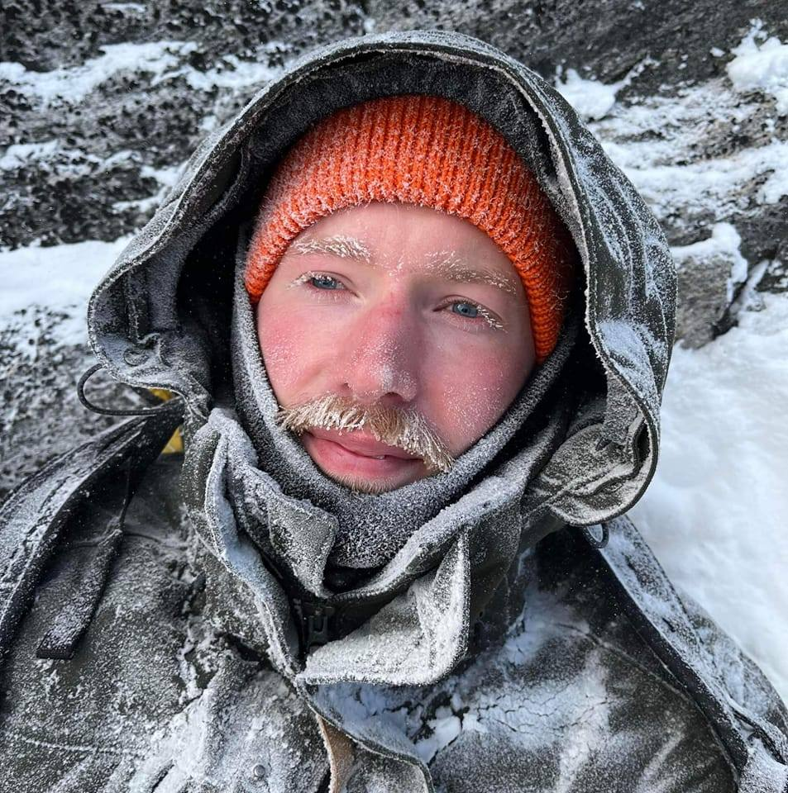
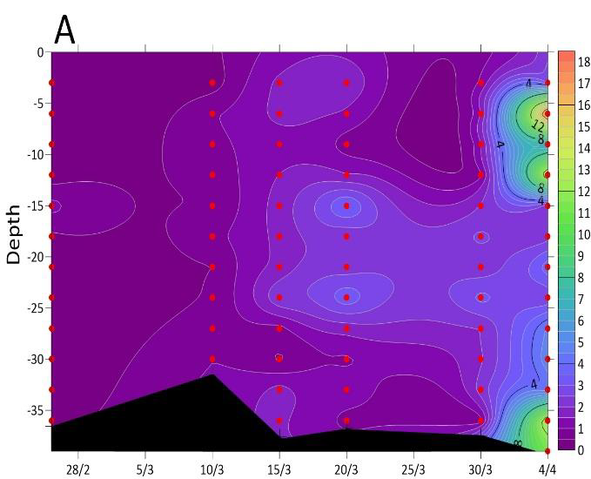
What is the temporal and spatial dynamics of INPs In Arctic sea ice?
4 X cores Nuuk
Ice cores was collected on 5 dates in
March and April following the bloom
Chlorophyll a concentrations increased
with time troughout the cores
Ice core from Maaluto had high
chlorophyll a at the bottom
We measured INP concentrations and
The microbial community abundance and
composition
5 cm
1 x core
Maalutu
30 cm

Slide 10
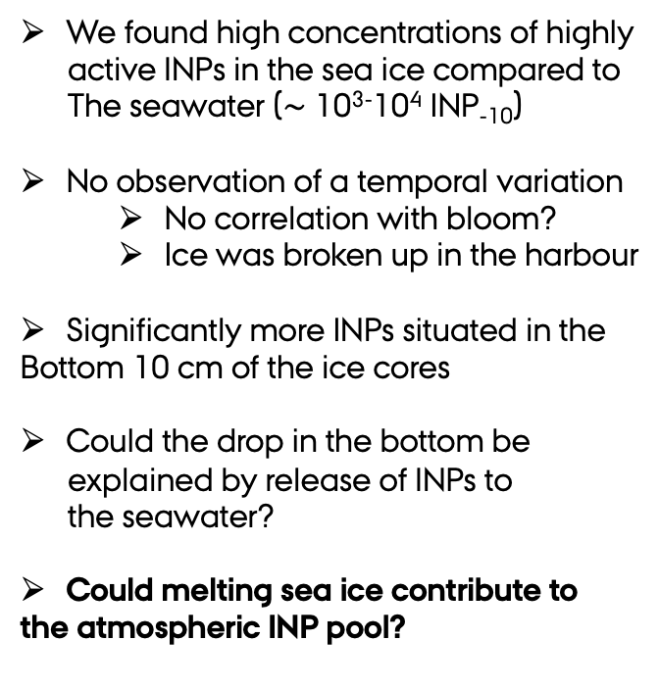
Spatial and temporal variation
We found high concentrations of highly
active INPs in the sea ice compared to
The seawater ($\sim$ 10³⁻10⁴ INP₋₁₀)
No observation of a temporal variation
  No correlation with bloom?
  Ice was broken up in the harbour
Significantly more INPs situated in the
Bottom 10 cm of the ice cores
Could the drop in the bottom be
explained by release of INPs to
the seawater?
Could melting sea ice contribute to
the atmospheric INP pool?

Slide 11
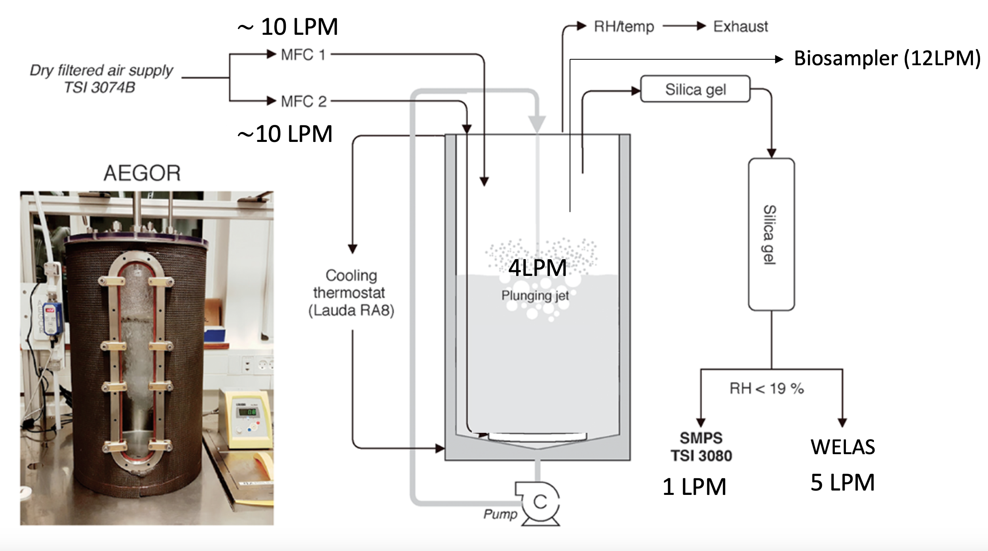
Sea spray experiments
3 x 20 liters of melted sea ice
1 x water under the ice
1 x summer water heavely
influenced by sea ice melt
Run the experiment for 8 hours
Measure INP concentrations

Slide 12
INPS are effeciently aerosolized
Summer
Station Nord
Sea water influenced
by sea ice melt
Spring
Sea ice Maaluto

Slide 13
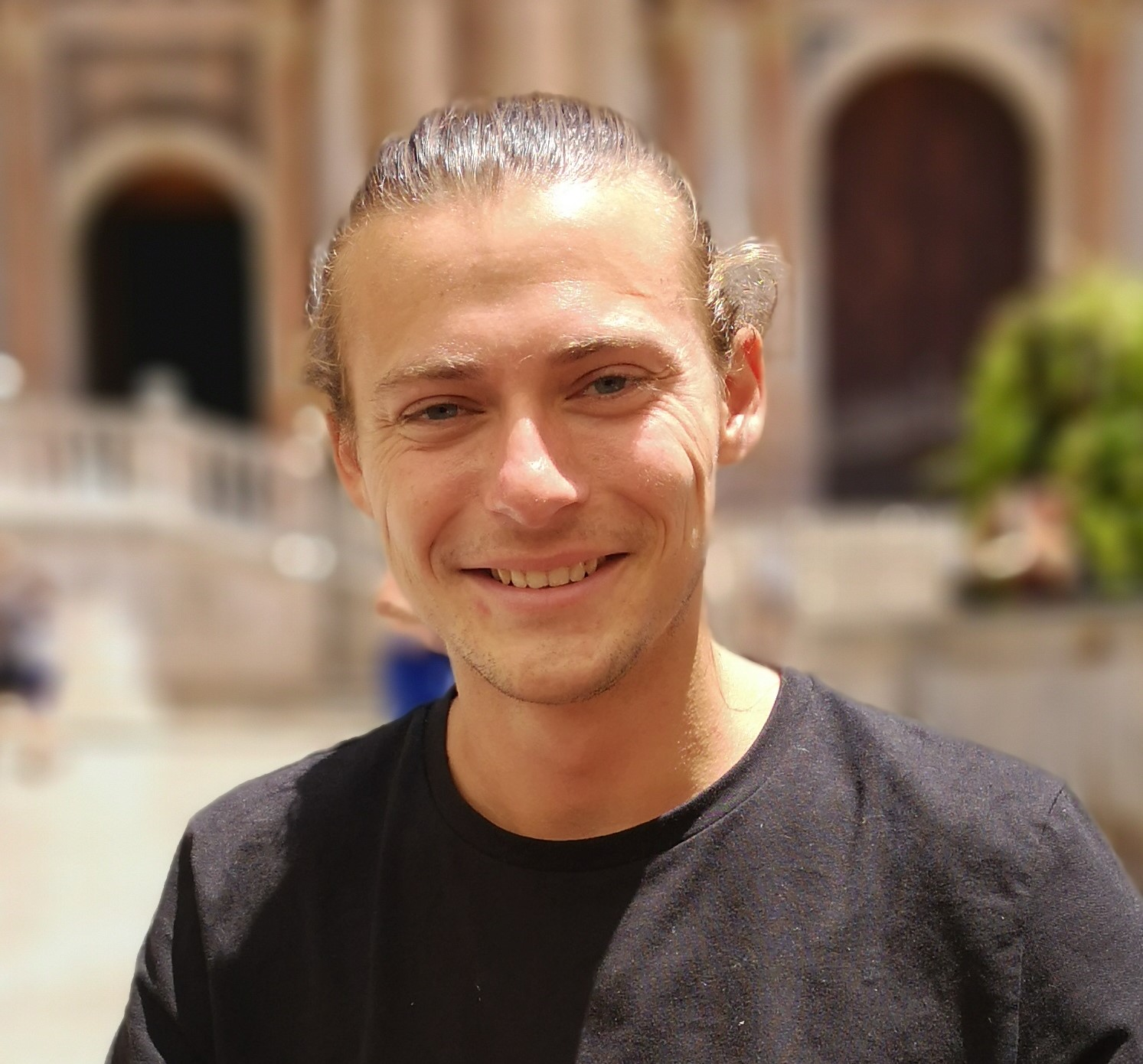
Sea ice associated INPs could have an atmospheric impact
Sea ice acts as a reservoir for INPs
INPs are stochastically incorporated or produced
Within the sea ice
High concentration can’t be explained by
stochastic incoporation
More INPs are situated at the bottom of the sea ice
Preliminary results show high atmospheric concentration
From sea spray experiments
Sea ice INPs are more effeciently aerosolized
Preliminary data fits with other lab experiments
We need to link the microbiology with the data
Station Nord sea water
Maalutu sea ice

Slide 15
