Slide 1
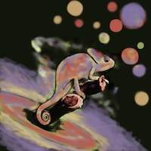
The effect of thermal non-equilibrium on aerosol formation in astrophysical environments
Sven Kiefer
David Gobrecht, Leen Decin, Christiane Helling
This project has received funding from the European Union’s Horizon 2020 research and innovation programme under the Marie Sklodowska-Curie grant agreement no. 860470.

Slide 2
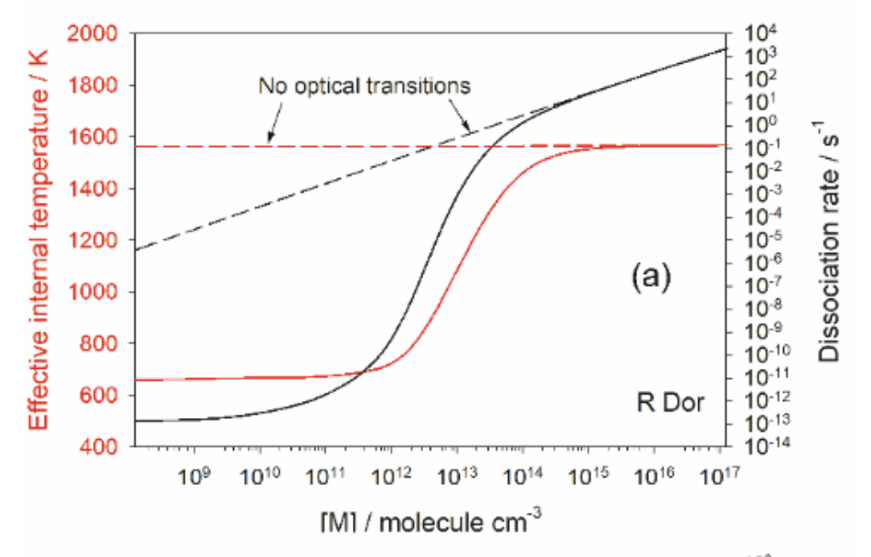
Overview
Plane and Robertson (2022):
Nucleation
equilibrium
Replenishment
Condensation
non-equilibrium
Molecule: OSi(OH)₂
Object: R Dor
H2 concentration [cm⁻³]
Evaporation
Image altered from Plane and Robertson (2022)
Observational evidence:
Fonfría et al. 2008, 2017, 2021
Image altered from Helling (2018)

Slide 3
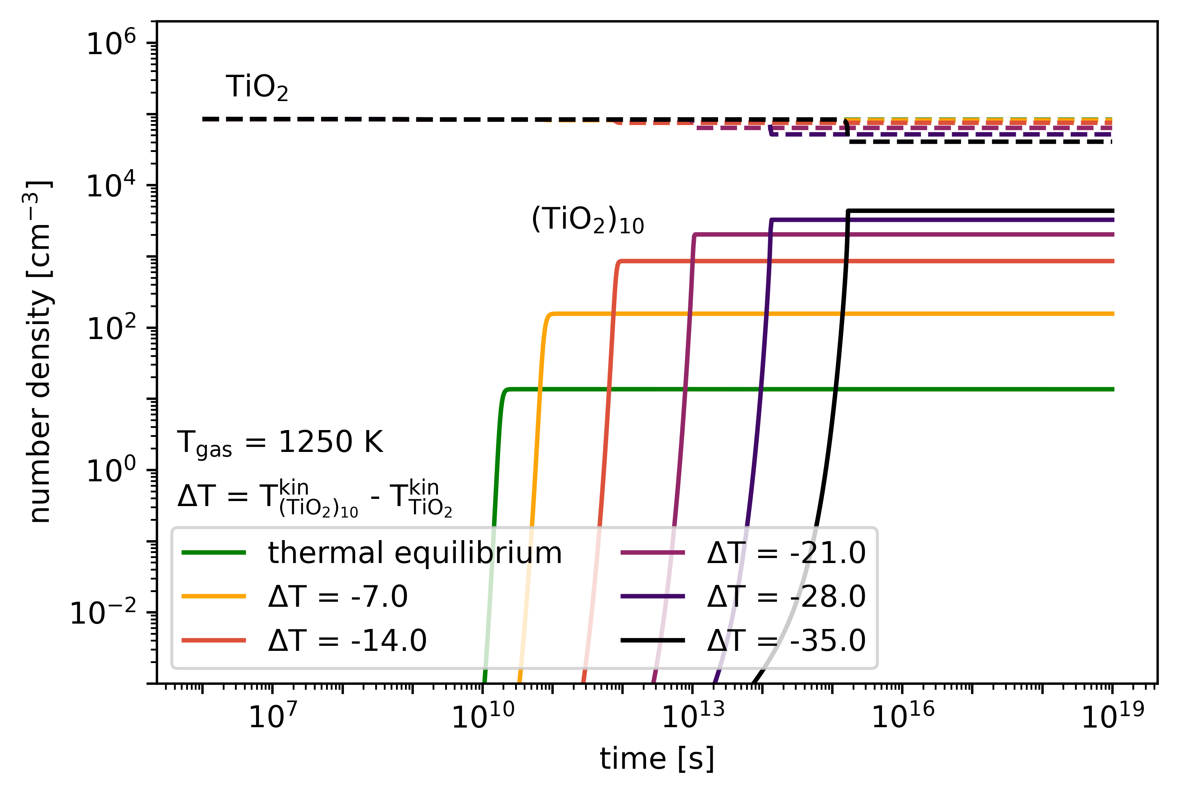
The effect of thermal non-equilibrium
sven.kiefer@kuleuven.be
Kiefersv.github.io
@ExoSvenK
Nucleation is sensitive to thermal non-equilibrium
The type of thermal non-equilibrium present matters
ΔT<0 can increase and ΔT>0 can decrease the amount of clusters
Check out the paper: ”The effect of thermal non-equilibrium on kinetic nucleation” - Kiefer et al. 2023

Slide 4
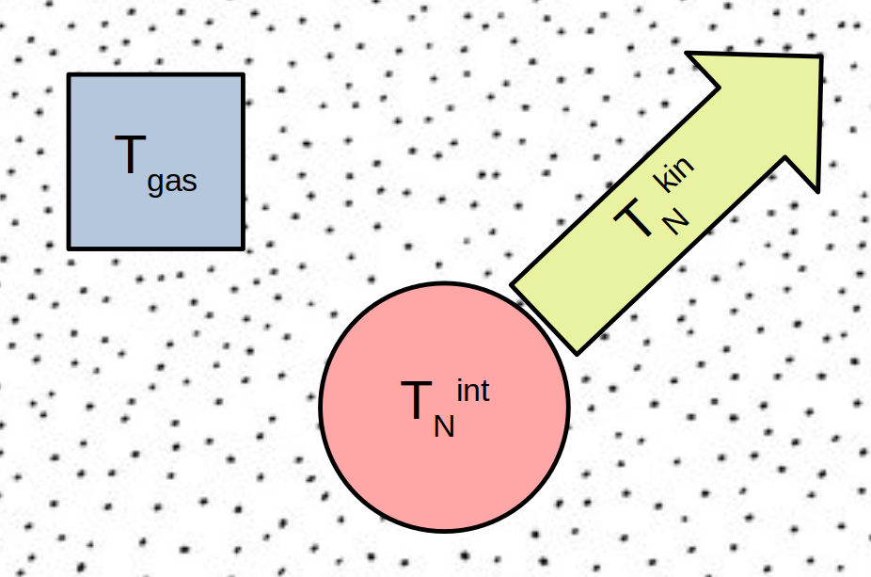
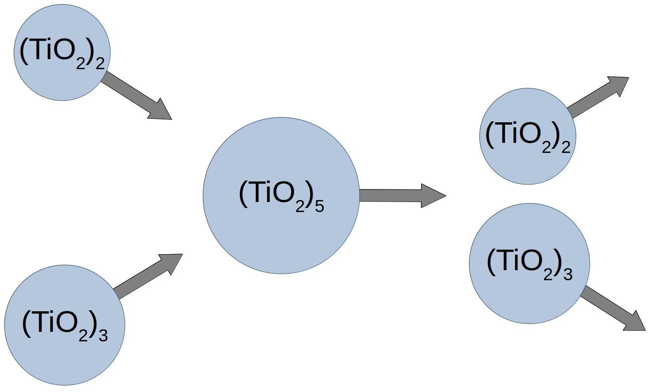
The effect of thermal non-equilibrium on aerosol formation in astrophysical environments Sven Kiefer^{1,2,3,4}, David Gobrecht¹, Leen Decin¹, Christiane Helling^{2,3,4}
Explore our work
30 second summary
About me
Here you can get a small guided tour through the theory behind kinetic nucleation, how thermal non-equilibrium can be described and our results.
Kinetic nucleation theory
Learn how the formation of clusters can be described fully kinetically
Thermal non-equilibrium
Learn where we can observe thermal non-equilibrium and how models describe it.
Results
Check out our results and how we expect thermal non-equilibrium to affect the formation of aerosols.
Cloud formation happens when gas phase species condense onto aerosols. The formation of aerosols, called nucleation, is the transition from gas phase chemistry to solid chemistry.
In this work, we study the impact of thermal non-equilibrium on the kinetic description of nucleation.
Results:
Sven Kiefer
Kiefersv.github.io
@ExoSvenK
Nucleation is sensitive to thermal non-equilibrium
The type of thermal non-equilibrium present matters
ΔT<0 can increase and ΔT>0 can decrease the amount of clusters
Read the paper: ”The effect of thermal
non-equilibrium on
kinetic nucleation”
Thermal non-equilibrium can be caused by, for example, radiative cooling in low density environments. In our work, we consider that the gas phase temperature and the kinetic and internal temperature of each cluster size can be different.
EGU:
Affiliations
1) Institute of Astronomy, KU Leuven, Celestijnenlaan 200D, 3001 Leuven, Belgium 2) Centre for Exoplanet Science, University of St Andrews, North Haugh, St Andrews, KY169SS, UK 3)Space Research Institute, Austrian Academy of Sciences, Schmiedlstrasse 6, A-8042 Graz, Austria 4)TU Graz, Fakultät für Mathematik, Physik und Geodäsie, Petersgasse 16, A-8010 Graz, Austria This project has received funding from the European Union’s Horizon 2020 research and innovation programme under the Marie Sklodowska-Curie grant agreement no. 860470.
Additional material
Cooling timescales
Learn more about the most important cooling and heating processes of clusters.
Mathematical derivation
Our work dives deep into thermodynamics. Here you can be guided through the core derivations of our work.
Re-visit the presentation
Did you miss something during the 2-minute PICO presentation? Look it up here!

Slide 5
The effect of thermal non-equilibrium on aerosol formation in astrophysical environments
Sven Kiefer
David Gobrecht, Leen Decin, Christiane Helling
This project has received funding from the European Union’s Horizon 2020 research and innovation programme under the Marie Sklodowska-Curie grant agreement no. 860470.
HOME

Slide 6
Overview
Plane and Robertson (2022):
Nucleation
equilibrium
Replenishment
Condensation
non-equilibrium
Molecule: OSi(OH)₂
Object: R Dor
H2 concentration [cm⁻³]
Evaporation
Image altered from Plane and Robertson (2022)
Observational evidence:
Fonfría et al. 2008, 2017, 2021
Image altered from Helling (2018)
HOME

Slide 7
The effect of thermal non-equilibrium
sven.kiefer@kuleuven.be
Kiefersv.github.io
@ExoSvenK
Nucleation is sensitive to thermal non-equilibrium
The type of thermal non-equilibrium present matters
ΔT<0 can increase and ΔT>0 can decrease the amount of clusters
Check out the paper: ”The effect of thermal non-equilibrium on kinetic nucleation” - Kiefer et al. 2023
HOME

Slide 8
Theory
Nucleation describes the change from the gas phase to the solid. Here we will show how we describe the first steps of this transition.
(TiO₂)₂
(TiO₂)₅
(TiO₂)₃
Press the arrow to go to the next step!
HOME

Slide 9
Additional
Theory
Similar to kinetic nucleation, the chemistry of the gas phase can also be described kinetically. This is commonly done to model the abundances of gas phase species in environments where chemical disequilibrium is expected. An important difference to the chemistry description is that the product of a cluster growth reaction has 1 product whereas chemistry often has 2.
In kinetic nucleation theory, the growth of clusters is described via collisions of smaller clusters resulting into a lager cluster.
(TiO₂)₂
(TiO₂)₅
Additional
(TiO₂)₃
For our work we looked at TiO2 because there is detailed cluster data available. The same technique can be applied to any nucleating species.
HOME

Slide 10
Theory
The growth rate, or forward rate, depends on the cross section of the colliding clusters ….
(TiO₂)₂
σ
(TiO₂)₅
Additional
For the calculation of the cross section we considered not only the geometric cross section but also the Coulomb potential.
(TiO₂)₃
HOME

Slide 11
Theory
…. the relative velocity between the clusters ….
(TiO₂)₂
σ
Additional
The relative velocity is given by a Maxwell-Boltzmann distribution:
(TiO₂)₅
ν_{r}
(TiO₂)₃
HOME

Slide 12
Theory
…. and the probability that a collision results in a bigger cluster, given by the sticking coefficient.
(TiO₂)₂
σ
α
(TiO₂)₅
ν_{r}
(TiO₂)₃
Additional
There are only few studies looking into the sticking coefficients of nucleation reactions. For this study we assume a coefficient of 1.
HOME

Slide 13
Theory
Integrating over the relative velocity distribution gives us the forward reaction rate.
(TiO₂)₂
σ
α
(TiO₂)₅
ν_{r}
+
(TiO₂)₃
HOME

Slide 14
Theory
The backward rate describes the dissociation of a large cluster into two smaller clusters.
(TiO₂)₂
(TiO₂)₅
(TiO₂)₃
HOME

Slide 15
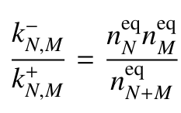
Theory
In chemical equilibrium, the number of forward reactions equals the number of backward reactions. Therefore we can find the relation between the two as:
(TiO₂)₂
(TiO₂)₅
(TiO₂)₃
Additional
This principal is called detailed balance and is also often used to find backward rate of gas phase chemical reactions.
HOME

Slide 16
Additional
The law of mass action is derived by minimizing the total Gibbs free energy of the gas and therefore maximizes the entropy.
Detailed balance:
(TiO₂)₂
(TiO₂)₅
(TiO₂)₃
Theory
The ratio between the number densities of the products and reactants in equilibrium is given by the law of mass action.
HOME

Slide 17
Detailed balance:
(TiO₂)₂
(TiO₂)₅
(TiO₂)₃
Law of mass action:
Theory
Combining both gives us the backward reaction rate.
HOME

Slide 18
Detailed balance:
(TiO₂)₂
(TiO₂)₅
(TiO₂)₃
Law of mass action:
Continue and learn about how thermal non-equilibrium affects the forward and backward rate.
HOME

Slide 19
T_{gas}
Theory
Thermal non-equilibrium means that not all particles are at the same temperature. Here, we explain how we and others describe these temperature differences and what effects they have on kinetic nucleation.
T_{N}^{kin}
T_{N}^{int}
Press the arrow to go to the next step!
HOME

Slide 20
T_{gas}
Theory
In our work, we assume the gas phase to be in thermal equilibrium. Each cluster size on the other hand can have a different internal and kinetic temperature:
T_{N}^{kin}
T_{gas} ≠ T_{N}^{kin} ≠ T_{N}^{int}
Additional
T_{N}^{int}
In our work, the internal and kinetic temperature are defined over the energy in the translational degrees of freedom (kinetic) and the vibrational/rotational degrees of freedom (internal):
Where Dn^{f} is the number of internal + rotational degrees of freedom and k is the Boltzmann constant.
HOME

Slide 21
Theory
Our work
T_{gas}
Plane and Robertson (2022) did a detailed analysis of internal cooling via optical lines of OSI(OH)2:
T_{gas} ≠ T_{N}^{kin} ≠ T_{N}^{int}
T_{gas} = T_{N}^{kin} ≠ T_{N}^{int}
T_{N}^{kin}
Additional
In their work, Plane and Robertson (2022) looked at 11 optical lines and derived a master equation which describes the internal temperature of OSI(OH)2 and its disassociation rate in detail. They found that thermal non-equilibrium can be present in low density environments, and that it can cause significant changes in the disassociation rate of OSI(OH)2.
T_{N}^{int}
HOME

Slide 22
Our work
T_{gas}
Theory
T_{gas} ≠ T_{N}^{kin} ≠ T_{N}^{int}
Other works (e.g. Patzer et al. 1998, Köhn et al. 2021) adopt a single temperature for each cluster size N:
Plane and Robertson (2022)
T_{gas} = T_{N}^{kin} ≠ T_{N}^{int}
T_{gas} ≠ T_{N}^{kin} = T_{N}^{int}
T_{N}^{kin}
T_{N}^{int}
HOME

Slide 23
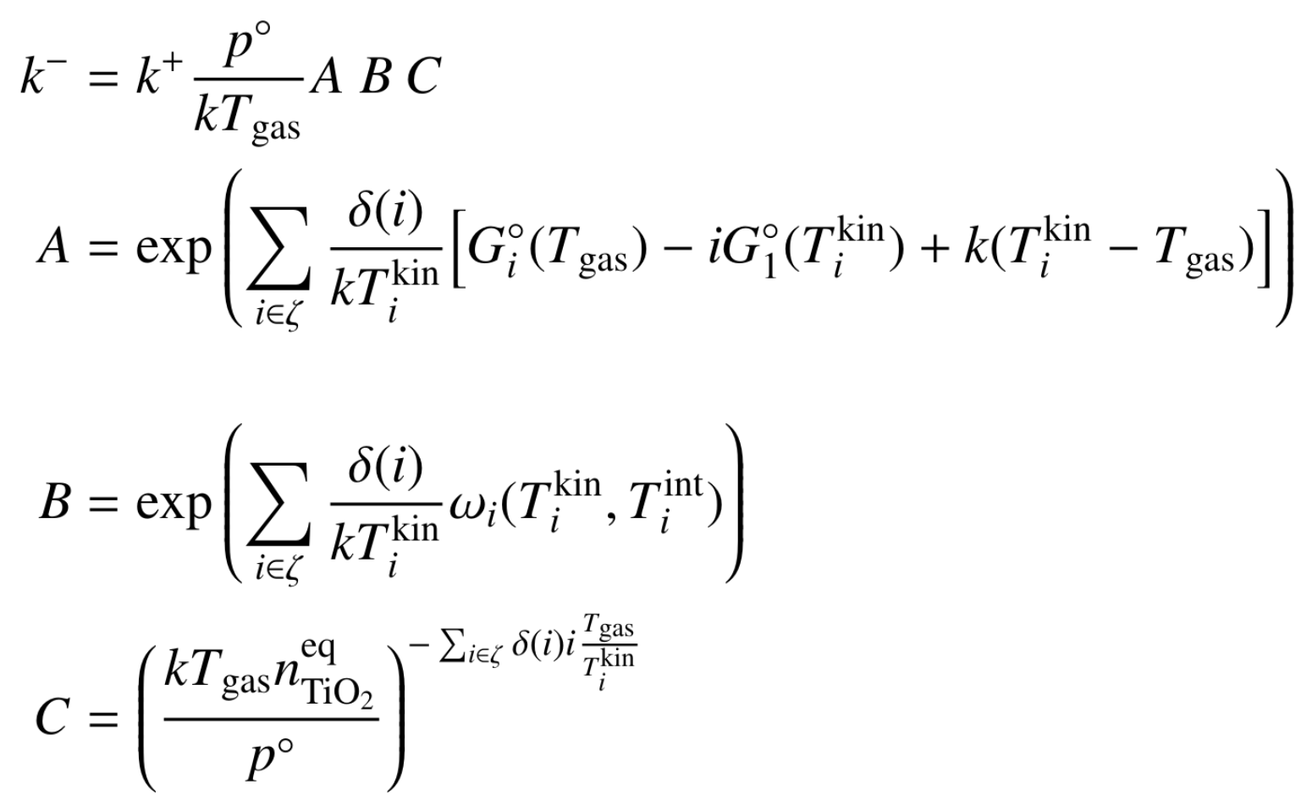
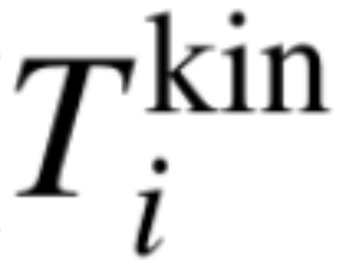
Thermal non-equilibrium
If you want to skip to the results click here:
Thermal equilibrium
Thermal non-equilibrium
+
+
Here we will only go through the results of the mathematical derivation. If you want an overview of the full derivation you can find it here:
1
HOME

Slide 24
T^{gas} = T^{kin} = T^{kin}
Thermal equilibrium
Thermal non-equilibrium
Additional
δ(i) is the sign for the sum over products and reactants where products have a positive sign and reactants have a negative sign.
+
+
Theory
The forward and backward rates in thermal non-equilibrium include all terms of the thermal equilibrium case. Both descriptions are equivalent in thermal equilibrium.
1
HOME

Slide 25
T^{gas} = T^{kin} = T^{kin}
T^{gas} ≠ T^{kin}
Thermal equilibrium
Thermal non-equilibrium
+
+
Theory
The impact of different gas and kinetic temperatures is given by the red terms. In the forward rate, the sticking coefficient and cross section can be affected by thermal non-equilibrium but these effects are not considered in this study.
1
1
HOME

Slide 26
T^{gas} = T^{kin} = T^{kin}
T^{gas} ≠ T^{kin}
Thermal equilibrium
Thermal non-equilibrium
T^{kin} ≠ T^{int}
+
+
Theory
The impact of different gas and kinetic temperatures is given by the green terms. The variable ωi denotes the difference in Gibbs free energy of a cluster if the kinetic and internal temperature are different.
1
HOME

Slide 27
T^{gas} = T^{kin} = T^{kin}
T^{gas} ≠ T^{kin}
Thermal equilibrium
Thermal non-equilibrium
T^{kin} ≠ T^{int}
+
+
Gauge
Theory
The orange terms are gauge terms. They originate from the fact that the Gibbs free energy is a relative quantity and only the difference between different particles matters.
Now that you know the theory, check out the results!
1
HOME

Slide 28
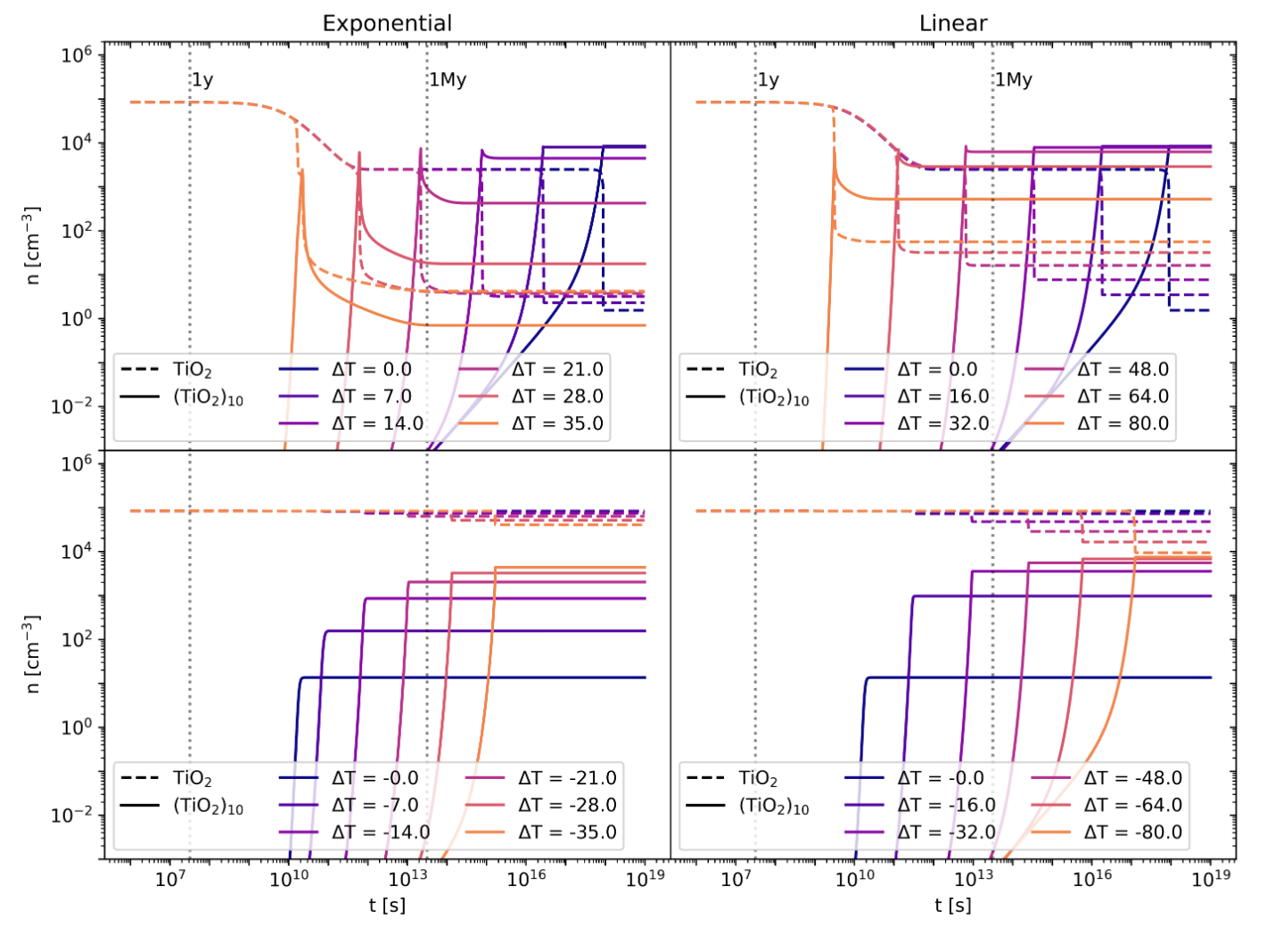
Theory
Thermal non-equilibrium affects the formation of aerosols. Here we elaborate on how the formation of larger clusters is affected.
Press the arrow to go to the next step!
HOME

Slide 29
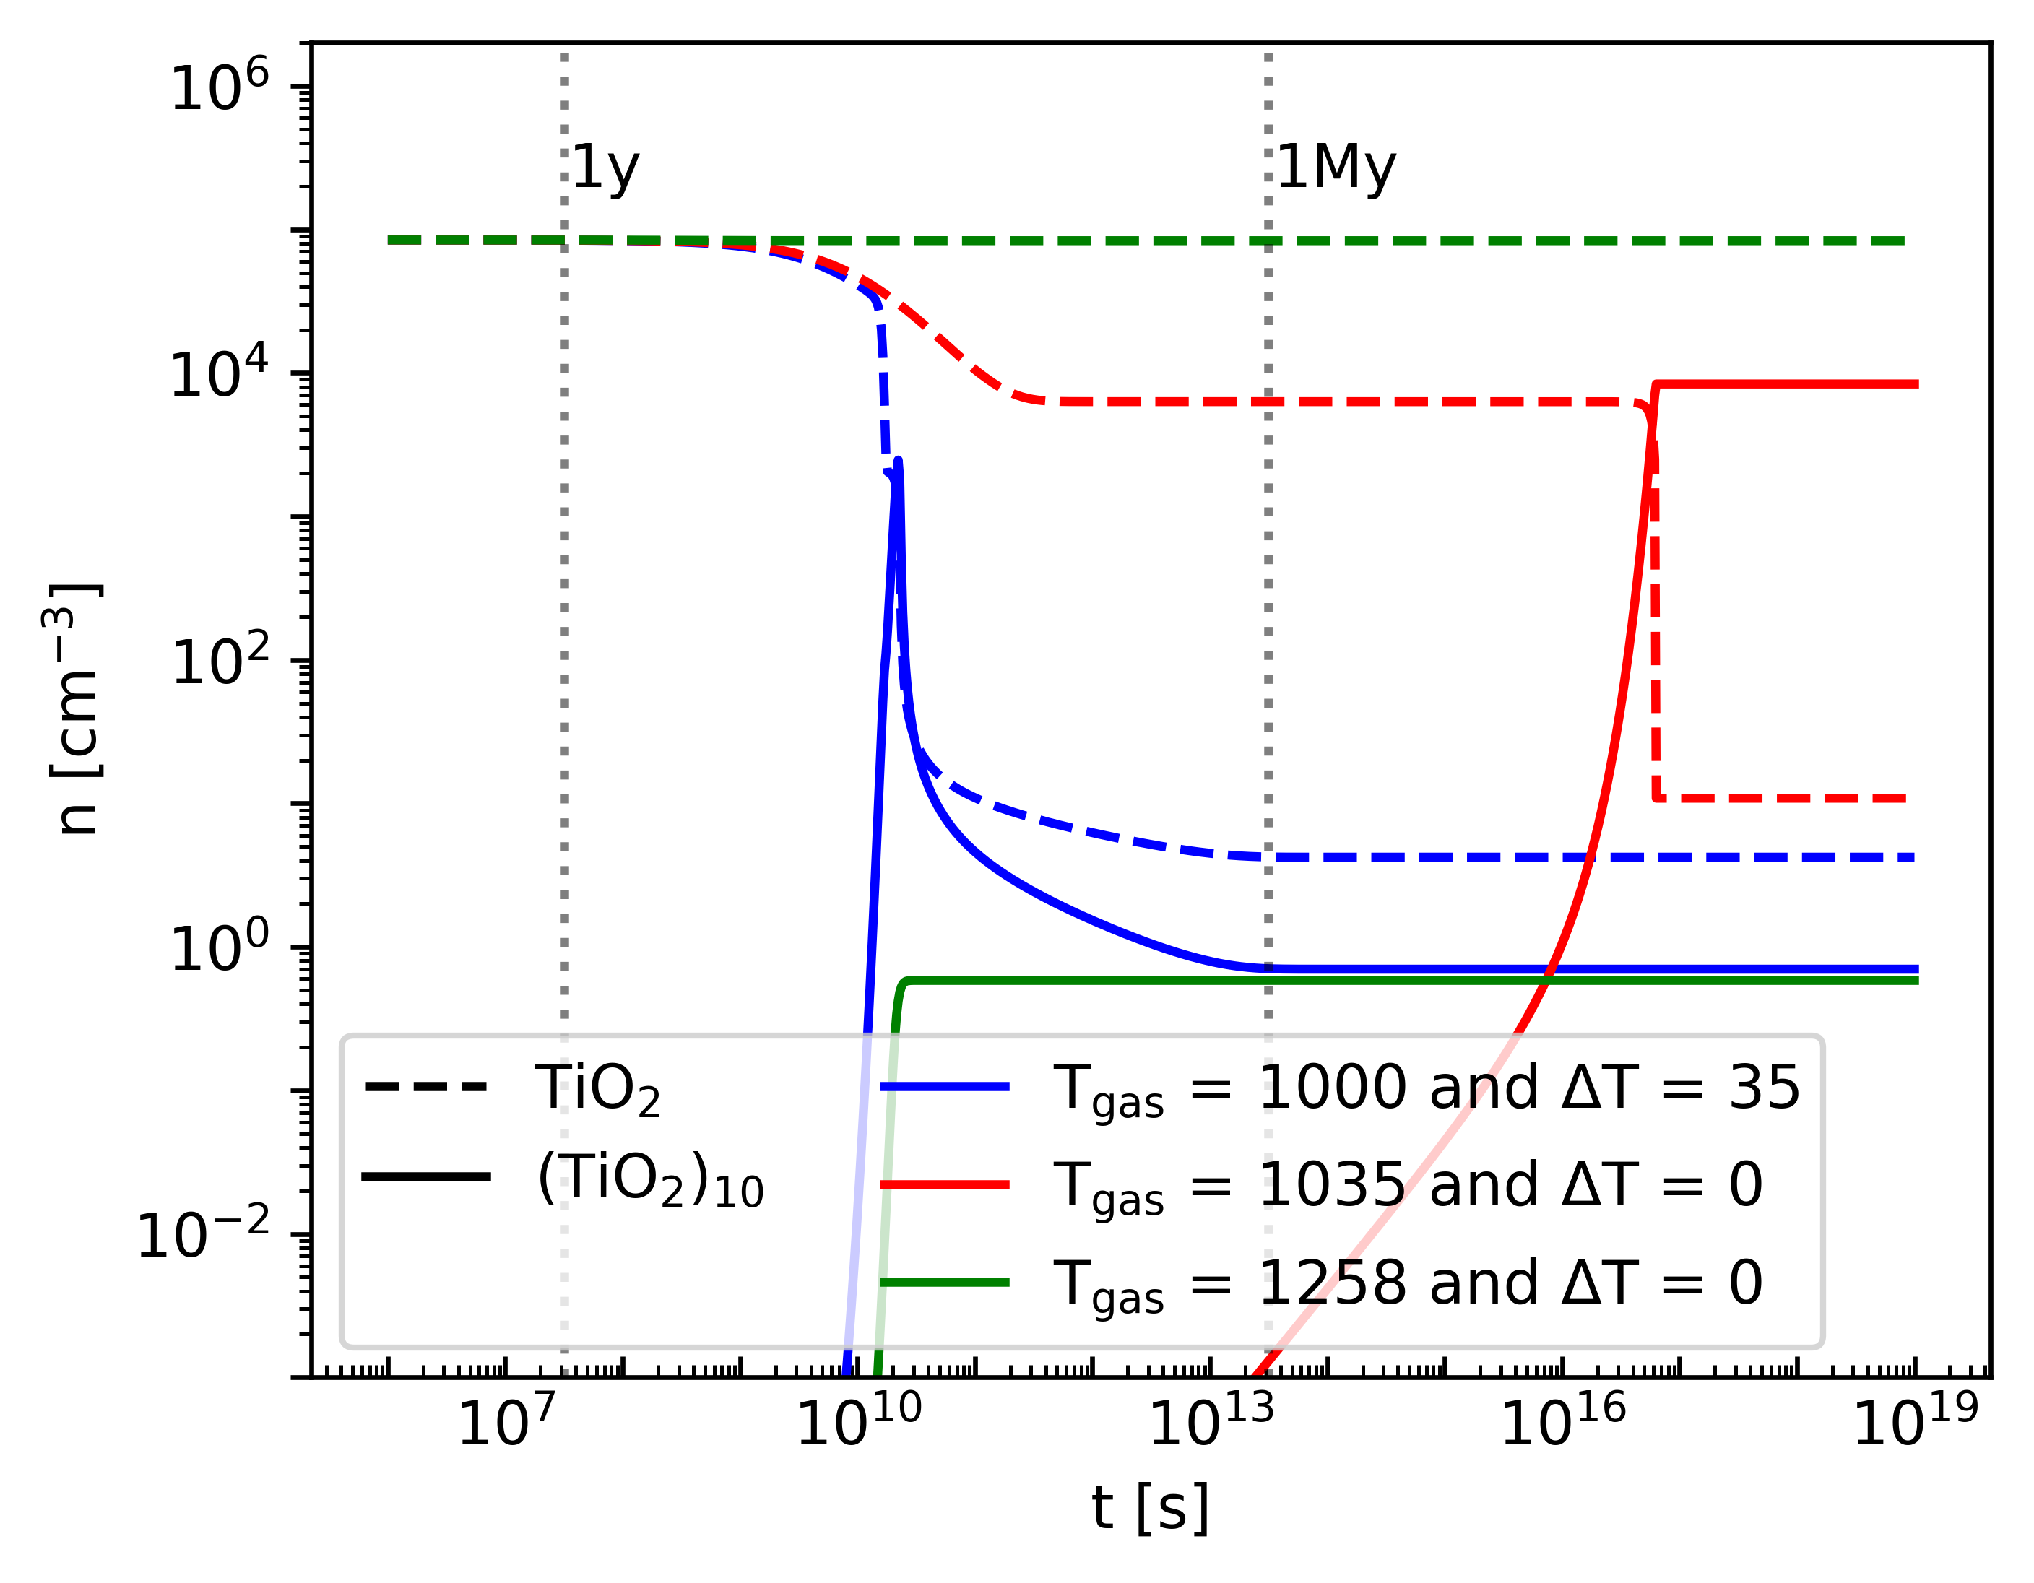
Additional
Theory
ΔT denotes the temperature difference between the smallest and largest size.
First, it is important to note, that small thermal non-equilibrium can have a strong effect on the occurrence of larger clusters.
Additional
Here we see that temperature differences of less then 35 K can already reduce the number density of our largest cluster (TiO2)10 by several orders of magnitude. This is much larger than an equivalent temperature decrease in thermal equilibrium would cause.
HOME

Slide 30
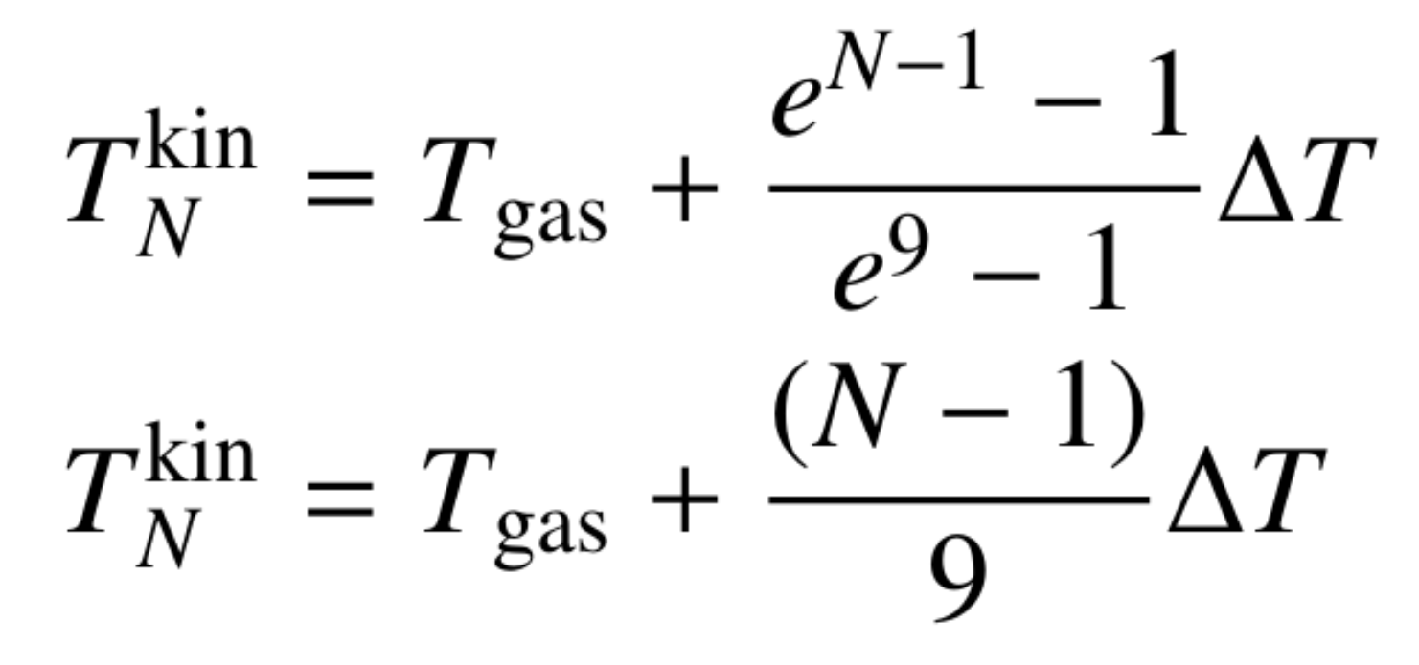
Additional
Linear: Exponential:
For this work, we considered two different temperature steppings.
Theory
Not only the temperature difference between the smallest and largest TiO2 cluster matters but also the difference in cluster temperature between all clusters.
HOME

Slide 31
Theory
If the formation of larger clusters is favored, increasing temperatures for larger clusters can inhibit the cluster formation. Vice versa, if the formation of larger clusters is disfavored, decreasing temperatures for larger clusters can increase the cluster formation
Additional
The examples chosen for this work were set up specifically to showcase the effect that thermal non-equilibrium can have. Other cases (like decreasing temperatures for larger clusters in an environment already favoring larger clusters) need to be studied on a case by case basis. Generally, our simulations showed the strongest impact of thermal non-equilibrium in temperature ranges where the number density of large clusters already showed a strong temperature dependence (e.g. around 1000 K - 1300 K for TiO2).
HOME

Slide 32
Theory
To Summarize:
Small temperature offsets can cause significant changes in the number density of larger clusters.
The change in number density depends on the thermal non-equilibrium present.
Thermal non-equilibrium can both increase (ΔT<0) or decrease (ΔT>0) the formation of larger clusters.
HOME

Slide 33
Theory
There are multiple processes that can change the temperature of a cluster. Here, we will give a short overview of the two most important ones: collisional and radiative cooling.
Theory
Collisional cooling describes the temperature adjustments of the clusters to the surrounding gas due to elastic collisions with the gas.
Theory
Radiative cooling describes the loss of energy via line emission of photons.
HOME

Slide 34
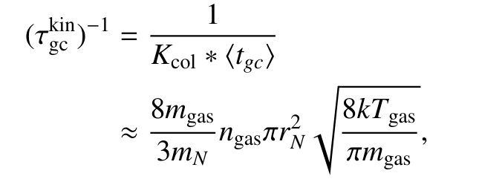
Kinetic – Collisional
Internal – Collisional
Theory
Additional
The thermal adjustment timescales for internal and kinetic cooling are slightly different but show the dependence for the gas phase number density (ngas), the cluster radius (rN) and the gas phase temperature.
Evaluating the timescales for a typical exoplanet atmosphere (ngas = 10¹⁴ cm⁻³, Tgas = 1000 K) and TiO2 clusters results in timescales of the order of 10⁻⁶ seconds for both timescales. Since this scales linearly with ngas these timescales become lower for low density environments.
HOME

Slide 35
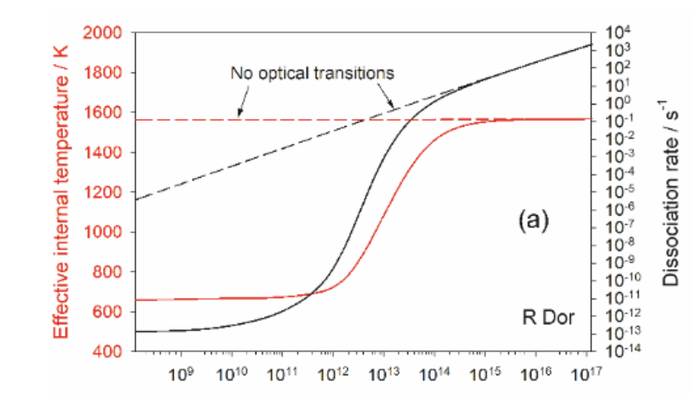
Theory
Radiative cooling is especially efficient via optical lines but can happen via all transitions. The exact calculations are complex and the example for OSi(OH)2 can be found in Plane and Robertson (2022).
Kinetic – Collisional
Internal – Collisional
Internal – Radiative
Additional
Within a strong radiative field, clusters can also absorb photons via the same lines and experience heating rather than cooling.
Plane and Robertson (2022)
HOME

Slide 36
Theory
In this section we give an overview over the derivation of the backwards rate. More details can be found in our paper.
Press the arrow to go to the next step!
HOME

Slide 37
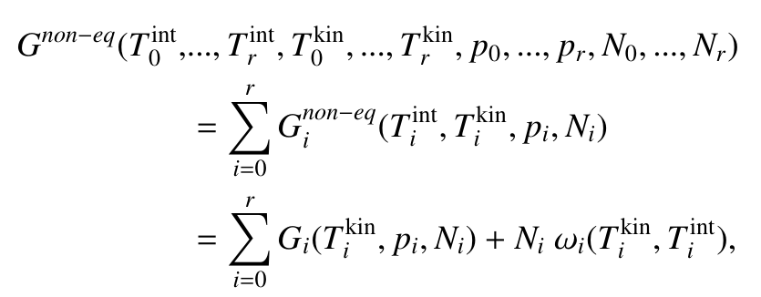
Theory
The law of mass action is derived by minimizing the total Gibbs free energy of the gas. Because changes in internal temperature do not change the pressure or number density of the gas, we can split the Gibbs free energy change due to internal thermal non-equilibrium using ωi.
HOME

Slide 38
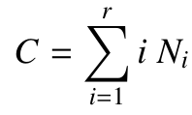
Theory
We use the definition of the chemical potential μ and assume that the number of monomer units is conserved. This conservation is always given in bimolecular association reactions.
HOME

Slide 39
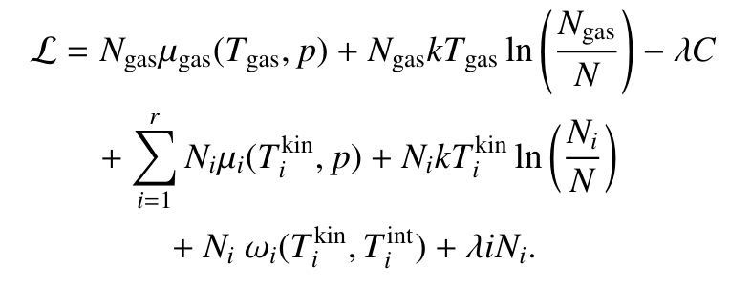
Theory
Using these three, we can define the Lagrangian function to minimize the Gibbs free energy under conservation of monomer units.
HOME

Slide 40
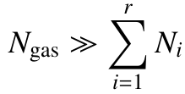
Theory
We assume that clusters are diluted in the gas. Furthermore we assume that even when multiplied with the kinetic temperature differences, the number of clusters is still much smaller than the number of gas phase particles.
HOME

Slide 41
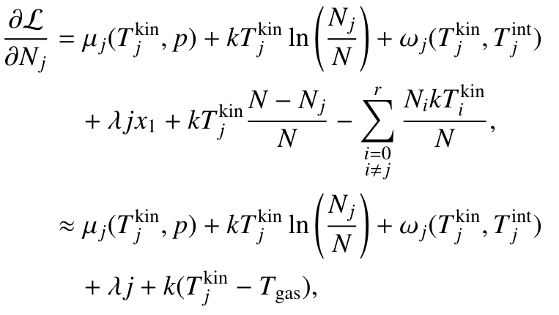
Theory
We then take the derivative of the Lagrangian function with respect to the number of clusters.
HOME

Slide 42
Theory
We assume that the monomer is in thermal equilibrium with the gas phase. This allows us to find the Lagrangian multiplier.
HOME

Slide 43
Theory
For all other cluster sizes, we rewrite the equations to find the number fraction of clusters compared to the gas phase.
HOME

Slide 44
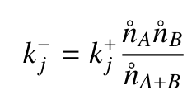
Theory
Lastly, we use detailed balance with chemical equilibrium as reference state to derive the backward rate in thermal non-equilibrium.
Go to the results!
HOME

